Slide 1
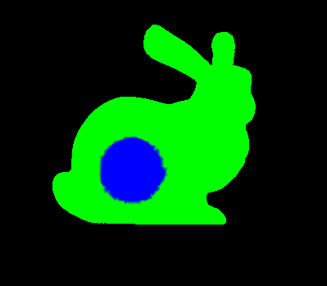
RAM
Space Ship
RAM
Space Ship
CPU
GPU
OpenGL

Slide 2
RAM
Space Ship
RAM
Space Ship
CPU
GPU
OpenGL

Slide 3
RAM
Space Ship
CPU
GPU
???????

Slide 4
sqrt(X^2 + y^2)

Slide 5
Shader program : 99
Vertex : 17
Fragment: 19

