Slide 1
R Markdown
Vincent Somerville
13.4.2021

Slide 2
What is a R Markdown
A “R” script where you can smoothly combine code, comments and results
Knit* a finished HTML or PDF file
*knit=put together all code, comments, results and create a PDF, HTML

Slide 3
Why use R Markdown
Housekeeping of your Code
If you want to keep 1. your Code, 2. your description, and 3. your results together
Constantly update and version control (e.g. github)

Slide 4
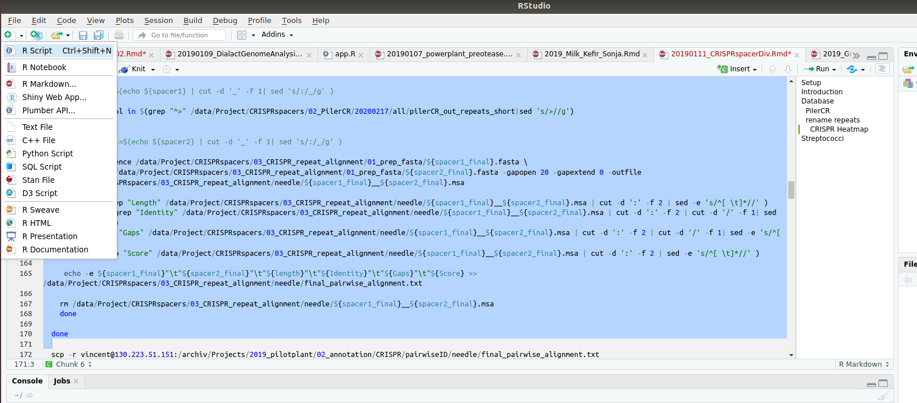
Getting started
Open dummy R Markdown

Slide 5
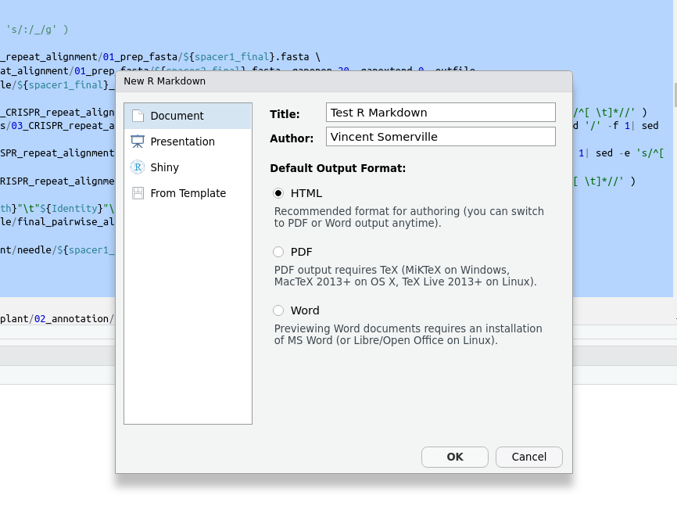
Getting started
Title and
Name of file
What file you
want to create
What final output
You want

Slide 6
What does it consist of...
1. header (title, name, Date, rendering)
2. written Text (your Description, Introduction,titles, Hyperlinks,...)
3. code chunks (R, bash ,python,...)
4. plots/results

Slide 7
1. Header
Includes multiple file information:
title
name
Date
Rendering (PDF, HTML, both,…)
No Need to change!!

Slide 8
2. Text
Includes:
Normal Text
Title (with #)
Bold (*bold text*)
Hyperlinks (with <http://rmarkdown.rstudio.com>)
Cheat Sheet (many online (e.g. https://www.markdownguide.org/cheat-sheet/))

Slide 9


3. Code chunks
Start of code chunk
Start of code chunk
Coding language
Chunk name (no Space!)
Chunk options
Code
end of code chunk
Most important Chunk options:
echo : Should the code in this chunk be plotted
eval : should the code run
message : should message be shown
Set your default options in a chunk first

Slide 10
Now knit* your document!
*knit=Run code + create file

Slide 11
Real life *
Keep track of your code
Comment and annotate where necessary
Polish in the end of the day, project
* my way (might not be the best approach or your approach)

Slide 12
Now it is your turn...

