Slide 1
Group 8: Phage defence mechanise
11.5.2021

Slide 2
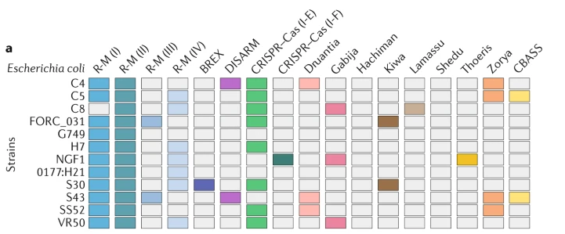
Reminder: What do we want to do?
We want to annotate the known defense mechanisms in the Lactos
Alessandro
All together
Vincent
Fabrice
Lucas
Retrons
Lactobacillus strains
Sorek et al. 2020

Slide 3
What have we done sofar
You have a broad understanding of the diversity of phage defense mechanisms (paper +5 min presentation)
A good understanding of what genes are involved in the “your” defense mechanism.
You saw that genome annotations are limited (no complete pathway annotated)
You saw how to loop. You saw how to if, else.
You have HMM of your genes-of-interest
You are currently identifying/annotating the mechanism
What is up next
- How can we annotate and illustrate all genomes?
- How can we annotate and illustrate CRISPR

Slide 4
What have we done sofar
Identify genes in
mechanism
Find
gene sequence
Find
gene family
Build HMM
Of gene family
plot
Identify pathway
completness
Scan genomes
With HMMs

Slide 5
What is up today?
1. scan the genomes with HMMs
2. analyse and plot data
3. run CRISPRcasTyper (https://cctyper.crispr.dk/#/ )

Slide 6
Questions?

Slide 7
Back to science: How can we identify/annotate the mechanism

Slide 8
What do we need!
First, remember what do we want to do and what data do we need!
Alessandro
All together
Vincent
Fabrice
Lucas
Retrons
Lactobacillus strains
-Absence/Presence/Abundance of gene-of-interest in all genomes
-(Name of matching gene/genes in genomes)

Slide 9
How do we work with Hidden Markov models (hmm)
1. Build model
- Identify gene-of-interest
- Get gene family
- Create multi-sequence-alignment (MSA) of all genes in the gene family
- Build the HMM with the MSA
2. Search the model
- search the model with all genes-of-interest
- search the model with all genomes
Done!
Let’s do this next!
We already know how we can search multiple genes & multiple genomes (for-loop)
Done!

Slide 10
Let’s try it out (scan for orthogroups)
4. scan for gene family
-Using Hmmmer (http://hmmer.org/ ) to scan for protein sequence.
-Therefore we use the hmmscan function
(=search protein sequences against a profile HMM database)
-Before we can scan the genome we however need to index the HMM profile
Thefore we use the hmmpress function
-Reminder: You want to scan all your genes and all different genomes (use for- loops)
-Reminder: Think about outputting the information in order to use it later in R.

Slide 11

Let’s try it out
Look at Rmarkdown CHAPTER 4. for instructions!

Slide 12
Let’s try it out (plotting data)
Look at Rmarkdown CHAPTER 5. for instructions!

Slide 13
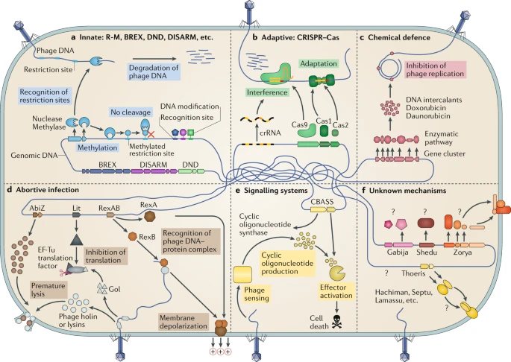
CRISPR
CRISPR is the only adaptive immunity mechanism
In Bacteria

Slide 14
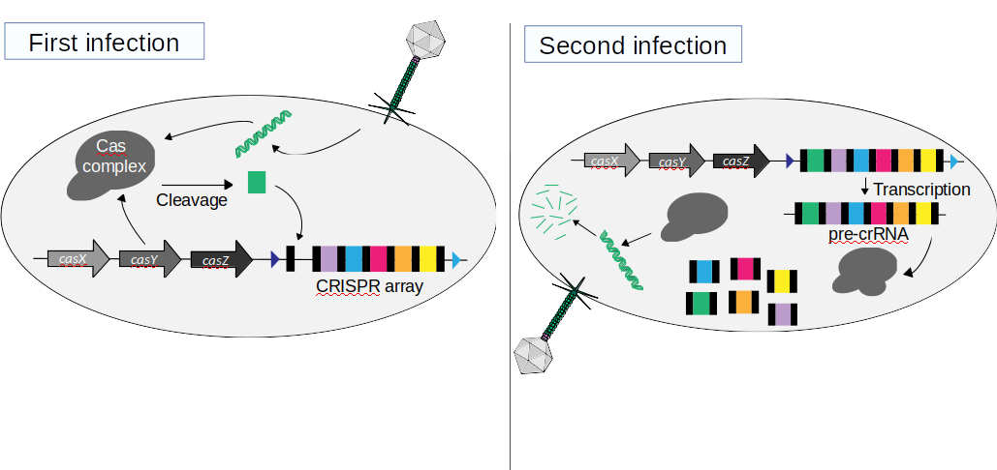
CRISPR functioning
Acknowledgement to the SAGE students 2020 for the figure:
Aya Iizuka
Simon Maréchal
Samuel Aubert

Slide 15
CRISPRcas annotation
Using CRISPRcasTyper
1. Transfer genome locally (needs ~2Gb)
2. select the genomes you want annotate in google.sheet (~13 genomes)
3. Run CRISPRcasTyper with the 5 genomes indiviually
4. copy output information into google.sheet
5. download .csv data and plotting in R

Slide 16
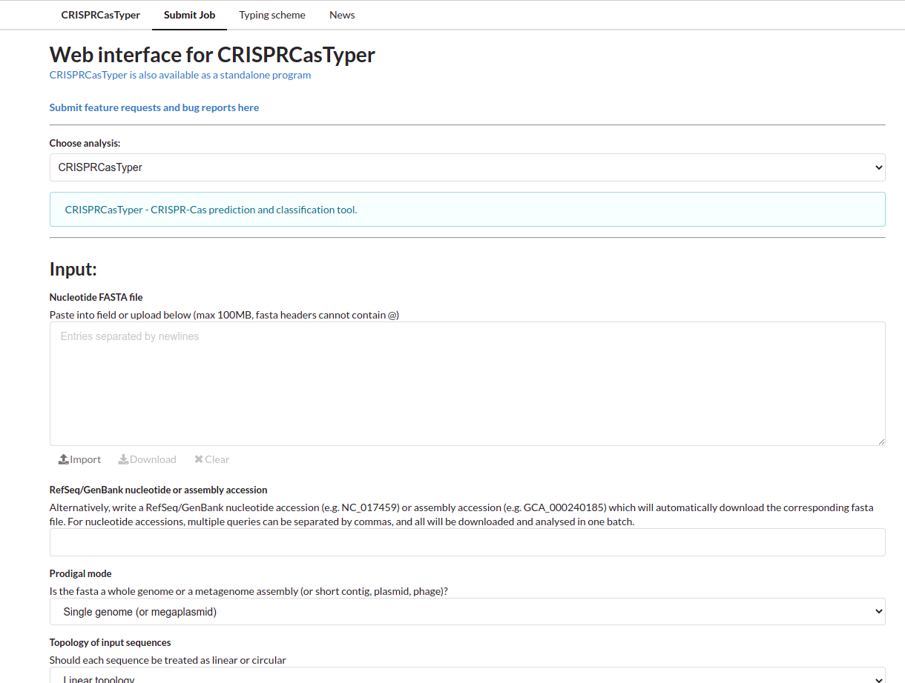
CRISPRcas annotation
Using CRISPRcasTyper (https://cctyper.crispr.dk/#/ )

Slide 17
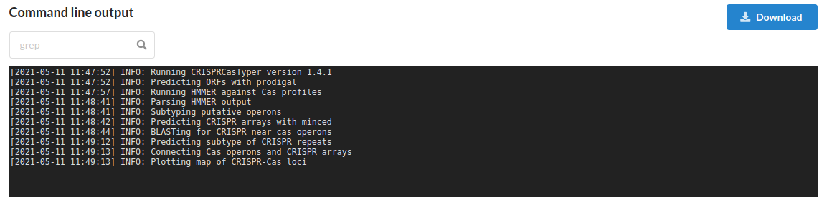
What do CRISPRcasTyper do?

Slide 18
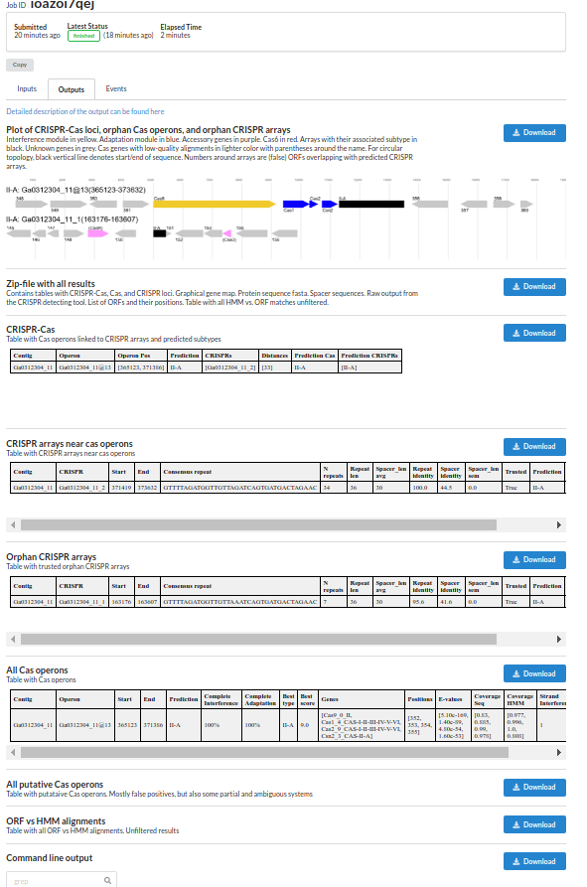
Output
Very fast (~20s per genome)
Cas gene structure
Download all results (interesting!)
CRISPR-cas clusters (interesting!)
CRISPR array information (interesting!)
Additional information

Slide 19
You need this:
Download all results + relabel according to you strain name
CRISPR-cas clusters: fill the first part of the google.sheet (orange part)
CRISPR array information: fill the second part of the google.sheet (blue part)
https://docs.google.com/spreadsheets/d/1Gp4cqbiYJ34fB7wbcqJBKsGxwgaMyPRrETnVK9PS_4M/edit#gid=732249118

Slide 20
Let’s try it out (CRISPR)
Look at Rmarkdown CHAPTER 6. for instructions!

