Slide 1
Group 8: Phage defence mechanise
27.4.2021

Slide 2
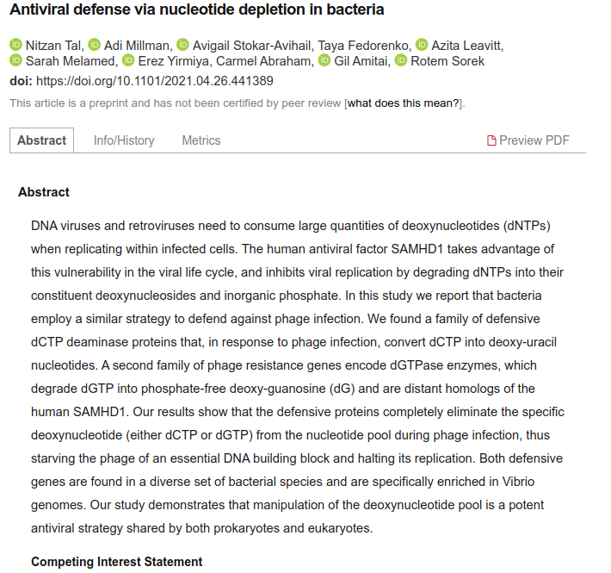
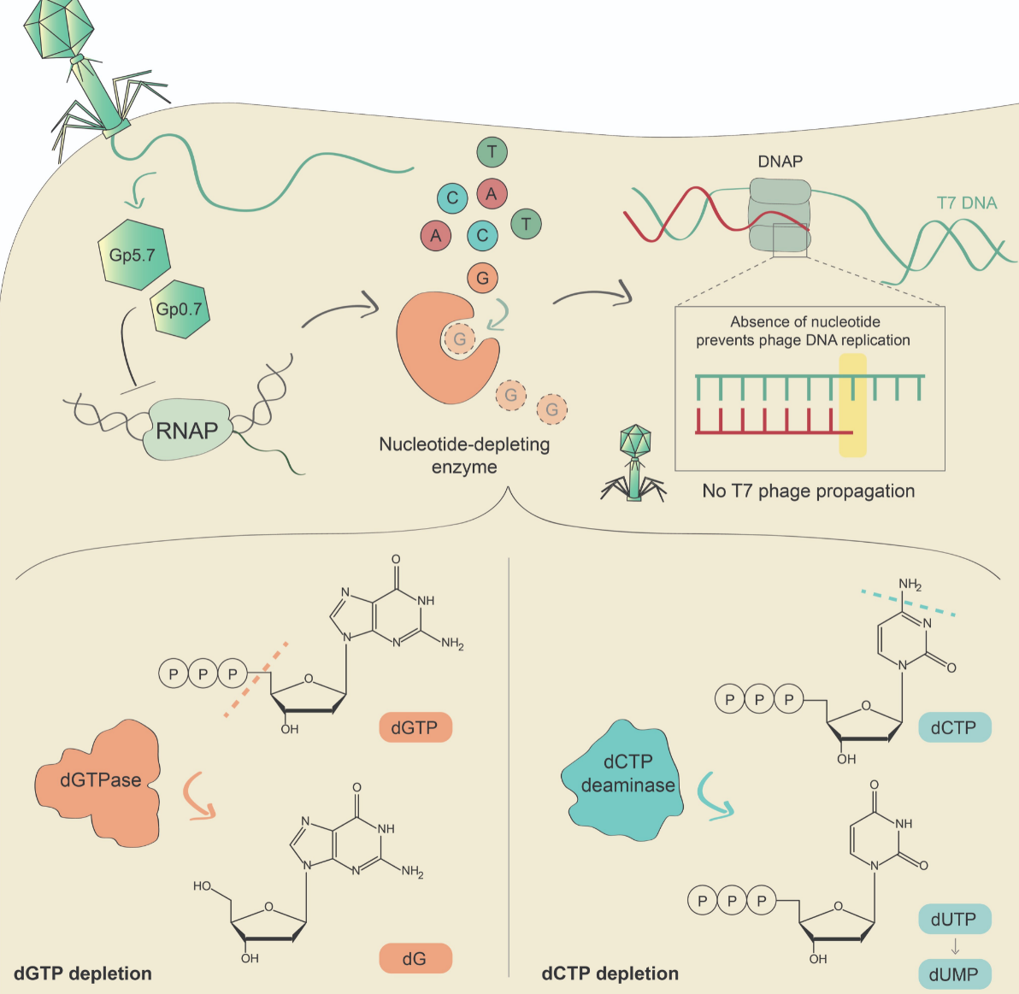
Reminder: How cool is life:)
From today!
https://www.biorxiv.org/content/10.1101/2021.04.26.441389v1

Slide 3
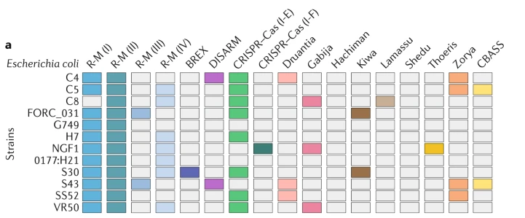
Reminder: What do we want to do?
We want to annotate the known defense mechanisms in the Lactos
Alessandro
All together
Vincent
Fabrice
Lucas
Retrons
Lactobacillus strains
Sorek et al. 2020

Slide 4
What have we done sofar
You have a broad understanding of the diversity of phage defense mechanisms (paper +5 min presentation)
A good understanding of what genes are involved in the “your” defense mechanism.
What is up next
How can we identify/annotate the mechanism (or genes)?
How can we annotate and illustrate all genomes?

Slide 5
We currently have ...
A gene-of-interest list
NCBI accession number of the genes-of-interest
Let’s keep track of our advances...

Slide 6
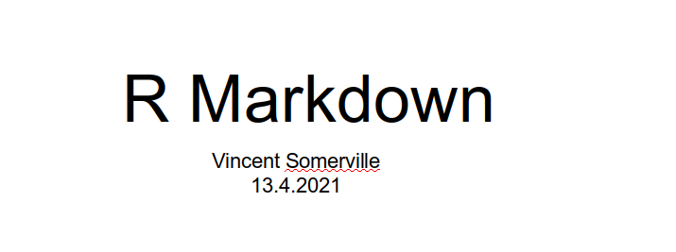
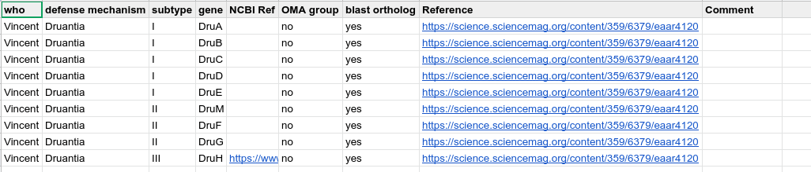
Let’s keep track of our advances...
Rmarkdown (keeping track of your code)
Presentation on 13.4.2021
Google.docs (keeping track of your results)
https://docs.google.com/spreadsheets/d/1Gp4cqbiYJ34fB7wbcqJBKsGxwgaMyPRrETnVK9PS_4M/edit?usp=sharing

Slide 7
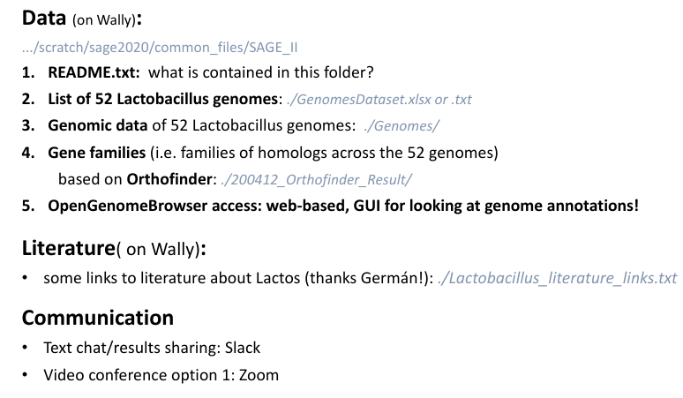
Reminder: Resources

Slide 8
Back to science: How can we identify/annotate the mechanism
Scan annotations
Hiden markov models (HMM)

Slide 9
Scan annotations
Query the PROKKA annotations for the genes-of-interest.
What we need for this:
Your gene names
The PROKKA.gff file (good annotation format)
An appropriate function to query your gene names in the PROKKA.gff
An appropriate way to output the search results (if, else, ifelse)
An appropriate way how to scan many genomes (loop-function)

Slide 10
Scan annotations
Query the PROKKA annotations for the genes-of-interest.
1. Your gene names
- the names are needed to query the annotations

Slide 11
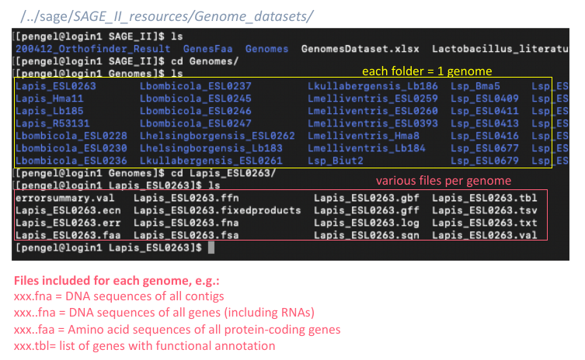
Scan annotations
Query the PROKKA annotations for the genes-of-interest.
2. The PROKKA.gff file (good annotation format)
/users/vsomervi/scratch/sage2020/common_files/SAGE_II/Genomes
.gff file (one annotation per line)

Slide 12
Scan annotations
Query the PROKKA annotations for the genes-of-interest.
3. An appropriate function to query your gene names in the PROKKA.gff
- use grep (grep –help for advice)
- use -i for --ignore-case

Slide 13
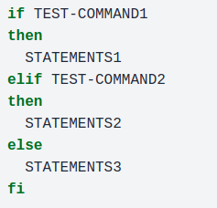
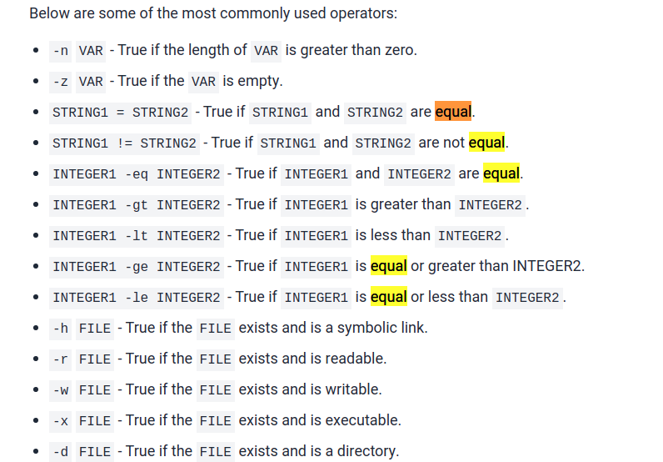
Scan annotations
Query the PROKKA annotations for the genes-of-interest.
4. An appropriate way to output the search results (if, else, ifelse)
If else in bash: https://linuxize.com/post/bash-if-else-statement/
See rShiny for example.

Slide 14
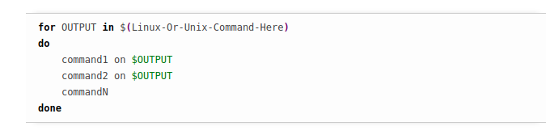
Scan annotations
Query the PROKKA annotations for the genes-of-interest.
5. An appropriate way how to scan many genomes (loop-function)
- you have previously used the loop function in bash…
https://www.cyberciti.biz/faq/bash-for-loop/

Slide 15
Scan annotations
Query the PROKKA annotations for the genes-of-interest.
Try it out!
Take my Rmarkdown and transfer it to your own renamed rMarkdown.

Slide 16
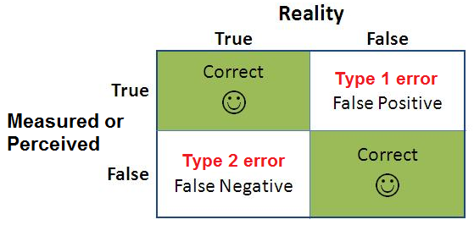
Why is looking at the annotation not optimal?

Slide 17
Why is looking at the annotation not optimal?
Annotation incomplete
Annotation old
Annotation wrong
What can we do to be more sure?

Slide 18
Why is looking at the annotation not optimal?
Annotation incomplete
Annotation old (outdated)
Annotation wrong (don’t trust anything if you have not seen it yourself)
What can we do to be more sure?
Annotate ourselves?

Slide 19
How do we annotate ourselves
We create Hidden markov models (HMMs) of our genes to account for all naturally observed variation and query our gene calls.

Slide 20
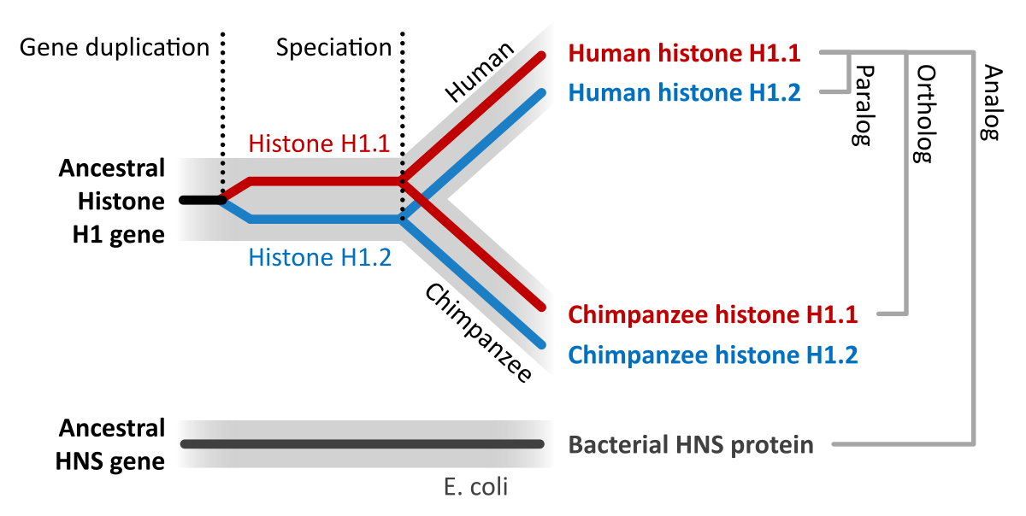
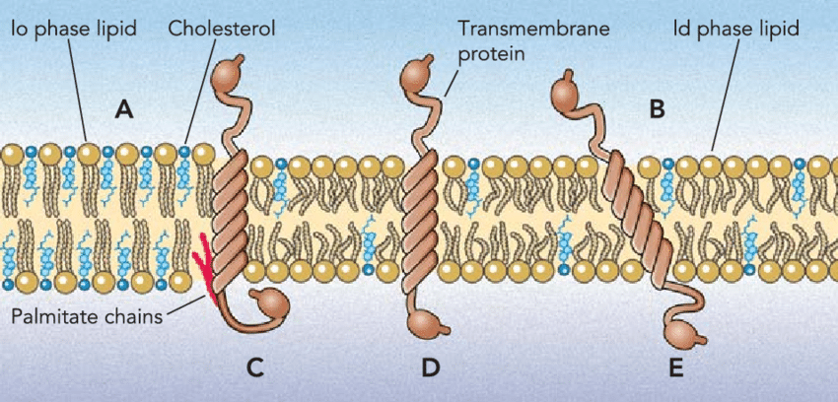
Simple and in my words
Why Hidden Markov model (hmm)
A gene rarely has a single representative in the tree of life (de novo)
… but is rather part of gene family with many representative in closely but sometimes also distantly related species (orthologs)
Genes has conserved (e.g. transmembrane domains or motifs or binding sites) and divergent regions (functionally-unimportant)
wikipedia

Slide 21
Simple and in my words
What is a Hidden Markov model (hmm)
First build a model then query your gene calls with the model
1. Build model
- Identify gene-of-interest
- Get gene family
- Create multi-sequence-alignment (MSA) of all genes in the gene family
- Build the HMM with the MSA
2. Search the model
- search the model with all genes-of-interest
- search the model with all genomes
Watch Pavel Pevzner (spades guy) explain HMM: https://www.youtube.com/watch?v=vO_6xfLwGao

Slide 22
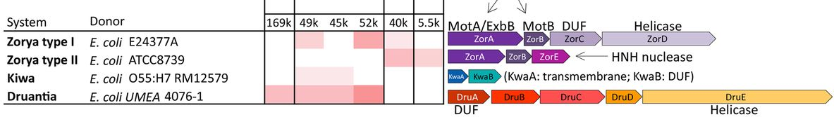
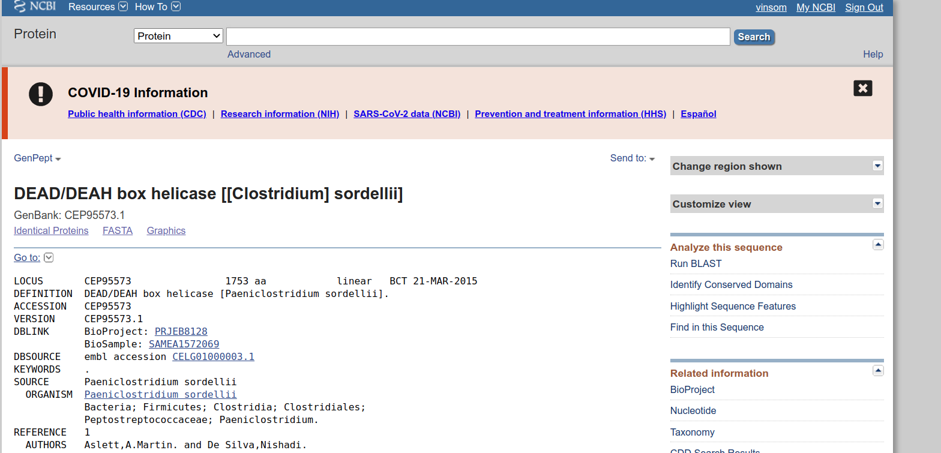
Use case=DRUANTIA defense mechanism & hsdr (restriction modification)
Let’s try it out
1. identify genes-of-interest
Sorek et al. 2020
1.2 find gene sequence on NCBI
https://www.ncbi.nlm.nih.gov/protein
https://www.ncbi.nlm.nih.gov/
e.g. DruE: https://www.ncbi.nlm.nih.gov/protein/CEP95573.1

Slide 23
Use case=DRUANTIA defense mechanism
Let’s try it out (finding orthogroups)
2. Get gene family
Easier Way!

Slide 24
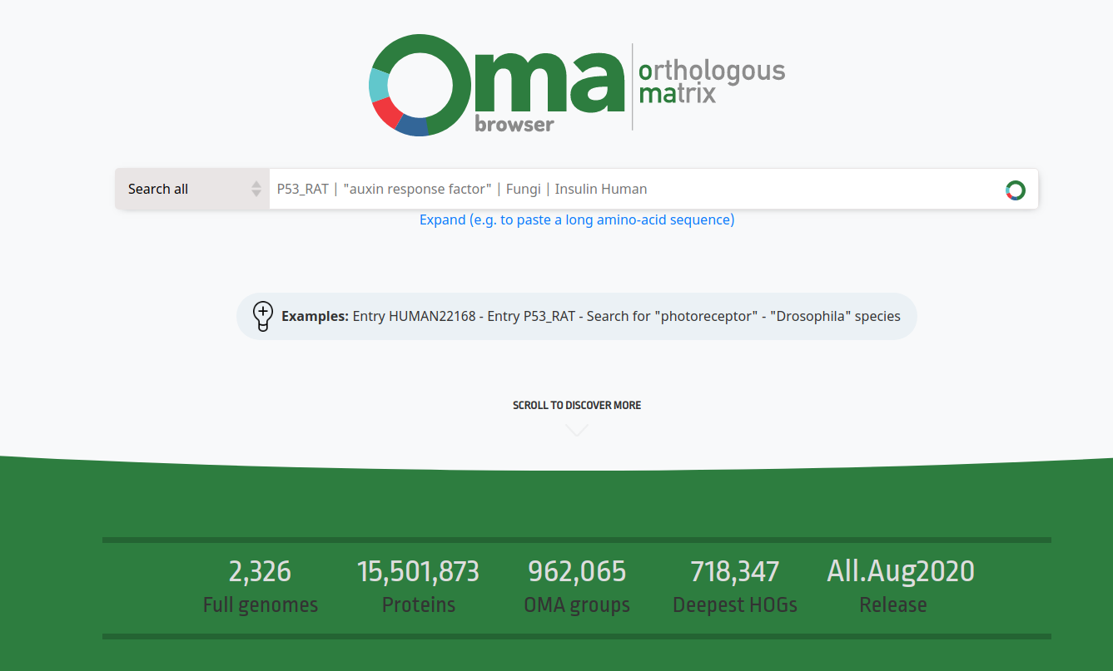
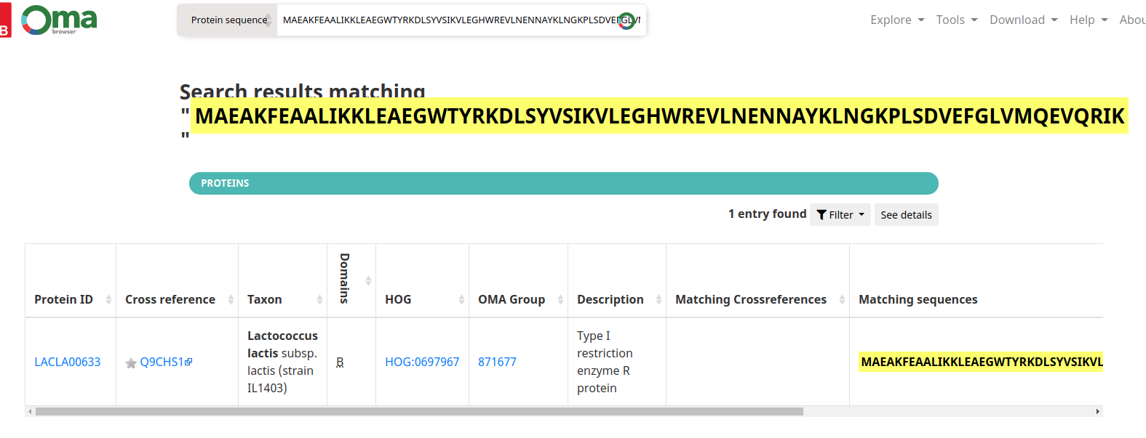
Use case=DRUANTIA defense mechanism
Let’s try it out (finding orthogroups)
2. Get gene family
Natacha et al. 2020
2.1 OMA browser (https://omabrowser.org/oma/home/ )
Identify OMA group
Search with your protein sequence

Slide 25
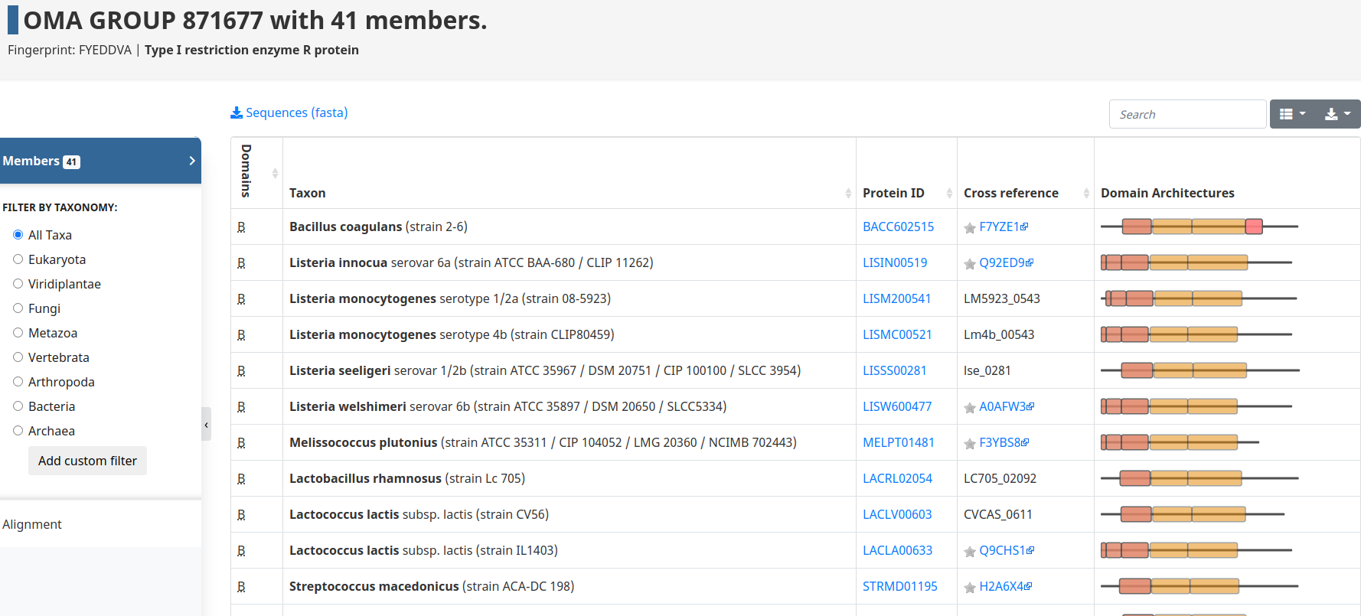
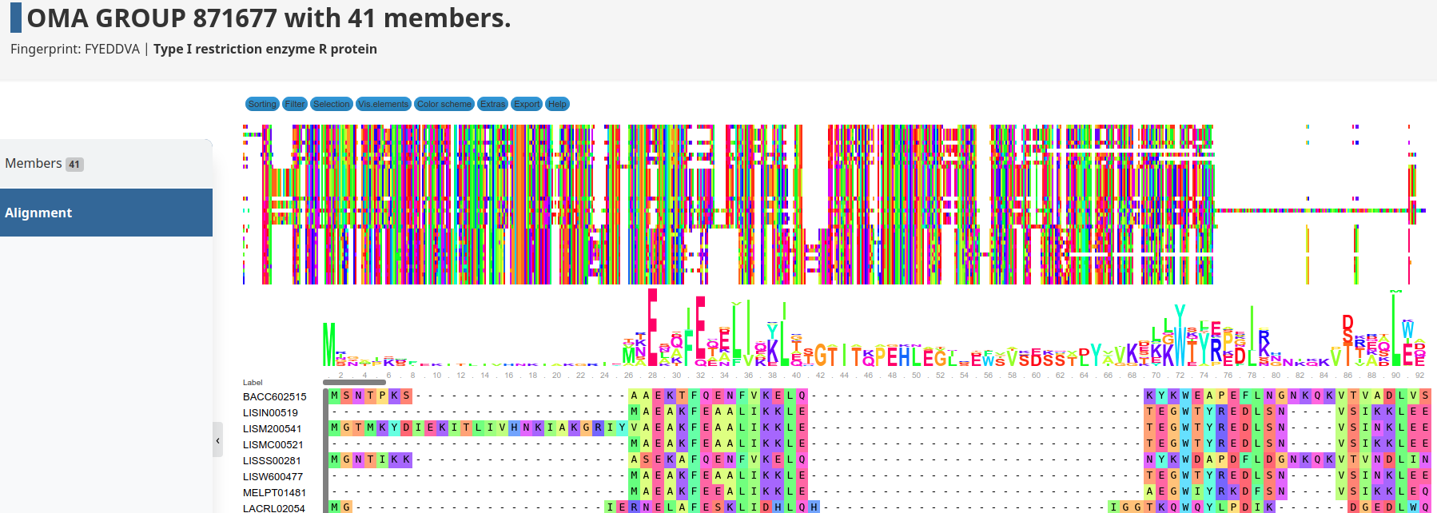
Use case=DRUANTIA defense mechanism
Let’s try it out (finding orthogroups)
3. Create multi-sequence-alignment (MSA)
Natacha et al. 2020
e.g. https://omabrowser.org/oma/omagroup/871677/members/
3.1 OMA browser (https://omabrowser.org/oma/home/ )
Go to alignment
Export alignment (=msa)
And save in directory with
Specific name (e.g. DruE.msa)
Do you see the variable and conserved regions?

Slide 26
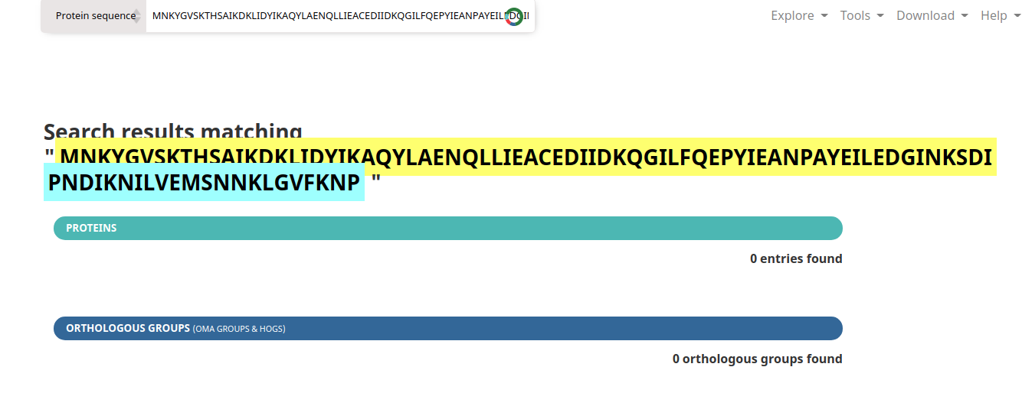
Use case=DRUANTIA defense mechanism
Let’s try it out (finding orthogroups)
2. Get gene family
Natacha et al. 2020
2.1 OMA browser (https://omabrowser.org/oma/home/ )
Unfortunately many hypothetical genes (e.g. novel defense mechanism) do not have a annotated OMA group
Search with your protein sequence

Slide 27
Use case=DRUANTIA defense mechanism
Let’s try it out (make orthogroups)
Alternative route via blast!
Harder Way!

Slide 28
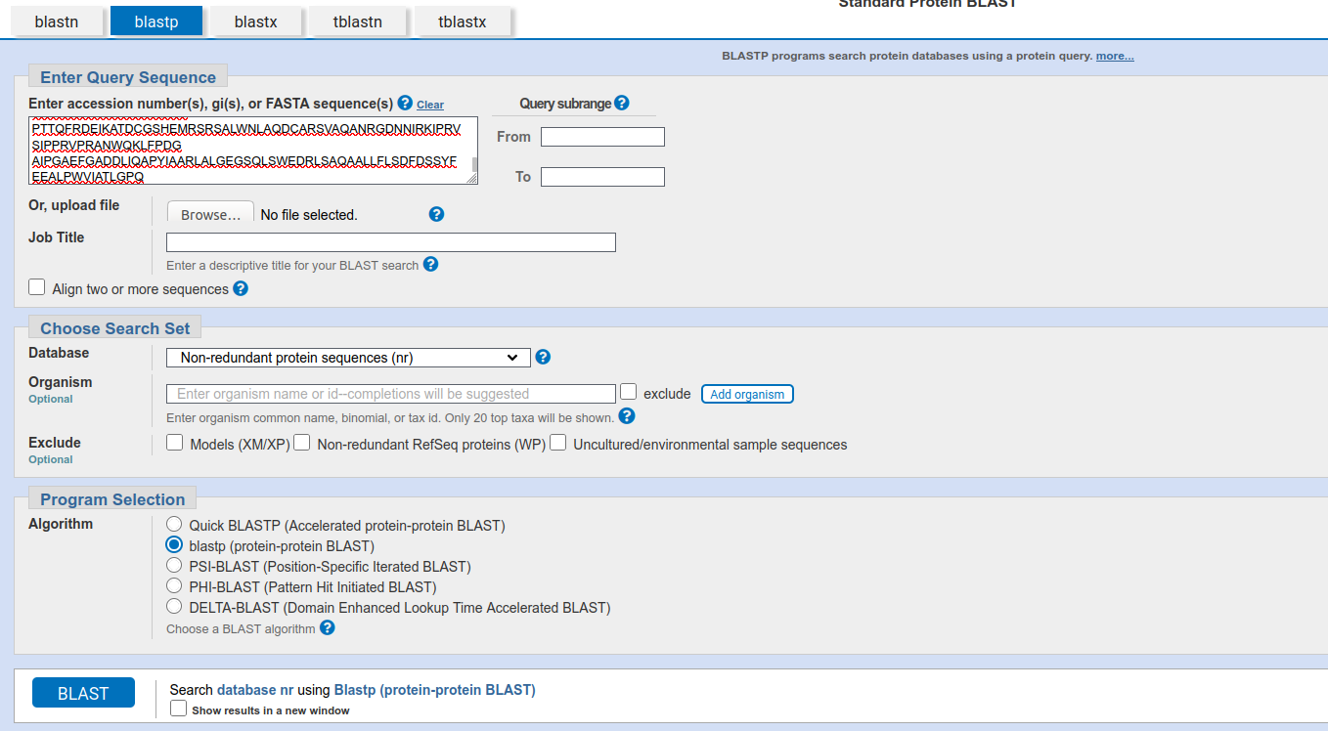
Use case=DRUANTIA defense mechanism
Let’s try it out (make orthogroups)
BlastP
Create own gene family with blast
Protein sequence
Non-redudant protein DB

Slide 29
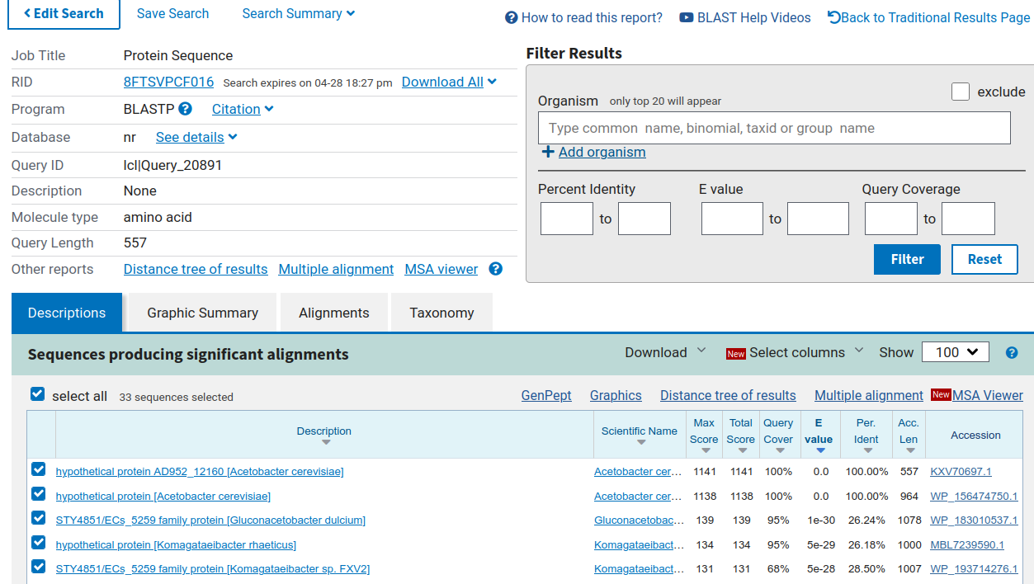
Use case=DRUANTIA defense mechanism
Let’s try it out (make orthogroups)
Look at results

Slide 30
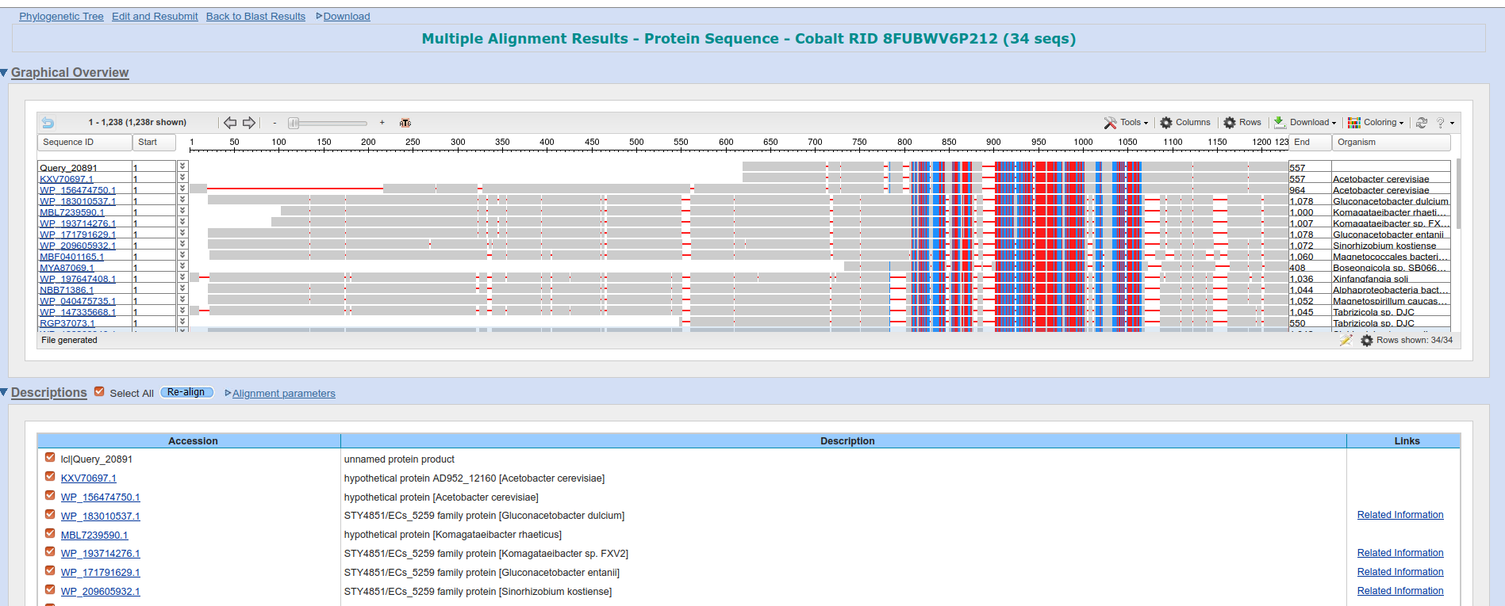
Use case=DRUANTIA defense mechanism
Let’s try it out (make orthogroups)
Look at results and download MSA
(And save in directory with Specific name (e.g. DruE.msa)

Slide 31
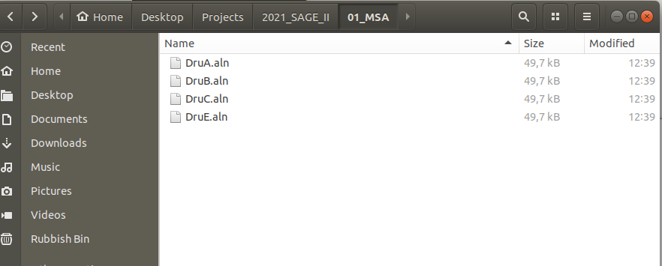
Use case=DRUANTIA defense mechanism
Let’s try it out
Now we have MSA or aln files for every gene-of-interest
Something like this!
Next Step: Build the HMM with the MSA. Therefore move the folder to your SAGE direcotry
(remember scp -r → look in Rmarkdown )

Slide 32
Use case=DRUANTIA defense mechanism
Let’s try it out
Using hmmbuild from hmmer (http://hmmer.org/ )
Go to Rmarkdown script!

