Slide 1
Group 8: Phage defence mechanise
4.5.2021

Slide 2
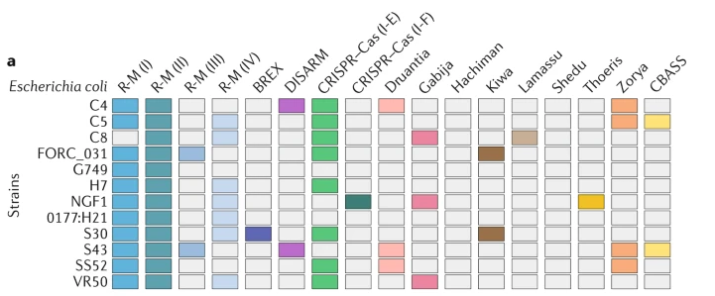
Reminder: What do we want to do?
We want to annotate the known defense mechanisms in the Lactos
Alessandro
All together
Vincent
Fabrice
Lucas
Retrons
Lactobacillus strains
Sorek et al. 2020

Slide 3
What have we done sofar
You have a broad understanding of the diversity of phage defense mechanisms (paper +5 min presentation)
A good understanding of what genes are involved in the “your” defense mechanism.
You saw that genome annotations are limited (no complete pathway annotated)
You saw how to loop. You saw how to if, else.
What is up next
How can we identify/annotate the mechanism (or genes)?
How can we annotate and illustrate all genomes?

Slide 4
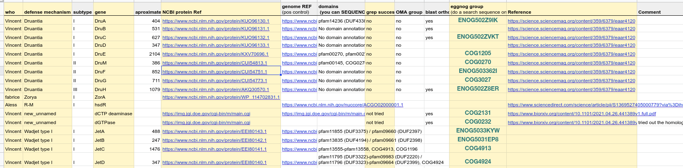
We currently have ...
A gene-of-interest list
NCBI accession number of the genes-of-interest
https://docs.google.com/spreadsheets/d/1Gp4cqbiYJ34fB7wbcqJBKsGxwgaMyPRrETnVK9PS_4M/edit?usp=sharing
You
NCBI
accession
Eggnog
Today!
mechanisms
gene
Did grep
Work?
paper

Slide 5
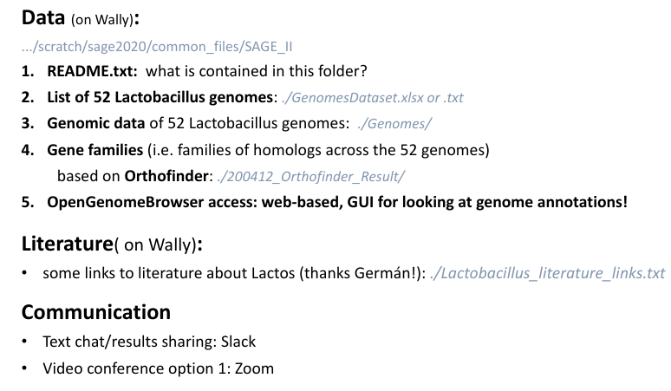
Reminder: Resources

Slide 6
Questions?

Slide 7
Back to science: How can we identify/annotate the mechanism

Slide 8
Back to science: How can we identify/annotate the mechanism
Scan annotations
Did not work properly! Why?
Annotation incomplete
Annotation old (outdated)
Annotation wrong (don’t trust anything if you have not seen it yourself)
Nevertheless, if you are looking for genes try to have a look at your annotations
Now what?! What is next? → let’s annotate the genes!!

Slide 9
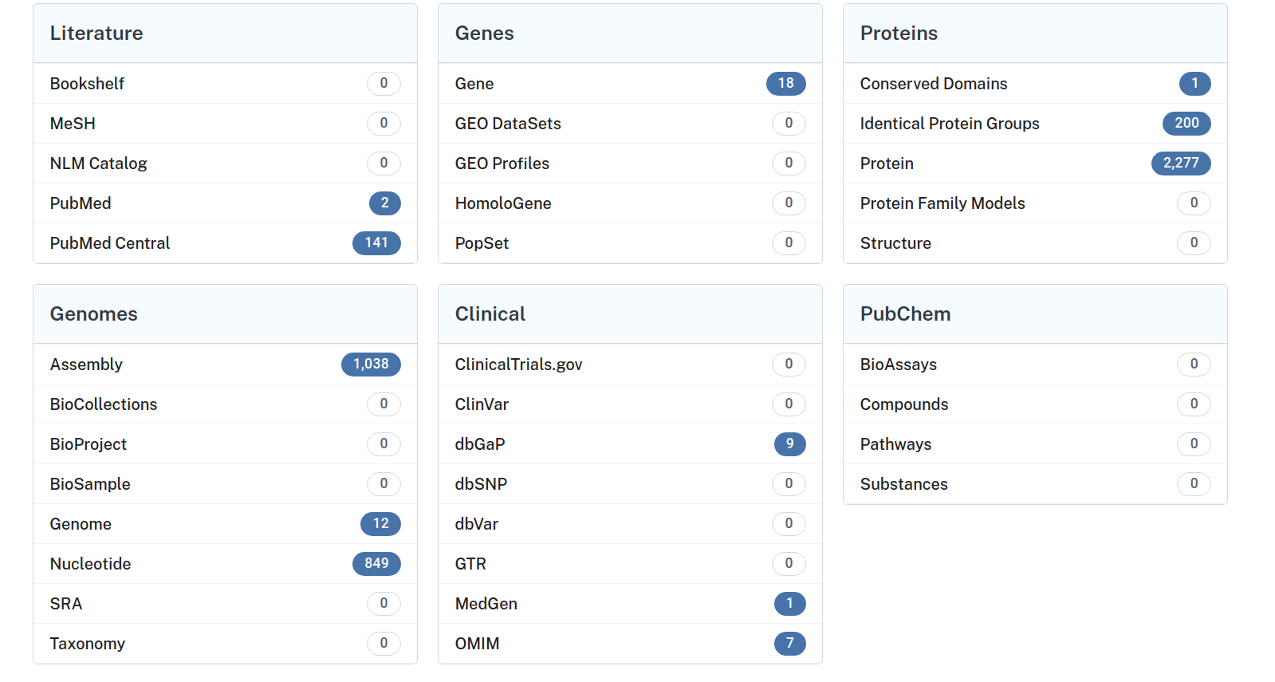
Find you gene-of-interest on NCBI?
1. Search with your gene name (+lactobacillus) on all databases (https://www.ncbi.nlm.nih.gov/ )
In order to get a protein sequence go to protein

Slide 10
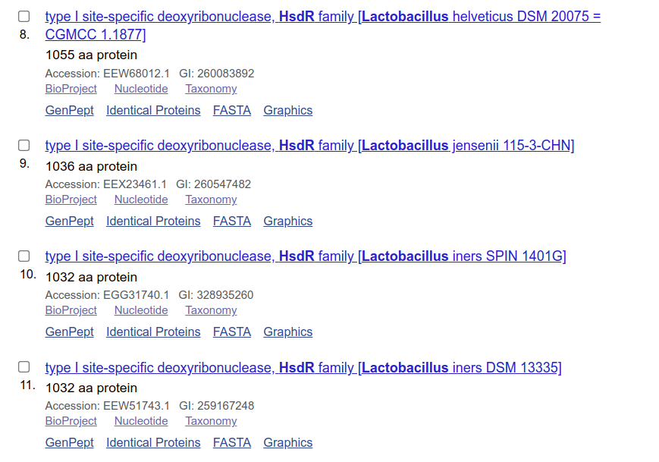
Find you gene-of-interest on NCBI?
Choose one and download fasta and put reference into google.sheets

Slide 11
How do we annotate ourselves
We create Hidden markov models (HMMs) of our genes to account for all naturally observed variation and query our gene calls.

Slide 12
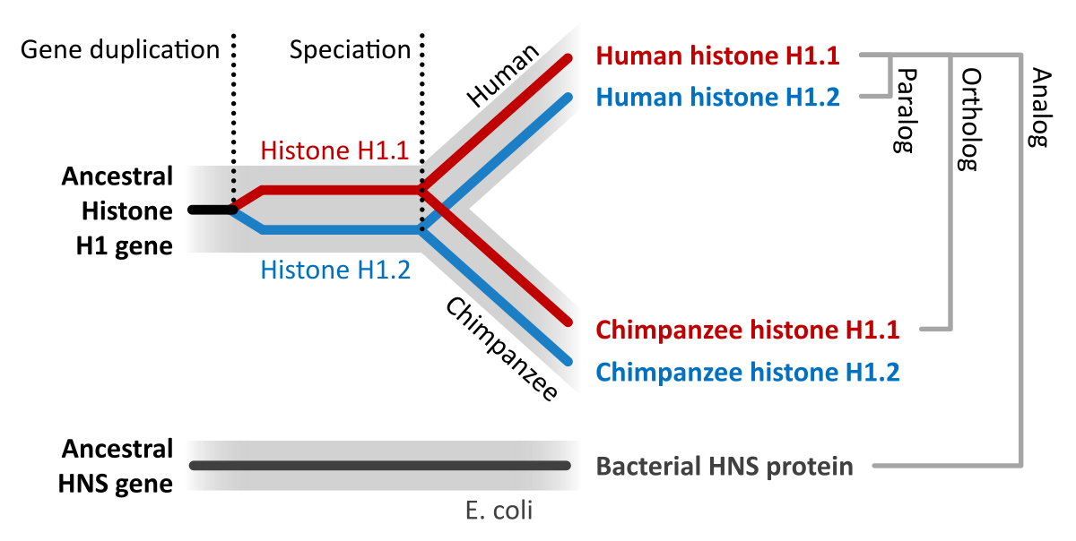
Simple and in my words
Why Hidden Markov model (hmm)
A gene rarely has a single representative in the tree of life (de novo)
… but is rather part of gene family with many representative in closely but sometimes also distantly related species (orthologs)
Orthologs are homologous genes in different species that diverged from a single ancestral gene after a speciation event
and
paralogs are homologous genes that originate from the intragenomic duplication of an ancestral gene.

Slide 13
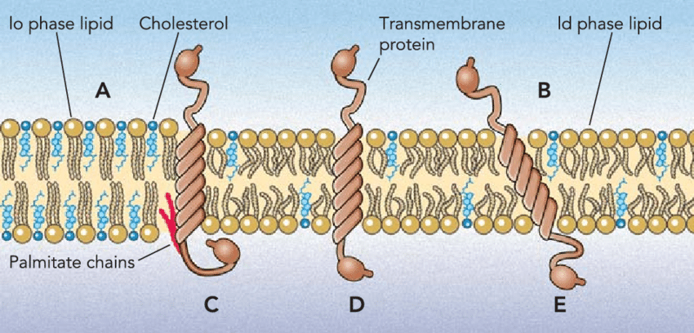
Simple and in my words
Why Hidden Markov model (hmm)
A gene rarely has a single representative in the tree of life (de novo)
… but is rather part of gene family with many representative in closely but sometimes also distantly related species (orthologs)
Orthologes genes are assumed to have the same function […]
[…] because the Genes have conserved Domains (e.g. transmembrane domains or motifs or binding sites) but can have divergent regions (functionally-unimportant)
wikipedia

Slide 14
How do we work with Hidden Markov models (hmm)
1. Build model
- Identify gene-of-interest
- Get gene family
- Create multi-sequence-alignment (MSA) of all genes in the gene family
- Build the HMM with the MSA
2. Search the model
- search the model with all genes-of-interest
- search the model with all genomes
Done!
Watch Pavel Pevzner (spades guy) explain HMM: https://www.youtube.com/watch?v=vO_6xfLwGao

Slide 15
How do we work with Hidden Markov models (hmm)
1. Build model
- Identify gene-of-interest
- Get gene family
- Create multi-sequence-alignment (MSA) of all genes in the gene family
- Build the HMM with the MSA
2. Search the model
- search the model with all genes-of-interest
- search the model with all genomes
Let’s do this next!

Slide 16
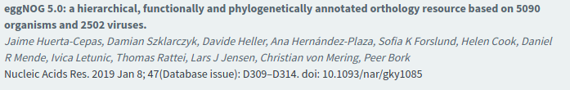
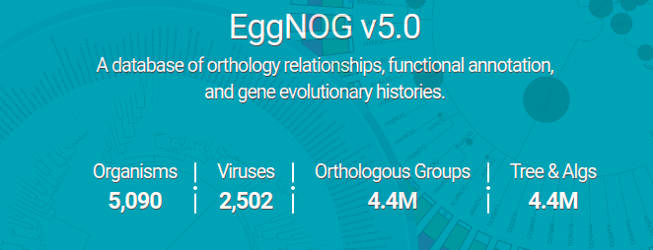
Use case=DRUANTIA defense mechanism
Identifying and extracting HMMs of your gene-of-interest
Using eggnog! An orthology database
http://eggnog5.embl.de/#/app/home

Slide 17
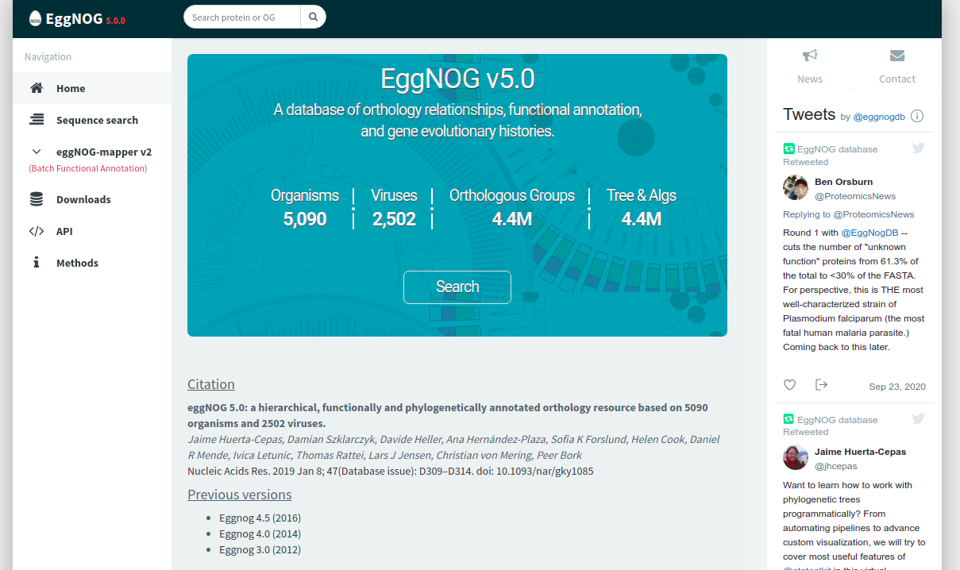
Let’s try it out (finding orthogroups)
2. Search for gene family
http://eggnog5.embl.de/#/app/home
Sequence search

Slide 18
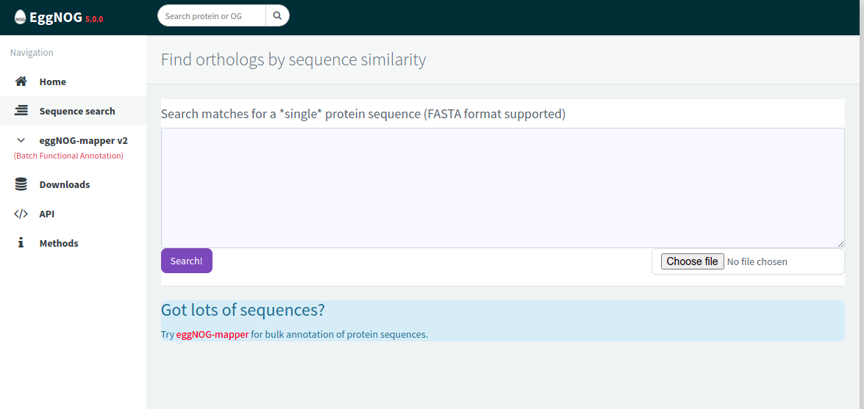
Let’s try it out (finding orthogroups)
2. Search for gene family
Paste
Or Upload gene-of-interest
*Eggnog identifieds by mapping (diamond) against the large orthology DB which gene family is most similiar

Slide 19
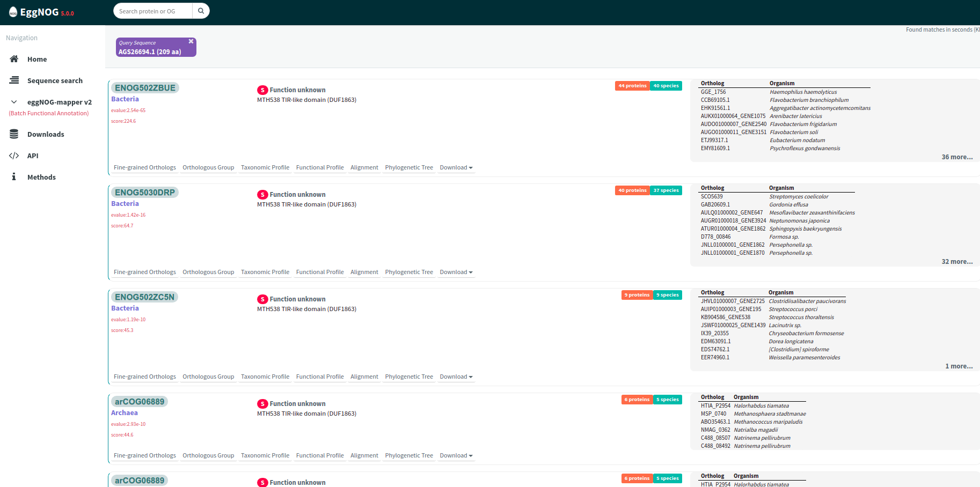
Let’s try it out (finding orthogroups)
2. Search for gene family
Best Hit
(Based on e-value)
=ortholog
Multiple additional hits
(Paralogs, xenologs)

Slide 20
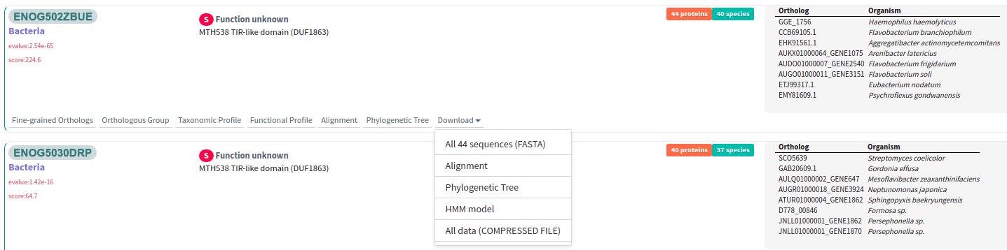
Let’s try it out (finding orthogroups)
2. Search for gene family
Gene family name (fill google.sheets)
How many orthologs/ which organism
Organism (check that is bacteria)
E-value
Download Hmm
(and rename like geneName also
put into specific folder for wally transfer)
domain function
* Remember: Any scoring system is an arbitrary measure of the quality of database matches =take best score, every score bellow 10 is significant)

Slide 21
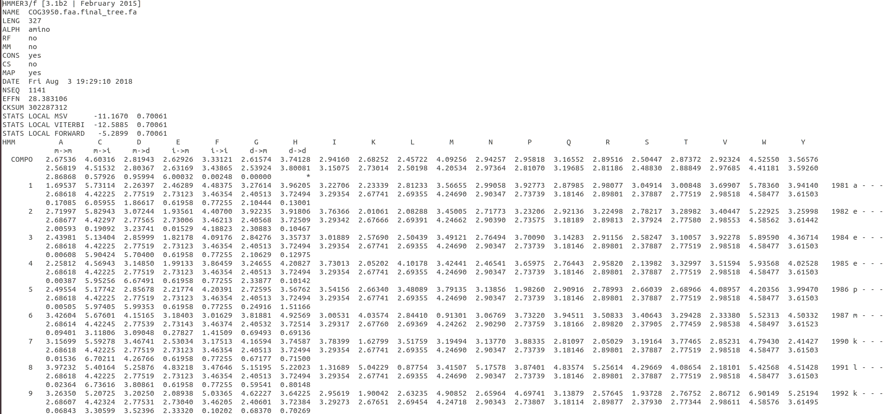
Let’s try it out (finding orthogroups)
Have a look at your HMM.
What is it?
header and descriptive records followed by large numerical matrix which holds probabilistic model of the motif.
Every bases
The file of this format is useful to search against sequnce databases to find out other proteins which share the same motif.

Slide 22

Optional: Let’s try it out (Understand your gene)
3. Understand your gene (search identifying domains (protein families=pfams)
Use Pfam (http://pfam.xfam.org/ ) to annotate Domain families (protien families name is irritating)
Protein search
Takes some time but might give you an understanding what your gene is doing.

Slide 23
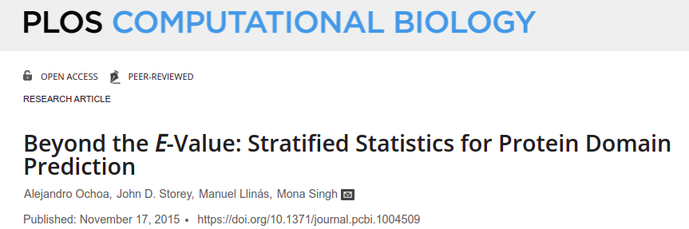
Optional: What is an E-value
The Expect value (E) is a parameter that describes the number of hits one can "expect" to see by chance when searching a database of a particular size. It decreases exponentially as the Score (S) of the match increases. Essentially, the E value describes the random background noise.
NCBI description
https://blast.ncbi.nlm.nih.gov/Blast.cgi?CMD=Web&PAGE_TYPE=BlastDocs&DOC_TYPE=FAQ#:~:text=The%20Expect%20value%20(E)%20is,describes%20the%20random%20background%20noise.
At its core, domain prediction is a multiple hypothesis testing problem, where tens of thousands of homology models (one for each domain) are scored against tens of millions of sequences. Each comparison yields a score s and a p-value, defined as the probability of obtaining a score equal to or larger than s if the null hypothesis holds. While a small p-value threshold (for example, 0.05 or smaller) is acceptable to declare a single test significant, this is inappropriate for a large number of tests. Instead, thresholds for domain prediction are typically based on the E-value. The E-value can be computed from a p-value thresholds as E = pN, where N is the number of tests, and yields the expected number of false positives at this p-value threshold. E-value thresholds make sense for a single database search, especially if few positives are expected. However, E-values are less meaningful when millions of positives are obtained, and a relatively larger number of false positives might be tolerated. Moreover, in multiple database query problems, such as BLAST-based orthology prediction [20] or genome-wide domain prediction [21], E-values are usually not valid because many searches are performed without the additional multiple hypothesis correction required.
https://journals.plos.org/ploscompbiol/article?id=10.1371/journal.pcbi.1004509

Slide 24

Let’s try it out

Slide 25
How do we work with Hidden Markov models (hmm)
1. Build model
- Identify gene-of-interest
- Get gene family
- Create multi-sequence-alignment (MSA) of all genes in the gene family
- Build the HMM with the MSA
2. Search the model
- search the model with all genes-of-interest
- search the model with all genomes
Done!
Let’s do this next!
We already know how we can search multiple genes & multiple genomes (for-loop)
Done!

Slide 26
Let’s try it out (scan for orthogroups)
4. scan for gene family
-Using Hmmmer (http://hmmer.org/) to scan for protein sequence.
-Thefore we use the hmmscan function
(=search protein sequences against a profile HMM database)
-Before we can scan the genome we however need to index the HMM profile
Thefore we use the hmmpress function
-Reminder: You want to scan all your genes and all different genomes (use for- loops)
-Reminder: Think about outputting the information in order to use it later in R.

Slide 27
Let’s try it out
Look at Rmarkdown for instructions!

