Slide 1
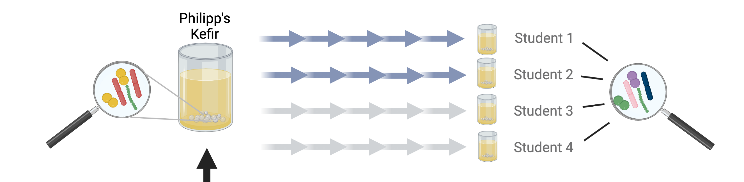
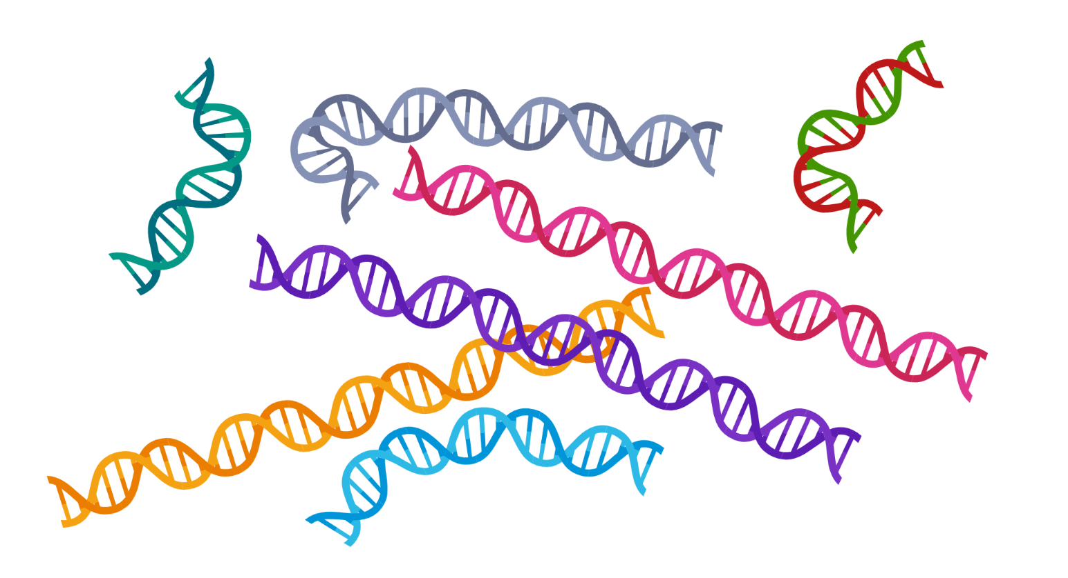
‘Sequence a Genome’ (SAGE II)
Master Molecular Life Sciences
(8th semester)
Department of Fundamental Microbiology, UNIL

Slide 2
Structure and content
What | Content | Responsible | When | When | Each session = half day
Student paper prep | six groups, each group = one paper | Students/Philipp | 17.03.23 | Session 1
Student paper presentation (each session one group) | six groups, each session one group presenting | Students/Philipp | Session 2-7 | Sessions 2-7
Lecture 1 | General intro | Philipp | 24.03.23 | Session 2
Lecture 2 | 16S rRNA amplicon sequencing (background, overall concept/approach, examples) | Daniel | 24.03.23 | Session 2
Tutorial 1 | 16S rRNA amplicon sequencing at GTF/UNIL (the approach we used for our project) and the Dada2 pipeline | Garance? | 24.03.23 | Session 2
Practical 1 | Dada2 pipeline(ASV table, phyloseq, metadata integrated) | Garance? | 24.03.2023 28.03.2023 | Session 2 + 3
Wrap-up 1 | Dada2 pipeline results summary and discussion | Garance? | 28.03.23 | Session 3
Tutorial 2 | ASV-isolate matching | Daniel/Philipp | 24.04.23 | Session 4
Practical 2 | ASV-isolate matching | Daniel/Philipp | 24.04.23 | Session 4
Wrap-up 2 | ASV-isolate matching | Daniel/Philipp | 24.04.23 | Session 4
Lecture 3 | Diversity analyses (alpha/beta diversity; 16S rRNA analysis) | Jeanne/Eric | 02.05.23 | Session 5
Tutorial 3 | Diversity analyses | Jeanne/Eric | 02.05.23 | Session 5
Practical 3 | Diversity analyses | Jeanne/Eric | 02.05.2023 09.05.2023 | Session 5 + 6
Wrap-up 3 | Diversity analyses | Jeanne/Eric | 09.05.23 | Session 6
Lecture 4 | Shotgun metagenomics | Philipp | 16.05.23 | Session 7
Tutorial 4 | Shotgun metagenomics | Malick/Aiswarya/Julian | 16.05.23 | Session 7
Practical 4 | Shotgun metagenomics | Malick/Aiswarya/Julian | 16.05.2023 22.05.2023 | Session 7 + 8
Wrap-up 4 | Shotgun metagenomics | Malick/Aiswarya/Julian | 22.05.23 | Session 8
Tutorial 5 | Isolate genome-MAG comparison | Malick/Aiswarya/Julian | 22.05.23 | Session 8
Practical 5 | Isolate genome-MAG comparison | Malick/Aiswarya/Julian | 22.05.23 | Session 8 + 9
Wrap-up 5 | Isolate genome-MAG comparison | Malick/Aiswarya/Julian | 22.05.23 | Session 9
Wrap-up 6 | Small apero and overall wrap-up | Philipp | 22.05.23 | Session 9
Report writing | 2 full days to generate and knit the two Markdowns | Students |  | Session 10-13

Slide 3
Lecture 1 (Philipp)
General introduction to the course
Organization
Evaluation
Content
Research topic
Objectives and teaching goals

Slide 4
Lecture 2 (Daniel)
“Introduction to microbial diversity analysis using 16S rRNA”
Why to assess diversity in environmental samples
Culture-dependent vs independent approaches
Molecular methods --> 16S rRNA gene = marker gene
Overall idea of amplicon sequencing
Overall idea of primary analysis: OTU clustering → ASV clustering
Overall idea of downstream analysis; alpha vs beta diversity*
Some cool examples from literature (human gut, earth microbiome project)
How we can use it to study our water kefir dataset.
How our samples were sequenced (can be covered in Tutorial 1)
*some things will be discussed into more detail in other lectures and tutorials, but here we can already give some first hints.

Slide 5
Tutorial 1 (Garance)
“16S rRNA gene amplicon sequencing of our WK experiment using Dada2”
How our samples were sequenced (can be covered in lecture 2)
What type of data we got.
Which student/group, which data?
Dada2 pipeline idea
Dada2 pipeline step-by-step
Dada2 pipeline in R and how to use it on the server.

Slide 6
Practical 1 (Garance)
“16S rRNA gene amplicon sequencing of our WK experiment using Dada2”
Dada2 pipeline in R studio on server
Starting with QC-ed reads
Error models and correction
Merging of FW and rv reads
ASV generation and determining abundances
Phyloseq object generation

Slide 7
Wrap-up 1 (Garance)
“16S rRNA gene amplicon sequencing of our WK experiment using Dada2”
Discuss a few important points of the exercise with the class
Let the students participate and take the lead.
E.g. present one of the results and let the students discuss what they see.

Slide 8
Tutorial 2 (Daniel/Julian)
“How much of the WK diversity does our isolate strain collection represents?”
Go back to the idea of culture-dep and independent approaches
Make the point that having bacterial isolates of the major community members is great for conducting experiment in the future
This leads to the aim of this tutorial: ASV- isolate genome/strain matching
Introduce the practical

Slide 9
Practical 2 (Daniel /Julian)
“How much of the WK diversity does our isolate strain collection represents?”
Build blast database of all ASVs
Extract the 16S rRNA genes from our isolates using barrnap (or provide the sequences)
BlastN
Extract meaningful info from blast results
Plot results in R to show which fraction of the ASVs is represented by isolates and relative to their abundance in the community
(see Sarton-Loheac et al bioRxiv/mBio 2023)

Slide 10
Wrap-up 2 (Daniel /Julian)
“How much of the WK diversity does our isolate strain collection represents?”
Discuss the results
Highlight limitations of this analysis.
Let the students participate and take the lead.
E.g. present one of the results and let the students discuss what they see.

Slide 11
Lecture 3 (Jeanne/Eric)
“Diversity analysis in microbiome research”
Ecological concepts of diversity (alpha, beta, gamma)
How to apply these concepts to microbiome research
What can we learn from it
Implementations of alpha and beta diversity
How can we use these measures to describe our WK experiment and address the three questions we have posed in the beginning of the course

Slide 12
Tutorial 3 (Jeanne/Eric)
“Diversity analysis of our WK dataset”
Repeat the core questions we want to address
Explain how we will do this using the output generated by Dada2
Short intro to the written tutorial and practical sessions

Slide 13
Tutorial 3 (Jeanne/Eric)
“Diversity analysis of our WK dataset”
Generate alpha and beta diversity plots
Look at what we did last year and what Vincent Sommerville put in a first draft manuscript about this dataset:
https://docs.google.com/document/d/1i4S8PZabOORNi6uvmJwye3v38z4ahdoMYBxDXnfe3rQ/edit#heading=h.de61uoi29q2s

Slide 14
Wrap-up 3 (Jeanne/Eric)
“Diversity analysis of our WK dataset”
Discuss results with the class
What are the answers to the questions we have posed in the beginning
How do we interpret the produced plots?
Let the students participate and take the lead.
E.g. present one of the results and let the students discuss what they see.
This part will close the 16S rRNA analysis part of the course, so it is important to make some concluding points here.

Slide 15
Lecture 4 (Philipp?)
“Shotgun metagenomics in microbiome research”
History and overall idea
Pros and cons
Examples
Overall analysis approaches that exist
Focus on MAGs
Give some examples.

Slide 16
Tutorial 4 (Malick/Aiswarya)
“Generate bacterial genomes from WK metagenomics”
Goal of the practical
Approach
Step-by-step

Slide 17
Practical 4 (Malick/Aiswarya)
“Generate bacterial genomes from WK metagenomics”
Or let them at least do the assemblies?
Start with reads mapped to contigs
Co-variation analysis
QC of MAGs
Filter MAGs

Slide 18
Wrap-up 4 (Malick/Aiswarya)
“Generate bacterial genomes from WK metagenomics”
How many MAGs remain
Which taxa do the y belong to?
Matching some of our ASVs or isolate genomes?

Slide 19
Tutorial 5 (Malick/Aiswarya)
“How representative are MAGs of isolate genomes”
Short intro to comparative genomies
Goal of the practical
Approach
Step-by-step

Slide 20
Practical 5 (Malick/Aiswarya)
“How representative are MAGs of isolate genomes”
Whole genome alignment
Metabolic maps of isolates compared to MAGs
Objective/question: can we extract meaningful biological info from MAGs in terms of phylogeny and function?

Slide 21
Wrap-up 5 (Malick/Aiswarya/Philipp)
“How representative are MAGs of isolate genomes”
Discuss results of tutorial 5
Discuss overall course
Clarify report writing questions
Have a small apero with students and assistants?

Slide 22
Resources (to get ideas)
From previous years or from other courses:
Lecture 1 – Intro
220405_SAGE2_2022_General_Intro.ppt
2. Lecture 2 - 16S rRNA analysis
230221_Lecture1_MicroEcol2023_handout1.pptx (general lecture with a long intro to Microbial Ecol)
FEB2021_SAGE_AmpliconSequencing_GB_GSL.pptx (from last year SAGE)
220412_SAGE_16SAmpSeq_2_DADA2_GSL_GBR.pptx
3. Tutorial 1 – Dada2 pipeline
220412_SAGE_16SAmpSeq_2_DADA2_GSL_GBR.pptx
220405_SAGE2_Dada2_tutorial1.Rmd
3. Lecture 3 – Diversity analysis in microbiome research
230221_Lecture1_MicroEcol2023_handout1.pptx (general lecture with a long intro to Microbial Ecol)
220408_16SrRNAtutorial_Diversity.pptx
Diversity_Analysis.pdf
4. Tutorial 2 – ASV-Isolate matching
https://www.biorxiv.org/content/10.1101/2022.12.08.519137v3.full Figure 2B
5. Tutorial 3 – Diversity analysis in microbiome research
https://docs.google.com/document/d/1i4S8PZabOORNi6uvmJwye3v38z4ahdoMYBxDXnfe3rQ/edit?usp=sharing
WrapUp_Diversity.pdf
230426_Tutorial_16Sdiversity_GBR.Rmd
6. Lecture 4 – Shotgun metagenomics
230228_Lecture2_MicroEcol2023_handout1.pptx

