Slide 1
Reads QC and what to do with it
SAGE 2022-2023

Slide 2
Today’s workflow
Pre-timming QC
Everything’s fine?
Raw Reads
Trimming
Everything’s fine?
Post-trimming QC
Trimmed Reads

Slide 3
What we did for you

Slide 4
Lysis of the bacterial cells
With bead-beating
Bacterial debris
Bacteria Isolate
Bacterial DNA
Lysis
Bacterial DNA
Bacterial DNA
Bacterial DNA

Slide 5
DNA extraction
With the SPRI beads
Bacterial debris
Extraction
Bacterial DNA
Bacterial DNA

Slide 6
DNA tagmentation
≈250bp
Tagmentation
Bacterial DNA
Tagmented bacterial DNA

Slide 7
PCR DNA amplification (and addition of adapters)
Amplification
Tagmented bacterial DNA
Amplified tagmented bacterial DNA

Slide 8
Pooling the libraries
Amplified tagmented bacterial DNA library 1
Pooling
Pooled amplified tagmented bacterial DNA libraries
Amplified tagmented bacterial DNA library 2

Slide 9

Sequencing the libraries

Slide 10
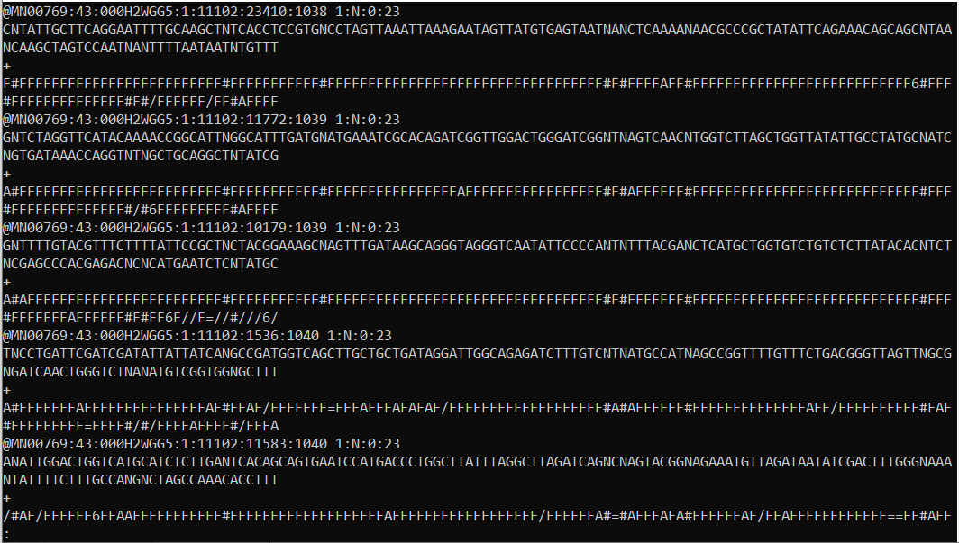
Structure of the data we get
Read ID
Read Sequence
+ sign
Sequence quality
(Phred score)
More on: http://maq.sourceforge.net/fastq.shtml
Notes:
Read ID contains info about machine, sequencing run, etc.
Read sequence can characters other than ATGC. For example, N means that the base was not determined.
Sequence quality is also called Phred quality.

Slide 11
Why do we want to QC it?
One spends a lot of time working on data: they better be good!
A lot of things can go wrong:
Lack of confidence of machine in base calling
Sequence overrepresentation
Contaminations

Slide 12
Analyzing a fastQC report

Slide 13

How?
FastQC is a software that checks several quality-linked statistics from the read files.

Slide 14
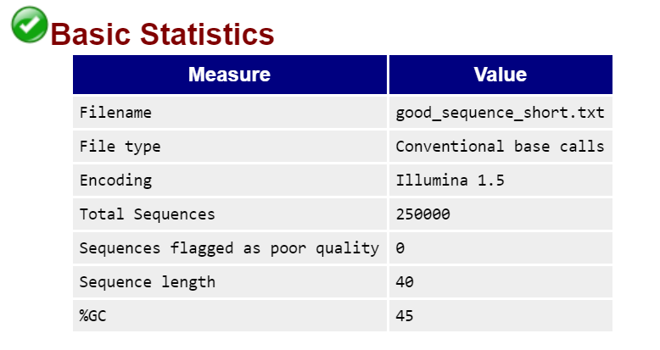
FastQC report – Basic statistics
Recapitulates some of the basic statistics of the sequence file
http://www.bioinformatics.babraham.ac.uk/projects/fastqc/

Slide 15
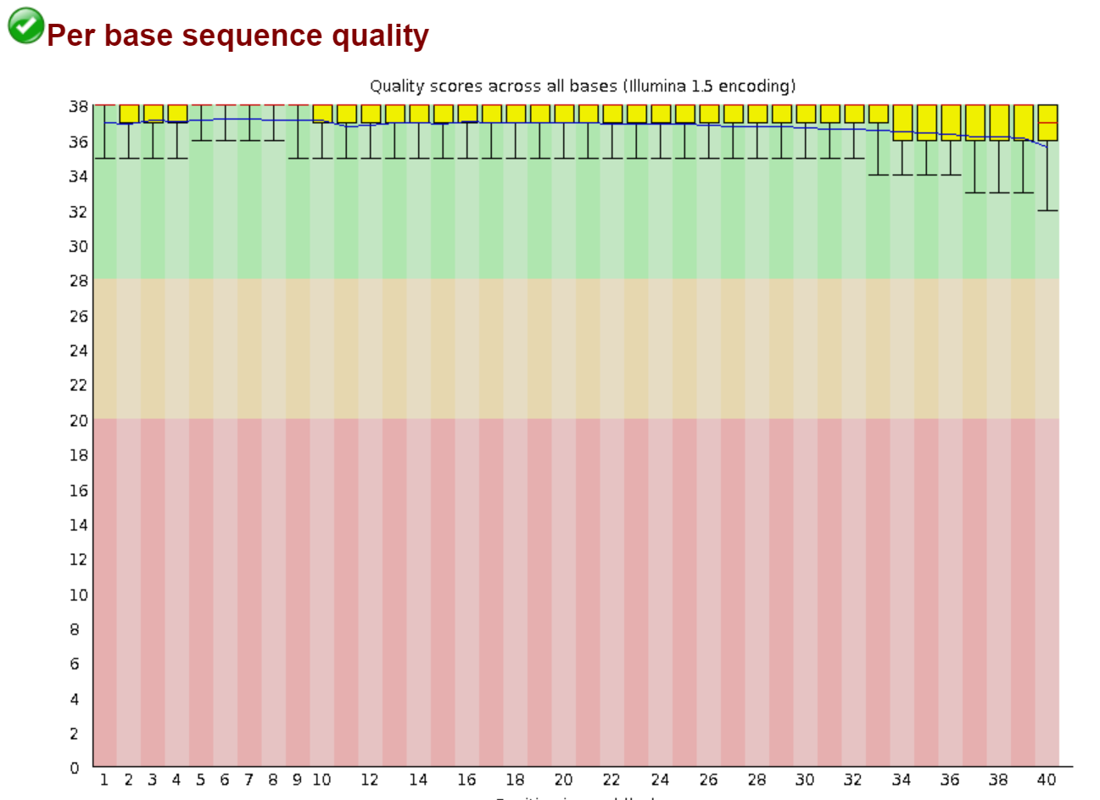
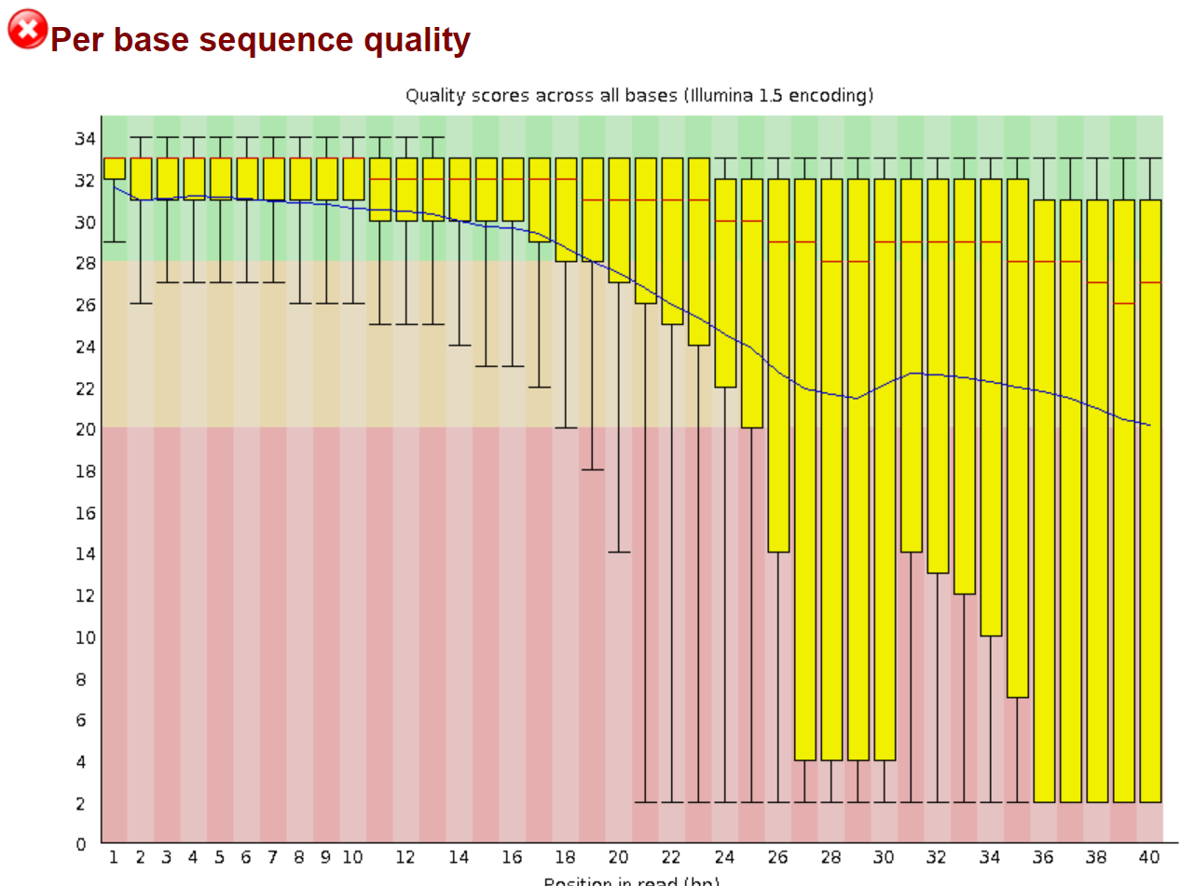
FastQC report – Per base sequence quality: Sequencing machine has a varying confidence in the base calls.
Good
Bad
http://www.bioinformatics.babraham.ac.uk/projects/fastqc/

Slide 16
FastQC report – Per base sequence quality
Why are we interested in that:
Quality of the calls generally degrades as run progresses.
Therefore, bases at further positions have lower quality.
You can also have bubbles passing through the flow cell.
Warnings can be raised by low scores or varying read lengths.
http://www.bioinformatics.babraham.ac.uk/projects/fastqc/

Slide 17
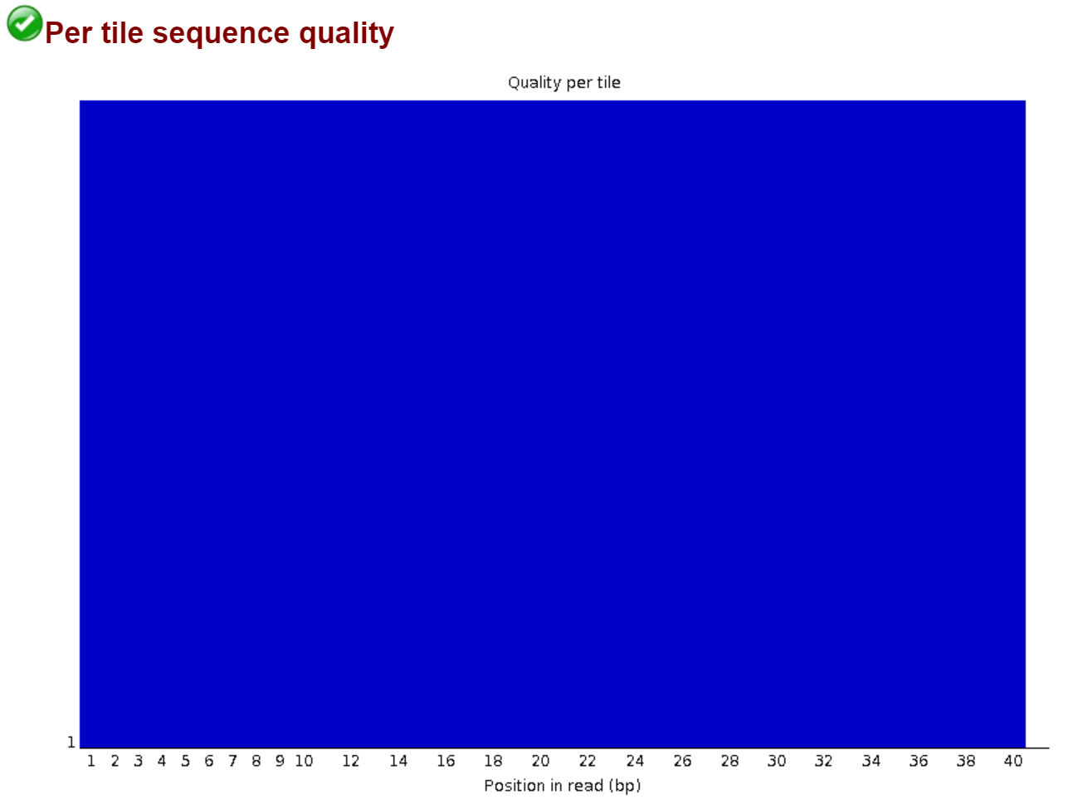
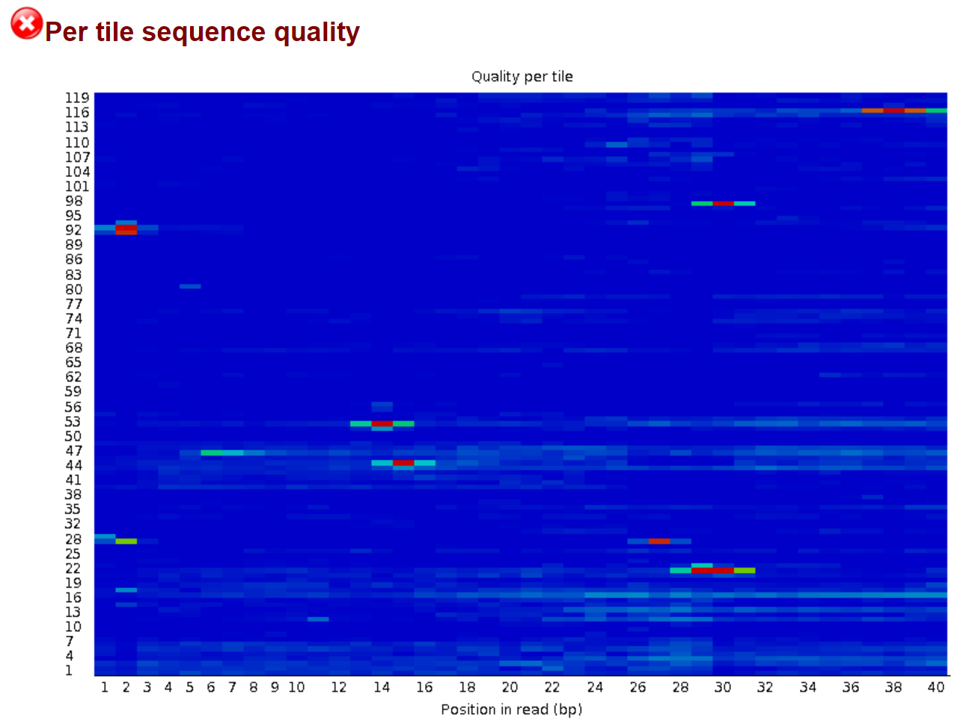
FastQC report – Tile quality: Tiles from which the reads come from on the sequencer and their quality.
Good
Bad
http://www.bioinformatics.babraham.ac.uk/projects/fastqc/

Slide 18
FastQC report - Tile quality
Why are we interested in that:
Flow cell can be overloaded.
Allows to detect consistent problems coming from a tile.
http://www.bioinformatics.babraham.ac.uk/projects/fastqc/

Slide 19
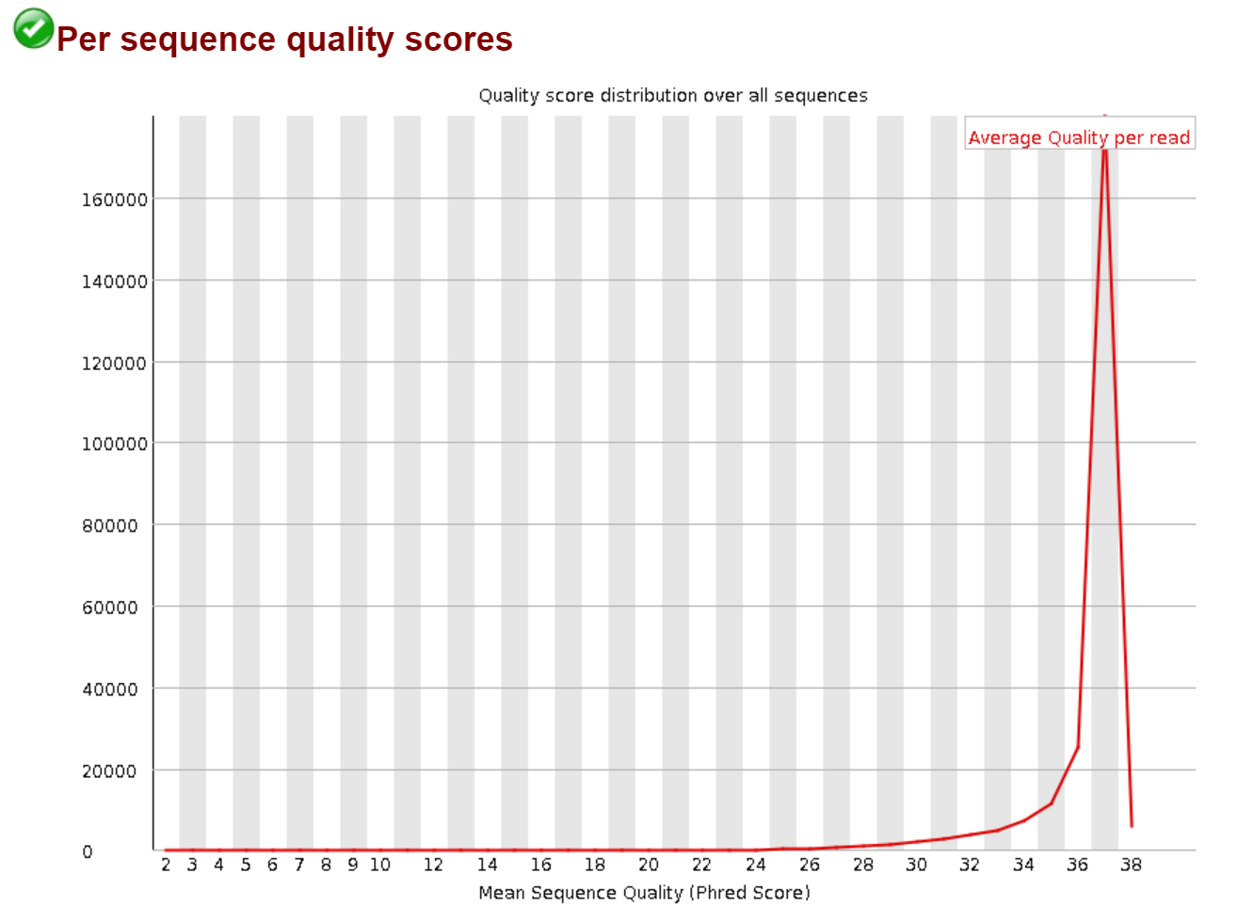
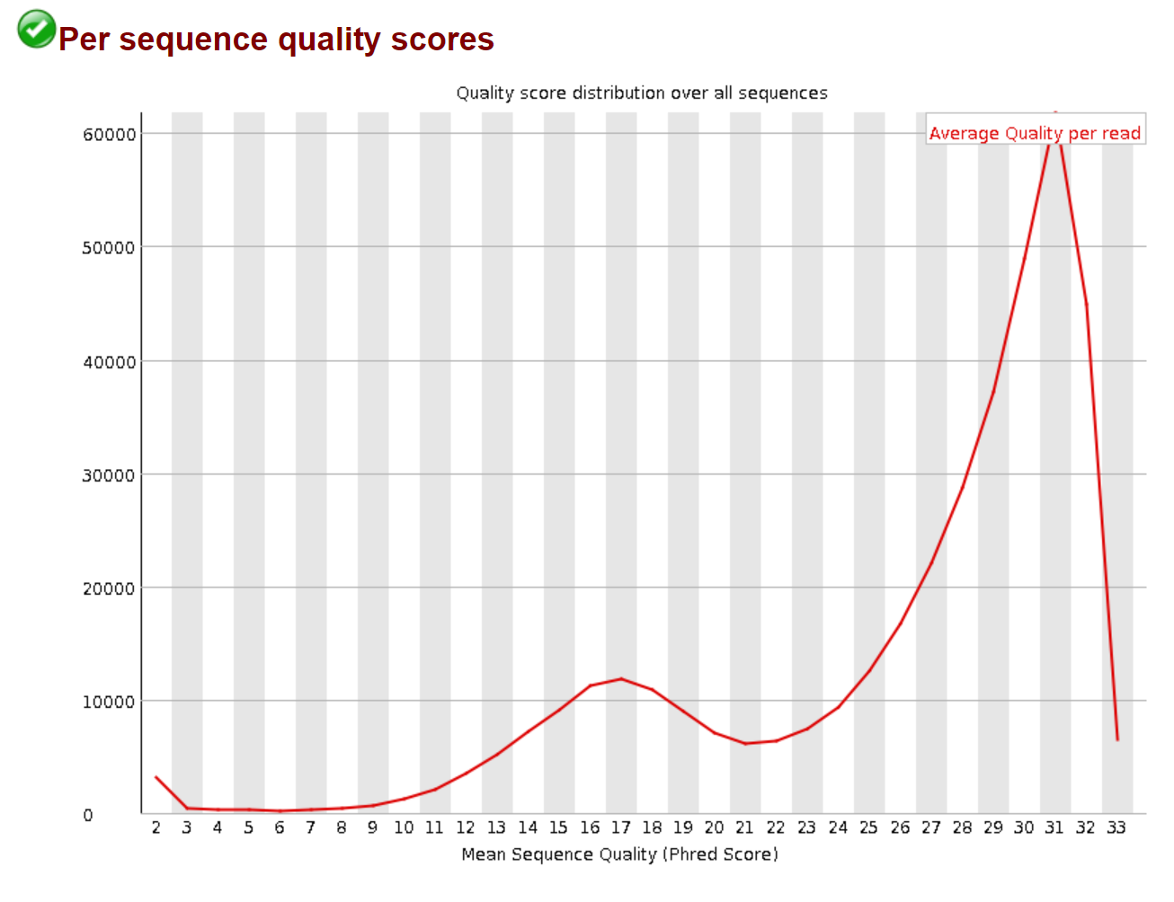
FastQC report – Per sequence quality scores: Plot of the overall quality of the reads.
Good
Less good but still OK
http://www.bioinformatics.babraham.ac.uk/projects/fastqc/

Slide 20
FastQC report – Per sequence quality scores
Why are we interested in that:
It is usual that a subset of the reads have a low quality value.
Can be due to an imaging problem.
Warnings can be raised by high (>0.2%) error rates.
http://www.bioinformatics.babraham.ac.uk/projects/fastqc/

Slide 21
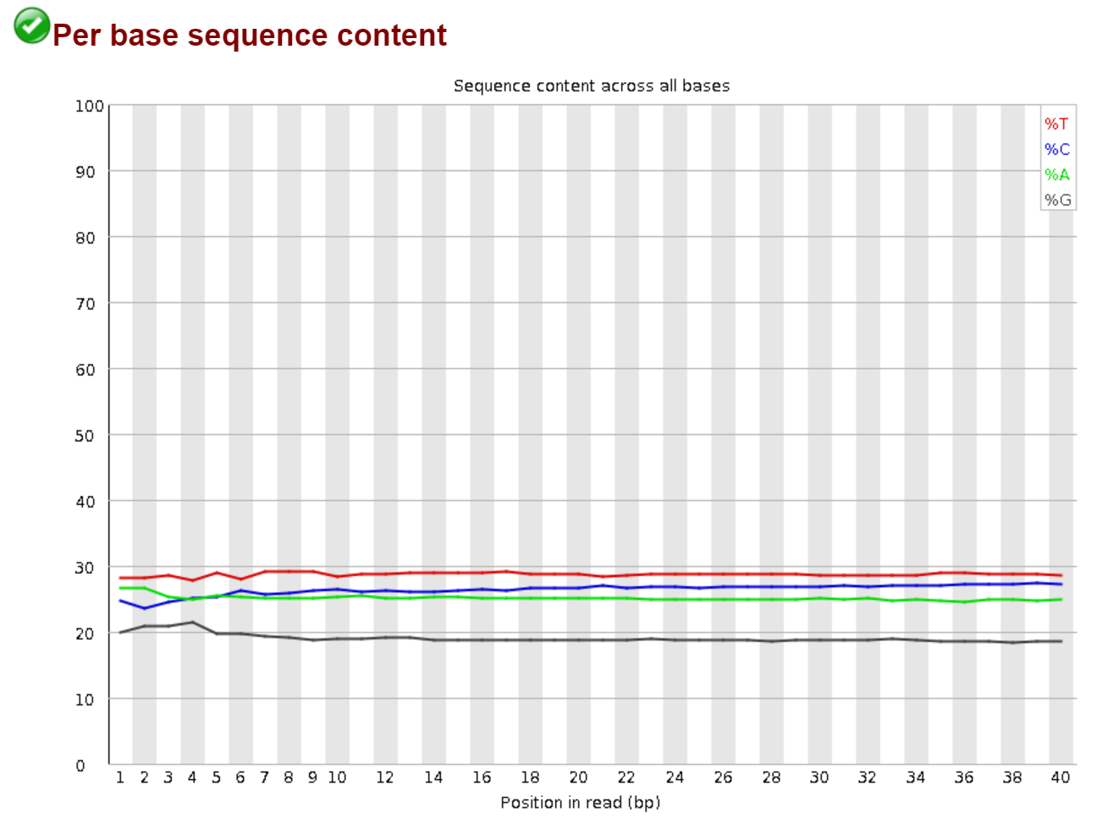
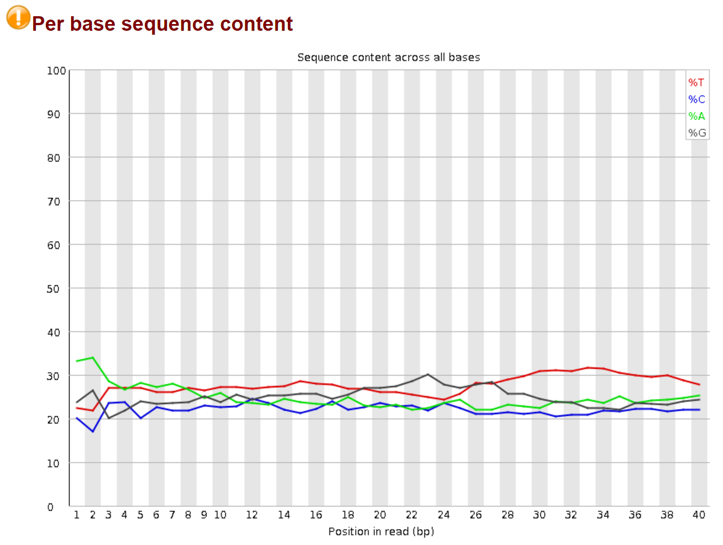
FastQC report – Per base sequence content: Proportion of each base at each position.
Good
Bad
http://www.bioinformatics.babraham.ac.uk/projects/fastqc/

Slide 22
FastQC report – Per base sequence content:
Why are we interested in that:
If library was perfectly random, all bases would have same representation.
Warnings can be raised by overrepresented sequences or biased fragmentation.
http://www.bioinformatics.babraham.ac.uk/projects/fastqc/

Slide 23
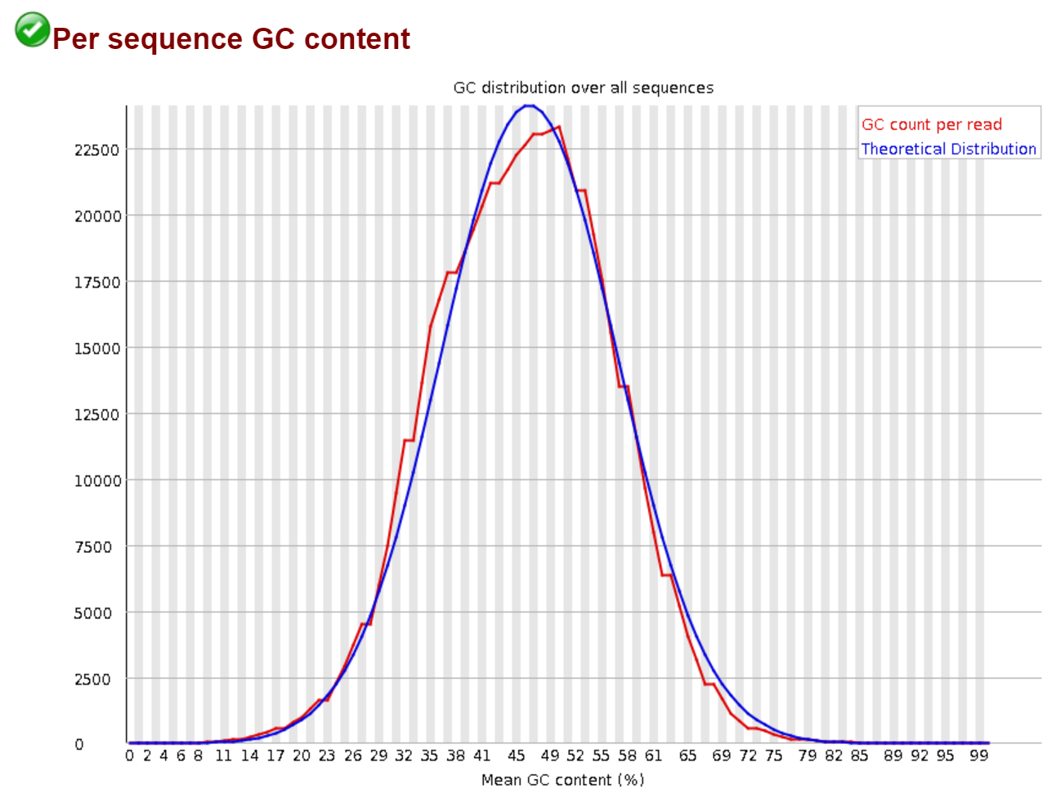
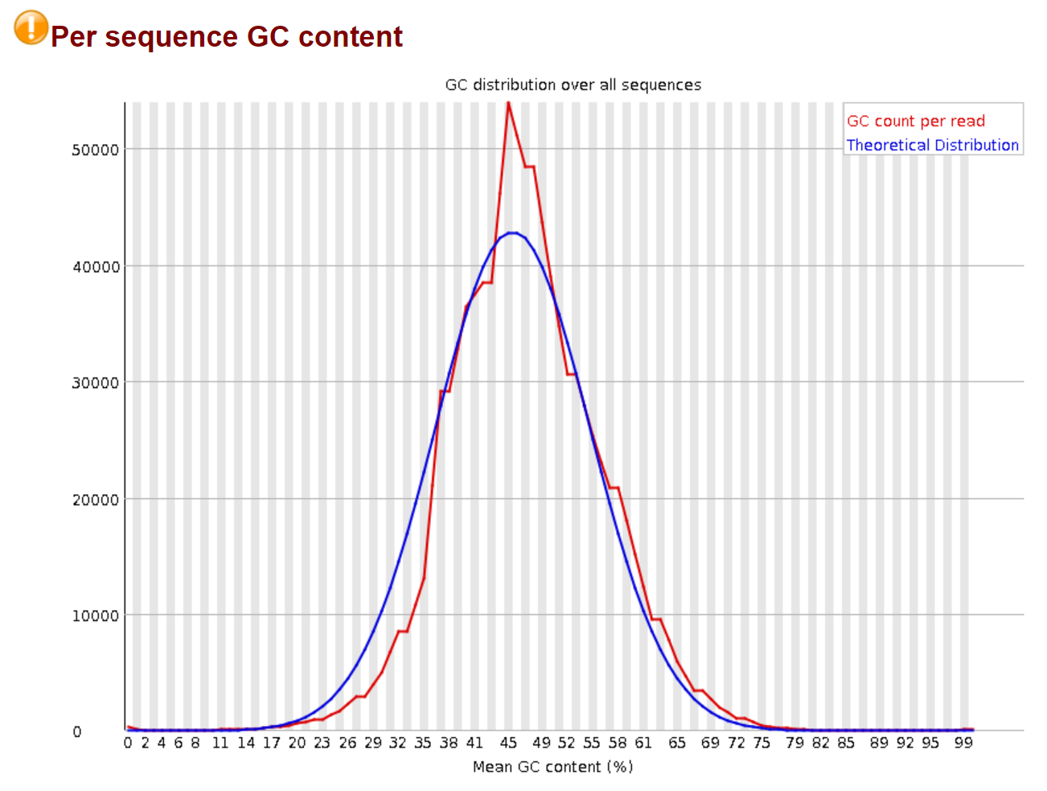
FastQC report – Per sequence GC content Average GC content of each sequence. Reference distribution is built with global GC content.
Good
Bad
http://www.bioinformatics.babraham.ac.uk/projects/fastqc/

Slide 24
FastQC report – Per sequence GC content
Why are we interested in that:
Sharp peaks can be due to contaminant that may be found in overrepresented sequences.
Broad peaks can be due to contamination by other species.
http://www.bioinformatics.babraham.ac.uk/projects/fastqc/

Slide 25
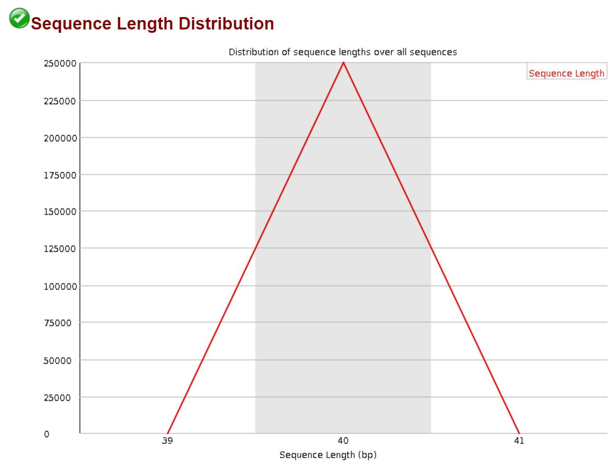
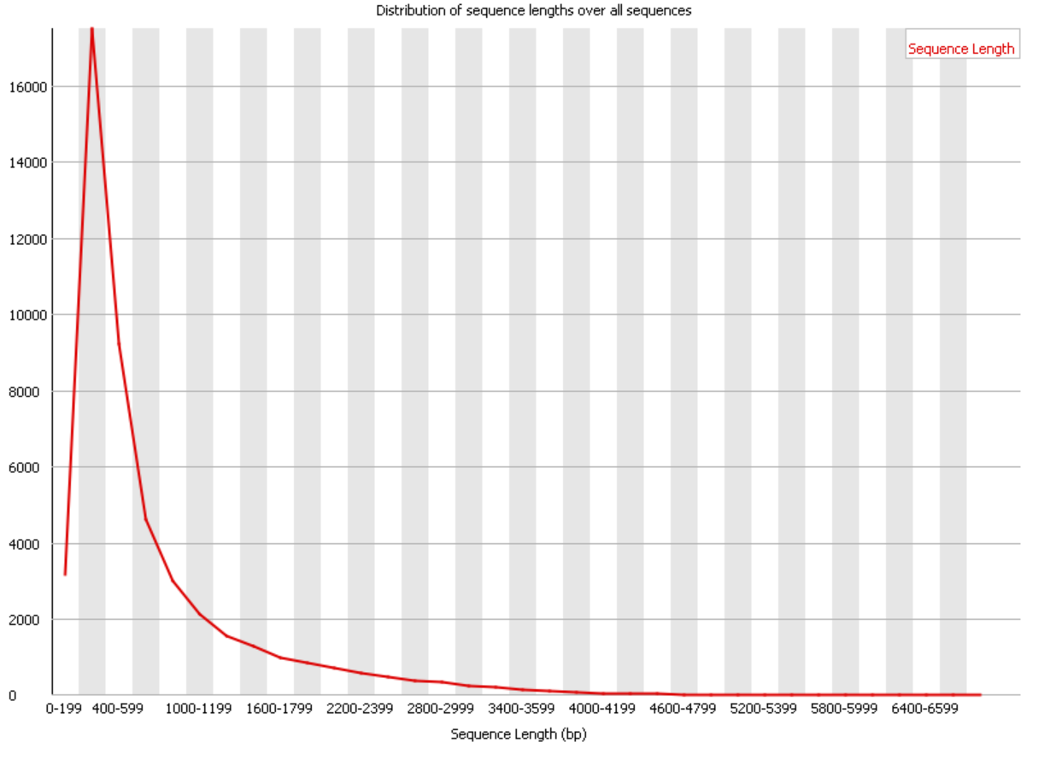
FastQC report – Sequence length distribution Depending on technology, sequencer can produce fragments of uniform lengths or not.
Good
Bad
http://www.bioinformatics.babraham.ac.uk/projects/fastqc/

Slide 26
FastQC report – Sequence length distribution
Why are we interested in that:
In our case, the fragments should have rather uniform lengths.
http://www.bioinformatics.babraham.ac.uk/projects/fastqc/

Slide 27
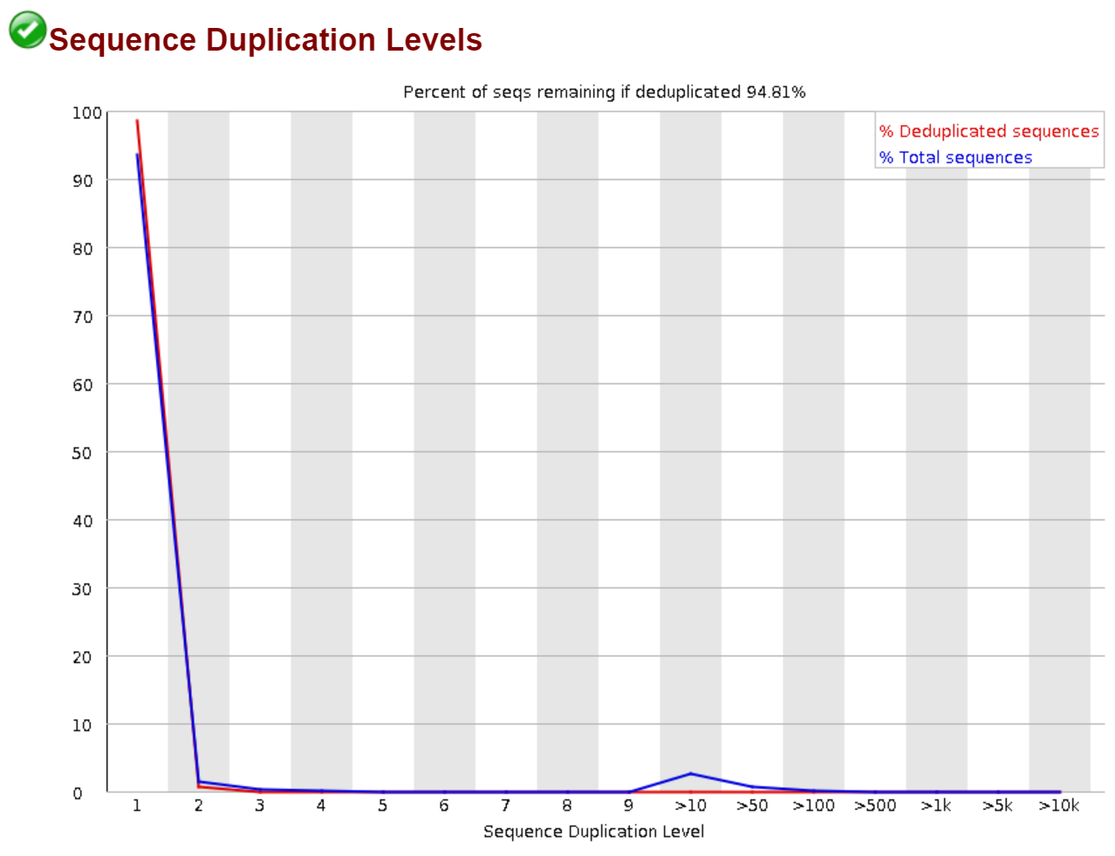
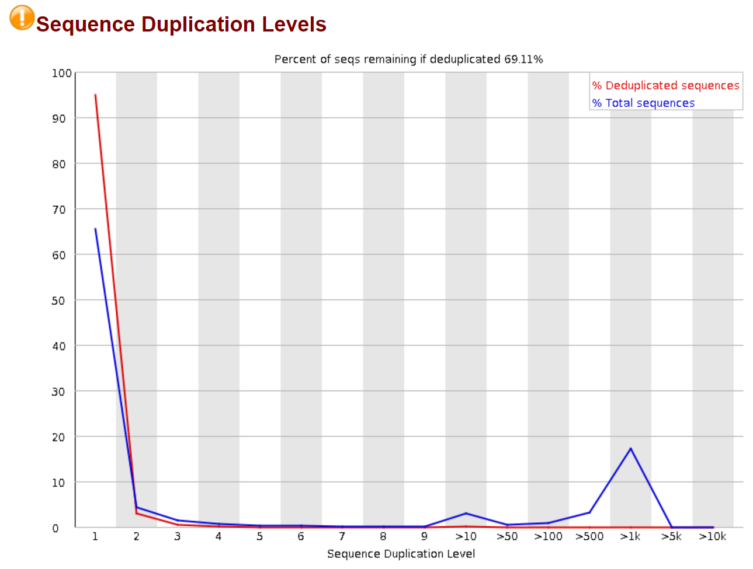
FastQC report – Sequence duplication level Assessment of duplication level in the first 100’000 reads.
Good
Bad
http://www.bioinformatics.babraham.ac.uk/projects/fastqc/

Slide 28
FastQC report – Sequence duplication level
Why are we interested in that:
In a very diverse library, sequences usually occur once.
High level of duplication can indicate high coverage…
… or enrichment bias.
Warnings can be raised by >20% duplicates.
http://www.bioinformatics.babraham.ac.uk/projects/fastqc/

Slide 29
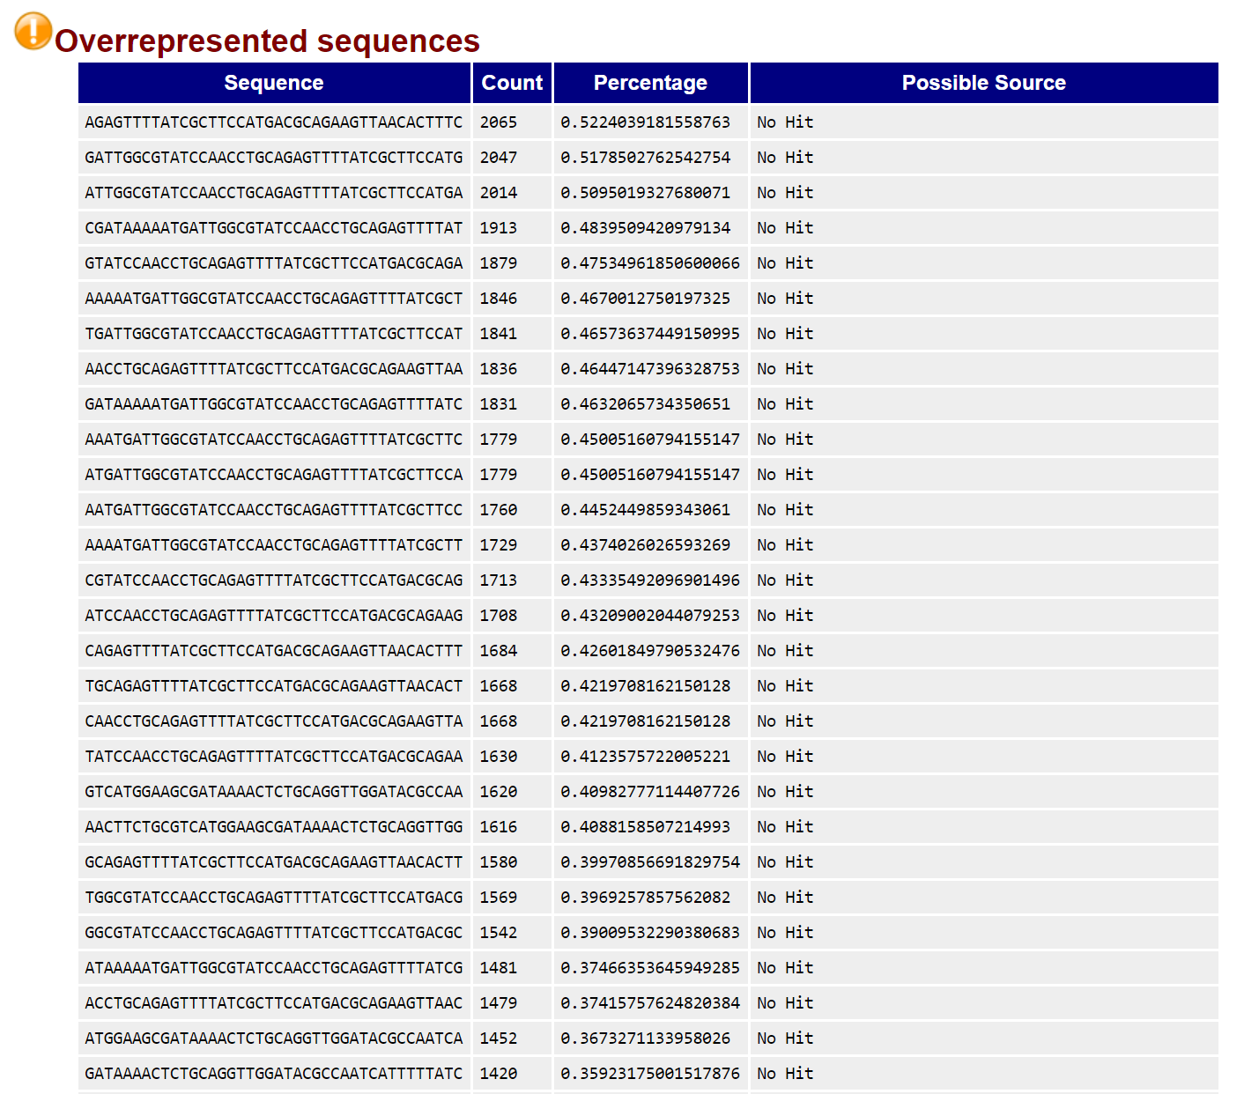

FastQC report – Overrepresented sequences: All sequences that represent more than 0.1% of the total on the first 100’000 sequences
Good
Bad
http://www.bioinformatics.babraham.ac.uk/projects/fastqc/

Slide 30
FastQC report – Overrepresented sequences
Why are we interested in that:
Overrepresented sequences can be adapters, non-random fragmentation.
http://www.bioinformatics.babraham.ac.uk/projects/fastqc/

Slide 31
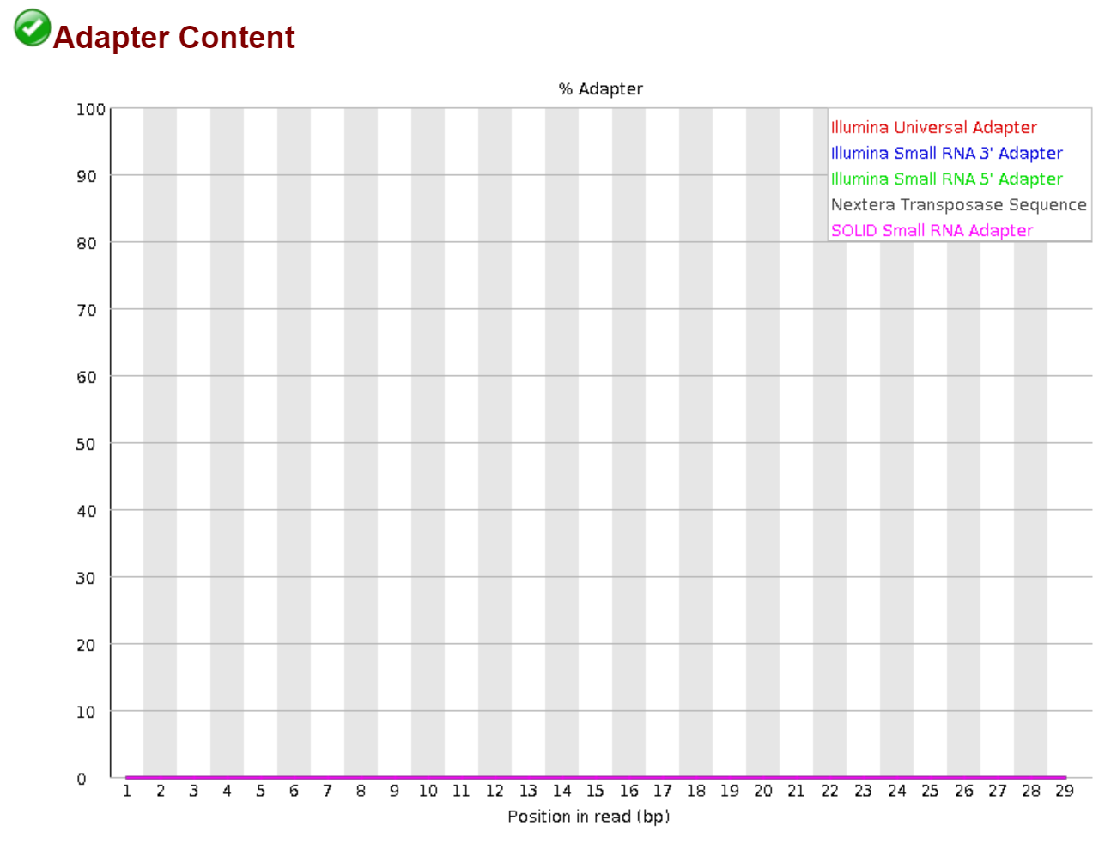
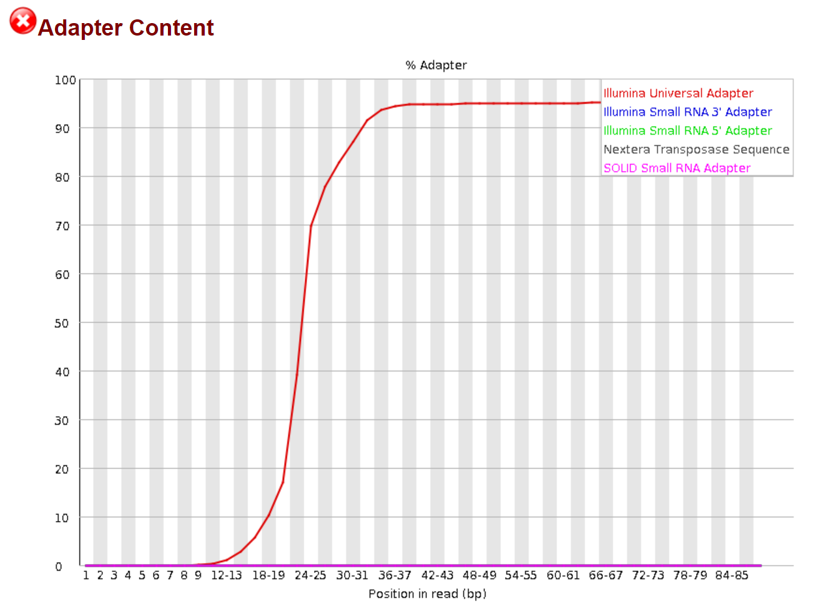
FastQC report – Adapter content: Shows you presence of adapters in what has been sequenced.
Good
Less good
http://www.bioinformatics.babraham.ac.uk/projects/fastqc/

Slide 32
FastQC report – Adapter content
Why are we interested in that:
You will need to remove the adapters, because that will temper with the assembly.
http://www.bioinformatics.babraham.ac.uk/projects/fastqc/

Slide 33
Today’s workflow
Pre-timming QC
Everything’s fine?
Raw Reads
Trimming
Everything’s fine?
Post-trimming QC
Trimmed Reads

Slide 34
Trimming the reads

Slide 35
The trimmomatic command
We work with paired-end reads
Number of threads usable in parallelization
Input files
Output files – R1 direction
Output files – R2 direction
Adapters to remove
Removes low quality leading bases
Removes low quality trailing bases
Removes 3’ end if window is low quality
Minimal length to be kept

Slide 36
Today’s workflow
Pre-timming QC
Everything’s fine?
Raw Reads
Trimming
Everything’s fine?
Post-trimming QC
Trimmed Reads

