Slide 1
Using R for contig filtering
Vincent de Bakker
SAGE I, fall 2022

Slide 2
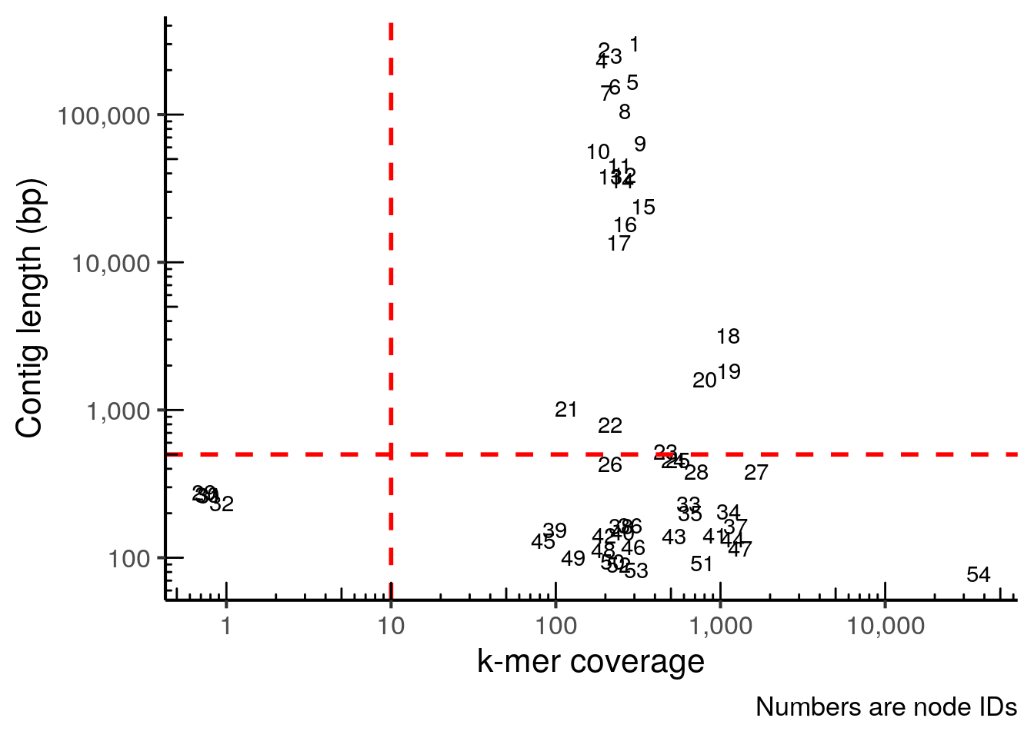


Goal: select only informative contigs
Why R?
Great for plotting / data visualization → intuitive
Useful skill
What is R?
Coding language for statistical computing and graphics
Open-source
Customizable and versatile
Much used in life sciences
What is RStudio?
Interface for R: makes it user-friendly
More advanced: debugging tools
Is not R itself!

Slide 3
You should have installed R and RStudio
In case you have not: see links in tutorial
Section 5.1: R installation

Slide 4
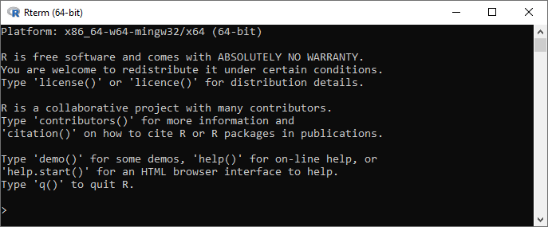
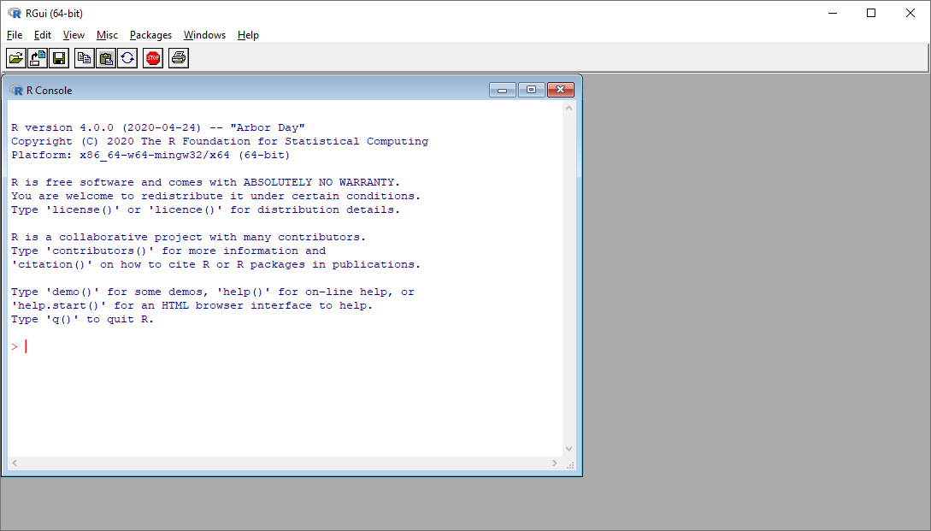
Why do we want RStudio?
R (terminal)
RGui
...because this can be more user-friendly

Slide 5
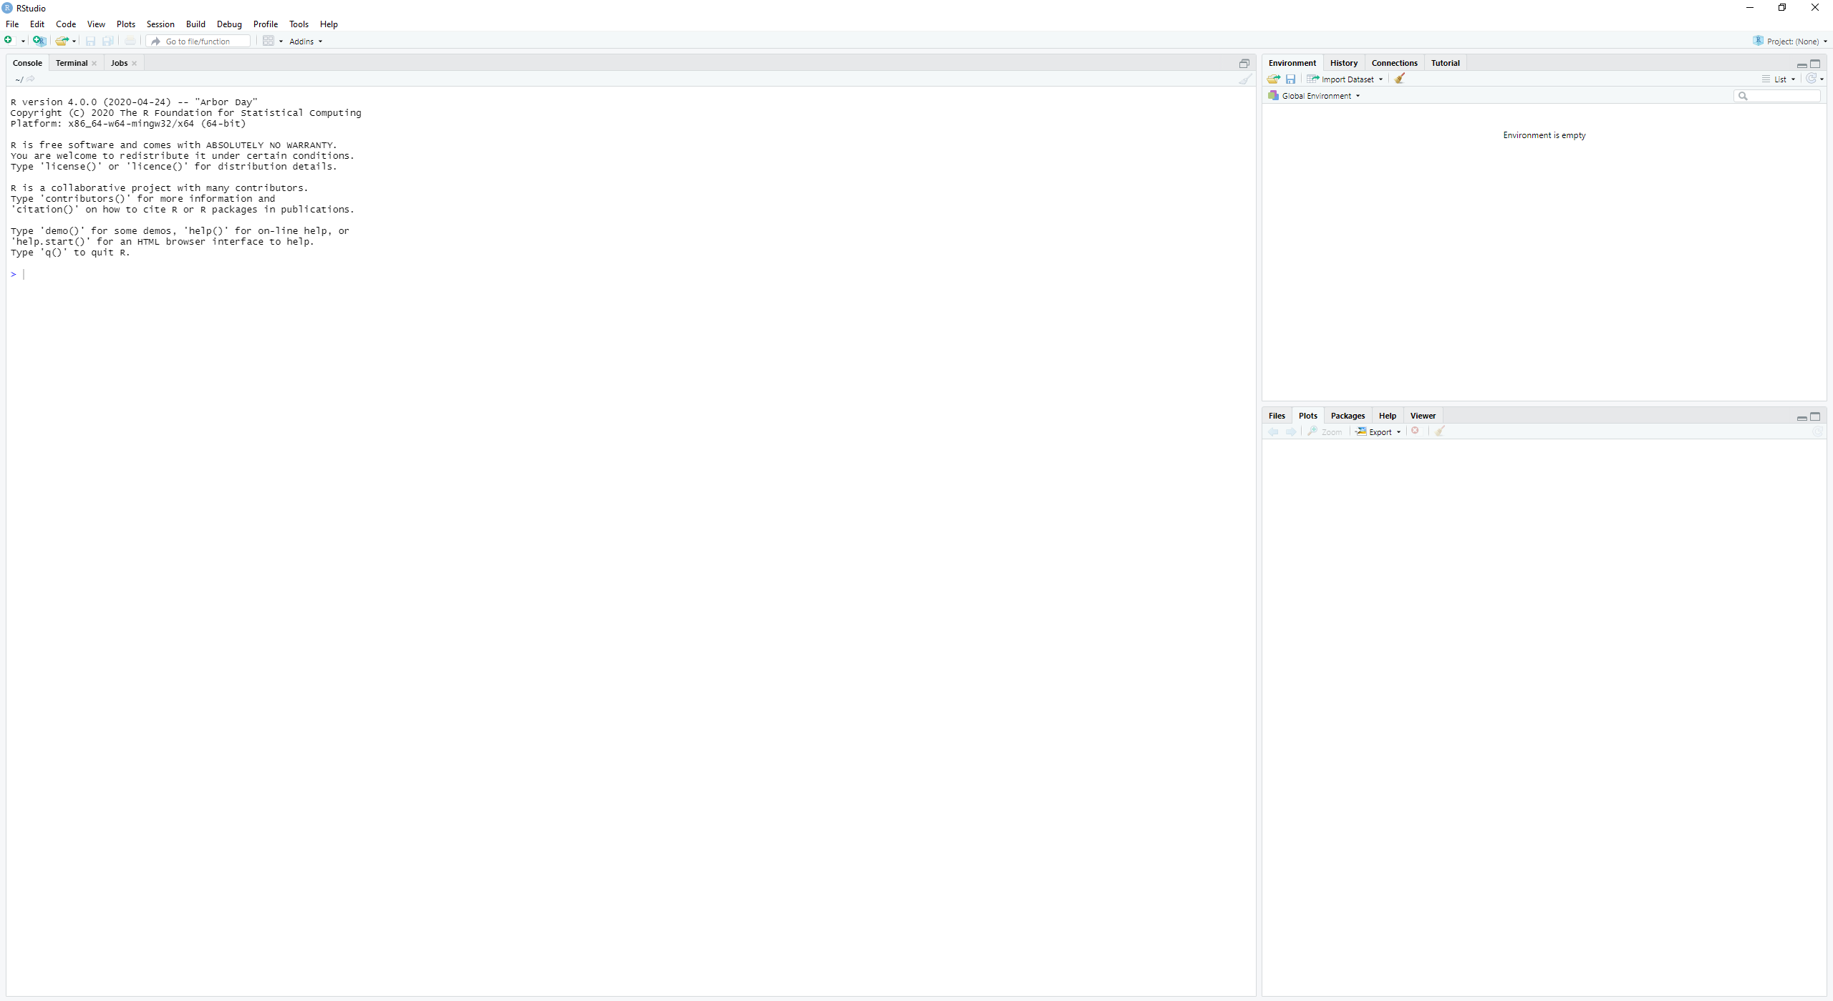

Slide 6
Console pane
Environment pane
Plot & help pane

Slide 7
Console pane
Environment pane
Here stored variables are shown
Plot & help pane
Here we can run R code as on a command line
The current working directory is shown
The prompt is “>”
Here plots are displayed...
...or e.g. help files

Slide 8
Console pane
Environment pane
Here stored variables are shown
What is my current working directory?
Plot & help pane
Here we can run R code as on a command line
The current working directory is shown
The prompt is “>”
Here plots are displayed...
...or e.g. help files

Slide 9
Console pane
Environment pane
~/
home directory
For me: C:/Users/vince/Documents
Here stored variables are shown
What is my current working directory?
Plot & help pane
Here we can run R code as on a command line
The current working directory is shown
The prompt is “>”
Here plots are displayed...
...or e.g. help files

Slide 10
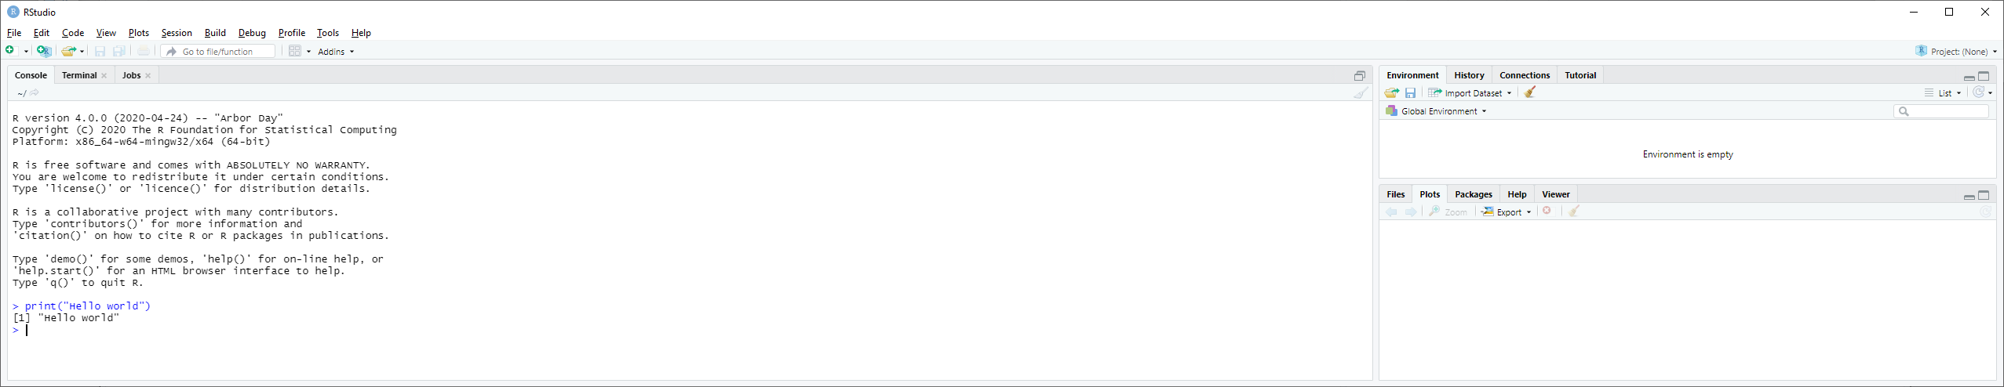
Running code in console

Slide 11
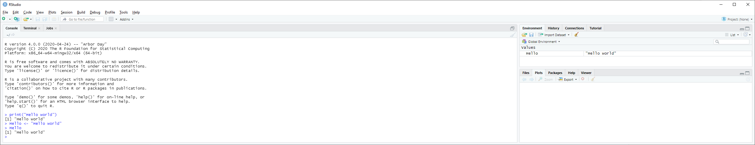
Running code in console
Storing information into “variables” or “objects”
Use: <-
(hot key: Alt + - [WIN])
Appears in “environment”
Run “object” to see contents

Slide 12
Next time I want to run this code...
...what was it again, exactly?
“Hello, world”
“hello, world”
“HelloWorld”
“Hello world”
“hello world”
...
“Hell, o World”?
Save your code in scripts, and run from there
Like with myFirstScript.sh, run_fastqc.sh, run_trimmomatic.sh, run_spades.sh
Cannot possibly remember exact code or parameters
Required for reproducibility

Slide 13
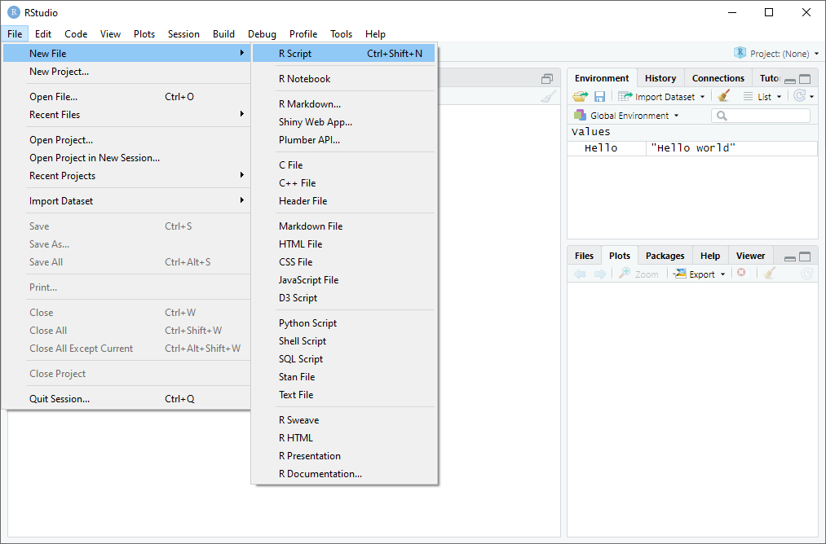
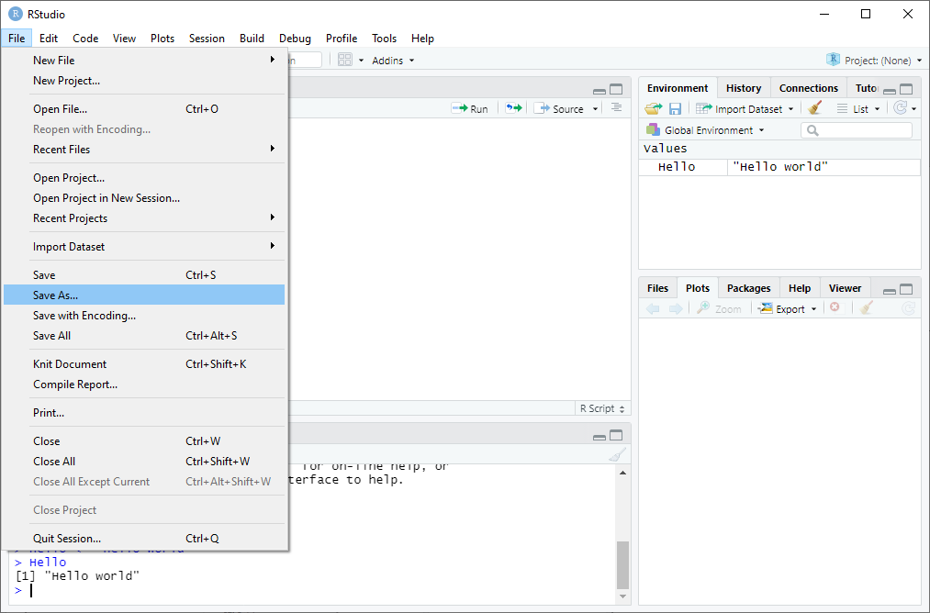
Opening & saving a new R Script
Open
Save
...saved as example.R in

Slide 14
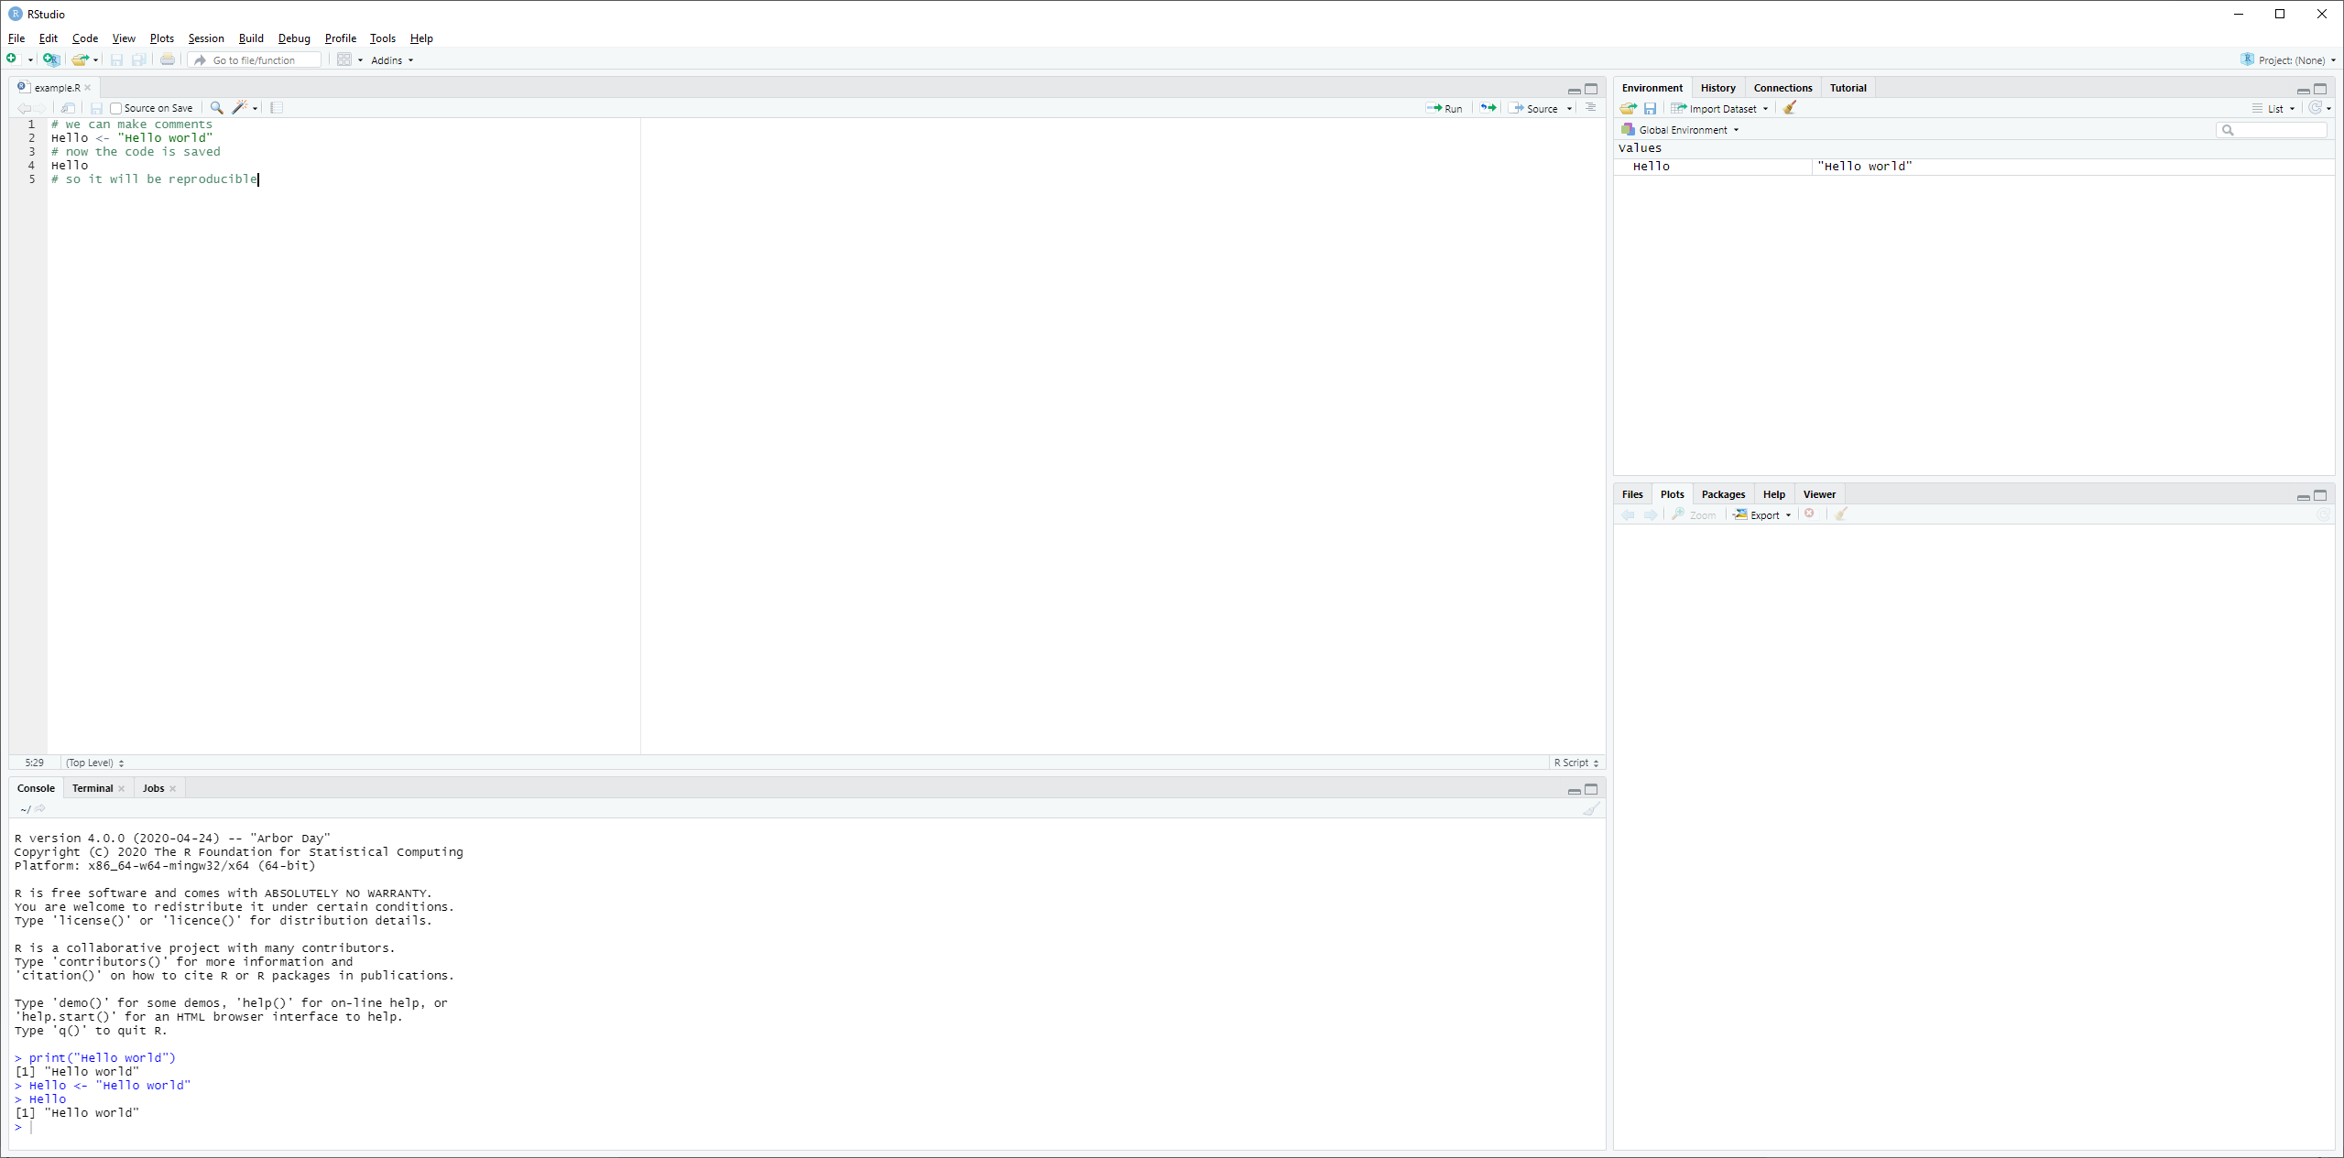
Source / script pane
Environment pane
Here we can write R code, save it and run it
Run current line or selection with...
...keyboard: Ctrl+Enter (WIN) / ⌘+Enter (MAC)
...mouse
Annotate your code with comments to recall what it does
Plot & help pane
Console pane
Whatever you run in the script, will still appear in the console
Naturally, save your changes every now and then

Slide 15
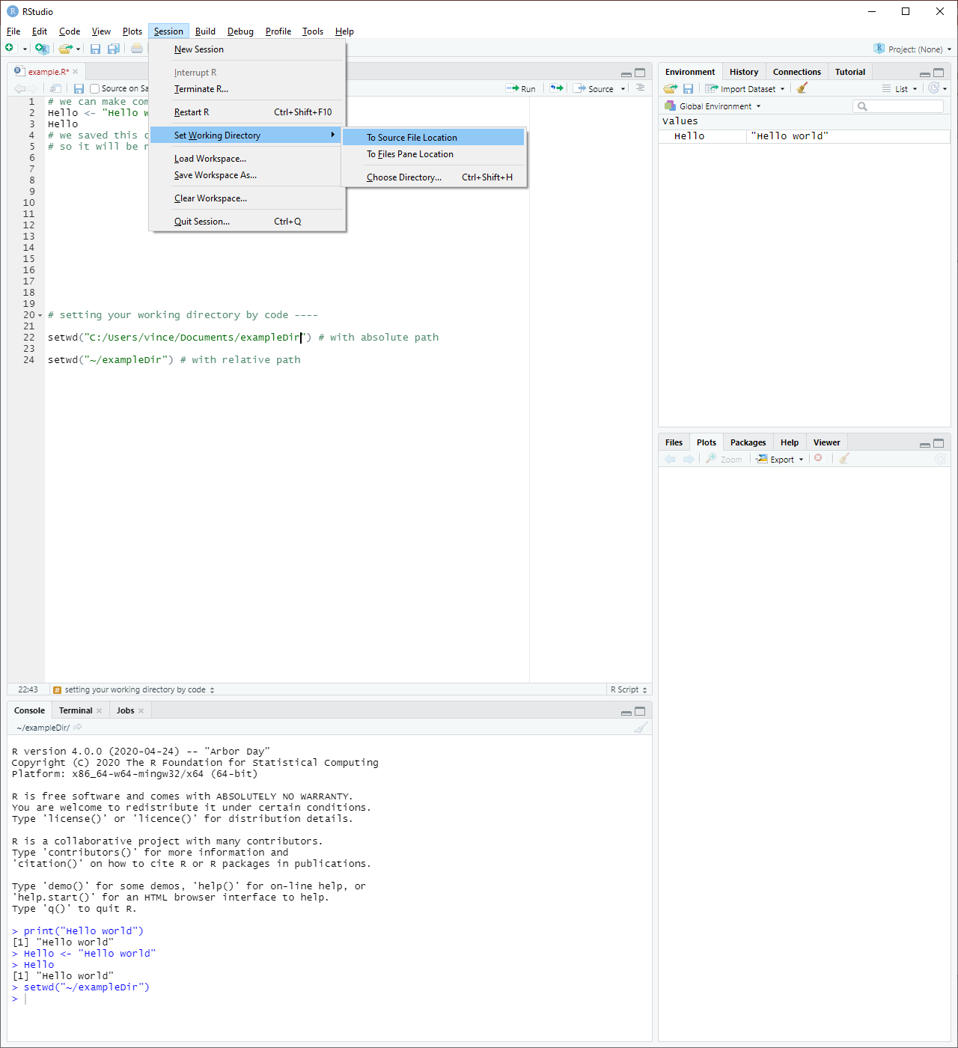
Setting your working directory
Useful, because...
...reading files...
...writing files...
Either by...
...point-and-click
...code
Then saved in script too!
Useful or not?
Remember, you can see your wd here

Slide 16
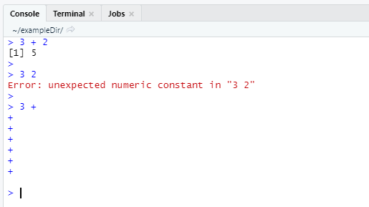
Common issues
Three options when you run code...
...it works
...it returns an error
warnings are not errors
...it shows a “+” prompt
Indicates unfinished code
e.g. print(“Hello world”
Press ESC to escape
Press ESC

Slide 17
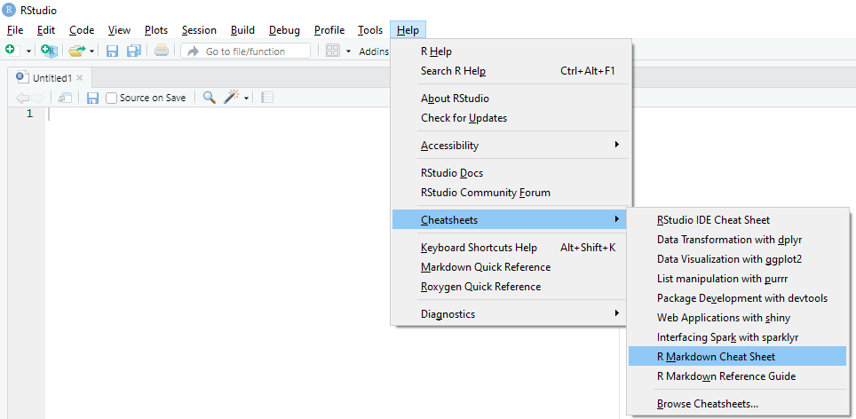
Resources
https://www.r-project.org/
Cheatsheets
https://stackoverflow.com/ (programming Q&A)
...Google!

Slide 18
Do it yourself!
221004_Tutorial4_Genome_Assembly.html
SECTION 5 to end

