Slide 1

Read Mapping | Tutorial 5
SAGE I | 11.10.22
Daniel Garrido-Sanz Presentation adapted from Aiswarya Prasad

Slide 2
Read Mapping | Tutorial 5
Brief recap: Assembly quality
What is read mapping?
Read Mapping workflow
· bwa
· samtools
Write mapping script and submit
Results visualization (R)

Slide 3

Read Mapping | Tutorial 5
What can we do to check the quality of assemblies?
Contiguity: How many contigs and length of the contigs ✓
Completeness: Size of the assembly (gross approximation) ✓
Correctness: Are the contigs supported by the reads?
· Check k-mer coverage ✓
· Map reads back to the assembly contigs
Filter by length > 500 bp and k-mer cov. > 10
03_<ESL0xxx>_contigs_filtered.fasta

Slide 4
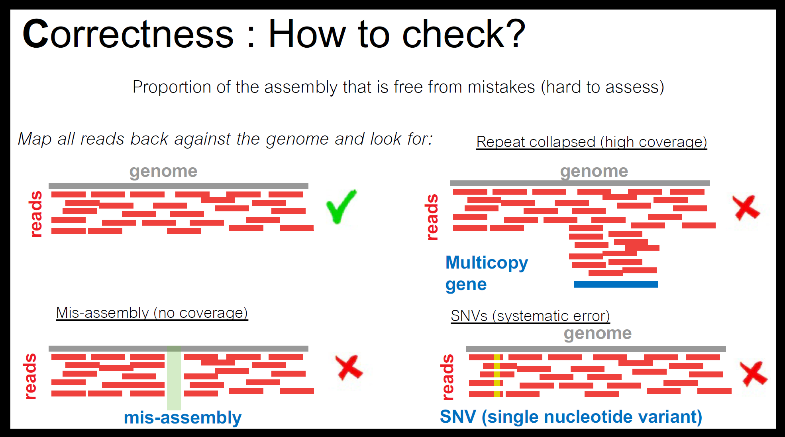
Read Mapping | Tutorial 5
What can we do to check the quality of assemblies?
20221004-genome_assembly_lecture | slide 65
Contiguity: How many contigs and length of the contigs ✓
Completeness: Size of the assembly (gross approximation) ✓
Correctness: Are the contigs supported by the reads?
· Check k-mer coverage ✓
· Map reads back to the assembly contigs
Filter by length > 500 bp and k-mer cov. > 10
03_<ESL0xxx>_contigs_filtered.fasta

Slide 5
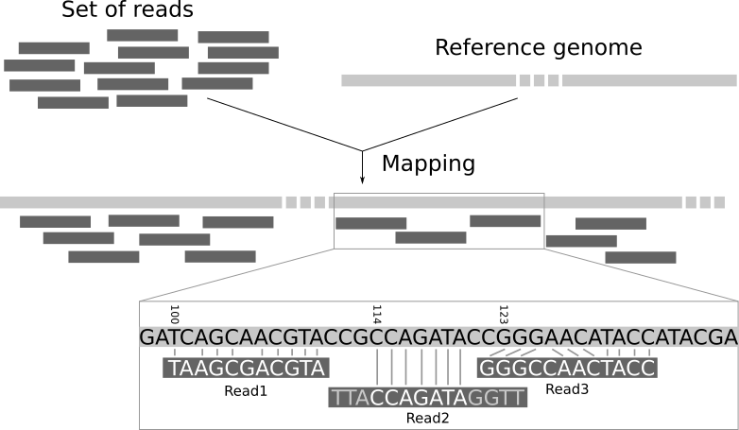
Read Mapping | Tutorial 5
What is read mapping?
Align reads to a reference sequence
Position: one or multiple?
Perfect or not-perfect match?

Slide 6
Read Mapping | Tutorial 5
Read mapping workflow
03_<ESL0xxx>_contigs_filtered.fasta
>NODE_1_...
AAGTACGTAGCT...
ACGTAGCTAAGT...
CTAAGTACGTAG...
>NODE_2_...
AAGTACGTAGCT...
ACGTAGCTAAGT...
CTAAGTACGTAG...
>NODE_3_...
AAGTACGTAGCT...
ACGTAGCTAAGT...
CTAAGTACGTAG...
...

Slide 7
Read Mapping | Tutorial 5
Read mapping workflow
03_<ESL0xxx>_contigs_filtered.fasta
Concatenate contigs
echo
cat | grep -v
1
>NODE_1_...
AAGTACGTAGCT...
ACGTAGCTAAGT...
CTAAGTACGTAG...
>NODE_2_...
AAGTACGTAGCT...
ACGTAGCTAAGT...
CTAAGTACGTAG...
>NODE_3_...
AAGTACGTAGCT...
ACGTAGCTAAGT...
CTAAGTACGTAG...
...
concat_<ESL0xxx>.fasta
>concat_<ESL0xxx>
AAGTACGTAGCT...
ACGTAGCTAAGT...
CTAAGTACGTAG...
AAGTACGTAGCT...
ACGTAGCTAAGT...
CTAAGTACGTAG...
AAGTACGTAGCT...
ACGTAGCTAAGT...
CTAAGTACGTAG...
...

Slide 8
Read Mapping | Tutorial 5
Read mapping workflow
03_<ESL0xxx>_contigs_filtered.fasta
Concatenate contigs
Index reference genome – bwa index
echo
cat | grep -v
1
Indexing a genome allows the aligner to narrow down the potential origin of a query sequence within the genome, saving both time and memory.
concat_<ESL0xxx>.fasta
2
bwa index
.amb .ann .bwt
.pac .sa
https://bio-bwa.sourceforge.net/bwa.shtml

Slide 9
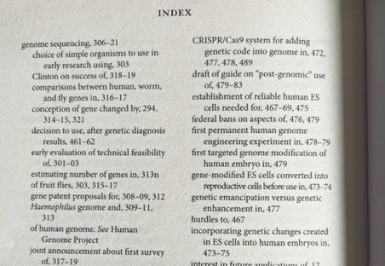
Read Mapping | Tutorial 5
Read mapping workflow
03_<ESL0xxx>_contigs_filtered.fasta
Concatenate contigs
Index reference genome – bwa index
echo
cat | grep -v
1
Indexing a genome allows the aligner to narrow down the potential origin of a query sequence within the genome, saving both time and memory.
concat_<ESL0xxx>.fasta
2
bwa index
.amb .ann .bwt
.pac .sa
Indexing a genome can be explained similar to indexing a book. If you want to know on which page a certain word appears or a chapter begins, it is much more efficient/faster to look it up in a pre-built index than going through every page of the book until you found it.
https://bio-bwa.sourceforge.net/bwa.shtml

Slide 10
Read Mapping | Tutorial 5
Read mapping workflow
03_<ESL0xxx>_contigs_filtered.fasta
Concatenate contigs
Index reference genome – bwa index
Reads mapping – bwa mem
echo
cat | grep -v
1
concat_<ESL0xxx>.fasta
bwa mem
3
2
bwa index
.amb .ann .bwt
.pac .sa
<ESL0xxx>.sam
https://bio-bwa.sourceforge.net/bwa.shtml

Slide 11
Read Mapping | Tutorial 5
Read mapping workflow
03_<ESL0xxx>_contigs_filtered.fasta
Concatenate contigs
Index reference genome – bwa index
Reads mapping – bwa mem
echo
cat | grep -v
1
concat_<ESL0xxx>.fasta
bwa mem
3
2
bwa index
.amb .ann .bwt
.pac .sa
SAM - Sequence Alignment Map format
<ESL0xxx>.sam
@SQ SN:concat_ESL0961 LN:3125346
@PG ID:bwa PN:bwa VN:0.7.17-r1188 CL:bwa mem concat_ESL0961.fasta 01_ESL0961_R1_paired.fastq.gz 01_ESL0961_R2_paired.fastq.gz
M02102:624:000000000-JY376:1:1101:16805:1626 65 concat_ESL0961 3125242 0 146S105M 3125219 -24 TTTTCCTTTC… >11>1133@1… NM:i:4 MD:Z:70T6T2T6T17 …
M02102:624:000000000-JY376:1:1101:16805:1626 129 concat_ESL0961 3125219 60 123S128M 3125242 24 TCCCTTTTCC… 11111111@13... NM:i:2 MD:Z:11T6T109 …
QNAME – Read id
FLAG – alignment information.
CIGAR – summary of alignment: insertion, deletion, etc.
https://bio-bwa.sourceforge.net/bwa.shtml

Slide 12
Read Mapping | Tutorial 5
Read mapping workflow
03_<ESL0xxx>_contigs_filtered.fasta
Concatenate contigs
Index reference genome – bwa index
Reads mapping – bwa mem
SAM to BAM – samtools view
echo
cat | grep -v
1
concat_<ESL0xxx>.fasta
bwa mem
3
2
bwa index
.amb .ann .bwt
.pac .sa
samtools view
<ESL0xxx>.sam
<ESL0xxx>.bam
4
http://www.htslib.org/doc/samtools.html

Slide 13

Read Mapping | Tutorial 5
Read mapping workflow
03_<ESL0xxx>_contigs_filtered.fasta
Concatenate contigs
Index reference genome – bwa index
Reads mapping – bwa mem
SAM to BAM – samtools view
echo
cat | grep -v
1
concat_<ESL0xxx>.fasta
bwa mem
3
2
bwa index
.amb .ann .bwt
.pac .sa
BAM - Binary Alignment/Map format
(compressed, indexed, binary form)
samtools view
<ESL0xxx>.sam
<ESL0xxx>.bam
4
[dgarrido@curnagl 03_mapping]$ head ESL0961.bam
�k�45C.�T���&-Yo��+�6ɤ�=��"�R-x {��0�~����; dS<�E�T����]��%�i�� ��r�����mR0̳1����������M:�#�船ʢ�^�k��3޳b�ߍEp!��"fu�֪ڰ������J���� {T��G�;m?��������9}>�
http://www.htslib.org/doc/samtools.html

Slide 14
Read Mapping | Tutorial 5
Read mapping workflow
03_<ESL0xxx>_contigs_filtered.fasta
Concatenate contigs
Index reference genome – bwa index
Reads mapping – bwa mem
SAM to BAM – samtools view
Sorted BAM – samtools sort
echo
cat | grep -v
1
concat_<ESL0xxx>.fasta
Sort alignments by leftmost coordinates
bwa mem
3
2
bwa index
.amb .ann .bwt
.pac .sa
samtools view
<ESL0xxx>.sam
<ESL0xxx>.bam
4
5
samtools sort
<ESL0xxx>_sorted.bam
http://www.htslib.org/doc/samtools.html

Slide 15
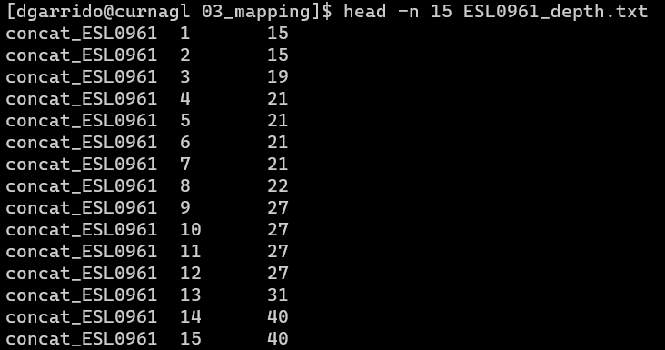
Read Mapping | Tutorial 5
Read mapping workflow
03_<ESL0xxx>_contigs_filtered.fasta
Concatenate contigs
Index reference genome – bwa index
Reads mapping – bwa mem
SAM to BAM – samtools view
Sorted BAM – samtools sort
Calculate depth – samtools depth
echo
cat | grep -v
1
concat_<ESL0xxx>.fasta
bwa mem
3
2
bwa index
Genome ID
Locus
Depth
.amb .ann .bwt
.pac .sa
samtools view
<ESL0xxx>.sam
<ESL0xxx>.bam
4
5
samtools sort
samtools depth
<ESL0xxx>_depth.txt
<ESL0xxx>_sorted.bam
6
http://www.htslib.org/doc/samtools.html

Slide 16
Read Mapping | Tutorial 5
Write mapping script
Do not copy&paste script from here /!!!\
Use the .html tutorial /!!!\
#!/bin/bash
…
#SBATCH --error /scratch/jgianott/SAGE/SAGE2022_2023/<username>/logs/read_mapping.err
#SBATCH --output /scratch/jgianott/SAGE/SAGE2022_2023/<username>logs/read_mapping.out
######### COMMANDS TO LOAD MODULES
module load gcc
module load bwa
module load samtools
##### VARIABLES
username=<username>
genome_id=<ESL0xxx>
##### Execute commands
#move to the directory 03_ReadMapping
cd /scratch/jgianott/SAGE/SAGE2022_2023/${username}/03_ReadsMapping
#execute the indexing, mapping, conversion to BAM, sorting BAM and depth:
bwa index concat_${genome_id}.fasta
bwa mem concat_${genome_id}.fasta 01_${genome_id}_R1_paired.fastq.gz 01_${genome_id}_R2_paired.fastq.gz > ${genome_id}.sam
samtools view -b ${genome_id}.sam > ${genome_id}.bam
samtools sort ${genome_id}.bam > ${genome_id}_sorted.bam
samtools depth -a ${genome_id}_sorted.bam > ${genome_id}_depth.txt

Slide 17

DIY
20221011_Tutorial5_Read_Mapping Part 1

Slide 18

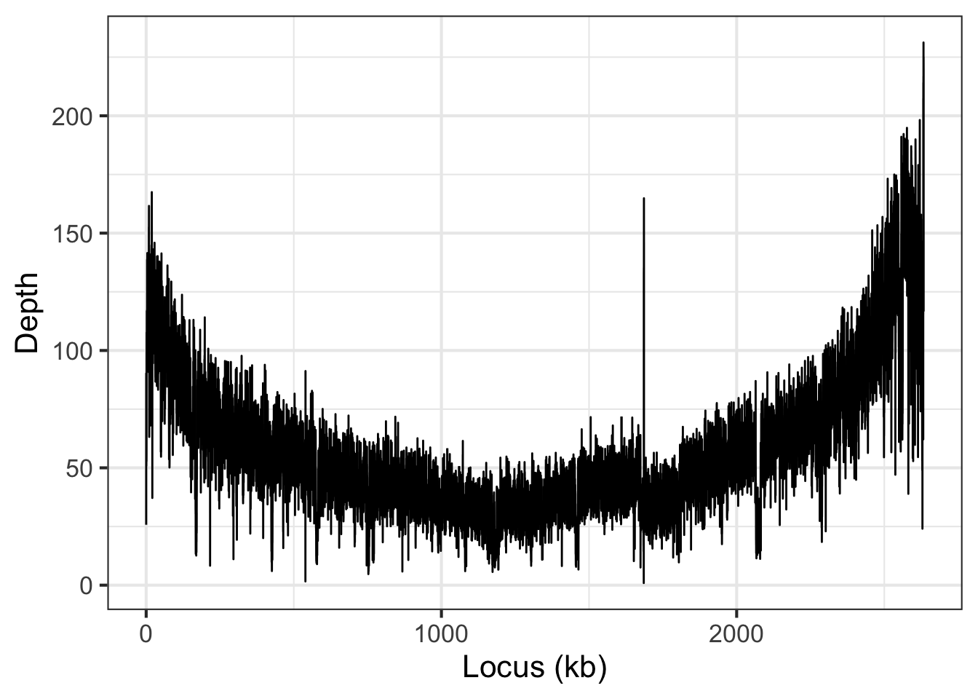
Read Mapping | Tutorial 5
Read mapping visualization

Slide 19
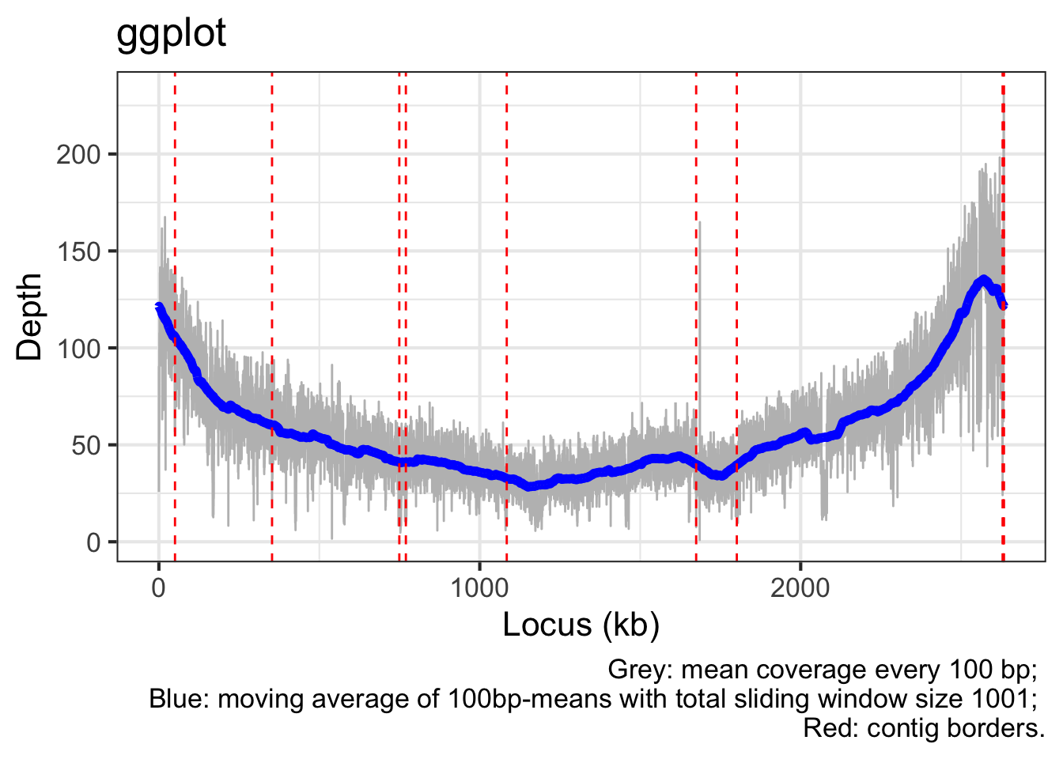
Read Mapping | Tutorial 5
Read mapping visualization

Slide 20
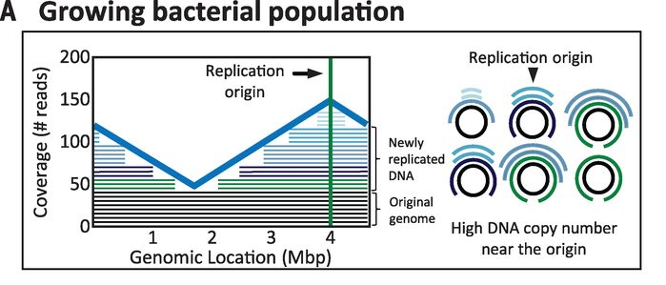
Read Mapping | Tutorial 5
Read mapping visualization
Korem et al. (2015)

