Slide 1
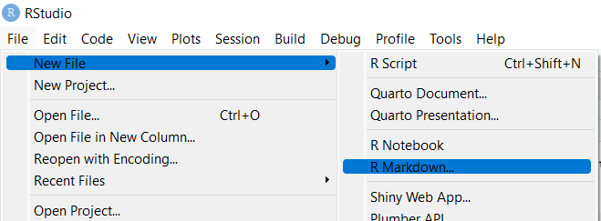
R Markdown; what and why
What is R markdown
Markdown: simple language for text formatting
Here: combine text, formatting, code, output, comments, discussion…
What can we use it for
Lots! e.g. these tutorials. Let me show you.
Short reports on analyses that can be understood later, or by others
Here: think of if as a lab book
reproducibility
"proof"
interpretability

Slide 2

Your turn
Go through the R Markdown template
Make a new R Markdown document with all you have done so far
Trimming, discuss fastQC, assembly, read mapping
Include scripts (eval=FALSE for bash)
Show input, output, annotate code with comments, discuss outcomes
Use Markdown formatting (headers!)
Tip: Help -> Cheat Sheets -> R Markdown Cheat Sheet

