Slide 1

Genome assembly | Tutorial 4
Submitting assembly to the cluster & assembly validation
SAGE I | 04.10.22
Daniel Garrido-Sanz Presentation adapted from Garance Sarton-Lohéac

Slide 2
Genome assembly | Tutorial 4
Check trimmed reads (from previous session)
Load modules on cluster
Write assembly script and submit assembly
Genome Assembly Lecture (by Aiswarya)
Assembly validation
Contig filtering using R (by Vincent)

Slide 3
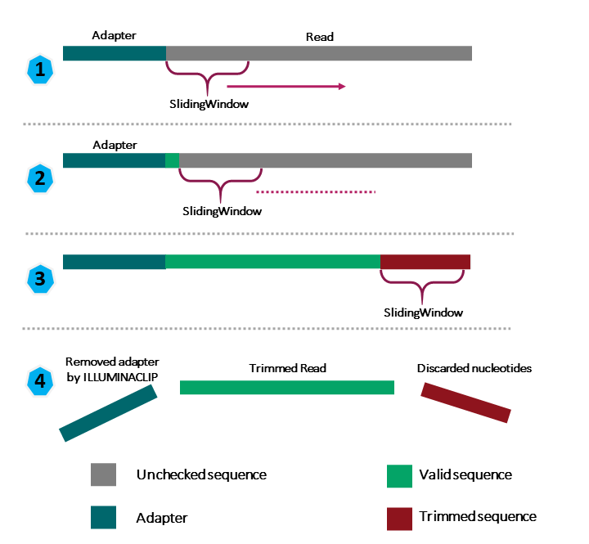
Genome assembly | Tutorial 4
Check trimmed reads (from previous session)
R1
R2
ESL0xxx_R1.fastq.gz
ESL0xxx_R2.fastq.gz
Trimmomatic
filtering
paired
unpaired
both reads survived
one read survived
R1
R2
R1
R2
ESL0xxx_R1_paired.fastq.gz
ESL0xxx_R2_paired.fastq.gz
ESL0xxx_R1_unpaired.fastq.gz
ESL0xxx_R2_unpaired.fastq.gz
in: /scratch/jgianott/SAGE/SAGE2022_2023/<username>/01_trim
Assemble

Slide 4
Genome assembly | Tutorial 4
Check trimmed reads (from previous session) ✓
Load modules on cluster
Write assembly script and submit assembly
Genome Assembly Lecture
Assembly validation
This is the software we will need and its dependencies!
spades/3.15.3
gcc/10.4.0
python/3.8.13

Slide 5
Genome assembly | Tutorial 4
Check trimmed reads (from previous session) ✓
Load modules on cluster ✓
Write assembly script and submit assembly
Genome Assembly Lecture
Assembly validation
spades.py -1 paired_R1.fastq -2 paired_2.fastq --careful -o /my/output/directory
but... we cannot execute from the front-end !
solution: submit job in script

Slide 6
Genome assembly | Tutorial 4
run_spades.sh
To submit the script/job: sbatch ./run_spades.sh
#!/bin/bash
######### SLURM OPTIONS
#SBATCH --partition cpu
#SBATCH --account jgianott_sage
#SBATCH --job-name spades
#SBATCH --nodes 1
#SBATCH --ntasks 1
#SBATCH --cpus-per-task 8
#SBATCH --mem 6G
#SBATCH --time 1:00:00
#SBATCH --error /scratch/jgianott/SAGE/SAGE2022_2023/<username>/logs/spades.err
#SBATCH --output /scratch/jgianott/SAGE/SAGE2022_2023/<username>/logs/spades.out
### Loading the modules ###
module load gcc/10.4.0
module load spades/3.15.3
module load python/3.8.13
#define variables
username=<username>
path_to_files=/users/${username}/sage22/${username}/01_trim
genome_id=<ESL0xxx>
### Commands ###
spades.py -1 ${path_to_files}/01_${genome_id}_R1_paired.fastq.gz \
-2 ${path_to_files}/01_${genome_id}_R2_paired.fastq.gz \
--careful \
-o /users/${username}/sage22/${username}/02_assembly
### END ###

Slide 7
Genome assembly | Tutorial 4
Genome assembly | Tutorial 4
Check trimmed reads (from previous session) ✓
Load modules on cluster ✓
Write assembly script and submit assembly ✓

Slide 8

DIY
20221004_Tutorial4_Genome_Assembly Part 3

Slide 9
Genome assembly | Tutorial 4
Check trimmed reads (from previous session)
Load modules on cluster
Write assembly script and submit assembly
Genome Assembly Lecture (by Aiswarya)
Assembly validation
Contig filtering using R (by Vincent)

Slide 10

What have we done so far?

Slide 11
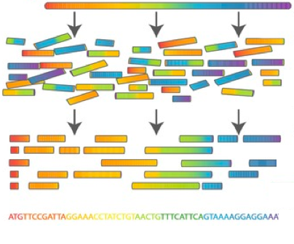
Genome assembly | Tutorial 4
Understanding SPAdes output

Slide 12
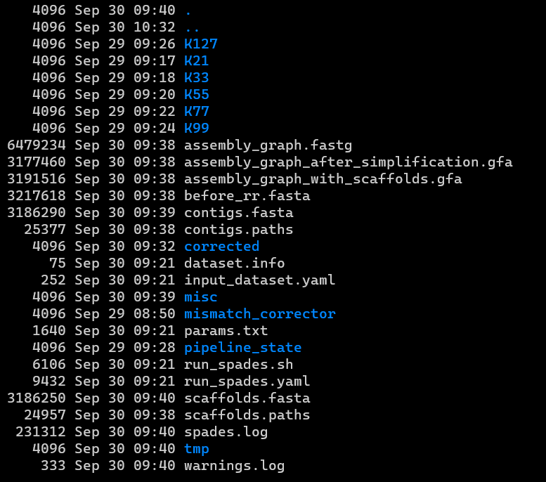
Genome assembly | Tutorial 4
Understanding SPAdes output
/scratch/jgianott/SAGE/SAGE2022_2023/<username>/02_assembly
Assembly logs

Slide 13
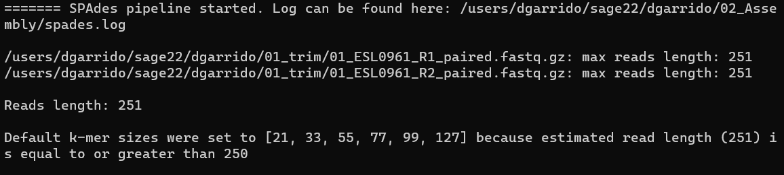
Genome assembly | Tutorial 4
Understanding SPAdes output
/scratch/jgianott/SAGE/SAGE2022_2023/<username>/02_assembly
===== Read error correction started.
…
===== Read error correction finished
…
===== Assembling started.
===== K21 started.
…
===== K21 finished.
===== K33 started.
…
===== K33 finished.
…
…
===== K127 finished.
…
===== Assembling finished.
…
===== Mismatch correction contigs started.
…
===== Mismatch correction contigs finished.
1. Read error correction
(rare k-mers)
2. k-mers assemblies
3. Error correction
Assembly logs

Slide 14
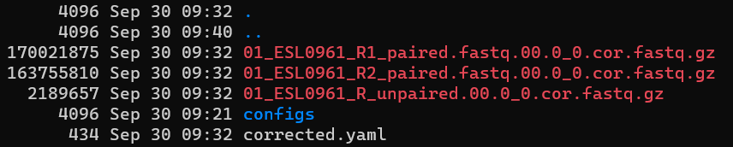
Genome assembly | Tutorial 4
Understanding SPAdes output
/scratch/jgianott/SAGE/SAGE2022_2023/<username>/02_assembly
/scratch/jgianott/SAGE/SAGE2022_2023/<username>/02_assembly/corrected
Error-corrected reads (rare k-mers)
Assembly logs

Slide 15
Genome assembly | Tutorial 4
Understanding SPAdes output
/scratch/jgianott/SAGE/SAGE2022_2023/<username>/02_assembly
Intermediate files from the assemblies with different k-mer lengths
Error-corrected reads (rare k-mers)
Assembly logs

Slide 16
Genome assembly | Tutorial 4
Understanding SPAdes output
/scratch/jgianott/SAGE/SAGE2022_2023/<username>/02_assembly
Intermediate files from the assemblies with different k-mer lengths
Contigs
Error-corrected reads (rare k-mers)
Scaffolds
Assembly logs

Slide 17
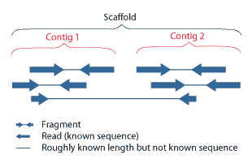
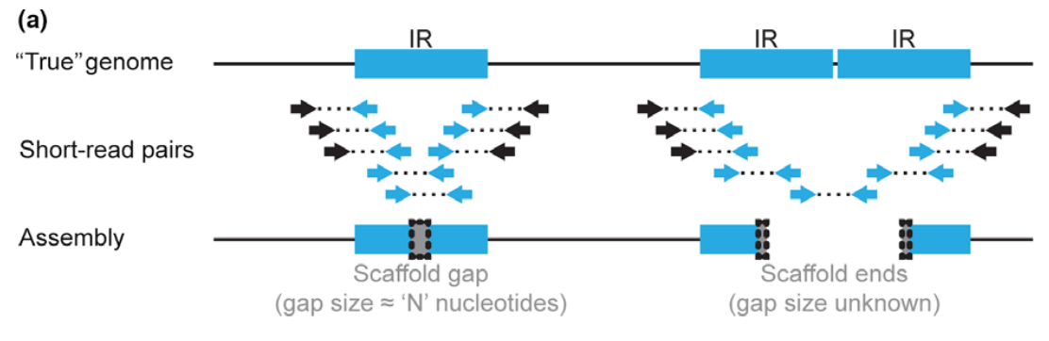
Genome assembly | Tutorial 4
Understanding SPAdes output
https://cab.spbu.ru/files/release3.15.4/manual.html
In general, SPAdes uses two techniques for joining contigs into scaffolds. First one relies on read pairs and tries to estimate the size of the gap separating contigs. The second one relies on the assembly graph: e.g. if two contigs are separated by a complex tandem repeat, that cannot be resolved exactly, contigs are joined into scaffold with a fixed gap size of 100 bp. Contigs produced by SPAdes do not contain N symbols.

Slide 18
Genome assembly | Tutorial 4
Contig analysis
/scratch/jgianott/SAGE/SAGE2022_2023/<username>/02_assembly/contigs.fasta
k-mer coverage
Length (bp)
Node number

Slide 19
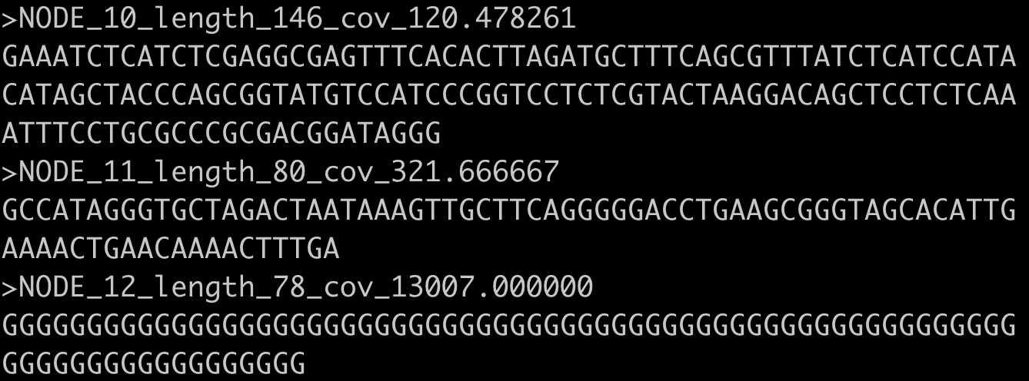
Genome assembly | Tutorial 4
Contig analysis
/scratch/jgianott/SAGE/SAGE2022_2023/<username>/02_assembly/contigs.fasta
k-mer coverage
Length (bp)
Node number

Slide 20
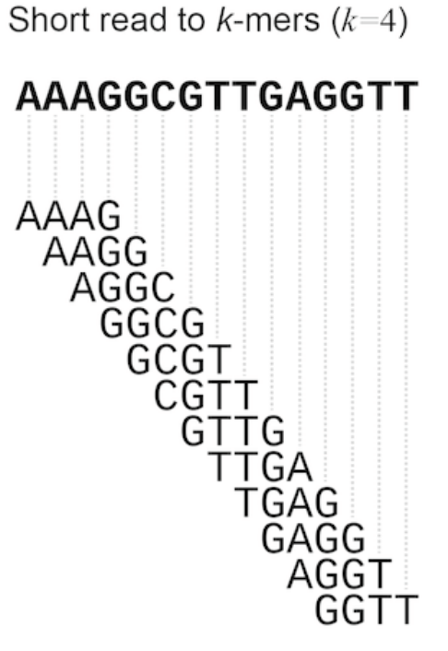
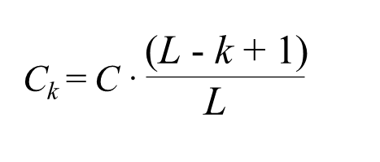
Genome assembly | Tutorial 4
Read coverage: number of reads that include a given nucleotide (position) in the reconstructed sequence (contig)
What is “k-mer coverage”?
8x
4x
2x
3x
4x
15 nt
Contig
read length
k-mer coverage
k-mer length
12 k-mers of k = 4
number of k-mers = L - k + 1
Read/nucleotide coverage
*However, SPAdes uses multiple k-mer lengths in combination. Some sources say the k-mer coverage in the final assembly contigs is based on the largest k-mer.

Slide 21
Genome assembly | Tutorial 4
What can we do to check the quality of assemblies?
Contiguity: How many contigs there and length of the contigs
Completeness: Size of the assembly
Correctness: We will do this in the next tutorial (11.10.22)
Did you get nice big contigs, or a lot of very small ones?
Are the assembly contigs supported by the reads?
Check the “k-mer” coverage in the contig headers
Map your reads back to the assembly contigs (next tutorial 11.10.22)

Slide 22
DIY
20221004_Tutorial4_Genome_Assembly Part 4

Slide 23

Genome assembly | Tutorial 4
Contig filtering using R
Removal of spurious contigs (length <500bp and/ or coverage <10)

