Slide 1
Processing of 16S rRNA
Amplicon-Sequencing Data
Germán Bonilla-Rosso
Garance Sarton
SAGE February 2021

Slide 2
How do we correct sequencing errors?
How do we make ASVs from the reads ?
How do we translate sequence reads to bacterial species?

Slide 3

Notes:
What are the first steps we did last week ? How was the read quality ? What do you think may remains ?

Slide 4
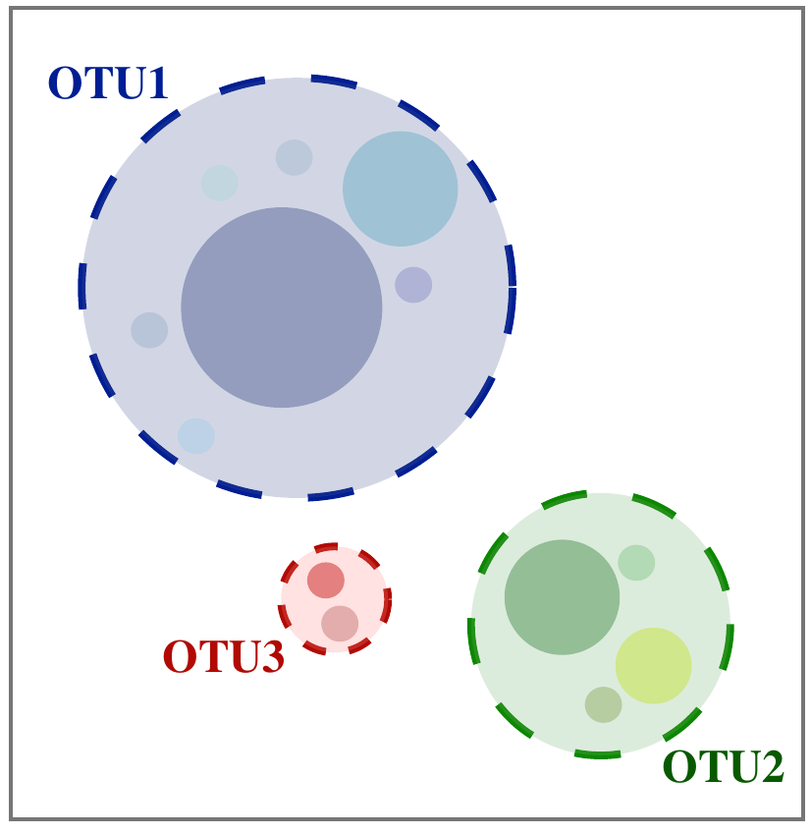
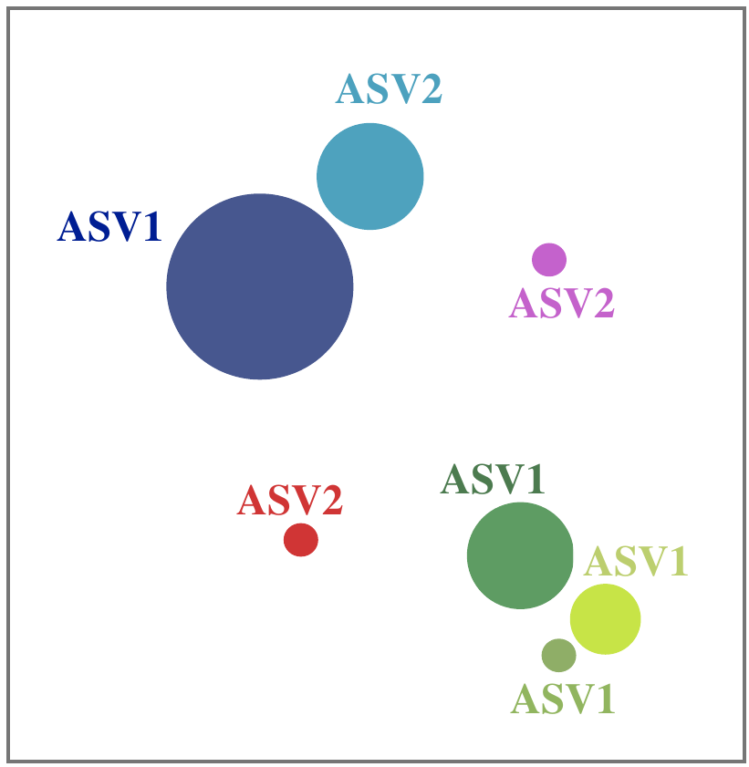
Strategies for Analysing Amplicon Sequences
Operational
Taxonomic Units
(OTUs)
Amplicon Sequence
Variants
(ASVs)

Slide 5
Clustering OTUs by % Identity

Slide 6
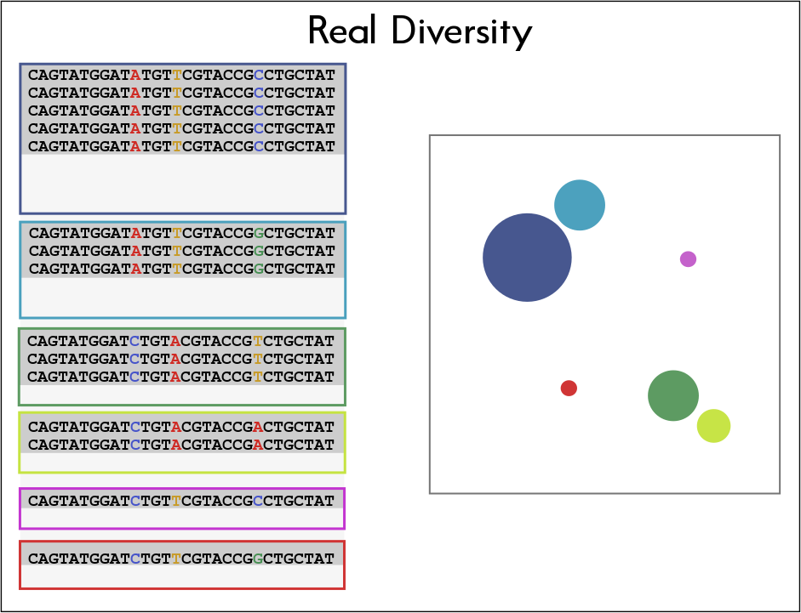

Slide 7
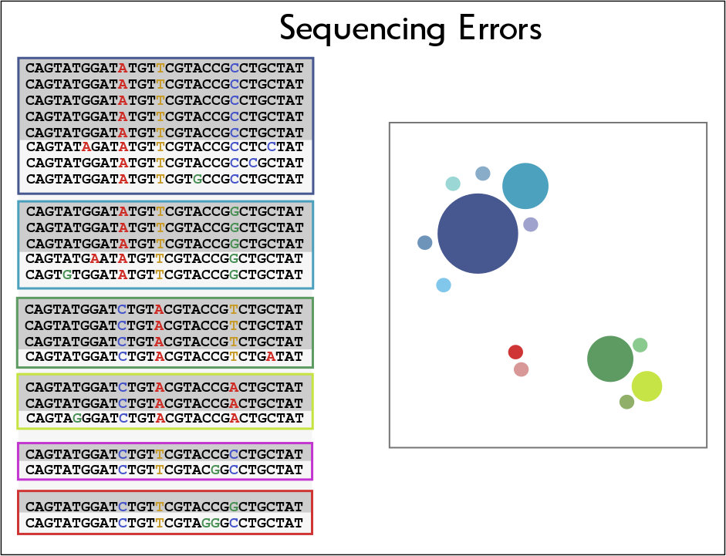

Slide 8
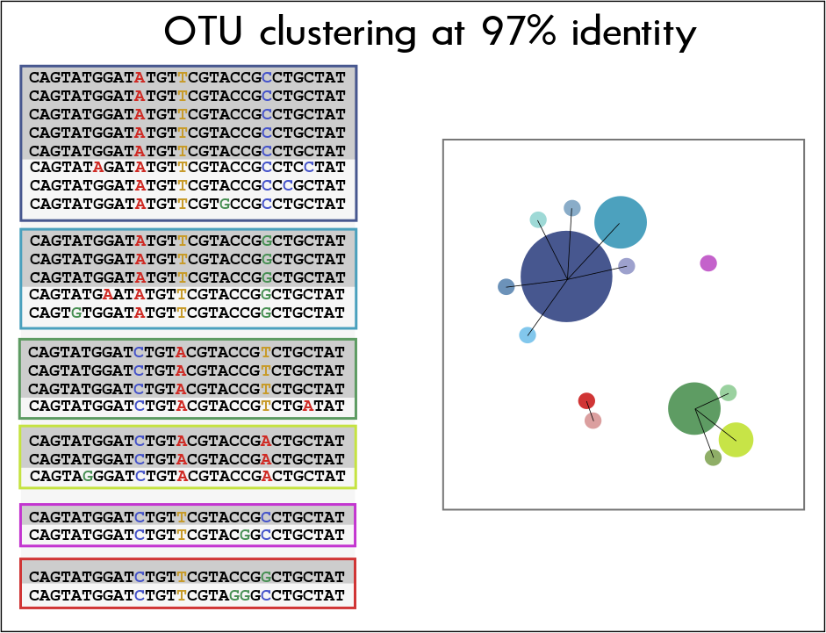

Slide 9
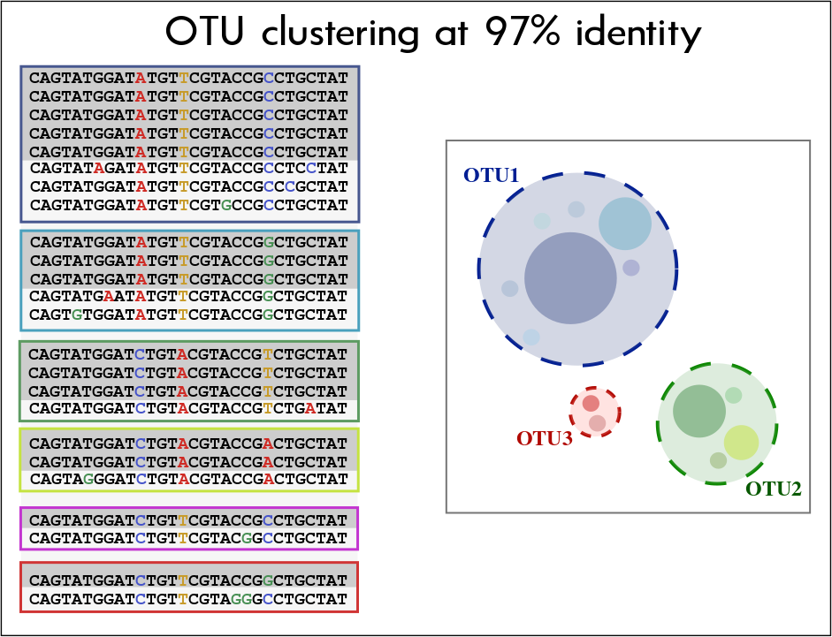

Slide 10
OTU Clustering
→ Arbitrary threshold:
The 97% identity threshold is not backed by any evolutionary or ecological theory
→ Low Resolution:
Short 16S fragments usually cannot resolve species/strains
→ Underestimation of Diversity:
At 97%, different strains are clustered into the same OTU
→ Inability to estimate singletons
Notes:
<for the dataseet we have this is reliable because it depends on the database

Slide 11
Detecting Exact Amplicon Sequence Variants after Noise Reduction

Slide 12
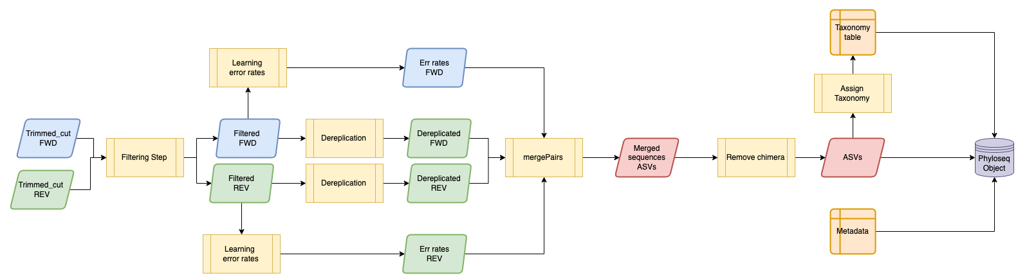
DADA2 pipeline

Slide 14


Slide 15
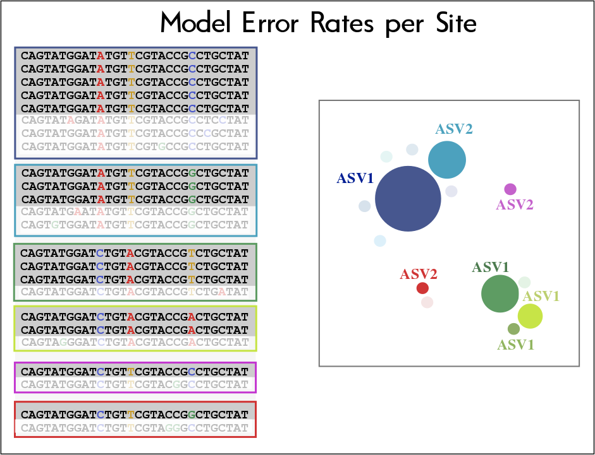

Slide 16
Divisive Amplicon Denoising Algorithm (DADA2)
Errors are independent events
- No correlation between errors, so errors occurring in different sequences and in the same sequence are independent of each other
Errors are dependent of the Q-score
- Each base has an associated Q-score
Error transitions can be modeled
- Transitions depend on original base, substituting base and quality

Slide 17
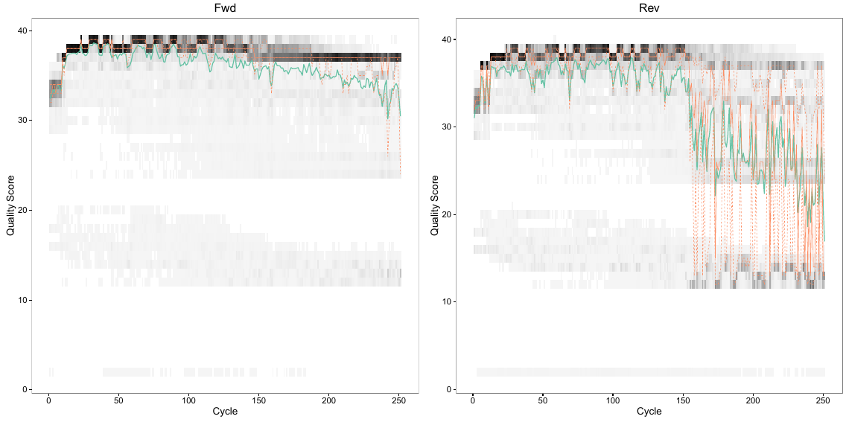
DADA2
Each read orientation has independent error profiles
More accurate models are generated with larger amount of data... but really bad quality reads reduce model accuracy

Slide 18
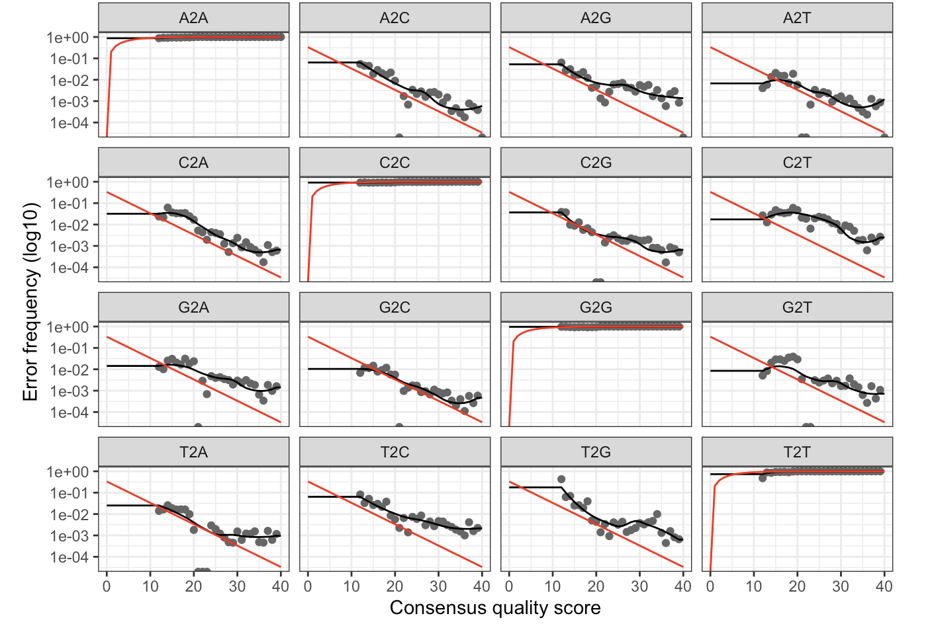
DADA2
Error rates are learnt (modeled) as a function of sequencing quality...
Notes:
The black line shows the estimated error rates after convergence of the machine-learning algorithm

Slide 19
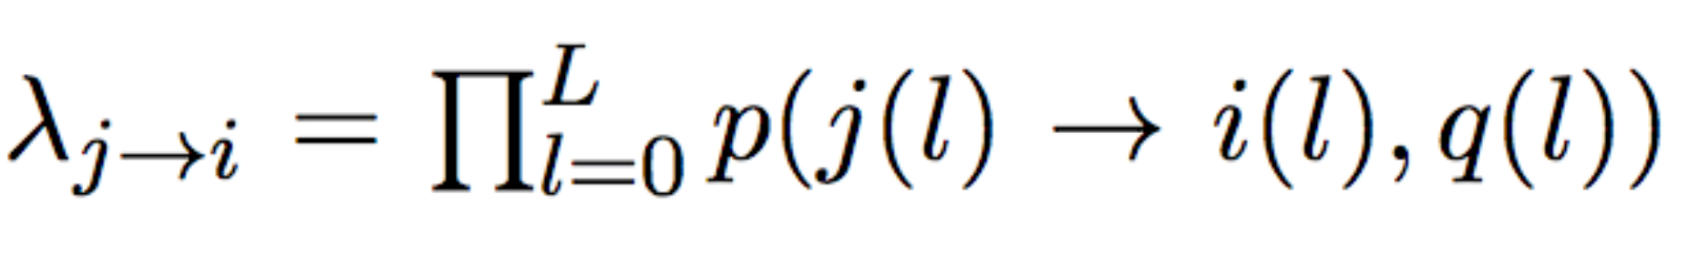
DADA2
What are the chances of generating a sequence with error?
The probability of generating a sequence i with an error from real sequence j equals the product of per-site probability of transition.
The transition probability depends on
- the original base,
- the substituting base,
- the quality score
Notes:
L = number of aligned nucleotides

Slide 20
DADA2
If errors are independent between reads, and error-containing reads originate from real reads... we can model their expected abundances
- Error reads will always be less abundant than real reads!
- The expected abundance of an error-containing sequence i follows a Poisson distribution and is equal to the error rate (previous slide) multiplied by the expected reads of sample sequence j.
- We can calculate a p-value, or the probability of seeing an error-containing sequence i with an abundance equal to or greater than the observed value by chance, given the abundance of parent sequence j.
→ A low pA(j→i) means the abundance of sequence i cannot be explained by errors during amplification and sequencing of n_{j} copies
Notes:
The

Slide 21
DADA2 pipeline

Slide 22
DADA2 pipeline

Slide 23

DADA2 pipeline
“SILVA provides comprehensive, quality checked and regularly updated datasets of aligned small (16S/18S, SSU) and large subunit (23S/28S, LSU) ribosomal RNA (rRNA) sequences for all three domains of life (Bacteria, Archaea and Eukarya)”
https://www.arb-silva.de/
Notes:
Looking for exact maches -> Tax assignment is dependant on your data and what is in the database

Slide 24
DADA2 pipeline

Slide 25
DADA2 pipeline

Slide 26
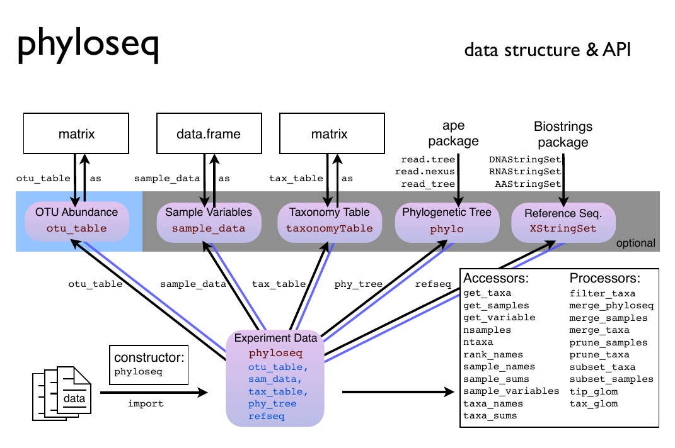
PHYLOSEQ

Slide 27
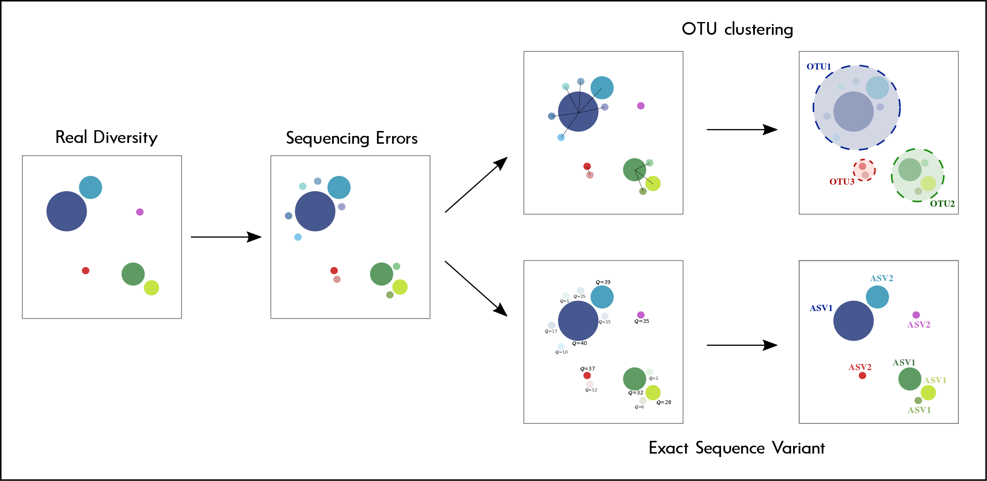
Strategies for Analysing Amplicon Sequences

Slide 28


ASVs or OTUs?
 | ASVs | OTUs
Unique Variants
Groups all copies within the same genome
Groups copies from different genomes
Inflates Diversity Estimates
Resolves Strains
Reflect real biological units
Provide Functional information

Slide 29
Final considerations
-> Neither OTUs not ASVs represent natural biological units, and they are just operational. You can argue that ASVs are “real” sequences and will be right, but knowing what that actually means in terms of bacterial cells or species is not straightforward.
-> The 16SrRNA fragment amplicons cannot delineate bacterial strains
-> The 16SrRNA cannot inform on bacterial phenotypes
-> You should always have a clear question that you want to answer with your analysis, and never stretch the limits of your technology and analyses.

