Slide 1
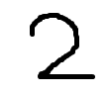
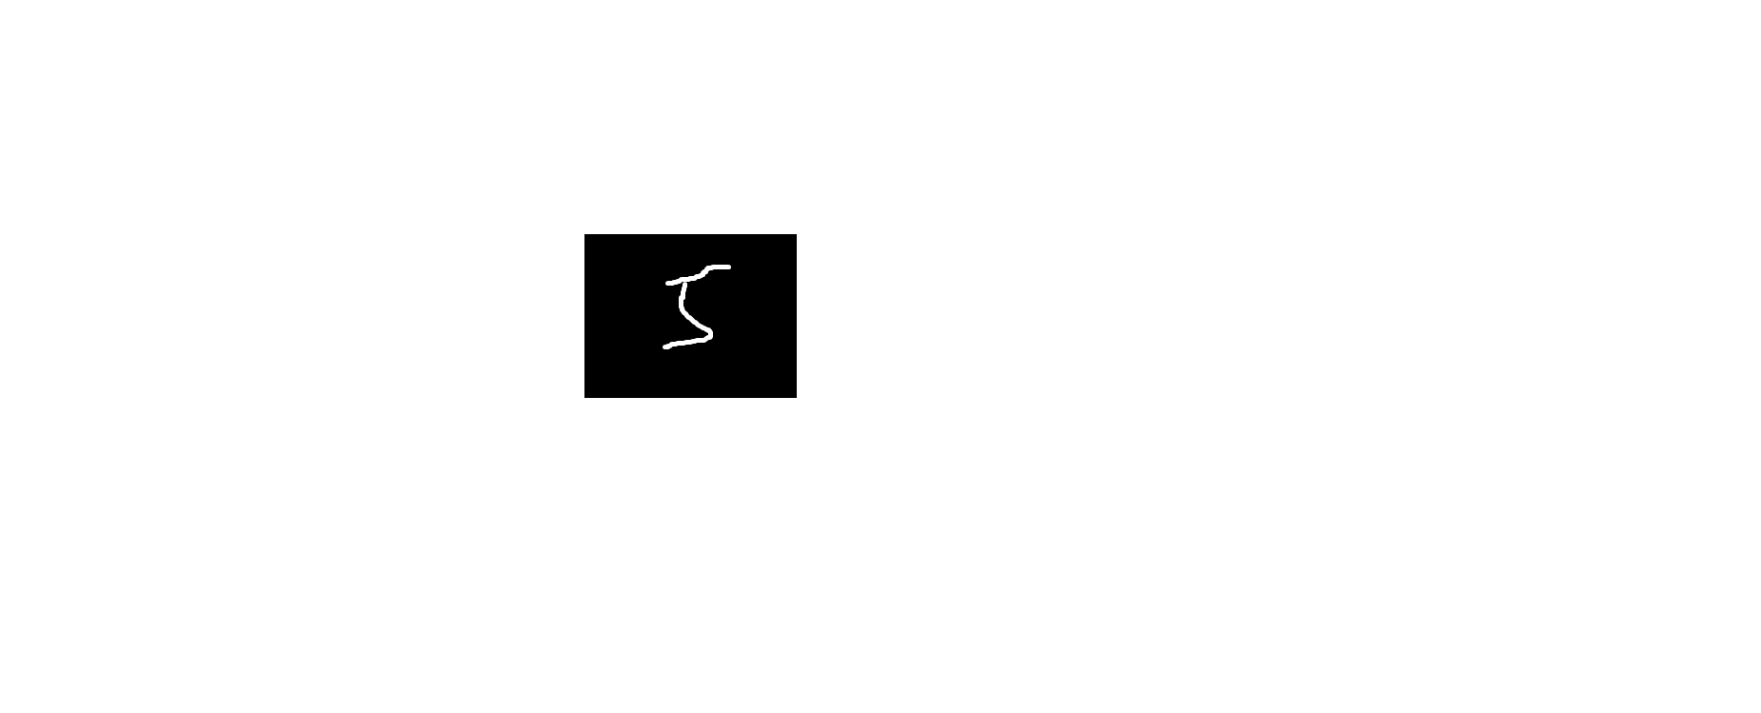
卷积神经网络结构
输入层
卷积层
全连接层
输出层
（1）
1
2
3
卷积
池化
卷积
池化
全连接
全连接
输出
C₁
S₁
C₂
S₂
Input
1×28×28
Feature maps
4×24×24
Feature maps
4×12×12
Feature maps
8×8×8
Feature maps
8×4×4
n₁
n₂
Output
（2）
0
1
..............
..............
8
9
5×5
Convolution
2×2
Subsampling
5×5
Convolution
2×2
Subsampling
Fully
Connected
Fully
Connected
Feature Extraction
Classification

Slide 2
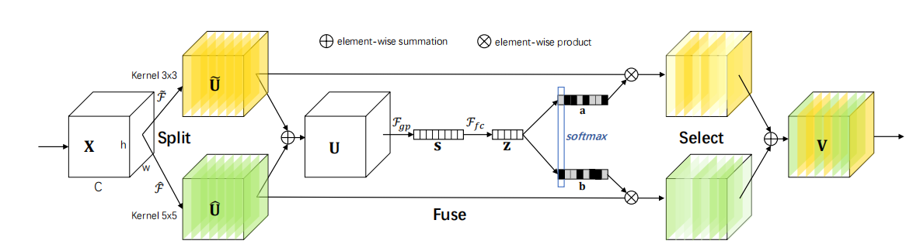






Selective Kernel Convolution
Original image
element-wise summation
element-wise product
Kernel 3×3
~
~
𝓕
𝓕
𝓕
_{gp}
fc
Split
softmax
Select
^
𝓕
^
Kernel 5×5
Fuse

Slide 3
卷积
1
2
1
0
2
3
0
1
1
2
0
1
3
0
2
1
2
2
（1）
0
1
1
1
0
0
卷积核3×3
5
4
5
5
1
0
0
1
2
3
2
0
2
0
0
0
·
·
·
·
0
0
1
0
1
0
0
0
2
·
·
·
·
输入图像6×6
·
·
·
·
特征图4×4
1
1
1
0
0
1
1
1
1
0
convolution
1
0
1
4
0
0
1
1
1
0
1
0
=
（2）
0
0
1
1
0
1
0
1
0
1
1
0
0
filter
feature map
5×5 image

Slide 4
池化
平均池化
步长为2，大小为2×2
2
5
4
4
3
6
2
3
9
7
3
2
（1）
4
1
0
0
最大池化
步长为2，大小为2×2
5
9
3
4
0
8
4
8
Pooling Indices
（池化索引）
2
5
7
3
0
7
0
0
4
1
9
3
0
0
6
0
（2）
6
8
3
6
0
5
0
0
5
9
7
6
3
2
1
5
0
0
1
2
8
5
5
2
Max Pooling
（最大池化）
Unpooling
（反池化）

Slide 5
卷积/转置卷积
卷积, k = 3, s = 1, p = 0
转置卷积, k = 3, s = 2, p = 0

Slide 6












Dropout 网络模型
Before Dropout
After Dropout

Slide 7

















全连接层结构
输入层
隐藏层
输出层
（1）
...
...
...
（2）
...
Input Layer
Fully Connected Layer
Output Layer

Slide 8




















MLP 多层感知器
Softmax
Softmax
Output Layer
Σ
Σ
Σ
（1）
1
Σ
Σ
Σ
Σ
Hidden Layer
1
Input Layer
x₁
x₂
Softmax
w₁
w₂
（2）
...
...
...
Input Layer
Hidden Layer
Output Layer

Slide 9
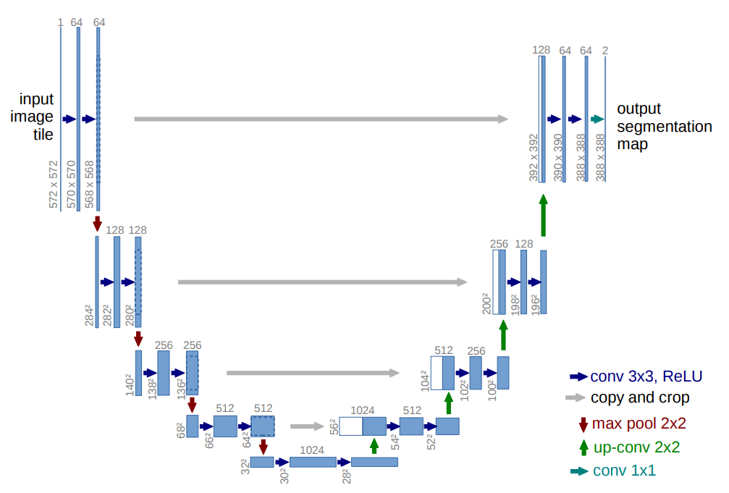
U-Net
Original image
1
64
64
128
64
64
1
input
image
output
128
128
256
128
256
256
512
256
Conv 3×3, ReLU
copy and crop
512
512
1024
512
Max Pooling 2×2
Up Conv 2×2
1024
Conv 1×1

Slide 10













RNN
Unfold

Slide 11
空洞卷积
Original image

Slide 12
可分离卷积
3 Channel Input
Filters×3
Maps×3
NxN
（1）深度卷积
NxN
Maps×3
Filters×4
Maps×4
NxN
（2）逐点卷积
NxN

Slide 13
决策树(Decision Tree)
DataSet
Tree-1
Tree-2
Tree-3
Majority Voting / Averaging
Final Result

Slide 14
支持向量机(Support Vector Machine)

Slide 15
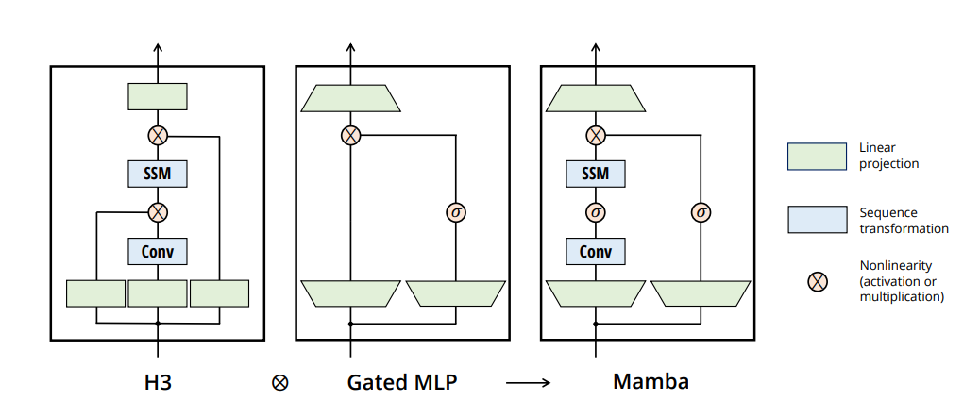
Mamba
Original image
Linear
Projection
SSM
SSM
Sequence
transformation
Conv
Conv
Nonlinearity
(activation or
multiplication)
H3
Gated MLP
Mamba

Slide 16
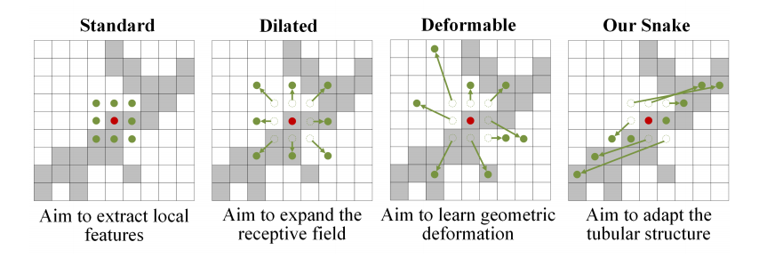
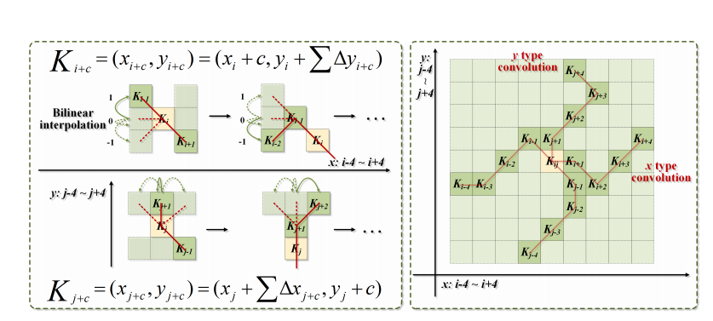



























动态蛇形卷积
Original image
Strandard
Dilated
Deformable
Snake
y type
convolution
Bilinear
interpolation
...
~
~
x type
convolution
~
...
~

Slide 17
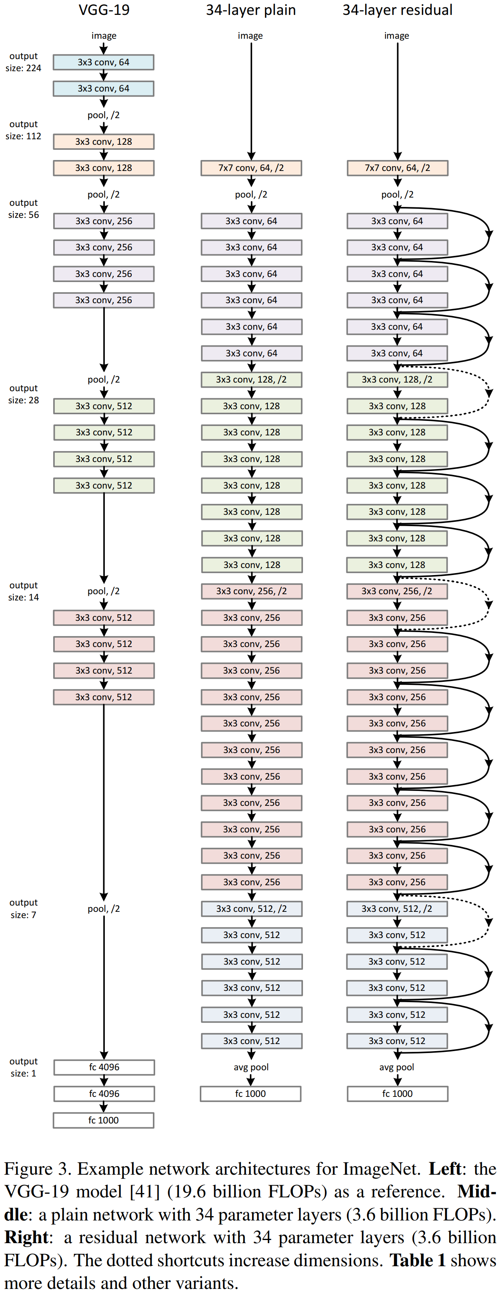

Original image
VGG-19
34-layer
34-layer
image
image
image
VGG-19/Plain Network/Residual Network
3×3 conv, 64
3×3 conv, 64
pool, /2
3×3 conv, 128
3×3 conv, 128
7×7 conv, 64, /2
7×7 conv, 64, /2
pool, /2
pool, /2
pool, /2
3×3 conv, 256
3×3 conv, 64
3×3 conv, 64
3×3 conv, 256
3×3 conv, 64
3×3 conv, 64
3×3 conv, 256
3×3 conv, 64
3×3 conv, 64
3×3 conv, 256
3×3 conv, 64
3×3 conv, 64
3×3 conv, 64
3×3 conv, 64
3×3 conv, 64
3×3 conv, 64
pool, /2
3×3 conv, 128, /2
3×3 conv, 128, /2
3×3 conv, 512
3×3 conv, 128
3×3 conv, 128
3×3 conv, 512
3×3 conv, 128
3×3 conv, 128
3×3 conv, 512
3×3 conv, 128
3×3 conv, 128
3×3 conv, 512
3×3 conv, 128
3×3 conv, 128
3×3 conv, 128
3×3 conv, 128
3×3 conv, 128
3×3 conv, 128
3×3 conv, 128
3×3 conv, 128
pool, /2
3×3 conv, 256, /2
3×3 conv, 256, /2
3×3 conv, 512
3×3 conv, 256
3×3 conv, 256
3×3 conv, 512
3×3 conv, 256
3×3 conv, 256
3×3 conv, 512
3×3 conv, 256
3×3 conv, 256
3×3 conv, 512
3×3 conv, 256
3×3 conv, 256
3×3 conv, 256
3×3 conv, 256
3×3 conv, 256
3×3 conv, 256
3×3 conv, 256
3×3 conv, 256
3×3 conv, 256
3×3 conv, 256
3×3 conv, 256
3×3 conv, 256
3×3 conv, 256
3×3 conv, 256
3×3 conv, 256
3×3 conv, 256
pool, /2
3×3 conv, 512, /2
3×3 conv, 512, /2
3×3 conv, 512
3×3 conv, 512
3×3 conv, 512
3×3 conv, 512
3×3 conv, 512
3×3 conv, 512
3×3 conv, 512
3×3 conv, 512
3×3 conv, 512
3×3 conv, 512
fc 4096
avg pool
avg pool
fc 4096
fc 1000
fc 1000
fc 1000

Slide 18
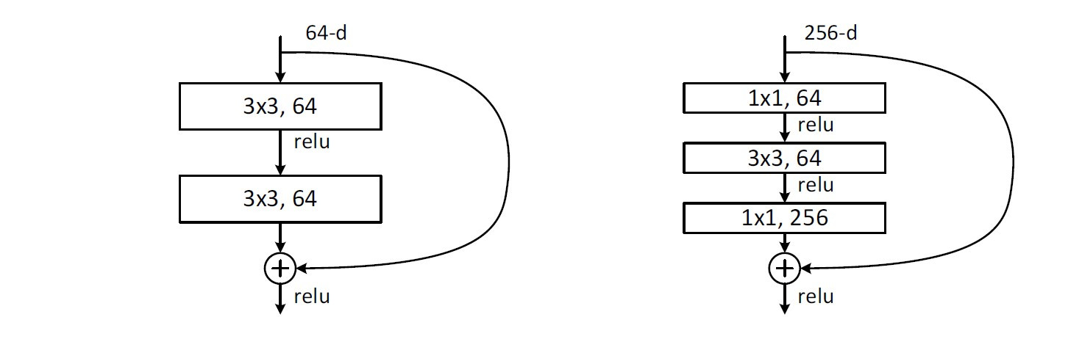
残差块(Residual Block)
Original image
64-d
256-d
3×3, 64
1×1, 64
relu
relu
3×3, 64
3×3, 64
relu
1×1, 256
relu
relu

Slide 19
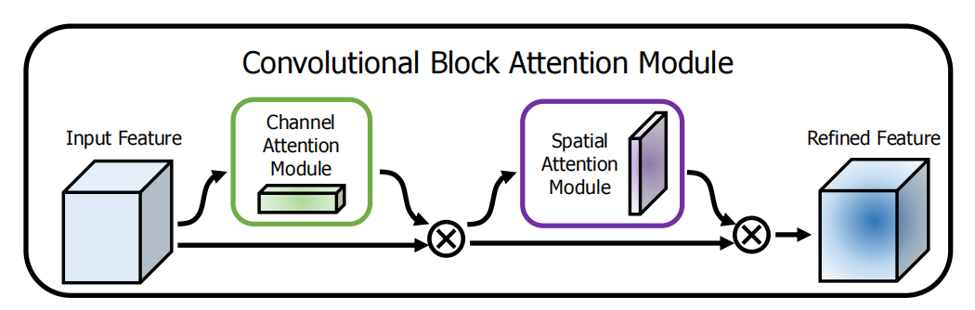
CBAM
Original image
Input Feature
Channel
Attention Module
Refined Feature
Spatial
Attention Module

Slide 20
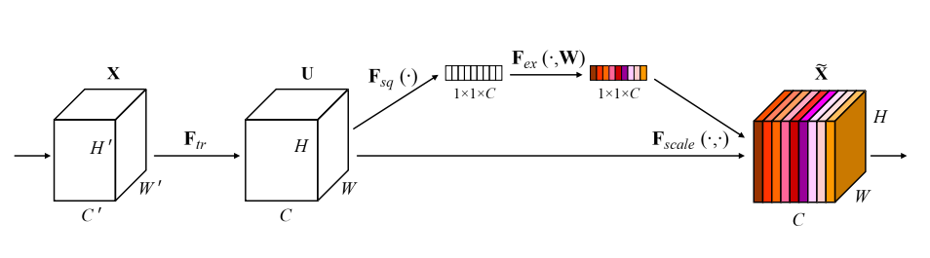






Squeeze-and-Excitation block
Original image
1×1×C
1×1×C
’
’
’

Slide 21
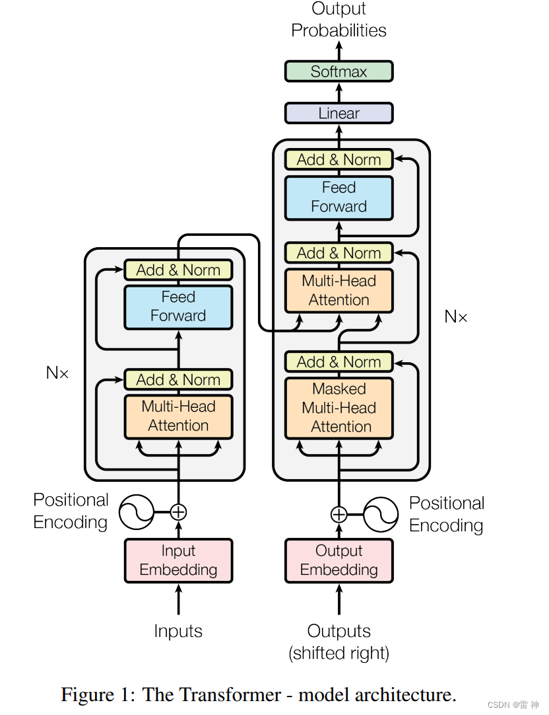
Transformer
Original image
Output
Probablities
Softmax
Linear
Add & Norm
Feed
Forward
Add & Norm
Add & Norm
Multi-Head
Attention
Feed
Forward
N×
Add & Norm
N×
Add & Norm
Masked
Multi-Head
Attention
Multi-Head
Attention
Positional
Encoding
Positional
Encoding
Input
Embedding
Output
Embedding
Inputs
Outputs
(Shifted right)

Slide 22
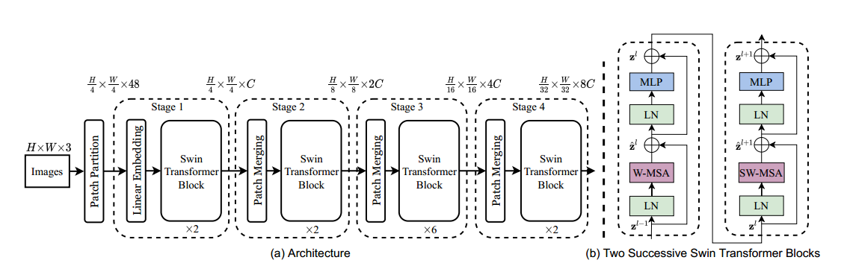








Swin Transformer
Original image
MLP
MLP
Stage 1
Stage 2
Stage 3
Stage 4
LN
LN
Linear Embedding
Swin
Transformer
Block
Swin
Transformer
Block
Swin
Transformer
Block
Swin
Transformer
Block
W-MSA
W-MSA
Images
Patch Partition
Patch Merging
Patch Merging
Patch Merging
LN
LN
×2
×2
×6
×2

Slide 23
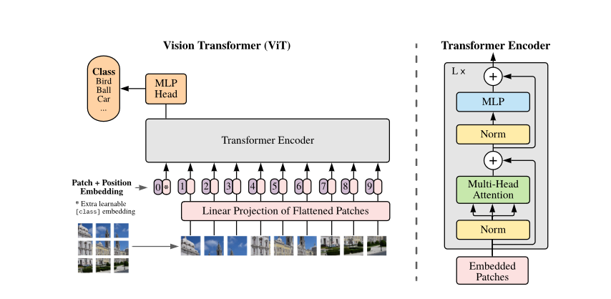
Visual Transformer(ViT)
Original image
Vision Transformer (ViT)
Transformer Encoder
Class
Bird
Ball
Car
...
MLP
Head
MLP
Transformer Encoder
Norm
Patch + Position
Embedding
Multi-Head
Attention
0
*
1
2
3
4
5
6
7
8
9
* Extra learnable
[class] embedding
Linear Projection of Flattened Patches
Norm
Embedded
Patches

Slide 24
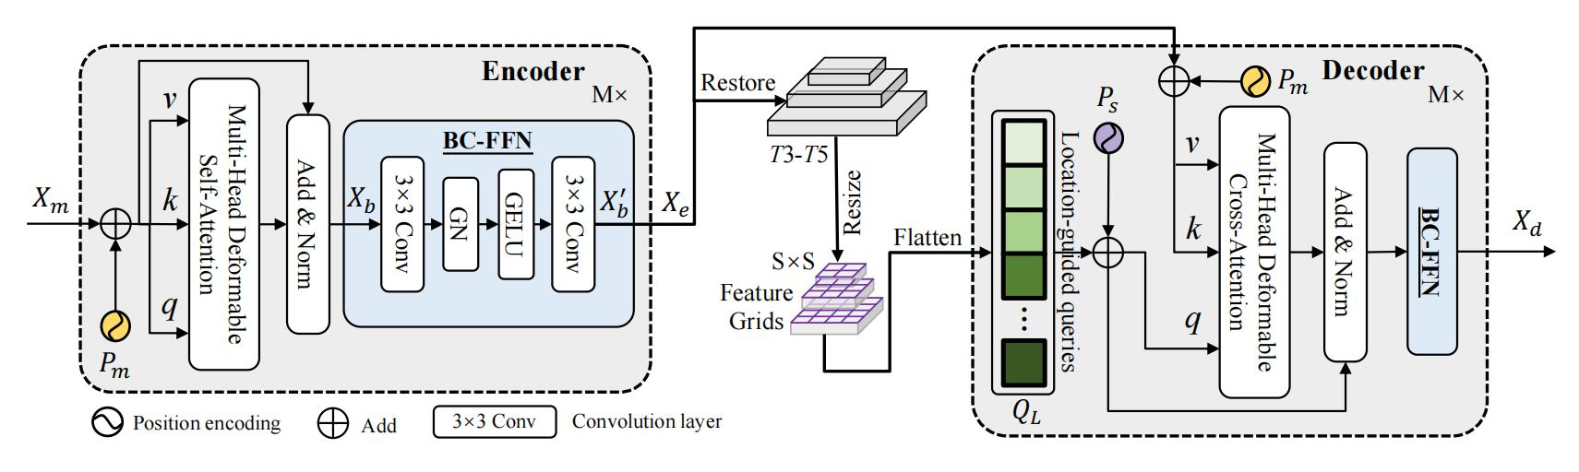







location-sensing transformer (LST)
Original image
Encoder
Restore
Decoder
M×
M×
BC-FFN
T3-T5
Resize
v
Multi-Head Deformable
Self-Attention
3×3 Conv
3×3 Conv
Add & Norm
GN
GELU
Flatten
Multi-Head Deformable
Cross-Attention
S×S
Location-guided queries
Add & Norm
BC-FFN
Feature Grids
...
Position encoding
Add
3×3 Conv
Convolution layer

Slide 25
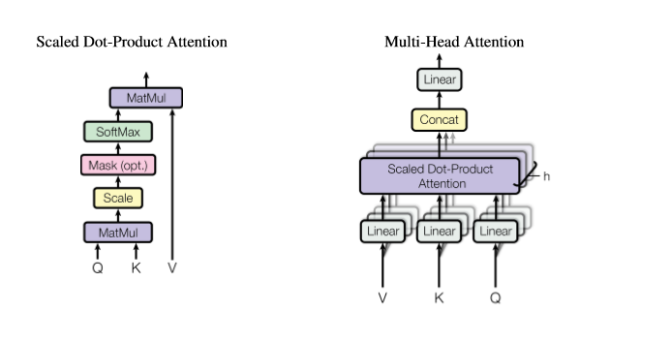
Scaled Dot-Product Attention/
Multi-Head Attention(多头注意力)
Original image
Scaled Dot-Product Attention
Multi-Head Attention
MatMul
Linear
SoftMax
Concat
Mask (opt.)
Scaled Dot-Product
Attention
Scale
MatMul
Linear
Linear
Linear
Q
K
V

Slide 26
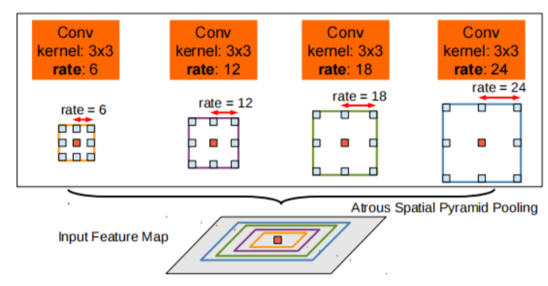
ASPP模块
Original image
Conv
Kernel: 3×3
rate: 6
Conv
Kernel: 3×3
rate: 12
Conv
Kernel: 3×3
rate: 18
Conv
Kernel: 3×3
rate: 24
rate = 18
rate = 24
rate = 6
rate = 12
Atrous Spatial Pyramid Pooling
Input Feature Map

Slide 27
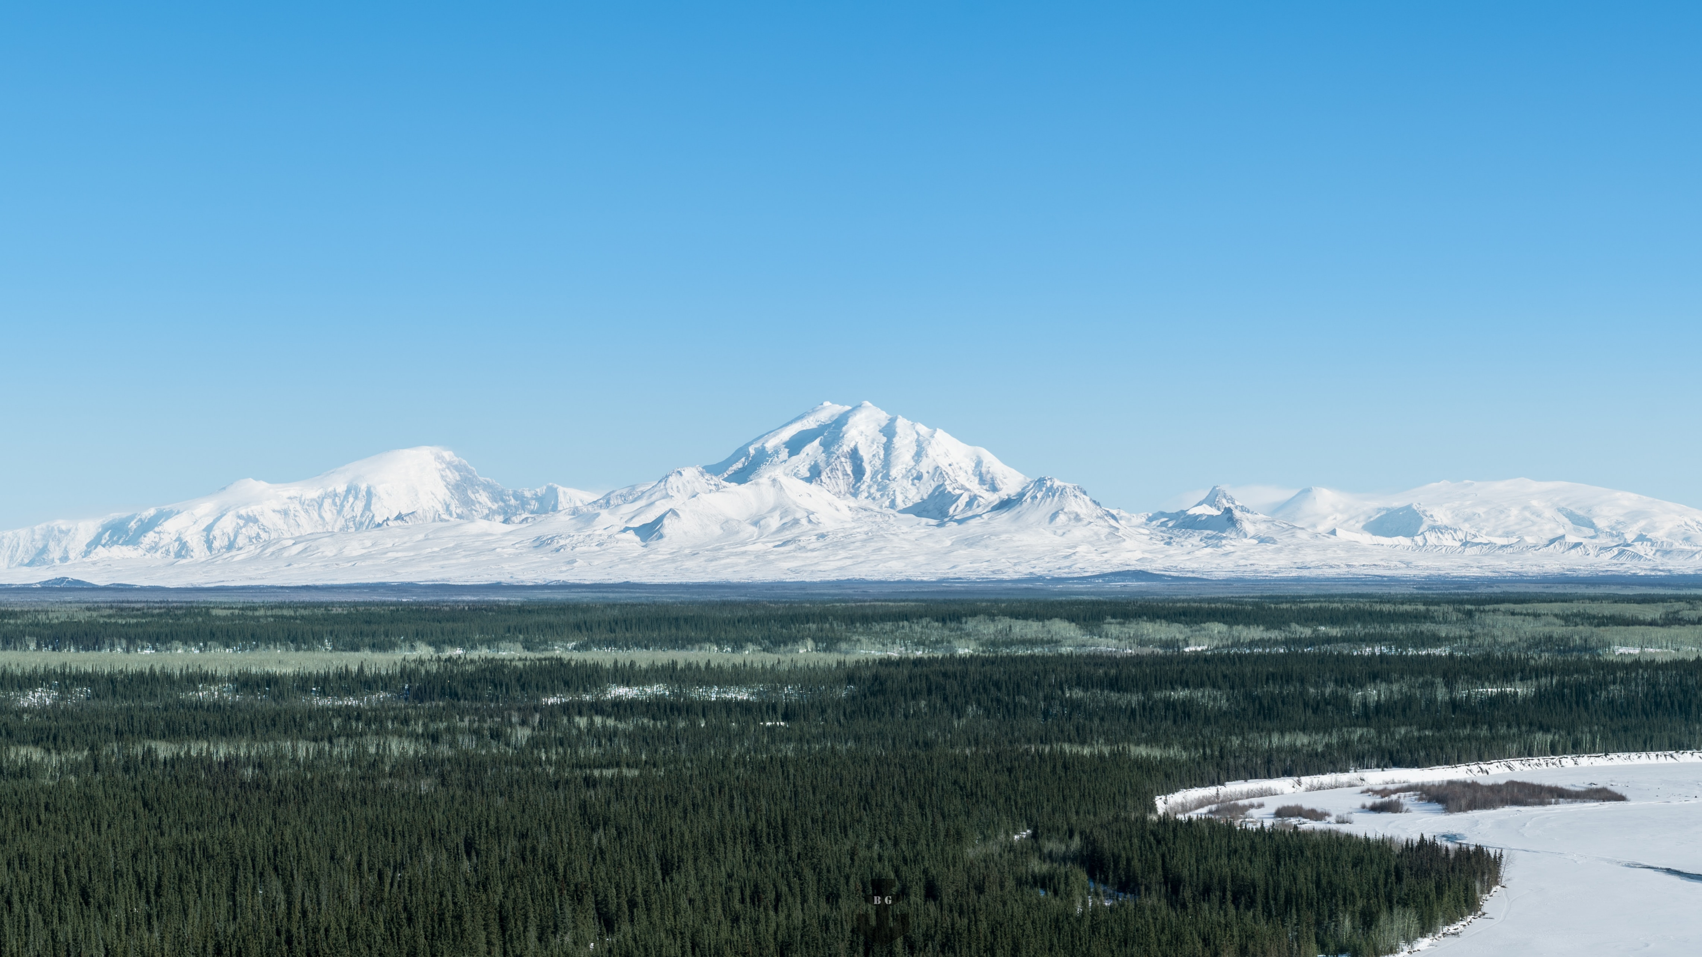
predict
predict
predict
2× up
1×1 conv
+

Slide 28
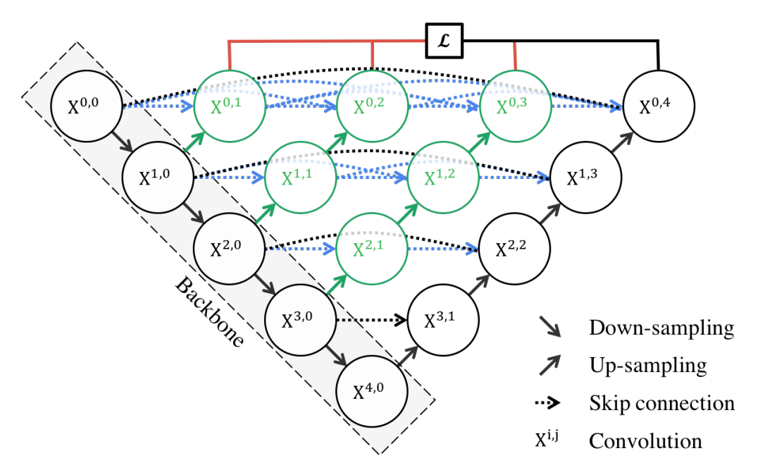
















UNet++整体架构
Original image
𝓛
Backbone
Down-sampling
Up-sampling
Skip connection
Convolution

Slide 29
Yolov5s
Focus
CBL
CSP1_1
CBL
CSP1_3
CBL
CSP1_3
CBL
SPP
CSP2_1
CBL
上采样
Concat
CSP2_1
CBL
上采样
Concat
CSP2_1
conv
CBL
=
Conv
BN
Leaky
relu
CBL
Concat
CSP2_1
conv
Res
unit
=
CBL
CBL
add
CBL
Concat
CSP2_1
conv
CSP1_X
=
CBL
Res
unit
Conv
Concat
BN
Leaky
relu
CBL
Conv
slice
Maxpool
CSP2_X
=
CBL
CBL
Conv
=
slice
=
Maxpool
Focus
Concat
CBL
SPP
CBL
Concat
CBL
Concat
BN
Leaky
relu
CBL
slice
slice
Maxpool
Conv

Slide 30
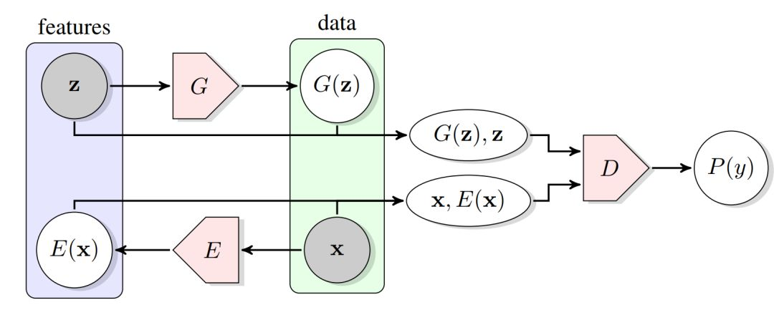










BiGAN 双向生成对抗网络
Original image
features
data

Slide 31
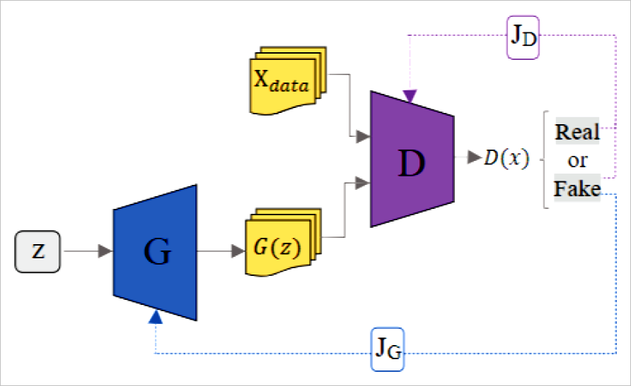
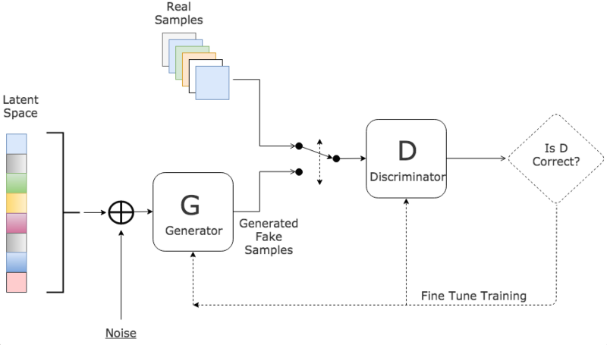
GAN 生成对抗网络
Original image
J_{D}
Real
Samples
X_{data}
Real
Latent
Space
D
D(x)
or
Fake
D
Is D
Correct?
G
G(z)
G
Discriminator
Z
Generator
Generated
Fake
Samples
J_{G}
Fine Tune Training
Noise

Slide 32
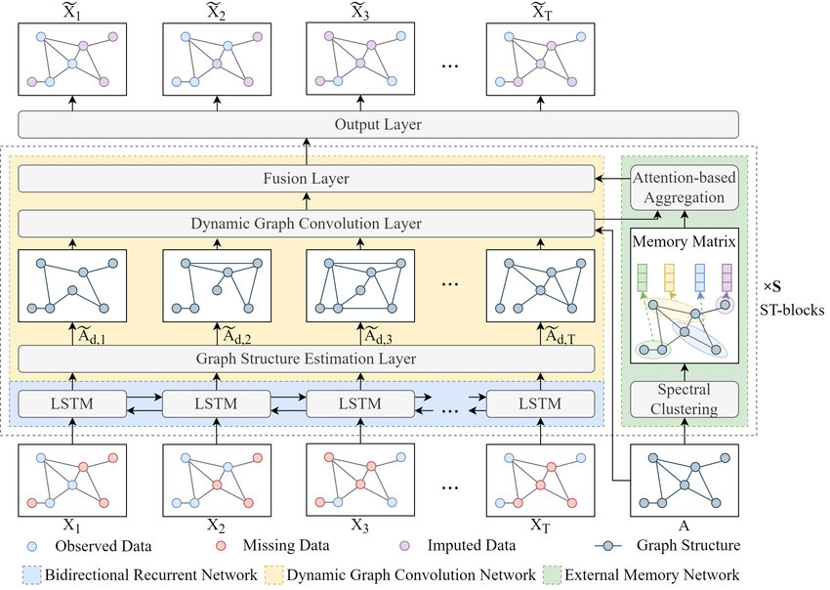









MDGCN
...
Output Layer
Fusion Layer
Attention-based
Aggregation
Dynamic Graph Convolution Layer
Memory Matrix
Original image
...
ST-blocks
Graph Structure Estimation Layer
LSTM
LSTM
LSTM
...
LSTM
Spectral
Clustering
...
X₁
X₂
X₃
X_{T}
A
Observed Data
Missing Data
Imputed Data
Graph Structure
Bidirectional Recurrent Network
Dynamic Graph Convolution Network
External Memory Network

Slide 33
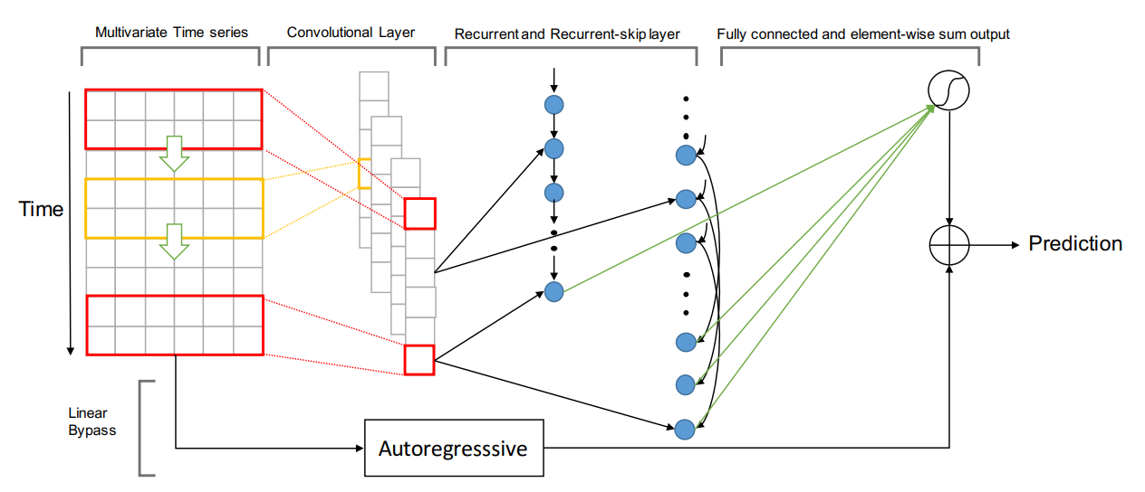
LSTNet 长期和短期时间序列网络
Original image
Multivariate Time series
Convolutional Layer
Recurrent and Recurrent-skip layer
Fully connected and element-wise sum output
Time
Prediction
Linear
Bypass
Autoregressive

Slide 34
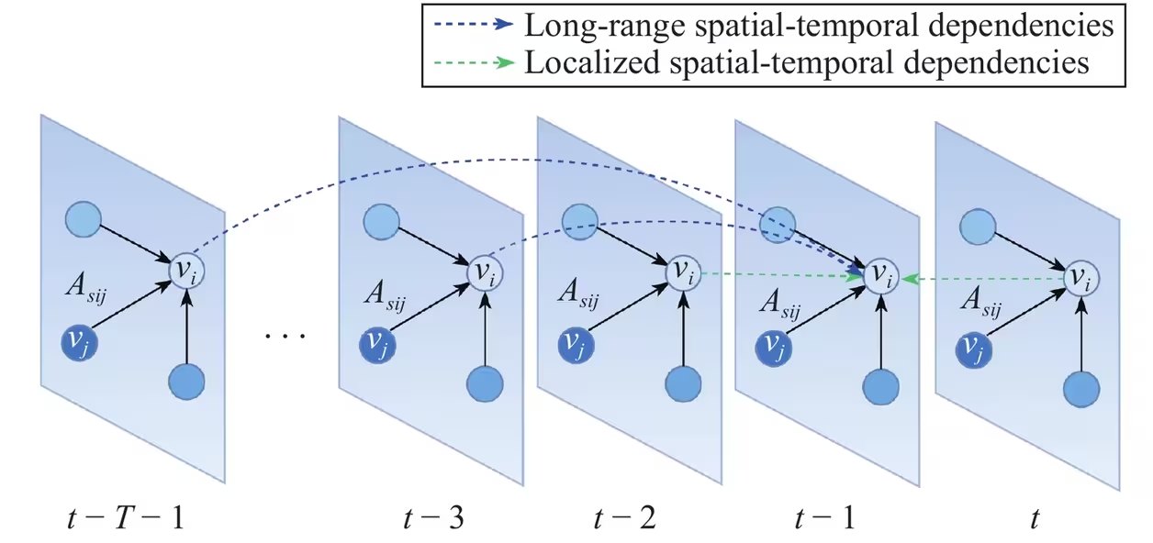




STGSA
Original image
Long-range spatial-temporal dependencies
Localized spatial-temporal dependencies
A_{sij}
v_{i}
A_{sij}
v_{i}
A_{sij}
v_{i}
A_{sij}
v_{i}
A_{sij}
v_{i}
v_{j}
. . .
v_{j}
v_{j}
v_{j}
v_{j}

Slide 35
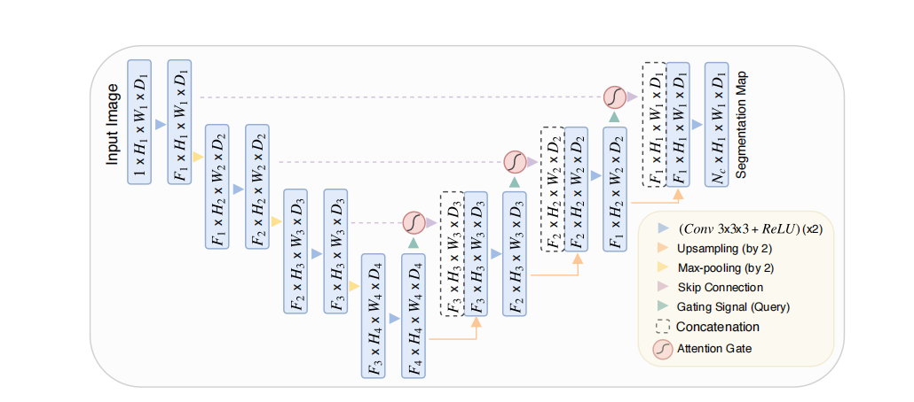
Attention U-Net整体架构
Original image
F₁×H₁×W₁×D₁
F₁×H₁×W₁×D₁
Input Image
F₁×H₁×W₁×D₁
F₁×H₁×W₁×D₁
Segmentation Map
1×H₁×W₁×D₁
F₂×H₂×W₂×D₂
F₁×H₂×W₂×D₂
F₁×H₂×W₂×D₂
F₂×H₂×W₂×D₂
F₂×H₂×W₂×D₂
F₃×H₃×W₃×D₃
(Conv 3×3×3+ReLU)(×2)
F₂×H₃×W₃×D₃
F₂×H₃×W₃×D₃
F₃×H₃×W₃×D₃
F₃×H₃×W₃×D₃
Upsampling(by 2)
Max-pooling(by 2)
Skip Connection
F₃×H₄×W₄×D₄
F₄×H₄×W₄×D₄
Gating Signal(Query)
Concatenation
Attention Gate

Slide 36
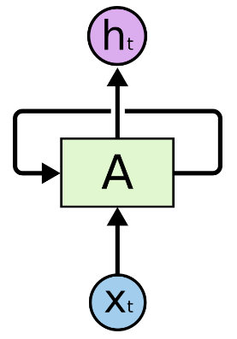
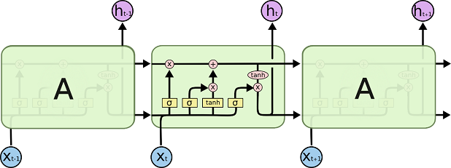

长短期记忆网络LSTM
Original image
h_{t}
A
X_{t}
h_{t-1}
h_{t}
h_{t+1}
A
A
X_{t-1}
X_{t}
X_{t+1}

Slide 37




















双向LSTM
softmax
Fc
last sequence
concat
concat
concat
concat
LSTM
LSTM
LSTM
LSTM
（1）
LSTM
LSTM
LSTM
LSTM
embedding
x₀
x₁
x₂
x₃
（2）

Slide 38
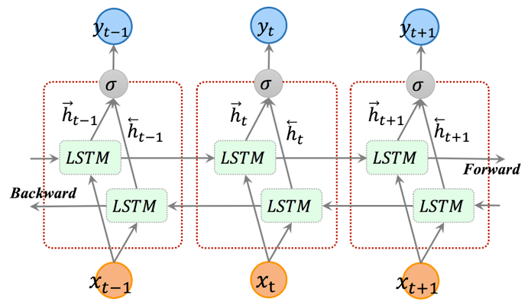














双向LSTM
Original image
Forward
Bcakward

Slide 39
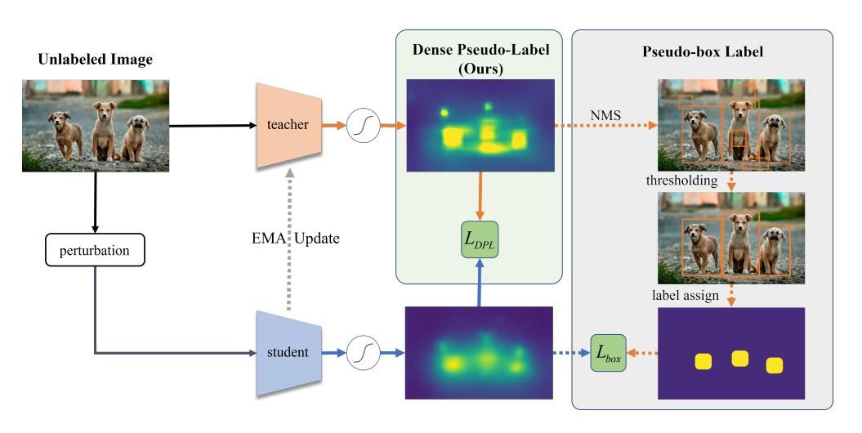


Dense Pseudo-Label
(DPL)
Original image
Unlabeled Image
Dense Pseudo-Label
(Ours)
Pseudo-box Label
teacher
NMS
thresholding
perturbation
EMA Update
label assign
student

Slide 40
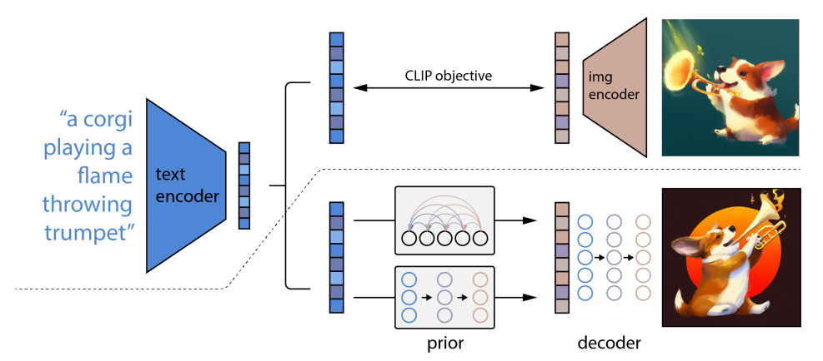
DALL·E 2 模型框架
Original image
CLIP objective
img
encoder
text
encoder
prior
decoder

Slide 41
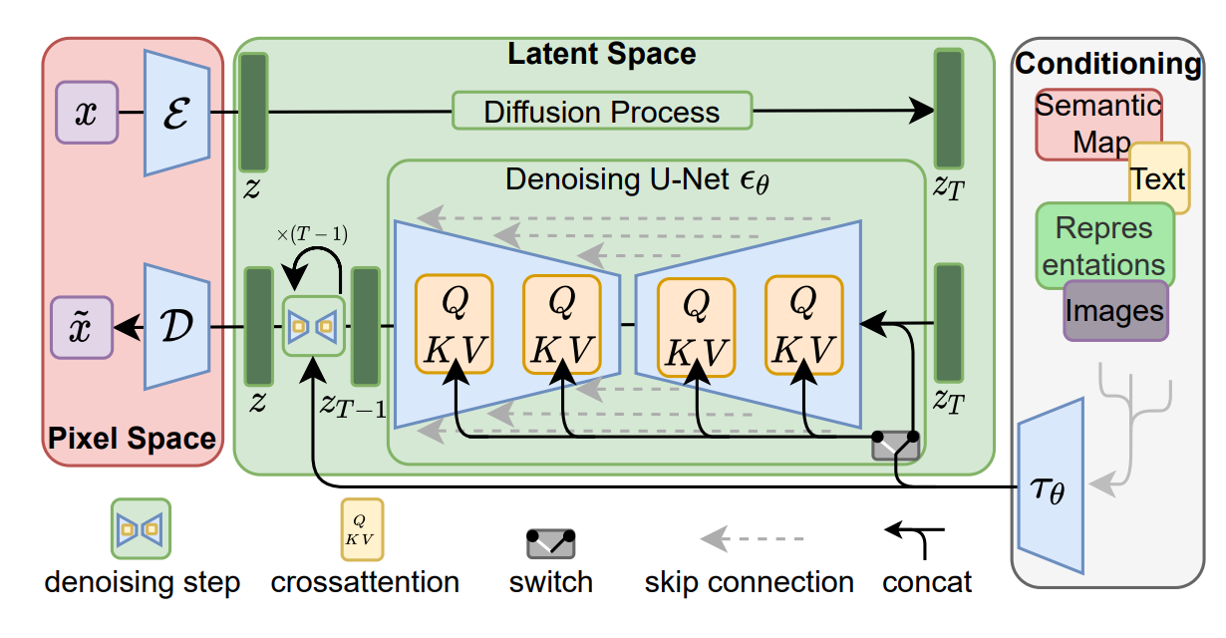


Latent Diffusion Model (LDMs)
Original image
Latent Space
Conditioning
ε
Diffusion Process
Semantic
Map
Denoising U-Net
ϵ_{θ}
𝓩
Text
𝓩
T
Repres
entations
×(T-1)
𝓓
Q
K V
Q
K V
Q
K V
Q
K V
Images
𝓩
𝓩
𝓩
Pixel Space
T-1
T
τ_{θ}

Slide 42
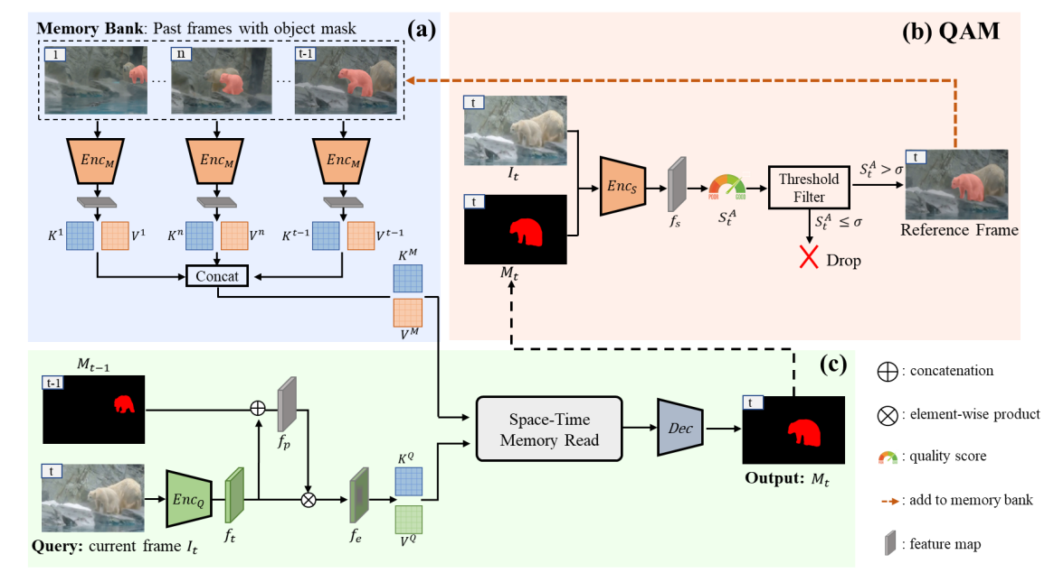
Quality-aware Dynamic M emory Network (QDMN)
Original image
Memory Bank: Past frames with object mask
Enc_{M}
Enc_{M}
Enc_{M}
Threshold
Filter
POOR
Good
Reference Frame
Reference Frame
Concat
Space-Time
Memory Read
Dec
Output: M_{t}
Query: current frame I_{t}

Slide 43
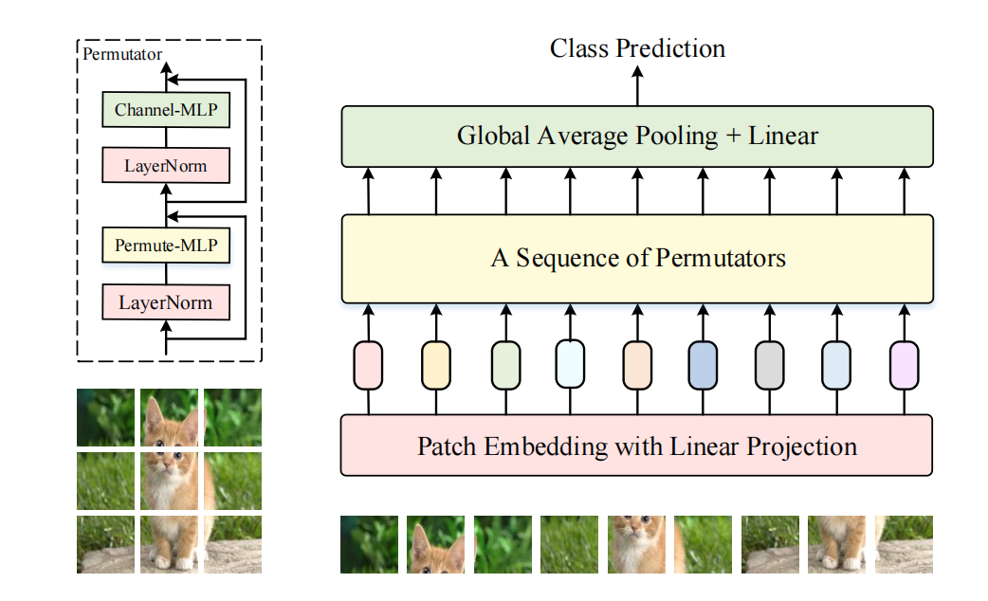
Vision Permutator
Original image
Permutator
Class Prediction
Channel-MLP
Global Average Pooling + Linear
LayerNorm
Permute-MLP
A Sequence of Permutators
LayerNorm
Patch Embedding with Linear Projection

Slide 44
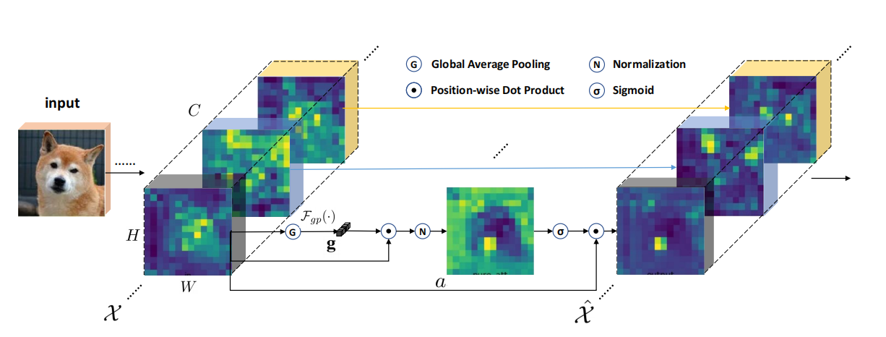
SGE Module
https://arxiv.org/abs/1905.09646
Original image
......
......
Input
C
......
......
H
G
g
N
σ
......
W
a
......
𝓧
^
𝓧

Slide 45
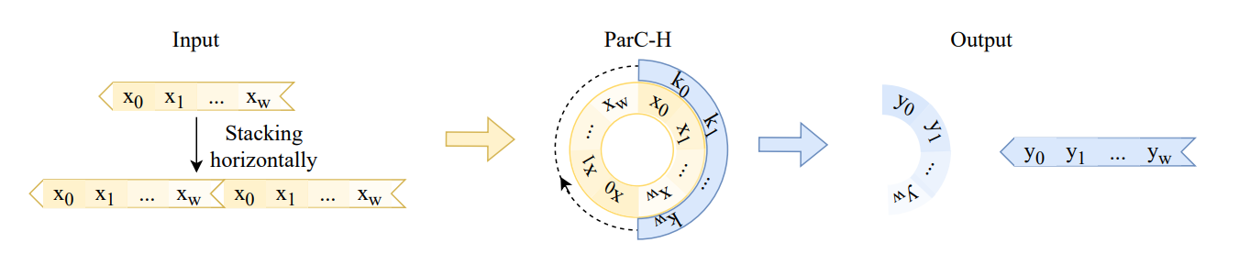
Illustration of global circular convolution on horizontal direction
Original image
Input
ParC-H
Output

Slide 46
杂项1
=
^
=
=

Slide 47
















杂项2
Attention

Slide 48
杂项3

