Slide 1
RESEARCH BRIEF
MULTIMODAL IN. REASONED ACTION OUT.
FinAgent
NEWS
PRICE
A Multimodal Foundation Agent
for Financial Trading
MEMORY + REFLECTION
Tool-Augmented, Diversified,
and Generalist
Context → decision
Beyond forecasting:
turn market evidence into action.
BUY
HOLD
SELL
Observe. Recall. Reflect. Act.

Slide 2
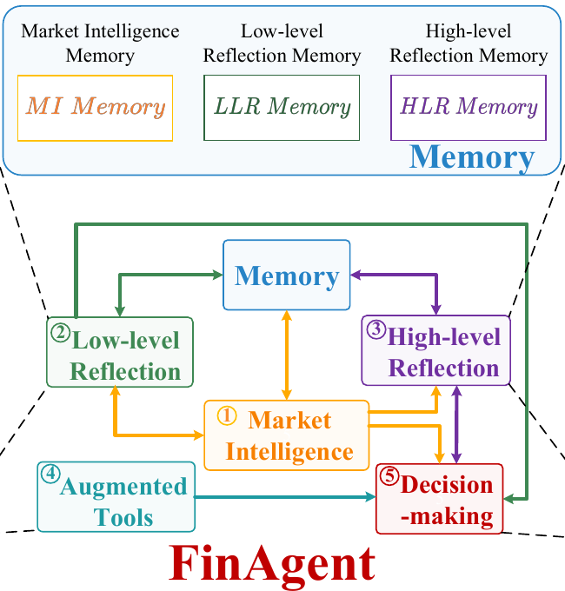
FINAGENT / SYSTEM DESIGN
02 / 06
FinAgent decision architecture
Core workflow
Market intelligence
Summarize current market information.
Memory and reflection
Retrieve relevant experience and review
market signals and previous trades.
Decision with tool support
Combine evidence with technical strategies,
expert guidance and trader preferences.

Slide 3
FINAGENT / KEY MECHANISM
03 / 06
Two reflections. Two different questions.
Separate market interpretation from evaluation of the agent’s own behavior.
01 LOW-LEVEL / THE MARKET
02 HIGH-LEVEL / THE TRADER
Why did
prices move?
Was the
trade sensible?
Market information ↔ price movements
Past action + rationale + outcome
SHORT
MEDIUM
LONG
EXTRACT LESSONS
DIVERSIFIED RETRIEVAL
Decision summary
Trading decision
Retrieval query
Relevant history

Slide 4
FINAGENT / EXPERIMENTAL EVIDENCE
04 / 06
Strong on stocks. Not best on every asset.
Annualized return (ARR, %) · Test window: 1 Jun 2023 – 1 Jan 2024
FinAgent
Best baseline for each asset
SPOTLIGHT / TSLA
AAPL
31.90
92.27%
24.84
AMZN
65.10
42.93
GOOGL
56.15
annualized return
for FinAgent
38.29
MSFT
44.74
40.58
TSLA
92.27
50.04%
for FinMem
50.04
ETH
43.08
44.72
ETH: FinMem is ahead.
0
25
50
75
100
5 stocks + Ethereum · 12 baselines · Historical backtest, not a live-trading guarantee

Slide 5
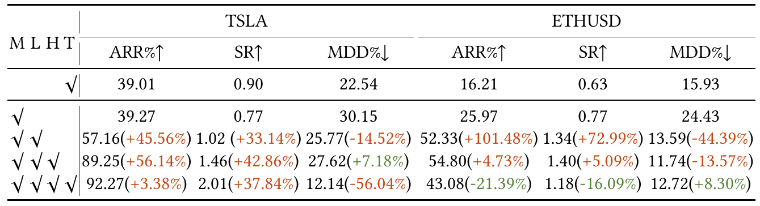
FINAGENT / WHAT MAKES IT WORK?
05 / 06
Tool effects differ across assets
Component ablation · Annualized return (ARR, %)
COMPONENT ABLATION
AFTER ADDING TOOLS
Market fit
matters.
TSLA +3.02 pp
The last two rows isolate the addition of tools
ETH −11.72 pp
M: market intelligence L: low-level reflection
pp = percentage points of ARR
H: high-level reflection T: augmented tools
The auxiliary strategies were designed for stocks. Their effect differs on Ethereum.

Slide 6
FINAGENT / TAKEAWAY
06 / 06
The contribution is the
decision architecture.
Multimodal evidence. Relevant memory. Structured self-review.
01
Combine evidence
KEEP THE CLAIM PROPORTIONATE
Read prices, language and visual context together.
Promising, not
proven everywhere.
02
Recall what matters
Retrieve relevant experience, not just more text.
03
Review both sides
Six assets. One historical window.
Further live-market validation is needed.
Interpret the market—and evaluate prior actions.

Slide 7
FINAGENT / SUPPORTING DATA
APPENDIX
Supporting data
Backup slide — excluded from the three-minute slide show.
ANNUALIZED RETURN (%)
Asset
FinAgent
Best baseline
Method
Gap (pp)
AAPL
31.90
24.84
SAC
+7.06
AMZN
65.10
42.93
FinGPT
+22.17
GOOGL
56.15
38.29
PPO
+17.86
MSFT
44.74
40.58
FinMem
+4.16
TSLA
92.27
50.04
FinMem
+42.23
ETH
43.08
44.72
FinMem
-1.64
ARR is annualized, not the cumulative test-period return.
Baseline selection uses the highest ARR in each asset column.
Notes:
Backup data, excluded from the three-minute slide show. ARR is annualized, not cumulative test-period return. The baseline is the highest-ARR comparator for each asset.

