Slide 1
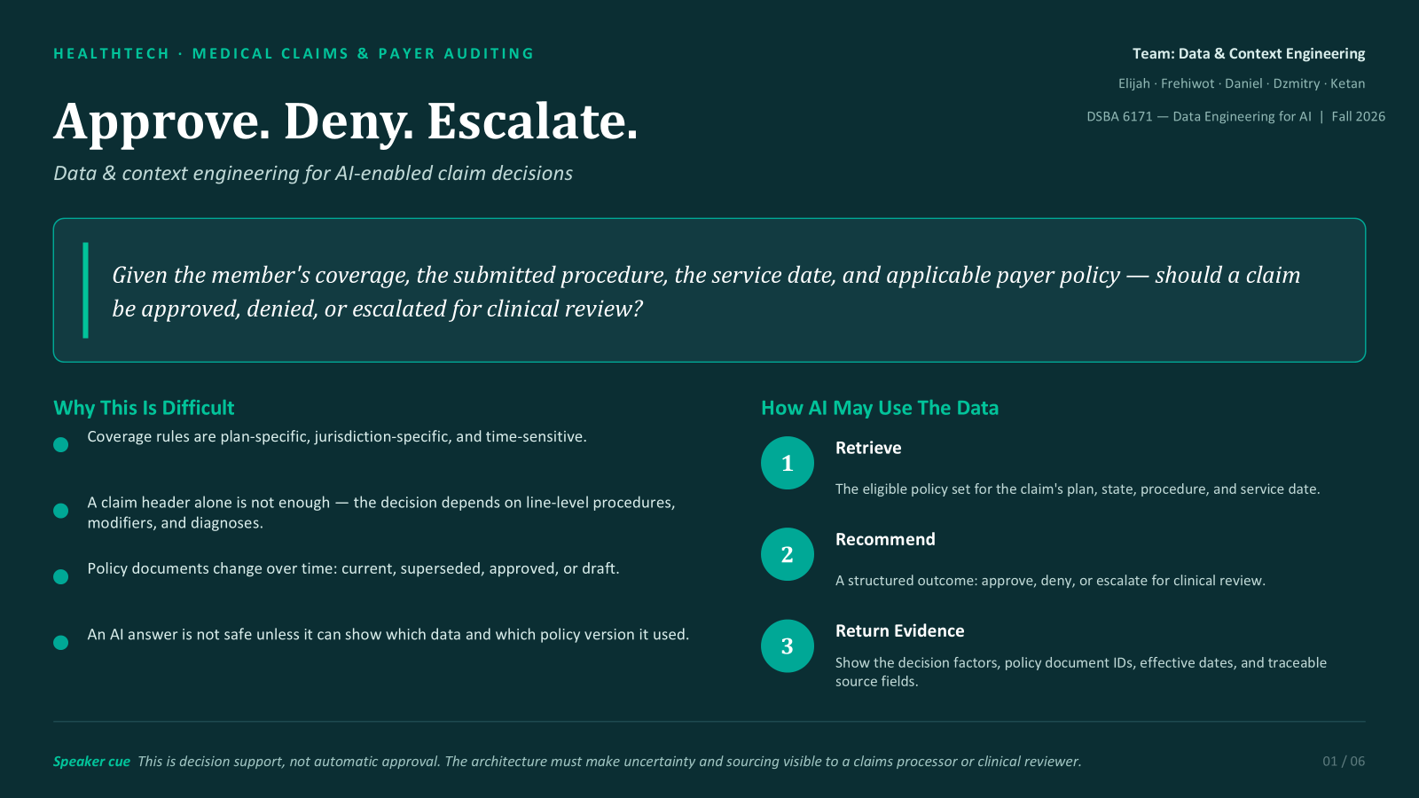

Slide 2
SLIDE 2
Business Data Microcosm
Six structured datasets across three grains
Grain
Dataset
What It Represents
One Row =
Key Relationships
Entity
patient_accounts
Member enrollment & coverage
One member enrollment
plan_id, primary_provider_id
Entity
providers
Provider identity & network
One provider
provider_id
Entity
insurance_plans
Plan design & benefits
One plan
plan_id
Entity
procedure_catalog
Procedure reference & policy pointer
One procedure
procedure_code, coverage_policy_id
Txn header
claims_ledger
Submitted claim header
One claim
claim_id, member_id, provider_id, plan_id
Txn detail
claim_line_items
Service line within a claim
One service line
claim_line_id, claim_id, procedure_code
Relationship Spine
Why Grain Matters
member → plan
claim → member + provider + plan
claims_ledger → one row = one claim
claim → many service lines → procedure
claim_line_items → one row = one service
procedure → policy document ID
⚠ If joined without declaring grain → claim total repeats for every service line.
Evidence to open
data/structured/raw/ • structured_data_dictionary.csv • architecture/domain_microcosm_erd.png
02 / 06

Slide 3
SLIDE 3
Architecture: Sources → AI Consumer
Two streams converge before decisioning — structured and knowledge paths remain traceable
STRUCTURED PATH
KNOWLEDGE PATH
Claims Feeds
Policy Documents
CSV files
PDF, Markdown, TXT
Ingestion
Document Ingestion
Parse, schema check
Extract, metadata
Raw Storage
Knowledge Corpus
Immutable
Source + versioned
TRANSFORMATION — Join at declared grain
Point-in-time + jurisdiction filters applied before decisioning
AI-READY DECISION RECORD
Features + policy IDs + quality flags
AI CONSUMER · Claims / Clinical Reviewer
Approve · Deny · Escalate
Evidence to open
domain_microcosm_erd.png • raw CSV directory • document_metadata.csv
03 / 06

Slide 4
SLIDE 4
How Architecture Can Affect AI
One-to-many join duplication: claim CLM-10058
Claims Ledger
JOIN on claim_id
One row = one claim
One row = one service. The same claim total repeats.
Claim ID | Claim total
CLM-10058 | $1,255.72
Claim ID | Service line | Service amount | Claim total
CLM-10058 | 1 | $72.48 | $1,255.72
CLM-10058 | 2 | $479.78 | $1,255.72
CLM-10058 | 3 | $703.46 | $1,255.72
Column sum |  | $1,255.72 | $3,767.16
Service Lines
One row = one service in CLM-10058
Service line | Service amount
1 | $72.48
2 | $479.78
3 | $703.46
Correct: add line amounts
Incorrect: add claim totals
Matches the original claim total.
Counts $1,255.72 three times.
Possible AI summary:
Business consequence:
“Total billed: $3,767.16.”
The wrong total can waste reviewers’ time and delay claim processing.
Control: Keep the claim total. Compare it with the service-line sum before AI.
The model can follow its input and still report the wrong amount.
Jupyter Notebook: full example
04 / 06
Notes:
This example shows how a data modeling mistake can change the information that AI receives.
The key concept is grain: what one row represents. In the Claims Ledger, one row represents one claim. In Service Lines, one row represents one service within a claim.
Claim CLM-10058 has a billed total of $1,255.72. Its three service amounts are $72.48, $479.78, and $703.46. Together they equal the original claim total.
We join the tables by matching claim_id. The result contains three legitimate service rows. Each row now includes the total for the same claim. The join is valid. It does not change the claim's actual total.
The error happens in the next step. If we add the claim-total column, we count $1,255.72 three times and get $3,767.16. If we add the service amounts, we get the correct $1,255.72. We also preserve the original claim total as context.
If AI receives the inflated number and we ask for a summary, it could report that the total billed amount is $3,767.16. The model can interpret its input reasonably while producing a wrong business summary. A reviewer may then spend time on an unnecessary investigation, potentially delaying processing. This is a possible consequence, not the result of an actual AI run.
The architectural control is to keep the original claim total, sum service amounts separately, and compare the two before supplying the context to AI. Flag mismatches for review.
Source cells: claims_ledger.csv A59=CLM-10058 and I59=1255.72. Match A59 to claim_line_items.csv B79:B81. Service amounts are F79:F81. Billed amount is already the amount for the entire service line, not a unit price.
Sources:
https://github.com/Freh-dev/dsba6171-healthtech-domain-project/blob/main/data/structured/raw/claims_ledger.csv#L59
https://github.com/Freh-dev/dsba6171-healthtech-domain-project/blob/main/data/structured/raw/claim_line_items.csv#L79-L81
https://github.com/Freh-dev/dsba6171-healthtech-domain-project/blob/main/notebooks/claim_join_grain_demo.ipynb

Slide 5
SLIDE 5
Meaning, Context & Trust
Section 3 — schema, semantic contract, semantic failure, quality controls
SCHEMA EXPECTATIONS + FAILURE EXAMPLE
SEMANTIC CONTRACT + 3 CONTROLS
Anchor dataset: claim_line_items.csv
Trust comes from declared meaning plus lineage.
Schema anchor
Contract: what AI must preserve
•
One row = one billed service line
Schema/version: claim_line_items_schema_v1.0
PK claim_line_id; FKs claim_id + procedure_code
•
service_date = point-in-time (date used for) coverage/policy date
•
amounts are USD line totals; 0.00 can be meaningful
Semantic failure example
3 quality/context controls
Contract: billed_amount = total USD line amount (not unit price)
• grain check
• amount meaning check (line total, not per unit price)
• service-date check (point-in-time)
•
•
LI-10031: Failure: $3,338.03 becomes per-unit; units = 2
Source of truth
Line amounts 🡪 claim_line_items
Claim totals 🡪 claims_ledger
•
(without contract) AI reports $3,338.03; true total = $6,676.06
Traceability
carry claim_line_id + source file + quality_flag forward
Reason: business meaning changes earlier in the data pipeline, before it reaches the AI 🡪 billed_amount changes from line total to per-unit amount
Result: AI receives a line-level record with meaning, timing, and traceability preserved.
Evidence to open
schema_claim_line_items_v1.csv • data dictionary • linkages.csv
05 / 06

Slide 6
SLIDE 6
Decisions, Tradeoffs & Feedback
The architecture is designed for correct context first, not complexity for its own sake
BIGGEST ARCHITECTURAL DECISION
BIGGEST REMAINING RISK
ACCEPTED TRADEOFF
Keep claim-header and service-line grain separate. Join only at a declared grain, then apply point-in-time and jurisdiction filters before decisioning.
A stale, draft, or jurisdictionally wrong policy could still reach retrieval if metadata controls are bypassed or incomplete.
Use a small synthetic microcosm instead of production-scale data. This keeps the architecture testable while preserving realistic relationships and failure modes.
PEER FEEDBACK REQUEST
Is our source-of-truth and point-in-time strategy clear enough to prevent an outdated or draft policy from reaching the AI consumer?
GitHub: https://github.com/Freh-dev/dsba6171-healthtech-domain-project.git
Evidence to open
GitHub repository • architecture decisions • peer-review question
06 / 06

