Slide 1
Diagnostic analysis of NHS data using Python
Francesca Galli

Slide 2
Agenda
Background and context
Analytical approach
Patterns, trends and insights
Recommendations

Slide 3
Background and context
The NHS incurs significant costs when patients miss general practitioner (GP) appointments, and the reasons for this need to be better understood
As a team of data analyst, our objective is to better understand:
If there has been adequate staff capacity in the networks
The actual utilisation of resources
For this project, we used the Pandas, Numpy, Matplotlib and Seaborn libraries to segment NHS appointment data across various categories and visualise insights
These techniques allowed us to create simple but effective visualisation ready for consumption of all stakeholders involved
As a team, we leveraged GitHub to work collectively on the same code and make updates throughout

Slide 4
Analytical approach
Load data sources into Jupiter Notebook as DataFrames
Check data for null values – none were identified
Conduct preliminary exploratory analysis to describe the data sources in terms of number of service settings (5), context types (3), national categories (18), appointment statuses (3).
Correct formatting of data types to ensure dates were recognised through the datetime method
Additional exploratory analysis focused on count of appointments, which was chosen as the main variable of interest to answer the business questions

Slide 5
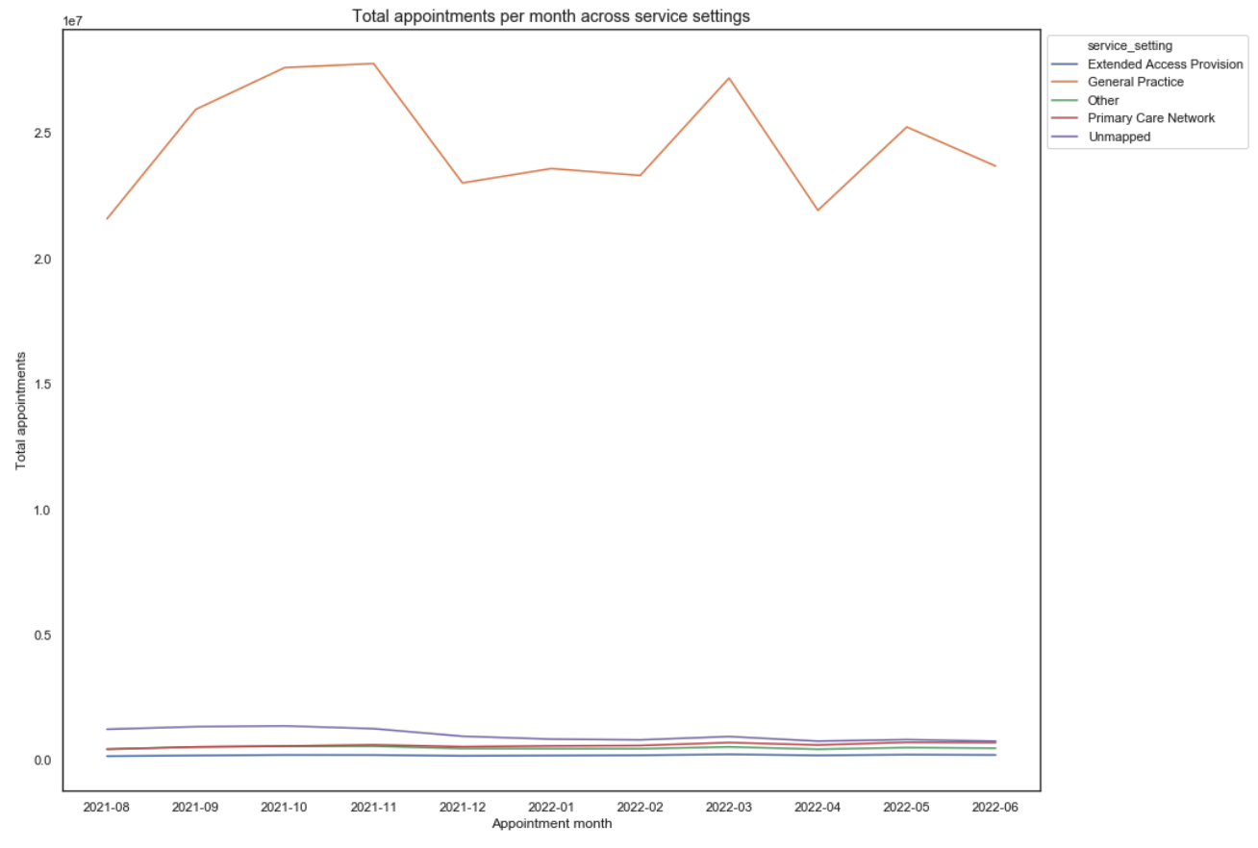
Patterns, trends and insights (I)
General practice is the service setting registering the highest number of appointments, and it shows greater seasonality in particular around the autumn and spring time.

Slide 6
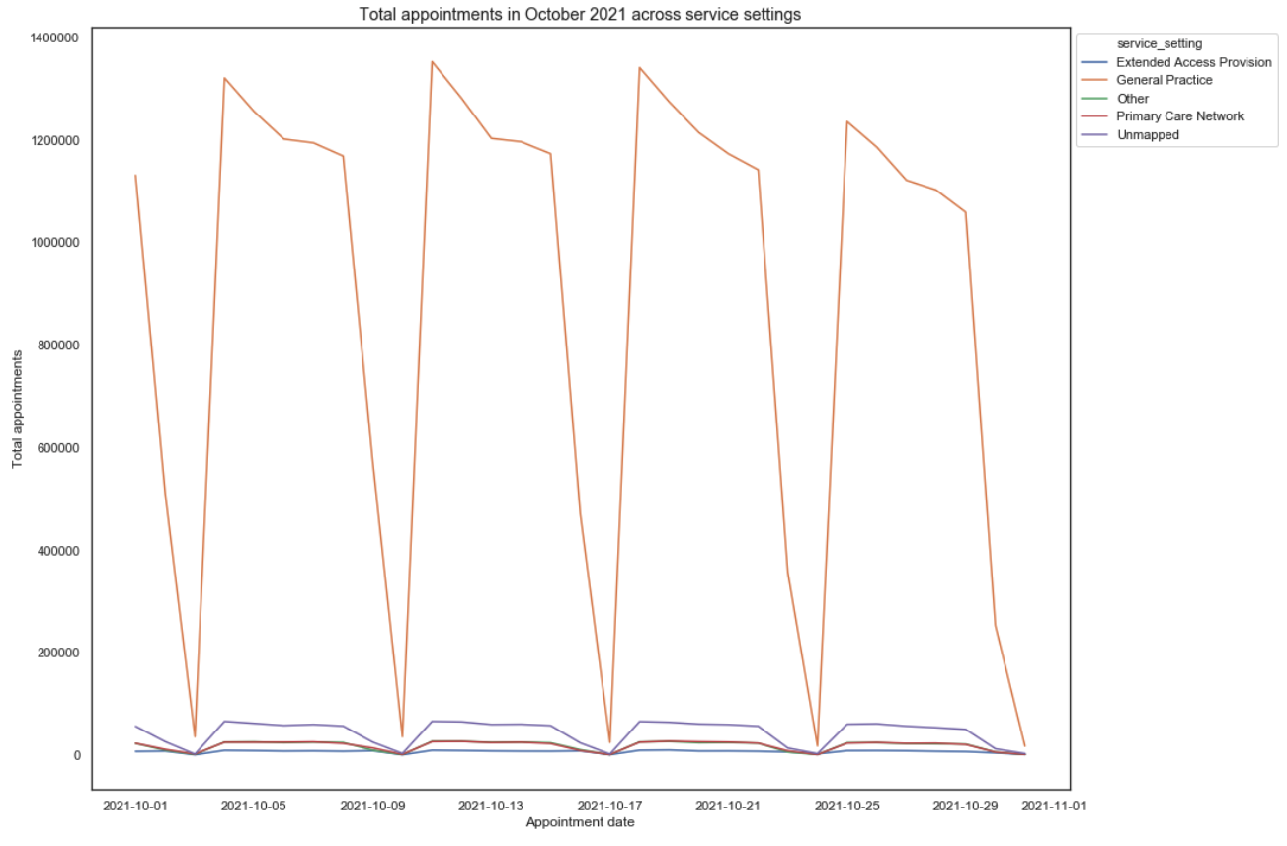
Patterns, trends and insights (II)
Secondly, we created four visualisations indicating the number of appointments for service setting per season, in order to identify more granular trends.
All four seasons show a drop in appointments coinciding with weekends, which accounts for lower volumes when certain service settings such as GP practices are closed.

Slide 7
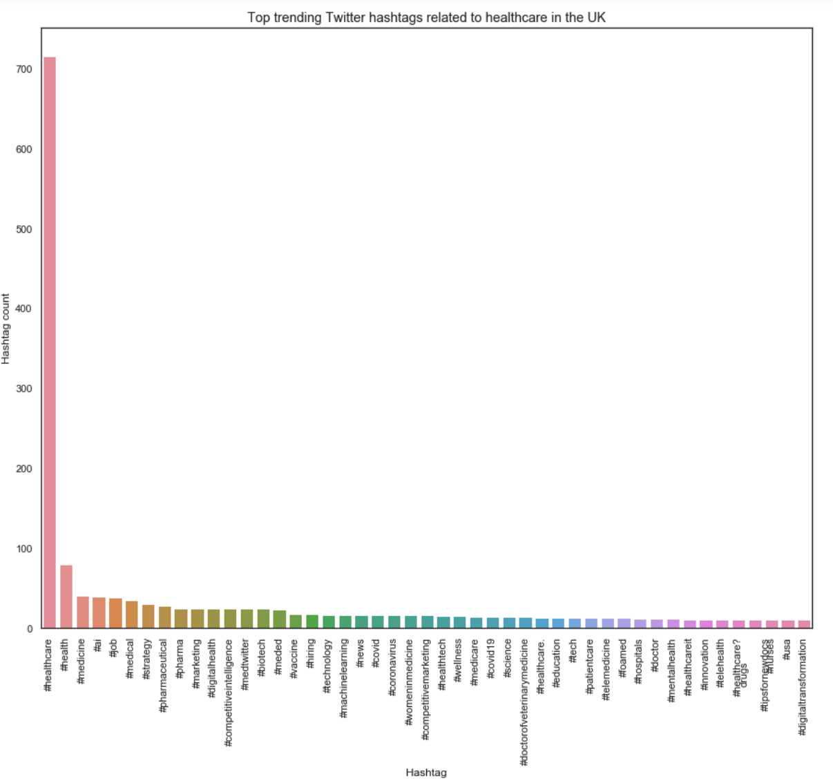
Patterns, trends and insights (III)
Thirdly, we analysed tweets about healthcare in the UK, for an external perspective.
The top trending hashtags feature #healthcare and #health as the most common, followed by #medicine, #ai, #job, perhaps suggesting a focus on the supply side of healthcare (related to resourcing, job optimisation and job search)

Slide 8
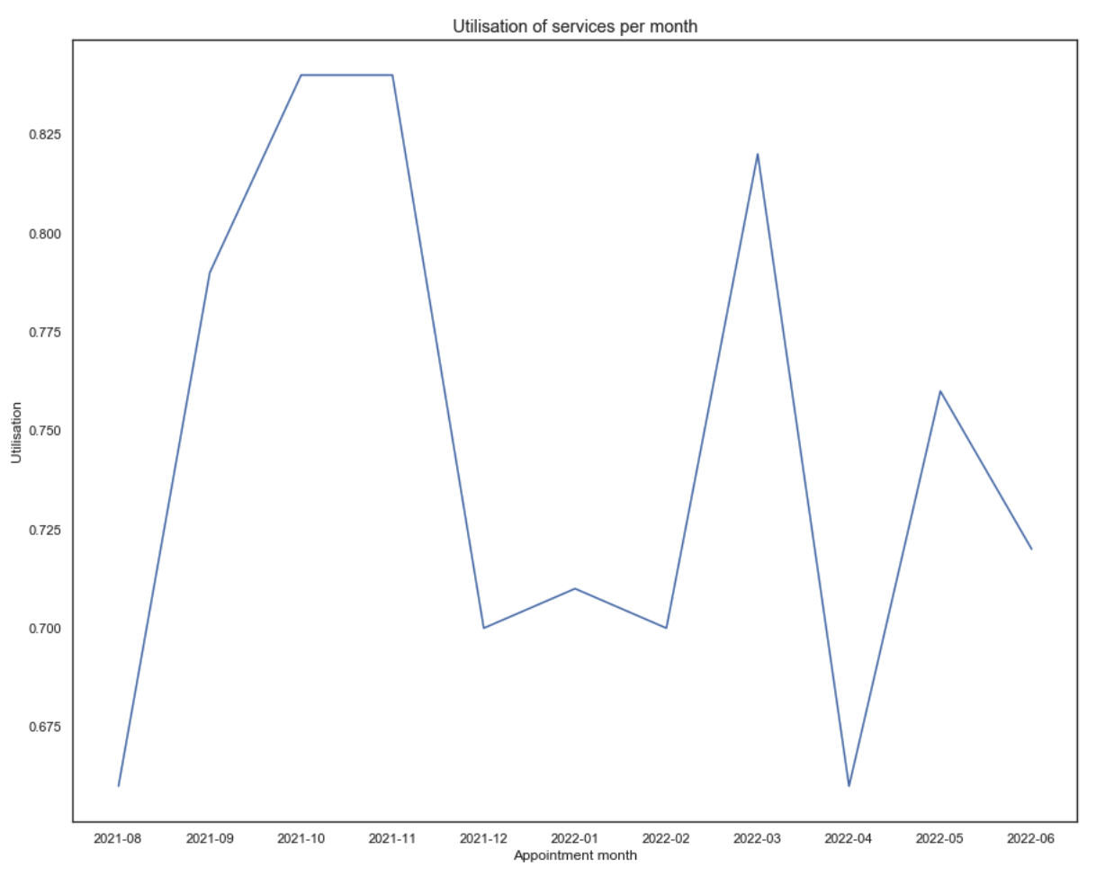
Patterns, trends and insights (IV)
To better address the business challenge on resource capacity, we created a ‘utilisation’ variable by adding a new column that divided the count of appointments by the maximum NHS capacity of 1,200,000 per day.
The utilisation data shows peaks in the autumn and spring, where service utilisation is around 84% and 82% respectively. Services are the least utilised in April at 66%.

Slide 9
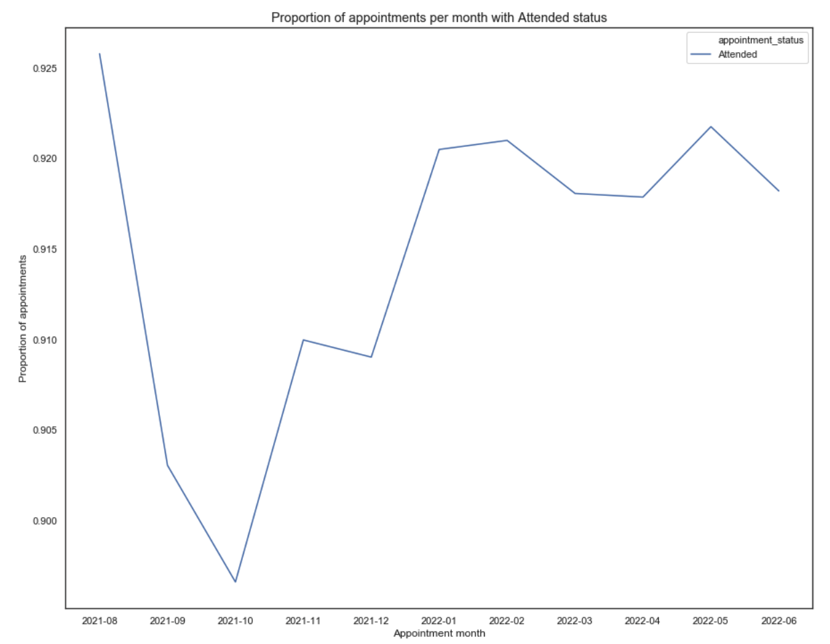
Patterns, trends and insights (V)
We then wanted to investigate attendance of appointments to see if there was any trend that could help predict demand for staff.
We could see that there is a drop in the proportion of attended appointments between the months of September and January compared with the rest of the year.

Slide 10
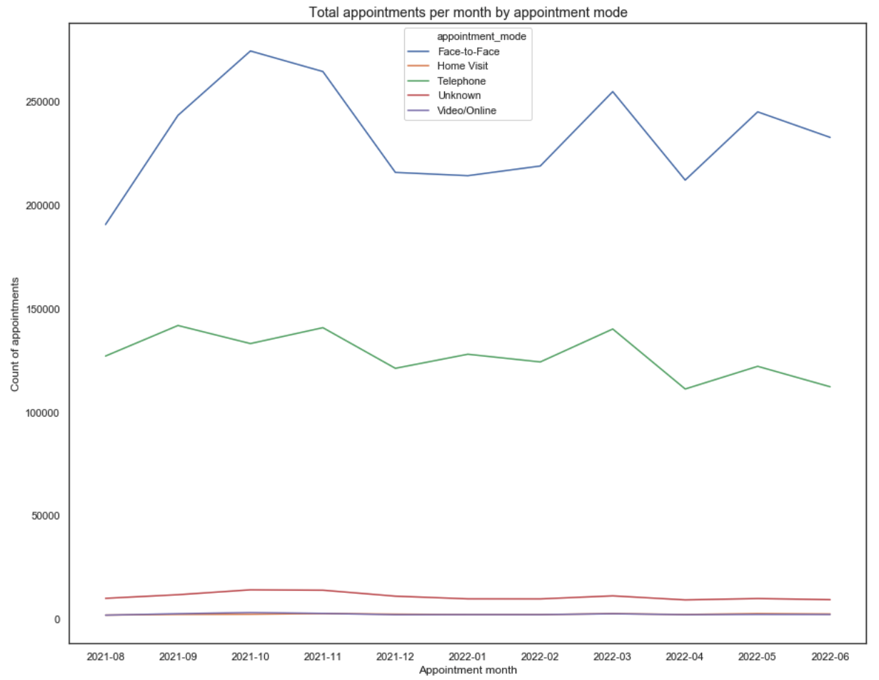
Patterns, trends and insights (VI)
In terms of appointment type, face-to-face appointments are the most frequent, and they are the ones experiencing the most evident seasonal peaks in autumn and spring.
On the other hand, telephone appointments, home visits and video/online are much more constant across the year.

Slide 11
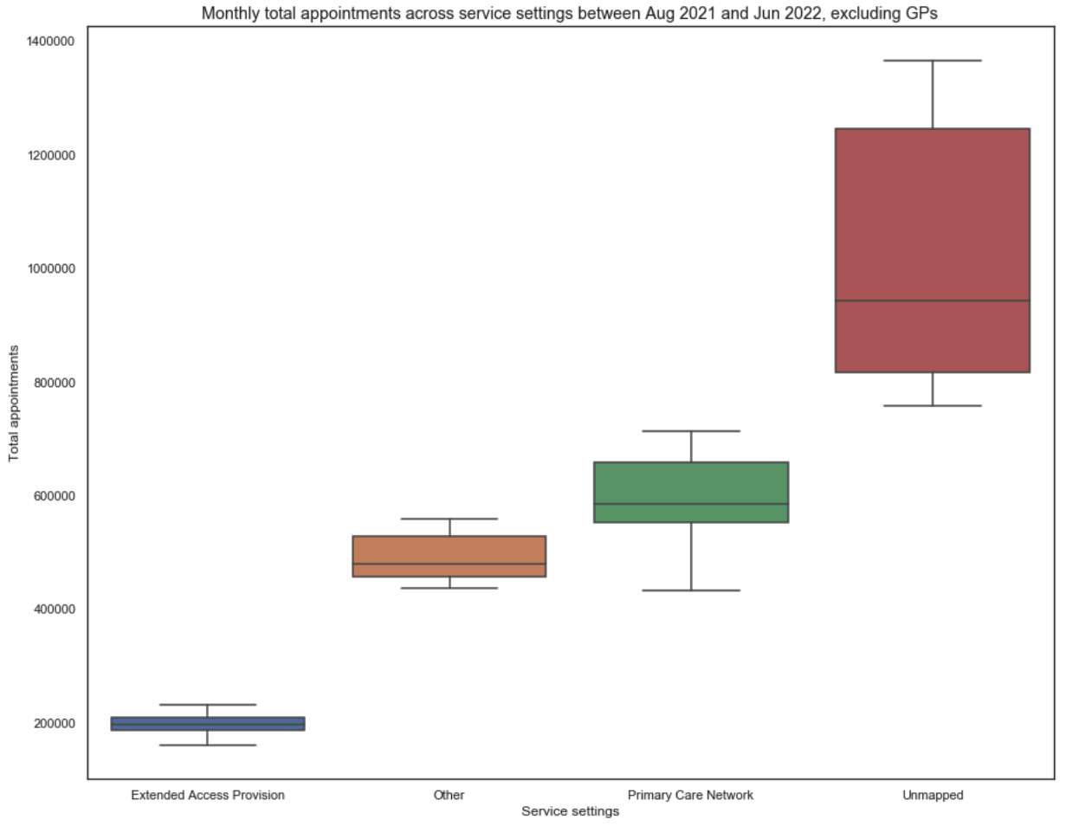
Patterns, trends and insights (VII)
Finally, we looked at the spread in the monthly total appointments across service settings, to determine where demand for NHS resources is the most variable.
The spread of General Practice monthly total appointments is much larger than the other service settings.
By excluding General Practice from the chart, we found that the Unmapped category is the second most variable on a monthly basis

Slide 12
Recommendations
In answer to the business questions:
Capacity in the networks has been able to cope with demand over the period analysed
The actual utilisation of resources was explored in the charts, and a few recommendations follow:
Smooth demand for GPs across the week where possible to lead to more predictable demand.
Conduct a more detailed analysis of the content of UK healthcare tweets beyond hashtags to help clarify the topics of interest.
The NHS might consider increasing staffing levels in the busiest part of the year to cope with any exceptional demand that might be required, however maximum capacity has not been reached within the period analysed.
More data could be collected at the point where patients cancel appointments to determine causes.
Telephone appointments seem to be more closely related with face-to-face appointments in terms of seasonal trend, which suggests that they might act as an effective substitute should the need arise.
A greater effort in mapping appointments to the appropriate category would help with understanding demand for specific service settings.

