Slide 1
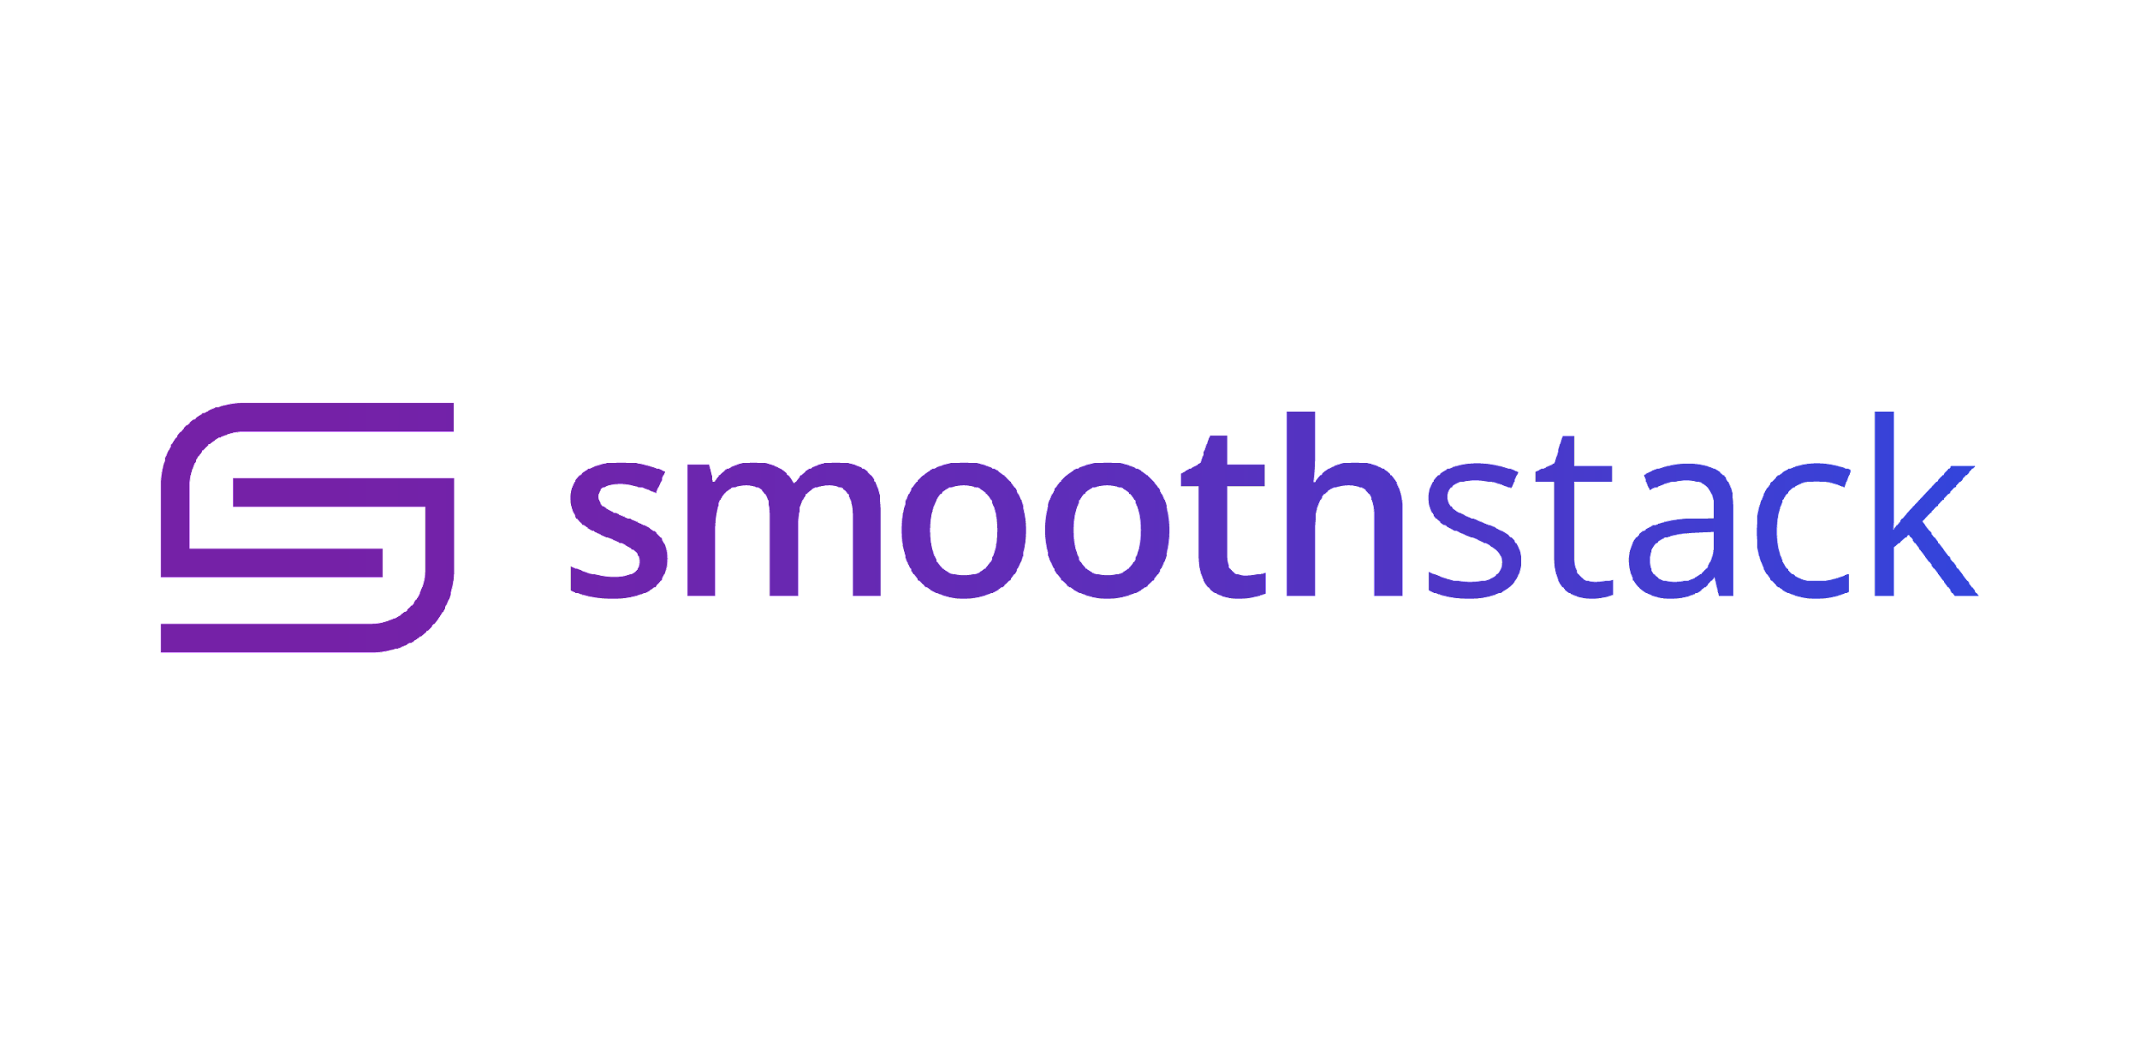
Instructor
Austin French
Austin.french@smoothstack.com
Python Cloud Day 3
learn.smoothstack.com

Slide 2
Learning Objectives
Venv
Flask
Cookies and sessions
Jinja2 templating
SQLAlchemy

Slide 3
venv
Venv is a tool to create isolated Python environments. The basic problem being addressed is one of dependencies and versions, and indirectly permissions.
you can create a virtual environment by running the following command:
python3 -m venv env
Once created run the activate executable from env/Scripts/activate

Slide 4
Flask
Flask is a micro web framework written in Python. It is classified as a micro-framework because it does not require particular tools or libraries.
To install flask:
Pip install flask
There are lots of plugins for flask that add functionality to the framework.
Flask-SQLAlchemy
Flask-login
Flask-WTForms
Flask-Bootstrap

Slide 5
Cookies and Sessions
Cookies are small files that are stored on the client side. They are used to store information about the user.
Sessions are used to store information about the user on the server side. Flask uses the `session` object to access session data.

Slide 6
Jinja2
Jinja2 is a modern and designer-friendly templating language for Python.
It is fast, widely used, and secure with the optional sand-boxed template execution environment.
We can use jinja2 templates in our html to add loops, conditionals, and variables into our rendered html output.
Jinja2 uses {{ }} for variables and {% %} for programmatic functionality.

Slide 7
SQLAlchemy
SQLAlchemy is the Python SQL toolkit and Object Relational Mapper.
It is used to create and manage relational databases.
When using SQLAlchemy with Flask, it is recommended to use Flask-SQLAlchemy.
SQLAlchemy supports many different databases. The most popular databases are:
SQLite
MySQL
PostgreSQL
Oracle
Microsoft SQL Server

