Slide 1
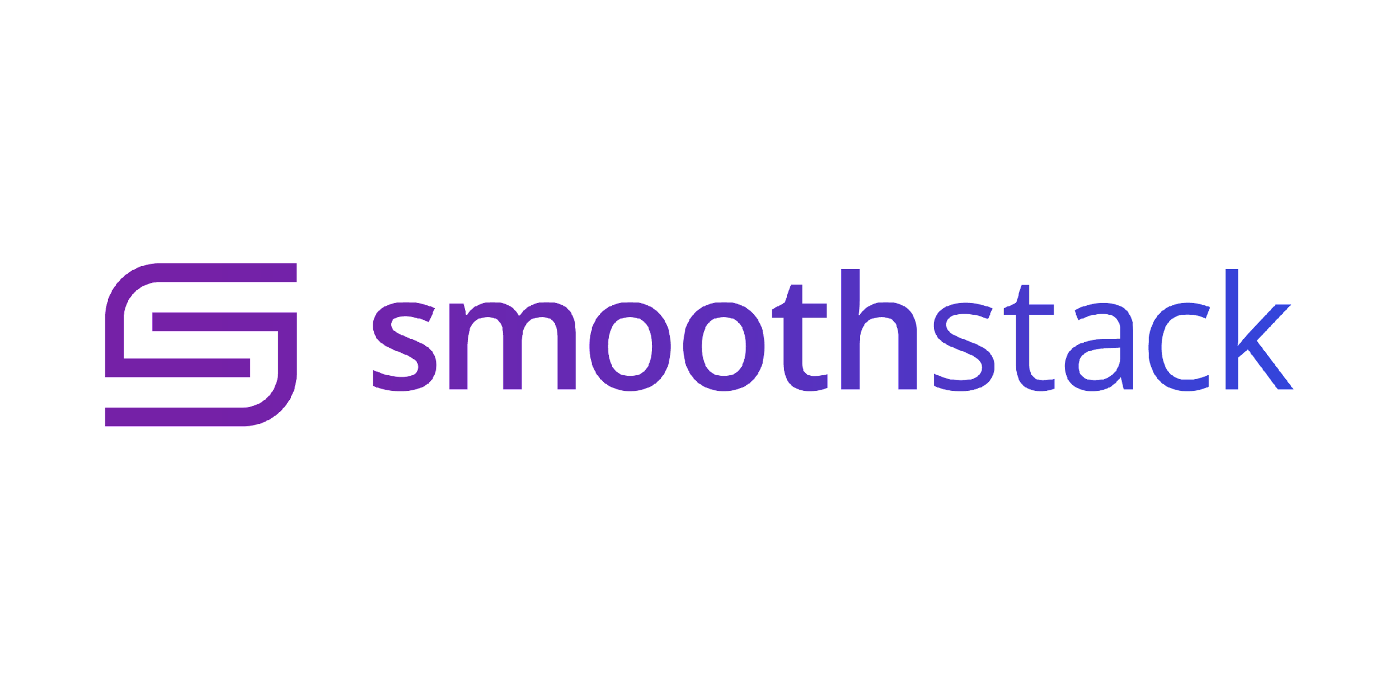
Instructor
Austin French
Austin.french@smoothstack.com
Python Cloud Day 1
learn.smoothstack.com

Slide 2
Learning Objectives
Introduction to python and IDE
Data Structures
Control Structures
Functions and methods
Advanced Functionality (lambdas, map, zip, filter)

Slide 3
What is python?
Python is a high level programming language that is used for general purpose programming.
It is a very popular language and is used in many different fields such:
Web development
Data Science
Machine Learning
Python is both Interpreted and compiled!

Slide 4
Why choose python?
Many developers choose to use python because it is easy to learn and has a large community of developers.
Other reasons to use python are:
It is free and open source
It is easy to read and understand
It has a vast ecosystem of libraries and frameworks

Slide 5
How we use python
We will be using the git bash terminal for CLI and VS Code for our IDE
VS Code https://code.visualstudio.com/
Git Bash https://gitforwindows.org/
You will also need to install python.
https://www.python.org/downloads/
Once installed you can run python in the CLI:
python3 --version
python3 filename.py

Slide 6
To the IDE!
Now that we have all the required tools to get us started, let’s jump into the IDE and make a python program.

