Slide 1
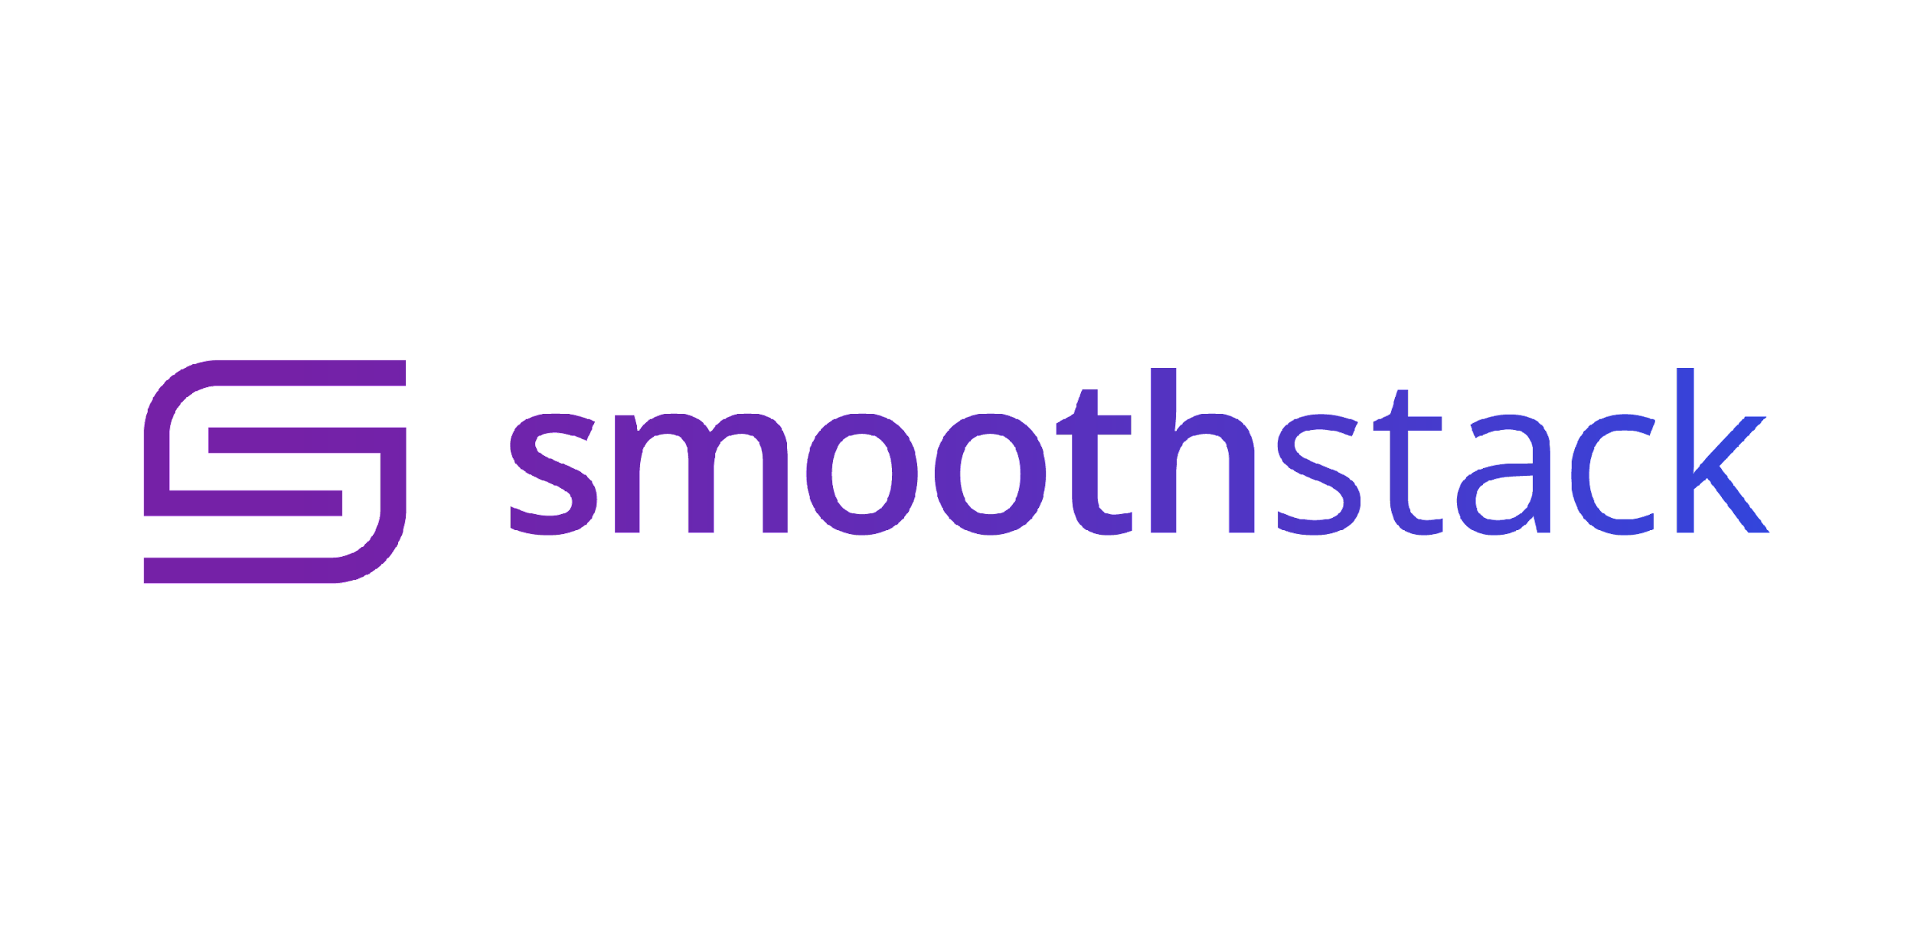
Instructor
Austin French
Austin.french@smoothstack.com
Python Cloud Day 2
learn.smoothstack.com

Slide 2
Learning Objectives
Functional VS Object Oriented Programming
Modules and Packages
Creating Modules and Packages
Testing with Pytest and coverage
Pylint and PEP8 Style Guidelines

Slide 3
Functional VS OO
Functional programming is a programming paradigm that treats computation as the evaluation of mathematical functions and avoids changing-state and mutable data.
In functional programming, functions are first-class objects, which means that functions can be assigned to variables, passed as arguments to other functions, returned as the values from other functions, and can be included in data structures.
Object-oriented programming (OOP) is a programming paradigm based on the concept of "objects", which can contain data, in the form of fields, often known as attributes; and code, in the form of procedures, often known as methods.
There is significant diversity of OOP languages, but the most popular ones are class-based, meaning that objects are instances of classes, which also determine their types.

Slide 4
Modules and Packages
A module is a file containing Python definitions and statements.
The file name is the module name with the suffix .py appended.
A package is a collection of modules.
A package must contain a special file called __init__.py, which can be empty. This file indicates that the directory it contains is a Python package, so it can be imported the same way a module can be imported.

Slide 5
Pytest and Coverage
Pytest is a testing framework that makes it easy to write small tests, yet scales to support complex functional testing for applications and libraries.
To install Pytest and coverage use pip ( pythons package manager )
Pip install pytest pytest-cov
Coverage is a tool for measuring code coverage of Python programs. It monitors your program, noting which parts of the code have been executed, then analyzes the source to identify code that could have been executed but was not.

Slide 6
Pylint and PEP8
pep8 is a style guide for Python code. It is a set of recommendations about how to write Python code that is more readable and consistent.
pylint is a Python source code analyzer. It looks for programming errors, helps enforcing a coding standard, sniffs for code smells and offers simple refactoring suggestions.
Install pylint with pip:
pip install pylint

