Slide 1
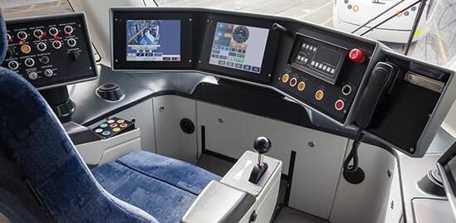
COMPUTERS IN TRANSPORTATION
By: Skyler French

Slide 2
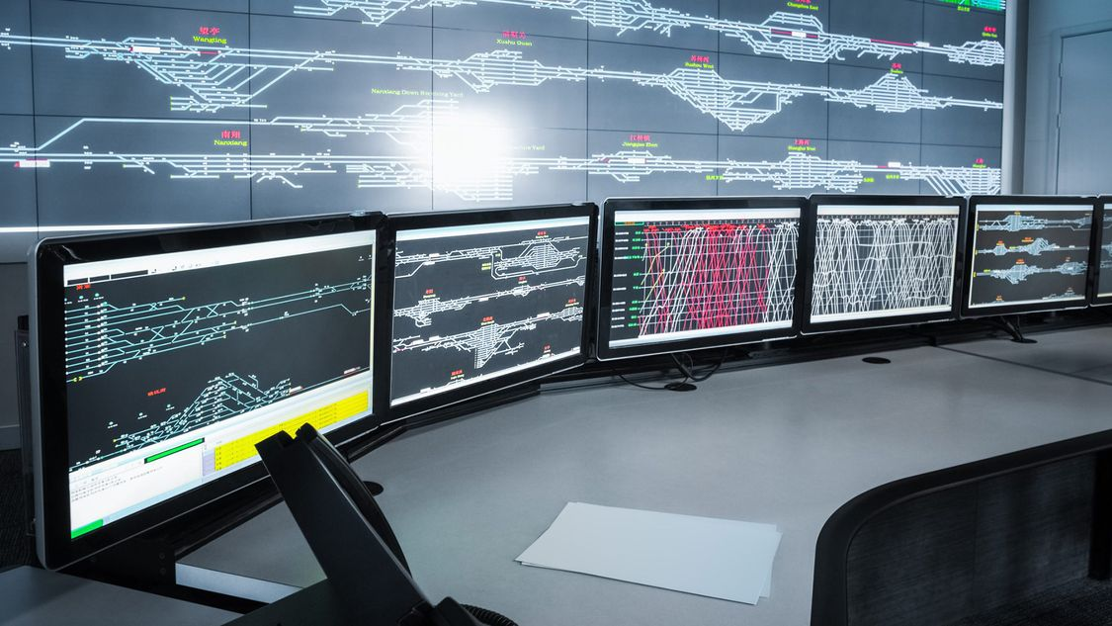
WHAT ARE COMPUTER SYSTEMS IN TRANSPORTATION?
Public Transit Scheduling and Tracking
Sensors & GPS Devices: For tracking vehicles, traffic flow, and environmental conditions.
Control Systems: Such as adaptive traffic signals, smart toll booths, and automatic train controls.
Software Platforms: Used for logistics, navigation, fleet management, and scheduling.
Communication Networks: Like 5G and vehicle-to-infrastructure (V2I) systems that enable fast, real-time data exchange.
These computer systems help reduce delays, fuel usage, and emissions, while improving reliability and safety across transportation networks. They're essential to building smarter, greener mobility solutions.

Slide 3
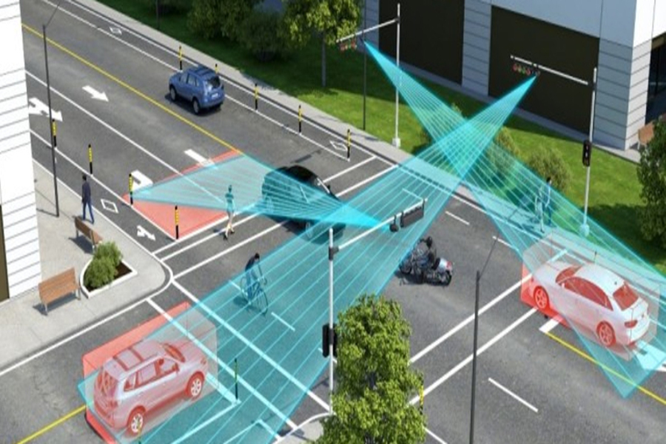
INTELLIGENT TRAFFIC MANAGEMENT
Intelligent Traffic Management Systems (ITMS) use advanced computer technologies to monitor, control, and optimize traffic flow in real time.
Reduced Congestion: Real-time adjustments ease traffic during rush hours.
Lower Emissions: Less idling means fewer greenhouse gases.
Improved Road Safety: Faster detection and response to hazards.
Time Savings: Drivers reach their destinations faster and more reliably.
Key Features Incldue Real-Time Traffic Monitoring, Adaptive Traffic Signals, Incident Detection & Response, Smart Toll Collection, and Vehicle-to-Infrastructure (V2I) Communication.

Slide 4
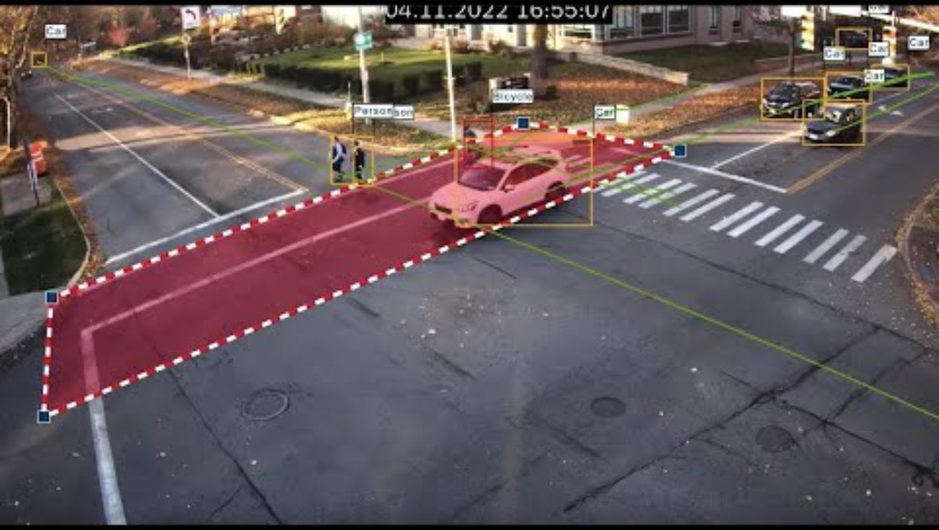
SENSORS AND GPS DEVICES
These type of technologies help monitor real-time conditions, guide vehicle movement, and collect valuable data for decision-making.
Traffic Flow Sensors: Installed on roads or intersections to count vehicles, measure speed, and detect congestion.
Environmental Sensors: Monitor air quality, weather, and road conditions like ice or flooding.
Vehicle Sensors: Found in modern cars and trucks to monitor tire pressure, engine health, and fuel usage.
Fleet Tracking: Businesses use GPS to track delivery trucks, buses, or taxis in real time for better coordination.
Geofencing: Creates virtual boundaries for vehicles—useful in logistics and autonomous transport.

Slide 5
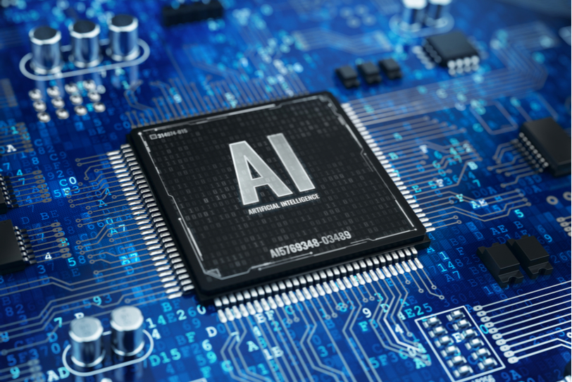
ARTIFICIAL INTELLIGENCE
Artificial Intelligence (AI) is the core technology that powers autonomous (self-driving) vehicles. It enables cars to perceive their environment, make decisions, and navigate roads safely—all without human intervention.
AI powers self-driving cars, trucks, and drones by interpreting sensor data, GPS signals, and road conditions.
It analyzes live traffic data to adjust signal timing, reduce congestion, and improve vehicle flow.
uses machine learning to monitor vehicle performance and predict mechanical failures before they happen.
AI algorithms optimize delivery routes, loading schedules, and warehouse operations.

Slide 6
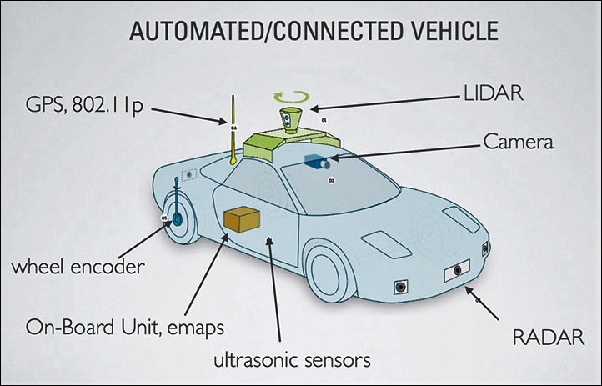
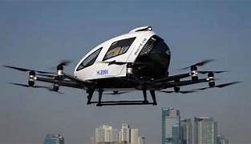
AI IN AUTONOMOUS CARS
Computer vision: Processes camera images to detect lanes, signs, lights, pedestrians, and other vehicles.
Sensor fusion: Combines data from LiDAR, radar, ultrasonic sensors, and cameras for a 3D view of the world.
​China is at the forefront of developing AI-powered autonomous flying taxis, with companies like EHang and AutoFlight leading the charge in the electric vertical takeoff and landing (eVTOL) sector.
Cruise & Zoox: Focus on urban AVs with heavy AI for dense traffic environments.

Slide 7
PUBLIC TRANSPORTATION
Electronic ticketing systems replace traditional paper tickets or cash payments with digital methods of fare collection.
Fare Media:
Smart cards (e.g., Oyster in London, Octopus in Hong Kong)
Mobile Apps
Ticket Validators & Gates:
Installed on buses, trams, trains, or metro gates.
Scan cards, apps, or QR codes to validate rides.
Back-End System:
Handles payment processing, fare calculation, and data analytics.
Tracks ridership patterns and manages fare capping, discounts, or passes.

Slide 8
BENEFITS OF PUBLIC TRANSPORTATION
Environmental Benefits
Reduces greenhouse gas emissions: Buses, trains, and trams carry many people at once, which means fewer cars on the road and lower CO₂ emissions per person.
Decreases air pollution: Public transport helps reduce pollutants like nitrogen oxides and particulate matter that come from private vehicles.
Traffic & Infrastructure Benefits
Reduces traffic congestion: Fewer private cars = less traffic.
Lowers road maintenance costs: Less wear and tear on roads from heavy traffic.
Saves money: Public transport is generally cheaper than owning and maintaining a private vehicle.
Improves accessibility: Essential for people who can’t drive due to age, income, or disability.

Slide 9
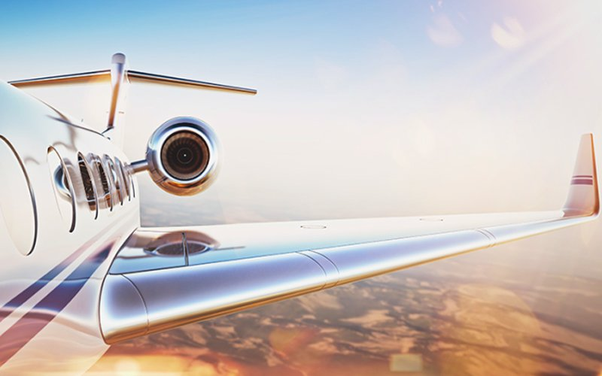
AIR SYSTEMS
Air Traffic Control (ATC): Guides aircraft during takeoff, flight, and landing.
Airspace Management (ASM): Allocates and organizes airspace usage.
Radar & ADS-B (Automatic Dependent Surveillance–Broadcast): Real-time aircraft position tracking.
A-SMGCS (Advanced Surface Movement Guidance and Control System): Used at airports for ground traffic monitoring.
Modern aircraft use advanced autopilot and avionics systems that manage many aspects of flying:
Autopilot (AFCS): Controls flight paths, altitude, and speed automatically.
Collision Avoidance Systems (TCAS): Warns pilots of potential mid-air collisions.
Fly-by-wire systems: Replaces manual flight controls with electronic interfaces.

Slide 10
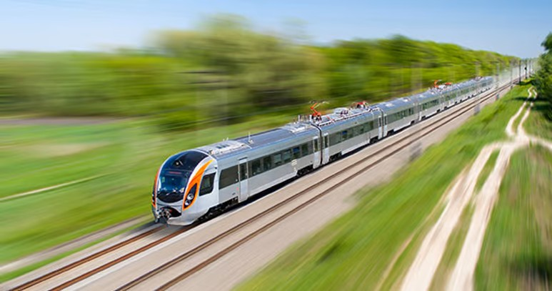
RAIL SYSTEMS
Modern railways are increasingly automated, ranging from partial automation (driver-assisted) to fully autonomous trains.
Levels of Train Automation (GoA – Grades of Automation):
GoA 0: Manual operation
GoA 1: Manual with automatic train protection (ATP)
GoA 2: Semi-automatic; driver starts/stops, system controls movement
GoA 3: Driverless with onboard staff
GoA 4: Fully autonomous (e.g., Dubai Metro, Paris Metro Line 14)
CBTC (Communication-Based Train Control): Allows real-time train tracking and control, increasing safety and efficiency.
ETCS (European Train Control System): Standardized control system for European railways.
PTC (Positive Train Control – USA): Prevents collisions, derailments, and unauthorized train movements.
Track-side sensors & IoT: Monitor tracks, train wheels, and environmental conditions.

Slide 11
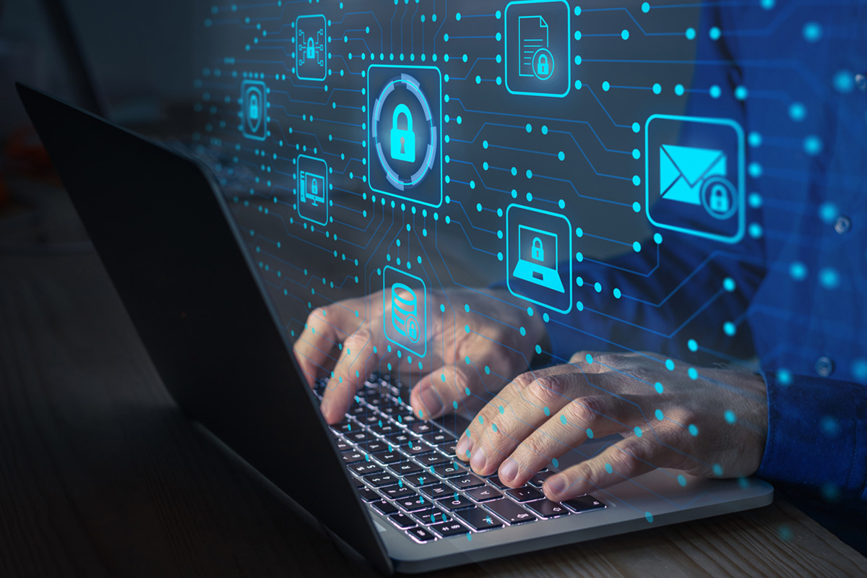
CHALLNGES AND CONCERNS
Software bugs & glitches: Errant code in control systems (e.g., rail signaling or avionics) can lead to service disruptions or, in worst cases, accidents.
System failures: Single points of failure (e.g., a central traffic‐management server) can cascade, causing city‑wide gridlock or grounding fleets.
Hacking & ransomware: Mass transit and air‐traffic networks are high‑value targets. A breach can not only disrupt service but also endanger lives (e.g., maliciously altering signal timings).
Biometric ID: Facial‐recognition turnstiles or license‐plate readers improve convenience but risk misuse of sensitive personal information.
Fragmented regulations: Varying technical standards across regions force operators to maintain multiple system versions.
Ongoing lifecycle costs: Licensing fees, support contracts, and regular upgrades can strain transit‑agency budgets.

Slide 12
FUTURE OF TRANSPORTATION TECHNOLOGY
V2X Communication (Vehicle-to-Everything)
Vehicles will communicate with other vehicles, infrastructure (like traffic lights), pedestrians, and even the cloud to improve safety and reduce congestion.
Mobility-as-a-Service (MaaS)
One app to plan, book, and pay for all your travel—buses, trains, taxis, e-scooters, etc.—with dynamic pricing and personalized routes.
Autonomous public transport
Shuttles and trains will operate without drivers, enhancing efficiency and reducing costs.
Electric Vehicles (EVs)
A shift from gasoline to electric cars, buses, scooters, and bikes, driven by lower emissions and better batteries.
Hyperloop
Vacuum-tube trains by Virgin Hyperloop and others aim to transport passengers at speeds over 1000 km/h.
Digital Twins
Cities create virtual replicas of transit systems to simulate and optimize operations in real-time.

Slide 13
REFERENCES
Transportation Automation Computer Solutions WinSystems. (2024, December 17). WINSYSTEMS. https://winsystems.com/transportation/
Greenip Services. (n.d.). Intelligent Traffic Management System – GREENIP. Retrieved April 16, 2025, from https://greenipservices.com/intelligent-traffic-management-system/
Siemens. (n.d.). Communications-Based train Control System. Siemens Mobility Global. Retrieved April 16, 2025, from https://www.mobility.siemens.com/global/en/portfolio/rail-infrastructure/mass-transit/communications-based-train-control-system.html
Bosch Security and Safety Systems. (2023, March 14). Bosch Video-as-a-Sensor Solutions for Intelligent Transportation Systems (ITS) [Video]. YouTube. https://www.youtube.com/watch?v=CVG7_ymt_QQ
Consumer Reports Top-Rated Active Driving Assistance System. (n.d.). Ford Motor Company. Retrieved April 16, 2025, from https://www.ford.com/technology/bluecruise/?searchid=579918131|1309519483915293|81845219427429&searchid=579918131|1309519483915293|kwd-81845219427429:loc-190&fcid=pse_579918131_bing&s_kwcid=AL!2519!10!81845023983758!!!!81845219427429!!579918131!1309519483915293&ef_id=9ece855db31f17293790e2a25e5b0626:G:s&gclid=9ece855db31f17293790e2a25e5b0626&gclsrc=3p.ds
Rowley, M. (2022, May 18). Privacy issues in Cybersecurity: An Overview. Columbia Southern University. https://www.columbiasouthern.edu/blog/blog-articles/2022/may/privacy-issues-in-cyber-security/
Kumar, A. (n.d.). Intelligent rail systems – Options for safer and efficient operations. TATA ELXSI. https://www.tataelxsi.com/insights/intelligent-rail-systems-options-for-safer-and-efficient-operations
Glenair. (2022, January 26). Interconnects and the Evolution of Modern Flight Systems. TTI. https://www.tti.com/content/ttiinc/en/resources/market---technology-resource-centers/military-aerospace/mil-aero-resources/interconnects-and-the-evolution-of-modern-flight-systems.html

