Slide 1
AbeBooks Sign On GUI Prototype

Slide 2
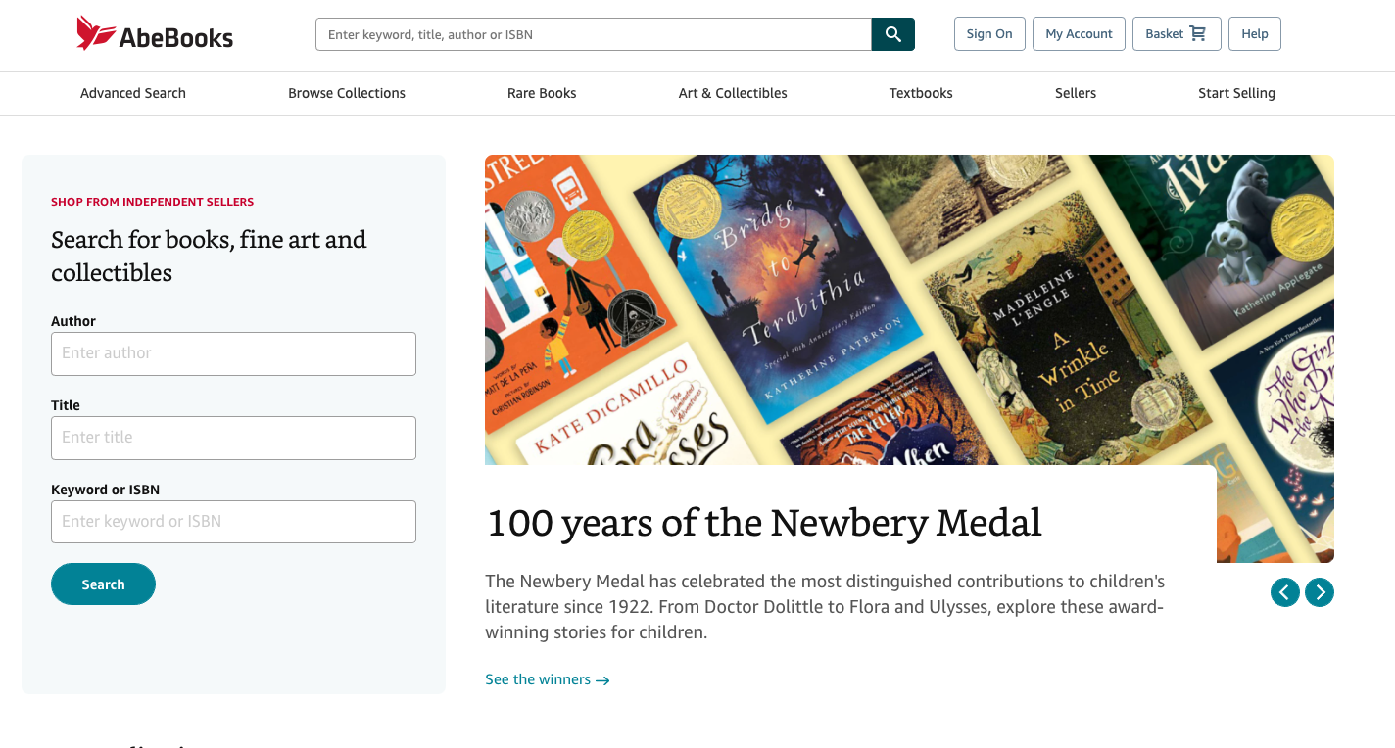
“Sign On” Use Case
User clicks on Sign On from the AbeBooks.com homepage

Slide 3
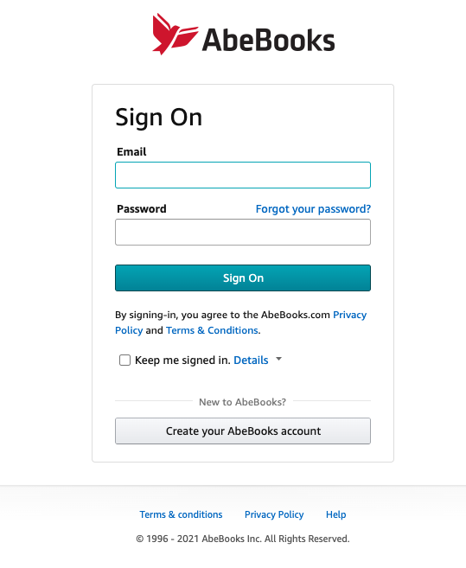
The system brings the user to the Sign On page.

Slide 4
The user enters in their account email address and password.
The user optionally selects “Keep me signed in”.
The user then clicks “Sign On”
The system checks that the username and password are both correct, and signs the user into the website. If the user has selected “keep me signed in”, the website will keep the user signed in for future visits. After authentication, the website will return the user to the home page.

Slide 5
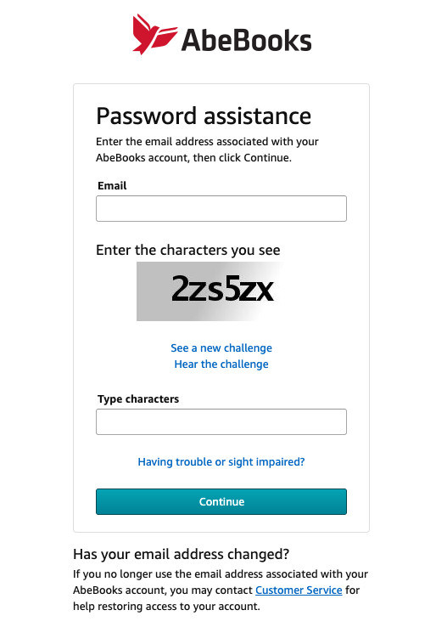
If the user selects [Forgot your password?], the user is redirected to a password change page.

Slide 6
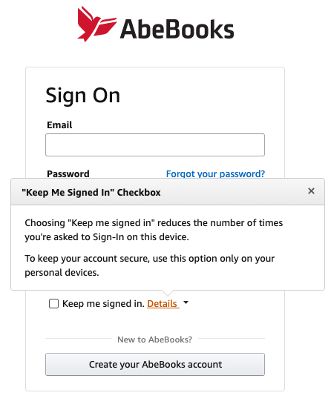
If the user selects [Details], the user is presented with an information pop-up describing the the “keep me signed in” functionality.

Slide 7
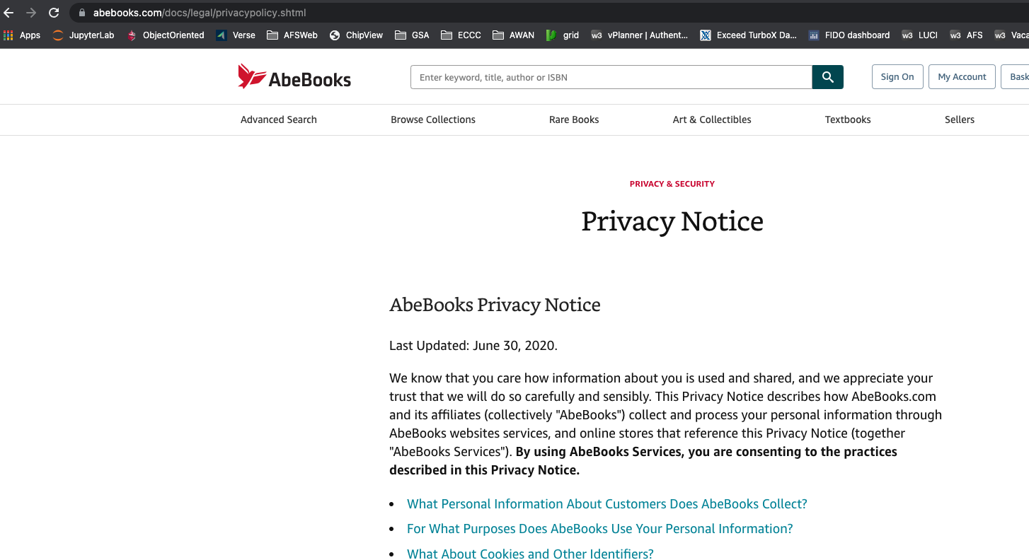
If the user selects [Privacy Policy], the user is redirected to AbeBooks’ privacy policy page.

Slide 8
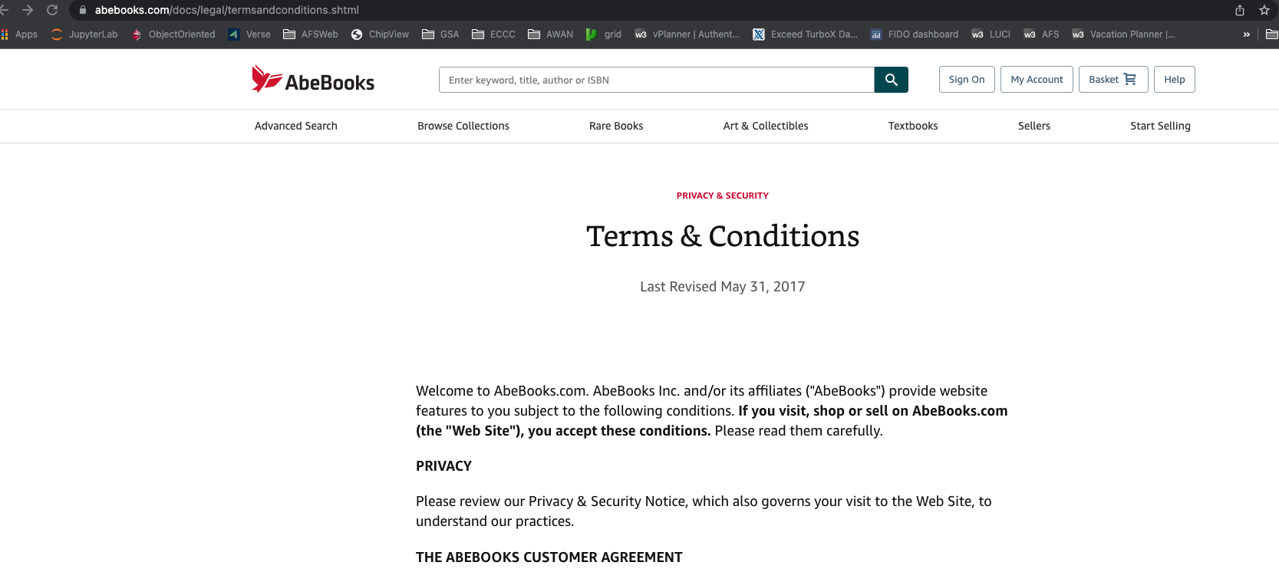
If the user selects [Terms and Conditions], the user is redirected to AbeBooks’ terms and conditions page.

Slide 9
Sign On Alternate Use Case
Alternate Courses
If the user has not typed anything into the email or password text fields, or has entered invalid characters into the text fields, selecting Sign On triggers an error indicating the invalid or missing data. The user is not redirected, and any text in the fields are not cleared. This enables the user to correct the invalid or missing email/password to attempt to sign in again.
If the user enters an incorrect email and password combination, after selecting Sign On, the user is presented with a “failed to sign on” error, indicating to the user that either the username or password is incorrect. The text in the email and password fields is cleared, and the user remains on the Sign On page allowing them to attempt to sign on again.
If the user fails to enter a correct email and password <n> number of times, the user will be warned that they have <x> number of more tries before the account will be frozen. The error will also provide a link to the “[Forgot your password?]” page. The text in the email and password fields are cleared, and the user remains on the Sign On page allowing them to attempt to sign on again.
After <y> number of failed tries to Sign On, the user’s account is temporarily frozen from additional Sign On attempts. This information is conveyed to the user in a warning. An email is sent to the account email indicating that it is temporarily locked, as a warning in case the failed Sign On attempts are not from the owner of the account.

