Slide 1
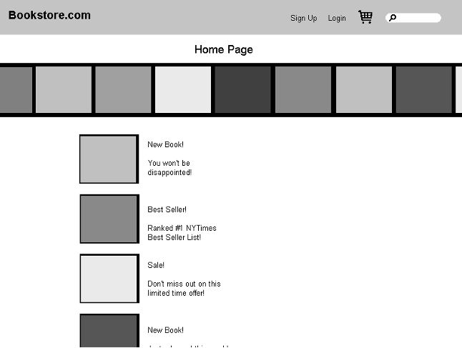
Basic Course
The Customer clicks the Log In button on the Home Page.

Slide 2
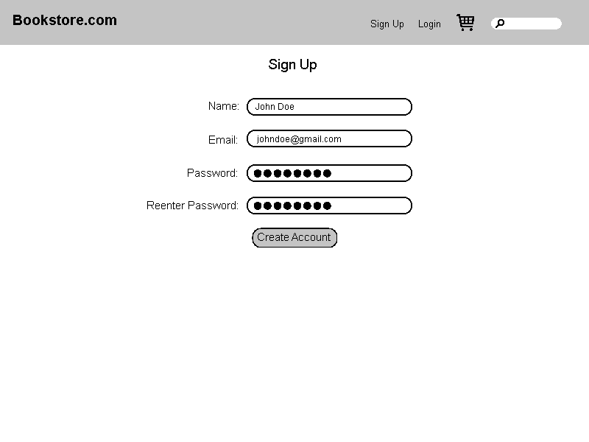
Basic Course: Log In (continued)
The system displays the Login Page. The Customer enters his or her user ID and password and then clicks the Log In button.
Log In
Log in
Create new account
Reminder word

Slide 3
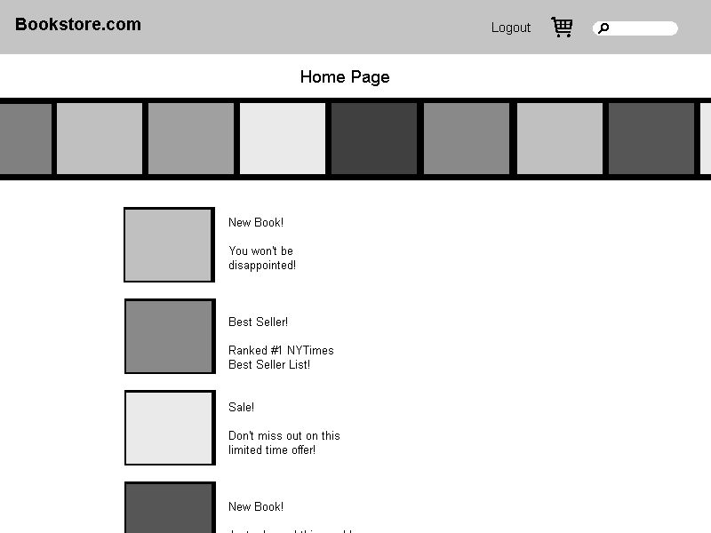
Basic Course: Log In (continued)
The system validates the login information against the persistent Account data and then returns the Customer to the Home Page.

Slide 4
Alternate Courses: Log in
If the Customer clicks the [New Account] button on the Login Page, the system invokes the Open Account use case.
Log In
Log in
Create new account
Reminder word

Slide 5
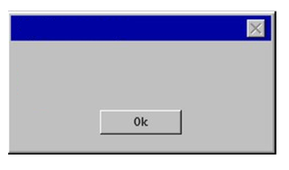
Alternate Courses: Log in
If the Customer clicks the [Reminder Word] button on the Login Page, the system displays the reminder word stored for that Customer, in a separate dialog box. When the Customer clicks the OK button, the system returns the Customer to the Login Page.
Password Reminder
Log In
Reminder: “foobar”
Log in
Create new account
Reminder word

Slide 6
Alternate Courses: Log in
If the Customer enters a user ID that the system does not recognize, the system displays a message to that effect and prompts the Customer to either enter a different ID or click the New Account button.
Log In
Does_not_exist@fake.com
Account does not exist. Please re-enter or create a new account.
Log in
Create new account
Reminder word

Slide 7
Alternate Courses: Log in
If the Customer enters an incorrect password, the system displays a message to that effect and prompts the Customer to reenter his or her password.
Log In
Does_not_exist@fake.com
Password is not correct. Please re-enter password.
Log in
Create new account
Reminder word

Slide 8
Alternate Courses: Log in
If the Customer enters an incorrect password three times, the system displays a page telling the Customer that he or she should contact customer service, and also freezes the Login Page.
Attention:
This account is temporarily frozen due to multiple failed log in attempts. Please contact customer service for assistance unlocking your account.

