Slide 1
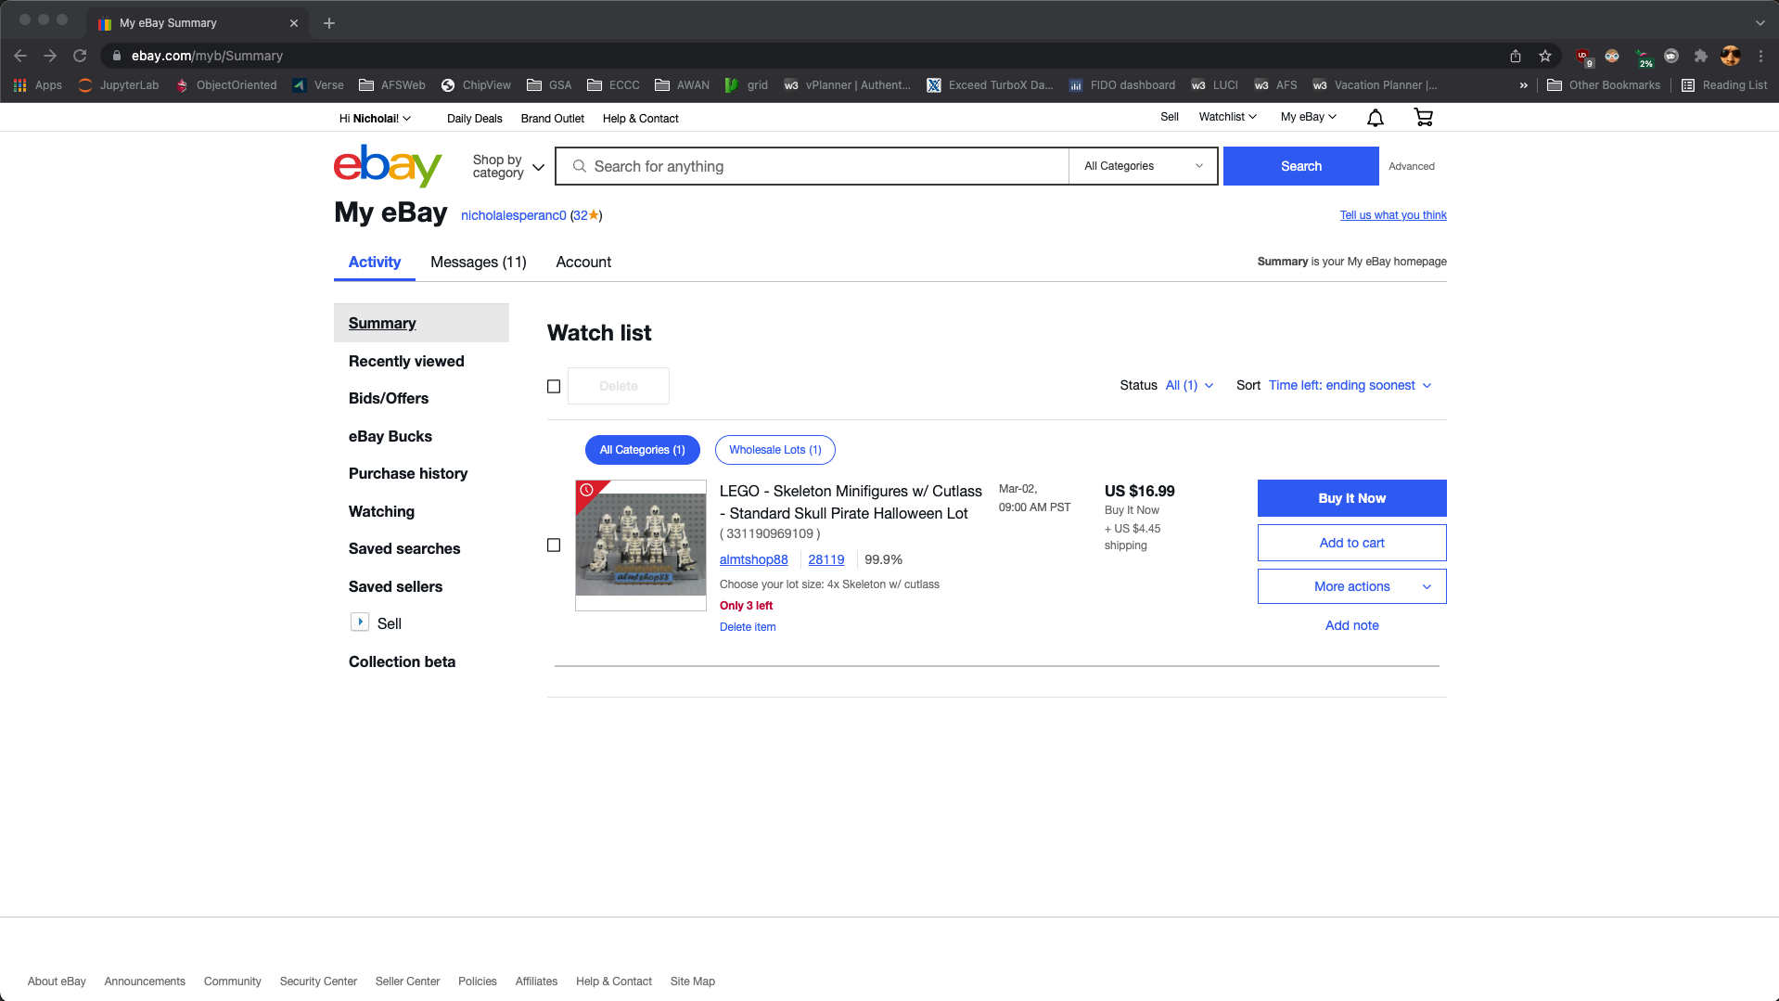
Step 1: Sign in, and get to “My eBay” page

Slide 2
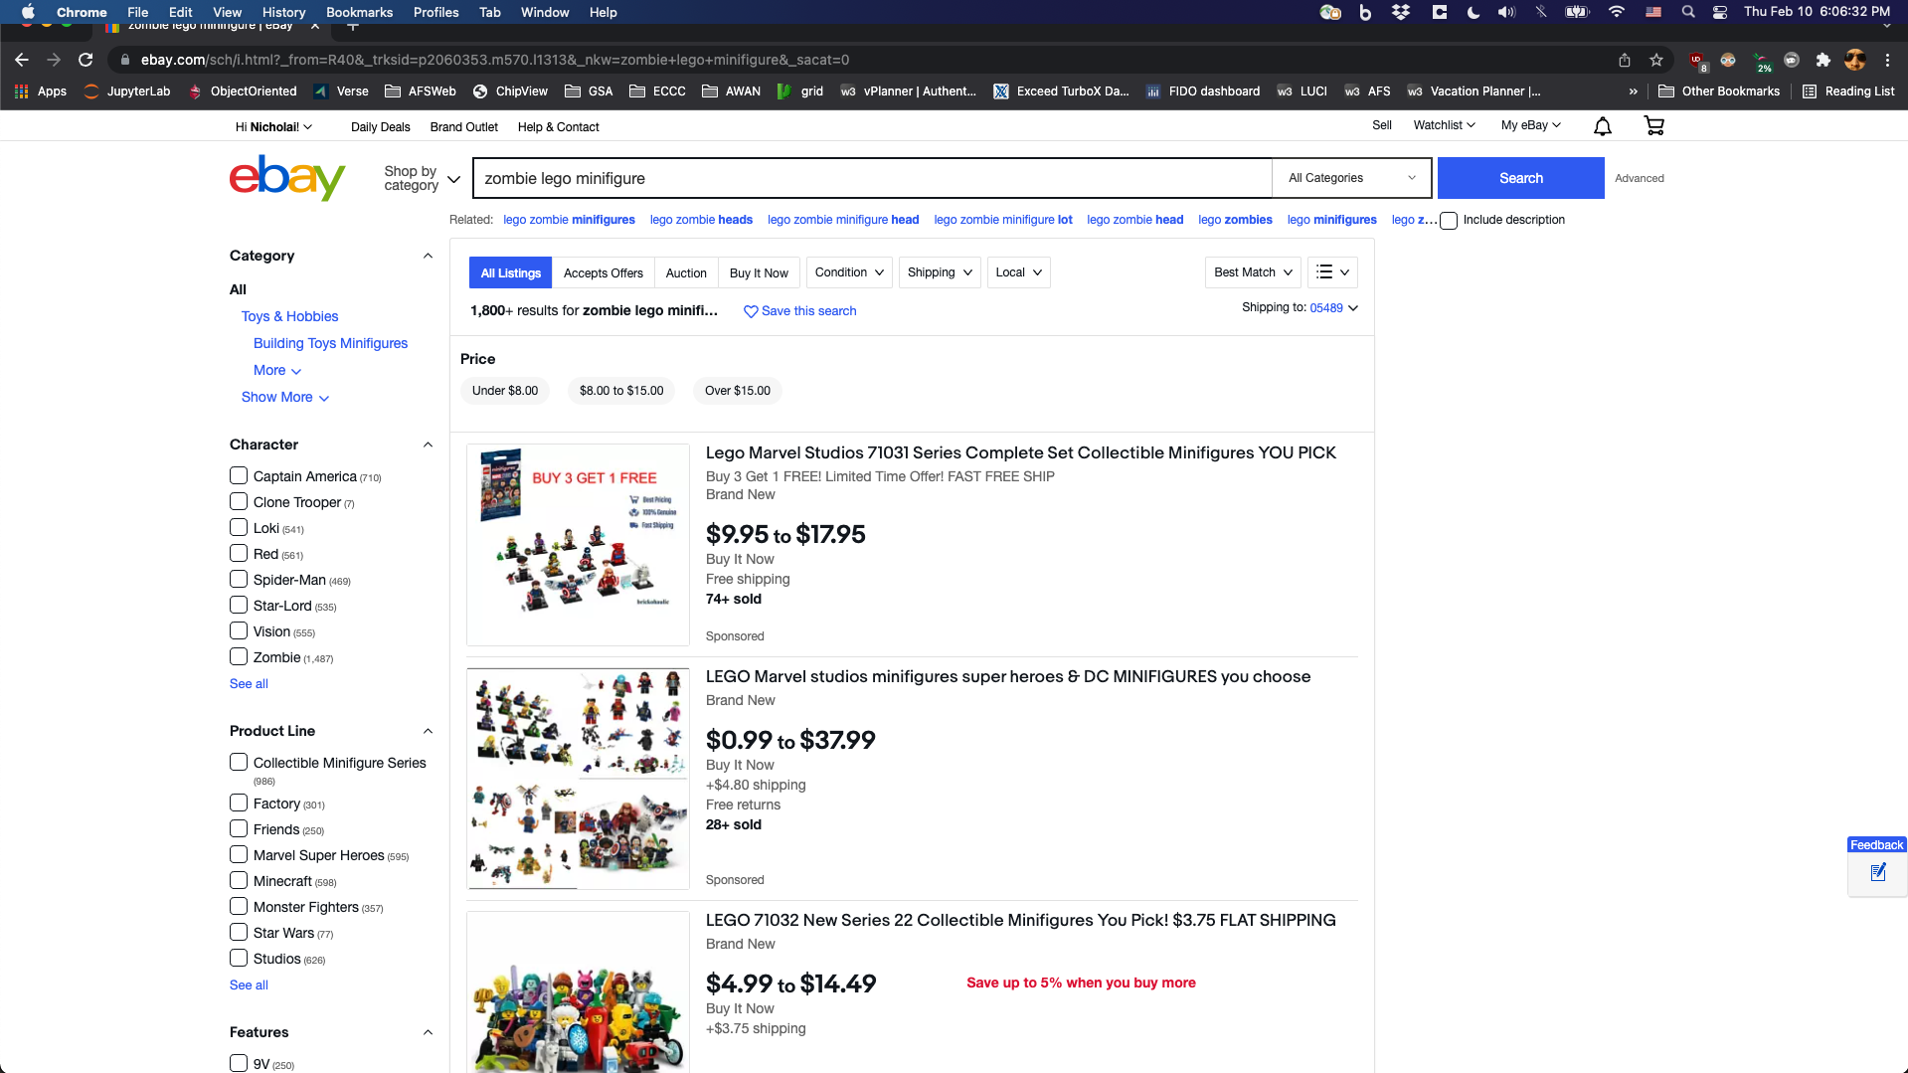
Step 2: Perform a search with several keywords

Slide 3
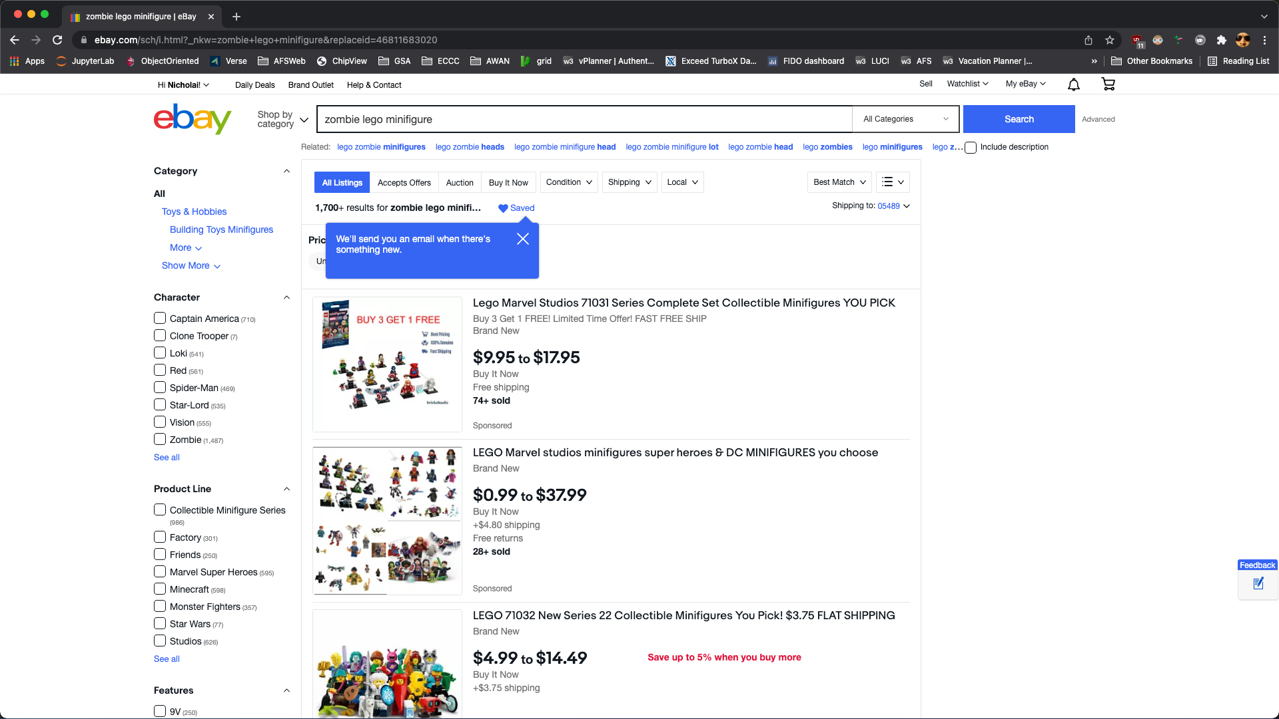
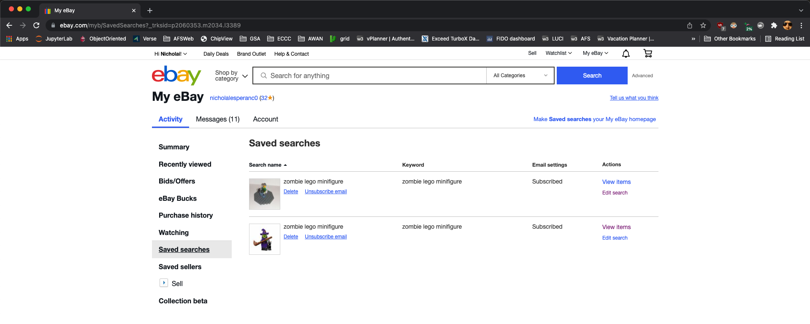
Step 3: Save the search, using desired parameters
NOTE: ebay appears to have removed the ability to set parameters on saved searches.
Even on the “Saved Searches” page, you can not set/save search parameters. You can only edit the keywords.

Slide 4
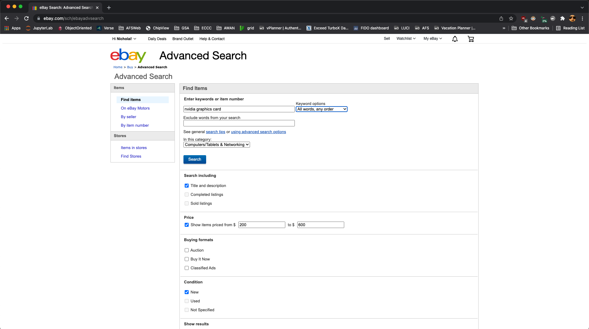
Step 4: Perform an advanced search

Slide 5

Email 1

Slide 6

Email 2

