Slide 1
Programming Logic and Design
Sixth Edition
103 – Basic Data Processing
Period – 1
Overview of Computer and Programming

Slide 2
Objectives
In this chapter, you will learn about:
Computer systems
Simple program logic
The steps involved in the program development cycle
Pseudocode statements and flowchart symbols
Using a sentinel value to end a program
Programming and user environments
The evolution of programming models
Faculty of Computer Science

Slide 3
Understanding Computer Systems
Computer system
  Combination of all the components required to process and store data using a computer
Hardware
  Equipment or physical devices associated with a computer
Software
  Computer instructions that tell the hardware what to do
  Software is programs: instructions written by programmers
Faculty of Computer Science

Slide 4
Understanding Computer Systems
(cont’d)
Computer hardware and software accomplish three major operations
  Input
    Data items enter the computer system and are put into memory .
  Processing
    By central processing unit (CPU)
  Output
    Display the results
Programming language
  Writing computer instructions in a computer
  Examples
    Visual Basic, C#, C++, or Java
Input
Processing
Output
Faculty of Computer Science

Slide 5
Understanding Computer Systems (cont’d)
Syntax
  Rules governing its word usage and punctuation
Computer memory
  Volatile : its contents are lost when the computer is turn off or loses power.
  Nonvolatile: their contents are persistent and are retained even when power is lost.
  Machine language
  - It is also called binary language and is represented as a series of 0s and 1s.
Faculty of Computer Science

Slide 6
Understanding Computer Systems (cont’d)
Compiler or an interpreter
  Translates program code into machine language (binary language)
  Checks for syntax errors
Program executes or runs
  Input will be accepted, some processing will occur, and results will be output
Faculty of Computer Science

Slide 7
Understanding Simple Program Logic
Program with syntax errors cannot execute
Logical errors
  Errors in program logic
  Produce incorrect output as a result
Logic of the computer program
  Sequence of specific instructions in specific order
Variable
  Named memory location whose value can vary
Faculty of Computer Science

Slide 8
Understanding the Program
Development Cycle
Program development cycle
  Understand the problem
  Plan the logic
  Code the program
  Use software (a compiler or interpreter) to translate the program into machine language
  Test the program
  Put the program into production
  Maintain the program
Faculty of Computer Science

Slide 9
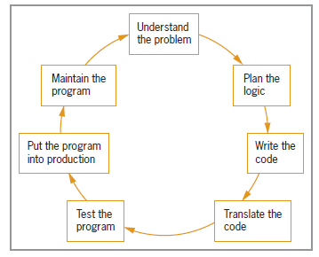
Understanding the Program
Development Cycle (continued)
Figure 1-1 The program development cycle
Faculty of Computer Science

Slide 10
1. Understanding the Problem
One of the most difficult aspects of programming
Users or end users
  Programmers are providing a service to these users
Documentation
Supporting paperwork for a program to help the programmer for understanding the problem.
Faculty of Computer Science
Notes:
Human Resources department that needs a printed list of all employees,
a Billing department that wants a list of clients who are 30 or more days overdue on their payments, and
an Order department that needs a Web site to provide buyers with an online shopping cart in which to gather their orders.
programmers are providing a service to these users, programmers must first understand what the users want.
Although when a program runs, you usually think of the logic as a cycle of input-processing-output operations;
when you plan a program, you think of the output first. After you understand what the desired result is, you can plan what to input and process to
achieve it.

Slide 11
2. Planning the Logic
Heart of the programming process
(Programming Logic and Design)
Most common planning tools
  Flowcharts
  Pseudocode
Desk-checking
  The process of walking through a program’s logic on paper before you actually write the program is called desk-checking.
Faculty of Computer Science

Slide 12
3. Coding the Program
After the logic is developed, only then the programmer write the program.
The logic developed to solve a programming problem can be executed using any number of languages.
Hundreds of programming languages are available
  Choose based on features
  Alike in their basic capabilities
  each language can handle input operations, arithmetic processing, output operations, and other standard functions.
Coding is easier than planning step
  Coding concerned with proper punctuation and the correct spelling of commands—in other words, using the correct syntax.
Faculty of Computer Science
Notes:
Which step is harder: planning the logic or coding the program?
Right now, it may seem to you that writing in a programming language is a very difficult task, considering all the spelling and syntax
rules you must learn. However, the planning step is actually more difficult.
Which is more difficult: thinking up the twists and turns to the plot of a best-selling mystery novel, or writing a translation of an
existing novel from English to Spanish? And who do you think gets paid more, the writer who creates the plot or the translator? (Try
asking friends to name any famous translator!)

Slide 13
4. Using Software to Translate the Program into Machine Language
Why we need software (program coding) to translate?
  Each computer knows only one language: its machine language, which consists of 1s and 0s.
Translator program
  Called “Compiler” or “interpreter”
  Changes the programmer’s English-like high-level programming language into the low-level machine language
  Produces the executable program only when the code is free of syntax errors.
Syntax error
  Misuse of a language’s grammar rules
  Programmer corrects listed syntax errors
  Might need to recompile the code several times to get the executable program
Faculty of Computer Science
Notes:
If you write a programming language statement incorrectly (for example, by misspelling a word, using a word that doesn’t exist in the language, or using “illegal” grammar),
the translator program doesn’t know how to proceed and issues an error message identifying a syntax error, which is a misuse of a language’s grammar rules. Although making errors is never desirable, syntax errors are not a major concern to programmers, because the compiler or interpreter catches every syntax error and displays a message that notifies you of the problem. The computer will not execute a program that contains even one syntax error.

Slide 14
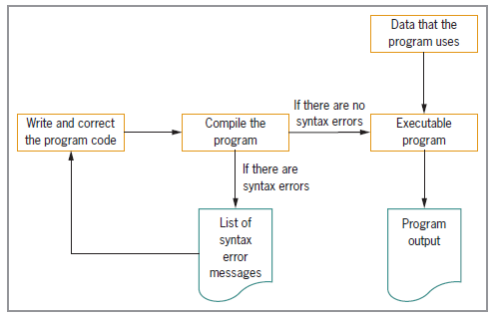
4. Using Software to Translate the Program into Machine Language (cont’d)
Figure 1-2 Creating an executable program
Programming Logic & Design, Sixth Edition
Notes:
Typically, a programmer develops a program’s logic, writes the code, and compiles the program, receiving a list of syntax errors. The programmer then corrects the syntax errors and compiles the program again. Correcting the fi rst set of errors frequently reveals new errors that originally were not apparent to the compiler.

Slide 15
5. Testing the Program
A program that is free of syntax errors is not necessarily free of logical errors.
Logical error
  Use a syntactically correct statement but use the wrong one for the current context
The process of finding and correcting program errors is called debugging.
Testing
  Execute/run the program with some sample data to see whether the results are logically correct
Programs should be tested with many sets of data
Programming Logic & Design, Sixth Edition

Slide 16
6. Putting the Program into Production
Once the program is tested adequately, it is ready for use.
Putting the program into production might mean simply running the program once, if it was written to satisfy a user’s request for a special list.
Process depends on program’s purpose
  May take several months
Conversion
  Entire set of actions an organization must take to switch over to using a new program or set of programs
  For example,
    data-entry people must be trained to prepare the input for the new program;
    users must be trained to understand the output; or
    existing data in the company must be changed to an entirely new format to accommodate this program.

Slide 17
7. Maintaining the Program
Maintenance
  Making changes after program is put into production
Common first programming job
  Maintaining previously written programs
Make changes (or) add new functions to existing programs
  Repeat the development cycle
Faculty of Computer Science

Slide 18
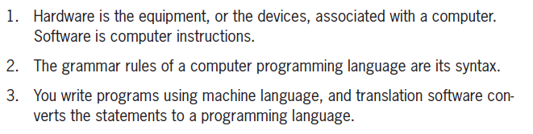
Which statements are true?
Faculty of Computer Science

Slide 19
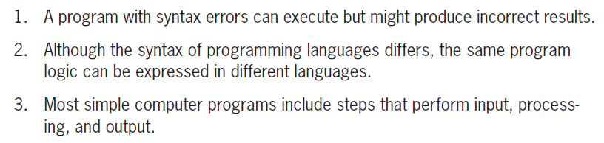
Which statements are true?
Faculty of Computer Science

Slide 20
Which statements are true?
Understanding the problem that must be solved can be one of the most difficult aspects of programming.
The two most commonly used logic-planning tools are flowcharts and pseudocode.
Flowcharting a program is a very different process of you use an older programming language instead of a newer one.
Faculty of Computer Science

Slide 21
PROGRAMMING LOGIC AND DESIGN
Step 1 : Understanding the Problem
Step 2 : Planning the Logic

Slide 22
Using Pseudocode Statements and Flowchart Symbols
Pseudocode
  English-like representation of the logical steps it takes to solve a problem
Flowchart
  Pictorial representation of the logical steps it takes to solve a problem
Faculty of Computer Science

Slide 23
Writing Pseudocode
Pseudocode representation involves
  writing down all the steps you will use in a program.
  Pseudocode representation of a number-doubling problem
  beginning statement like start and end it with a terminating statement like stop
  Pseudocode is fairly flexible because it is a planning tool
  start
    input myNumber
    set myAnswer = myNumber * 2
    output myAnswer
  stop
Faculty of Computer Science
Notes:
the pseudocode statements are instructions to retrieve an original number from an input device and store it in memory where it can be used in a calculation, and then to get the calculated answer from memory and send it to an output device so a person can see it.

Slide 24
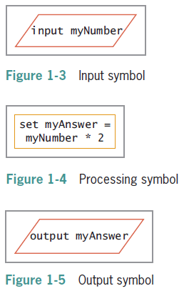
Drawing Flowcharts
Input symbol
  Indicates input operation
  Parallelogram
Processing symbol
  Processing statements such as arithmetic
  Rectangle
Output symbol
  Represents output statements
  Parallelogram
  Because the parallelogram is used for both input and output, it is often called the input/output symbol or I/O symbol.
Faculty of Computer Science

Slide 25
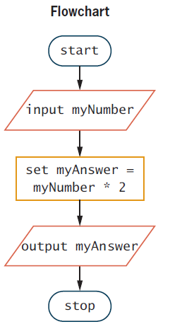
Drawing Flowcharts (continued)
Flowlines
  Arrows that connect steps
Terminal symbols
  Start/stop symbols
  Shaped like a racetrack
  Also called lozenge
Faculty of Computer Science

Slide 26
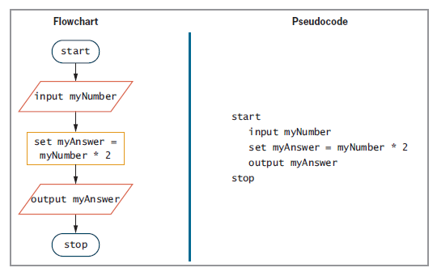
Drawing Flowcharts (continued)
Figure 1-6 Flowchart and pseudocode of program that doubles a number
Faculty of Computer Science

Slide 27
Which statements are true?
When you draw a flowchart, you use a parallelogram to represent an input operation.
When you draw a flowchart, you use a parallelogram to represent a processing operation.
When you draw a flowchart, you use a parallelogram to represent an output operation.
Faculty of Computer Science

Slide 28
Exercises
Draw a flowchart and write pseudo code to represent the logic of a program which will calculate area of the circle using the formula area=pi * radius * radius (pi = 3.142)
Draw a flowchart and write pseudo code to represent the logic of a program for the square and cube of any number input.
Draw a flowchart and write pseudo code to represent the logic of a program to input two sides of a rectangle. Calculate the area of the rectangle and print out the answer.
Draw a flowchart or write pseudocode to represent the logic of a program that allows the user to enter a value. The program multiplies the value by 10 and outputs the result.
Draw a flowchart or write pseudocode to represent the logic of a program that allows the user to enter a value for the radius of a circle. The program calculates the diameter by multiplying the radius by 2, and then calculates the circumference by multiplying the diameter by 3.14. The program outputs both the diameter and the circumference.
Faculty of Computer Science

Slide 29
Exercises(Cont’d)
Draw a flowchart or write pseudocode to represent the logic of a program that allows the user to enter two values. The program outputs the sum of the two values.
Draw a flowchart or write pseudocode to represent the logic of a program that allows the user to enter three values. The values represent hourly pay rate, the number of hours worked this pay period, and percentage of gross salary that is withheld. The program multiplies the hourly pay rate by the number of hours worked, giving the gross pay. Then, it multiplies the gross pay by the withholding percentage, giving the withholding amount. Finally, it subtracts the withholding amount from the gross pay, giving the net pay after taxes. The program outputs the net pay.
Draw a flowchart or write pseudocode to represent the logic of a program that allows the user to enter two values. The program outputs the product of the two values.
Draw a flowchart or write pseudocode to represent the logic of a program that allows the user to enter values for the width and length of a room’s floor in feet. The program outputs the area of the floor in square feet.
Faculty of Computer Science

Slide 30
Exercises (Cont’d)
Draw a flowchart or write pseudocode to represent the logic of a program that allows the user to enter values for the width and length of a wall in feet. The program outputs the area of the wall in square feet.
Modify the program that computes wall area to allow the user to enter the price of a gallon of paint. Assume that a gallon of paint covers 350 square feet of a wall. The program outputs the number of gallons needed and the cost of the job. (For this exercise, assume that you do not need to account for windows or doors, and that you can purchase partial gallons of paint.)
Programming Logic & Design, Sixth Edition

