Slide 1
Programming Logic and Design Sixth Edition
1103 – Basic Data Processing
Chapter - 2
Working with Data, Creating Modules, and Designing High-Quality Programs

Slide 2
Declaring and Using Variables and Constants
Data items in program has to deal with
All the text, numbers, and other information that are processed by a computer
Stored in variables in memory where they can be processed and converted to information that is output
Three Different forms of data storage in memory
Variables
Literals, or unnamed constants
Named constants

Slide 3
Working with Variables (cont’d)
Variables
Named memory locations whose contents can vary or differ over time
Variables must be declared before they are used in a program for the first time
Declaration
Statement that provides a data type and an identifier for a variable
Identifier is a variable’s name
A data item’s data type is a classification that describes the following:
What values can be held by the item
How the item is stored in computer memory
What operations can be performed on the data item

Slide 4
Working with Variables (cont’d)
Naming Variables
Programmer chooses reasonable and descriptive names for variables
Programming languages have rules for creating identifiers
Variable names must be one word
contain letters, digits, hypens, underscores, or any other characters you choose, with the exception of spaces.
2. Variable names should have some appropriate meaning

Slide 5
Working with Variables (cont’d)
Camel casing
the variable starts with a lowercase letter and any subsequent word begins with an uppercase letter, is called camel casing— “hourlyWage”
Pascal casing
When the first letter of a variable name is uppercase, as in HourlyWage, the format is known as Pascal casing.

Slide 6
Understanding the Data Types of Variables
Variables can also be different data types:
Numeric variable (num)
Holds digits
Can perform mathematical operations on it
String variable (string)
Can hold text
Letters of the alphabet
Special characters such as punctuation marks
Assign data to a variable only if it is the correct type
Eg: set taxRate = 2.5
set inventoryItem = “ monitor “

Slide 7
Working with Variables (cont’d)
Initializing Variables
Declaring a starting value for any variable
For example, a valid declaration:
Garbage
If you declare a variable and do not initialize it, the variable contains an unknown value until it is assigned a value
A variable’s unknown value commonly called garbage
Identifier (variable name)
Data Type
num mySalary
num yourSalary = 14.55
string myName
string yourName = "Juanita"
Value
(a starting value)
initializing

Slide 8
Basic Data Type
Type | Storage size | Value range
char | 1 byte | -128 to 127 or 0 to 255
unsigned char | 1 byte | 0 to 255
signed char | 1 byte | -128 to 127
int | 2 or 4 bytes | -32,768 to 32,767 or -2,147,483,648 to 2,147,483,647
unsigned int | 2 or 4 bytes | 0 to 65,535 or 0 to 4,294,967,295
short | 2 bytes | -32,768 to 32,767
unsigned short | 2 bytes | 0 to 65,535

Slide 9
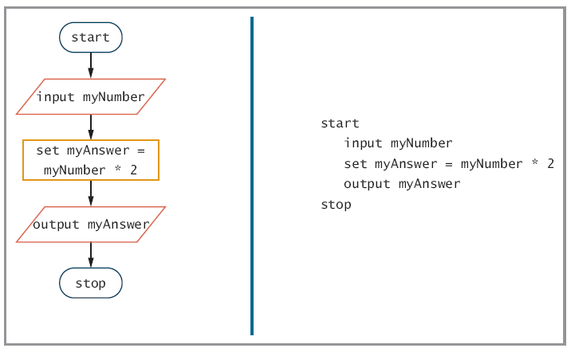
Working with Variables (cont’d)
Figure 2-1 Flowchart and pseudocode for the number-doubling program

Slide 10
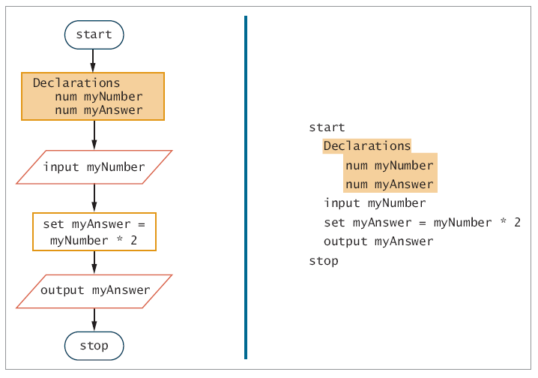
Declare Variable before they are used in the program
Variable contains garbage value
Figure 2-2 Flowchart and pseudocode of number-doubling program with variable declarations

Slide 11
Understanding Unnamed, Literal Constants and their Data Types
Numeric constant (or literal numeric constant)
Specific numeric value because it does not change - a 43 always has the value 43.
String constant (or literal string constant)
Specific text value or string of characters enclosed within quotation marks- “Amanda”.
Unnamed constants
Numeric constant and string constant

Slide 12
Declaring Named Constants
Named constant
Similar to a variable
Can be assigned a value only once
Assign a useful name to a value that will never be changed during a program’s execution
For example, if a program uses a sales tax rate of 6%, to declare a named constant as follows:
num SALES_TAX = 0.06
Then use SALES_TAX in a program statement again as in the following:
set taxAmount = price * SALES_TAX
Magic number
Unnamed constant
Purpose is not immediately apparent
Avoid this

Slide 13
Assigning Values to Variables
Assignment statement
set myAnswer = myNumber * 2
Assignment operator
Equal sign
Always operates from right to left
Valid
set someNumber = 2
set someNumber = someOtherNumber
set totalScore = test1 + test2
Not valid
set 2 + 4 = someNumber

Slide 14
Performing Arithmetic Operations
Standard arithmetic operators:
+ (plus sign) — Addition
− (minus sign) — Subtraction
* (asterisk) — Multiplication
/ (slash) — Division

Slide 15
Performing Arithmetic Operations (cont’d)
Rules of precedence
Also called the order of operations
Dictate the order in which operations in the same statement are carried out
Expressions within parentheses are evaluated first
Multiplication and division are evaluated next: from left to right
Addition and subtraction are evaluated next :from left to right

Slide 16
Performing Arithmetic Operations (cont’d)
For example
firstAnswer = 2 + 3 * 4 “14”
secondAnswer = (2 + 3) * 4 “20”
average = score1 + score2 / 2
average = (score1 + score2) / 2
totalPriceWithTax = price + price * TAX_RATE
totalPriceWithTax = price + (price * TAX_RATE)

Slide 17
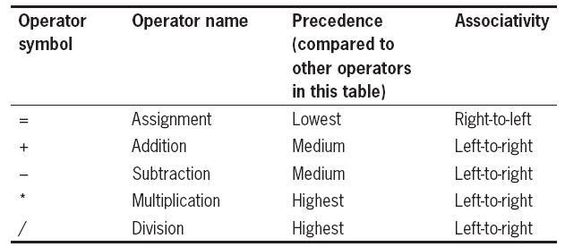
Performing Arithmetic Operations (cont’d)
Table 2-1 Precedence and associativity of five common operators

Slide 18
Performing Arithmetic Operations (cont’d)
Left-to-right associativity
Operations with the same precedence take place from left to right
For example,
answer = a + b + c * d / e – f
answer = 10 + 11 + 20 * 3 / 2 – 15
answer = a + b + (temporary result just calculated) - f

Slide 19
Performing Arithmetic Operations (cont’d)
Then, addition and subtraction are carried out from left to right as follows:
a and b are added, the temporary result is added, and then f is subtracted. The final result is then assigned to answer.
Another way to say this is that the following two statements are equivalent:
answer = a + b + c * d / e – f
answer = a + b + ((c * d) / e) - f

Slide 20
Modularizing a Program
Figure 2-3 Program that produces a bill using only main program

Slide 21
Modularizing a Program (cont’d)
Figure 2-4 Program that produces a bill using main program that calls displayAddressInfo() module

Slide 22
Modularizing a Program(cont’d)
The process of breaking down a large program into modules is called modularization.
Visual Basic programmers – procedure (subprocedure)
C, C++ programmers – function
C#, Java and other object-oriented programmer – method
COBOL, RPG, BASIC – subroutine
Programmers say the statements that are contained in a module have been encapsulated.
The more the statements contribute to the same job, the greater the functional cohesion of the module.

Slide 23
Modularizing a Program(cont’d)
Main program which contains the basic steps, or the mainline logic of the program.
To create the module-
A header – A module’s header includes the module identifier and possibly other necessary identifying information.
A body – A module’s body contains all the statements in the module.
A return statement – A module’s return statement marks the end of the module and identifies the point at which control returns to the program or module that called the module.

Slide 24
Modularizing a Program(cont’d)
There are at least three reasons for doing so:
Modularization provides abstraction.
The process of paying attention to important properties while ignoring nonessential details.
Modularization allows multiple programmer to work on a problem.
Modularization allows you to reuse your work more easily
The feature of modular programs that allows individual modules to be used in a variety of applications is known as reusability.
Reliability is the feature of programs that assures a module has been tested and proven to function correctly.
Reliable software saves time and money.

Slide 25
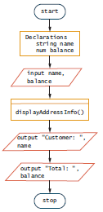
Declaring Variables and Constants within Modules
Figure 2-5 the billing program with constants declared within the module

Slide 26
Declaring Variables and Constants within Modules (cont’d)
Visibility and scope is important for variable declaration and constants within modules.
Variables and constants are local to the module in which they are declared.
Global variables and constants are known to the entire program (declared at the program level)

Slide 27
Creating Hierarchy Charts
Figure 2-11 Billing program hierarchy chart
Hierarchy chart that operates in a similar manner to show the overall picture of how modules are related to one another.
Blacken a corner of each box that represents a module used more than once.

Slide 28
Features of Good Program Design
Use program comments where appropriate
Identifiers should be well-chosen
Strive to design clear statements within your programs and modules
Write clear prompts and echo input
Continue to maintain good programming habits as you develop your programming skills

Slide 29
Features of Good Program Design
Program comments
Written explanations
Not part of the program logic
Serve as documentation for readers of the program
Syntax used differs among programming languages
In a flowchart, can use an annotation symbol to hold information that expands on what is stored within another flowchart symbol
An annotation symbol is most often represented by a three-sided box that is connected to the step it references by a dashed line.

Slide 30
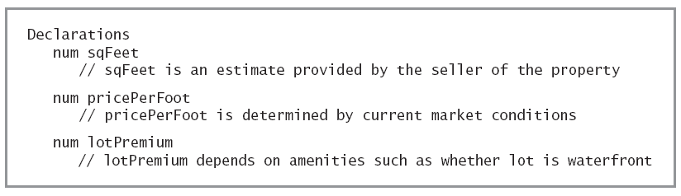
Features of Good Program Design (cont’d)
Figure 2-12 Pseudocode that declares some variables and includes comments

Slide 31
Features of Good Program Design (cont’d)
Figure 2-13 Flowchart that includes some annotation symbols

Slide 32
Writing Clear Prompts and Echoing Input
Prompt
Message displayed on a monitor to ask the user for a response
Used both in command-line and GUI interactive programs
Echoing input
Repeating input back to a user either in a subsequent prompt or in output

Slide 33
Maintaining Good Programming Habits
Every program you write will be better if you:
Plan before you code
Maintain the habit of first drawing flowcharts or writing pseudocode
Desk-check your program logic on paper
Think carefully about the variable and module names you use
Design your program statements to be easy to read and use

