Slide 1
Programming Logic and Design Sixth Edition
1103 – Basic Data Processing
Chapter - 3
Understanding Structure

Slide 2
Objectives
You will learn about:
The features of unstructured spaghetti code
The three basic structures—sequence, selection, and loop
Using a priming input to structure a program
The need for structure
Recognizing structure
Structuring and modularizing unstructured logic

Slide 3
Understanding Unstructured Spaghetti Code
Spaghetti code
Logically snarled program statements
Can be the result of poor program design
Programs often work but are difficult to read and maintain
Convoluted logic usually requires more code
Unstructured programs
Do not follow the rules of structured logic
Structured programs
Do follow rules of structured logic

Slide 4
Figure 3-1 Spaghetti code logic for washing a dog

Slide 5
Understanding the Three Basic Structures
Mathematicians proved that any program, no matter how complicated, can be constructed using one or more of only three structures.
Structure
Basic unit of programming logic
Sequence
Perform actions in order
No branching or skipping any task
Selection (decision)
Ask a question, take one of two actions
Dual-alternative or single-alternative ifs
Loop
Repeat actions based on answer to a question

Slide 6
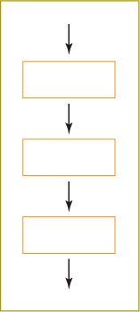
A sequence structure
Perform actions or tasks in order.
A sequence can contain any number of tasks, but there is no option to branch off and skip any of the tasks.
For example, driving directions how to get to from your house to university, you might provide the sequence of directions, in which one step follows the other and no steps can be skipped.
Get bus to get to 7 miles
Then walk to Parami road to get to university
Figure 3-2 Sequence structure

Slide 7
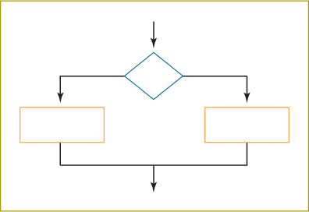
A selection structure (or) decision structure
With this structure, you ask a question and, depending on the answer, you take one of two courses of action.
A flowchart that describes a selection structure must begin with a decision symbol, and the branches of the decision must join at the bottom of the structure.
Pseudocode that describes a selection structure must start with if and end with endif.
Dual-alternative if
Single-alternative if
Figure 3-3 Selection structure

Slide 8
A selection structure (or) decision structure (cont’d)
if someCondition is true then
do oneProcess
else
do theOtherProcess
endif
Dual-alternative if
Contains two alternatives
If-then-else structure
For example, a payroll program statement may involves:
if hoursWorked is more than 40 then
calculate regularPay and overtimePay
else
calculate regularPay
endif

Slide 9
Problem: Checking the number is even or odd - Pseudo code
start
Declarations
num myNumber
input myNumber
if remainder(myNumber/2)=0 then
output “Given Number is an Even Number”
else
output “Given Number is an Odd Number”
endif
stop

Slide 10
Problem: Checking the number is even or odd - Flowchart
start
Declarations
num myNumber
input myNumber
Remainder (myNumber/2)= 0
Yes
No
Output “Even Number”
Output “Odd Number”
stop

Slide 11
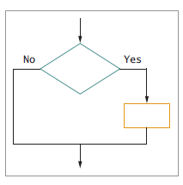
A selection structure (or) decision structure (cont’d)
if employee belongs to dentalPlan then
deduct $40 from employeeGrossPay
endif
Single-alternative if
Only one action is done if the condition is satisfied
Otherwise nothing is done so Else clause is not required, called null case
Figure 3-4 Single-alternative selection structure

Slide 12
Problem: Checking the number positive or not - Pseudo code
start
Declarations
num myNumber
input myNumber
if myNumber>0 then
output “Given Number is Positive Number”
endif
stop

Slide 13
Problem: Checking the number positive or not - Flowchart
start
Declarations
num myNumber
input myNumber
No
myNumber>0
Yes
Output “Positive Number”
stop

Slide 14
A loop structure
Loop structure
Repeats a set of actions based on the answer to a question.
Continue to repeat actions while a condition remains true.
The action or actions that occur within the loop are known as the loop body. Also called repetition or iteration
In the most common type of loop, called while … do or while loop
Question is asked first in the most common form of loop
A condition is evaluated; if the answer is true, execute the loop body and evaluate the condition again.
If the condition is still true, execute the loop body again and then re-evaluate the original condition.
This continues until the condition becomes false, and then exit the structure.

Slide 15
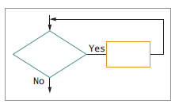
A loop structure(cont’d)
A flowchart that describes a loop structure always begins with a decision symbol that has a branch that returns to a spot prior to the decision.
Figure 3-5 Loop structure

Slide 16
A loop structure(cont’d)
Loop structure Pseudocode that describes a loop starts with while and ends with endwhile.
while testCondition continues to be true
do someProcess
endwhile
while quantityInInventory remains low
continue to orderItems
endwhile
Notes:
page97

Slide 17
Understanding the Three Basic Structures (cont’d)
All logic problems can be solved using only these three structures
Structures can be combined in an infinite number of ways
Stacking
Attaching structures end-to-end
End-structure statements
Indicate the end of a structure
The endif statement ends an if-then-else structure
The endwhile ends a loop structure

Slide 18
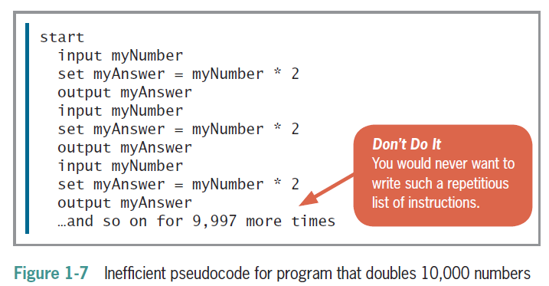
Problem: Repeating Instructions
The number doubling problems
Double the 10,000—numbers in a limited amount of time—let’s say the next two minutes.
Pseudocode

Slide 19
Problem: Repeating Instructions
The number doubling problems
For example, Double the input numbers being entered at the keyboard, the program will keep accepting numbers and outputting doubles until the user input “0” (zero).
Pseudo code
start
Declarations
num originalNumber
num calculatedAnswer
input originalNumber
while originalNumber <> 0
set calculatedAnswer = originalNumber *2
output calculatedAnswer
input originalNumber
endwhile
stop

Slide 20
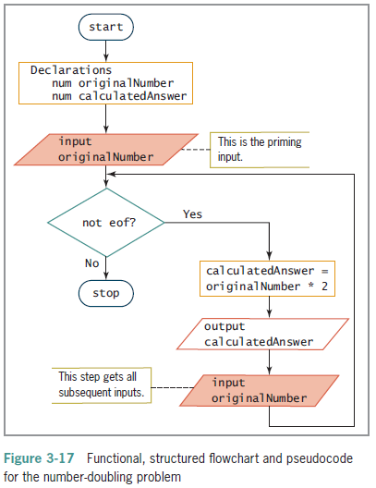
Problem: Repeating Instructions
The number doubling problems
originalNumber < > 0

Slide 21
Problem: Sum of the given numbers
Write a pseudo code and draw a flowchart that accept the user input numbers until user input the stop value “999” and output the sum of all input numbers excluding the stop value.

Slide 22
Problem: Sum of the given numbers - Pseudo code
start
Declarations
num userNumber
num sum = 0
input userNumber
while userNumber < > 999
set sum = sum + userNumber
input userNumber
endwhile
output sum
stop

Slide 23
Problem: Sum of the given numbers - Flowchart
start
Declarations
num userNumber
num sum = 0
input userNumber
Yes
userNumber <> 999
No
sum = sum + userNumber
output “Sum=”, sum
input userNumber
stop

Slide 24
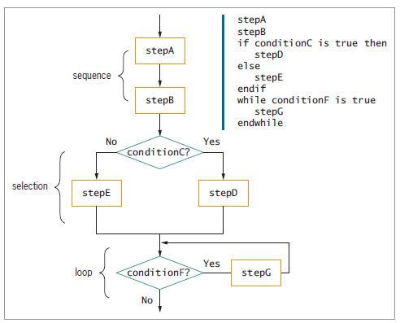
Understanding the Three Basic Structures (cont’d)
In figure 3-6, the two end-structure statements -endif and endwhile
Attaching structures end to end is called stacking structures.
Figure 3-6 Structured flowchart and pseudocode with three stacked structures

Slide 25
Understanding the Three Basic Structures (cont’d)
Any individual task or step in a structure can be replaced by a structure
Nesting
Placing one structure within another
Indent the nested structure’s statements
Block
Group of statements that execute as a single unit

Slide 26
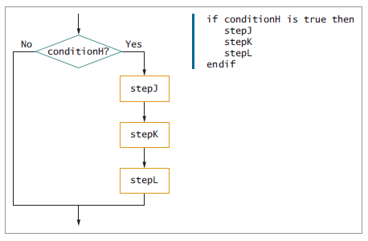
Understanding the Three Basic Structures (cont’d)
Placing a structure within another structure is called nesting structures.
Figure 3-7 Flowchart and pseudocode showing nested structures—a sequence nested within a selection

Slide 27
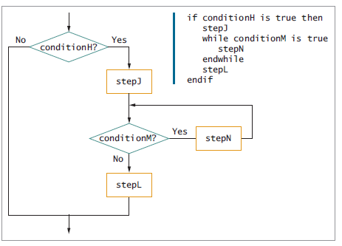
Understanding the Three Basic Structures (cont’d)
if and endif are vertically aligned. This shows that they are all “on the same level.”
Similarly,
stepJ, while, endwhile, and stepL are aligned, and they are evenly indented.
Figure 3-8 Flowchart and pseudocode showing nested structures—a loop nested within a sequence, nested within a selection

Slide 28
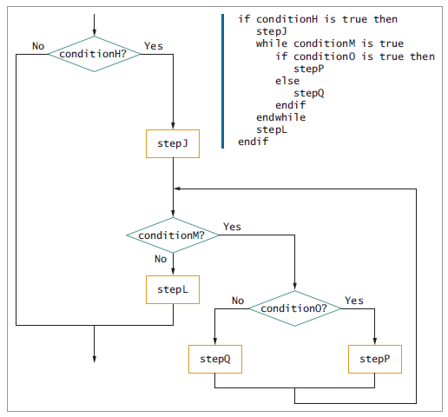
Understanding the Three Basic Structures (cont’d)
There is no limit to the number of levels you can create when you nest and stack structures.
Figure 3-9 Flowchart and pseudocode for loop within selection within sequence within selection

Slide 29
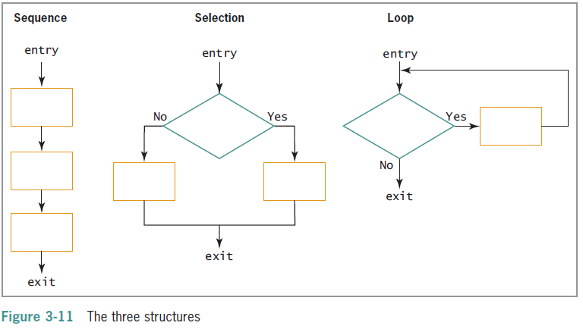
Understanding the Three Basic Structures (cont’d)

Slide 30
Understanding the Three Basic Structures (cont’d)
Structured programs have the following characteristics:
Include only combinations of the three basic structures
Each of the structures has a single entry point and a single exit point
Structures can be stacked or connected to one another only at their entry or exit points
Any structure can be nested within another structure

Slide 31
Using a Priming Input to Structure a Program
Priming read (or priming input)
Reads the first input data record
continue the loop that reads the rest of the records
Helps keep the program structured
Analyze a flowchart for structure one step at a time
Watch for unstructured loops that do not follow this order
First ask a question
Take action based on the answer
Return to ask the question again
Notes:
page103

Slide 32
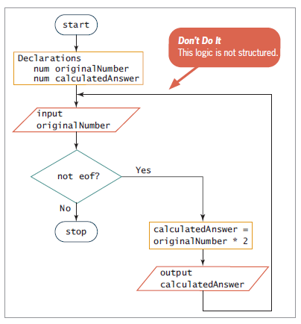
Using a Priming Input to Structure a Program
it is not structured!
the flow of logic must return directly to the loop-controlling question.
the logic does not return to this question; instead, it goes “too high” outside the loop to repeat the input originalNumber task.
In this case, it is a priming input step. A priming input or priming read is an added statement that gets the first input value in a program.
Figure 3-16 Functional but unstructured flowchart

Slide 33
Using a Priming Input to Structure a Program
Priming read sets up the process so the loop can be structured
To analyze a flowchart’s structure, try writing pseudocode for it
start
Declarations
num inputNumber
num calculatedAnswer
input inputNumber
while not eof
calculatedAnswer = inputNumber * 2
output calculatedAnswer
input inputNumber
endwhile
stop

Slide 34
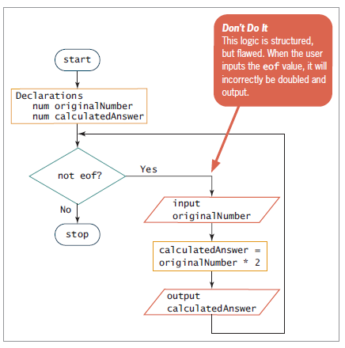
The solution in Figure 3-18; it is seem to be structured, contains a single loop with a sequence of three steps within it, and appears to eliminate the need for the priming input statement.
It will incorrectly be doubled and output the first inputs “ the eof value”.
Figure 3-18 Structured but incorrect solution to the number-doubling problem

Slide 35
Understanding the Reasons for Structure
Clarity:
The number-doubling program is small. As programs get bigger, they get more confusing if they are not structured.
Professionalism
All other programmers expect your programs to be structured. It is the way things are done professionally.
Efficiency
Most newer computer languages are structured languages with syntax that lets you deal efficiently with sequence, selection, and looping.
Newer languages such as C#, C++, and Java enforce structure by their syntax.
Ease of maintenance
It easier to modify and maintain structured programs as changes are required in the future.
Supports modularity
Structured programs can be easily broken down into routines or modules that can be assigned to any number of programmers.
The routines are then pieced back together like modular furniture at each routine’s single entry or exit point.
Additionally, a module often can be used in multiple programs, saving development time in the new project.

Slide 36
Recognizing Structure
To learn about structured program design, it is difficult to detect whether a flowchart of a program’s logic is structured.
Recognizing structure is the detecting program’s logic is structured
Any set of instructions can be expressed in structured format
Any task to which you can apply rules can be expressed logically using sequence, selection, loop

Slide 37
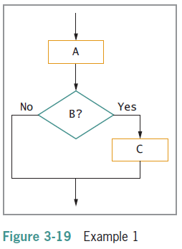
Recognizing Structure (cont’d)
Is the flowchart segment in Figure 3-19 structured?
Yes, it is. It has a sequence and a selection structure.

Slide 38
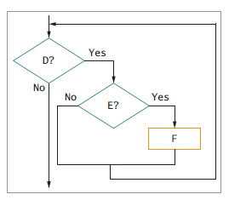
Recognizing Structure (cont’d)
Is the flowchart segment in Figure 3-20 structured?
Yes, it is. It has a loop, and within the loop is a selection.
Figure 3-20 Example 2

Slide 39
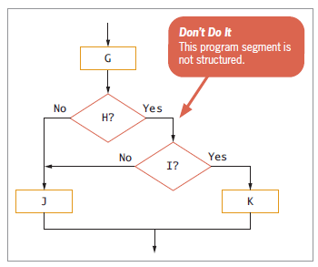
Recognizing Structure (cont’d)
Is the flowchart segment in Figure 3-21 structured?
No, it is not constructed from the three basic structures.
One way to straighten out an unstructured flowchart segment is to use the “spaghetti bowl” method; that is, picture the flowchart as a bowl of spaghetti that you must untangle.
Figure 3-21 Example 3

Slide 40
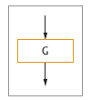
Recognizing Structure (first step)
Start pulling at the top, a procedure box labeled G.
(See Figure 3-22.)
Single process like G is part of an acceptable structure
At least the beginning of a sequence structure
Pull the top
Figure 3-22 Untangling Example 3, first step

Slide 41
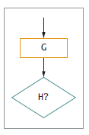
Recognizing Structure (second step)
Continue pulling symbols from the tangled segment.
The next item is a question that tests a condition labeled H, in Figure 3-23.
At this point, the sequence that started with G has ended.
H is either a selection or a loop.
A loop must return to the loop-controlling question at some later point.
from the original logic of figure 3-21 whether the answer to H is Yes or No, the logic never returns to H.
Therefore, H begins a selection structure, not a loop structure.
Figure 3-23 Untangling Example 3, second step

Slide 42
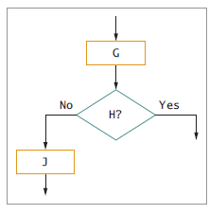
Recognizing Structure (third step)
Pull up on the flow line from the left side (the No side) of H
You found J, in Figure 3-24.
When you continue beyond J, you reach the end of the flowchart.
Pull left side
Figure 3-24 Untangling Example 3, third step

Slide 43
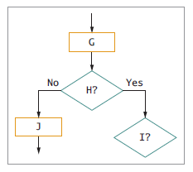
Recognizing Structure (fourth step)
Next, pull up the flowline on the right side of H
When you pull up on the right side, you found Question I.
Pull right side
Figure 3-25 Untangling Example 3, fourth step

Slide 44
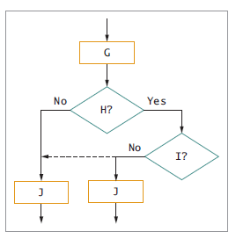
Recognizing Structure (fifth step)
Pull up the flowline on the left side of I and untangle it from the B selection by repeating J
Pull left side
Figure 3-26 Untangling Example 3, fifth step

Slide 45
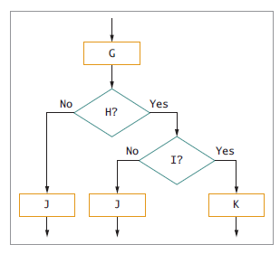
Recognizing Structure (sixth step)
Now pull up the flowline on the right side of I
At this point, the untangled flowchart has three loose ends.
The loose ends of Question I can be brought together to form a selection structure;
Then the loose ends of Question H can be brought together to form another selection structure.
Figure 3-27 Untangling Example 3, sixth step

Slide 46
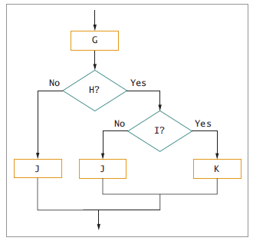
Recognizing Structure (final step)
Bring together the loose ends of I and of H
The result is the flowchart shown in Figure 3-28.
The entire flowchart segment is structured— it has a sequence followed by a selection inside a selection.
Figure 3-28 Finished flowchart and pseudocode for untangling Example 3

Slide 47
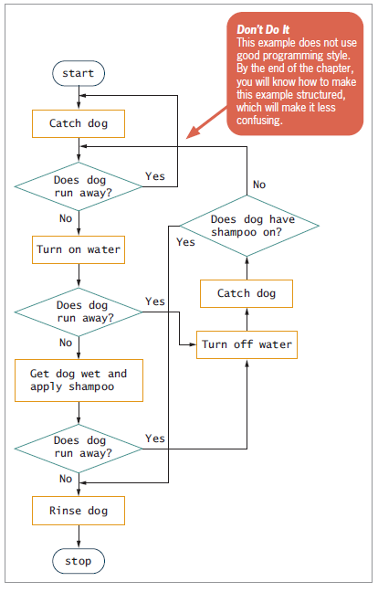
Structuring the Unstructured Logic
Dog-washing process
Unstructured
Can be reconfigured to be structured

Slide 48
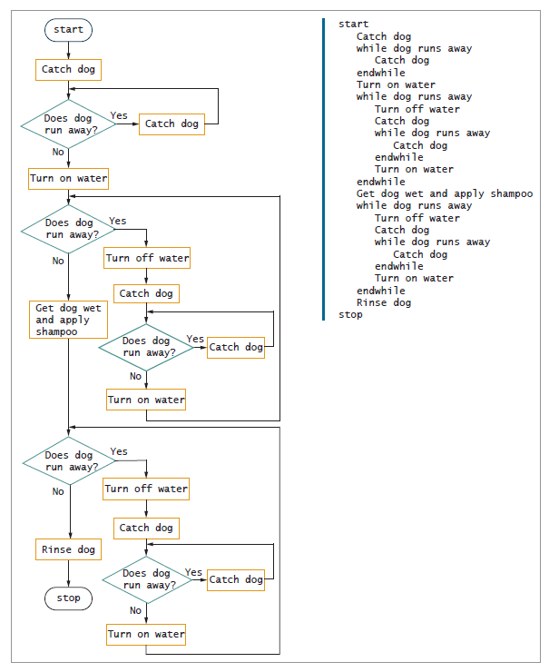
The flowchart in Figure 3-33 is complete and is structured.
It contains alternating sequence and loop structures.
Figure 3-33 shows three places where the sequence-loop-sequence of catching the dog and turning the water on are repeated.
Figure 3-33 Structured dog-washing flowchart and pseudocode

Slide 49
Summary
Spaghetti code
Snarled program logic
Three basic structures
Sequence, selection, and loop
Combined by stacking and nesting
Priming read
Statement that reads the first input data record

Slide 50
Summary (cont’d)
Structured techniques promote:
Clarity
Professionalism
Efficiency
Modularity
Flowchart can be made structured by untangling

