Slide 1
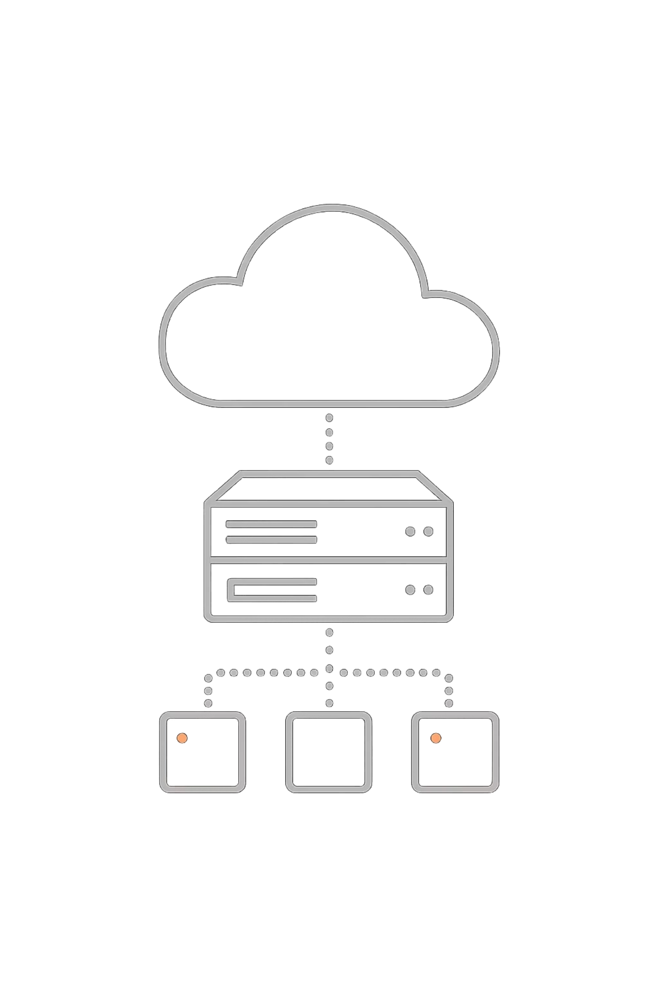
HKBU Campus Assistant
A Cloud-Deployed Telegram Bot with LLM Memory
COMP7940 CLOUD COMPUTING & DEVOPS PROJECT
Student Name: [Ou Xunxiong] | Student ID: [25401564] | Date: 15/22 April 2026

Slide 2

Project Overview
Upgrade the laboratory chatbot into a production-ready cloud service—not just to make it run, but to make it reliable, observable, and cost-controlled.
LLM-Powered
AWS EC2 Deployment
Connected to the HKBU GenAI API to provide natural language conversation capabilities
Docker containerized and running on an Ubuntu 22.04 instance
Conversation Memory
Fully Observable
Persistent context storage based on the Supabase cloud database
Log tracking + AWS cost budget monitoring

Slide 3

System Architecture
Telegram
Parallel Backend Calls
Message entry point, supports commands and natural language
Telegram Users
Supabase (memory) and HKBU LLM (inference)
Send commands or natural language
Four-Layer Architecture Message Flow
AWS EC2
t3.micro instance, Ubuntu 22.04 host environment
Docker Container
Docker Container
AWS EC2 Receives
bot.py runtime environment, --restart always ensures high availability
Runs bot.py inside the container
t3.micro Ubuntu host
Supabase + HKBU LLM
User messages are routed via Telegram to EC2, where a Python bot inside a Docker container dispatches requests to Supabase (memory) and the HKBU GenAI API (inference), creating a clear modular architecture.
PostgreSQL memory storage + gpt-5-mini inference engine

Slide 4
Meets All 7 Technical Requirements
All mandatory requirements have been fully implemented, and the details are listed below.
Technical Requirement
Implementation
Telegram Bot
Responds to /start, /stats, /clear, and natural language messages
Cloud Database
Supabase (PostgreSQL) persists all conversations
Cloud Platform
AWS EC2 (t3.micro, Ubuntu 22.04)
LLM API
HKBU GenAI API (gpt-5-mini deployment)
Git Managed
GitHub repository, with full commit history
Container Tech
Docker image + --restart always automatic recovery
Cost Monitoring
AWS Budget set to a $1 threshold alert

Slide 5


Innovation — Persistent Conversation Memory
Core Implementation (Simplified)
User Sends Message
Inject Context
Merge history into the LLM prompt
history = await get_user_history(user_id)
prompt = f"""Previous conversation:
{history}
User: {message}"""
response = await call_llm(prompt)
Send a new message to the system
Fetch History
Retrieve the most recent three conversations from Supabase
Generate Reply
The LLM outputs a response with context
Example: if the user says “My name is Xiaoming,” and later asks “What is my name?” — the bot accurately replies “Xiaoming,” keeping context consistent across turns.
Unlike a stateless chatbot, every message is stored in Supabase. Before calling the LLM, the system first retrieves the conversation history and injects it into the prompt, creating a coherent conversational experience powered entirely by free cloud services.

Slide 6
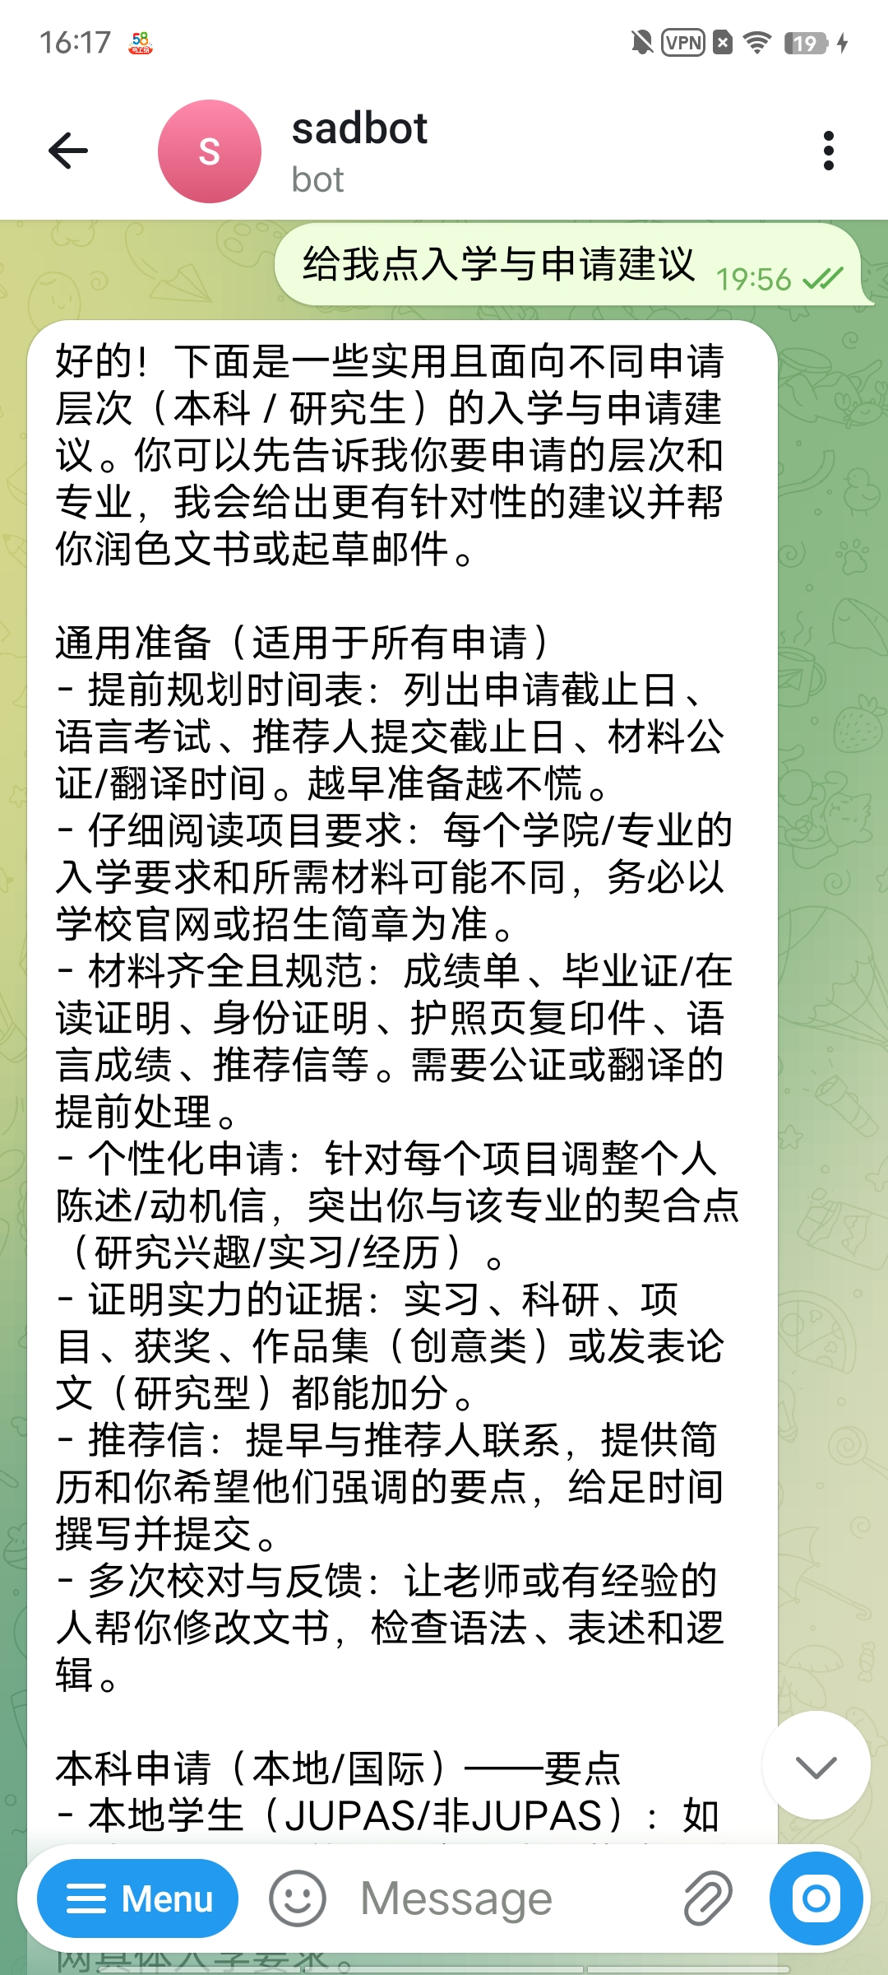
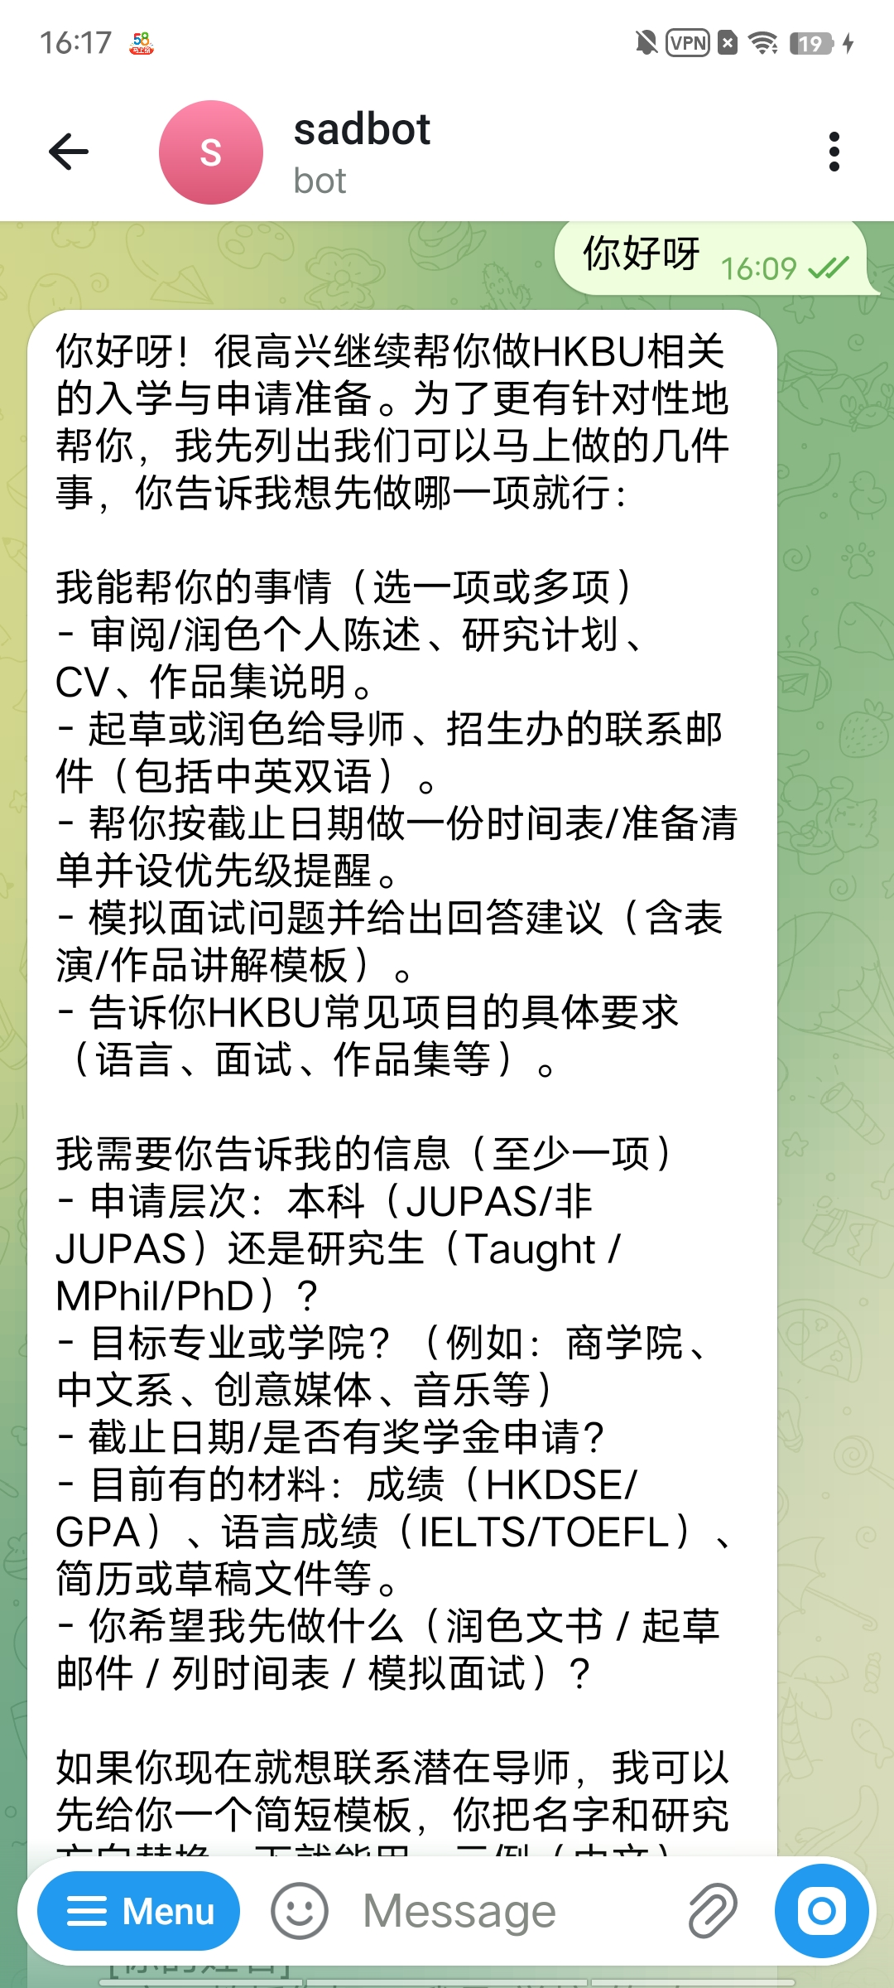

Slide 7

Cloud Deployment and DevOps Practices
Complete Deployment Workflow
1
SSH into a new Ubuntu instance
2
Build and start the container
Install Docker and clone the GitHub repository
docker run --restart always ensures the instance automatically recovers after reboot
3
Logs and debugging
docker logs provides real-time access to runtime logs without online monitoring

Slide 8



Cost Control and Observability
Cost Breakdown by Service
Service
Plan
Monthly Cost
AWS EC2
Free Tier (t3.micro)
$0.00
Supabase
Free Tier (500 MB)
$0.00
Telegram API
Free
$0.00
HKBU GenAI
University Provided
$0.00
Total
$0.00
AWS Budget has been configured with a $1 alert threshold. Actual spend is zero, and the system runs entirely within each service's free tier.
0%
100%
Actual Cost Used
Free Resource Coverage
Still 100% below the $1 alert threshold
All components run on free tiers

Slide 9
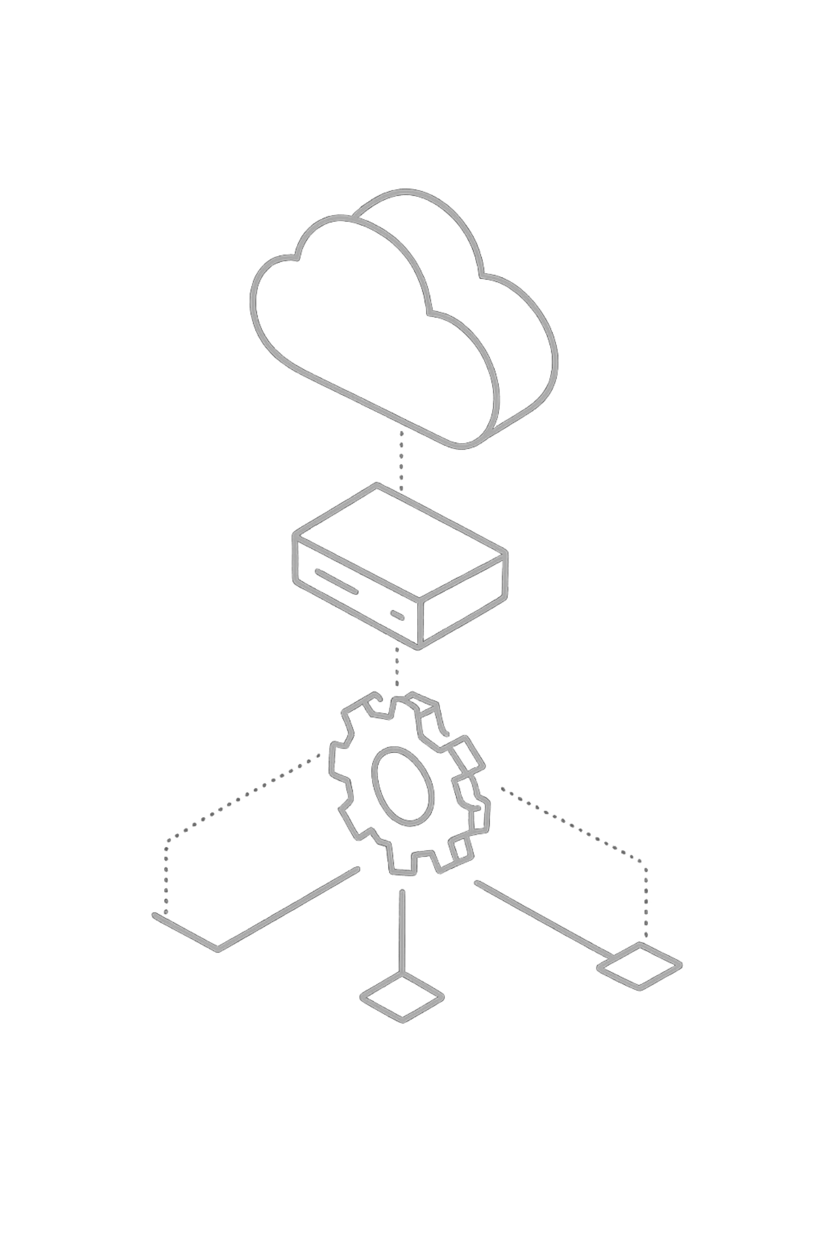



Presentation Summary
Send /start
Show the welcome message and command instructions
Memory Test
Say "My name is Alex," then ask "What's my name?" — the bot accurately recalls it
Send /stats
Display the current conversation turn statistics
✅ All 7 requirements met
✅ Fully cloud-native architecture
✅ Zero-cost end-to-end monitoring
✅ Memory innovation validated
Thank you for listening.

