Slide 1
Climate Change Dynamics
Instructor: Om Damani
Team: Dynamic Synergy
Mrunal Janbandhu (22M0811)
Pratik Kumar (19d170020)
Aman Kashyap (190050012)

Slide 2
Problem statement
The problem with climate change dynamics is that it is causing significant and potentially cirreversible hanges to our planet's climate system.
Human activities, such as burning fossil fuels and deforestation, have resulted in an increase in greenhouse gas emissions, leading to global warming and climate instability.
However, this is just one aspect of a much larger and more complex system, including land use, deforestation, energy consumption, and more.
One of the critical challenges in addressing climate change is understanding how these different factors interact with one another and how changes in one part of the system can have ripple effects throughout the entire system.
We need to understand the underlying dynamics of climate change, including the feedback loops, nonlinear relationships, and time delays that are involved.

Slide 3
Motivation
Urgency of action: The impacts of climate change are already being felt around the world. Understanding the dynamics of climate change is crucial for developing effective policies and strategies to mitigate and adapt to the impacts of climate change.
Future generations: Climate change will have significant impacts on future generations, and understanding the dynamics of the problem can help us make decisions that ensure a sustainable future for upcoming generation.
Opportunities for innovation: Addressing climate change presents opportunities for innovation and progress in areas such as renewable energy, sustainable agriculture, and green transportation. Understanding the dynamics of the problem can help us identify these opportunities and drive progress towards a sustainable future.

Slide 4
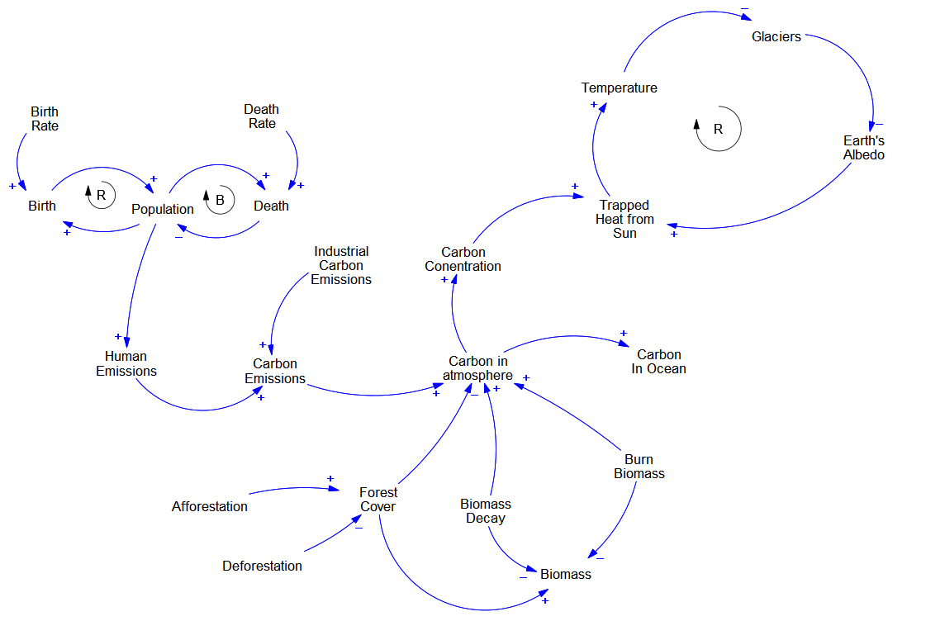
CLD

Slide 5
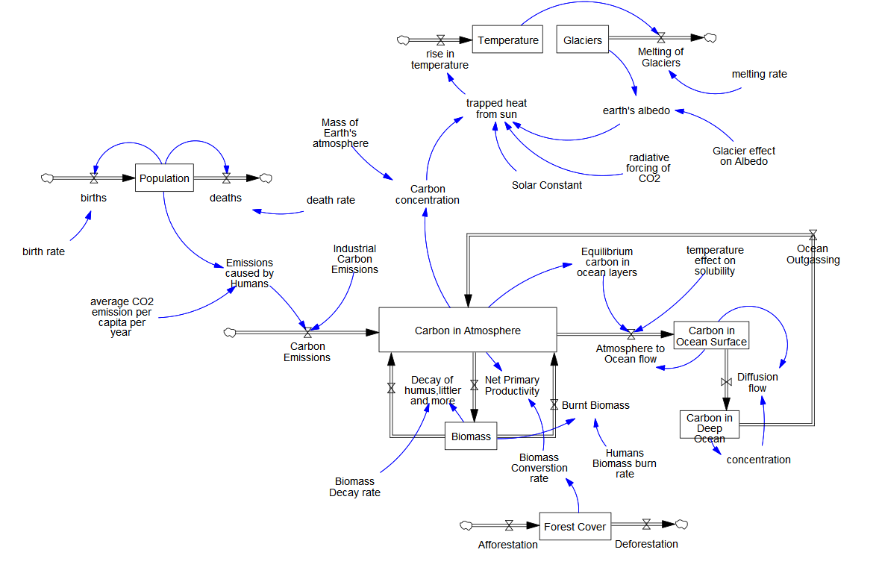
SFD

Slide 6
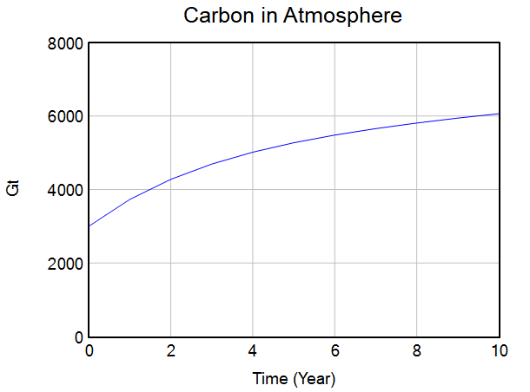
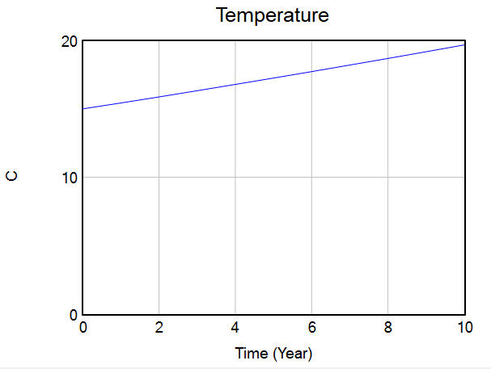
Simulation

Slide 7
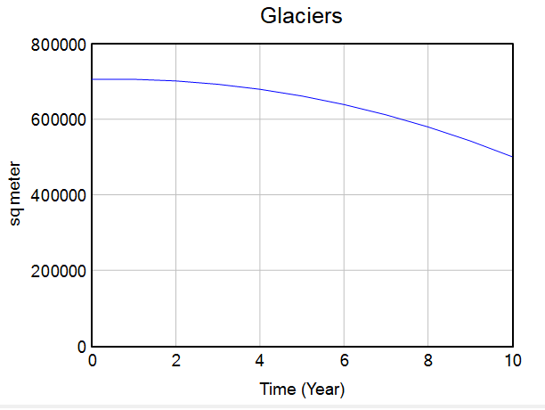
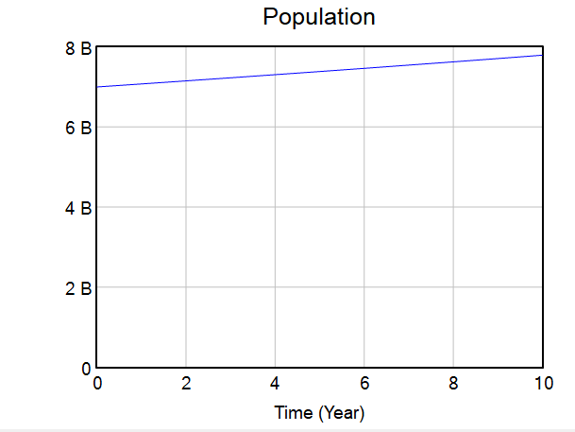
Simulation

Slide 8
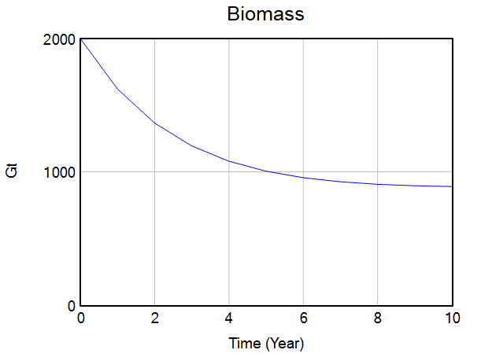
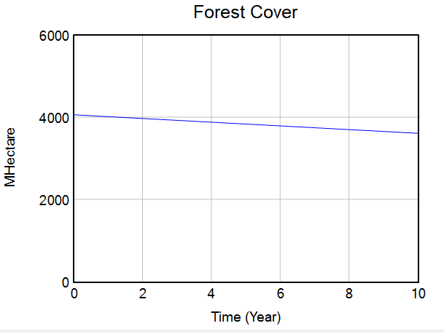
Simulation

Slide 9
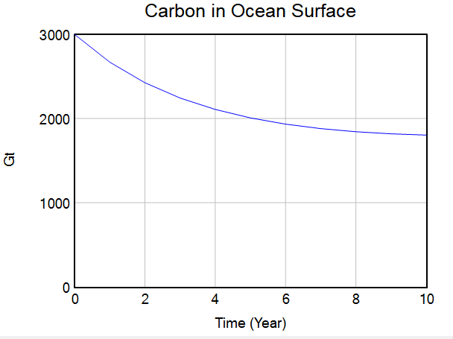
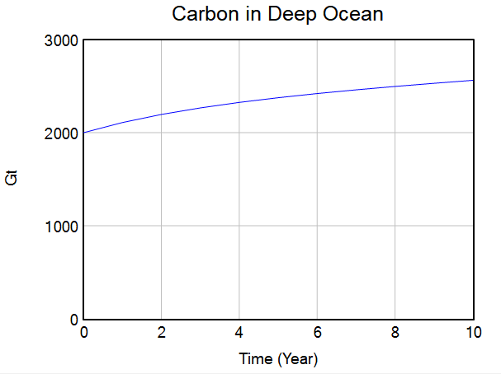
Simulation

Slide 10
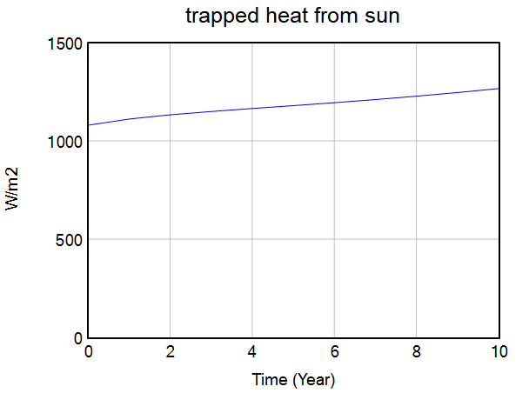
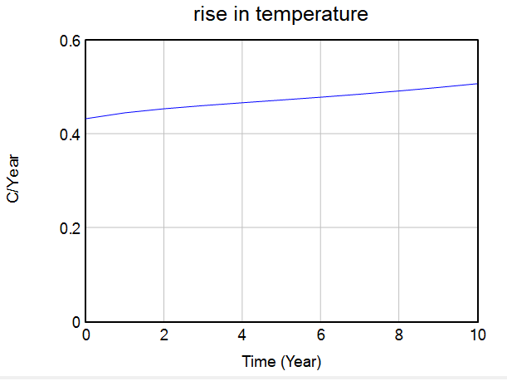
Simulation

Slide 11
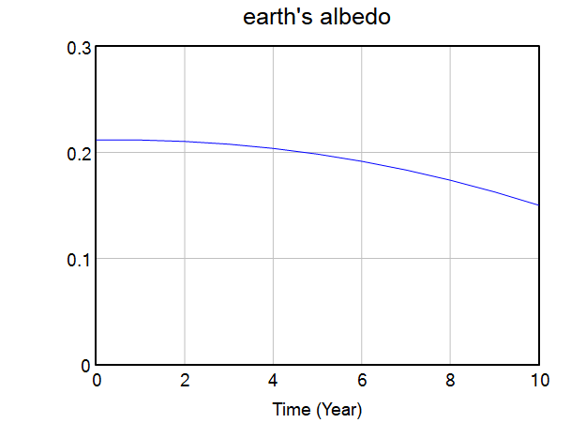
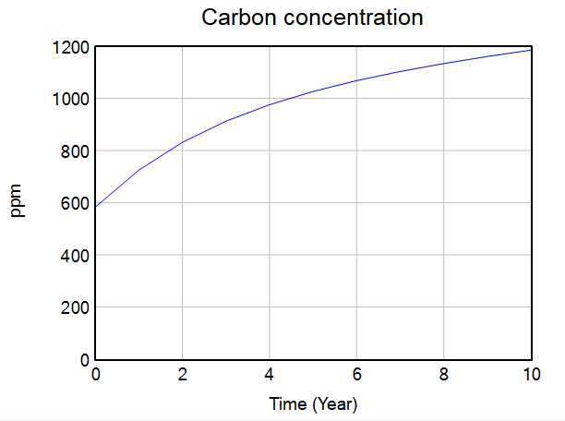
Simulation

Slide 12
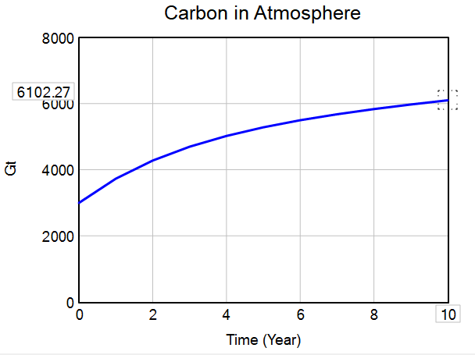
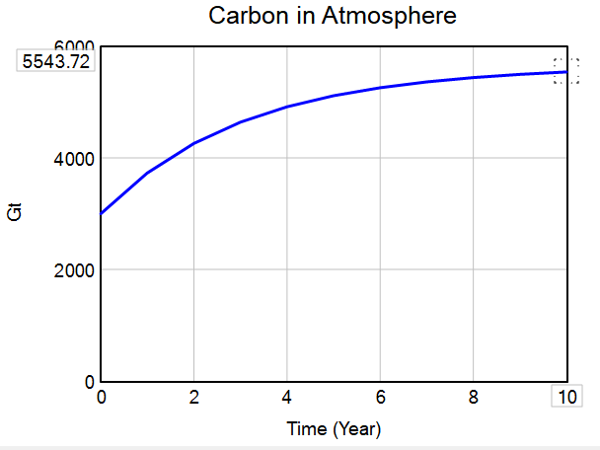
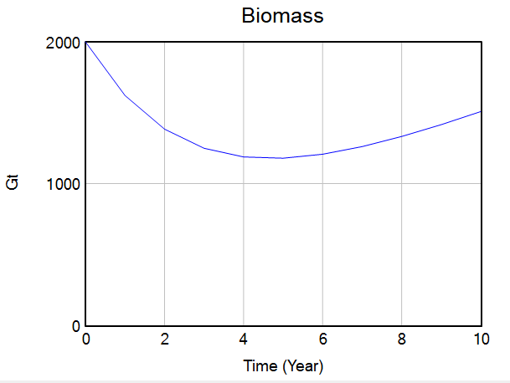
What If..? Afforestation x 100

Slide 13
Thank You

