Slide 1
Matrix Factorization for Recommendation Systems
Freny Savalia & Omkar Kakde

Slide 2
Project Definition
A movie recommender system. Given a user and their ratings of movies on a scale of 1-5, the system will recommend movies the user is likely to rank highly.
The input is an array of ratings for the given movies by the users.
The output is an array of predictive ratings for a specific user.

Slide 3
Matrix Factorization
Matrix factorization is a class of collaborative filtering algorithms used in recommender systems. Matrix factorization algorithms work by decomposing the user-item interaction matrix into the product of two lower dimensionality rectangular matrices.
Characterizes both items and users by vectors of factors inferred from item rating patterns.
Allows incorporation of additional information.

Slide 4
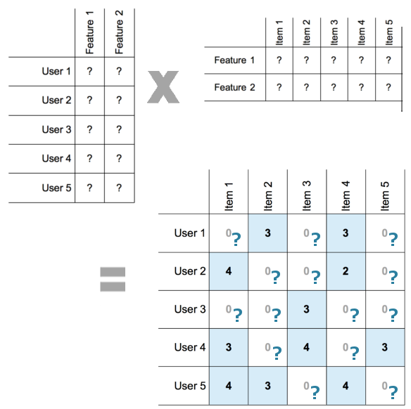

Slide 5
Stochastic Gradient Descent
Stochastic gradient descent is an iterative method for optimizing an objective function with suitable smoothness properties (e.g. differentiable or subdifferentiable). It can be regarded as a stochastic approximation of gradient descent optimization, since it replaces the actual gradient (calculated from the entire data set) by an estimate thereof (calculated from a randomly selected subset of the data).
Gradient descent is an iterative algorithm, that starts from a random point on a function and travels down its slope in steps until it reaches the lowest point of that function.
SGD randomly picks one data point from the whole data set at each iteration to reduce the computations enormously.

Slide 6
The steps of the algorithm are:
Find the slope of the objective function with respect to each parameter/feature. In other words, compute the gradient of the function.
Pick a random initial value for the parameters.
Update the gradient function by plugging in the parameter values.
Calculate the step sizes for each feature as : step size = gradient * learning rate.
Calculate the new parameters as : new params = old params -step size.
Repeat steps 3 to 5 until gradient is almost 0.

Slide 7
Performance Model
 | CPU Time (per iteration) | GPU(per iteration)
Time (100k) | 0.42 seconds | 0.223 milliseconds
Time (1M) | 1.69 seconds | 0.376 milliseconds
Time (10M) | 3.73 seconds | 0.82 milliseconds

Slide 8
Results
 | CPU Time (per iteration) | GPU(per iteration)
Time (100k) | 9.2 seconds | 7.63 seconds
Time (1M) | 21.54 seconds | 12.41 seconds
Time (10M) | 36.81 seconds | 21.456 seconds

Slide 9
Accuracy
Iterations | CPU | GPU
100 | 0.556 | 0.551
500 | 0.583 | 0.578
1000 | 0.637 | 0.623

Slide 10
References
Wikipedia
towardsdatascience.com
https://datajobs.com/data-science-repo/Recommender-Systems-%5BNetflix%5D.pdf

Slide 11
Thank You !

