Slide 1


Slide 2
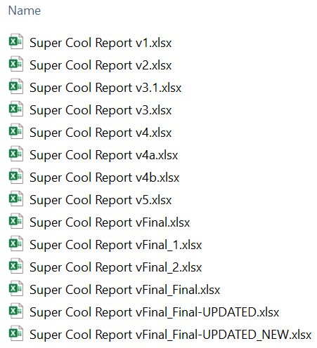
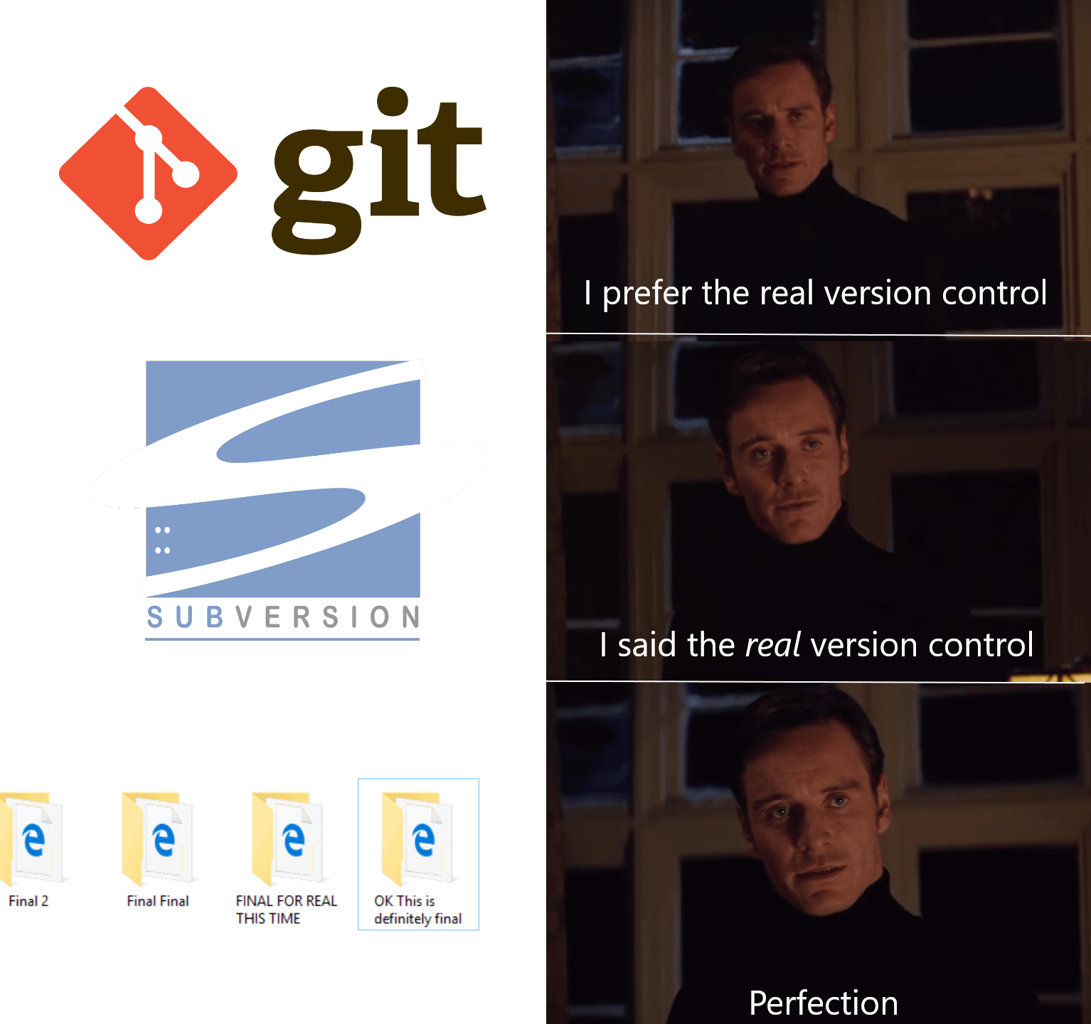

Slide 3
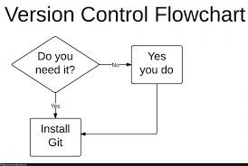


Slide 4
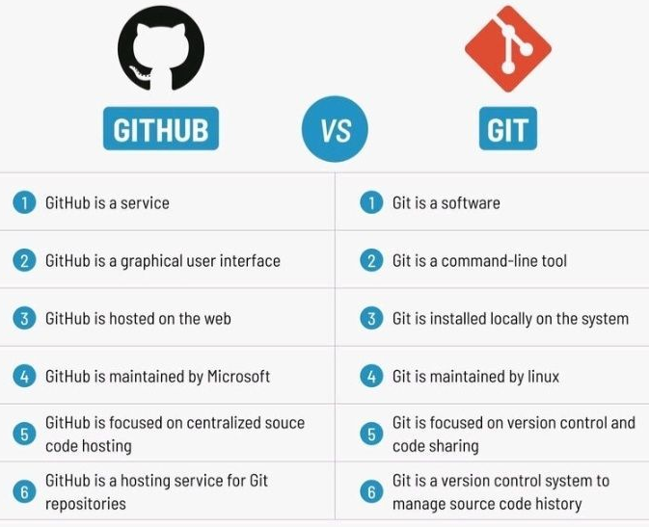

Slide 5
INSTALL GIT ON YOUR MACHINE
git config --global user.email "pippo@gmail.com"
git config --global user.name "Pippo"
FIRST REPO SIMPLE:
Create a repo with Readme file
Clone repo locally
Modify Readme file (add some text)
git add .
git commit –m “first commit”
git push

Slide 6


Slide 7
SECOND REPO: ADD A FOLDER TO AN EMPTY REPO
git init
git add .
git commit -m "first commit"
git branch -M main
git remote add origin https://github.com/User/repoxxx.git
git push -u origin main
GIT PULL!!
Every time you work on remote folder

Slide 8
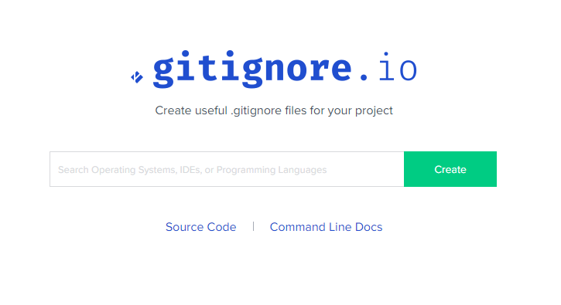
.gitignore file
https://www.toptal.com/developers/gitignore

Slide 9
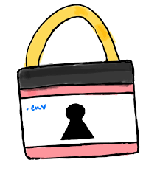


Slide 10

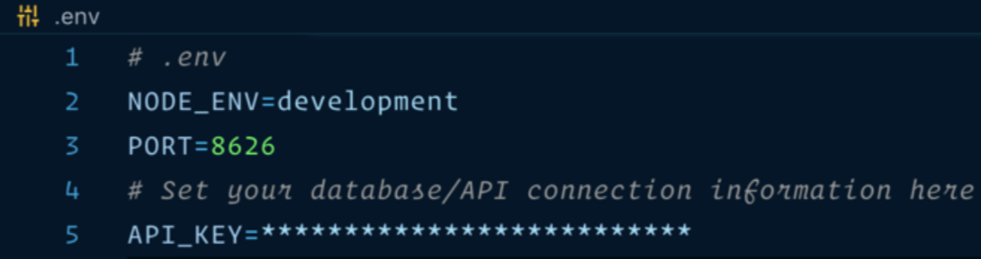

Slide 11
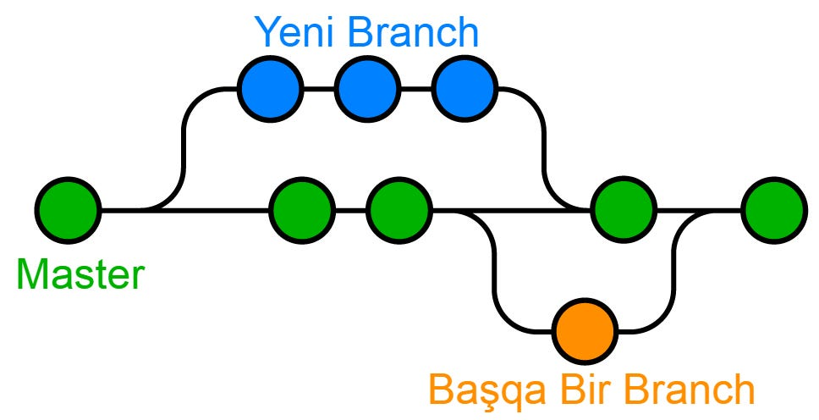

Slide 12


Slide 13
