Slide 1
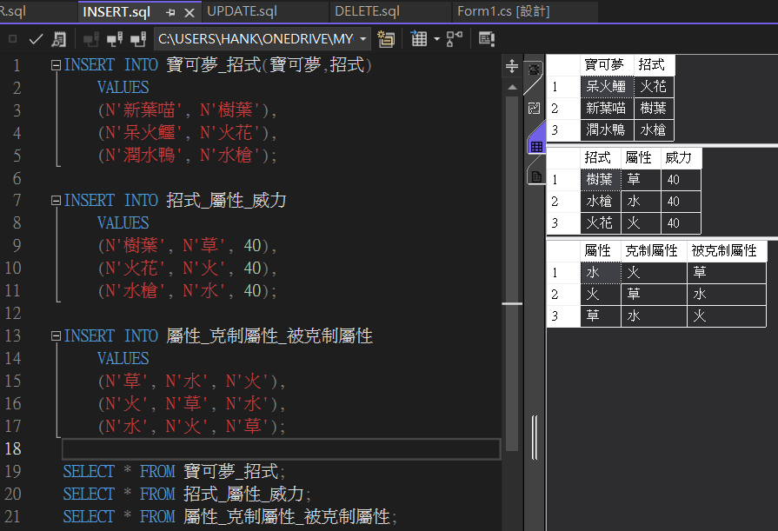
1. INSERT & SELECT

Slide 2
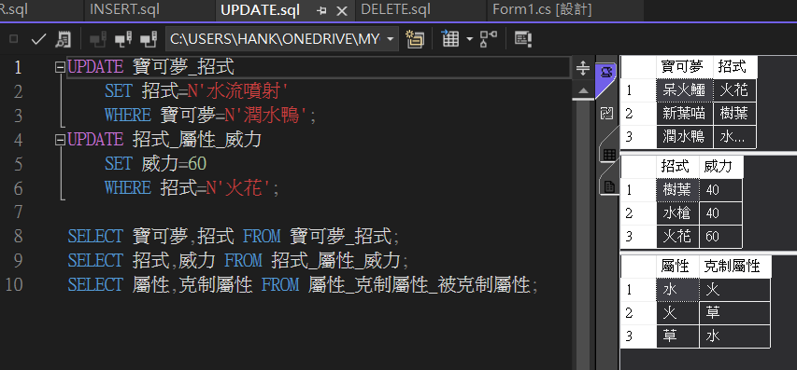
2. UPDATE & SELECT

Slide 3
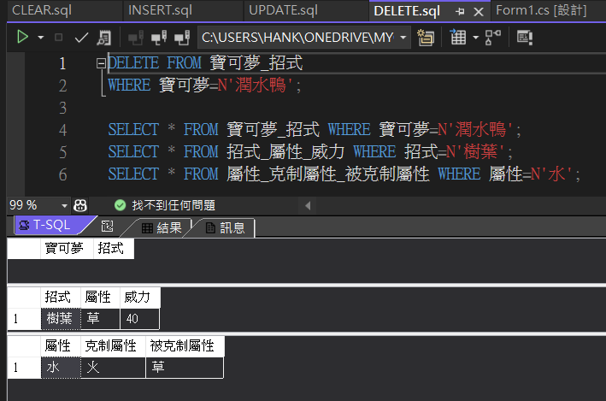
3. DELETE & SELECT

Slide 4
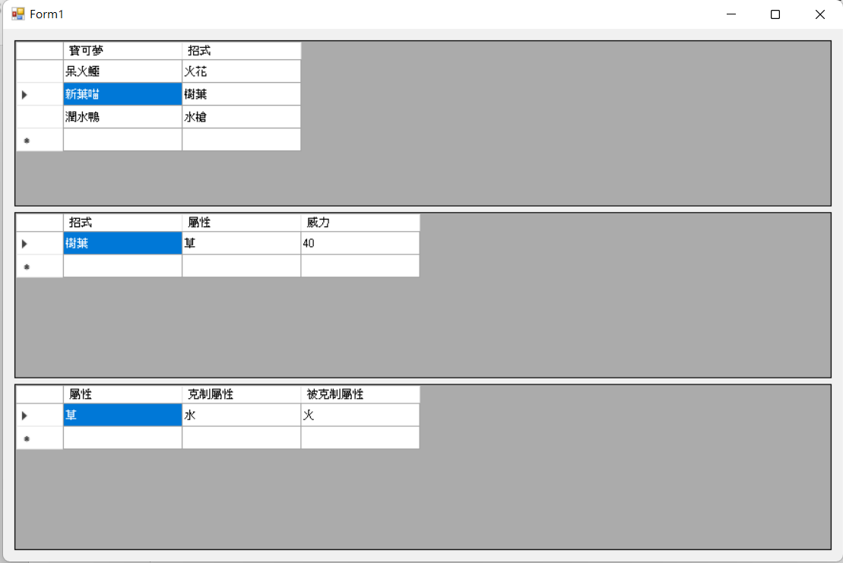
4. 程式執行畫面

