Slide 1

team fresh cabbage

Slide 2


Slide 3
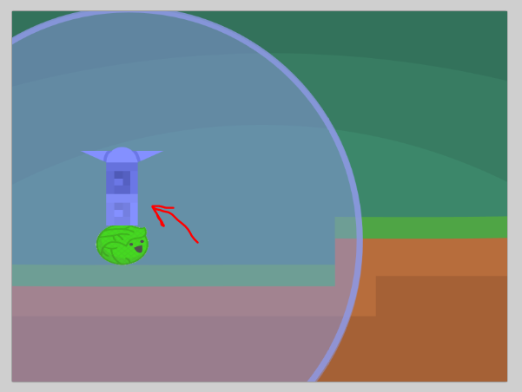

Slide 4
