Slide 1
Subsidiary ICT for Uganda
Curriculum Topic 8 out of 15: INTERNET AND WORLD WIDE WEB
Recommended Coverage Duration: 12 periods (2 weeks)
Senior Five Term II
Notes:
Guidance to the Teacher
Guide the learners to identify the different internet services and their usefulness.
Demonstrate effective use of search engines and give learners activities to practise use of refined searches as individuals or in groups.
Guide the learners to use email communication. You need to make sure that all learners in the class have working email addresses for effective teaching of this topic.
Creating an email address is expected.
As much as possible encourage internet etiquette practices. Suggested Competences for Assessment
Assess the learners’ ability to search for information from the internet and use email communication in addition to other services covered in this topic.

Slide 2
Background
The number of users of the internet is exponentially growing due to increasing ease of use, low cost of the hardware and availability of adequate facilities in schools, public libraries, internet cafes etc.
Although the basic use of internet was research, the number of users of e-mail has outgrown that of research. One can use the internet to communicate with anyone else online, in any place in the world without incurring any extra cost. It can also be used to join mailing list, bulletin boards or discussion groups that cover a huge variety of subjects.
Learning Outcome: The learner should be able to use the Internet to communicate and enhance research in order to develop the lifelong learning skill

Slide 3
Presentation Outline
UACE Sub – ICT Topic 8:
Topic 8: Internet and World Wide Web
Sub Topic 8.1. Introduction to the Internet
Sub Topic 8.2. Internet Services
Sub Topic 8.3. World Wide Web

Slide 4
Sub Topic 8.1: Introduction to the Internet
Sub topic Objectives:
8.1.1. Meaning of Internet
Explaining the meaning of the Internet
8.1.2. Implications of the Internet
Discussing the advantages and disadvantages of using the Internet

Slide 5
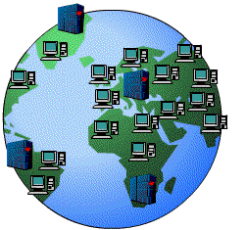
8.1.1 Meaning of Internet
Internet refers to the global interconnection of computer networks.
Computers within a laboratory or office can be connected together using transmission media such as cables to form a local area network (LAN).
Several LANs can be connected to form Wide Area Networks (WANs), which constitute the global Internet.
The Internet enables millions of computers to communicate and share resources globally.

Slide 6
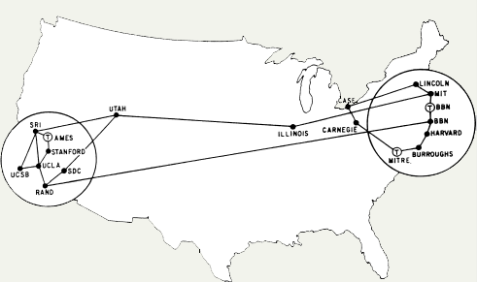
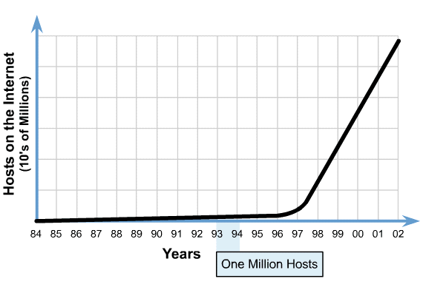
8.1.1 Meaning of Internet
History of the Internet: In 1969 the U.S. Department of Defense commissioned the Advanced Research Projects Agency Network (ARPANET). The purpose was to provide communication links between supercomputers located at various regional sites (Universities and defense bases) within the United States.
It is this ARPANET that evolved into the Internet after computer networks were connected to it in different parts of the world.
By1992, more than 1 million hosts existed on the Internet
In 1973 ARPANET was extended to Europe.

Slide 7
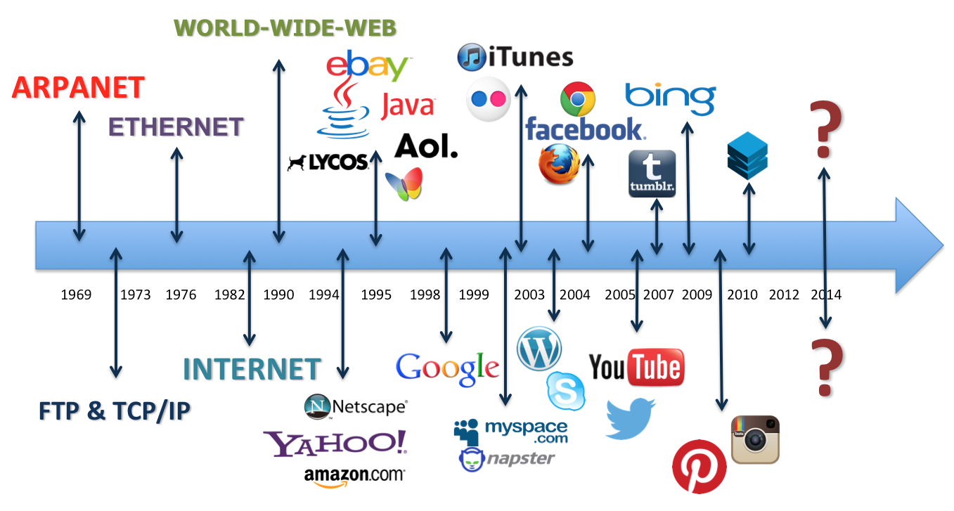
8.1.1 Meaning of Internet
History of the Internet: Timeline of Key Developments

Slide 8
8.1.1 Meaning of Internet
Requirements for Connecting to the Internet: These include:
Computer / Device with a Network Interface Card. The NIC may be based on Ethernet or wireless technologies.
An Internet Service Provider (ISP): the company that takes care of the technical aspects of connecting to the internet. ISPs available in Uganda include Mobile telephone companies like Orange, MTN, Airtel, UTL, etc.
Modem: This is a device that converts analogue telephone signals into digital computer information and vice-versa. Some computers have internal / inbuilt modems.
Required Software: programs necessary to use the internet services such as web browsers and Email Clients, FTP software, etc.

Slide 9
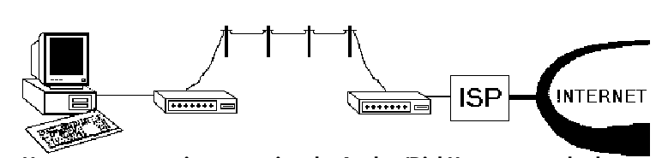
8.1.1 Meaning of Internet
Methods of Connecting to the Internet
As technologies develop, bigger, better and faster Internet connections methods evolve. ISPs provide internet connectivity through the following
(a) Dial Up/ Analog access / Phone Line Connection,
(b) Broadband (cable or Digital Subscriber Line (DSL))/ Fiber
(c) Satellite Connection, and other
(d) Wireless broadcasts e.g Wi-Fi hotspots and Wi-Max.

Slide 10
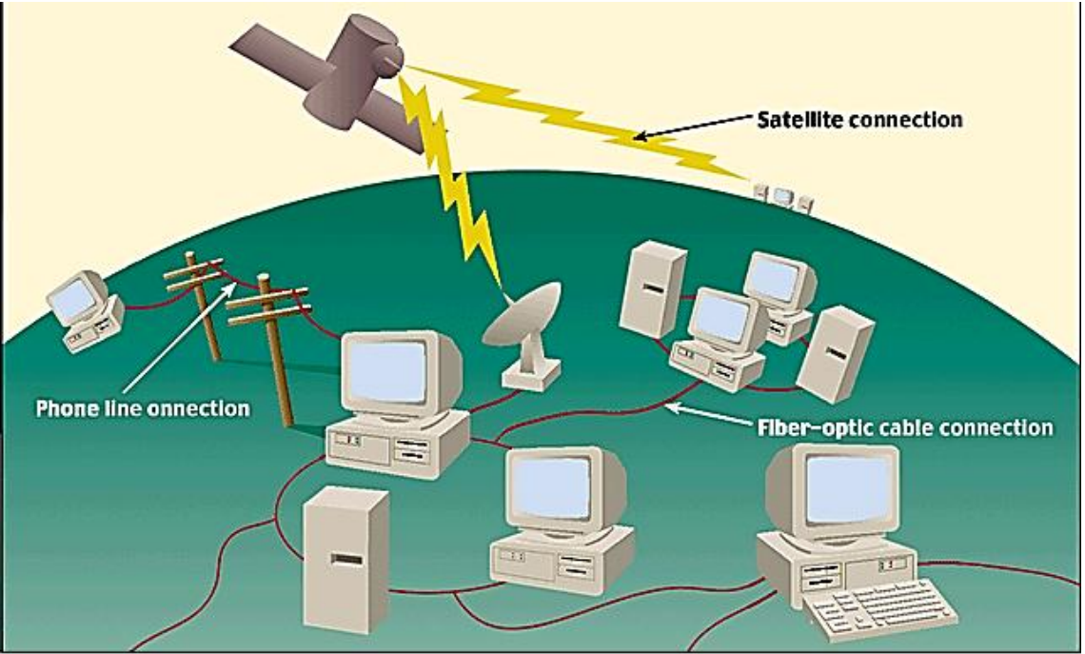


8.1.1 Meaning of Internet
Methods of Connecting to the Internet
Wireless broadcasts
In 1973 ARPANET was extended to Europe.

Slide 11
8.1.1 Meaning of Internet
FACTORS TO CONSIDER WHEN CHOOSING ISPS: These include:
Availability: Not all ISPs offer services in on all areas.
Speed/ Network Performance
Price. Prices vary by package
Support Services / Customer care
Restrictions of use
Reliability : How long the ISP has been in business
Compatibility: That the speed of their modems and their software should match the speed of yours
Email addresses: Check whether the ISP has email and WWW services. Some ISPs can set up a custom email address when you activate your account. This would appear something like name@isp.com.
In 1973 ARPANET was extended to Europe.

Slide 12
8.1.1 Meaning of Internet
FACTORS AFFECTING THE SPEED OF AN INTERNET CONNECTION: These include:
Computer Processor speed
. Distance the data travels
Traffic / number of users on the network
Malware, Spyware and Viruses.
Modem speed.
Natural Conditions
Positioning of wireless access points
Memory available.
Computer internet settings
Technological Circumstances such as loose connections of cables or maintenance works being done by the ISP.
Cookies: Over time, cookie files saved by websites in browser can compromise the speed .
In 1973 ARPANET was extended to Europe.

Slide 13
8.1.2 Implications of the Internet
The Internet is available for everybody’s use (public use). Unlike traditional broadcasting media, such as radio and television, the Internet does not have a centralized distribution system, or ownership.
This flexibility has greatly contributed to the success and proliferation/expansion of the Internet.
The increased use of the internet has come with both advantages and disadvantages.

Slide 14
8.1.2 Implications of the Internet
Advantages of using the Internet
Interactive communication; internet offers several communication tools such as emails, chatting, instant messaging, audio and video conferencing, online telephone calls etc.
Resource sharing; data, information, software programs can be shared over the internet.
Research; internet helps in conducting research using books online, encyclopaedia, audio and video tutorial to answer research questions.
Entertainment tools for leisure; through on-line games, online chats, multimedia (audio, video) etc.

Slide 15
8.1.2 Implications of the Internet
Advantages of using the Internet
Online services; internet offers online services like e-business, e-commerce and e-learning.
Information on the World Wide Web is easily accessible, powered by search engines.
Telecommuting. Through internet connectivity and interactivity one can now work from home and communicate with the office through networked computers and telephone facilities.
Has storage where you can store information safely and can access it anywhere.
It is accessible 24/7 (always on)
Plus a lot more advantages!!

Slide 16
8.1.2 Implications of the Internet
Disadvantages of using the Internet
Computer viruses can be spread over the internet.
Internet provides access to unsuitable material such as Pornography, the biggest threat to healthy mental life.
Theft of Personal information: If you use the Internet, you may be facing grave danger as your personal information such as name, address, credit card number etc. can be accessed by hackers or thieves.
Spamming: Spamming refers to sending unwanted e-mails in bulk, which provide no purpose and needlessly obstruct the entire system.

Slide 17
8.1.2 Implications of the Internet
Disadvantages of using the Internet
Some people get addicted to the internet, causing problems with their social interactions of friends and loved ones.
The initial cost of connecting to the internet is high. e.g. buying computers.
Many people are computer illiterate and so can not use internet, hence miss.
There is a lot of wrong information on the internet. Anyone can post anything, and much of it is garbage/ inaccurate.

Slide 18
Sub Topic 8.2. Internet Services
Sub topic objectives:
8.2.1 Identifying the different internet services.
8.2.2 Using email to communicate.
8.2.3 Using internet facility for research.
8.2.4 Explaining the concept of netiquette.

Slide 19
8.2.1 Internet services
Below are some of the services enabled by the internet
Telnet – enables users to use the resources of a computer in another part of the world. This is done by remotely logging to the distant computer which is called the host.
Email – It allows the transfer of messages, documents, and pictures among others, across the Internet.
Mailing list – This is based on the email protocol. As an electronic mailing list it is very convenient when somebody wants to send a message or newsletter, for example, to many people in one go.

Slide 20
8.2.1 Internet services
Internet Relay Chat (IRC) – A live interactive discussion in which parties on the network exchange ideas and observation electronically. Chats are usually organized in what we call chat rooms.
File Transfer Protocol – The standard method for transferring files, whether downloading or uploading, to and from your computer with another computer on the Internet.
Newsgroups – Worldwide discussion areas where notices can be posted for anyone to view. They are equivalent to a discussion group or an electronic bulletin board. There are newsgroups for every conceivable topic and more, e.g. educational technology.

Slide 21
8.2.1 Internet services
World Wide Web – This refers to the global collection of websites consisting of linked electronic documents called Webpages stored on internet servers all over the world. The www is the most exciting service that has revolutionized the Internet, people use this service to browse for information.
Instant Messaging: A combination of real-time chat and e-mail by which short text messages are rapidly exchanged over the Internet, with messages appearing on recipient’s display screen immediately upon arrival.
Usenet: A system of worldwide discussion groups.

Slide 22
8.2.1 Internet services
Internet Telephony or Voice over IP: Real-time voice conversations transmitted between computers on the Internet.
Web Directory: A listing of Web sites and their URLs, categorized by topic.
Electronic Commerce/e-commerce: Conducting commercial activities on the Internet.
Social Networking. A type of service where users can seek others who share their interests, find out what's going on in their areas of concern, and share information with one another (e.g. Facebook, Twitter).

Slide 23
8.2.1 Internet services
Cloud Computing: A service in which computer software, hardware and data are used remotely over the Internet, instead of acquiring and using them on a local computer.
Search Engines: Software programs that look through the Web to locate sites matching a keyword entered by the user. Keyword: A string of letters or words that indicates the subject to be searched.

Slide 24
8.2.2 Using email to communicate
Email communications refers to the transmission of messages via computer networks such as; a local area network, WANs, or internet.
The email can be simple text, or include an attachment such as a word processing document, PDF or graphic.
Email software (Commonly known as email client) is a computer program used to access and manage a user‘s email account. It may be web based or not.
Popular locally installed email clients include Microsoft Outlook, Pegasus Mail, KMail, Evolution and Apple Mail.
Popular web-based email clients / webmail include: GMail, Yahoo!, Lycos mail, and Hotmail.

Slide 25
8.2.2 Using email to communicate
Advantages of using email as a means of communication
Easy to use. Emails applications have user friendly tools that help during composing messages.
Email supports sending of attachments like documents, zipped files, e.t.c
It is very fast in terms of speed: The e-mail is delivered instantly, anywhere across the globe.
Easy to prioritize: Since the mails have subject lines, it is easy to prioritize them and ignore unwanted mails.
Email messages can be sent to many recipients at the same time

Slide 26
8.2.2 Using email to communicate
Advantages of using email as a means of communication
Emails can also carry hyperlinks that lead to other webpages with just a click
One can subscribe to news and other online services through email
Email software have management features that help users to organize their messages in folders like inbox, sent, draft, etc.
Easier for reference: When one needs to reply to a mail, there is a provision in the mailing system to attach the previous mails as references. This refreshes the recipient's knowledge, on what he is reading.

Slide 27
8.2.2 Using email to communicate
Advantages of using email as a means of communication
Environment friendly: Compared to postal mails which use paper and fuel to transport letters. Electronic mail saves a lot of trees from being axed. It also saves fuel needed in transportation.
Email software have address book features that may be sorted in alphabetical order.
Email software has a good degree of security features such as username and password before sign in
Email applications have inbuilt English dictionary which safeguards the sender from incorrect spelling and grammar.

Slide 28
8.2.2 Using email to communicate
Advantages of using email as a means of communication
Email is a relatively cheap means of communication since there are no printing or postage expenses involved.
24/7 any time access. At any time of the day or night, one can communicate with friends, relatives, professors and business associates.
Messages remain permanent for future access from anywhere.
Use of graphics such as colorful greeting cards and interesting pictures can be sent through e-mails.
Advertising tool: many individuals and companies are using e-mails to advertise their products, services, etc.

Slide 29
8.2.2 Using email to communicate
Limitations of using Email as means of communication.
Emails can spread Viruses: The recipient needs to scan the mails, as viruses are transmitted through them and have the potential to harm computer systems.
Spam and Junk: E-mails when used to send unsolicited messages and unwanted advertisements create nuisance called Spam. Checking and deleting these unwanted mails can unnecessarily consume a lot of time, and it has become necessary to block or filter the unwanted e-mails by means of spam filters.
E-mail spoofing is another common practice. Spoofing involves disguising as different sender by altering the e-mail headers or the addresses from which the mail is sent.

Slide 30
8.2.2 Using email to communicate
Limitations of using Email as means of communication.
Hacking and email interception: The act of unauthorized attempts to bypass the security mechanisms of an information system or network is termed as hacking. After the e-mail is sent and before it is received by the desired recipient, it "bounces" between servers located in different parts of the world. Hence, the e-mail can be intercepted by a professional hacker.
Misinterpretation: One has to be careful while posting any kind of content through an e-mail. If typed in a hurry, the matter could be misinterpreted.
Since the content posted via e-mails is considered informal, there is a chance of business documents going unnoticed. Thus, vital communications and especially those requiring signatures are not managed through e-mails.

Slide 31
8.2.2 Using email to communicate
Limitations of using Email as means of communication.
Crowded inbox: Over a period of time, the e-mail inbox may get crowded with mails. It becomes difficult for the user to manage such a huge chunk of mails.
Need to check the inbox regularly: In order to be updated, one has to check his e-mail account regularly, which may be expensive in the long run.
Email cannot be used without computers especially in remote areas without electricity.
In case one forgets his/her password, signing in is not possible and this can lead to loss of information.
Email may violate privacy in case someone else gets to know your user password since the other may check your mails.

Slide 32
8.2.2 Using email to communicate
Components of an e-mail message: Headers, Body, and Attachments
Headers : The message headers contain information concerning the sender and recipients. The exact content of mail headers can vary depending on the email system that generated the message. Generally, headers contain the following information:
Subject. The theme of the email message
Sender (From). This is the senders Internet email address.
Date and time received (On). The time the message was received.
Recipient (To :). First/last name of email recipient, as configured by the sender.
CC: “Carbon copy” enables copies of the email message to be sent to third party while acknowledging other recipients
Bcc: Enables copies of the mail message to be sent to the third party without acknowledging nay other recipients.
Reply-to. This is the Internet email address that will become the recipient of your reply if you click the Reply button.

Slide 33
8.2.2 Using email to communicate
Components of an e-mail message: Headers, Body, and Attachments
Body:
The body of a message contains text that is the actual content.
The message body also may include signatures or automatically generated text that is inserted by the sender's email system.
Attachments
Attachments are optional and include any separate files that may be part of the message.
ASSIGNMENT: Use an Internet facility to search for a webpage with the lyrics of the East African Anthem including both Kiswahili and English versions. Copy the lyrics text and save it in a new word document. Send it as an attachment to your friend’s email and send a blind carbon copy to your teachers’ email.

Slide 34
8.2.3 Using internet facility for research
Research on the World Wide Web is very different from traditional library research, and the differences can cause problems. The internet is a tremendous resource, but it must be used carefully and critically. Here are a few basic guidelines to remember:
Don’t rely exclusively on Net resources. Cross-checking information from the Net against information from the Library is a good way to make sure that the Net material is reliable and authoritative.
Narrow your research topic before logging on.. Before you start your search, think about what you’re looking for, and if possible formulate some very specific questions to direct and limit your search.

Slide 35
8.2.3 Using internet facility for research
Narrow your research topic before logging on.. Before you start your search, think about what you’re looking for, and if possible formulate some very specific questions to direct and limit your search.
Keep a detailed record of sites you visit and the sites you use. Keeping track is necessary so that you can revisit the useful ones later, and also put the required references in your paper.
Know your subject directories and search engines. There are several high quality peer-reviewed subject directories containing links selected by subject experts. INFOMINE and Academic Info are good examples. Google, Bing, Yahoo, Ask.com and other search engines differ how much of the Net they search. Get to know the best search engine to use for the needed information.

Slide 36
8.2.3 Using internet facility for research
Guidelines for evaluating specific resources on the internet. If you ask these questions when looking at a Web site, you can avoid many errors and problems.
Authority
Who is the author?
Is the author’s name given?
Are her qualifications specified?
Is there a link to information about her and her position?
Is there a way to contact her (an address or a “Mailto” link)?
Have you heard of her elsewhere (in class, or cited in your course text or in Library material)?

Slide 37
8.2.3 Using internet facility for research
Affiliation
Who is the sponsor of the Web site? Is the author affiliated with a reputable institution or organization?
Check the URL.
It may contain the name of a university or the extension .edu, which is used by many educational institutions.
Government sites are identified by the extension .gov.
URLs containing .org are sponsored by non-profit organizations, some of which are reliable sources.
Sites with the .com extension should also be used with caution, because they have commercial sponsors who probably want to sell you something and may give biased information.

Slide 38
8.2.3 Using internet facility for research
Audience Level
What audience is the Web site designed for? Don’t use sites intended for elementary students or sites that are too technical for your needs.
Currency
Is the Web site current? Is the date of the most recent update given? Internet resources should be up-to-date; after all, getting the most current information is the main reason for using the Net for research.
Are all the links up-to-date and working? Broken links may mean the site is out-of-date; they’re certainly a sign that it’s not well-maintained.

Slide 39
8.2.3 Using internet facility for research
Content Reliability/Accuracy
Is the site free of errors in spelling or grammar and other signs of carelessness in its presentation of the material?
Is a valid source of the information clearly stated, whether original research material or secondary material borrowed from elsewhere?
Is the information factual, not opinion? Is the author’s language free of emotion and bias?
Are additional electronic and print sources provided to complement or support the material on the Web site?
If you can answer all these questions positively when looking at a particular site, then you can be pretty sure it’s a good one

Slide 40
8.2.3 Using internet facility for research
ASSIGNMENT:
Use an Internet facility to search for a webpage with the lyrics of the East African Anthem including both Kiswahili and English versions. Copy the lyrics text and save it in a new word document. Send it as an attachment to your friend’s email and send a blind carbon copy to your teachers’ email.
Use the internet to search for the forex rates of the US Dollar to Uganda Shillings. Evaluate the reliability of your forex rates.

Slide 41

8.2.4 The concept of Netiquette
Netiquette: rules of Behavior when using the Internet
"Netiquette" refers to Internet etiquette. This simply means the use of good manners in online communication such as e-mail, forums, blogs, and social networking sites.
It is important to use netiquette and communicate to people online in the same manner you would communicate physically.

Slide 42
8.2.4 The concept of Netiquette
Netiquette guidelines:
Be clear: Make sure the subject line (e-mail) or title (web page) reflects your content
Use appropriate language: Avoid sending Abusive and Emotional messages.
Don't use ALL CAPITAL LETTERS--it's equal to shouting or screaming
Be brief: If your message is short, people will be more likely to read it
Make a good impression: Your words and content represent you; review/edit your words and images before sending

Slide 43
8.2.4 The concept of Netiquette
Netiquette guidelines:
Don’t Forward e-mail messages you receive without permission of the original sender.
Obey copyright laws: Don't use others' images, content or use web site content without permission.
Do not send SPAM: Spamming is posting or e-mailing unsolicited e-mail, often advertising messages, to a wide audience (another way of thinking of it is electronic junk mail).
Don't respond to "flames" or personal attacks
Always keep messages brief and use proper grammar and spellings.

Slide 44
8.2.4 The concept of Netiquette
Netiquette guidelines
Never read someone’s private mail.
Don’t Click on hyperlinks to unknown sites, especially on adverts and popups.
Don’t download attachments from unknown sources.
Avoid impersonation.
Adhere to the same standards of behaviour online that you follow in real life.
Respect other people’s time and bandwidth.
Make yourself look good online.
Respect other people’s privacy.
Logout or log off your account after use.
Post only acceptable information that has no harm to the public.
Remember you are not anonymous. What you write in an e-mail and web site can be traced back to you.
Know where you are in cyber space.

Slide 45
Sub Topic 8.3. World Wide Web
Sub topic Objectives:
8.3.1 Defining a web browser
8.3.2 Identifying different web browsers.
8.3.3 Defining a search engine.
8.3.4 Identifying different search engines.
8.3.5 Searching for information from the web.
8.3.6 Using search engine syntax.
8.3.7 Defining a website.
8.3.8 Identifying different types of websites.
8.3.9 Explaining the concept of cloud computing.

Slide 46
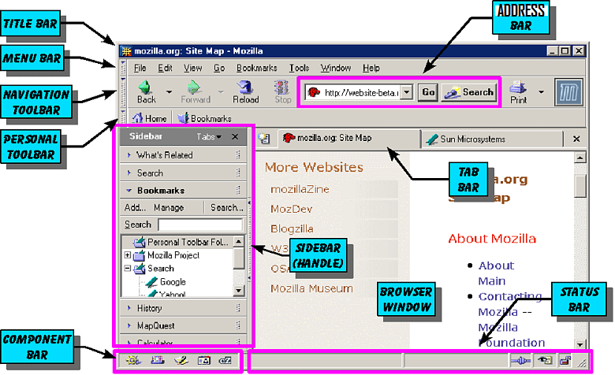
8.3.1 Defining a web browser
This is the type of software that is used for displaying Webpages from the internet or html documents on computers. It enables people to browse the World Wide Web.

Slide 47
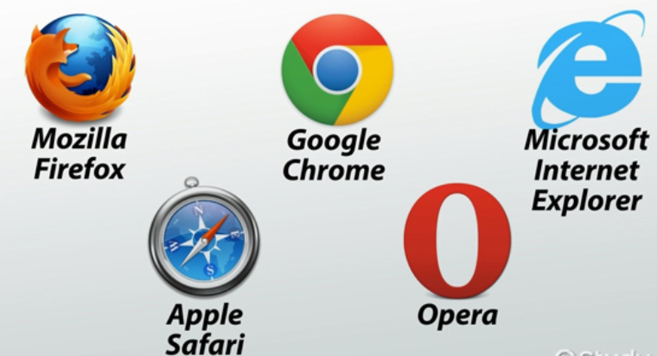
8.3.2 Identifying different web browsers
There are hundreds of web browsers. Popular ones include: Mozilla Firefox, Google Chrome, Opera, Apple Safari and Microsoft Internet Explorer/ Edge

Slide 48
8.3.3 Defining a search engine
The world wide web is a big place. If you know the web address, or URL, of a site you can find it by typing it into the address bar along the top of your browser. But what if you don’t know the URL?
You can find pages easily search by using a search engine.
A web search engine is a system that takes in user keywords, looks for information on the World Wide Web and return a line of results (hits), usually in form of a mix of links to matching webpages.

Slide 49
8.3.3 Defining a search engine
How search Engines Work
Web search engines work by storing information about many web pages, which they retrieve by a spider (an automated Web crawler) which follows every link on the web pages.
The search engine analyzes the contents of web pages and determines words to store in an index database.
Index words can be extracted from the
titles,
page content,
headings (eg <H1>, <H2>), etc or
special fields called meta tags.

Slide 50
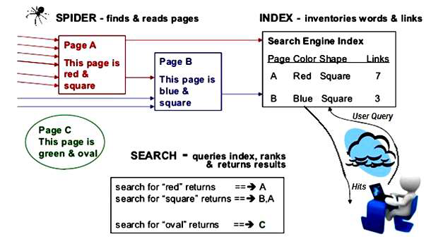
8.3.3 Defining a search engine
How search Engines Work
When a user enters a query into a search engine (typically by using keywords), the engine examines its index database and provides a listing of best-matching web pages according to its criteria, usually with a short summary containing the document's title and sometimes parts of the text.

Slide 51
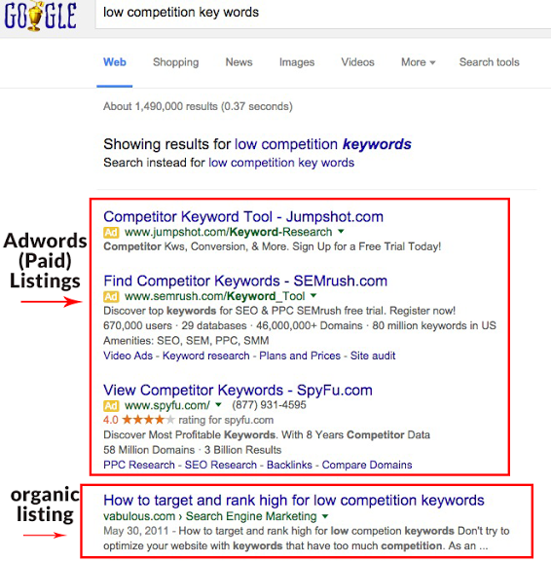
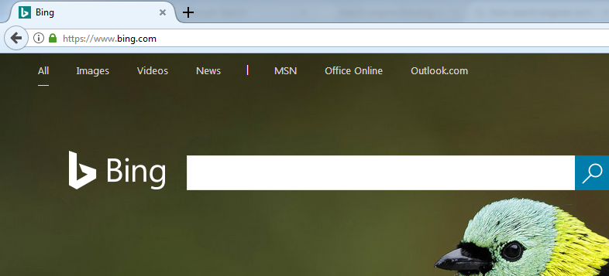
8.3.4 Identifying different search engines
Popular search engines on the world wide web include
Google,
Bing,
Yahoo,
Ask.com, AOL.com, etc

Slide 52

8.3.5 Searching for information from the web
Effective Internet Searching
The challenge is to ask your question the right way, so that you don’t end up overwhelmed with too many search results, underwhelmed with too few, or simply unable to locate the material that you need.
Keywords: Search engines don’t read sentences the way people do: instead, they look for the key words in your query in the websites they search. Common words are ignored (that, to, which, a, the, …)
SEARCH STRATEGIES
Keyword Searching
Boolean
Advanced
Specify Filetypes
Search within a website
Search By Date
Use browser history etc

Slide 53
8.3.6 Using search engine syntax
Use “quotation marks” to search as a phrase and keep the words linked together.
+ and – can be used to include or exclude a word
Boolean Syntax: Enter words and connect with Boolean Operators: AND, OR, NOT
AND will include sites where both words are found. Uses: joining different topics eg (ie. “global warming” AND California).
OR - requires at least one of the terms is found Uses: join similar or synonymous topics (ie. “global warming” OR “greenhouse effect”)
NOT – searches for the first term and excludes sites that have the second term Uses: join similar or synonymous topics (ie. Washington NOT school)

Slide 54
8.3.6 Using search engine syntax
Other Syntax:
The wildcard operator (*): Google calls it the fill in the blank operator. For example, amusement *
Site search: Many Web sites have their own site search feature, but you may use a search engine to get results from one website Example: site:www.newvision.co.ug ICT in schools.
Related sites: For example, related:www.youtube.com can be used to find sites similar to YouTube.
etc

Slide 55
8.3.7 Defining a website
A collection of linked Web pages that has a common theme or focus is called a Web site.
The Web (World Wide Web) consists of websites hosted on servers on the internet globally.
Webpages are electronic documents with text and graphic images, written in Hyper Text Markup Language (HTML).
Websites contain information organized into Web pages.
It contains hypertext links, or highlighted keywords and images that lead to related information.
The main page that all of the pages on a particular Web site are organized around and link back to is called the site’s home page.

Slide 56
8.3.7 Defining a website
Client/Server Structure of the Web
Web is a collection of files that reside on computers, called Web servers, that are located all over the world and are connected to each other through the Internet.
When you use your Internet connection to become part of the Web, your computer becomes a Web client in a worldwide client/server network.
A Web browser is the software that you run on your computer to make it work as a web client.

Slide 57
8.3.7 Defining a website
Hypertext Markup Language (HTML)
WebPages are written in HTML, which is interpreted by web browsers.
HTML uses codes, or tags, to tell the Web browser software how to display the text contained in the document.
For example, a Web browser reading the following line of text:
<B> A Review of the Book<I>Wind Instruments of the 18th Century</I></B>
recognizes the <B> and </B> tags as instructions to display the entire line of text in bold and the <I> and </I> tags as instructions to display the text enclosed by those tags in italics.

Slide 58
8.3.7 Defining a website
Website Addresses
Each computer on the internet does have a unique identification number, called an IP (Internet Protocol) address.
The IPv4 addressing system uses a four-part number. For example, 106.29.242.17
Most web browsers do not use the IP address to locate Web sites and individual pages.
They use domain name addressing.
A domain name is a unique name associated with a specific IP address by a program that runs on an Internet host computer.
This program, which coordinates the IP addresses and domain names for all computers attached to it, is called DNS (Domain Name System ) software.

Slide 59
8.3.7 Defining a website
Uniform Resource Locators
The IP address and the domain name each identify a particular computer on the Internet.
However, they do not indicate where a Web page’s HTML document resides on that computer.
To identify a Web pages exact location, Web browsers rely on a Uniform Resource Locator (URL).
URL is a four-part addressing scheme that tells the Web browser:
What transfer protocol to use for transporting the file
The domain name of the computer on which the file resides
The pathname of the folder or directory on the computer on which the file resides
The name of the file

Slide 60
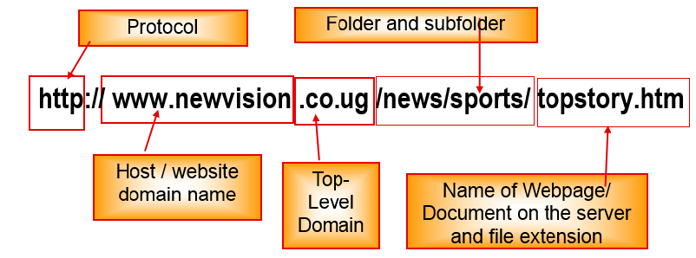
8.3.7 Defining a website
Structure of a Uniform Resource Locator
pathname
protocol
http://www.chicagosymphony.org/civicconcerts/index.htm
File/webpage
http => Hypertext Transfer Protocol
Domain name

Slide 61
8.3.7 Defining a website
READING WEB ADDRESSES
Let's look at the parts of a typical URL:
http://www.sc.edu/beaufort/library/pages/bones/lesson1.html
Here's what it all means:
"http" means hypertext transfer protocol and refers to the rules used to transfer and deal with information
"www" stands for World Wide Web and is the general name for the host server that supports text, graphics, sound files, etc. (It is not an essential part of the address, and some sites choose not to use it)
"sc" is the second-level domain name and usually designates the server's location, in this case, the University of South Carolina
"edu" is the top-level domain name (see below)
"beaufort" is the directory name
"library" is the sub-directory name
"pages" and "bones" are the folder and sub-folder names
"lesson1" is the file name
"html" is the file type extension and, in this case, stands for “hypertext mark-up language" (that's the language the computer reads).

Slide 62
8.3.8 Types of websites
1. Web portal : An internet-based website that can perform many electronic functions and provide the user with quick access to a variety of information and services. EG. UNEB Results Portal
2. Content aggregator: Combines information such as news and entertainment, sports scores, weather forecasts, photographs and video from a variety of sources and makes the combined content available to its customers e.g Web-based feed readers like RSS Feeds, delicious.com, etc.
3. A wiki: A website that allows collaborative editing of its content and structure by its users. E.g. Wikipedia
4. A blog: A blog is a website in which journal entries are posted on a regular basis. A person who posts entries is called a blogger
Blog posts are typically displayed in reverse chronological order (the most recent post appears first).A majority are interactive, allowing visitors to leave comments.

Slide 63
8.3.8 Types of websites
5. Media sharing website
Media sharing sites allow you to upload your photos, videos and audio to a website that can be accessed from anywhere in the world. E.g youtube.com, dailymotion.com, blip.tv, slideshare.net, archive.org, podbean.com, and many, many others.
6. Social networking Website
An online service, platform, or site that focuses on building social relations among people who share interests by posting information, comments, messages, images, etc.
A type of website where users can seek others who share their interests, find out what's going on in their areas of concern, and share information with one another
Examples include i).Facebook (ii) Twitter (iii) Google Plus, etc.

Slide 64
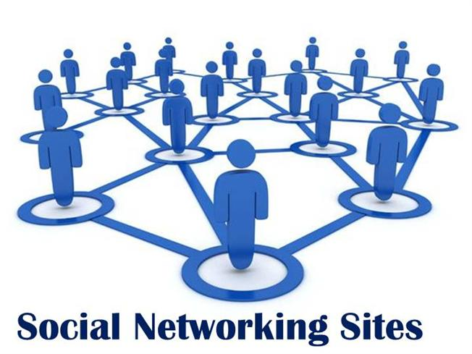
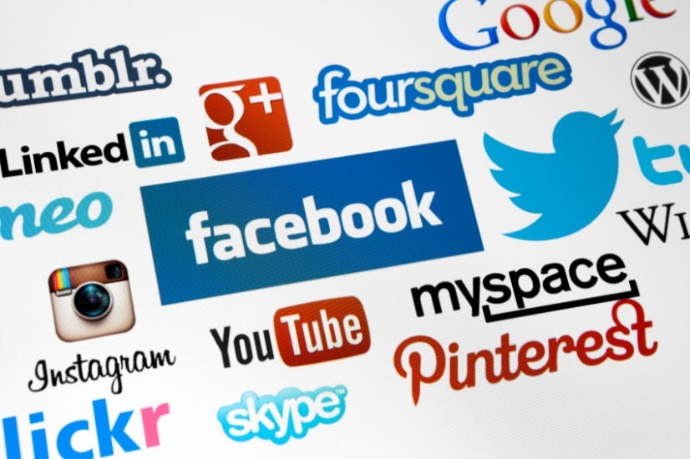
8.3.8 Types of websites
Social Networking Websites: Advantages
Staying Connected: The main purpose of social media is to be able to stay connected to friends and families The main purpose of social media is to be able to stay connected to friends and families
Finding People With Common Interests: Social networking is also a great way to meet peers.
Invaluable Promotional Tool: Companies, artists, etc use Social Media for advertising to the masses
Information Spreads Incredibly Fast Breaking news and other important information can spread like wildfire on social media sites.
Helps To Catch And Convict Criminals: The Police uses social media to to persecute criminals.
Notes:
Social networking is a relatively new advancement in technology. They are different platforms or websites that people can create personal profiles, share pictures, videos, and text updates to their friends, family, and people from all over the world. News, trends, videos, pictures, and just about anything else can go “viral” in a matter of hours, which makes you wonder, what is all of the craze about? It is very easy to get carried away with the attention and interactions you can have twenty four hours a day on websites like Facebook, Twitter, and Instagram, but what are the pros and cons that these social networking sites are having on our society?
The Pros of Social Networking
1. Staying Connected The main purpose of social media is to be able to stay connected to friends and families in today’s fast paced and ever changing worlds. You are able to rekindle old friendships, share family photos, and special events in your life with just about everyone you know, at the same time.
2. Finding People With Common Interests Social networking is also a great way to meet entirely new people. You can seek out groups that are focused towards your special interests and hobbies and connect with local people that share the same interests. Online and social media dating is almost more common than traditional dating is in today’s world.
3. Invaluable Promotional Tool Companies, artists, and musicians can reach an impossibly large and diverse amount of people using social media sites. This allows them to promote and market themselves and their products in a way that has never been seen before.
4. Information Spreads Incredibly Fast Breaking news and other important information can spread like wildfire on social media sites. Important things like recalls, storm information, or missing children are all communicated and taken seriously very quickly.
5. Helps To Catch And Convict Criminals People often do not think of the consequences of what they post of these social sites. Pictures of themselves doing illegal things, or even bragging posts about crimes they have committed are all things that law enforcement use to persecute these criminals. They also use these sites to identify and solve existing cases.
The Cons of Social Networking
1. Perpetuates False And Unreliable Information Just like stated above, anything can spread to millions of people within hours or days on social media. This also, unfortunately, includes things that are false or made up. This information can cause panic and severe misinformation in society.
2. Causing Major Relationship Problems Online social interactions with social networking have not only been starting new relationships, but ending many others. It is very simple to communicate and share pictures or plans with a person on social media and keep it completely under wraps. This new temptation has been driving wedges into people’s real life, offline relationships, often time ending them for good. Social networking puts trust to the limit.
3. Cyber Bullying Is A Growing Problem Having access to people’s lives at all times is not always a good thing. A new trend of cyber bullying is wreaking havoc all across the world. This is especially true with young kids. They are publicly harassing one another, and posting mean or slanderous things which are broadcast-ed to the entire cyber world.
4. Used To Profile and Discriminate In The Job World Just about everyone has a social media account the shows what they look like, the type of life that they live, and how old they are. Employers are using this to their advantages is some very unsettling ways. Jobs that are looking for a certain criteria of person, but cannot legally express these criteria, are using social media to prescreen their applicants.
5. The Addiction Is Real One of the biggest problems with the social media craze is that people are becoming more and more addicted to using it. It is the number one time waster at work, in school, and at home. All of this has caused people to have literal withdraws from their social networks. Crazy
Source: https://futureofworking.com/10-advantages-and-disadvantages-of-social-networking/

Slide 65
8.3.8 Types of websites
Social Networking Websites: Disadvantages
Perpetuates False And Unreliable Information: Anyone can post any unverified rumours which cause panic and severe misinformation in society.
Causing Major Relationship Problems: Online social interactions have cause many breakups.
Cyber Bullying: A new trend of cyber bullying is wreaking havoc all across the world. This is especially true with young kids publicly harassing one another, and posting mean or slanderous things which are broadcasted to the entire cyber world.
Used To Profile and Discriminate In The Job World: Employers are using social media to pre-screen their applicants.
The Addiction Is Real: One of the biggest problems with the social media craze is that people are becoming more and more addicted to using it. It is the number one time waster at work, in school, and at home.
Privacy Violation: Social Networks may violate privacy in case someone else gets to know your user password.
Misinterpretation: One has to be careful while posting any kind of information on social networks. If typed in a hurry, the matter could be misinterpreted.
Notes:
Social networking is a relatively new advancement in technology. They are different platforms or websites that people can create personal profiles, share pictures, videos, and text updates to their friends, family, and people from all over the world. News, trends, videos, pictures, and just about anything else can go “viral” in a matter of hours, which makes you wonder, what is all of the craze about? It is very easy to get carried away with the attention and interactions you can have twenty four hours a day on websites like Facebook, Twitter, and Instagram, but what are the pros and cons that these social networking sites are having on our society?
The Pros of Social Networking
1. Staying Connected The main purpose of social media is to be able to stay connected to friends and families in today’s fast paced and ever changing worlds. You are able to rekindle old friendships, share family photos, and special events in your life with just about everyone you know, at the same time.
2. Finding People With Common Interests Social networking is also a great way to meet entirely new people. You can seek out groups that are focused towards your special interests and hobbies and connect with local people that share the same interests. Online and social media dating is almost more common than traditional dating is in today’s world.
3. Invaluable Promotional Tool Companies, artists, and musicians can reach an impossibly large and diverse amount of people using social media sites. This allows them to promote and market themselves and their products in a way that has never been seen before.
4. Information Spreads Incredibly Fast Breaking news and other important information can spread like wildfire on social media sites. Important things like recalls, storm information, or missing children are all communicated and taken seriously very quickly.
5. Helps To Catch And Convict Criminals People often do not think of the consequences of what they post of these social sites. Pictures of themselves doing illegal things, or even bragging posts about crimes they have committed are all things that law enforcement use to persecute these criminals. They also use these sites to identify and solve existing cases.
The Cons of Social Networking
1. Perpetuates False And Unreliable Information Just like stated above, anything can spread to millions of people within hours or days on social media. This also, unfortunately, includes things that are false or made up. This information can cause panic and severe misinformation in society.
2. Causing Major Relationship Problems Online social interactions with social networking have not only been starting new relationships, but ending many others. It is very simple to communicate and share pictures or plans with a person on social media and keep it completely under wraps. This new temptation has been driving wedges into people’s real life, offline relationships, often time ending them for good. Social networking puts trust to the limit.
3. Cyber Bullying Is A Growing Problem Having access to people’s lives at all times is not always a good thing. A new trend of cyber bullying is wreaking havoc all across the world. This is especially true with young kids. They are publicly harassing one another, and posting mean or slanderous things which are broadcast-ed to the entire cyber world.
4. Used To Profile and Discriminate In The Job World Just about everyone has a social media account the shows what they look like, the type of life that they live, and how old they are. Employers are using this to their advantages is some very unsettling ways. Jobs that are looking for a certain criteria of person, but cannot legally express these criteria, are using social media to prescreen their applicants.
5. The Addiction Is Real One of the biggest problems with the social media craze is that people are becoming more and more addicted to using it. It is the number one time waster at work, in school, and at home. All of this has caused people to have literal withdraws from their social networks. Crazy
Source: https://futureofworking.com/10-advantages-and-disadvantages-of-social-networking/

Slide 66
8.3.8 Types of websites
Sample Examination Type Question:
(a) The World Wide Web has greatly evolved and it consists of different types of websites, including blogs and wikis. Tabulate three differences between blogs and wikis. (3 marks)
(b) Describe two ways to evaluate the reliability of information found on a website. (2 marks)

Slide 67
8.3.8 Types of websites
Possible Answer:(a) Differences between a Blog and a Wiki
Blog | Wiki
Blog usually has a single author | a Wiki usually has many authors
Blog is usually in reverse chronological structure | a Wiki has a structure determined by content and users
Blog is usually personal/someone’s opinion | a Wiki is usually objective
The public can’t edit someone’s blog, can only add comments to a blog. | a Wiki can be edited by the public users.

Slide 68
8.3.8 Types of websites
B)Evaluating the reliability of information found on a website
Check the last part of the URL. The top level domain can help to identify reliability (for example .gov, .ac, .ed, .sch are usually fairly reliable, while.org, .co, .com are less reliable).
See if responsible bodies have endorsed the site e.g. UNEB. If site is endorsed by reliable/reputable people/organizations it can be accepted as being reliable.
Checking the author’s credentials. If the author’s credentials are good it is likely to be reliable.
Can compare information from sites to see if it is reliable. If information is comparable to information from reliable/ authenticated/text books it is likely to be reliable.
Check the date of the last update. If the date of the last update was a long time ago it is likely to be unreliable.
Are any advertisements present? If site has excessive advertising it could be unreliable. If the advertising is related only to its own products it could be unreliable. If it has testimonials it is likely to be reliable.

Slide 69
8.3.9 Cloud computing
Cloud computing is Internet-based computing, whereby shared resources e.g hardware, software and information are provided to other devices on-demand.
In simple terms, Cloud computing is using the internet to access someone else's software running on someone else's hardware in someone else's data center.
Cloud computing operates on a similar principle as web-based email clients, allowing users to access all of the features and files of the system without having to keep the bulk of that system on their own computers. In fact, most people already use a variety of cloud computing services without even realizing it such as Gmail, Google Drive, Google Docs, etc.
The online software services ‘on the cloud’ have long been referred to as Software as a Service (SaaS) and the hardware as Infrastructure as a service (IaaS).

Slide 70
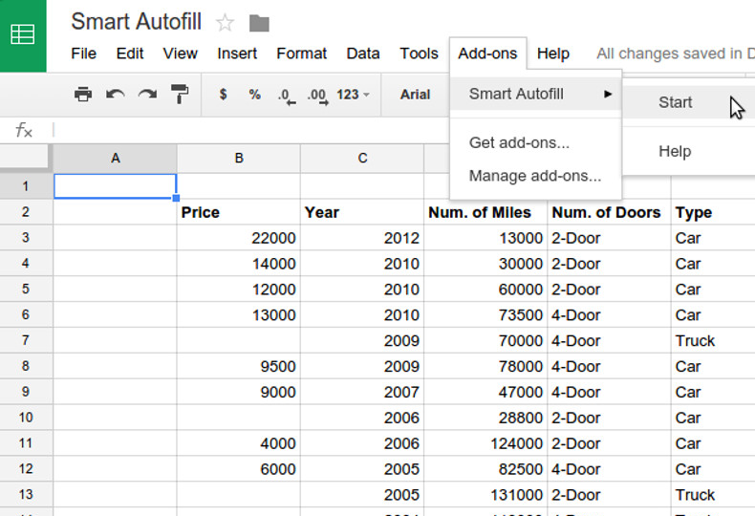
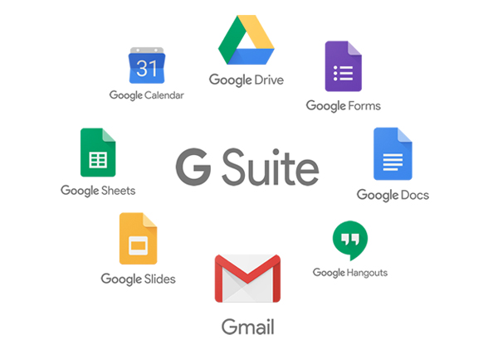
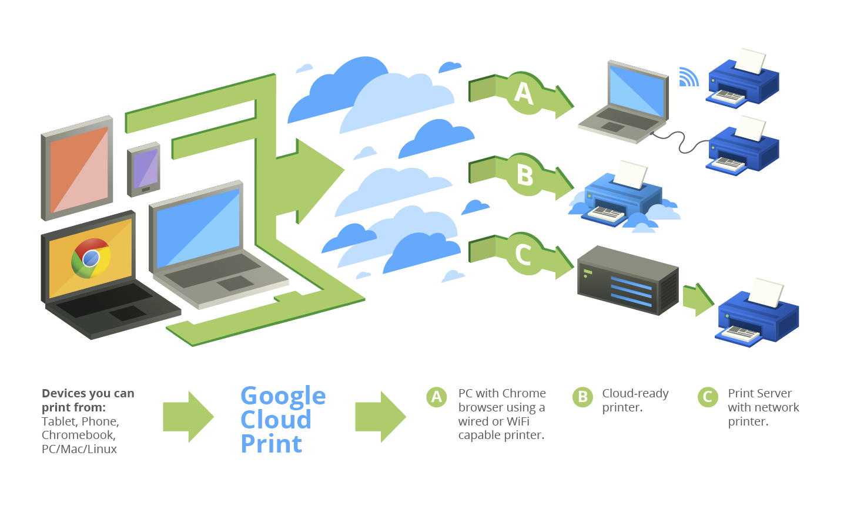
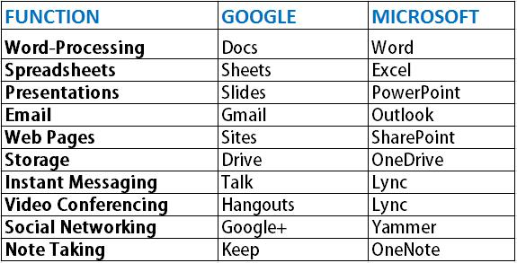
8.3.9 Cloud computing
Some Examples of Cloud computing applications
Right: Online Google Sheets, Part of Google Docs Suite, the Cloud Alternative to Microsoft Office Programs
Comparison of Google Suite vs Microsoft Suite
Google Cloud Print Service

Slide 71
8.3.9 Cloud computing
Advantages of Cloud Computing
Lower computer costs:
You do not need a high-powered and high-priced computer to run cloud computing's web-based applications.
Since applications run in the cloud, not on the desktop PC, your desktop PC does not need the processing power or hard disk space demanded by traditional desktop software.
Improved performance: With few large programs hogging your computer's memory, you will see better performance from your PC.
Reduced software costs:
Instead of purchasing expensive software applications, you can get most of what you need cheaply, e.g most cloud computing applications today, such as the Google Docs suite better than paying for similar commercial software.
Better Security: By using encryption, information on the cloud is less accessible by hackers or anyone not authorized to view the data. As an added security measure, with most cloud-based services, different security settings can be set based on the user.

Slide 72
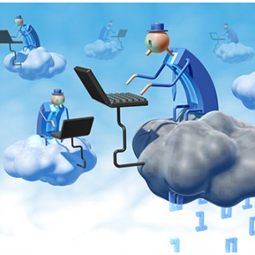
8.3.9 Cloud computing
Advantages of Cloud Computing
Instant software updates:
Another advantage to cloud computing is that you are no longer faced with choosing between obsolete software and high upgrade costs.
When the application is web-based, updates happen automatically.
Improved document format compatibility.
You do not have to worry about the documents you create on your machine being compatible with other users' applications.

Slide 73
8.3.9 Cloud computing
Advantages of Cloud Computing
Unlimited storage capacity: Cloud computing offers virtually limitless storage on servers in powerful datacenters.
Increased data reliability/ safety: Unlike desktop computing, in which if a hard disk crashes and destroy all your valuable data, a computer crashing in the cloud should not affect the storage of your data.
Universal document access: That is not a problem with cloud computing, because you can access it whenever you have a computer and an Internet connection.
Easier group collaboration: multiple users can collaborate easily on documents and projects
Device independence: Even to a portable device, and your applications and documents are still available.

Slide 74
8.3.9 Cloud computing
Disadvantages of Cloud Computing
Requires a constant Internet connection: Cloud computing is impossible if you cannot connect to the Internet. A dead Internet connection means no work.
Does not work well with low-speed connections: Web-based applications require a lot of bandwidth to download, as do large documents.
Features might be limited: Many web-based applications simply are not as full-featured as their desktop-based applications. For example, you can do a lot more with Microsoft PowerPoint than with Google Presentation's web-based offering.

Slide 75
8.3.9 Cloud computing
Disadvantages of Cloud Computing
Can be slow: Even with a fast connection, web-based applications can sometimes be slower than accessing a similar software program on your desktop PC. Everything about the program, from the interface to the current document, has to be sent back and forth from your computer to the computers in the cloud.
Stored data might not be secure: With cloud computing, all your data is stored on the cloud. Any unauthorised users gaining access to your password may access confidential data.
Migration issues: Each cloud systems uses different protocols and different APIs, so your normal applications will have to be adapted to execute on these platforms.

Slide 76
Subsidiary ICT for Uganda
End of Topic 8:
Internet and World Wide Web
Next Topic:
Topic 9: Computer Word Processing II

