Slide 1
Subsidiary ICT for Uganda
Curriculum Topic 11 out of 15: DATA COMMUNICATION AND NETWORKING
Recommended Coverage Duration: 18 periods (3 weeks)
Senior Six Term I
Notes:
Guidance to the Teacher
It is important for the learners to interact with all the data communication tools mentioned in this topic for them to appreciate and clearly make a distinction between their usage.
You are advised to use physical network devices as visual aids for the learners to visualise and learn from.
Prepare activities that allow learners to work individually or in groups to identify and list the components of a computer network and their uses, to identify and list the implications of a computer network.
Suggested Competences for Assessment
Assess the learners’ ability to effectively communicate using data communication tools and explain the types of computer networks.

Slide 2
Background
Communication is one of the fundamental aspects of life. In this regard, electronic communication means have been developed on top of the traditional manual and mechanical modes of communication for individuals and organisations to communicate more effectively. A person can now communicate through contemporary media like mobile phones and over the internet.
It is therefore important that learners are introduced to basic data communication and ICT networking infrastructure and services in order to come to terms with contemporary data communication facilities.
Learning Outcome: The learner should develop basic skills, knowledge and expertise in the use of contemporary communication facilities like computers, mobile telephones, the Internet, among others.

Slide 3
Presentation Outline
UACE Sub – ICT Topic 11/15:
Data Communication and Networking
Sub Topic 11.1: Introduction to Data Communication
Sub Topic 11.2: Introduction to Computer Networks

Slide 4
Sub Topic 11.1: Introduction to Data Communication
Sub topic Objectives:
defining data communication.
explaining the elements of data communication (sender, receiver, messages, transmission media and protocol).
defining data communication tools
describing types of electronic data communication tools like computers, mobile phones, the Internet, among others.
comparing electronic and manual data communication tools (manual drums, bells and messengers).
defining data transmission media.
differentiating between physical transmission media and wireless transmission media.
describing services offered by data communication tools like E-mail, Skype, News groups, and instant messaging.
explaining the implications of using data communication services.

Slide 5
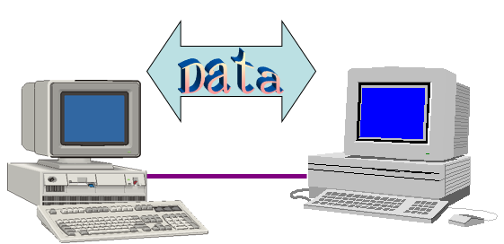
a) Data communication
Data Communication refers to the transmission of data between two connected devices.
Data communication is the transmission of electronic data over a medium.
Data communication can be as simple as a having a laptop connected to a mobile phone.

Slide 6
b) Elements of data communication
Sender. The computer or device that generates and sends data is called the sender, source or transmitter. It can be a computer, workstation (node), telephone handset, video camera. Etc.
Message: is the information or data to be communicated. It consists of text, numbers, pictures, sound or video.
Transmission Medium. is the physical pathway by which a message travels from sender to receiver.
Receiver. The device or computer that receives the message is called receiver. The receiver can be a computer, printer, a fax machine, etc.

Slide 7
b) Elements of data communication
Protocol: a set of rules that allow devices to exchange information. A protocol defines the format for communication between systems. For example the Hyper Text Transfer Protocol (HTTP) defines the format for communication between Web browsers and Web servers on the internet.
Other examples of communication protocols include: Internet Protocol (IP), Transmission Control Protocol (TCP), Trivial File Transfer Protocol (TFTP), Wireless Application Protocol (WAP), and Simple Mail Transfer Protocol (SMTP ) - for emails.

Slide 8
c) Data communication tools
Data communication tools are devices that enable the users to send and receive messages. Etc.
Data communication tools can be categorised into two: electronic and manual data communication tools.
Electronic data communication tools use electric power. Examples include Computers, Mobile phones and internet.
Manual data communication tools don’t use electricity. Examples include drums, bells and messengers.

Slide 9
d) Types of electronic data communication tools
As technology progresses, new communications are born and old fade away. When you're trying to connect with employees, colleagues, bosses, clients, customers or suppliers electronic media are critical to getting business done efficiently and cost-effectively.
Examples of data communications tools include Computers, Fax machines, Radio and Television, Mobile Devices like phones and PDAs, internet services (Email, Websites, Social networking, chartrooms Forums, etc).

Slide 10
e) Comparing electronic and manual data communication tools
Manual data communication tools | Electronic data communication tools
-Do not use power and transmit slower | -Are quick and fast especially over networks.
-Cover a short distance | -Cover a large distance
-Do not support digital information | -Support digital information
-Require a low level of literacy to operate. E.g the drums | -Usually require a higher level of literacy to use, e.g computers.

Slide 11
f) Data transmission media
The term transmission media refers to any physical or non-physical link / pathway between two or more devices and in which a signal can be made to flow from source to destination.
A data signal cannot be sent from one place to another without a medium of communication.
Data communication media can be divided into two:
1. Physical /Wired / Bounded/ Guided transmission media
2. Wireless / Unbounded / Unguided transmission media

Slide 12
f) Data transmission media
Transmission Media
Guided/ Bounded/ Physical / Wired
Unguided/ Unbounded/ Wireless
Twisted Pair Cable
Coaxial Cable
Fiber Optic
Radiowave
Microwave
Infrared wave
Bluetooth
Satellite
Wifi
Terrestrial Microwave
RFID
Wimax
Shielded
Unshielded

Slide 13
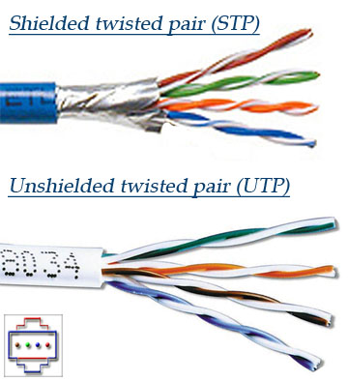
g) Physical transmission media and wireless transmission media
Physical media transmits data signals from the source to the destination through a restricted pathway such as a cable. Examples include:
Twisted pair cable: Twisted pair cable is made up of solid copper wire strands wound in pairs within a single media. The winding of the wires is meant to avoid the development of an electromagnetic field around the two wires as they transmit data.
TP is commonly used to interconnect devices on a Local Area Network.
There are two common types of twisted pair cabling, STP and UTP. The S stands for Shielded, the U stands for Unshielded.
The extra covering in shielded twisted pair wiring protects the transmission line from electromagnetic interference leaking into or out of the cable, but makes it more expensive.

Slide 14
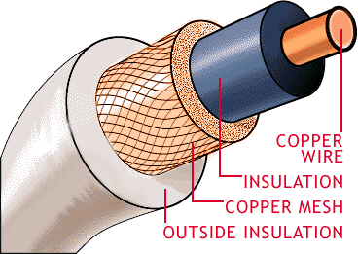
g) Physical transmission media and wireless transmission media
Coaxial cables. Coaxial cables consist of a core copper wire in the center enclosed in an insulating sheath, followed by hollow mesh conductor which is covered by a shield making the cable more resistant to electromagnetic interference than the twisted pair cable.
Coaxial cables have bandwidths in Gigabits per second. Hence, they are installed in a network to form the network backbone.

Slide 15
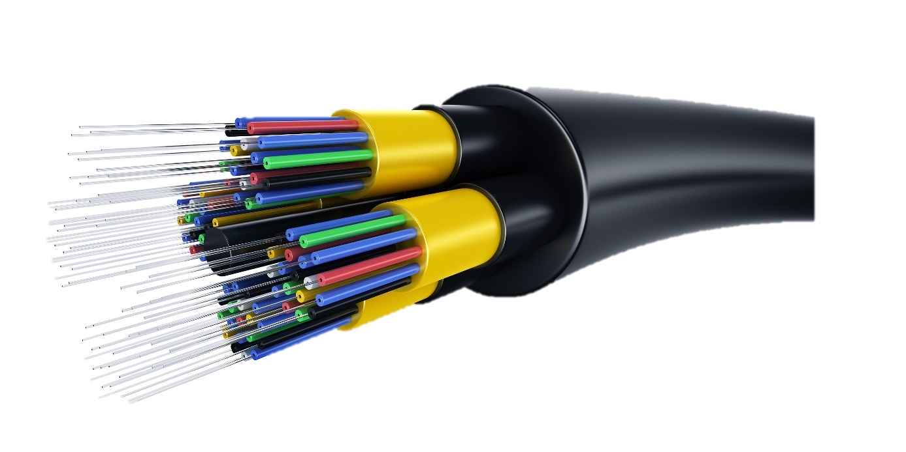
g) Physical transmission media and wireless transmission media
Fibre optic cable. Fibre optic cable utilizes light to transmit data from one point to another on the network. The electrical signal from the source are converted to light signals, and then propagated along the fiber optic cable.
To convert an electric signal to light, you need a light emitting diode (LED) at the transmitter. At the receiving end, a photosensitive device can be used to convert the light signals back to electric signals that can be processed by the computer. The fiber optic cable is made of hair-like glass strands, cladding, buffer, a jacket.
They have the highest bandwidth as compared to other transmission media

Slide 16
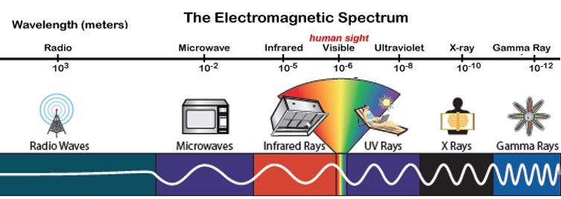
g) Physical transmission media and wireless transmission media
Wireless or unbounded media is that is where data signals flow through the air. In this case transmitting antenna and receivers aerial facilitates the communication. Example of wireless transmission media include:
The major wireless transmission media include radio waves, microwaves, and infrared which are part of the electromagnetic spectrum, which is the range of all possible frequencies of electromagnetic radiation.

Slide 17
g) Physical transmission media and wireless transmission media
Radio waves: Radio waves frequencies are easy to generate and are widely used for communication, both indoors and outdoors. Examples of communication technologies using radio waves include Bluetooth, Wireless Fidelity (Wifi), and Wimax.
Bluetooth is a short range wireless based information transmission system which works on the basis of a microchips embedded in the digital devices like mobile phones, speakers.
Wireless Fidelity (Wifi) is used to create a hotspots from where information signals can be easily accessed by Wi-Fi enabled devices, forming a wireless local area network (WLAN).
Wimax stands for Worldwide Interoperability for Microwave Access. It is a telecommunication technology providing wireless data over long distances in a variety of ways from point to point links to full mobile cellular type access.
Radio-frequency identification (RFID) uses radio waves to automatically identify and track tags attached to objects. The RFID tag can be affixed to an object and used to track and manage inventory, assets, people, etc. For example, it can be affixed to cars, computer equipment, books etc.

Slide 18
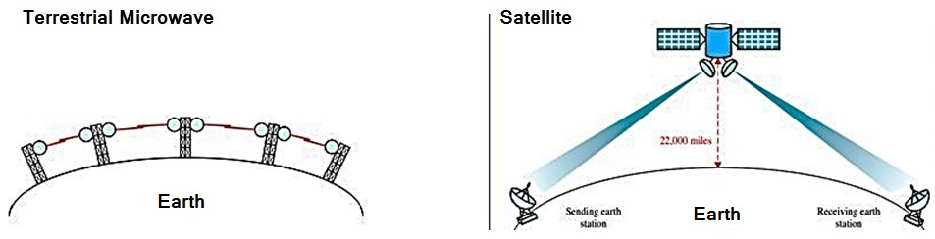
g) Physical transmission media and wireless transmission media
microwaves: Microwaves are high-frequency electromagnetic radiations that are sent through space to deliver telecommunications services. Microwaves are dependent on line of sight. Microwave communication systems are mainly classified into satellite and terrestrial.
Satellite microwave signals travel from Earth to a satellite in space and then back to a station on the earth.
Terrestrial microwave signals are sent from one ground-based antenna to another.

Slide 19
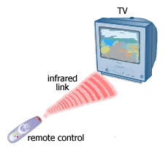
g) Physical transmission media and wireless transmission media
Infrared Rays use electromagnetic waves with smaller wavelength than radio and microwaves to transmit data. IrDA (Infrared Data Association) ports transmit data via infrared light waves.
As long as the devices are within a few feet and nothing obstructs the path of the infrared light wave, data can be transferred without the use of cables.
A TV remote control is an example of an Infrared application.

Slide 20
g) Physical transmission media and wireless transmission media
Advantages of physical over wireless transmission media
Physical media support higher bandwidth
They can carry voice, data and video signal simultaneously.
They are more resistant to radio and electromagnetic interference.
Disadvantages of physical transmission media
Installation is difficult because the cables must be carefully handled.
They are relatively complex to expand as compared to wireless
Cover short distance since they use the physical wires
Inconvenience due to inflexibility of restrictive cables.

Slide 21
h) Services offered by data communication tools
Data communication tools offer services like Telephone, SMS, E-mail, Skype, Newsgroups and instant messaging.
Telephone voice calls help keep people talking even when they are distant and mobile.
Short Messaging Services SMS facilitate sending and receiving of brief text messages
Electronic mail and fax : An electronic mail is the message transmitted electronically over the internet, from one user to another. A fax machine is a device that transmits and receives typed or hand written documents over telephone lines.
Skype supports voice and video calls, text, instant messaging and sharing conversation with (someone) over the Internet using the software application Skype, frequently also viewing by webcam.
Newsgroups are organized group of internet users who wish to share ideas and interests through discussion forums and debates.
Instant messaging: This is a more enhanced messaging service that allows two or more people to chat directly in real time.
Social networking e.g. Facebook and Twitter create digital societies through linking people of common interests.

Slide 22
h) Implications of using data communication services.
Positive Implications
Have led to faster, simpler communications between people e.g. through electronic-mail, mobile phones, social networks etc.
Communications costs have become lower e.g. Making cheap internet calls, for example via Google talk and Skype
Community mobilization now easier - its now very simple to send a message to many people in one go e.g using Mailing lists and group chats.
Data communication tools like the internet have facilitated emergence of the world wide web where there is a wealth of information, such as news, weather reports, and airline schedules.
Data communication tools like telephones and SMS Have revolutionised the way people transact businesses e.g access to mobile money services using phones.

Slide 23
h) Implications of using data communication services.
Negative Implications
Security and privacy: data communication services have made it easy access private information e.g. on social networks, hence posing security concern.
Spamming is high especially by advertisers who send unwanted e-mails in bulk, such as email adverts.
There has been emergency of new kinds of crimes facilitated by data communication services, such as cyberbullying.
Inaccurate information on the internet can be misleading and lead to dire consequences to the users.
Data communication services have facilitated the digital divide in society, hence disadvantaging the computer illiterate people when it comes to opportunities like jobs and government services.

Slide 24
Sub Topic 11.2: Introduction to Computer Networks
Sub topic Objectives:
defining a computer network.
explaining the basic requirements for setting up a computer network (Routers, transmission media, modems and network software like windows internet explorer.)
c. explaining the implications of computer networks.
d. identifying different types of computer networks (LAN, MAN, WAN).
e. explaining the Network models (Client-server, and Peer-to-peer).

Slide 25
a. Definition of a computer network
A computer network is defined as a collection of computers linked together using transmission media for the purpose of communication and resource sharing.
Some of the shared resources include internet connectivity, printers, fax machines, modems, storage devices, networked software programs etc.

Slide 26
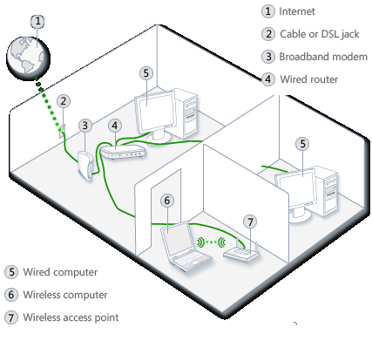
a. Definition of a computer network
An illustration of A SOHO (small office/ home office) network

Slide 27
b. Basic requirements for setting up a computer network
The basic requirements for setting up a computer network can be classified under
Data transmission media, [Already discussed in previous sub topic]
Networking Hardware / Communication devices like Routers, and modems
Networking software like windows internet explorer.

Slide 28
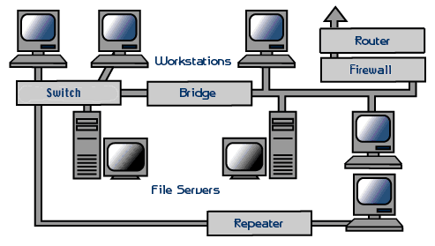
b. Basic requirements for setting up a computer network
NETWORKING HARDWARE includes all computers, peripherals and Communications devices that enable two or more computers to exchange items such as data, instructions, and information with each other.
Examples include: a network interface card, modem, Hub/ Switch, Router, repeater, network Bridge, Firewall etc.

Slide 29
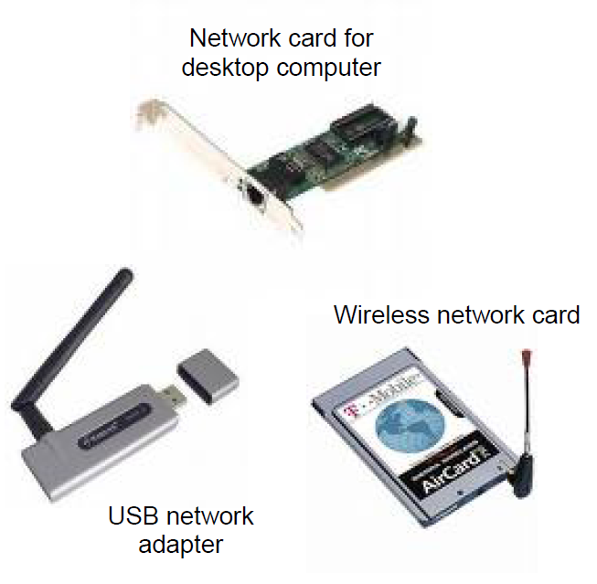
b. Basic requirements for setting up a computer network
A network interface card (NIC), is a device that enables the computer or device that does not have built-in networking capability to access a network.
Examples include adapter card, PC Card, USB network adapter, flash card e.t.c

Slide 30
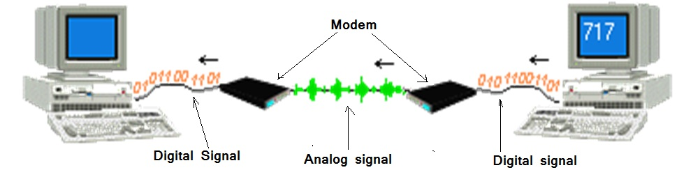
b. Basic requirements for setting up a computer network
A modem is a device which Modulates a digital signal from computers into an analog one to send data out over the phone line. Then for an incoming signal it Demodulates, the analog signal into a digital one.

Slide 31
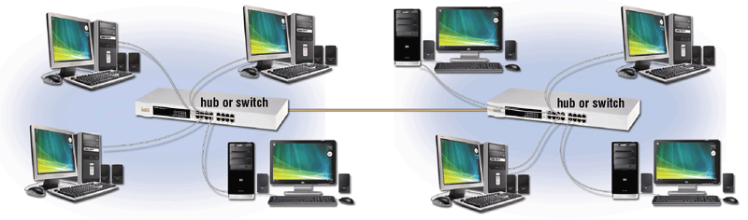
b. Basic requirements for setting up a computer network
A hub, (also called a multi-station access unit (MAU)) is a device that provides a central point for cables in a network.
Unlike the hubs, a switch does not broadcast the data to all the computers, it sends the data packets only to the destined computer.

Slide 32
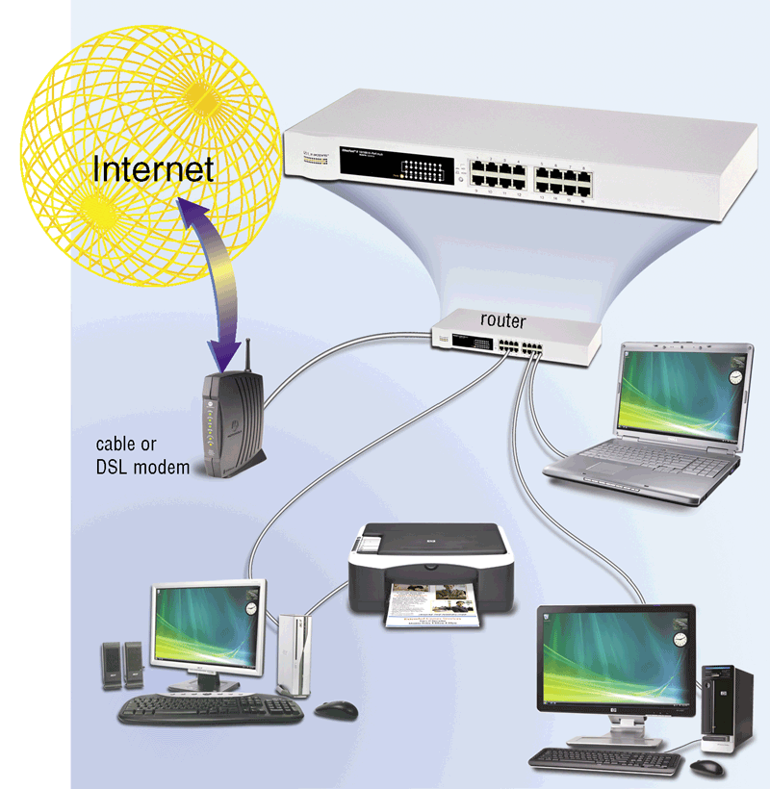
b. Basic requirements for setting up a computer network
A Router connects multiple networks and routs communications traffic to the appropriate network using the fastest available path.
A router allows multiple computers to share a single high-speed Internet connection such as through a cable modem

Slide 33
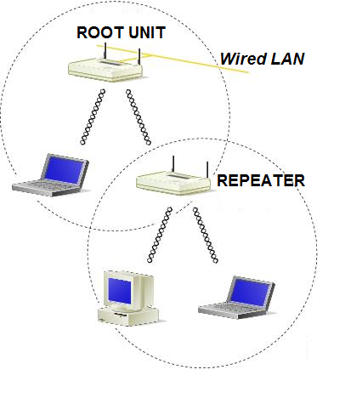
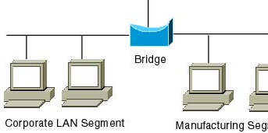
b. Basic requirements for setting up a computer network
A repeater is a device that accepts a signal from a transmission medium, amplifies it, and retransmits it over the medium. As a signal travels over a long distance, it undergoes a reduction in strength, an occurrence called attenuation.
A network bridge is device that connects two networks making each accessible to the other. A bridge knows all of the addresses on each side of the bridge and can send information accordingly.

Slide 34
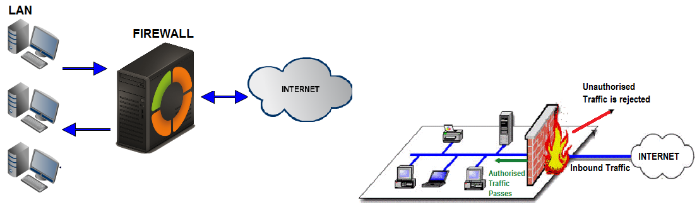
b. Basic requirements for setting up a computer network
A firewall is a networking device that is installed at the entrance to a LAN, particularly when connecting a private network to a public network, such as the internet. The firewall uses rules to filter inbound traffic into the private network, to protect the private network users and data from malevolent hackers. Unauthorized traffic is rejected, and authorized traffic passes as illustrated below.

Slide 35
b. Basic requirements for setting up a computer network
NETWORKING / COMMUNICATIONS SOFTWARE consists of programs that aid the setup and use of a network. It includes network operating systems (NOS) and network application software programs.
A network operating system (NOS) is the system software that organizes and coordinates the activities on a network.
NOS software consists of programs that help users establish a connection to another computer or network, such as network drivers, and manage the transmission of data, instructions, and information.
Examples of NOSs include: Novell NetWare, Microsoft Windows server 2008, 2012, 2016, Sun Solaris, etc.
Network application software
These are programs that provide an interface for users to communicate over computer networks. A variety of examples of application software for communications include:
E-mail client applications,
FTP programs,
Web browsers like Internet Explorer,
Newsgroup/ message boards,
Chat apps,
Instant messaging,
Video conferencing applications e.g. Skype, and VoIP.

Slide 36
c. Implications of computer networks. Advantages of Installing a Network
Speed. Networks provide a very rapid method for sharing and transferring files.
Enable central management of resources like an antivirus solution can be easily deployed and managed over a network, i.e. security updates are installed only on one Machine (server), and then all the Machines receive the update and get protected.
Cost saving- e.g. Networkable versions of many popular software programs are available at considerable savings when compared to buying individually licensed copies.
Easier backup especially in centralized databases.
Sharing resources such as laser printers, fax machines, modems, scanners, etc. is simplified
Improved collaboration. Networks allow users to access their files from computers throughout the network. Users can also work cooperatively through the network.

Slide 37
c. Implications of computer networks. Disadvantages of Installing a Network
Expensive to Install. Although a network will generally save money over time, the initial costs of installation, purchase of additional networking hardware can be prohibitive.
Requires Administrative Time. Proper maintenance of a network requires considerable time and expertise which usually requires hiring a network administrator, hence additional operating costs.
Security Issues. There are common cases of hackers accessing network resources and stealing data especially over wireless networks.
Computer Networks can fail. In case any network device or media gets a fault, the work is halted and every user is stranded.
Rapid Spread of Computer Viruses is usually facilitated by computer networks.

Slide 38
d. different types of computer networks
Local Area Network (LAN)
Personal area network (PAN)
Wide area network (WAN)
Campus Area Networks (CANs)
Metropolitan area networks (MANs)
Virtual Private Networks (VPNs)
Difference between Intranet, Extranet and Internet
A network can be relatively small or extensively large.
It can be setup for private-access or public-access
The most common types of computer networks include:

Slide 39
d. different types of computer networks
A local area network (LAN) is a network that connects computers in a small geographic area such as a building like a computer laboratory, or an office.
A wireless LAN (WLAN) is a LAN that uses wireless technologies such as Wi-Fi so connect the computers.
A personal area network (PAN) is a LAN within the range of an individual person, typically interconnecting personal devices like phone, tablet, laptop, speakers, music player, etc.

Slide 40
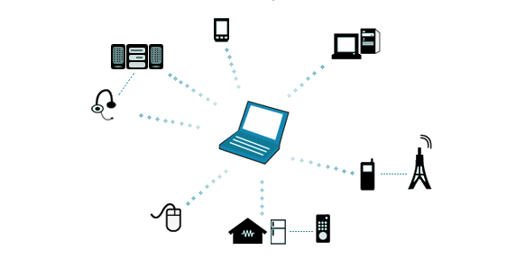
d. different types of computer networks
An example of a PAN is a person traveling with a laptop, a personal digital assistant (PDA), and a portable printer could interconnect them without having to plug anything in, using some form of wireless technology.

Slide 41
d. different types of computer networks
A wide Area Network (WAN) is a network that covers a large geographic area.
An example of a WAN is a network that connects the district office computers of a company across the country or across several counties in the world.
Computers are often connected to a WAN via public networks such as the telephone system or by dedicated lines or satellites.

Slide 42
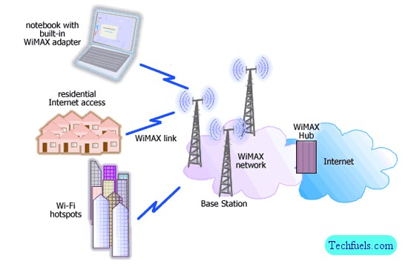
d. different types of computer networks
The Internet is the world’s largest WAN.

Slide 43
d. different types of computer networks
A metropolitan area network (MAN) is a large computer network that usually spans a city or a large campus. A MAN usually interconnects two or more LANs using a high-capacity backbone technology, such as fiber-optical links or other digital media. A MAN covers a smaller geographic area than a WAN.
A Campus Area Network (CAN) is a network that connects two or more LANs but is limited to a specific and contiguous geographical area such as a college campus, industrial complex, or a military base. It spans multiple LANs but smaller than a MAN

Slide 44
d. different types of computer networks
A virtual private network (VPN) extends a private network across a public network, and enables users to send and receive data across shared or public networks as if their computing devices were directly connected to the private network. Applications running across the VPN may therefore benefit from the functionality, security, and management of the private network.
VPNs may allow employees to securely access a corporate intranet while located outside the office. They are used to securely connect geographically separated offices of an organization, creating one cohesive network.

Slide 45
d. different types of computer networks
Individual Computer networks such LANS and PANs can be interconnected to form extended networks such as Intranets, Extranets and the Internet.
What is the difference between Intranet, Extranet and Internet?
Intranet is refers to an inter connection of private computer networks within an organization;
Extranet is and extension of an intranet - used even out side the organization.
Internet is global.

Slide 46
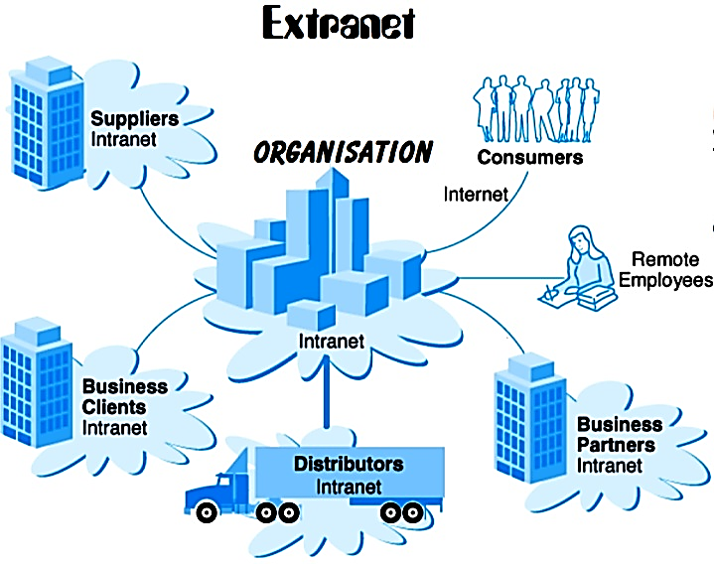
d. different types of computer networks
Extranets are extended private intranet networks that have been built in many organisations. Most extranets use the internet as the entry point for outsiders, a firewall configuration to limit access and a secure protocol for authenticating users.

Slide 47
e. explaining the Network models (Client-server, and Peer-to-peer)
A client/server network has one or more computers acting as a server while the other computers (i.e., clients) on the network can request services from the server.
A client computer is a computer that can access the resources on a network.
A server provides a centralized storage area for programs, data, and information.
A dedicated server is a server that performs a specific task. Examples of dedicated Servers include: file server, print server, database server, and a network server

Slide 48
e. explaining the Network models (Client-server, and Peer-to-peer)
A file server stores and manages files on a network
A print server manages printers and print jobs.
A database server stores and provides access to a database
A network server (e.g., a DNS) manages network traffic.
Requirements of a server computer
It needs a computer with very high processing speed
It needs large amounts of RAM
It needs a very big storage capacity
It needs a very fast Network interface card
It needs network operating system such as Novell Netware, Windows NT Server or Apple Share

Slide 49
e. explaining the Network models (Client-server, and Peer-to-peer)
Advantages of a Client/Server Network
All Resources are centralized and easier to access.
Easy management and administration of the network.
More data security since all network access is controlled through the server.
The network is flexible, because changes and new technology can be easily included into system.
Client /Server network is faster than P2P since data and resources are handled by a dedicated machine.
It is easy to backup all data stored centrally on the server.
Client Server network can support many computers as compared to a P2P network

Slide 50
e. explaining the Network models (Client-server, and Peer-to-peer)
Disadvantages of a Client /Server Network
It is expensive to set up as compared to a P2P network.
It requires an extra computer to serve as a dedicated server.
Maintenance – large networks will require an administrator staff to ensure efficient operation
Dependence – When the server goes down, operations will cease across the network
Server can get overloaded since all the processing is controlled at one point.

Slide 51
e. explaining the Network models (Client-server, and Peer-to-peer)
Peer-to-Peer Networks Involve the sharing of Information or resources between two or more computers connected to each other without the use of a Server. Each computer stores files on its own storage devices and each computer on the network contains both the network operating system and application software. It can use either Point to point Connections or Multi point Connections.
A point-to-point connection
Multipoint connection (multidrop)

Slide 52
e. explaining the Network models (Client-server, and Peer-to-peer)
Advantages of Peer to Peer Network
A peer-to-peer network is simple to setup i.e. does not require too much configuring.
It is not expensive to set up.
It does not require a dedicated server to control the network.
It is perfect for home and small business users.
Disadvantages of a Peer to Peer Network
The system is not centralized, making administration difficult.
Limited security i.e. files can be accessed by any one on the network

Slide 53
Subsidiary ICT for Uganda
End of Topic
11: Data Communication and Networking
Next Topic:
Topic 12: Electronic Publication

