Slide 1
EMERGENCE AND GROWTH OF NATIONALISM IN AFRICA

Slide 2
Content
Rise and growth of African Nationalism in
Ghana,
Mozambique and
South Africa.

Slide 3
Definition
Nationalism –
the feeling of national pride, patriotism, and belonging towards one's country.
It is also loyalty and devotion to one's country
It is a feeling based on common cultural char­acteristics that binds a population and produces a policy of national independence.

Slide 4
For the purpose of this topic our centre of interest will be on three African countries i.e.
Ghana
Mozambique
South Africa

Slide 5
African Nationalism
This is the African reaction and struggle against colonialism
African desire for independence and self deter­mination
African desire to determine their own affairs and destiny
Desire of different communities to fight for independence from their colonial masters

Slide 6
Factors for the rise of African Nationalism
Land alienation
Forced labour
Over taxation
Racial segregation
Western education made Africans aware of their rights
Urbanization made different communities interact
Colonial labour laws
Trade union movements
Role of independent church movements

Slide 7
Disregard of traditional rulers by colonialists
The Africans who participated in the 1st and 2nd world wars met Africans from other coun­tries and exchanged ideas
The Pan African movement
UNO after 1945 declared colonization as inhu­man and illegal and called for colonial powers to decolonize
The independence of India and Pakistan in 1947 inspired African Nationalists to demand for independence
Emergence of the labour party in Britain which did not favour colonization and began the recess of decolonization after coming to power
Communists attacked colonialism and argued that it was aimed at economic exploitation the weaker people of the world.

Slide 8
Nationalism in Ghana
Factors that facilitated the growth of Ghanaian nationalism
Discontentment of world war II ex-servicemen. who were not compensated for their services : war, and hence remained unemployed
Ghanaians who participated in World War II met with different people from other countries, with whom they shared ideas. This exposed them to radical nationalism
The granting of independence to India inspired Ghanaian nationalists
The colonial system of education produced many school leavers, who were jobless and frustrated

Slide 9
The British continued to exploit Ghanaian mineral and agricultural produce
Ghanaians were forced to cut down their cocoa trees due to the outbreak of the 'swollen shoot" disease
High prices of essential commodities in the towns
The African elite resented the fact that they were represented in the Legco by uneducated chiefs
Africans were denied import and export licences
Ghanaians got inspiration from the Pan-African movement
Their morale was boosted by the UNO, which supported decolonization.

Slide 10
Course of Ghanaian Nationalism
Nationalism in Ghana began in 1868 in response to British colonialism
Before the 2nd world war, Ghana's nationalism was mild but after the 2nd world war it became radical and demanded complete independence
Nationalism in Ghana was characterized by formation of political parties
The 1st party was National League of Gold Coast started by Akufo Addo in 1941
1947 - several parties merged together to form United Gold Coast Convention (UGCC)

Slide 11
During the Accra Riots of 1948, British sol­diers killed people who had marched to present their grievances, it caused riots in Accra which spread to other parts of the country
Nkrumah and others were arrested
The Watson Commission was set up and reported that oppressive social, economic and political conditions were the cause of the riots
A new constitution was recommended to cater for Ghanaian interests, black people to be given more say in the running of the country, reorganization of local government and devel­opment of education be greatly accelerated
In 1949 the Coussey Commission was appointed to prepare a new constitution for Ghana

Slide 12
Cont’
African nationalists were included with the exception of Nkrumah who was radical
The Commission recommended a semi-responsible government, an executive council and a nationally elected assembly with elections to be held in 1951
In 1949 Kwame Nkrumah formed Convention Peoples Party (CPP)
He rejected the Coussey constitution , demanded for independence and got support from the masses
In 1950, he encouraged constitutional strikes, boycotts and non co-operation without the use of violence, but violence broke out
The government declared a state of emergency

Slide 13
Kwame Nkrumah and officials of CPP were imprisoned
During his imprisonment newspapers campaigned for independence
In 1951 a general election was held, CPP won and Nkrumah was allowed to form a govern­ment and he became the leader of government business
In 1954, NLM (National Liberation Movement) emerged to compete with CPP
Two more elections were held in 1954 and 1956 but CPP won
On 5th March 1957, the country attained inde­pendence under CPP and Kwame Nkrumah became the first prime minister and changed the Country's name from Gold coast to Ghana.

Slide 14
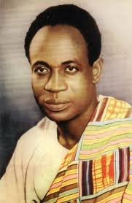
KWAMME NKRUMA OF GHANA: THE FIRST PRESIDENT OF GHANA

Slide 15
Methods used by Ghanaian nationalists in their struggle for independence
They made use of public rallies
Channeled their grievances through trade unions
Used protests and demonstrations against the colonial government
Use of international forums e.g. UNO
Participated in constitutional negotiations e.g. Coussey Commission
Wrote various publications e.g. Accra Evening News' through which they articulated their grievances
Participated in the pre-independence elections i.e. 1954, 1956.

Slide 16
Problems faced by Ghanaian nationalists
Disunity among Africans
Rivalry among political parties e.g. CPP and UGCC
Imprisonment and arrest of African nationalists
Lack of funds to finance their activities
Brutal killing of Africans e.g. in Accra riots
Poor means of transport and communications
Differences in ideologies or policies between political parties e.g. UGCC and CPP which was radical.

Slide 17
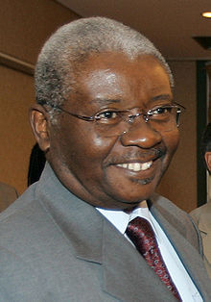
Nationalism in Mozambique
ARMANDO GEUBUZA
CURRENT PRESIDENT OF MOZAMBIQUE

Slide 18
Background
Mozambique was a Portuguese colony
Formal establishment of Portuguese rule started in 1891 as a result of Anglo-Portuguese treaty
As early as 1600, the Portuguese Crown (Gover­nment) had granted land in Mozambique to Portuguese settlers
In 1951, the government of Portugal declared Mozambique its colony and took over the administration from Portuguese companies until 1975.

Slide 19
Factors for the growth of nationalism in Mozambique
Internal factors that led to nationalism in Mozambique
Increased settlement of Portuguese citizens in Mozambique. By 1960 they were about 200,000
Land alienation by Portuguese settlers
Forced labour - Africans were forced to work on Portuguese farms
Poor working conditions for Africans

Slide 20
Africans were forced to grow cash crops and sell to particular companies
Drop in food production leading to famine
The policy of assimilation of Africans to the Portuguese way of life where many Africans could not qualify
Low wages and excessive poverty among Africans
Africans were not allowed to strike, form political associations and trade unions or fight for reforms or even vote
Inadequate medical facilities for Africans

Slide 21
Restriction of African movement in and out of Mozambique, hence they were not able to interact with other Africans elsewhere
Racial discrimination
Censorship of the press
Disrespect of African culture and traditional leaders
Arbitrary replacement of African traditional leaders with Portuguese appointees
Africans were forced to pay taxes.
Backward educational facilities for Africans.

Slide 22
External factors that led to nationalism in Mozambique
They were encouraged by independence of India in 1947, Pakistan 1949 and Ghana in 1957
Rise of cold war, where China a communist country became interested in Mozambique and gave advice and material support to the FRELIMO party
Pressure from USA asking European powers in Africa to decolonize, to check communism and open Africa for investment and trade
Formation of OAU (Organisation of African Unity) in 1963, called for the freedom of Africans from colonialism which encouraged Mozambican nationalists and other African countries.

Slide 23
Course of nationalism in Mozambique
In 1960 the Makonde people formed the African National Union (MANU).
It was the first political organization with its headquarters in Tanganyika
MANU organized a peaceful protest in June 1960 against forced labour and taxes. When the people resisted arrest, the governor ordered the police to open fire and killed about 600 Africans.
The government banned all African organiza­tions
In June 1962, three political organizations unit­ed and formed the Front for the Liberation of Mozambique (FRELIMO). Eduardo Mondlane was its president
From 1964 FRELIMO started full scale gueril­la warfare in Mozambique, with war breaking out at once in four provinces in the Northwest

Slide 24
This forced the Portuguese to station their troops all over the country. The war lasted eleven years
In 1969 Eduardo was assassinated and Samora Machel replaced him in 1970
In 1972, the Portuguese defeated FRELIMO after getting support from South African and Rhodesia
FRELIMO got support from ZANU fighters in Zimbabwe and by 1972, FRELIMO had liberated almost the whole of Mozambique.
In September 1974 the Portuguese government held peace talks with FRELIMO and agreed:-
To establish a provincial government consist­ing of Portuguese and FRELIMO ministers
The provincial government to be in office for nine months in order to oversee smooth transition to independence
On 25 the June 1975 Mozambique attained independence with Samora Machel as the first president.

Slide 25
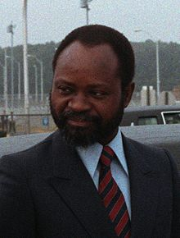
SAMORA MACHEL: THE FIRST PRESIDENT OF MOZAMBIQUE

Slide 26
Reasons why FRELIMO succeeded in its armed struggle against the Portuguese
It was well organized.
They used guerilla warfare in the heavily forested areas
They had support from the local people who joined the war, provided food, information and other necessities
FRELIMO also cultivated its own food to relieve the locals of the burden
FRELIMO knew the terrain well unlike the Portuguese who did not
FRELIMO was also supported by women who mobilized the communities to support the struggle and they also had guerilla units

Slide 27
FRELIMO had support from communist countries e.g. USSR and China, in form of train­ing of guerillas, provision of food, medicine, weapons and finances
It was also supported by independent African countries through OAU
The unity of Africans in fighting the common enemy
Coup in Lisbon (Portugal) carried out by officers who were against colonial wars. In September 1974, the army officers signed an agreement with FRELIMO
FRELIMO system of administration in liber­ated areas. In these areas it abolished:-
Forced labour, taxes e.t.c
Established schools and health centres
Abolished forceful cultivation of cash crops and peasants were allowed to form cooperatives. This made FRELIMO very popular and many Africans supported them.

Slide 28
Problems faced by FRELIMO in its struggle for independence
The West European countries did not support them
The Catholic Church viewed it negatively as a terrorist organization which made African Catholics reluctant to support it
Assassination of Eduardo on 3rd February 1969 was a setback to the struggle
Severe shortage of food, clothes, medicine when the war started. The peasants migrated to areas where supplies were available hence withdrawing their support
Internal division, competition and rivalry with FRELIMO because of ideological differences and selfish ambition among the leaders

Slide 29
It was difficult to keep Africans united as they were from different tribes
The Portuguese also adopted cruel methods in fighting civilians who supported FRELIMO e.g. In December 1972 about -400 African civilians
were killed.
The Portuguese got support from South Africa and Southern Rhodesia to fight the nationalist in Mozambique
In mid 1965 a section of FRELIMO broke off and formed the Revolutionary Committee of Mozambique (COREMO).

Slide 30
Nationalism in South Africa
The history of South Africa is one of conflict between three competing nationalisms i.e.
Afrikaner nationalism
British nationalism
Indigenous African and other non-whites nationalism
The South African problem has been referred to as apartheid or racial discrimination or separate development.

Slide 31
Afrikaner nationalism
It started as a resistance movement of the Dutch speaking whites against British imperialism
After the 2nd World War Afrikaner nationalism was transformed to a movement for establishing and defending racial discrimination politically, economically and socially in form of the laws of Apartheid through the national party

Slide 32
African nationalism Grievances of the Africans in South Africa
Loss of land.
Ban on political parties and trade unions
Suppression of individual rights and liberties freedom of speech, association-conscience e.t.c.
Poor social facilities i.e education, health e.t.c. Creation of Bantustans i.e. African homelands where life was miserable, there was congestion and poor sanitation

Slide 33
Unequal distribution of wealth and job opportunities
Africans were denied parliamentary representation
Enslavement of blacks by white
The government controlled the movement of blacks by a system of pass laws (Black labour)
Payment of taxes
Black workers were forbidden to strike and were barred from holding skilled jobs.

Slide 34
Course African Nationalism in South Africa
African nationalism started way back in 1652 with the arrival of the Dutch at the Cape In 1912 the South African Native Congress SANC) was formed
In 1923, the organization changed its name to African National Congress (ANC). It pressed for
End of racial discrimination
End of economic exploitation
Improvement of working conditions for African workers

Slide 35
The ANC Youth League was formed in 1943. It mobilized the masses to make them politically conscious. They used civil disobedience The government retaliated by passing legisla­tive measures restricting freedom of association
Bans were imposed on the leaders e.g. Luthuli in 1952
In 1959 Robert Sobukwe broke away from the ANC and formed the Pan Africanist Congress (PAC)

Slide 36
In march 1960, the PAC organized a peaceful demonstration against pass laws The police opened fire on the unarmed and defenceless mob i.e the Sharpeville Massacre In 1960 political parties e.g. ANC, PAC, Indian National Congress of South African (INCS A) and South African Communist Party (SACP) were banned
From 1960, nationalism was driven under­ground
Black consciousness movement led by Steve Biko came to the limelight in 1976 when school children demonstrated against apartheid. They were joined by university students and workers
In 1977 Steve Biko was tortured to death in police custody
Students were protesting against the poor quality education and imposition of Afrikaans in school as a medium of instruction in the 1980's.

Slide 37
Prime Minister Botha made considerable reforms to the apartheid laws that eventually brought it to an end.
Blacks were allowed to join trade unions
Blacks were allowed to elect their own local township councils
A new constitution set up a bi-cameral legis­lature though Africans were not included
Sexual relations and marriage were allowed between people of different races in 1985
Hated pass laws for non-whites were abol­ished.
These reforms escalated violence

Slide 38
Late 1980's international pressure on South increased. In 1986 the US congress agreed on economic sanctions against the apartheid regime. USA stopped American loans to South Africa and cut air links and imports of iron, steel and coal from South Africa
The number of educated professional blacks was growing e.g. Anglican Archbishop Desmond Tutu
The Dutch Reformed Church started to con­demn apartheid
In 1989 F.W. de Clerk was elected as president and he gradually moved the country towards black majority rule
In 1991 talks began between the government and the ANC to work out a new constitution
A coalition government of the ANC, National Party and Inkhatha Freedom Party took office

Slide 39
The growth of the ANC
Initially, the ANC followed moderate policies of protest petitions, delegations and representations.
It changed its moderate stance when Oliver Tambo, Walter Sisula and Nelson Mandela joined the party and it organised job boycotts.
After apartheid was adopted formally in 1948, the ANC tried, without success, to petition the United Nations Organisation to intervene.
The ANC launched a mass campaign of defiance and industrial boycotts

Slide 40
In 1955:
the ANC and the South African Congress adopted the Freedom Charter
the ANC was still moderate
-Robert Sobukwe formed the Pan African Congress (PAC) in 1958, with ANC support
In March 1960:
Albert Luthuli, leader of the ANC, staged a mass demonstration against the pass laws
the police opened fire and many were killed
this came to be known as the Sharpeville massacre
a state of emergency was declared
the ANC was banned.

Slide 41
Nationalist political leaders:
went underground
opened military bases in neighbouring countries
used sabotage
bombed strategic areas such as military and economic installations.
The Black Consciousness Movement:
was another form of nationalism
led by students and spearheaded by Steve Biko
children demonstrated against carrying pass books

Slide 42
Methods used by the African Nationalists to Fight against Apartheid in South Africa
Through publication or mass media to articulate their grievances e.g. Jabavu Editor of 'African Opinion' Seme - 'The Abantu‘ Luthuli - 'Let my People Go'
Formation of legal political parties e.g. ANC, PAG, UDF (united Democratic Front) e.t.c
Job boycotts and strikes/protests
Demonstrations and defiance campaigns

Slide 43
Underground nationalism
Seeking support from friendly countries e.g. Zambia and Tanzania where they opened military bases
Armed resistance or struggle e.g. military guerillas after 1960 by PAC and ANC.
They used international forums e.g. O.A.U, U.N.O and Commonwealth
Hunger strikes by those serving in jail
Church leaders and missionaries spoke out against apartheid, e.g. Desmond Tutu and Trevor Huddleston, a British missionary.

Slide 44
Nelson Mandela's contribution to the fight for freedom and democracy in South Africa
Nelson Mandela joined the ANC in 1944 and in 1952 he was elected Deputy President of the ANC.
As a member of the ANC, he was involved in protests and demonstrations against the government.
In 1953, he was sentenced to a nine month suspended jail term for organizing defiance campaigns against unjust laws in 1952.
In 1955, Mandela and others formulated the Freedom Charter which called for equal rights for all races.
In 1956, he was arrested alongside other nationalists and charged with treason.

Slide 45
After the Sharpeville massacre in 1960, a state of emergency was declared and the ANC and other freedom movements were banned.
Mandela and Sisulu went underground.
In 1961, the military wing of the ANC, Umkonto we Sizwe, meaning the 'spear of the nation', was founded.
In 1963 Mandela secretly left South Africa to seek military assistance abroad.
He returned home and continued to operate underground until 5 August 1962.
He was arrested in 1962 and charged with inciting African workers.
He was imprisoned for five years with hard labour.

Slide 46
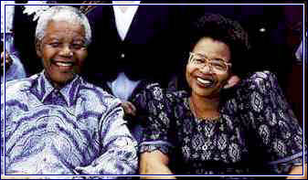
NELSON MANDELA & HIS WIFE GRACA: THE FIRST PRESIDENT OF S. AFRICA

Slide 47
Problems encountered by South African Nationalists
They were harassed, arrested and detained by the authorities e.g. Mandela, Oliver Tambo, and Walter Susulu. They had to flee and live in exile
Banning of political organizations by the racist regime
A lot of violence was unleashed on them. Many were killed e.g. 1960 Sharpeville massacre
Deliberate policy of divide and rule to weak­en African unity e.g. establishment of black homelands
Use of emergency powers to harass and frustrate nationalist leaders
Lack of money and other resources slackened the struggle
Nationalists were denied access to state owned radio and other mass media outlets.

Slide 48
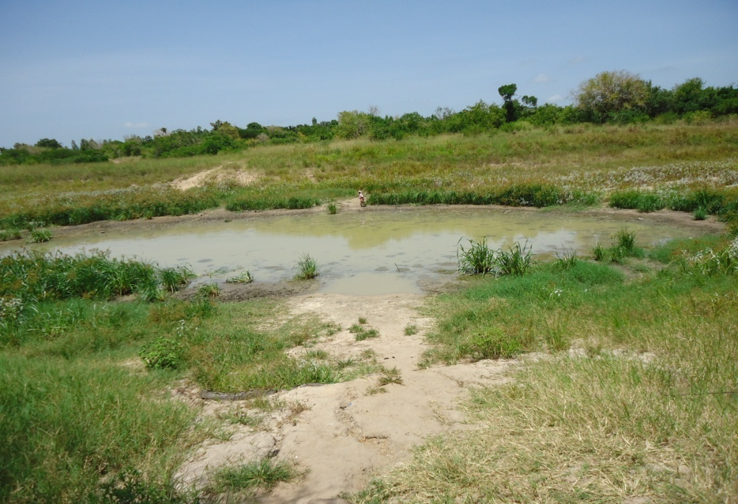
The End

