Slide 1

Gravity and Circular Motion Revision
AQA syllabus A
Section 13.3.1-6
B.W.Hughes

Slide 2
Circular motion
When an object undergoes circular motion it must experience a
centripetal force
This produces an acceleration
towards the centre of the circle

Slide 3
Angular Speed
Centripetal Force

Slide 7
Angular speed
Angular speed can be measured in ms⁻¹ or
Rads⁻¹ (radians per second) or
Revs⁻¹ (revolutions per second)
The symbol for angular speed in radians per second is
ω

Slide 8
Converting to ω
To convert v to ω
ω = v/r
To convert revs per second to ω
Multiply by 2π

Slide 9
Acceleration
The acceleration towards the centre of the circle is
a = v²/r OR
a = ω²r

Slide 10
Centripetal Force Equation
The general force equation is
F = ma
so the centripetal force equation is
F = mv²/r OR
F = m ω²r
THESE EQUATIONS MUST BE LEARNED!!

Slide 11
Example
Gravity provides the accelerating force to keep objects in contact with a humpback bridge. What is the minimum radius of a bridge that a wheel will stay in contact with the road at 10 ms^{-1?}
v = 10 ms⁻¹, g = 10 ms⁻², r = ?
a = v²/r = g so r = v²/g
r = 10²/10 = 10 m

Slide 12
Newton’s Gravitation Equation
Newton’s Gravitation equation is
F = -Gm₁m₂/r²
MUST BE LEARNED!!
Negative sign is
a vector sign
G is
Universal Gravitational Constant

Slide 13
More about the equation
m₁ and m₂ are
the two gravitating masses
r is
the distance between their centres of gravity
The equation is an example of an
Inverse square law

Slide 14
Gravitational field
A gravitational field is an area of space subject to the force of gravity. Due to the inverse square law relationship, the strength of the field fades quickly with distance.
The field strength is defined as
The force per unit mass OR
g = F/m in Nkg⁻¹

Slide 15
Radial Field
Planets and other spherical objects exhibit radial fields, that is the field fades along the radius extending into space from the centre of the planet according to the equation
g = -GM/r²
Where M is
the mass of the planet

Slide 16
Gravitational Potential
Potential is a measure of the energy in the field at a point compared to an infinite distance away.
The zero of potential is defined at
Infinity
Potential at a point is
the work done to move unit mass from infinity to that point. It has a negative value.
The equation for potential in a radial field is
V = -GM/r

Slide 17
Potential Gradient
In stronger gravitational fields, the potential graph is steeper. The potential gradient is
ΔV/Δr
And the field strength g is
equal to the magnitude of the Potential gradient
g = -ΔV/Δr

Slide 18
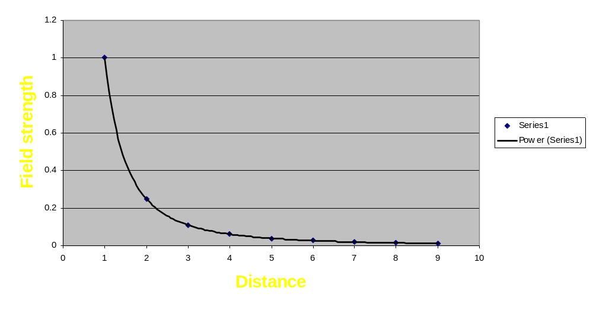
Graph of Field strength against distance

Slide 19
Field strength graph notes
Outside the planet field strength
follows an inverse square law
Inside the planet field strength
fades linearly to zero at the centre of gravity
Field strength is always
positive

Slide 20
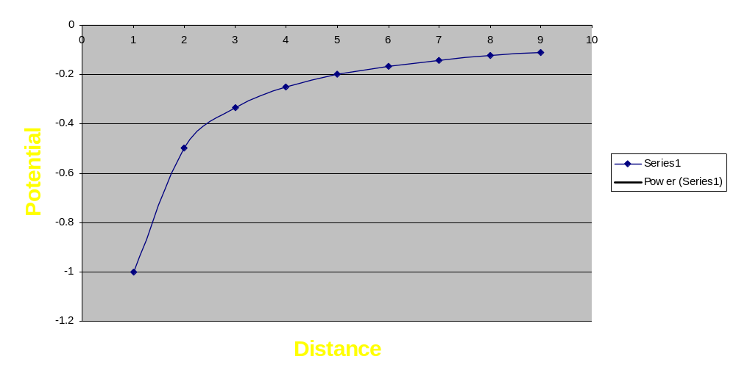
Graph of Potential against distance

Slide 21
Potential Graph Notes
Potential is always
negative
Potential has zero value at
infinity
Compared to Field strength graph,
Potential graph is less steep

Slide 22
Orbits
Circular orbits follow the simple rules of gravitation and circular motion. We can put the force equations equal to each other.
F = mv²/r = -Gm₁m₂/r²
So we can calculate v
v² = -Gm₁/r

Slide 23
More orbital mechanics
Period T is the time for a complete orbit, a year. It is given by the formula.
T = 2π / ω
and should be calculated in
seconds

Slide 24
Example
The Moon orbits the Earth once every 28 days approximately. What is the approximate radius of its orbit? G = 6.67 x 10⁻¹¹ Nm²kg⁻², mass of Earth M = 6.00 x 10²⁴ kg
ω = 2π / T = 2π/(28x24x60x60) =
2.6 x 10⁻⁶ rads⁻¹
F = mω²r = -GMm/r² so
r³ = -GM/ω²

Slide 25
Example continued
r³ = 6.67 x 10⁻¹¹ x 6.00 x 10²⁴/(2.6x10⁻⁶)²
= 5.92 x 10²⁵
r = 3.90 x 10⁸ m

Slide 26

The End!
With these equations we can reach the stars!

