Slide 1
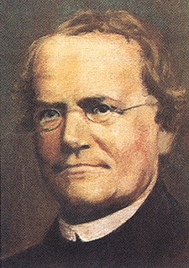
Johann Gregor Mendel (1822-1884) Father of Genetics
Children resemble their parents.

Slide 2
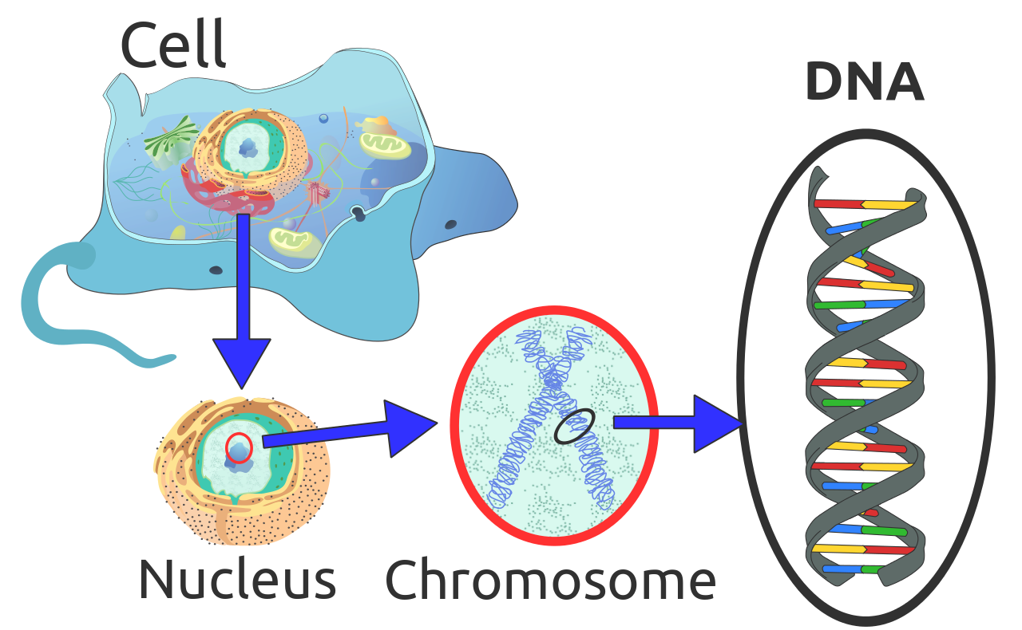

Slide 3
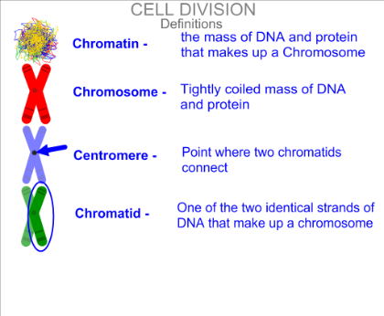
Structure of the chromosome

Slide 4

Forensic science

Slide 5
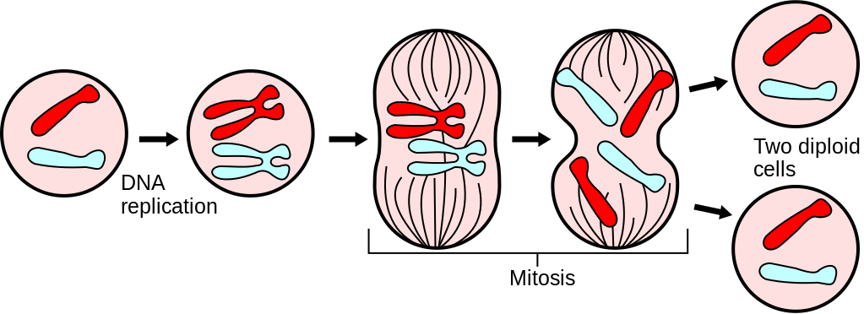

Slide 6
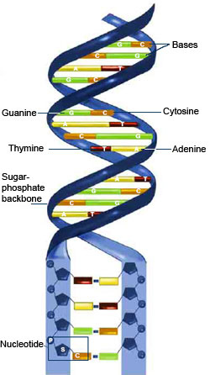

Slide 7
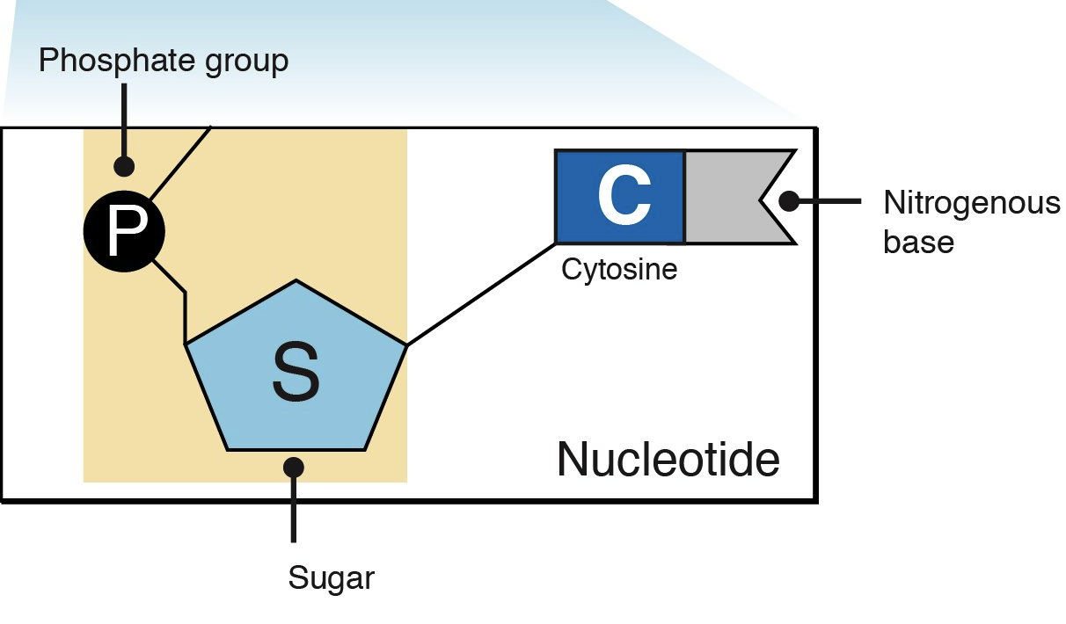

Slide 8
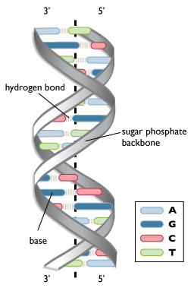

Slide 9
Natural selection
Natural selection is the process in nature by which organisms better adapted to their environment tend to survive and reproduce more than those less adapted to their environment.

Slide 10
Examples
Sharks are colored white on the underside and blue or gray on the top. This is their camouflage as the top blends with the water color to someone looking down into the water and the bottom blends with the light coming through the water from above.
In a habitat there are red bugs and green bugs. The birds prefer the taste of the red bugs, so soon there are many green bugs and few red bugs. The green bugs reproduce and make more green bugs and eventually there are no more red bugs.

Slide 11
Galapagos finches showing different beak shapes
Whilst studying wildlife on the Galapagos Islands [Darwin] noticed that the Galapagos finches showed wide variations - eg in beak shape and size - from island to island. Darwin deduced that these differences made the finches better adapted to take advantage of the food in their particular local environment - thin, sharp beaks prevailing where the birds' main food was insects and grubs, and large claw-shaped beaks where their diet was buds, fruit and nuts. In each locality the finch population had somehow developed beaks which were suitable for that particular environment.

Slide 12
Darwin concluded that in each locality one or more individual finch happened to acquire, by random mutation, a beak shape more suitable for the food sources in that locality. These individuals then had a competitive advantage over their fellow finches, enabling them to grow and reproduce more successfully, and pass on their more specialized beaks to successive generations - until eventually the characteristic had spread throughout the finch population in that locality.

Slide 13
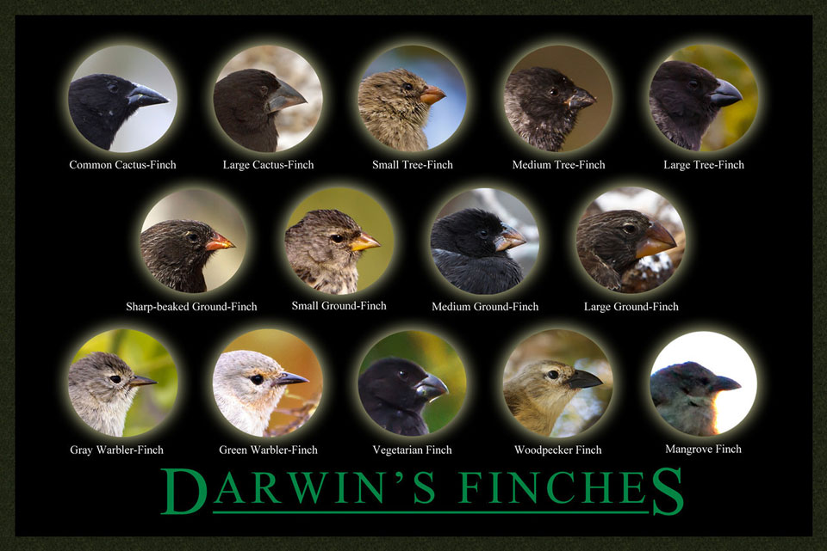

Slide 14
natural selection can create new species
The Hawaiian honeycreepers all evolved from a single ancestor, which arrived on the islands long ago. With no other birds for competition, the honeycreepers began to feed on different foods. Over many generations, their bills changed to cope with their new diets.

Slide 15
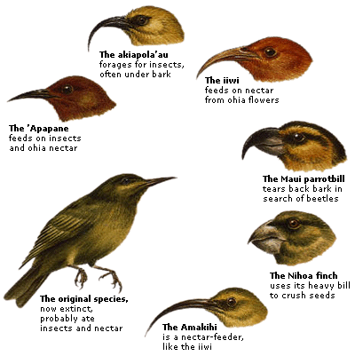

Slide 16
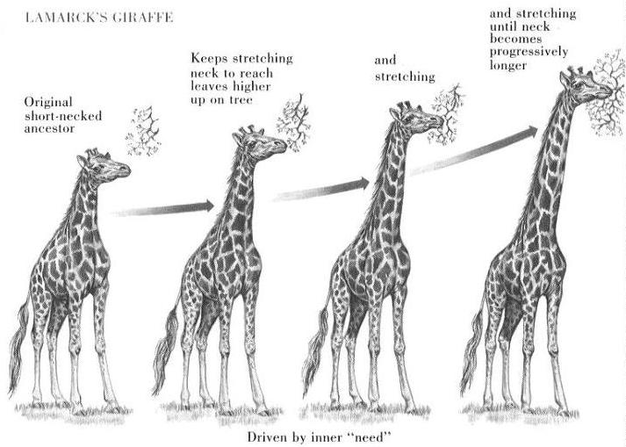

Slide 17
Survival for the fittest:
Survival for the fittest" is a phrase that originated from an evolutionary theory as a way of describing the mechanism of natural selection.
Adaptation is an outcome of natural selection.

