Slide 1



Staging Area
Condition
Contract Req
Contract Req C
Creation
SOURCE
Calendar
[I,S,C, Null]
Concept
Classification
DMS
JSON
Supplier
ID
Description
DWH
Project
Resp Eng
ID
Name
Data Lake
ITEM
Sequence Number
Serial
Status
Group
DISAGGREGATED DATA

Slide 2
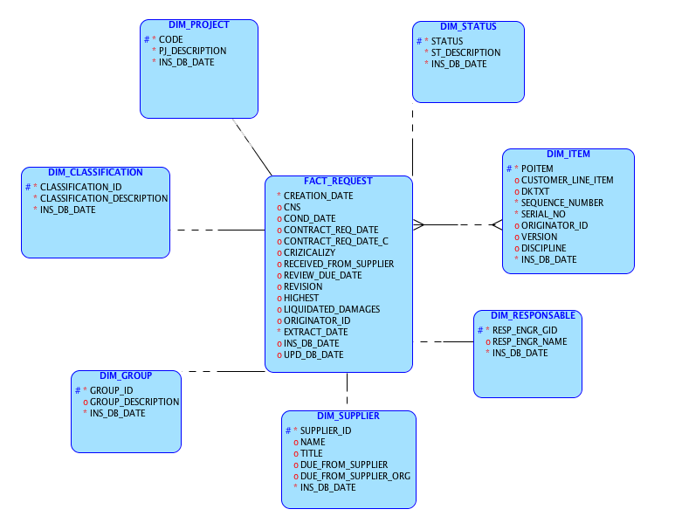
Logic Model

Slide 3
What type of data does the JSON data file contain?
Date, Number, Character and Boolean
2. What is the total size of the JSON data file?
there are 32 attributes and 8062 records
3. What key information is present in the JSON data, and how is it structured?
-There is only one extraction date 09/19/2023, data contains ITEM, SUPPLIER, RESPONSIBLE, Categories and Dates
4. Are there any missing or inconsistent data in the JSON file, and how do you address them?
- Yes, there columns that share data like DKTXT, TITLE
- These columns don’t have NULL values
AccessGroup, CREATION_DATE, EXTRACT_DATE, LiquidatedDamages, OriginatorID, ProjectCode, ProjectDescr, Revision, Supplier, Title and Vversion
- Some columns need to be cleaned or replaced, they have dummy characters like CREATION DATE, Revision, this probably an issue in DMS, it is necessary a default value, what are the key columns that generates a unique record
- There is no standard format in dates
Highest filed could be boolean but has TRUE, FALSE, and N and Y, are they equivalent?
There are records that do not have Classification but they have RespEngID
5. What libraries or tools are you using to analyze the JSON data?
MySQL Workbench, SQL, Python, JSON lib , SQL Data Modeler and Excel
6. What statistical metrics or measures are you extracting from the data?
- Data contains multiple categories like Classification that has Internal, Supplier, Customer and Null values.
- AccessGroup for Internal and Customer, Supplier only has one type
- Customer_line_item, item shares multiple lines
- CN, Crizicalizy, Discipline, Status, Revision, Version
7. How do you identify trends or patterns within the data?
- Base on dates and categories or hierarchies
8. What challenges have you encountered in processing or analyzing the JSON data? Splitting data and creating a model without a KT
9. How do you ensure the quality of the analyzed data?
disaggregating data, counting, comparing and validating integration
10. What conclusions or insights can you draw from the analysis of the JSON data, and how can they be applied in practice?- Base on data we can split data in different subject areas, data can be saved for historical analysis, and data can be group by the different dimensions to get a result or for exploration

