Slide 1

Biodiversity in Natural Parks
A Data Science project

Slide 2
Scope
Project Aim:
The Data Science project aims to derive insightful conclusions from existing datasets about the current state of species within designated Natural Parks in the USA.
Methodology:
Leveraging already available data sets, our approach involves formulating key questions.
These questions guide us in analyzing, concluding, visualizing, and presenting a comprehensive overview of the conservation status of diverse species.
Focus Area:
Our primary focus is on understanding the various degrees of extinction risk that existing species in these Natural Parks may face.

Slide 3
Objectives
Utilize Existing Data: Leverage pre-existing datasets on species within Natural Parks.
Analyze: Employ robust analytical methods to extract meaningful patterns.
Conclude: Draw insightful conclusions about the conservation status of species.
Visualize: Use visualization techniques for effective data representation.
Present: Communicate findings to provide a holistic picture of the state of species in the selected Natural Parks.

Slide 4
Questions
1. What endangered species are present today in natural parks?
2. Which species are the most endangered today?
3. What are the most common and least common species found in national parks today?

Slide 5
Exploratory data analysis

Slide 6
Table: Overview of Input Data
File Name | N° Rows | N° Columns | Description
species_info.csv | 5824 | 5 | Holds the information on the conservation status of a myriad of species
observations.csv | 26296 | 3 | Holds the information on the number of observations on a number of Natural Parks

Slide 7
Table: Column Information for species_info.csv
Column | Data Type | Description | Example Values
Category | Str | Loose term to refer to one of the taxons of the species (e.g. domain or class) | 'Mammal', 'Bird', 'Reptile', 'Amphibian', 'Fish', 'Vascular Plant', 'Nonvascular Plant'
Scientific Name | Str | Unique standarized name of a organism | ‘Canis lupus’, ‘Bos bison’, ‘Cervus elaphus’
Common Names | Str | Names given by the general populatotion to an organism | ‘Wolf’, ‘Bison’, ‘Wapiti or Elk’
Conservation Status | Str | Loose term to refer to the probability of a given species in the near future | 'Species of Concern', 'Endangered', 'Threatened', 'In Recovery’

Slide 8
Table: Column Information for observations.csv
Column | Data Type | Description | Example Values
Scientific Name | Str | Unique standarized name of a organism | ‘Canis lupus’, ‘Bos bison’, ‘Cervus elaphus’
Park Name | Str | Name of the Natural Park | 'Great Smoky Mountains National Park', 'Yosemite National Park', 'Bryce National Park', 'Yellowstone National Park'
Observations | Int | Number of organism of the species present at the park | 68, 173, 130

Slide 9
Addressing Missing Conservation Status
Data Gap:
Conservation Status missing for 5633 entries in the Species CSV.
This accounts for 96.73% of the total entries, nearly the entire dataset.
Assumption and Action:
Assuming species with missing status are not at risk of extinction.
Filled missing values with 'Least Concern' in the data frame.

Slide 10
Addressing Missing Conservation Status
Rationale:
Least-Concern Species:
Classified by IUCN as not a priority for conservation efforts.
Abundance in the wild; not threatened, near-threatened, or conservation-dependent.
Signifies a stable and healthy population status.
Decision-Making:
Despite the absence of international standards in the data, we followed IUCN guidelines.
Aiming for better comprehension of the phenomena at hand.
Key Insight: Taking a proactive approach to fill missing conservation statuses enhances the dataset's interpretability, aligning with IUCN least-concern guidelines.

Slide 11
Conservation Status Recategorization
Current Situation:
No standardized system for conservation status values.
Lack of consistency poses challenges in data analysis.
International Standards:
Designed as an ordinal variable.
Ranges from the lowest risk of extinction to presumed extinct.

Slide 12
Conservation Status Recategorization
Analytical Challenge:
Absence of standards hampers effective data assessment.
Proposed Approach:
Recategorization based on Perceived Risk:
At Risk: Includes Species of Concern, Threatened, and Endangered.
Secure: Encompasses Least Concern and In Recovery.
Key Takeaway: A simplified approach to conservation status allows for a clearer understanding, categorizing species as either "At Risk" or "Secure" based on perceived risk levels.

Slide 13
Results

Slide 14
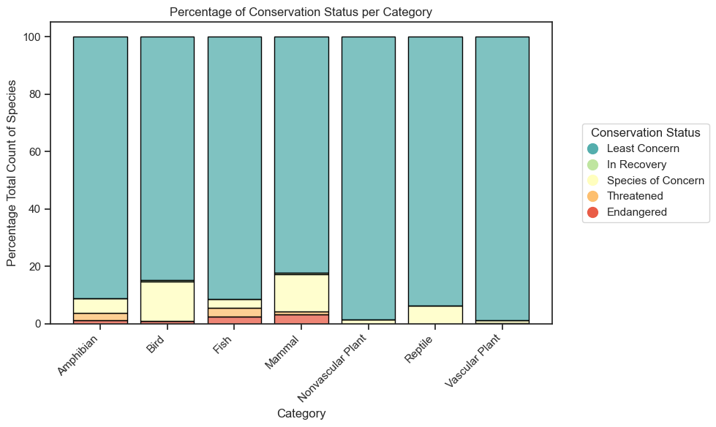

Slide 15
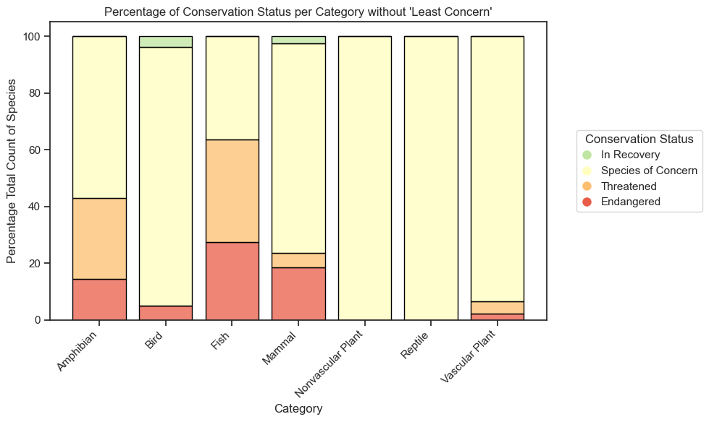

Slide 16
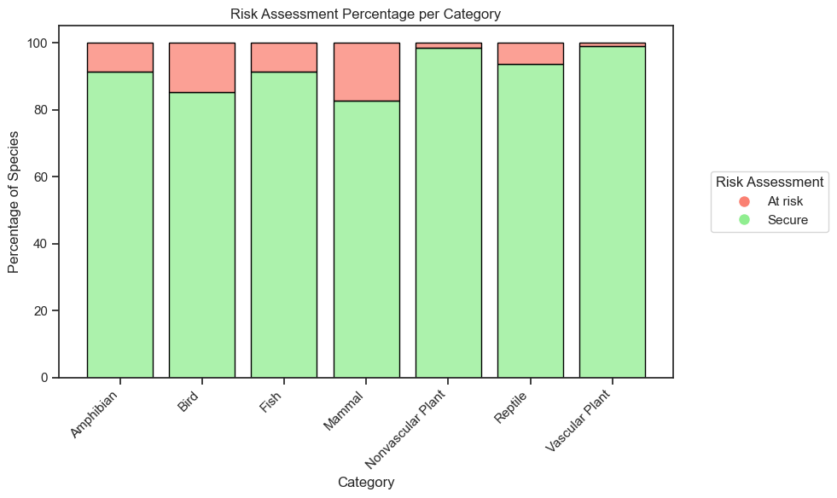

Slide 17
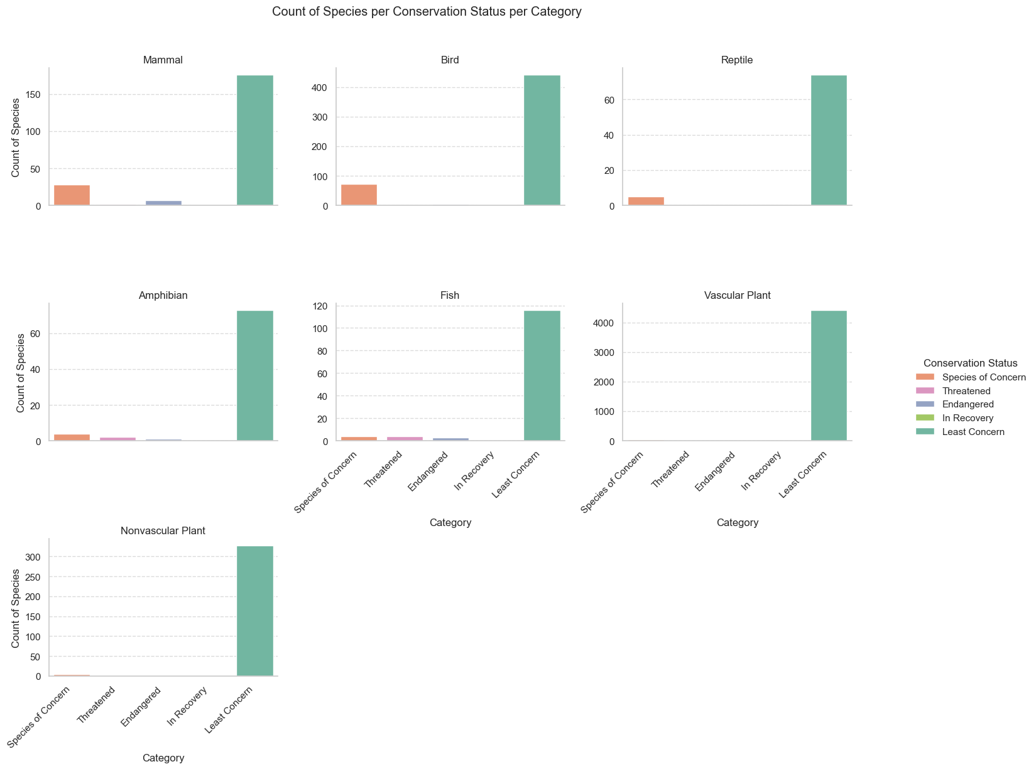

Slide 18
Chi-2 test for Risk Assesment analysis

