Slide 1
网络安全原理与实践
林峰
2024年春季学期

Slide 2
Lecture 2 DDoS Attack & Defense
林峰
flin@zju.edu.cn

Slide 3
DDoS? DoS?

Slide 4

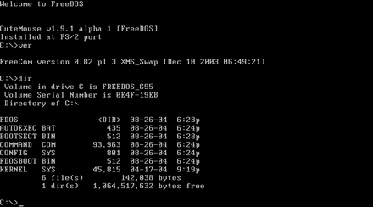
DDoS?
Notes:
DOS (/dɒs/, /dɔːs/) is a platform-independent acronym for disk operating system which later became a common shorthand for disk-based operating systems on IBM PC compatibles. (kidding)

Slide 5
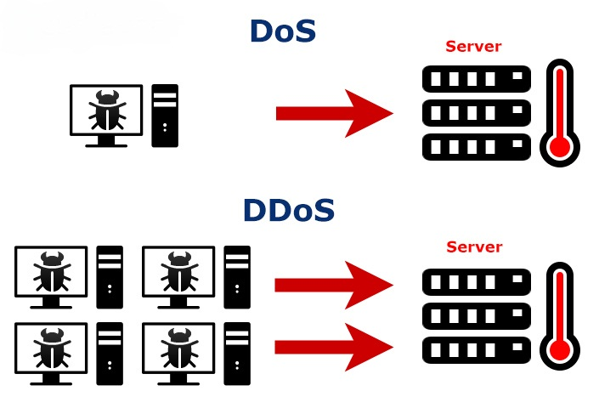
DDoS!
Denial-of-Service Attack:
control an attacking computer/device;
flood victim with superfluous requests;
overload victim and prevent it from fulfilling some legitimate requests;
Notes:
其目的是使计算机或网络无法提供正常的服务，导致合法用户无法访问系统资源，从而破坏目标系统的可用性。
superfluous 多余的，不必要的
https://en.wikipedia.org/wiki/Denial-of-service_attack
Denial of service is typically accomplished by flooding the targeted machine or resource with superfluous requests in an attempt to overload systems and prevent some or all legitimate requests from being fulfilled.

Slide 6
DDoS!?
Denial-of-Service Attack:
control an attacking computer/device;
flood victim with superfluous requests;
overload victim and prevent it from fulfilling some legitimate requests;
defense: block the attacking source
Notes:
https://en.wikipedia.org/wiki/Denial-of-service_attack

Slide 7



Denial of Service Attack
Forms of DoS attacks
Although many forms of DoS attacks exist, the most common types are the following:
Network resource overload
Protocol resource overload
Application resource overload
Notes:
Although many forms of DoS attacks exist, the most common types are the following:
Network resource overload consumes all available network hardware, software, or bandwidth of the target.
In a direct network resource overload attack, the cyber threat actor overloads resources using tactics, such as exploiting a server vulnerability or inundating servers with requests.
b. In a reflection amplification attack, the threat actor consumes network resources by reflecting a high volume of network traffic to the target. The actor use a third-party server (the “reflector”) as an intermediary that hosts and responds to the given spoofed source IP address.
2. Protocol resource overload consumes the available session or connection resources of the target.
3. Application resource overload consumes the available compute or storage resources of the target.

Slide 8
DDoS!!
Distributed Denial-of-Service Attack:
control many different attacking sources;
make it harder to stop the attack simply by blocking a single source;
Notes:
https://en.wikipedia.org/wiki/Denial-of-service_attack
In a distributed denial-of-service attack (DDoS attack), the incoming traffic flooding the victim originates from many different sources. This effectively makes it impossible to stop the attack simply by blocking a single source.

Slide 9
DDoS!!
Distributed Denial-of-Service Attack:
how to attack?
how to defend?
Notes:
下面的课程，我们要解决的是DDOS是如何攻击，我们是如何防御的

Slide 10
DDoS!!
Distributed Denial-of-Service Attack:
how to attack a network service?
Notes:
More specifically, the question would be how to attack a network service using ddos?
下面我们来介绍几种典型的DOS攻击

Slide 11
PING Flood （Network Layer, ICMP）
SYN Flood （TCP Layer）
Smurf Attack（ Network Layer, ICMP）
DNS Amplification Attack
NTP Amplification Attack
Memcached Attack
SSDP Attack

Slide 12
Ping Flood
Exploit Internet Control Messge Protocol (ICMP)
an internet layer protocol used by network devices to communicate;
also used by network diagnostic tools such as traceroute and ping;
ICMP Echo Request: sender to receiver
ICMP Echo Reply: receiver to sender
Notes:
Commonly, ICMP echo-request and echo-reply messages are used to ping a network device for the purpose of diagnosing the health and connectivity of the device and the connection between the sender and the device.
https://www.cloudflare.com/learning/ddos/ping-icmp-flood-ddos-attack/

Slide 13
Ping Flood
Attack principle
both incoming ICMP Echo Request and outgoing ICMP Echo Reply consume bandwidth;
Goal：overwhelm the target device’s ability to respond to a high number of requests
and/or overload the network connection with bogus traffic
Notes:
An ICMP request requires some server resources to process each request and to send a response. The request also requires bandwidth on both the incoming message (echo-request) and outgoing response (echo-reply).
The Ping Flood attack aims to overwhelm the targeted device’s ability to respond to the high number of requests and/or overload the network connection with bogus traffic.
Bogus：假冒的，伪造的

Slide 14
Ping Flood
DDoS form
Attack principle
The attacker sends many ICMP echo request packets to the targeted server using multiple devices;
The targeted server then sends an ICMP echo reply packet to each requesting device’s IP address as a response.

Slide 15
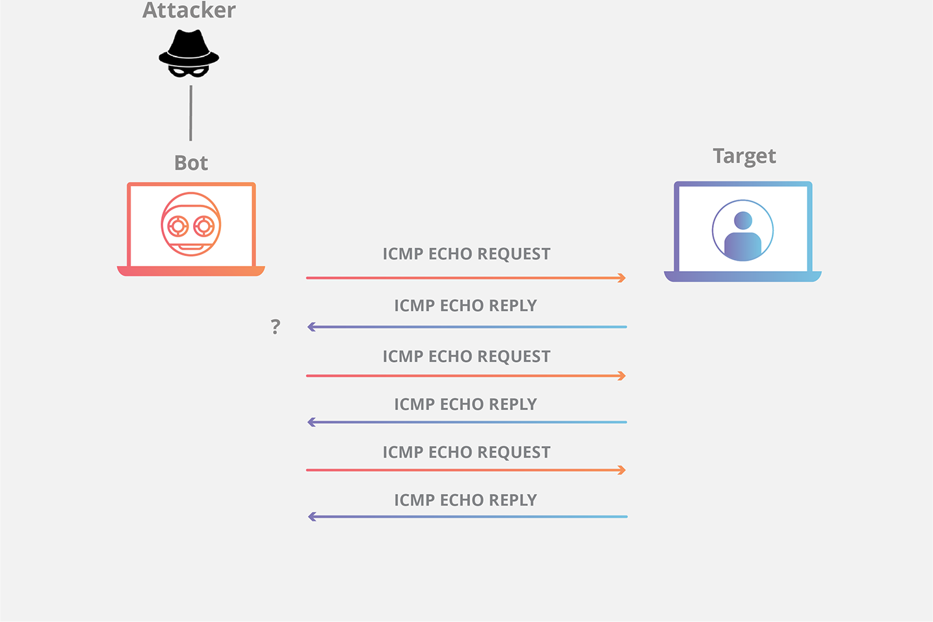
Ping Flood
https://www.cloudflare.com/learning/ddos/ping-icmp-flood-ddos-attack/
Notes:
Botnet 僵尸网络
通过让僵尸网络中的许多设备针对相同互联网或基础设施组件发起ICMP 请求，攻击流量会大幅增加，从而可能导致正常网络活动中断。
从历史上看，攻击者通常会伪造虚假的 IP 地址以掩盖发送设备。对于现代僵尸网络攻击，很少看到攻击者需要掩盖僵尸节点的 IP，而是依靠一个庞大的非伪造的僵尸网络来饱和攻击目标的容量。

Slide 16
Ping Flood Summary
Attack principle
saturate the target device’s capacity by sending many requests;
Solution
disable the ICMP functionality of the target device;
(make the device unresponsive to ping requests and traceroute requests)
Notes:
如何缓解平洪水攻击？
禁用 ping 泛洪最容易通过禁用目标路由器、计算机或其他设备的 ICMP 功能来实现，从而有效地消除了请求和 Echo 回复的处理。这样做的结果是，所有涉及 ICMP 的网络活动都被禁用，使设备对 ping 请求、跟踪路由请求和其他网络活动无响应。
https://www.cloudflare.com/learning/ddos/ping-icmp-flood-ddos-attack/

Slide 17
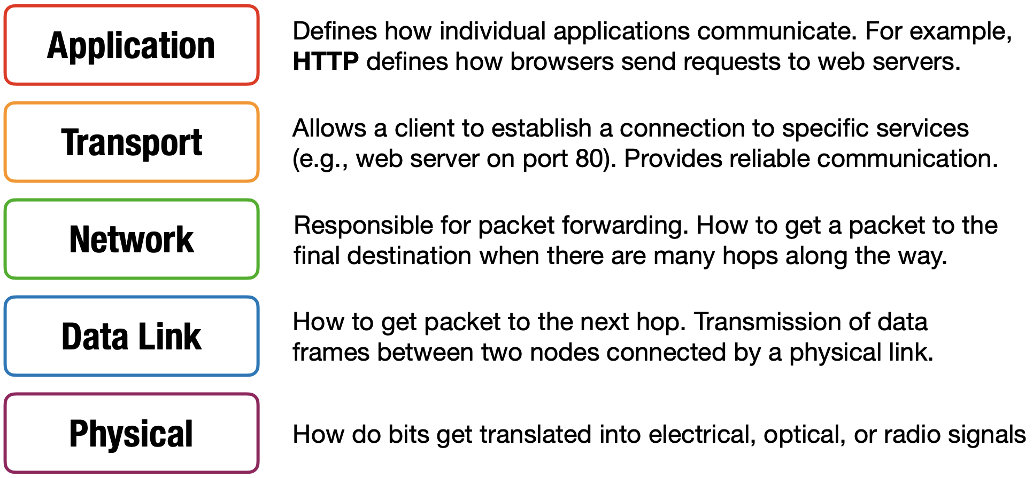
OSI 5 Layer Model
examples from https://cs155.stanford.edu/lectures/13-internet-protocols.pdf
Notes:
上面我们举了一个简单的DDOS攻击案例。下面我们来在网络的每一层上是如何实现其他的DDOS攻击的。
数据链路层提供直连两个设备之间的通信功能，处理的是帧，网络传输的最小单位。

Slide 18
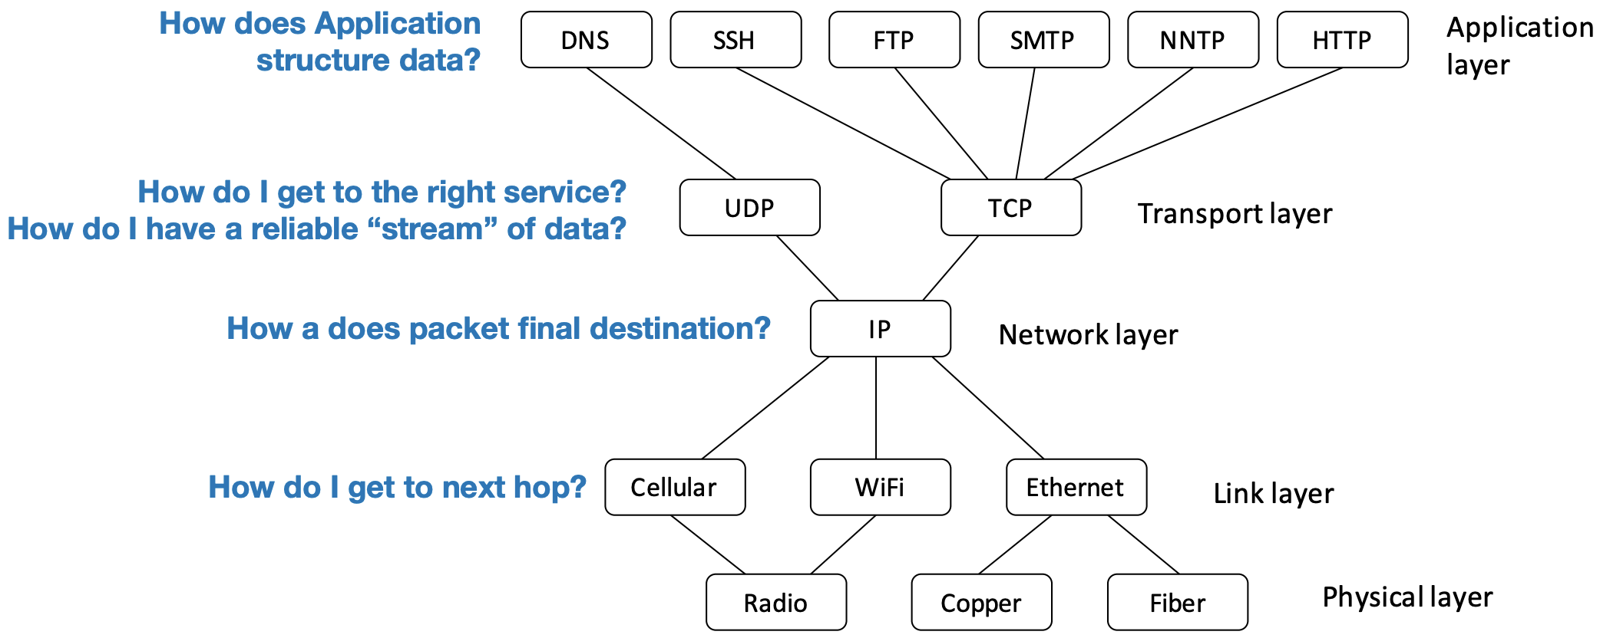
OSI 5 Layer Model

Slide 19
OSI 5 Layer Model
how to ddos at each layer?

Slide 20
OSI 5 Layer Model
link layer:
send too much traffic for switches/routers to handle
Notes:
对于以太网来说

Slide 21
OSI 5 Layer Model
transport layer:
require servers to maintain large number of concurrent connections or state
Notes:
维持大量并发的连接或状态

Slide 22
OSI 5 Layer Model
application layer:
require servers to perform expensive queries or cryptographic operations
Notes:
查询或加密运算

Slide 23

OSI 5 Layer Model
Notes:
在传输层进行DoS攻击主要利用了TCP协议的缺陷

Slide 24
TCP Handshake
C
S
SYN:
SN_{C}←rand_{C}
Listening
SN_{S}←rand_{S}
AN_{S}←SN_{C}+1
Store SN_{C} , SN_{S}
SYN/ACK:
Wait
SN←SN_{C}+1
AN←SN_{S}+1
ACK:
Established
Notes:
Client 客户端
server

Slide 25
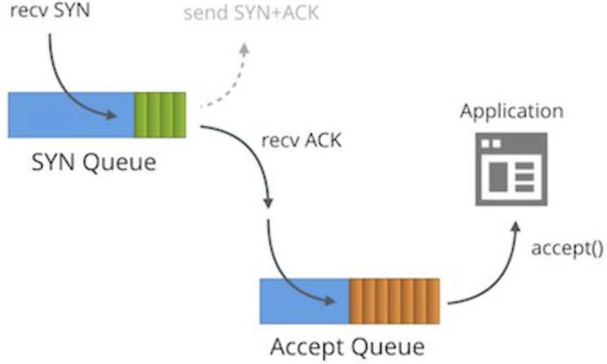
TCP Handshake
C
S
SYN:
SN_{C}←rand_{C}
Listening
SN_{S}←rand_{S}
AN_{S}←SN_{C}+1
Store SN_{C} , SN_{S}
SYN/ACK:
Wait
SN←SN_{C}+1
AN←SN_{S}+1
ACK:
Established

Slide 26
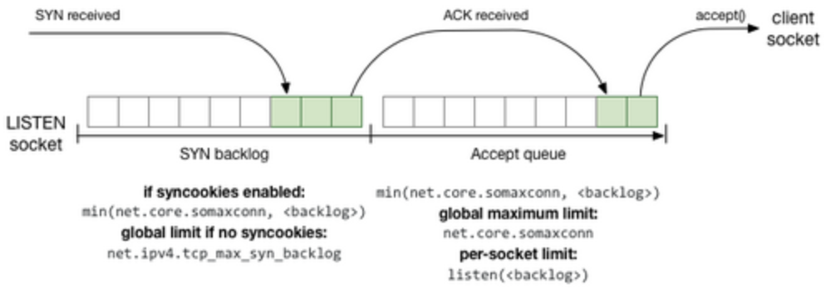
TCP Handshake
C
S
SYN:
SN_{C}←rand_{C}
Listening
SN_{S}←rand_{S}
AN_{S}←SN_{C}+1
Store SN_{C} , SN_{S}
SYN/ACK:
Wait
SN←SN_{C}+1
AN←SN_{S}+1
ACK:
Established
Notes:
backlog：积压代办的事务

Slide 27
TCP SYN Flood
C
S
Single machine:
SYN packets with random source IP addresses
Fill up backlog queue on server
No further connections possible
SYN_{C1}
SYN_{C2}
SYN_{C3}
SYN_{C4}
SYN_{C5}
Notes:
在建立TCP连接的三次握手中，如果不完成最后一次握手，则服务器将一直等待最后一次的握手信息直到超时。这样的连接称为半开连接。
如果向服务器发送大量伪造IP地址的TCP连接请求，则由于IP地址是伪造的，无法完成最后一次握手。此时服务器中有大量的半开连接存在，这些半开连接占用了服务器的资源。如果在超时时限之内的半开连接超过了上限，则服务器将无法响应新的正常连接。这种攻击方式称为SYN Flood攻击
backlog：积压代办的事务

Slide 28
TCP SYN Flood
C
S
IP Spoofing:
SYN packets with random source IP addresses
Fill up backlog queue on server
No further connections possible
SYN_{C1}
SYN_{C2}
SYN_{C3}
SYN_{C4}
SYN_{C5}
Notes:
如果向服务器发送大量伪造IP地址的TCP连接请求。
IP 欺骗：伪造随机的 IP 地址制作 SYN 数据包;
对于此类随机 IP 地址，客户端从服务器接收到 SYN ACK 数据包后，它们可能会简单地丢弃它们，因为这些 IP 地址根本没有发送 SYN 请求

Slide 29
TCP SYN Flood
Queue size
commonly set as 128 by default on some Linux systems;
Timeout
evict a backlog entry if no ACK is received until timeout, e.g., 3 mins
Attack example:
attacker sends 128 SYN every 3 mins without responding with ACK pkts
Notes:
每3分钟不停收到包，队列一直被占用。

Slide 30
TCP SYN Flood Summary
Attack principle
server commits resources (memory) before confirming response of client (when client responds)
Solution?
Notes:
服务器在回复客户端响应之前占用资源（内存）（当客户端响应时）

Slide 31
TCP SYN Flood Summary
Attack principle
server commits resources (memory) before confirming response of client (when client responds)
Solution?
increase backlog queue size
Notes:
攻防互相较劲

Slide 32
TCP SYN Flood Summary
Attack principle
server commits resources (memory) before confirming response of client (when client responds)
Solution?
increase backlog queue size
attacker sends more SYN packets!
Notes:
increase backlog queue size
decrease timeout

Slide 33
TCP SYN Flood Summary
Attack principle
server commits resources (memory) before confirming reponse of client (when client responds)
Solution?
decrease timeout
Notes:
比如1分钟就把之前的SYN清除出去

Slide 34
TCP SYN Flood Summary
Attack principle
server commits resources (memory) before confirming reponse of client (when client responds)
Solution?
decrease timeout
interrupt normal service requests!
Notes:
其他服务可能需要比较长的timeout时间

Slide 35
SYN Cookies
Goal
avoid state storage on server
until 3-way handshake completes
Idea
server sends necessary states to client along with SYN-ACK;
client sends these states back to server along with ACK;
Notes:
防御方法

Slide 36
SYN Cookies
C
S
SYN:
SN_{C}←rand_{C}
Listening
SN_{S}←rand_{S}
AN_{S}←SN_{C}+1
Store SN_{C} , SN_{S}
SYN/ACK:
Wait
SN←SN_{C}+1
AN←SN_{S}+1
ACK:
Established
traditional TCP handshake

Slide 37
SYN Cookies
C
S
SYN:
SN_{C}←rand_{C}
Listening
SN_{S}←rand_{S}
AN_{S}←SN_{C}+1
Store SN_{C} , SN_{S}
SYN/ACK:
Store SN_{C} , SN_{S}
traditional TCP handshake
Notes:
SN SYN序列号 AN ACK序列号

Slide 38
SYN Cookies
C
S
SYN:
SN_{C}←rand_{C}
Listening
SYN/ACK:
SN_{S}←(T||M||L)
Store none info
Send SN_{S} to client
SYN cookies
Notes:
而是根据这个SYN包计算出一个cookie值。这个cookie作为将要返回的SYN ACK包的初始序列号。

Slide 39
SYN Cookies
C
S
SYN:
SN_{C}←rand_{C}
Listening
SYN/ACK:
SN_{S}←(T||M||L)
Store none info
Send SN_{S} to client
T: 5-bit timestamp
time() logically right-shifted 6 positions;
64-second resolution;
SYN cookies
Notes:
T- timestamp
？？

Slide 40
SYN Cookies
C
S
SYN:
SN_{C}←rand_{C}
Listening
SYN/ACK:
SN_{S}←(T||M||L)
Store none info
Send SN_{S} to client
M: 3-bit MSS
maximum segment size
SYN cookies

Slide 41
SYN Cookies
C
S
SYN:
SN_{C}←rand_{C}
Listening
SYN/ACK:
SN_{S}←(T||M||L)
Store none info
Send SN_{S} to client
L: 24-bit keyed hash
L = MAC_{key}(SAddr, SPort, DAddr, DPort, SN_{C}, T)
SYN cookies
Notes:
消息摘要mac，MAC是密码学中的一个消息认证码函数。在Linux实现中，MAC函数为SHA1

Slide 42
SYN Cookies
C
S
SYN:
SN_{C}←rand_{C}
Listening
SYN/ACK:
SN_{S}←(T||M||L)
Store none info
Send SN_{S} to client
5 + 3 + 24 = 32 bits
SYN cookies

Slide 43
SYN Cookies
L = MAC_{key}(SAddr, SPort, DAddr, DPort, SN_{C}, T)
C
S
SYN:
SN_{C}←rand_{C}
Listening
SYN/ACK:
SN_{S}←(T||M||L)
Store none info
Send SN_{S} to client
5 + 3 + 24 = 32 bits
SN←SN_{C}+1
AN←SN_{S}+1
ACK:
Recover SN_{c}, SN_{s}
Recompute SN_{s}
SYN cookies
Notes:
返回的确认序列号AN，减1(得到初始序列号SNs)与原SNs进行对比。
SNs-1 = SNc得到原SYN报文信息。
无需存储即可恢复

Slide 44
SYN Cookies
C
S
SYN:
SN_{C}←rand_{C}
Listening
SYN/ACK:
SN_{S}←(T||M||L)
Store none info
Send SN_{S} to client
5 + 3 + 24 = 32 bits
SN←SN_{C}+1
AN←SN_{S}+1
ACK:
Recover SN_{c}, SN_{s}
Verify SN_{s}
SYN cookies
Notes:
将高 5 位表示的t与当前之间比较，看其到达地时间是否能接受。
根据t和连接元组重新计算s，看是否和低 24 一致，若不一致，说明这个报文是被伪造的。
解码序号中隐藏的mss信息

Slide 45
SYN Cookies
C
S
SYN:
SN_{C}←rand_{C}
Listening
SYN/ACK:
SN_{S}←(T||M||L)
Store none info
Send SN_{S} to client
5 + 3 + 24 = 32 bits
SN←SN_{C}+1
AN←SN_{S}+1
ACK:
Established
if SN_{s} is valid
SYN cookies

Slide 46
TCP SYN Flood Backscatter
SYN with forged source IP ⇒ SYN-ACK to random host
Notes:
会导致这样的现象
For detection

Slide 47
TCP SYN Flood Backscatter
SYN with forged source IP ⇒ SYN-ACK to random host
backscatter packets can be used for detecting DDoS
Notes:
For detection

Slide 49
DDoS attacks so far

Slide 50
Ping Flood
1 request vs 1 reply
https://www.cloudflare.com/learning/ddos/ping-icmp-flood-ddos-attack/

Slide 51
TCP SYN Flood
C
S
Single machine:
SYN packets with random source IP addresses
Fill up backlog queue on server
No further connections possible
SYN_{C1}
SYN_{C2}
SYN_{C3}
SYN_{C4}
SYN_{C5}
1 SYN vs 1 SYN-ACK

Slide 52
asymmetric DDoS attack
the amount of bandwidth the targeted device consumes is simply the sum of the total traffic sent from each attacker/bot;

Slide 53
asymmetric DDoS attack
the attacker requires a substantial amount of traffic to succeed;
how to attack with less effort?

Slide 54
asymmetric DDoS attack
a relatively small number or low levels of resources are required by an attacker to cause a significantly greater number or higher level of target resources to malfunction or fail
Notes:
以小博大
https://www.radware.com/security/ddos-knowledge-center/ddospedia/asymmetric-attack

Slide 55
Smurf Attack
Amplify the effect of ping flood
Exploit IP broadcast address
Forward the single ICMP Echo Request to any other hosts in the same network
Each host responds with an ICMP Echo Reply
1 request vs many replies
Combine IP spoofing and ping flood.
Notes:
https://www.cloudflare.com/learning/ddos/smurf-ddos-attack/
网络层DDOS，它以最初发动这种攻击的程序名Smurf来命名
Smurf结合使用了IP欺骗和ICMP 回应请求，使大量的ICMP 回应报文充斥目标系统

Slide 56
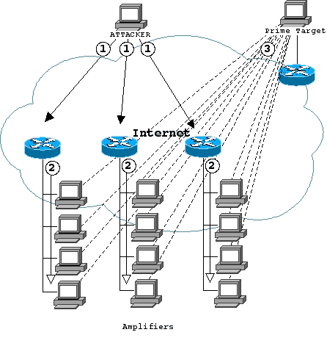
Smurf Attack
Amplify the effect of ping flood
1 request vs many replies
router and firewall
as amplifier
shorturl.at/iBDQR
Notes:
https://searchnetworking.techtarget.com/tip/Router-Expert-Smurf-fraggle-attack-defense-using-SACLs

Slide 57
Smurf Attack
Attack with an ICMP Echo Request with spoofed source IP address of the targeted server and destination IP address of an IP broadcast address
1 ICMP Echo Request Spoofed Src: DDos Target
Dest: brdct addr
3 ICMP Echo Reply Dest: DDos Target
router/firewall
DDoS Target
DDoS Source
Notes:
https://www.cloudflare.com/learning/ddos/smurf-ddos-attack/
向一个网络上的多个系统发送定向的ICMP request请求，这些系统接着对这种请求作出响应。
(1) 黑客向一个具有大量主机和因特网连接的网络(反弹网络)的广播地址发送一个欺骗性Ping分组（echo 请求），该欺骗分组的源地址就是Attacker希望攻击的系统。
(2) 路由器接收到这个发送给IP广播地址（如212.33.44.255）的分组后，会认为这就是广播分组，会对本地网段中的所有主机进行广播。
(3) 网段中的所有主机都会向欺骗性分组的IP地址发送echo响应。如果这是一个很大的以太网段，可以会有几百个主机对收到的echo请求进行回复。
由于多数系统都会尽快地处理ICMP传输信息，目标系统很快就会被大量的echo信息吞没，这样轻而易举地就能够阻止该系统处理其它任何网络传输，从而拒绝为正常系统提供服务
https://searchnetworking.techtarget.com/tip/Router-Expert-Smurf-fraggle-attack-defense-using-SACLs
Here's How a Smurf attack works:
First the Smurf malware builds a spoofed packet that has its source address set to the real IP address of the targeted victim.
The packet is then sent to an IP broadcast address of a router or firewall, which in turn sends requests to every host device address inside the broadcasting network, increasing the number of requests by the number of networked devices on the network.
Each device inside the network receives the request from the broadcaster and then responds to the spoofed address of the target with an ICMP Echo Reply packet.
The target victim then receives a deluge of ICMP Echo Reply packets, potentially becoming overwhelmed and resulting in denial-of-service to legitimate traffic.

Slide 58
Smurf Attack
Solution
disable IP broadcast addresses on router and firewall, or
reject external packets to brdct addr
1 ICMP Echo Request Spoofed Src: DDos Target
Dest: brdct addr
3 ICMP Echo Reply Dest: DDos Target
router/firewall
DDoS Target
DDoS Source

Slide 59
asymmetric DDoS attack
any other amplifiers?

Slide 60
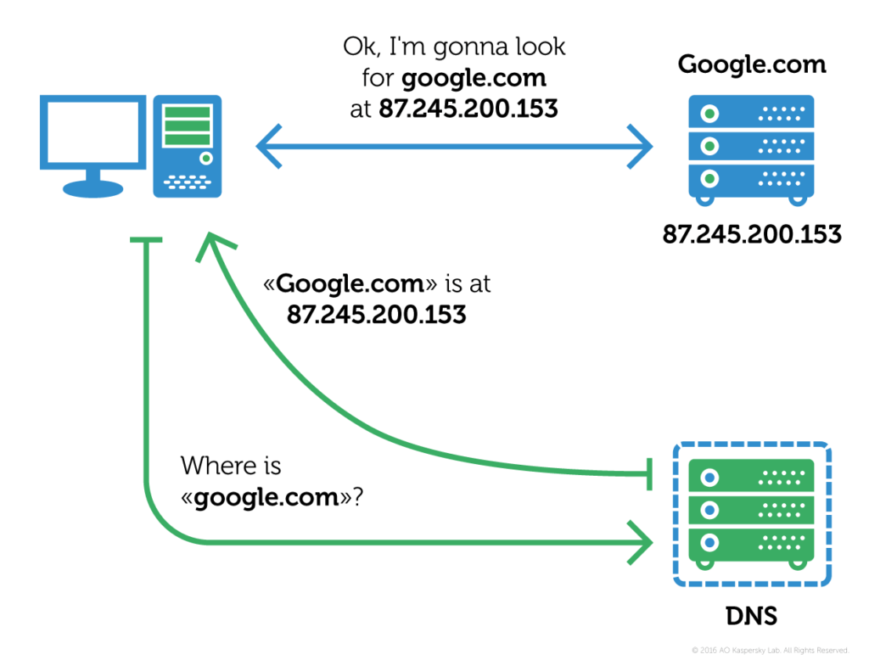
DNS Resolver
3
2
1
Notes:
域名系统,Domain Name System
DNS 解析。每个Web服务器（实际上连接到Internet的任何主机）都有一个文本形式的唯一IP地址，将其转换为IP地址是一个称为DNS解析或DNS查找的过程;

Slide 61
DNS Amplification Attack
Leverage open DNS resolvers
Exploit DNS query of type ANY that retrieves all the available types for a given name
Notes:
open DNS resolvers“开放 DNS 解析器”:是一种愿意为互联网上的任何人解析递归 DNS 查找的 DNS 服务器。
攻击者利用开放 DNS 解析器的功能产生大量流量，使目标服务器或网络不堪重负，导致服务器及其周围基础设施无法访问。
在 DNS 放大攻击中，其中一个机器人好比是一个心怀恶意的人打电话订外卖，说“我要每样东西点一份，请给我回电话，告诉我整个订单”。当餐厅询问回电号码时，提供的是目标受害者的电话号码。然后目标会接到来自餐厅的电话，提供其并未请求的大量信息。
https://www.cloudflare.com/learning/ddos/dns-amplification-ddos-attack/

Slide 62
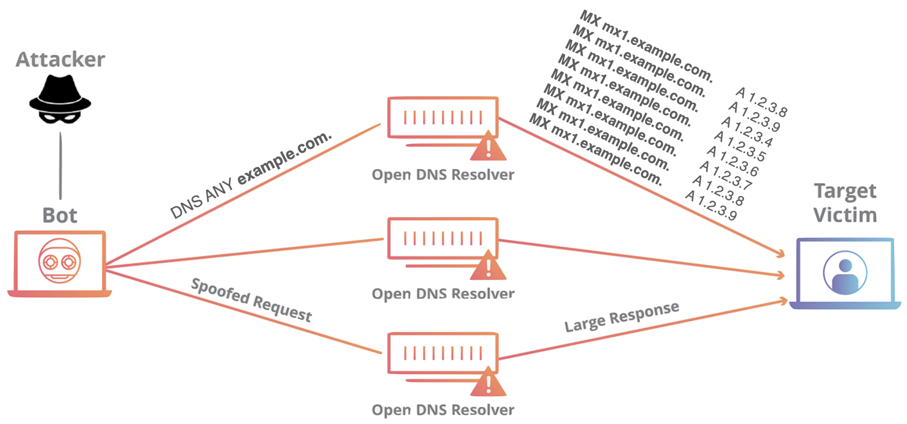
DNS Amplification Attack
Amplify the effect of DNS query
1 query vs many responses

Slide 63
DNS Amplification Attack
Attack with an ANY-type DNS query with spoofed source IP address of the targeted server
DNS Query Spoofed SrcIP: DDos Target
(60 bytes)
EDNS Reponse
(3000 bytes)
DDoS Source
DNS Server
DDoS Target
Notes:
DNS 放大可分为3个步骤：
攻击者使用受损的端点将有欺骗性 IP 地址的 UDP 数据包发送到 DNS 递归服务器。数据包上的欺骗性地址指向受害者的真实 IP 地址。
每个 UDP 数据包都向 DNS 解析器发出请求，通常传递一个参数（例如“ANY”）以接收尽可能最大的响应。
DNS 解析器收到请求后，会向欺骗性 IP 地址发送较大的响应。
目标的 IP 地址接收响应，其周边的网络基础设施被大量流量淹没，从而导致拒绝服务。

Slide 64
DNS Amplification Attack
Attack with an ANY-type DNS query with spoofed source IP address of the targeted server
EDNS: Extension Mechanisms for DNS sends DNS data in larger UDP packets
DNS Query Spoofed SrcIP: DDos Target
(60 bytes)
EDNS Reponse
(3000 bytes)
DDoS Source
DNS Server
DDoS Target
Notes:
DNS 放大可分为3个步骤：
攻击者使用受损的端点将有欺骗性 IP 地址的 UDP 数据包发送到 DNS 递归服务器。数据包上的欺骗性地址指向受害者的真实 IP 地址。
每个 UDP 数据包都向 DNS 解析器发出请求，通常传递一个参数（例如“ANY”）以接收尽可能最大的响应。
DNS 解析器收到请求后，会向欺骗性 IP 地址发送较大的响应。
目标的 IP 地址接收响应，其周边的网络基础设施被大量流量淹没，从而导致拒绝服务。

Slide 65
DNS Amplification Attack
Solution
reduce the number of open resolvers;
source IP verification – stop spoofed packets leaving network;
DNS Query Spoofed SrcIP: DDos Target
(60 bytes)
EDNS Reponse
(3000 bytes)
DDoS Source
DNS Server
DDoS Target
Notes:
How is a DNS amplification attack mitigated?
减少开放 DNS 解析器的总数。限制 DNS 解析器，使其仅响应来自受信任来源的查询，即可使服务器无法被用于任何类型的放大攻击。
源 IP 验证 —— 阻止欺骗性数据包离开网络。如果一个从网络内部发送的数据包带有一个看起来像来自网络外部的源地址，那么它就有可能是伪造数据包并可被丢弃。

Slide 66
NTP Amplification Attack
Leverage Network Time Protocol (NTP) servers
Exploit monlist command that triggers a response with the last 600 source IP addresses of requests made to the NTP server
Notes:
网络时间协议（NTP）旨在允许连接到互联网的设备同步其内部时钟，在互联网架构中发挥重要作用
How does a NTP amplification attack work?
利用 monlist 命令触发响应，其中包含向 NTP 服务器发出的请求的最后 600 个源 IP 地址
The https://www.cloudflare.com/learning/ddos/ntp-amplification-ddos-attack/

Slide 67
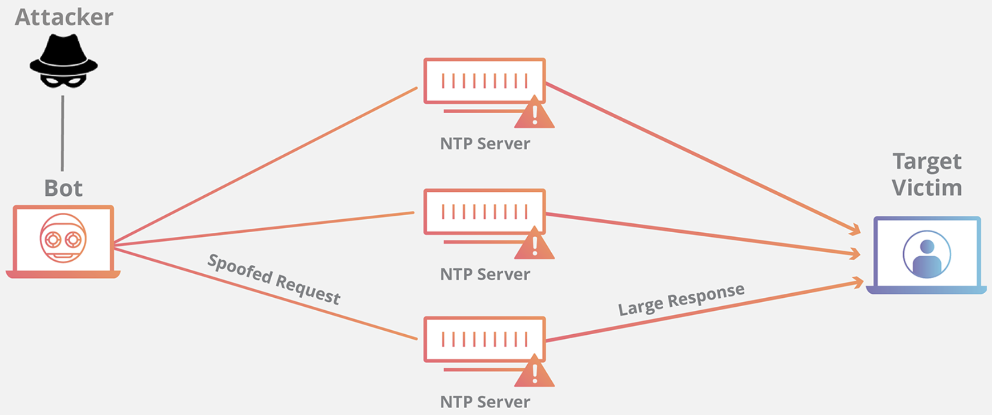
NTP Amplification Attack
Amplify the effect of NTP query
1 query vs a large response
monlist
600 IP addr
Notes:
https://www.cloudflare.com/learning/ddos/ntp-amplification-ddos-attack/
NTP 放大攻击可分为四个步骤：
攻击者使用僵尸网络将带有伪造 IP 地址的 UDP 包发送到启用了 monlist 命令的 NTP 服务器。每个包的伪造 IP 地址都指向受害者的真实 IP 地址。
每个 UDP 数据包使用其 monlist 命令向 NTP 服务器发出请求，导致较大的响应。
然后，服务器用结果数据响应欺骗性的地址。

Slide 68
NTP Amplification Attack
Amplify the effect of NTP query
1 query vs a large response
monlist
30+ bytes
600 IP addr
22,000 bytes of pkts
Notes:
带宽差异，资源差异，导致以小博大的攻击

Slide 69
NTP Amplification Attack
Solution
reduce the number of NTP servers that support monlist;
source IP verification – stop spoofed packets leaving network;
monlist
30+ bytes
600 IP addr
22,000 bytes of pkts
Notes:
禁用 monlist - 减少支持 monlist 命令的 NTP 服务器的数量
源 IP 验证- - 阻止欺骗性数据包离开网络。禁用 NTP 服务器上的 monlist 并在当前允许 IP 欺骗的网络上实施入口过滤

Slide 70
Memcached Attack
Leverage Memcached servers a general-purpose distributed memory-caching system for speeding up websites and networks
Exploit memcached request that triggers a response with a large volume of data to target
Notes:
https://www.cloudflare.com/learning/ddos/memcached-ddos-attack/
*Memcached is a database caching system for speeding up websites and networks.
How does a memcached attack work?
A Memcached attacks operates similarly to all DDoS amplification attacks such as NTP amplification and DNS amplification. The attack works by sending spoofed requests to a vulnerable server, which then responds with a larger amount of data than the initial request, magnifying the volume of traffic.
Memcached amplification can be thought of in the context of a malicious teenager calling a restaurant and saying "I’ll have one of everything, please call me back and tell me my whole order." When the restaurant asks for a callback number, the number given is the targeted victim’s phone number. The target then receives a call from the restaurant with a lot of information that they didn’t request.
This method of amplification attack is possible because memcached servers have the option to operate using the UDP protocol. UDP is a network protocol that allows for the sending of data without first getting what’s known as a handshake, which is a network process where both sides agree to the communication. UDP is utilized because the targeted host is never consulted on whether or not they’re willing to receive the data, allowing for a massive amount of data to be sent to the target without their prior consent.

Slide 71
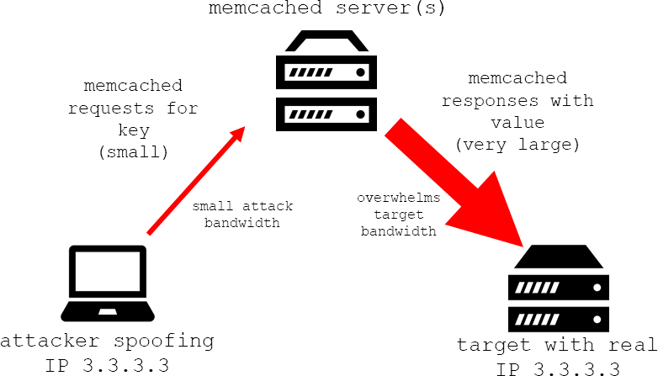
Memcached Attack
Exploit memcached request that triggers a response with a large volume of data to target
Notes:
https://www.cloudflare.com/learning/ddos/memcached-ddos-attack/
https://cloudshark.io/articles/memcached-memcrashed-ddos-attack/
How does a memcached attack work?
A Memcached attacks operates similarly to all DDoS amplification attacks such as NTP amplification and DNS amplification. The attack works by sending spoofed requests to a vulnerable server, which then responds with a larger amount of data than the initial request, magnifying the volume of traffic.
This method of amplification attack is possible because memcached servers have the option to operate using the UDP protocol. UDP is a network protocol that allows for the sending of data without first getting what’s known as a handshake, which is a network process where both sides agree to the communication. UDP is utilized because the targeted host is never consulted on whether or not they’re willing to receive the data, allowing for a massive amount of data to be sent to the target without their prior consent.

Slide 72
Memcached Attack
Attack principle
preload large data to Memcached server;
spoof request to preloaded data from target;
Notes:
A memcached attack occurs in 4 steps:
攻击者在暴露的 memcached 服务器上植入大量有效负载数据。
攻击者使用目标受害者的 IP 地址进行伪造欺骗的HTTP GET 请求。
接收请求的易受攻击的 memcached 服务器试图通过响应提供帮助，向目标发送大量响应。
对合法请求的过载和拒绝服务。

Slide 73
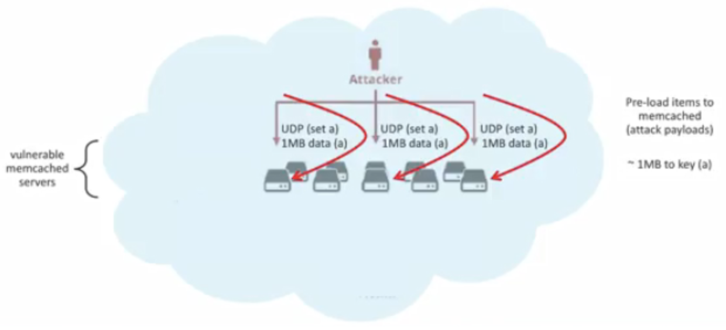
Memcached Attack
Attack principle
preload large data to Memcached server;
Notes:
攻击者在暴露的 memcached 服务器上植入大量有效负载数据（attack payload）。

Slide 74
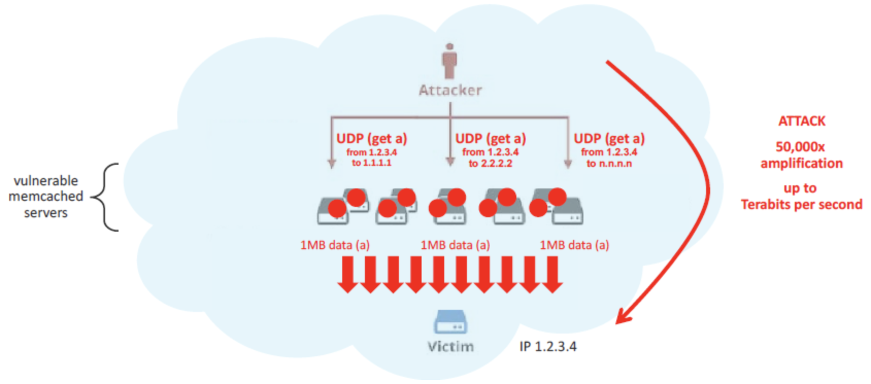
Memcached Attack
Attack principle
spoof request to preloaded data from target;
Notes:
接下来，攻击者使用目标受害者的 IP 地址进行伪造欺骗的HTTP GET 请求。
Victime向Memcached server请求

Slide 75
Memcached Attack
Solution
disable UDP on Memcached server;
firewall Memcached server;
source IP verification;
flush_all command to Memcached server;
Notes:
Disable UDP -对于 memcached 服务器，如果不需要，请确保禁用 UDP 支持。默认情况下，memcached 启用了 UDP 支持，这可能会使服务器容易受到攻击。
Firewall memcached servers -通过从互联网对memcached服务器进行防火墙，系统管理员可以在必要时对memcached使用UDP，而不会暴露。
Prevent IP spoofing - as long as IP addresses can be spoofed, DDoS attacks can make use of the vulnerability to direct traffic to a victim's network. Preventing IP spoofing is a larger solution that cannot be implemented by any particular system administrator, and it requires transit providers to not allow any packets to leave their network that have a source IP address originating outside the network. In other words, companies such as internet service providers (ISPs) must filter traffic such that the packets that leave their network are not allowed to pretend to be from a different network somewhere else. If all major transit providers implemented this type of filtration, spoofing-based attacks would disappear overnight.

Slide 76
SSDP Attack
Leverage Simple Service Discovery Protocol (SSDP)
Exploit Universal Plug and Play (UPnP) networking protocols that trigger UPnP devices to respond with a complete list of all services it has to offer
Notes:
SSDP 协议用于允许 UPnP 设备将广播其存在到网络上的其他设备。
利用通用即插即用 （UPnP） 协议触发 UPnP 设备，使其必须响应所有服务的完整列表。
https://www.cloudflare.com/learning/ddos/ssdp-ddos-attack/

Slide 77
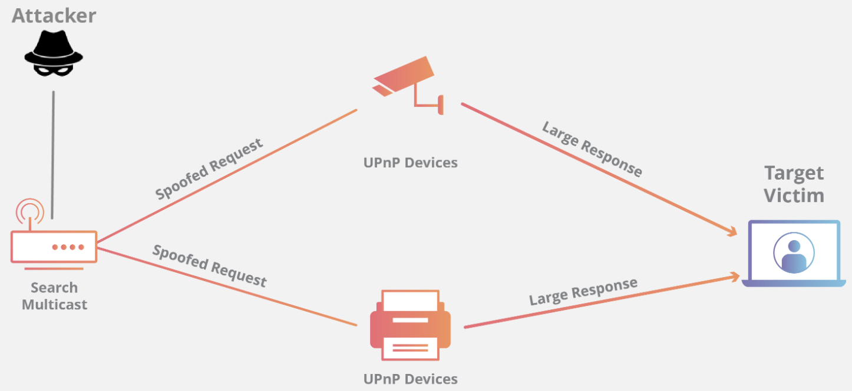
SSDP Attack
Exploit SSDP and UpnP
Notes:
https://www.cloudflare.com/learning/ddos/ssdp-ddos-attack/

Slide 78
SSDP Attack
Attack principle
1. the attacker conducts a scan looking for plug-and-play devices that can be utilized as amplification factors;
Notes:
https://www.cloudflare.com/learning/ddos/ssdp-ddos-attack/

Slide 79
SSDP Attack
Attack principle
1. the attacker conducts a scan looking for plug-and-play devices that can be utilized as amplification factors;
2. as the attacker discovers networked devices, they create a list of all the devices that respond;
Notes:
https://www.cloudflare.com/learning/ddos/ssdp-ddos-attack/
list of all the devices：upnp设备

Slide 80
SSDP Attack
Attack principle
1. the attacker conducts a scan looking for plug-and-play devices that can be utilized as amplification factors;
2. as the attacker discovers networked devices, they create a list of all the devices that respond;
3. the attacker creates a UDP packet with the spoofed IP address of the targeted victim.
Notes:
https://www.cloudflare.com/learning/ddos/ssdp-ddos-attack/

Slide 81
SSDP Attack
Attack principle
4. the attacker then uses a botnet to send a spoofed discovery packet to each plug-and-play device with a request for as much data as possible by setting certain flags, specifically ssdp:rootdevice or ssdp:all;
Notes:
complete list of everything it has to offer

Slide 82
SSDP Attack
Attack principle
5. as a result, each device will send a reply to the targeted victim with an amount of data up to about 30 times larger than the attacker’s request;
Notes:
https://www.cloudflare.com/learning/ddos/ssdp-ddos-attack/

Slide 83
SSDP Attack
Attack principle
5. as a result, each device will send a reply to the targeted victim with an amount of data up to about 30 times larger than the attacker’s request;
6. the target then receives a large volume of traffic from all the devices and becomes overwhelmed, potentially resulting in denial-of-service to legitimate traffic;
Notes:
https://www.cloudflare.com/learning/ddos/ssdp-ddos-attack/

Slide 84
SSDP Attack
Mitigation Solution
block incoming UDP traffic on port 1900 at the firewall;
Notes:
https://www.cloudflare.com/learning/ddos/ssdp-ddos-attack/

Slide 85
asymmetric DDoS attack
exploit traffic amplifier so far
Notes:
https://www.radware.com/security/ddos-knowledge-center/ddospedia/asymmetric-attack

Slide 86
Smurf Attack
Attack with an ICMP Echo Request with spoofed source IP address of the targeted server and destination IP address of an IP broadcast address
1 ICMP Echo Request Spoofed Src: DDos Target
Dest: brdct addr
3 ICMP Echo Reply Dest: DDos Target
router/firewall
DDoS Target
DDoS Source
Notes:
https://www.cloudflare.com/learning/ddos/smurf-ddos-attack/
https://searchnetworking.techtarget.com/tip/Router-Expert-Smurf-fraggle-attack-defense-using-SACLs
Here's How a Smurf attack works:
First the Smurf malware builds a spoofed packet that has its source address set to the real IP address of the targeted victim.
The packet is then sent to an IP broadcast address of a router or firewall, which in turn sends requests to every host device address inside the broadcasting network, increasing the number of requests by the number of networked devices on the network.
Each device inside the network receives the request from the broadcaster and then responds to the spoofed address of the target with an ICMP Echo Reply packet.
The target victim then receives a deluge of ICMP Echo Reply packets, potentially becoming overwhelmed and resulting in denial-of-service to legitimate traffic.

Slide 87
DNS Amplification Attack
Attack with an ANY-type DNS query with spoofed source IP address of the targeted server
EDNS: Extension Mechanisms for DNS sends DNS data in larger UDP packets
DNS Query Spoofed SrcIP: DDos Target
(60 bytes)
EDNS Reponse
(3000 bytes)
DDoS Source
DNS Server
DDoS Target
Notes:
https://www.cloudflare.com/learning/ddos/dns-amplification-ddos-attack/
An "open DNS resolver" is a DNS server that's willing to resolve recursive DNS lookups for anyone on the internet.
https://en.wikipedia.org/wiki/Extension_Mechanisms_for_DNS
Extension mechanism for DNS (EDNS, or EDNS(0)) gives us a mechanism to send DNS data in larger packets over UDP.

Slide 88
NTP Amplification Attack
Amplify the effect of NTP query
1 query vs a large response
monlist
30+ bytes
600 IP addr
22,000 bytes of pkts
Notes:
https://www.cloudflare.com/learning/ddos/ntp-amplification-ddos-attack/
https://www.akamai.com/us/en/multimedia/documents/state-of-the-internet/ntp-amplification-threat-advisory.pdf
An NTP amplification attack can be broken down into four steps:
The attacker uses a botnet to send UDP packets with spoofed IP addresses to a NTP server which has its monlist command enabled. The spoofed IP address on each packet points to the real IP address of the victim.
Each UDP packet makes a request to the NTP server using its monlist command, resulting in a large response.
The server then responds to the spoofed address with the resulting data.
The IP address of the target receives the response and the surrounding network infrastructure becomes overwhelmed with the deluge of traffic, resulting in a denial-of-service.

Slide 89
Memcached Attack
Attack principle
preload large data to Memcached server;
Notes:
A memcached attack occurs in 4 steps:
An attacker implants a large payload* of data on an exposed memcached server.
Next the attacker spoofs an HTTP GET request with the IP address of the targeted victim.
The vulnerable memcached server that receives the request, which is trying to be helpful by responding, sends a large response to the target.
The targeted server or its surrounding infrastructure is unable to process the large amount of data sent from the memcached server, resulting in overload and denial-of-service to legitimate requests.

Slide 90
Memcached Attack
Attack principle
spoof request to preloaded data from target;
Notes:
A memcached attack occurs in 4 steps:
An attacker implants a large payload* of data on an exposed memcached server.
Next the attacker spoofs an HTTP GET request with the IP address of the targeted victim.
The vulnerable memcached server that receives the request, which is trying to be helpful by responding, sends a large response to the target.
The targeted server or its surrounding infrastructure is unable to process the large amount of data sent from the memcached server, resulting in overload and denial-of-service to legitimate requests.

Slide 91
SSDP Attack
Exploit SSDP and UpnP
Notes:
https://www.cloudflare.com/learning/ddos/ssdp-ddos-attack/

Slide 92
asymmetric DDoS attack
computation asymmetry:
server costs more computation resources than attacker for a service request
Notes:
https://www.radware.com/security/ddos-knowledge-center/ddospedia/asymmetric-attack

Slide 93
什么是DDoS攻击 （5分钟）
https://www.bilibili.com/video/av89393544?from=search&seid=15146171245294332324

Slide 94
Thank You
be on the road
Notes:
Run your own race.

