Slide 1
网络安全原理与实践
林峰
2024年春季学期

Slide 2
Lecture 1 Secure Routing
林峰
flin@zju.edu.cn

Slide 3
Routing
The process of moving a packet of data from source to destination
When a router receives a packet, it reads the headers of the packet to see its intended destination.

Slide 4
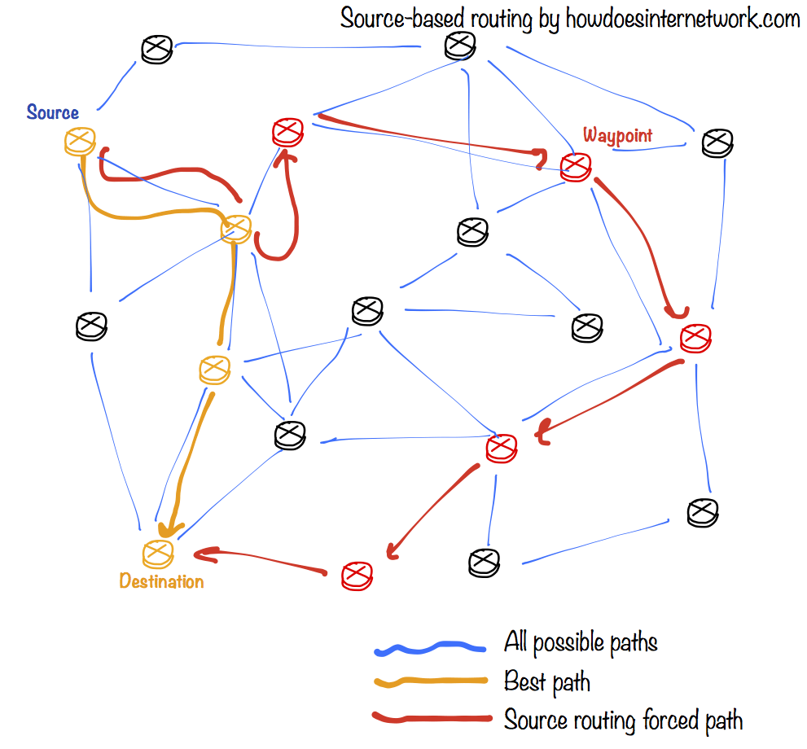
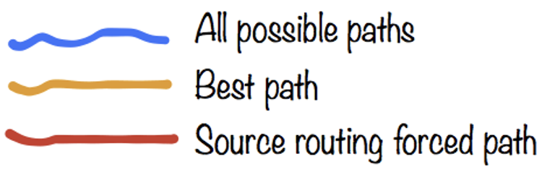
Secure Routing
select a path for traffic
in a network
Notes:
Routing
By definition, routing is the process of selecting a path for traffic in a network, or between or across multiple networks.

Slide 5
Secure Routing
How does routing work?
How is routing attacked?
How is routing secured?
Notes:
Discussions to be covered include routing’s working principles, vulnerabilities, and security solutions.

Slide 6




Delivery Scheme
unicast
deliver msg to a single node
broadcast
deliver msg to all nodes in network
multicast
deliver msg to a group of nodes
anycast
deliver msg to any one of a group
Notes:
Routing schemes differ in how they deliver messages:
unicast delivers a message to a single specific node
broadcast delivers a message to all nodes in the network
multicast delivers a message to a group of nodes that have expressed interest in receiving the message
anycast delivers a message to any one out of a group of nodes, typically the one nearest to the source
geocast delivers a message to a group of nodes based on geographic location
Unicast is the dominant form of message delivery on the Internet.

Slide 7

Delivery Scheme
unicast
deliver msg to a single node
broadcast
deliver msg to all nodes in network
geocast
deliver a message to a group of nodes
based on geographic location
multicast
deliver msg to a group of nodes
anycast
deliver msg to any one of a group
Notes:
geocast delivers a message to a group of nodes based on geographic location

Slide 8
Delivery Scheme
unicast
deliver msg to a single node
dominant form of msg delivery on inet
Notes:
Unicast is the dominant form of message delivery on the Internet.
Build most of our discussions on it

Slide 9
Routing Scheme
unicast
deliver msg to a single node
how to find a feasible path?
Notes:
Now given the goal of delivering a message from one node to another, how to find a feasible path between them?
This is the focus of a routing scheme.

Slide 10
Routing Scheme
Intra-domain routing
inside an autonomous system
Inter-domain routing
between autonomous systems
Notes:
自治系统是由单个组织管理的大型网络或网络组。AS可能有许多子网，但都共享相同的路由策略。一个域可能是由一所大学或其它机构管理的互联网。
Depending on whether the two communication entities are in the same autonomous system,
There are two different routing schemes.
One is intra-domain routing, it targets path finding inside an autonomous system
The other is inter-domain routing, apparently, it aims to find paths between nodes from different autonomous systems.

Slide 11
Routing Scheme
Intra-domain routing
consider A-F as routers
Inter-domain routing
consider A-F as autonomous systems
5
B
3
C
2
5
A
2
1
F
examples from
https://www.cs.umd.edu/~shankar/417-F01/Slides/chapter4a-aus/
https://www.cs.umd.edu/~shankar/417-F01/Slides/chapter4b-aus/
3
1
2
D
E
1
Notes:
自治系统是由单个组织管理的大型网络或网络组。AS可能有许多子网，但都共享相同的路由策略

Slide 12
Route Computation
Link-state algorithms
each router knows complete topology & link cost information;
independently run routing algorithm to calculate shortest path to each destination;
5
B
3
C
2
5
A
2
1
F
3
1
2
D
E
1
Notes:
~网络进行了分层设计，大型网络通常如此。
~管理员对于网络中采用的链路状态路由协议非常熟悉。
~ 网络对收敛速度的要求极高。

Slide 13
Dijkstra
c(i,j) link cost from i to j (∞ if unknown)
D(v) current value of cost of path from
source to destination v;
p(v) predecessor node along path from
source to v; (neighbor of v)
N’ set of nodes whose least
cost path is already known;
5
B
3
C
2
5
A
2
1
F
3
1
2
D
E
1
Notes:
迪杰斯特拉，典型的最短路径路由算法. Dijkstra 算法是求一个图中一个点到其他所有点的最短路径的算法.
Dijkstra 算法，是由荷兰计算机科学家 Edsger Wybe Dijkstra 在1956 年发现的算法，迪杰斯特拉算法使用类似广度优先搜索的方法解决权重图的单源最短路径问题
predecessor：前辈

Slide 14
Dijkstra
1 Initialization:
2 N' = {A}
3 for all nodes v
4 if v adjacent to A
5 then D(v) = c(A,v)
6 else D(v) = ∞
7
8 Loop
find w not in N' such that D(w) is
minimum
10 add w to N'
11 update D(v) for all v adjacent to w and not in N':
12 D(v) = min(D(v), D(w) + c(w,v))
/* new cost to v is either the old cost, or known shortest path cost to w plus cost from w to v */
13 until all nodes in N'
5
B
3
C
2
5
A
2
1
F
3
1
2
D
E
1
Notes:
example
每次从 「未求出最短路径的点」中 取出 距离离起点 最小路径的点，以这个点为桥梁 刷新「未求出最短路径的点」的距离
w not in N’ 意味着least cost path未知。D（w）指source到w
N' 已求出最短路径的点
D(v) = min(D(v), D(w) + c(w,v)) 找到新的w后，看看原来D（V）和新的路径比哪个小

Slide 15
Dijkstra
Step
0
1
2
3
4
5
start N'
A
AD
ADE
ADEB
ADEBC
ADEBCF
D(B),p(B)
2,A
2,A
2,A
D(C),p(C)
5,A
4,D
3,E
3,E
D(D),p(D)
1,A
D(E),p(E)
infinity
2,D
D(F),p(F)
infinity
infinity
4,E
4,E
4,E
find w not in N' such that D(w) is
minimum
10 add w to N'
11 update D(v) for all v adjacent to w and not in N':
12 D(v) = min(D(v), D(w) + c(w,v))
/* new cost to v is either the old cost, or known shortest path cost to w plus cost from w to v */
13 until all nodes in N'
5
Old value
B
3
C
2
5
A
2
1
F
3
1
2
D
E
1

Slide 16
Dijkstra
Step
0
1
2
3
4
5
start N'
A
AD
ADE
ADEB
ADEBC
ADEBCF
D(B),p(B)
2,A
2,A
2,A
D(C),p(C)
5,A
4,D
3,E
3,E
D(D),p(D)
1,A
D(E),p(E)
infinity
2,D
D(F),p(F)
infinity
infinity
4,E
4,E
4,E
resulting shortest-path tree for A:
5
5
3
B
3
C
B
C
5
2
5
2
A
A
2
2
F
1
F
3
1
3
1
1
2
D
2
D
E
E
1
1
Notes:
通过前辈节点倒推回去就是route

Slide 17
Dijkstra
Step
0
1
2
3
4
5
start N'
A
AD
ADE
ADEB
ADEBC
ADEBCF
D(B),p(B)
2,A
2,A
2,A
D(C),p(C)
5,A
4,D
3,E
3,E
D(D),p(D)
1,A
D(E),p(E)
infinity
2,D
D(F),p(F)
infinity
infinity
4,E
4,E
4,E
resulting shortest-path tree for A:
destination
link
5
5
B
(A, B)
3
D
(A, D)
B
3
C
B
C
5
2
5
2
E
(A, D，E)
A
A
2
2
F
1
F
3
1
C
(A, D，E，C)
3
1
1
2
D
2
D
E
F
(A, D，E，F)
E
1
1

Slide 18
what if no global view?
Notes:
Such link-state algorithms require that each router knows complete topology & link cost information;
What if a router has no such global view, especially in a relatively large network?

Slide 19
Route Computation
Distance-vector algorithms
each router knows direct neighbors & link costs to neighbors;
independently calculate shortest path to each destination through an iterative process based on neighbors’ distances to dest;
5
B
3
C
2
5
A
2
1
F
3
1
2
D
E
1
Notes:
距离向量算法。贝尔曼福特算法。In this case, we can turn to distance-vector algorithms;
~ 网络结构简单、扁平，不需要特殊的分层设计。
~管理员没有足够的知识来配置链路状态协议和排查故障。
~特定类型的网络拓扑结构，如集中星形（Hub-and-Spoke）网络。
~无需关注网络最差情况下的收敛时间。

Slide 20
Bellman-Ford
D_{x}(y) cost of least-cost path from x to y:
Then D_{x}(y) = min{c(x,v) + D_{v}(y)} for all neighbors v of x
5
B
3
C
2
5
A
2
1
F
3
1
2
D
E
1
Notes:
a typical distance-vector algorithm is Bellman-Ford
Define: D_{x}(y) := cost of least-cost path from x to y
Then D_{x}(y) = min {c(x,v) + D_{v}(y) }
where min is taken over all neighbors v of x

Slide 21
Bellman-Ford
D_{x}(y) cost of least-cost path from x to y:
wait for (change in local link cost of msg from neighbor)
recompute estimates
if DV to any dest has changed, notify neighbors
5
B
3
C
2
5
A
2
1
F
3
1
2
D
E
1

Slide 22
Bellman-Ford
D_{x}(y) cost of least-cost path from x to y:
D_{x}(y) = min{c(x,v) + D_{v}(y)} for all neighbors v of x
D_{A}(F) = min {c(A,B) + D_{B}(F),
c(A,D) + D_{D}(F),
c(A,C) + D_{C}(F) }
= min {2 + 5,
1 + 3,
5 + 3} = 4
5
B
3
C
2
5
A
2
1
F
3
node leading to shortest path is next hop → forwarding table
1
2
D
E
1
Notes:
现在图上面也看得出来，实际上要迭代的算

Slide 24
intra-domain vs inter-domain
Notes:
上面这两种类型的路径计算算法都可用于域内路由和域间路由

Slide 25
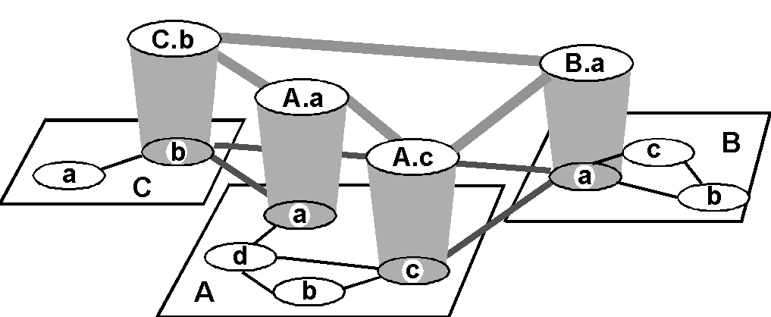
Hierarchical Routing
inter-AS border (exterior gateway) routers
intra-AS (interior gateway) routers
Notes:
分级路由选择，包括了域内路由和域间路由。每个长方形代表AS，高的椭圆在边界的代表域间边界路由器

Slide 26
Hierarchical Routing
inter-AS border (exterior gateway) routers
intra-AS (interior gateway) routers
AS: autonomous system
IGP：Interior Gateway Protocol
BGP：Border Gateway Protocol
Notes:
IGP：Interior Gateway Protocol
BGP：Border Gateway Protocol

Slide 27
Hierarchical Routing
inter-AS border (exterior gateway) routers
intra-AS (interior gateway) routers
each AS uses its own IGP internal routing protocol;
border routers run BGP as well;
Notes:
IGP：Interior Gateway Protocol
BGP：Border Gateway Protocol

Slide 28
IGP: Interior Gateway Prot
RIP
routing information protocol
OSPF
open shortest path first
Notes:
IGP: interior gateway protocols

Slide 29
RIP
Distance-vector algorithm
distance metric: # of hops (max=15)
Neighbor routers exchange routing advertisement every 30 seconds
Failure and recovery
if no update from neighbor N after 180s，invalidate routes via N, notify neighbors
Notes:
RIP协议采用距离向量算法，Distance vector algorithm （Bellman-ford），在实际使用中已经较少适用
RIP协议是以“跳数”来定义路由的开销cost。“跳数”：指到达目的地所需要经过的路由器的个数
Failure and Recovery: If no update from neighbor N heard after 180 sec  neighbor/link declared dead
All routes via N invalidated; updates sent to neighbors

Slide 30
RIP
Notes:
Source 路由器D覆盖的AS
假设到z需要7跳

Slide 31
RIP
Notes:
Neighbor routers exchange routing advertisement
广告信息A-D：Source 路由器A覆盖的AS

Slide 32
RIP
Notes:
D进行路由表更新

Slide 33
OSPF
Open Shortest Path First (belong to Link-state algorithm)
each node knows its direct neighbors & the link distance to each(link-state);
each node periodically broadcasts its link-state to the entire network;
Notes:
每个节点虽然只知道自己邻居和链路信息，但会通过形成拓扑图知道全网信息

Slide 34
OSPF
LSP (Link-State Packet)
one entry per neighbor router containing:
1.ID of the node that created the LSP;
2.a list of direct neighbors, with link cost;
3.sequence number for this LSP (SEQ);
4.time-to-live (TTL) for info in this LSP;
Notes:
包含：1. 创建该链路状态包的节点的ID
A list of 包含链路开销信息的直接邻居
序列号
包里信息的TTL

Slide 35
OSPF
Build a complete map using link states
everyone broadcasts a piece of topology;
put all pieces together → complete map
Notes:
通告给邻居一些链路状态
运行该路由协议的路由器不是简单地从相邻的路由器学习路由，而是把路由器分成区域，收集区域的所有的路由器的链路状态信息，根据状态信息生产网络拓扑结构，每一个路由器再根据拓扑结构计算出路由

Slide 36
OSPF
Each node stores and forwards LSPs
Decrement TTL of stored LSPs
Discard info when TTL=0
Compute routes using Dijkstra
Generate LSPs periodically with increasing SEQ
Notes:
The routing daemon running at each node: Builds and maintains topology map at each node

Slide 37
OSPF
Reliable flooding of LSP
forward each received LSP to all neighbors but the one that sent it;
use the source-ID and SEQ to detect duplicates;
X
A
C
B
D
X
A
X
A
X
A
C
B
D
C
B
D
C
B
D
Notes:
距离矢量路由协议，她必须首先运行贝尔曼-福特算法来处理路由更新，然后才将他们发送至其他路由器。而链路状态协议则是在泛洪完成后在计算SPF算法，因此到达收敛的速度比距离矢量路由协议速度要快。

Slide 38
Security of OSPF
All OSPF messages are authenticated
Multiple same-cost paths are allowed
Hierarchical OSPF is used in large domains
Notes:
For each link, multiple cost metrics for different TOS (eg, satellite link cost set “low” for best effort; high for real time)

Slide 39
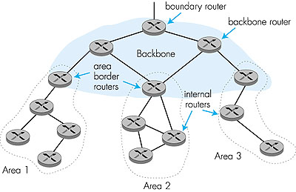
Hierarchical OSPF
Link-state ads only in area
each node has detailed
area topology,
but only direction (shortest
path) to other areas;
Notes:
Two-level hierarchy: local area, backbone.
Link-state advertisements only in area
each nodes has detailed area topology; only know direction (shortest path) to nets in other areas.
Area border routers: “summarize” distances to nets in own area, advertise to other Area Border routers.
Backbone routers: run OSPF routing limited to backbone.
Boundary routers: connect to other AS’s.

Slide 40
Hierarchical OSPF
summarize distances
to routers in local area;
advertise to
other area border routers;
Notes:
Two-level hierarchy: local area, backbone.
Link-state advertisements only in area
each nodes has detailed area topology; only know direction (shortest path) to nets in other areas.
Area border routers: “summarize” distances to nets in own area, advertise to other Area Border routers.
Backbone routers: run OSPF routing limited to backbone.
Boundary routers: connect to other AS’s.

Slide 41
Hierarchical OSPF
run OSPF routing
limited to backbone
Notes:
Two-level hierarchy: local area, backbone.
Link-state advertisements only in area
each nodes has detailed area topology; only know direction (shortest path) to nets in other areas.
Area border routers: “summarize” distances to nets in own area, advertise to other Area Border routers.
Backbone routers: run OSPF routing limited to backbone.
Boundary routers: connect to other AS’s.

Slide 42
Hierarchical OSPF
connect to
other ASes
Notes:
通过自治系统边界的路由器注入其他AS的路由信息，从而得到整个Internet的路由信息

Slide 43
inter-domain routing
BGP: Border Gateway Protocol
Notes:
边界网关协议
Connect other Ases
inter-domain routing required;

Slide 44
BGP
Path-vector protocol among border routers
each border router broadcasts to neighbors entire path of AS sequence to destination:
e.g., Path(B,C) = B, A, C
Notes:
边界网关协议（BGP）是运行于 TCP 上的一种 自治系统 的 路由协议 。BGP的特点：
（1）BGP能够承载大批量的路由信息，能够支撑大规模网络。
（2）BGP能够支持多协议的扩展（IP v4、IP v6）。
（3）BGP能够支撑MPLS/VPN的应用，传递客户VPN路由
AS_Path属性记录了BGP路由传递过程中所经过的AS号，实际上它是一个AS号的列表
Path Vector protocol:
similar to Distance Vector protocol，都记录顺序（前一个节点是谁）

Slide 45
BGP
For each AS:
Obtain subnet reachability information from neighbor ASes;
Propagate the reachability information to all internal routers;
Determine routes to subnets based on reachability information and policy
Notes:
Subnet：每个路由器下面都有一个子网
Allows a subnet to advertise its existence to rest of the Internet: “I am here”

Slide 46
BGP
x
Example: forwarding table entry for d→x

Slide 47
BGP
x
x
Example: forwarding table entry for d→x
AS A learns from BGP that subnet x is reachable from AS B via border router A.c;
Notes:
上面提到过：1. Obtain subnet reachability information from neighbor ASes;
2. Propagate the reachability information to all internal routers;
Suppose AS A learns from the inter-AS protocol that subnet x is reachable from AS B (gateway A.c) but not from AS C.
Inter-AS protocol propagates reachability info to all internal routers.

Slide 48
BGP
I
x
x
x
Example: forwarding table entry for d→x
router d determines from intra-domain routing info that its interface I is on the least cost path to c;
Notes:
Puts in forwarding table entry (x, I).

Slide 49
BGP
I
x
x
x
Example: forwarding table entry for d→x
destination | next hop
x | I
Puts in forwarding table entry (x, I).

Slide 50
BGP
Distribute reachability information:
internal bgp session, iBGP, adjcent BGP information in same AS
external bgp session，eBGP, adjcent BGP information in different AS
3c
P
3a
2c
3b
2a
AS3
2b
1c
AS2
1a
1b
AS1
1d
eBGP session
iBGP session
Notes:
internal bgp, iBGP, 位于相同自治系统的BGP路由器之间的BGP邻接关系，类似OSPF
external bgp，eBGP, 位于不同自治系统的BGP路由器之间的BGP邻接关系
Prefix: A route announcement: path of AS numbers +the IP block that is being routed. For example:701 1239 42 206.24. 14.0/24.

Slide 51
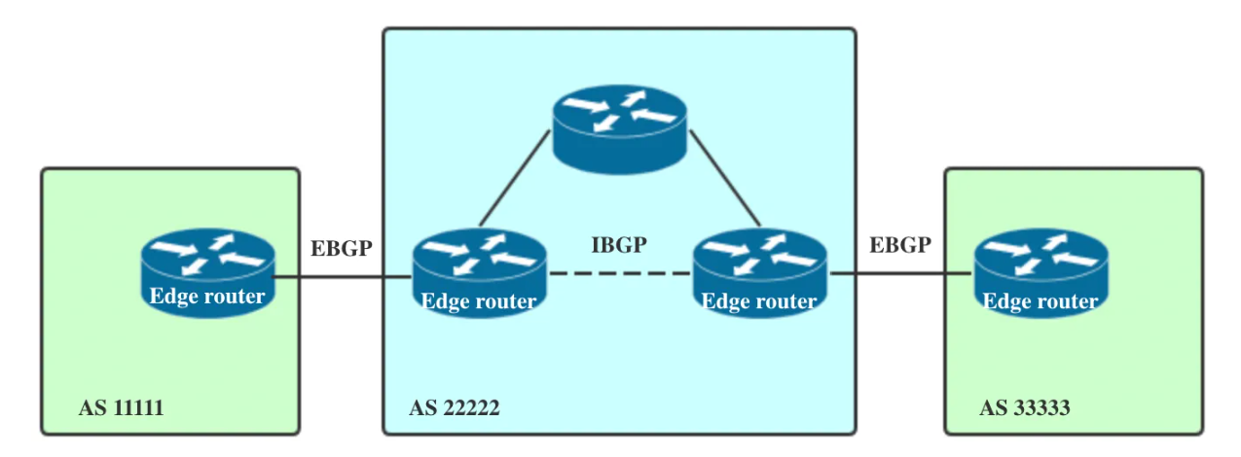
BGP

Slide 52
BGP
Distribute reachability information:
with eBGP session 3a-to-1c,
AS3 sends prefix reachability info to AS1
Prefix: A route announcement-path of AS numbers +the IP block that is being routed.
3c
P
3a
2c
3b
2a
AS3
2b
1c
AS2
1a
1b
AS1
1d
eBGP session
iBGP session
Notes:
internal bgp, iBGP, 位于相同自治系统的BGP路由器之间的BGP邻接关系
external bgp，eBGP, 位于不同自治系统的BGP路由器之间的BGP邻接关系
Prefix: A route announcement: path of AS numbers +the IP block that is being routed. For example:701 1239 42 206.24.14.0/24.

Slide 53
BGP
Distribute reachability information:
1c uses iBGP sessions to distribute
this new prefix reachability info to all routers in AS1;
3c
3c
P
P
2c
3a
2c
3a
3b
3b
2a
2a
AS3
AS3
2b
2b
1c
1c
AS2
AS2
1a
1a
1b
1b
1d
AS1
1d
AS1
eBGP session
eBGP session
iBGP session
iBGP session

Slide 54
BGP
Distribute reachability information:
1b re-advertises the new reachability info to AS2
over the 1b-to-2a eBGP session;
3c
3c
3c
P
P
P
2c
2c
3a
2c
3a
3a
3b
3b
3b
2a
2a
2a
AS3
AS3
AS3
2b
2b
2b
1c
1c
1c
AS2
AS2
AS2
1a
1a
1a
1b
1b
1b
1d
1d
AS1
1d
AS1
AS1
eBGP session
eBGP session
eBGP session
iBGP session
iBGP session
iBGP session

Slide 55
BGP
Distribute reachability information:
1b re-advertises the new reachability info to AS2
over the 1b-to-2a eBGP session;
when a router learns about a new prefix,
it creates a forwarding table entry for the prefix
3c
3c
3c
3c
P
P
P
P
2c
2c
2c
3a
2c
3a
3a
3a
3b
3b
3b
3b
2a
2a
2a
2a
AS3
AS3
AS3
AS3
2b
2b
2b
2b
1c
1c
1c
1c
AS2
AS2
AS2
AS2
1a
1a
1a
1a
1b
1b
1b
1b
1d
1d
1d
AS1
1d
AS1
AS1
AS1
eBGP session
eBGP session
eBGP session
eBGP session
iBGP session
iBGP session
iBGP session
iBGP session

Slide 56
BGP
provider
networks
customer
networks
Routing policy:
Provider networks: A, B, C
Customer networks (of provider networks): X, Y, W
Notes:
ABC，XYW都AS
根据资源的情况，AS自己决定是否要advertise.

Slide 57
BGP
provider
networks
customer
networks
Routing policy:
Provider networks: A, B, C
Customer networks (of provider networks): X, Y, W
X is dual-homed: attached to two networks

Slide 58
BGP
X does not want to carry traffic from B to C,
so X will not advertise to B a route to C.
provider
networks
customer
networks
Routing policy:
Provider networks: A, B, C
Customer networks (of provider networks): X, Y, W
X is dual-homed: attached to two networks
Notes:
有这样一种情况
X does not want to carry traffic from B to C,
so X will not advertise to B a route to C.

Slide 59
BGP
provider
networks
customer
networks
Routing policy:
A advertises to B the path AW
B advertises to X the path BAW

Slide 60
BGP
provider
networks
customer
networks
Routing policy:
A advertises to B the path AW
B advertises to X the path BAW
Should B advertise to C the path BAW?
Notes:
Should B advertise to C the path BAW?
No way! B gets no “revenue” for routing CBAW since neither W nor C are B’s customers
B wants to force C to route to w via A
B wants to route only to/from its customers!

Slide 61
BGP
B gets no revenue for routing CBAW as neither W nor C is B’s customer.
B wants to route only to/from its customers.
provider
networks
customer
networks
Routing policy:
A advertises to B the path AW
B advertises to X the path BAW
Should B advertise to C the path BAW?
No way!
Notes:
跟自己无关的不要占用自己资源。
B wants to route only to/from its customers.
B wants to force C to route to w via A

Slide 62
routing attacks
distance-vector (RIP)
link-state (OSPF)
BGP

Slide 63
routing attacks
distance-vector:
announce 0 distance to all other nodes
link-state:
drop links; claim direct link to other routers
BGP:
announce arbitrary prefix; alter paths
Notes:
Distance Vector Routing
Announce 0 distance to all other nodes
Blackhole traffic
Eavesdrop
Link State Routing
Can drop links randomly
Can claim direct link to any other routers
A bit harder to attack than DV
BGP
ASes can announce arbitrary prefix
ASes can alter path

Slide 64
Prefix Hijacking: Case 1
“The Internet”
Pakistan
Telecom
YouTube
I’m YouTube:
IP 208.65.153.0 / 22
Telnor
Pakistan
Multinet
Pakistan
Aga Khan
University
examples from https://people.cs.umass.edu/~phillipa/CSE390/RoutingSecurity.pptx
Notes:
-level of autonomous systems
-e.g., YouTube, AT&T, pakistan telecom
-routing is done on IP addresses, so when someone wants to go to YouTube they get YouTube’s IP address and YouTube announces to the world that they have the ip address and traffic is forwarded towards them. So here multinet would route to it’s provider pakistan telecom that then forwards the traffic on to youtube.

Slide 65
Prefix Hijacking: Case 1
“The Internet”
Pakistan
Telecom
YouTube
I’m YouTube:
IP 208.65.153.0 / 22
Telnor
Pakistan
Multinet
Pakistan
Aga Khan
University
pakistan telecom actually hijacked traffic going to youtube (misconfiguration)
examples from https://people.cs.umass.edu/~phillipa/CSE390/RoutingSecurity.pptx
Notes:
Bgp Hijack 劫持是指攻击者恶意改变互联网流量的路由。攻击者通过错误地宣布他们实际上并不拥有、控制或路由的IP地址组(称为IP前缀)的所有权来实现这一点。
bgp劫持很像是有人在高速公路上改变所有的标志，将汽车指向错误的出口。https://www.idcbest.com/idcnews/11004842.html

Slide 66
Here’s what should have happened….
“The Internet”
Hijack + drop packets going to YouTube
X
Pakistan
Telecom
YouTube
I’m YouTube:
IP 208.65.153.0 / 22
Telnor
Pakistan
Multinet
Pakistan
Aga Khan
University
Block your own customers.
pakistan telecom actually hijacked traffic going to youtube (misconfiguration)
Notes:
-these networks chosen for a specific reason which is that there was an incident in february 2008 pakistan telecom actually hijacked traffic going to youtube (misconfiguration).
-they announced to the world that they’re youtube and traffic destined to youtube was routed to them
-youtube was unavailable for a couple of hours as operators phone each other to figure out what was going on.

Slide 67
But here’s what Pakistan ended up doing…
“The Internet”
No, I’m YouTube!
IP 208.65.153.0 / 24
Pakistan
Telecom
Pakistan
Telecom
YouTube
I’m YouTube:
IP 208.65.153.0 / 22
Telnor
Pakistan
Multinet
Pakistan
Aga Khan
University
Notes:
-these networks chosen for a specific reason which is that there was an incident in february 2008 pakistan telecom actually hijacked traffic going to youtube (misconfiguration).
-they announced to the world that they’re youtube and traffic destined to youtube was routed to them
-youtube was unavailable for a couple of hours as operators phone each other to figure out what was going on

Slide 68
Prefix Hijacking: Case 2
Level3, VZW, 22394 66.174.161.0/24
ISP 1
VZW, 22394 66.174.161.0/24
Level 3
China
Telecom
Verizon
Wireless
22394 66.174.161.0/24
22394
Paths chosen based on cost and length.
66.174.161.0/24
Notes:
B4 we start with attacks lets lookat how bgp works
We have this prefix
22394 Ann, verizon routes traffic to it, reannounces it “ (level 3)
There have been many well publicized misconfigurations that illustrate the insecurity of BGP. For example consider the prefix on the last slide. In april 2010 China telecom announced a direct path to this. So now ISP 1 has two paths to the prefix and needs to pick 1. Since the china telecom path is shorter ISP 1 will choose to route through it. And what’s interesting here, is that since China Telecom is so large they actually had a router in their network that still new the correct path to the prefix so the traffic went back out to level 3 and on to verizon.

Slide 69
April 2010 : China Telecom intercepts traffic
ChinaTel path is shorter
?
ChinaTel 66.174.161.0/24
Level3, VZW, 22394 66.174.161.0/24
ISP 1
Level 3
China
Telecom
Verizon
Wireless
22394
This prefix and 50K others were announced by China Telecom
Traffic for some prefixes was possibly intercepted
66.174.161.0/24
Notes:
B4 we start with attacks lets lookat how bgp works
We have this prefix
22.. Ann, verizon routes traffic to it, reannounces it
“ (level 3)
There have been many well publicized misconfigurations that illustrate the insecurity of BGP. For example consider the prefix on the last slide. In april 2010 China telecom announced a direct path to this prefix (as well as 50k other ones). So now ISP 1 has two paths to the prefix and needs to pick 1. Since the china telecom path is shorter ISP 1 will choose to route through it. And what’s interesting here, is that since China Telecom is so large they actually had a router in their network that still new the correct path to the prefix so the traffic went back out to level 3 and on to verizon.

Slide 70

Path Tampering
Remove ASes from the AS path
Add ASes to the AS path
701 3715 88
701
3715
88
?
701
701 88 →
701 3715 88
88
Notes:
Tampering 干预

Slide 71
how to secure routing?

Slide 72
RPKI
Resource Public Key Infrastructure
certified mapping
from ASes to public keys and IP prefixes
X
RPKI: Invalid!
?
ChinaTel 66.174.161.0/24
Level3, VZW, 22394 66.174.161.0/24
ISP 1
Level 3
China
Telecom
Verizon
Wireless
22394
RPKI shows China Telecom is not a valid origin for this prefix.
66.174.161.0/24
Notes:
One way we might solve this is using the cryptgraphy
One way to solve this is to do origin authentication using RPKI which is a certified mapping between IP prefixes and the Ases that own them. So now ISP 1 can check the RPKI and see that china telecom is not a valid originator of this prefix and choose the correct path to the prefix.

Slide 73
RPKI
insufficient!
?
ChinaTel, 22394 66.174.161.0/24
Level3, VZW, 22394 66.174.161.0/24
ISP 1
Level 3
China
Telecom
Verizon
Wireless
22394
Malicious router can pretend to connect to the valid origin.
66.174.161.0/24
Notes:
However, if instead of just being misconfigured, china telecom decided to behave maliciously, RPKI would not be enough. So for example china telecom could pretend they have a direct connection to the AS that owns the prefix by announcing China telecom 22394.

Slide 74
S-BGP
Each AS on the path cryptographically signs its announcement
Guarantees that each AS on the path made the announcement in the path:
AS path indicates the order ASes were traversed;
No intermediate ASes were added or removed;
Notes:
S-BGP: Secure BGP
Address attestations
Claim the right to originate a prefix
Signed and distributed out-of-band
Checked through delegation chain from ICANN
Route attestations
Distributed as an attribute in BGP update message
Signed by each AS as route traverses the network
Signature signs previously attached signatures

Slide 75
S-BGP
Deployment challenges:
Complete, accurate registries
Public key infrastructure
Cryptographic operations
Need to perform operations quickly
Difficulty of incremental deployment
Notes:
Complete, accurate registries
E.g., of prefix ownership
Public Key Infrastructure
To know the public key for any given AS
Cryptographic operations
E.g., digital signatures on BGP messages
Need to perform operations quickly
To avoid delaying response to routing changes
Difficulty of incremental deployment
Hard to have a “flag day” to deploy S-BGP

Slide 76
Readings
BGP Hijack Explained by Jorge Ribas
Why Is It Taking So Long to Secure Internet Routing? by Sharon Goldberg

Slide 77
Thank You
be on the road
Notes:
Run your own race.

