Slide 1
网络安全原理与实践
林峰
2024年春季学期

Slide 2
Lecture 4 Anonymous Communication
林峰
flin@zju.edu.cn

Slide 3
Anonymous Communication
Disclaimer:
The content to be presented aims only for
helping students understand principles of
anonymous communication. It should not be
used for abusive Internet activities.

Slide 4



Anonymous Communication
jzk
txh
hello, txh
Notes:
考虑最基本的通信，没有任何的保护。
Exchange messages

Slide 5
Anonymous Communication
jzk
Internet
txh
hello, txh
Notes:
Through Internet

Slide 6
Anonymous Communication
jzk: ip1
Internet
ip2 :
txh
hello, txh
Notes:
用IP地址取代身份，
源地址和目的地地址
Source IP and Destination IP for specifying users

Slide 7

Anonymous Communication
jzk: ip1
???
Internet
ip2 :
???
hello, txh
Notes:
攻击无法关联到用户的真实身份信息，比如他不知道发消息的是李同学，还是王同学，但他知道通信双方的ip地址是ip1 和 ip2.
即使攻击者不知道通信双方用户的确切身份，只知道用户通信设备的ip地址，这也同样引起用户对隐私的关切。
很多接入网络都是固定IP（比如说办公室的固定IP）。即使通过无线局域网连接，对外出口还是同一个IP地址
For an attacker snooping on the communication
Even though he may not know the exact identities of the two users

Slide 8
Anonymous Communication
jzk: ip1
???
Internet
ip2 :
???
asdfghjkl
Notes:
前面我们提到消息可以加密，保护信息不被泄露。因为加密了，攻击者窃听到的是一串被加密算法保护的密文，里面的明文信息他是不知道的。
但加密没法解决收发两端ip地址被恶意用户知道的问题。
And not know the message content protected by encryption

Slide 9
Anonymous Communication
jzk: ip1
???
Internet
ip2 :
???
asdfghjkl
Notes:
He can using their IP addresses;

Slide 10
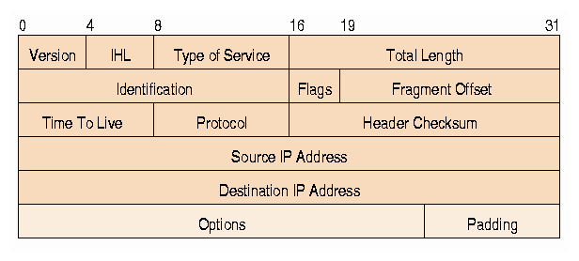
Anonymous Communication
Notes:
我们看看攻击者是如何获取两端的ip地址的
网络上传输IP 包的包头结构 header。里面有源和目的地ip地址。不管后面payload 负载的内容是否加密，都不影响前面的包头信息。
所以攻击者利用网络嗅探器截获数据包，就能关联ip地址。
Because, for users to communicate via internet, their devices assigned with IP addresses,
which are usually fixed within a communication session or more;
This can be used to infer critical privacy of users

Slide 11
Anonymous Communication
anonymity & privacy:
who is communicating?
who are you talking to?
what type of activities?
what type of information?
Notes:
我们还想知道攻击者都会获取哪些资源，从而对我们的隐私造成伤害
关于以下一些问题。

Slide 12
Anonymous Communication
why wanted?
Notes:
对研究者来说，或对在座的同学来说，为什么需要这些信息来设计匿名通信，从而保护我们的隐私

Slide 13
Anonymity for Mortals
Unmonitored access to health and medical information
Preservation of democracy:
anonymous election/jury
Censorship circumvention:
anonymous access to otherwise restricted information
…
Notes:
Mortals 人类
Censorship 审查制度

Slide 14
Anonymity for Attackers
Misbehaviors without getting caught:
Terrorism
Darknet
Spam
Pirate
…
Notes:
但是对犯罪分子，他们会做一些违法或不得体的行为。他们又希望利用这个匿名性来保护他们的身份信息。

Slide 15
Anonymous Communication
how to?

Slide 16
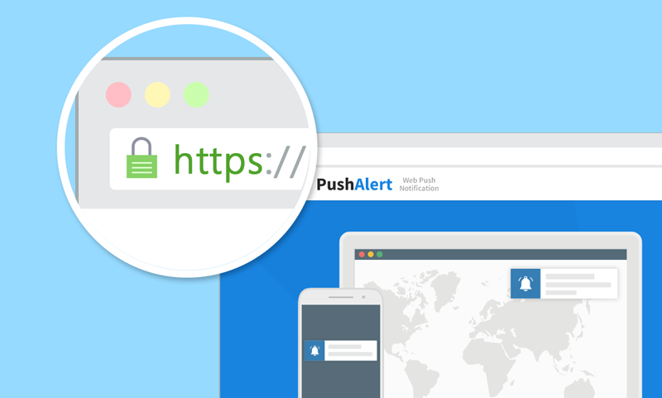
HTTPS?
asdf
Notes:
User types a link in the address bar

Slide 17
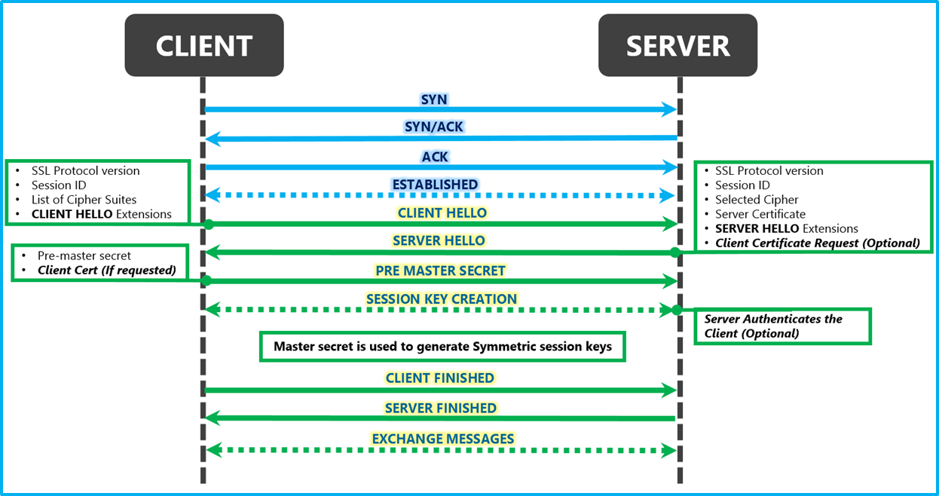

HTTPS for Confidentiality
TCP
handshake
TLS
handshake
connection
termination
FIN
FIN, ACK
ACK
Notes:
实现了保密性。对消息内容的保密。

Slide 18
HTTPS Not for Anonymity
TCP
handshake
TLS
handshake
connection
termination
FIN
FIN, ACK
ACK
Notes:
注意的是

Slide 19
HTTPS?
https://www.votefor.com
asdf
Notes:
Even if we don’t know what you communicated, knowing with
whom you communicated leaks a lot of information as well
谁在投票

Slide 20
Anonymous Communication
how to?

Slide 21
Anonymous Communication
hide destination address;

Slide 22
Anonymous Communication
hide destination address;
how to deliver packets to destination?

Slide 23
Anonymous Communication
RELAY!
Notes:
中继节点。
relay attack

Slide 24

ip3
ip1
Internet
ip2

Slide 25
monitored:
ip1->ip3, ip3->ip2
protected:
ip1->ip2
ip3
ip1
Internet
ip2

Slide 26
monitored:
ip1->ip3, ip3->ip2
protected:
ip1->ip2
overlay
communication
ip3
ip1
Internet
ip2
Notes:
实现这个relay，我们需要上一层的帮助

Slide 27
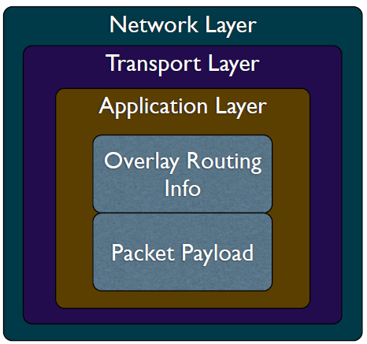
Overlay Network
Handle routing at the application layer
Tunnel messages inside other messages
Notes:
覆盖。不需要改变Network layer或。。layer

Slide 28


Traceforward Attack
passive attacker
traces messages from sender, thwarts receiver anonymity

Slide 29
Marking Attack
active attacker
marks messages,
discovers marked msg elsewhere

Slide 30
Anonymous Communication
anonymizing proxy

Slide 31

Anonymizing Proxy

Slide 32
Anonymizing Proxy
intermediary between sender & receiver
Sender relays all traffic through proxy
Encrypt destination and payload
Asymmetric technique:
receiver not involved (or informed of) anonymity

Slide 33

Anonymizing Proxy
k: shared key of sender and proxy
proxy
sender
receiver
{msg,dest}_{k}
msg
{response}_{k}
response

Slide 34
Anonymizing Proxy
k: shared key of sender and proxy
if attacker is located between
sender and proxy:
sender anonymity:
receiver anonymity:
0:
1
proxy
sender
receiver
{msg,dest}_{k}
msg
{response}_{k}
response

Slide 35
Anonymizing Proxy
k: shared key of sender and proxy
if attacker is located is located between
proxy and receiver:
sender anonymity:
receiver anonymity:
1:
0
proxy
sender
receiver
{msg,dest}_{k}
msg
{response}_{k}
response

Slide 36
Anonymizing Proxy
k: shared key of sender and proxy
if two attackers collude to correlate
ingress and egress proxy traffic:
sender anonymity:
receiver anonymity:
0:
0
proxy
sender
receiver
{msg,dest}_{k}
msg
{response}_{k}
response
Notes:
Yet in practical, require sophosticated traffic correlation techniques

Slide 37
Anonymizing Proxy
If attacker is the proxy per se:
decrypt all messages;
crack both confidentiality & anonymity;
sender anonymity:
receiver anonymity:
0:
0
proxy
sender
receiver
{msg,dest}_{k}
msg
{response}_{k}
response

Slide 38
what if receiver is attacker?

Slide 39
what if receiver is attacker?
protect sender anonymity from receiver

Slide 40

Receiver as Attacker
Known-location attacker
Use proxy to protect sender anonymity:
do not vote for letting votefor website
know that I accessed votefor
proxy
votefor
sender
Notes:
访问的目标网站是明确知道的。
Vote for 投票赞成

Slide 41
Receiver as Attacker
Known-location attacker
Use proxy to protect sender anonymity:
do not vote for letting votefor website
know that I accessed votefor
have to trust
proxy
votefor
sender

Slide 42
Anonymizing Proxy
Advantages
Easy to configure
Require no active participation of
receiver, which need not be aware of
anonymity service
Have been widely deployed on Internet

Slide 43
Anonymizing Proxy
Disadvantages
Require trusted third party
proxy may release logs,
or sell them,
or blackmail sender
Anonymity largely depends on the
(likely unknown) location of attacker

Slide 45
how to evade attacker?
Notes:
如何消除去匿名攻击

Slide 46
how to evade attacker?
dynamize proxy location
Notes:
Evade 规避，逃脱
Dynamize 使动态

Slide 47
Crowds Algorithm
Basic idea:
get lost in a crowd
Jump from one crowd to another
Members of a crowd called Jondos

Slide 48
Crowds Algorithm
Algorithm:
Relay message to random jondo
With probability p, jondo forwards
message to another jondo
With probability 1-p, jondo delivers
message to its intended destination

Slide 49

Crowds Algorithm

Slide 50
Crowds Algorithm

Slide 51
Crowds Algorithm
p

Slide 52
Crowds Algorithm
p
1-p
Notes:
有问题？1-p还是同一个vpn

Slide 53
Anonymizing Proxy
k: shared key of sender and proxy
proxy
sender
receiver
{msg,dest}_{k}
msg
{response}_{k}
response

Slide 54
Crowds Algorithm
{@dest, hello}_{k}
p
{@dest, hello}_{k}
1-p
hello

Slide 55
Crowds Algorithm
must trust jondos;
{@dest, hello}_{k}
p
{@dest, hello}_{k}
1-p
hello

Slide 56

Crowds Algorithm
must trust jondos;
if any message is intercepted,
receiver is exposed.
{@dest, hello}_{k}
p
{@dest, hello}_{k}
1-p
hello
Notes:
Intercepted by untusted jondo

Slide 57
how to evade
untrusted proxies?

Slide 58
proxy++
how to evade
untrusted proxies?

Slide 59
hard for an attacker
to simultaneously control
too many proxies
proxy++
how to evade
untrusted proxies?
Notes:
proxy++

Slide 60
source routing
specify on-path routers by source
Allows a sender of a packet to partially or completely specify the route the packet takes through the network.
In contrast, in conventional routing, routers in the network determine the path incrementally based on the packet's destination

Slide 61
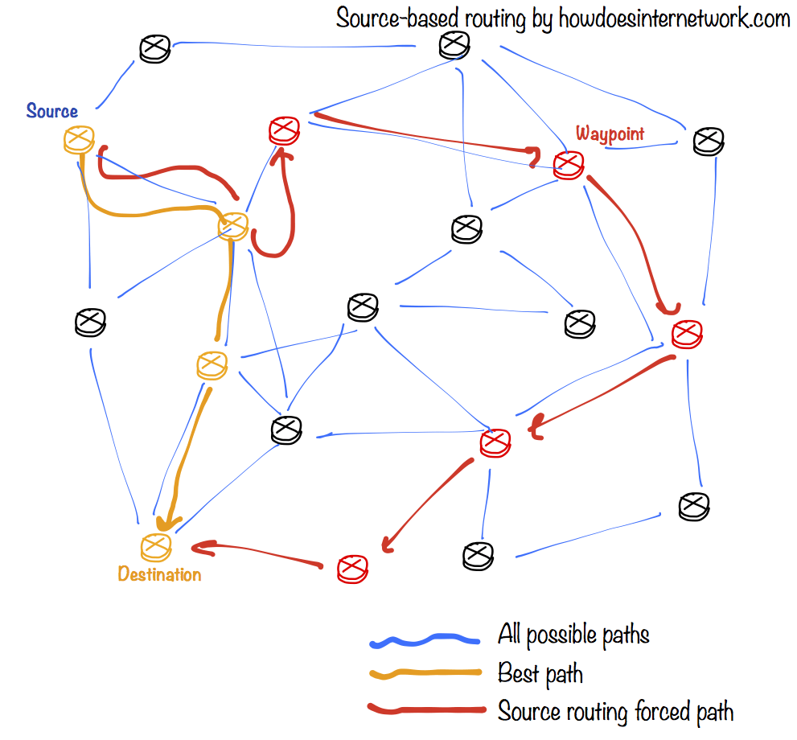
Notes:
https://en.wikipedia.org/wiki/Source_routing
传统路由，是source根据目标地址，通过路由算法，哪个路由节省路径，哪个路由节省时间，就往哪里走。
但还有一种路由方法，是source强制标明，A要往哪个方向走，就往哪个方向走。这就是源路由。

Slide 62
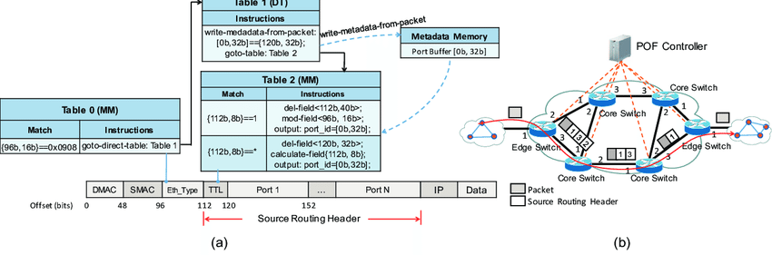
POF-based Source Routing
POF: Protocol Oblivious Forwarding
Port bound
forwarding
table
forwarding
process
Notes:
Oblivious 不经意的，未察觉到的
协议无感知转发，2016年华为提出。SDN数据平面的创新技术
其本质是把网络转发应用和网络设备本身彻底解耦，通过标准接口，进行网络信息的获取
通过forwarding table里的port号决定下一跳的路径。

Slide 63
POF-based Source Routing
POF: Protocol Oblivious Forwarding
Port bound
forwarding
table
forwarding
process
anonymity protected?

Slide 64
POF-based Source Routing
POF: Protocol Oblivious Forwarding
Port sequence leaked
forwarding
table
forwarding
process
anonymity protected? nah!

Slide 65
source routing
how to anonymize?

Slide 66
POF-based Source Routing
POF: Protocol Oblivious Forwarding
Port sequence leaked
forwarding
table
forwarding
process
should hide ports from non-neighbors

Slide 67
onion routing
source-routing based anonymous overlay communication

Slide 68
onion routing
source-routing based anonymous overlay communication
Notes:
Leverage the overlay network architecture
Otherwise, underlying forwarding devices do not support the modification

Slide 69

onion routing
source-routing based anonymous overlay communication
Notes:
Use onion router called Tor

Slide 70
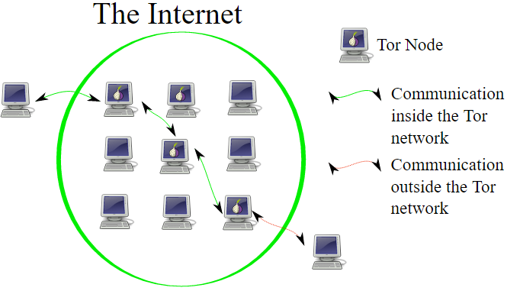
Onion Routing
Notes:
左边图是否有问题？

Slide 71
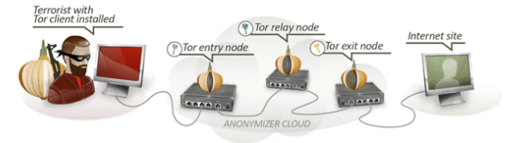
Onion Routing
Connect to Tor entry
Randomly select a series of Tors
Relay messages across them
Tor exit relays messages to destination
Notes:
Tor网络由大量的志愿者贡献自己的PC/服务器运行洋葱路由协议的节点（node）而组成，Tor客户端（如嵌入Tor的浏览器）随机的从Tor网络中选取3台路由器形成一个私有网络路径传输加密的流量

Slide 72
Onion Routing
Reply traffic from destination traverses
the reverse path
Maintains a bidirectional persistent
multi-hop path between source and
destination

Slide 73
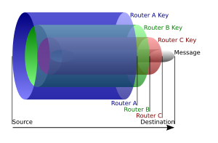
Onion Routing
B
Layered Encryption
A
C
{{{{msg}_{D}}_{C}}_{B}}_{A}
sufficient?
Notes:
{{{{msg}_{D}}_{C}}_{B}}_{A}
发送端就这样加密好，通过洋葱路由一层层的解密。

Slide 74
Onion Routing
B
Layered Encryption
Leaked routing info:
neighborship only
A
C
{{{{msg}_{D}}_{C}}_{B}}_{A} ?
Notes:
每台节点路由器只知道数据送往的一下跳，而不知道发送流量的来源。这样就保证了这3个节点没有谁知道完整的流量传输路径。也就是说，Tor网络将流量的源地址与目的地址进行了隔断，从而无法根据截取的流量进行源地址追踪

Slide 75
onion routing
applications?

Slide 76
Darknet
Portions of the Internet purposefully
not open to public view
or hidden networks whose architecture
is superimposed on that of Internet.
Install Tor
Access darknet.onion through it
Notes:
Superimposed 叠加

Slide 77
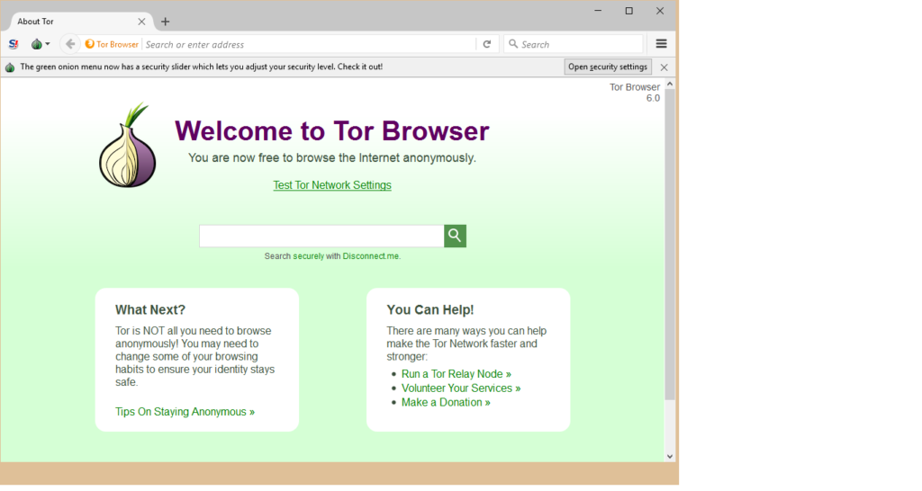
Darknet

Slide 78

Darknet
Notes:
维基解密网站 (Wikileaks) 朱利安·阿桑奇，一个澳大利亚互联网积极分子。在美国大选中席卷希拉里的黑料 ，当时处于领先地位的希拉里·克林顿被解雇。录像带揭示了美军在伊拉克屠杀平民的情况

Slide 79
how to de-anonymization?
Notes:
去匿名化 attack to anonymization

Slide 80
Tor Traffic Correlation
Passive monitoring
Active attraction:
deploy a Tor router;
attract Tor traffic;
perform traffic analysis and correlation;

Slide 81
Path Selection Attack
Tor path selection algorithm:
weight nodes by self reported bandwidth;
select each node using weighted
probability distribution;
Attack:
malicious relay reports very high bw to
increase selection probability;
if it controls the first hop, de- sender;
if it controls the last hop, de- receiver;
Notes:
Tor path selection algorithm 和source routing冲突？不冲突，预先选定

Slide 82
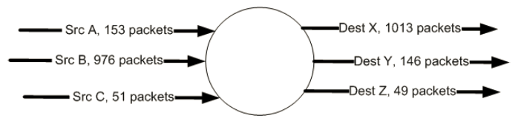
Counting Attack
Correlate incoming and outgoing flows
by counting the number of packets
Notes:
原理？
数量相关

Slide 83
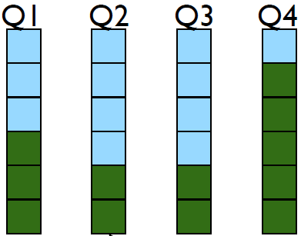
Low Latency Attack
Tor router assigns each anonymous
circuit its own queue
Dequeue one packet from each queue
in round-robin fashion

Slide 84
Low Latency Attack
Tor router assigns each anonymous
circuit its own queue
Dequeue one packet from each queue
in round-robin fashion
new queue affects
latencies of all other
queues;
Notes:
New queue 由 new packet 引起
每一个环路都会产生新的queue，例如init 到 T2的线路，和A到T2的线路。
每发一个包就是从一个queue到另一个queue。

Slide 85
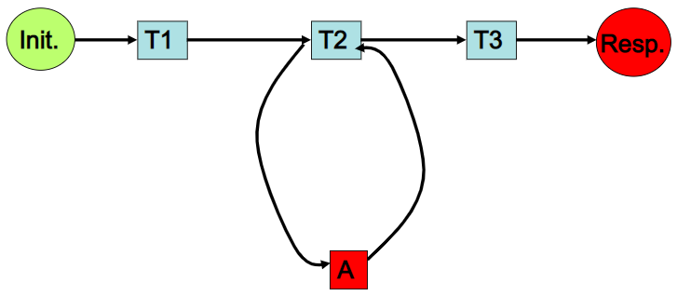
Low Latency Attack
Attacker:
intends to infer Init’s activity

Slide 86
Low Latency Attack
Attacker:
intends to infer Init’s activity
Assumption:
only Init and A occupy T2

Slide 87
Low Latency Attack
Attacker:
loop:
send packets to T2;
measure latency;

Slide 88
Low Latency Attack
larger latency indicate Init’s traffic!
Attacker:
loop:
send packets to T2;
measure latency;
Notes:
A 这端显示大量latency，说明Init 有traffic

Slide 89
Cross Site Attack
Crawling:
Deploy Tor routers
Access darknet
Crawl transaction information
Extract Bitcoin accounts of interest
Correlation:
Search the accounts on public websites
Notes:
Crawling 爬虫

Slide 90
Readings
Anonymous Communication
by Nick Mathewson
Tor: The Second-Generation Onion Router (2012 DRAFT)
by Dingledine et al.
Disclaimer:
The content aims only for helping students understand
principles of anonymous communication. It should not be
used for abusive Internet activities.

Slide 91
暗网并没有你们想象中的那么恐怖恶心 十分钟带你了解暗网|深网|tor洋葱
https://www.bilibili.com/video/BV13y4y1b7cP/?spm_id_from=333.337.search-card.all.click

