Slide 1


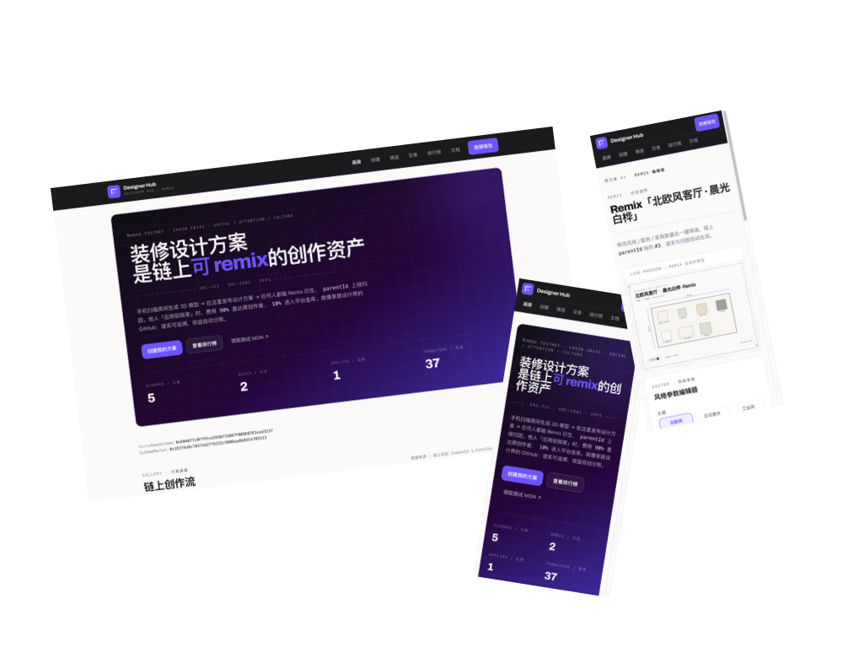
TRACK 04 · TRUST, IDENTITY & AI INFRASTRUCTURE
Designer Hub
A GitHub for home design.
Export a scheme. Mint it as an on-chain asset. Remix it, keep your name on it, and get paid when it is used.
MONAD TESTNET
5 CONTRACTS
96 TESTS
2-MIN PITCH

Slide 2




FOUNDER
Designer first, builder second.
Domain authority
FOUNDER
I know what a scheme is worth — and who pays for it.
榮 (Rong)
DESIGNER + FULL-STACK BUILDER
OCADU — Interior Design
UCL — MArch, Architecture
GAD · AECOM — practice
Founder — 云筑家 VirtuHome
Lived the problem
My own work was remixed with no trace back.
Shipped it solo
The contracts, the app and the typed SDK.
DESIGNER HUB
02 / 13

Slide 3




THE PROBLEM
Generative design has no authorship.
Remix, no recourse
Locked in a silo
AI, no record
Identity churns
Copied and reused — the original earns nothing.
Attribution lives in one database — freezable.
No neutral proof of which model made what.
Custodial accounts or seed phrases — high friction.
Today's fixes just re-centralize the problem — one more vault, one more private database.
DESIGNER HUB
03 / 13

Slide 4
WHY WE'RE BUILDING IT
I've been on the losing side of this.
BET 01
Provenance matters as much as generation.
As a designer, my schemes were remixed with no trace back. As a founder, my 云筑家 users hit the same wall.
BET 02
Ownership belongs on-chain, not in a database.
Creative work needs a settlement layer — and it has to be a primitive, not a feature of one app.
BET 03
Attribution is what creators pay for.
DESIGNER HUB
04 / 13

Slide 5




THE SOLUTION
Four primitives. Live on Monad.
IDENTITY
PROVENANCE
ASSETS
AGENT TRUST
Passkey Account
ProvenanceRegistry
DreamScheme + Market
AgentRegistry
No seed phrase. The key never leaves the secure element.
Only a commitment hash goes on-chain. Content stays off.
Every mint records the AI that made it.
ERC-721 lineage, creator pricing, instant splits.
Packaged as a typed SDK so any design tool, marketplace or agent platform can build on it — without our UI.
DESIGNER HUB
05 / 13

Slide 6
HOW IT WORKS
One scheme JSON in. A living asset out.
01
02
03
04
05
Export from 云筑家
Pin to IPFS
Mint ERC-721
Remix (parentId)
Apply → split
Revenue, enforced by the contract
Original → 90 / 10 (creator / platform)
Remix → 85 / 10 / 5 (creator / platform / lineage)
Resale royalty 5% · heat = remixes ×2 + applies ×3
Splits settle in the same transaction — no vault to freeze.
DESIGNER HUB
06 / 13

Slide 7

RUBRIC 01 · TECHNICAL EXECUTION — 20%
Real WebAuthn, verified on-chain.
96
The chain verifies a real WebAuthn assertion; the challenge binds the calldata, so a relayer pays gas but cannot tamper.
CREATE2 address from (x, y, rpIdHash, originHash); up to 4 keys for recovery.
Pure-Solidity P-256 fallback → runs without the RIP-7212 precompile.
No secrets in the repo; threat model in docs/SECURITY.md.
FOUNDRY TESTS PASSING
5
CONTRACTS LIVE ON MONAD
0
PRIVATE KEYS LEAKED
DESIGNER HUB
07 / 13

Slide 8

RUBRIC 02 · DESIGN & CRAFT (DX) — 20%
A primitive anyone can build on.
TIER 1 · READ-ONLY
No wallet, no keys — first result in ~2 minutes.
@yunzhujia/sdk — typed, buildable, cross-checked against the contracts.
Docs, an in-app /docs page, and a runnable example.
TIER 2 · EOA
Mint / setPrice / apply with any wallet.
Rebuild cost ≈ one week of security work → a few typed calls.
TIER 3 · PASSKEY
Mnemonic-free identity + sponsored gas.
DESIGNER HUB
08 / 13

Slide 9
RUBRIC 03 · ORIGINALITY & TRACK INSIGHT — 15%
Privacy-preserving. Not capturable.
Privacy-first: only a commitment hash is stored — content stays off-chain.
No vault: payment splits in-transaction, so nothing can be frozen.
Lineage on-chain: attribution survives any single app.
Permissionless relayer: the signature authorizes, not the operator.
Non-custodial: the key lives in the user’s secure element.
HOW OTHERS “FIX” IT
Another vault, another private database.
DESIGNER HUB
On-chain split + lineage + open relay. No single party to capture.
DESIGNER HUB
09 / 13

Slide 10

RUBRIC 04 · FOUNDER & MARKET READINESS — 25%
Who adopts it — and why not build it.
01 · DESIGN TOOLS
02 · MARKETPLACES
03 · AI PLATFORMS
04 · IDENTITY SDKs
Attribution + payouts, no crypto to build.
Passkey login + resale royalty, plug-in.
A neutral record of which model made what.
A P-256 account that needs no precompile.
Why not roll your own?
Rebuilding is about a week of security-sensitive work: WebAuthn parsing, P-256 math, replay-safe CREATE2 accounts, a challenge scheme and a lineage splitter.
The SDK reduces it to a few typed calls — and 云筑家 already exports the scheme JSON.
DESIGNER HUB
10 / 13

Slide 11
RUBRIC 05 · TRACTION & PATH FORWARD — 20%
Honest status. Concrete plan.
Where we are
Path forward
E2E live on Monad testnet
SDK + docs shipped
No third-party integration yet
NOW
HACKATHON
NEXT
SCALE
Integration kit shipped
Land one external integration
Bounties + “built on” track
Metered relay · EIP draft
We would rather land one real integration than claim ten.
DESIGNER HUB
11 / 13

Slide 12
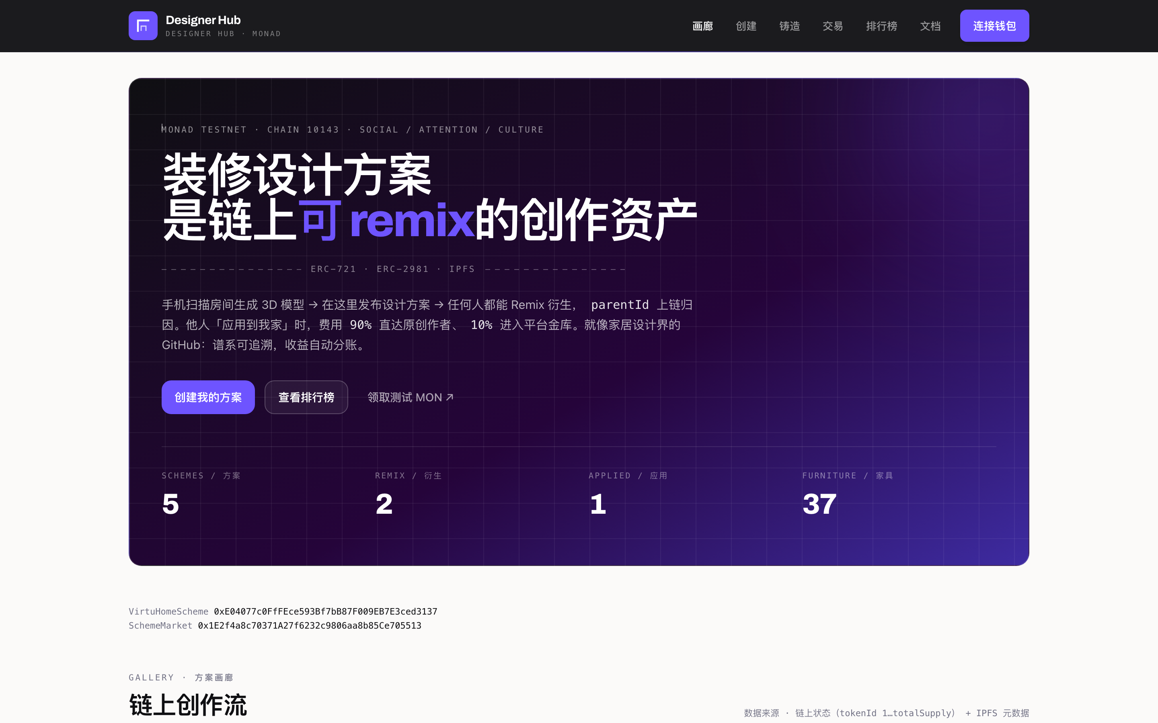
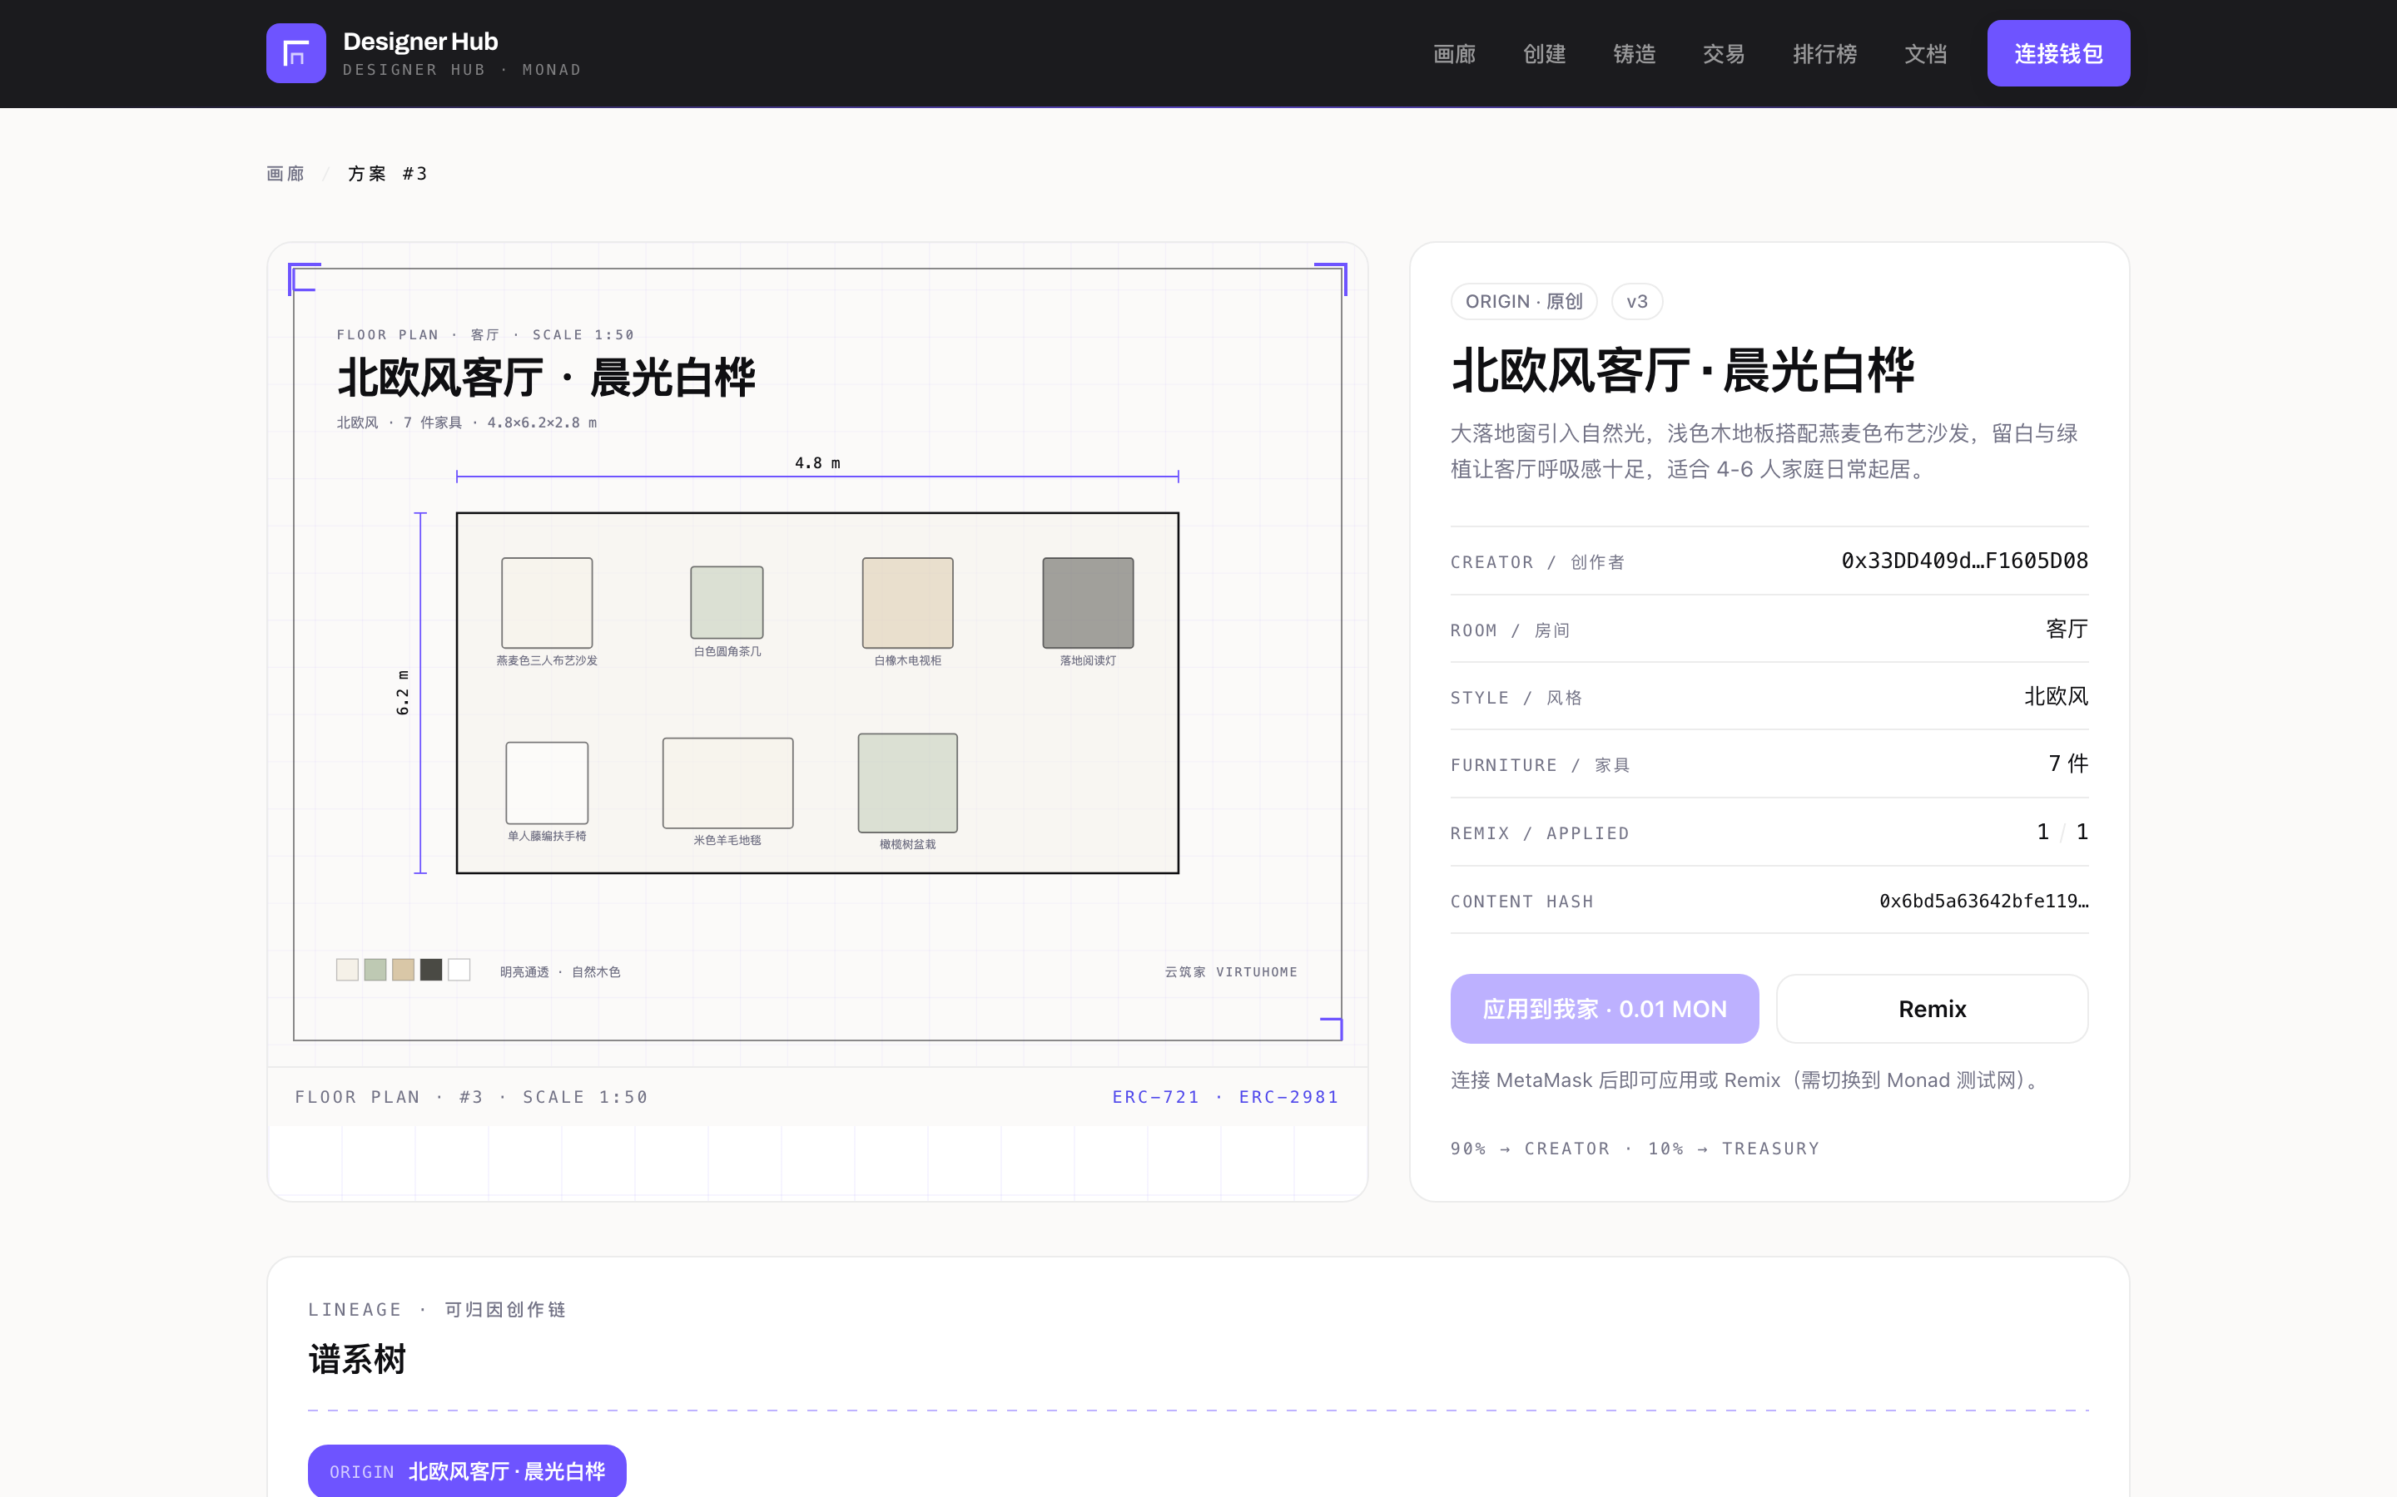
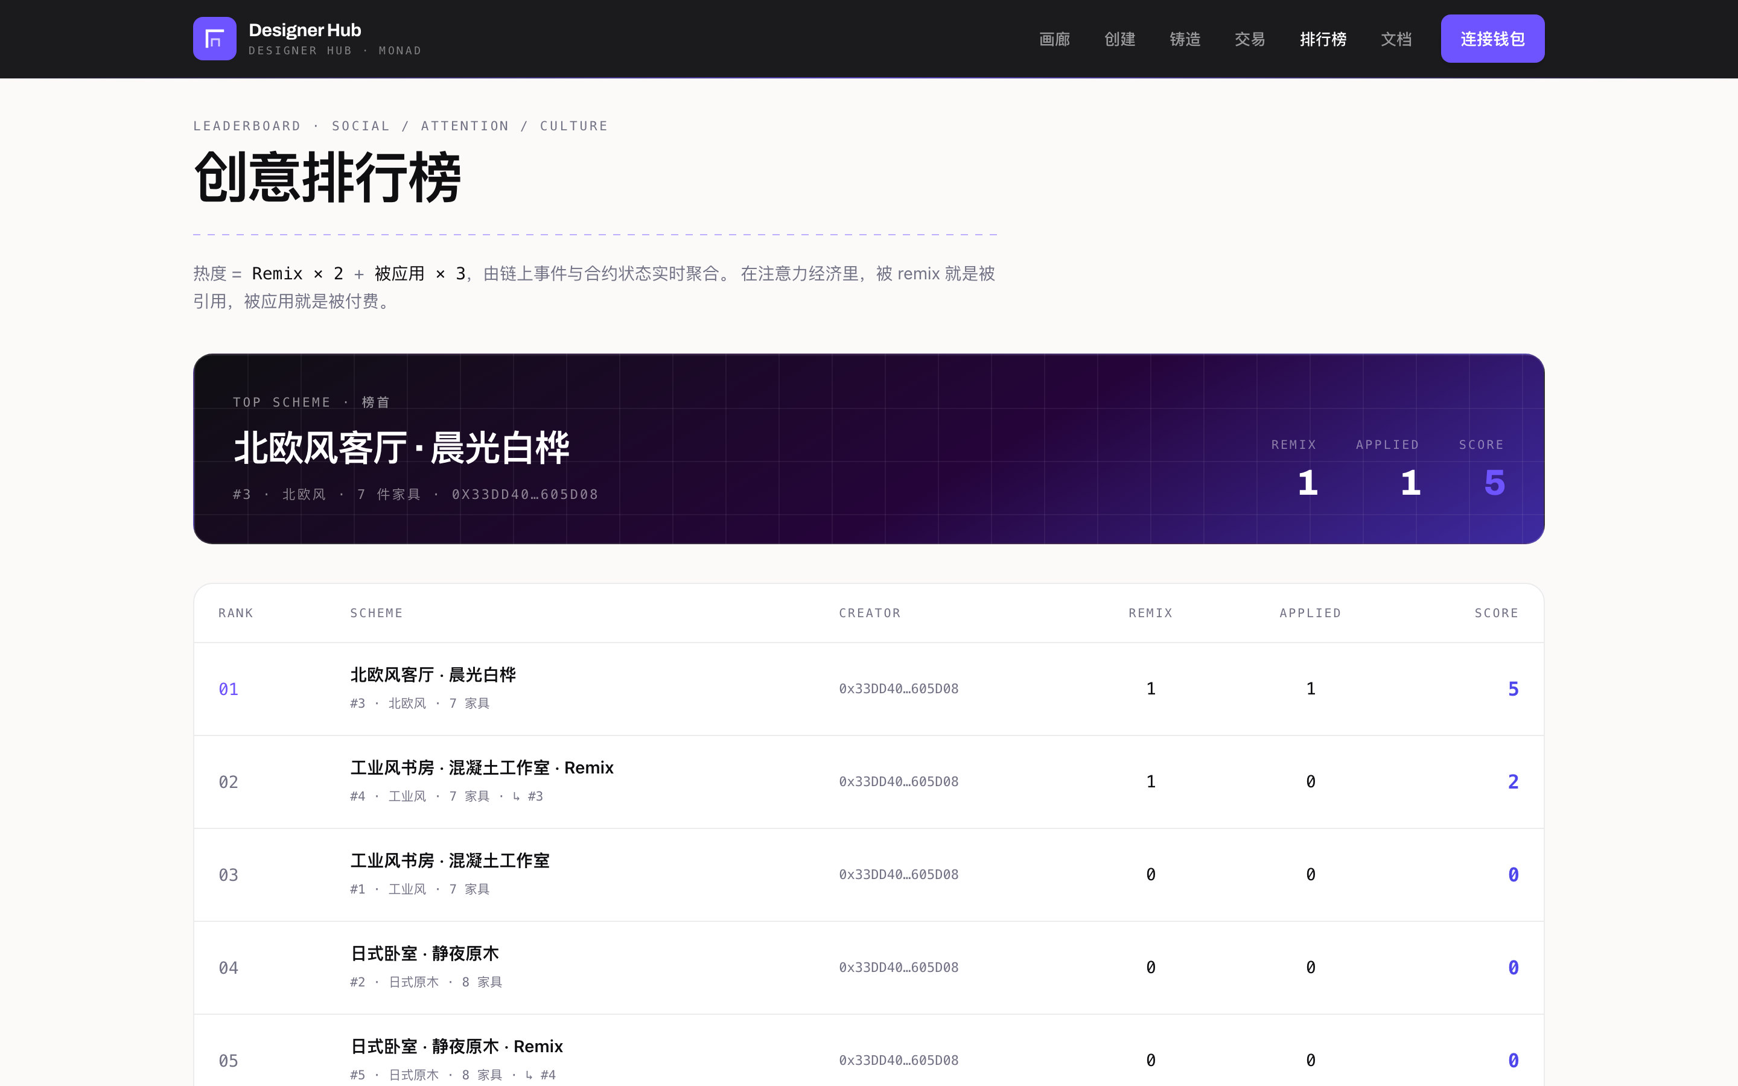
THE PRODUCT
Real on-chain data — not mocks.
GALLERY · LIVE FEED
LINEAGE + VERSIONS
LEADERBOARD · HEAT
Ledger, remix editor and comments all read live Monad testnet events.
DESIGNER HUB
12 / 13

Slide 13
TRACTION · BUSINESS
From testnet to real homes.
IN DISCUSSION
WHY IT MATTERS
Commercial partnership
Real volume, real rail
In talks with a renovation company (刘 binyue) to use Designer Hub schemes in real projects — vetted, traceable designs; the author gets paid on application.
Real projects turn the primitive into traction and revenue — 云筑家 supplies the schemes, the partner brings the demand.
The settlement layer for creative work on the AI-native internet.
DESIGNER HUB · MONAD TESTNET · TRACK 04 · 榮 / 云筑家 VirtuHome
DESIGNER HUB
13 / 13

