Slide 1
Thesis THEORETICAL Background
Explain all the theories used in this thesis

Slide 2
Table of contents
01
02
03
04
05
06
Overview of Recommender Systems
User Feedback in RS
Factorization-Based Models
Defines what a recommender system (RS) is, types of RS
Explains explicit vs. implicit feedback
Defines Matrix Factorization (MF), Factorization Machines (FM)
Performance Evaluation and Data Processing
Optimization Strategies
Conclusion - ENSFM
Discusses negative sampling, its limitations, and how ENSFM improves accuracy and stability
Explains Evaluation Metrics and Data Preprocessing Steps
Summarizes ENSFM’s benefits

Slide 3
Overview of Recommender Systems
01
Defines what a recommender system (RS) is, explains different types (Collaborative Filtering, Content-Based, Hybrid), and real-world applications.

Slide 4
Recommender systems (RS)
Is an algorithmic approach to suggest relevant items to users based on their preferences, behaviors, and contextual factors.
Widely applied in e-commerce (Amazon, eBay), streaming services (Netflix, Spotify), and content platforms (YouTube, news apps) to enhance user experience and engagement.

Slide 5
Types of RS
Collaborative Filtering (CF)
Concept:
Uses past user-item interactions to predict future preferences.
Types:
User-based CF: Recommends items based on similarity between users.
Item-based CF: Recommends items similar to those previously interacted with by the user.
Limitations:
Cold start problem: Struggles with new users or items with little interaction data.
Sparsity issue: Many users interact with only a few items, leading to data sparsity.

Slide 6

Content-Based Filtering (CB)
Concept:
Recommends items similar to those a user has previously interacted with.
How it works:
Uses item attributes (e.g., genre, keywords, descriptions) to find similar items.
Builds a user profile based on past interactions.
Limitations:
Overspecialization: Users might only receive recommendations similar to past interests.
Cold start issue for new items: Requires item descriptions to generate recommendations.

Slide 7

Hybrid Models
Combine CF and CB approaches to improve accuracy.
Help mitigate challenges like the cold start problem (new users/items with limited data).

Slide 8
Context-Aware Recommender Systems (CARS)
Enhance traditional recommender models by incorporating contextual factors such as time, location, device, and user mood into the recommendation process. Unlike standard CF or CBF, which focus solely on past interactions or item attributes, CARS considers external conditions that influence user preferences in real-time.
CARS IN ENSFM PAPER IS AN EXTENSION OF COLLABORATIVE FILTERING (CF):
In ENSFM, CARS is an extension of Collaborative Filtering (CF) because it builds on Factorization Machines (FM), a CF-based technique.
How it works:
Traditional CF models user-item interactions without context.
CARS-enhanced CF integrates contextual data to adjust recommendations dynamically.
Example: A CF model might recommend a movie based on similar users, but CARS would also consider whether it's daytime or nighttime to suggest appropriate genres.
Key benefit:
Reduces bias and suboptimal ranking by leveraging full contextual information.

Slide 9
Top-K Recommendation
Top-K Recommendation is a ranking-based approach in recommender systems that focuses on selecting the K most relevant items for each user rather than predicting ratings for all possible items. This method improves user experience by ensuring that only the most useful and engaging recommendations are presented.
Por favor, conserva esta diapositiva para atribuirnos

Slide 10
How Top-K Recommendation Works
Top-K Recommendation
Recommender systems analyse user-item interactions and assign relevance scores to candidate items. Instead of showing all possible recommendations, the system:
Estimates item relevance for a user.
Sorts items based on their relevance scores in descending order.
Selects the top K items that are most relevant to the user.
This ranking-based method ensures that the system prioritizes high-value recommendations, enhancing both accuracy and user satisfaction.

Slide 11
User Feedback in RS
02
Differentiates between explicit and implicit feedback, points out their impact on recommendation models

Slide 12
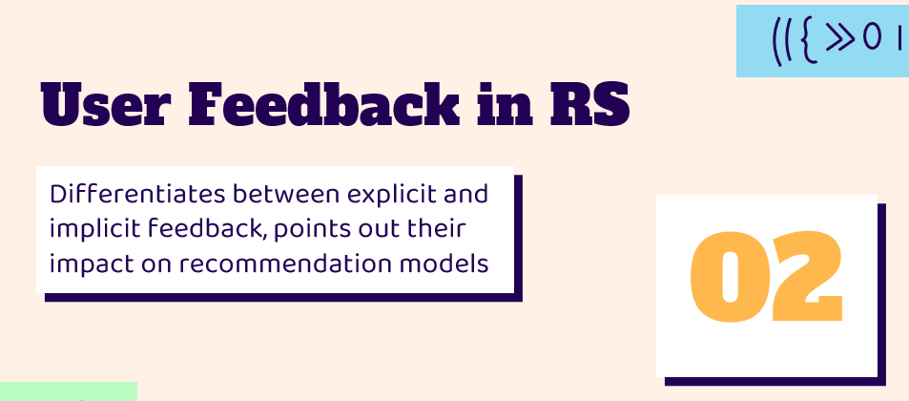
Explicit Feedback
Definition: Direct user input indicating preferences.
Examples:
Star ratings (e.g., 5-star rating for a movie).
Thumbs up/down (e.g., YouTube, Netflix).
Written reviews or comments (e.g., Amazon product reviews).

Slide 13
Helps CF models learn user-item relationships more accurately.
Provides clear and direct user preferences.
Low participation – Many users do not actively rate or review items.
Bias issues – Some users may overrate or underrate based on subjective factors.

Slide 14
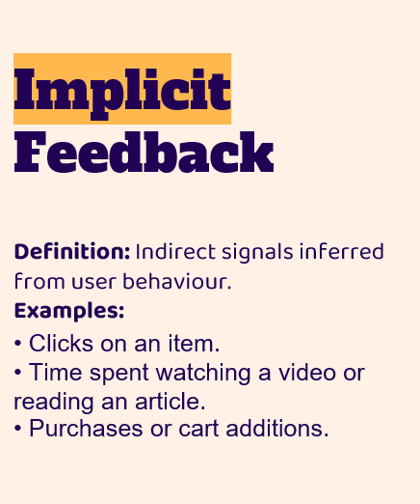
Implicit Feedback
Definition: Indirect signals inferred from user behaviour.
Examples:
Clicks on an item.
Time spent watching a video or reading an article.
Purchases or cart additions.

Slide 15
Advantages & Disadvantages
Automatically collected
Ambiguous intent
No user effort required
Clicking or watching does not always mean preference.
More abundant
Noise in data
More abundant data than explicit feedback
Users may interact with items accidentally or out of curiosity

Slide 16
Negative Sampling vs. Non-Sampling
Criteria | Negative Sampling | Non-Sampling
Approach | Selects a subnet of unobserved data as negative samples | Processes the entire observed dataset without sampling negatives
Goals | Reduces computational cost | Increases accuracy and eliminates data bias
Bias | May introduce bias by assuming unobserved items are irrelevant | No bias from sampling; uses real observed data
Computation | Faster, lower resource consumption | More computationally expensive, requires optimization
Accuracy | Can be lower due to learning from an incomplete dataset | Higher accuracy as it learns from all observed interactions

Slide 17
Importance of Feedback in ENSFM
ENSFM effectively handles both explicit and implicit feedback.
Works well in e-commerce scenarios where purchase data (implicit feedback) is dominant.

Slide 18
Questions?
If you have any questions, just ask. If I don’t know, maybe we will find out together!

Slide 19
Factorization-Based Models
03
Defines Matrix Factorization (MF), Factorization Machines (FM)

Slide 20
What is Factorization-Based Models?
Factorization models decompose user-item interaction matrices into low-dimensional representations to capture hidden relationships.
Widely used in recommender systems to handle sparse data and improve prediction efficiency.

Slide 21
Matrix Factorization (MF)
Handles Sparsity by Learning Latent Factors
Instead of directly working with the sparse user-item matrix, MF decomposes it into two lower-dimensional matrices then used dot products to make predictions.
User Embeddings (latent factors for users)
Item Embeddings (latent factors for items)
These latent factors capture hidden relationships between users and items, even if there are missing interactions.
Example:
If a user has only rated a few movies, MF can infer their preferences based on similar users’ ratings, even for movies they haven’t rated.
Advantage: MF fills in missing values by generalizing preferences from observed interactions.

Slide 22
Item Embeddings
 | M1 | M2 | M3 | M4
 | 3 | 1 | 1 | 3
 | 1 | 2 | 4 | 2
User Embedding
 | OK | NO
 | NO | OK
 | NO | OK
 | OK | OK
 | M1 | M2 | M3 | M4
 | 3 | 1 | 1 | 3
 | 1 | 2 | 4 | 2
 | 1 | 2 | 4 | 2
 | 4 | 3 | 5 | 5
Predictions

Slide 23
Factorization Machines (FM)
FM applies a linear transformation to input features to compute a scalar prediction score, making it more efficient than MF.
How it works:
Unlike MF, FM captures pairwise feature interactions by learning latent factor representations for each feature.
These feature vectors are decomposed into low-dimensional representations, then dot products are computed to model interactions.
Example:
A new user who hasn’t watched many movies can still get relevant recommendations based on their age, genre preferences, and similar user behaviours.
Advantage: FM incorporates side information to improve recommendations in sparse datasets.

Slide 24
Efficient Non-Sampling Factorization Machines (ENSFM)
Concept:
ENSFM removes the need for negative sampling, making factorization models more accurate and stable.
Key Improvements Over Traditional FM:
Uses all observed interactions instead of a limited subset of negative samples.
Eliminates bias from negative sampling, leading to more stable and accurate predictions.
Designed for large-scale recommendation tasks, especially in implicit feedback settings.
Why ENSFM Is More Effective?
Traditional FM assumes unobserved interactions are irrelevant due to negative sampling.
ENSFM learns from all observed interactions, ensuring unbiased learning and better ranking performance.

Slide 25
Optimization Strategies
04
Explores negative sampling, its limitations, and how Efficient Non-Sampling Factorization Machines (ENSFM) improve recommendation accuracy and stability

Slide 26
Negative Sampling
How Negative Sampling Works:
Nega-tive Sam-pling
Factorization Machines (FM) and Matrix Factorization (MF) use negative sampling to handle missing interactions in large datasets.
Instead of processing the entire dataset, a subset of unobserved items is randomly selected and treated as "negative" examples (items that the user is assumed to dislike).
This approach reduces computational cost and speeds up training.

Slide 27
Why Negative Sampling Causes Problems
Unstable learning
Loss of valuable data
Bias
The model assumes that unobserved items are irrelevant, even if users simply haven't discovered them yet
Sampling fluctuates between training runs, leading to inconsistent ranking performance
Only a small fraction of the dataset is used, ignoring many potential interactions
Example:
In a movie recommendation system, if a user has never watched a particular movie, negative sampling may incorrectly assume they dislike it, leading to misleading recommendations.

Slide 28
Non-Sampling Optimization in ENSFM
How ENSFM Solves the Problem:
ENSFM removes negative sampling and instead uses all observed interactions, making the learning process more accurate and stable.
Instead of randomly selecting "negative" samples, ENSFM directly learns from the full dataset, reducing bias and improving ranking accuracy.

Slide 29
Why ENSFM is More Effective:
Improves ranking performance, especially in Top-K recommendations (where only the most relevant items matter).
Eliminates the bias caused by negative sampling, leading to more precise recommendations.
Uses the full dataset, ensuring that every observed interaction contributes to learning.

Slide 30
Challenges of Removing Sampling
Higher computational cost
Requires advanced optimization techniques
Processing the full dataset requires more resources
ENSFM uses memory-efficient methods to speed up learning while maintaining accuracy
Example:
In an e-commerce setting, ENSFM analyses all purchase interactions, rather than assuming unbought products are "negative" choices. This results in better predictions of user preferences.

Slide 31
Questions?
If you have any questions, just ask. If I don’t know, maybe we will find out together!

Slide 32
Performance Evaluation and Data Processing
05
Introduces key evaluation metrics (HR@K, NDCG@K) and discusses essential data preprocessing techniques to improve model efficiency

Slide 33

Hit Ratio (HR@K)
Formula:
HR@K $=\frac{\text{Total} \text{number} \text{of} \text{users}}{\text{Number} \text{of} \text{times} \text{relevant} \text{items} \text{appear} \text{in} }$
Explanation:
Measures how often the correct item appears in the top-K recommendations for a user.
Higher HR@K values indicate that the system successfully ranks relevant items among the top-K suggestions.
Useful for e-commerce and media streaming platforms where users only engage with a few top-ranked items.

Slide 34

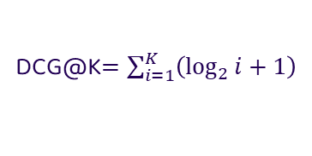
Normalized Discounted Cumulative Gain (NDCG@K)
Evaluates the ranking quality of recommendations by giving higher weights to relevant items that appear at the top of the list.
Explanation:
Rewards models that place relevant items higher in the ranking list, improving the user experience.
Frequently used in personalized content recommendations, such as news and video streaming platforms.
Formula:
NDCG@K$=\frac{\text{DCG}\text{@}\text{K}\text{​}}{IDCG@K}$
where:
DCG@K$=\sum_{i=1}^{K}{\left(\log_{2}{i+1}\right)}$
and IDCG@K is the ideal DCG, serving as a normalization factor.

Slide 35
Computational Efficiency
Measures the time and resources required for model training and inference.
Evaluates:
Training time: How long the model takes to learn from data.
Inference speed: The time needed to generate recommendations in real-time.
Importance:
Critical for large-scale applications, where rapid predictions are necessary (e.g., real-time product recommendations).

Slide 36
General Data Preprocessing for Machine Learning Models
Optimization of Hyperparameters for Efficient Training
Data Representation and Encoding
Feature Engineering for Factorization Machines
1
2
3
4
5
Handling Missing Data and Implicit Feedback
Data Splitting for Training and Evaluation

Slide 37
1. Data Representation and Encoding
- The datasets used in ENSFM contain user-item interactions, which include implicit feedback such as clicks, purchases, and views.
- Each interaction is represented as a feature vector, using one-hot encoding for categorical features.
Example structure of encoded data:
User Context: [0,1,0,...] (one-hot encoding for user IDs, demographics, and preferences).
Item Context: [0,0,1,...] (one-hot encoding for item ID, category, and attributes).
Purpose: Converts raw categorical data into a machine-readable format for factorization models.

Slide 38
2. Handling Missing Data and Implicit Feedback
- Missing interactions are not treated as explicit negatives.
- Instead of assuming missing data as negative feedback (as in negative sampling), ENSFM assigns weights to missing interactions to ensure a balanced learning process.
Example strategy:
If a dataset is sparse, missing values are treated with a lower confidence weight instead of zero.
If an item is popular (e.g., widely purchased), missing interactions for that item may be weighted higher since the user is more likely to be interested in it.
Purpose: Prevents bias caused by negative sampling and ensures a fair representation of unobserved interactions.

Slide 39
3. Feature Engineering for Factorization Machines
- ENSFM automatically learns feature interactions without requiring extensive manual feature engineering.
- The system captures second-order interactions between features, such as:
User-item relationships (e.g., user preferences for certain categories).
Contextual interactions (e.g., how time of day affects product purchases).
- The FM model structure efficiently computes these interactions without expanding feature dimensions, reducing computational costs.
Purpose: Allows ENSFM to generalize well on high-dimensional and sparse datasets.

Slide 40
4. Data Splitting for Training and Evaluation
The datasets are split into training, validation, and test sets using a leave-one-out evaluation approach:
For each user, the last interaction is held out for testing.
The remaining interactions are used for training.
Why this is important?
Mimics real-world scenarios where the system predicts the next item a user will interact with.
Evaluates how well ENSFM ranks relevant items in a Top-K recommendation setting.
Purpose: Ensures realistic evaluation of recommendation accuracy using HR@K and NDCG@K metrics.

Slide 41
5. Optimization of Hyperparameters for Efficient Training
The ENSFM model undergoes hyperparameter tuning to balance efficiency and accuracy:
Embedding size (d): Adjusted to optimize memory usage while capturing enough latent features.
Batch size: Selected to maximize parallel computation efficiency.
Learning rate: Fine-tuned to prevent overfitting and speed up convergence.
Purpose: Optimizes model efficiency while maintaining high ranking accuracy.

Slide 42
Conclusion - ENSFM
06
ENSFM enhances traditional Factorization Machines by removing negative sampling, ensuring unbiased learning, and improving recommendation accuracy. It efficiently handles sparse data, high-dimensional interactions, and implicit feedback, making it ideal for large-scale applications like e-commerce and content recommendations.

Slide 43
How ENSFM Operates
1. Data Representation and Preprocessing:
ENSFM starts by encoding user-item interactions into a structured format.
Uses one-hot encoding to convert categorical data (e.g., user IDs, item IDs, metadata).
Feature vectors are efficiently processed to avoid high computational costs.
Unlike traditional FM models, ENSFM does not rely on negative samples to approximate missing interactions.
Advantage: Avoids bias caused by random negative sampling, leading to more accurate and fair predictions.
2. Handling Sparse Data and Implicit Feedback:
ENSFM efficiently learns from both explicit and implicit feedback.
Unlike traditional methods that assume missing interactions are negative samples, ENSFM assigns appropriate weights to unobserved data.
If an interaction is missing, ENSFM does not assume the user dislikes the item but instead learns from the available implicit signals (e.g., purchase frequency, click-through rate).
Advantage: Provides more accurate recommendations by leveraging all available data, rather than discarding missing interactions.

Slide 44
3. Feature Interaction Modelling:
ENSFM extends Factorization Machines by capturing feature relationships beyond just user-item interactions.
It learns second-order interactions using factorized embeddings to model relationships between contextual factors (e.g., time, device, item attributes).
Instead of brute-force calculating feature interactions, ENSFM efficiently computes pairwise interactions, reducing the risk of overfitting.
Advantage: Handles high-dimensional data efficiently, making it scalable for large datasets.

Slide 45
4. Training and Optimization Without Negative Sampling:
ENSFM optimizes model training using full-batch learning rather than relying on negative sampling.
Traditional FM models require sampling unobserved interactions, which introduces bias and slows down convergence.
ENSFM trains on the full dataset, ensuring every interaction contributes to the learning process.
Uses efficient memorization strategies to minimize computational costs while handling large-scale datasets.
Advantage: Eliminates inconsistent ranking performance caused by sampling while improving scalability and training efficiency.

Slide 46
5. Performance Evaluation and Real-World Applicability:
ENSFM is evaluated using industry-standard ranking metrics (HR@K, NDCG@K) to measure recommendation quality.
Ensures that relevant items are ranked higher in the recommendation list.
Computational efficiency is optimized to balance model complexity and speed.
Advantage: Provides reliable, high-performance recommendations suitable for real-world applications in e-commerce, streaming services, and online advertising.

Slide 47
Why ENSFM Outperforms Traditional FM Models?
Feature | Traditional FM (with Negative Sampling) | ENSFM
Handling Sparse Data | Assumes missing interactions are negative | Learns from all available data
Bias in Learning | Introduces bias through negative sampling | Eliminates bias by using all observed interactions
Feature Interaction | Models second-order feature interactions | More efficient pairwise feature learning
Computational Efficiency | Requires extensive sampling, leading to instability | Uses full dataset with optimized memory usage
Ranking Performance | May fluctuate due to sampling errors | More stable and accurate ranking

Slide 48
Questions?
If you have any questions, just ask. If I don’t know, maybe we will find out together!

