Slide 1

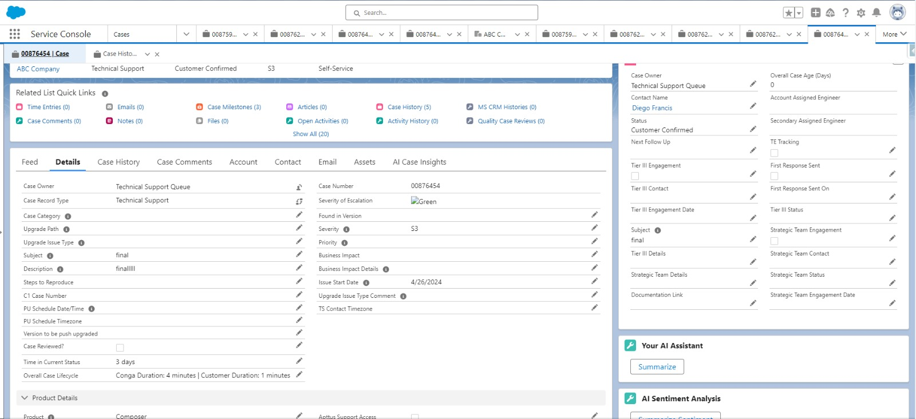
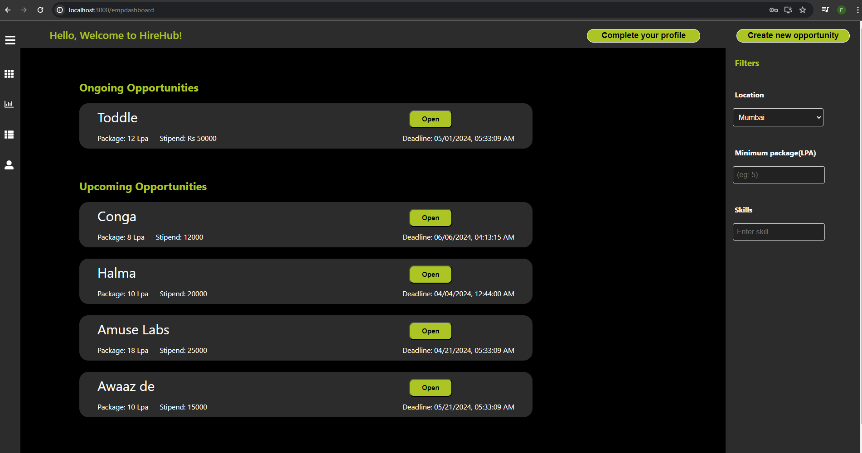

Conga Internship + HireHub project
Freya Modi – AU2040222
ENR497: BTech Engineering Project (Winter 2024)
External mentor: Sameer Chheda Internal mentor: Shefali Naik
Introduction
Objectives
Conclusions
Conga:
Conga:
Case Management Lifecycle
Customers and employees are engaged in multiple cases and spend days working with one particular case.
The overall goal is to develop a feature that tells the number of days of engagement with case whether it is customer or Conga.
Hirehub:
Conga:
Our case tracking feature lets employees and customers easily follow the progress of their specific cases.
Avoid conflicts between the company and customers.
User-Friendly Interface
Efficient Information Flow
Automated Task Management
Data-Driven Decision Making
Task Management
Enhanced Reputation for Institutions
Helps customer and company to get an insight about the ongoing case.
Increases productivity on both sides
Developing troubleshooting and communication skill to deal with customers
Hirehub:
The existing placement system relies on disorganized communication, causing delays and inefficienciesemails and messages.
The motivation is to introduce a streamlined web app for better coordination and communication.
Hirehub:
Organize things in a better way and get data stored in a particular software instead of tons of excel files.
Students will be benefitted in a way to be aware of the placement processes and companies.
Results
Conga:
Novelty
Methodology
Organizes things by putting all the important info in one easy-to-use platform, stopping the confusion of emails. It does tasks automatically to save time, keeps everything safe, and is designed to be super easy for everyone.
The goal is to make it work well for colleges that haven't used something like this before, making the whole process smoother and more successful for everyone involved.
Conga:
Understanding Salesforce Platform.
Learning Conga products
Understanding requirements for Case Lifecycle management.
Development of trigger and class handler
Testimg
Hirehub:
Hirehub:
References
https://conga.com/
https://hygger.io/guides/agile/
https://dotnet.microsoft.com/en-us/apps/aspnet

