Slide 1
Welcome to the Cloud
Chapter 1
Panko and Panko
Business Data Networks and Security
Copyright © 2015 Pearson Education, Inc.

Slide 2
Netflix Jumps Into the Amazon
Messages
Single Networks
Internets
Standards Layers

Slide 3
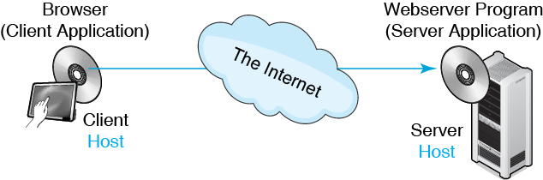
1.1 Internet Communications

Slide 4
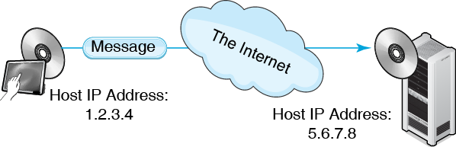
1.1 Internet Communications

Slide 5
1.2 Dotted Decimal Notation
Step | Action | Example
1 | Divide 32 bit IP address bits into four 8-bit segments. | 00000001 | 00000010 | 00000011 | 00000100
2 | Convert each segment from binary to decimal. | 1 | 2 | 3 | 4
3 | Assemble the segments in decimal, separated by dots. | 1.2.3.4

Slide 6
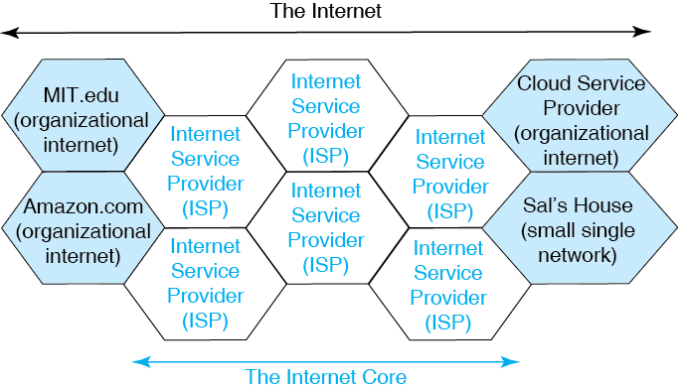
1.3 The Internet

Slide 7
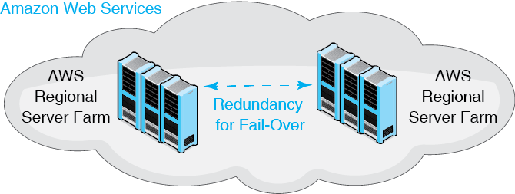
1.4 Netflix and Amazon Web Services
Servers for Rent!
No Long-Term Contracts

Slide 8
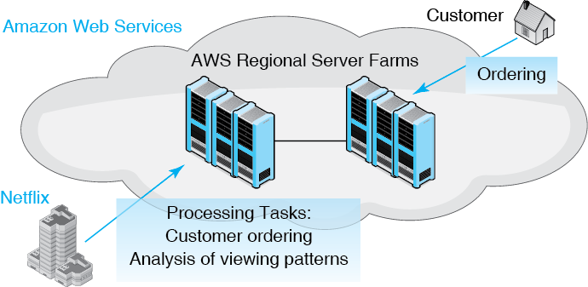
1.4 Netflix and Amazon Web Services

Slide 9
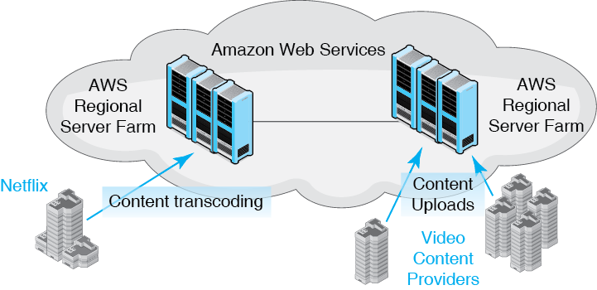
1.4 Netflix and Amazon Web Services

Slide 10
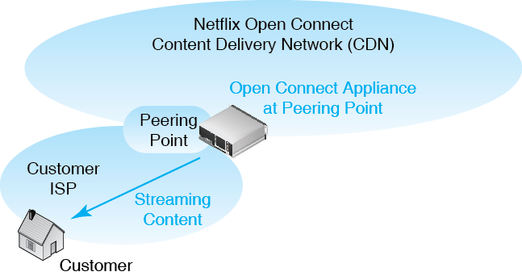
1.5 Netflix Open Distribution Network

Slide 11
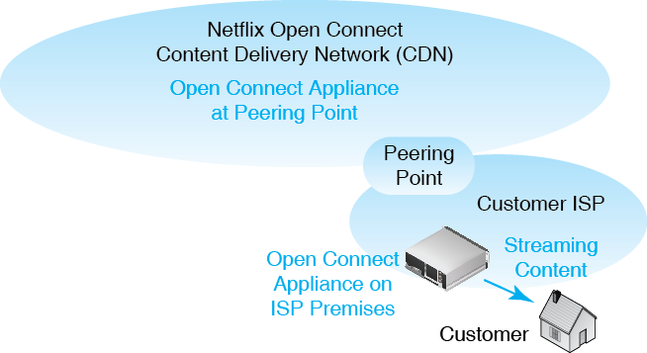
1.5 Netflix Open Distribution Network

Slide 12
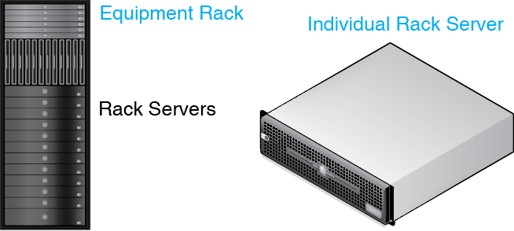
Rack Servers and Equipment Rack

Slide 13
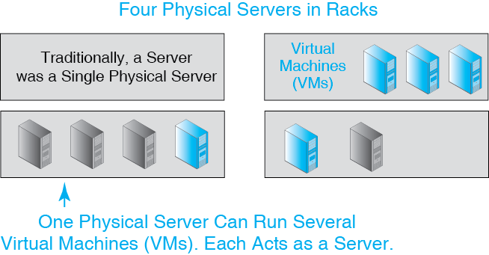
1.6 Server Virtualization

Slide 14
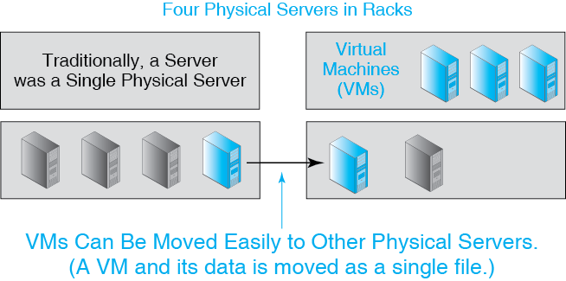
1.6 Server Virtualization

Slide 15
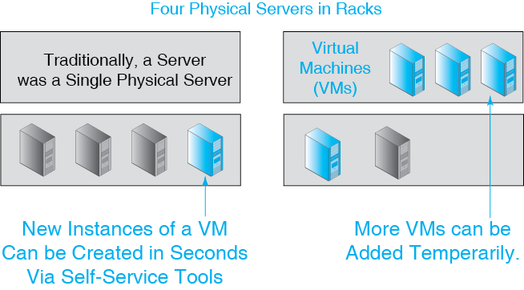
1.6 Server Virtualization

Slide 16
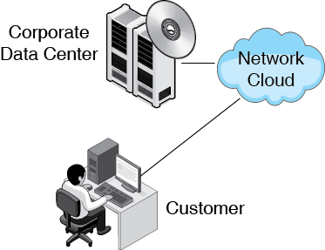
1.7 Cloud Service Providers

Slide 17
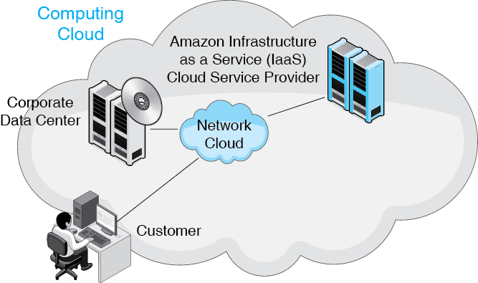
1.7 Cloud Service Providers

Slide 18
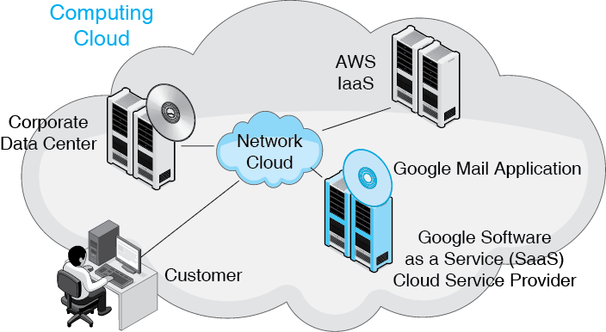
1.7 Cloud Service Providers

Slide 19
Corporate Data Centers, IaaSs, and SaaSs
 | Server Owner | Application Owner
Corporate Data Center | User (Organization) | User (Organization)
IaaS | IaaS CSP | User (Organization)
SaaS | SaaS CSP | SaaS CSP

Slide 20
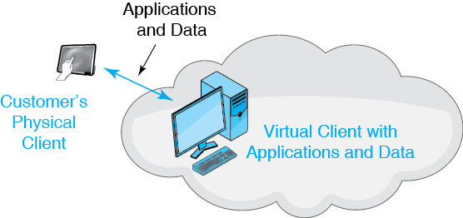
1.8 Cloud Client Services

Slide 21
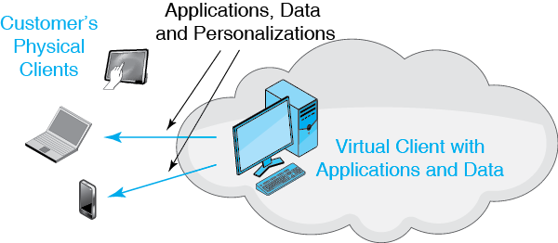
1.8 Cloud Client Services

Slide 22
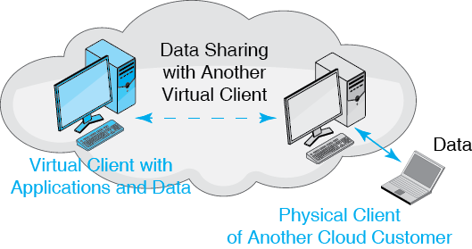
1.8 Cloud Client Services

Slide 23
As a Service
Traditionally,
  The organization owned and operated its own servers and application programs
  It purchased them
  This was Infrastructure and software as a product
Cloud Services
  No purchase for servers, applications, or both
  Pay by amount of use, like electrical service
  This is Infrastructure and software as a service

Slide 24
Cloud Concerns
Security
  Protection from hackers
  The possibility that the government is reading files in the cloud
Stress on the Network
  Cloud computing drives network demand
  This requires large increases in capacity
  Reliability must increase

Slide 25
1.9 Application Download Times
Application / Speed | 100 kbps | 1 Mbps | 10 Mbps | 100 Mbs | 1 Gbps
E-mail Message (250 words) | 0.02 sec | — | — | — | —
Photograph (2 MB) | 3 min | 16 sec | 2 sec | — | —
1-Hour HDTV Program (7 Mbps) | 3 days | 7 hr | 42 min | 4 min | 25 sec
Backup 500 GB hard drive | 16 yrs | 1.9 mo | 5.8 da | 14 hr | 2 hr

Slide 26
1.10 Metric Speed Designations
Metric Prefix | Meaning | Unabbreviated | Example
kbps | 1,000 bps | kilobits per second | 33 kbps is 33,000 bps 43,700 bps is 43.7 kbps
Mbps | 1,000 kbps | megabits per second | 3.4 Mbps is 3,400,000 bps or 3,400 kbps 523,750,000 bps is 523.75 Mbps

Slide 27
1.10 Metric Speed Designations
Metric Prefix | Meaning | Unabbreviated | Example
Gbps | 1,000 Mbps | gigabits per second | 62 Gbps is 62,000,000,000 bps or 62,000 Mbps or 62,000,000 kbps
Tbps | 1,000 Gbps | terabits per second | 1.5 Tbps is 1,500,000,000,000 bps

Slide 28
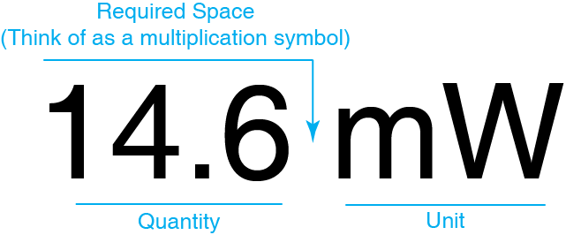
Metric (SI) Notation
SI is the International System of Units

Slide 29
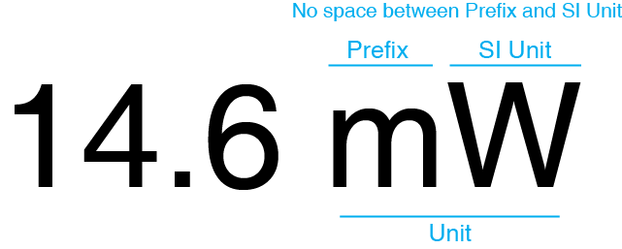
Metric (SI) Notation

Slide 30
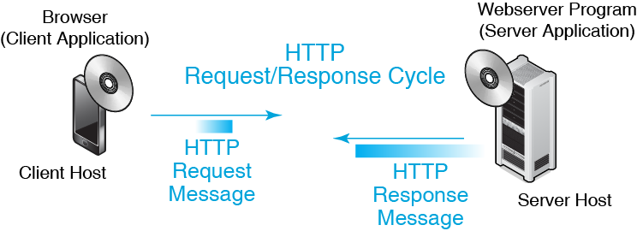
1.11 HTTP Request-Response Cycle

Slide 31
Netflix Jumps Into the Amazon
Messages
Single Networks
Internets
Standards Layers

Slide 32
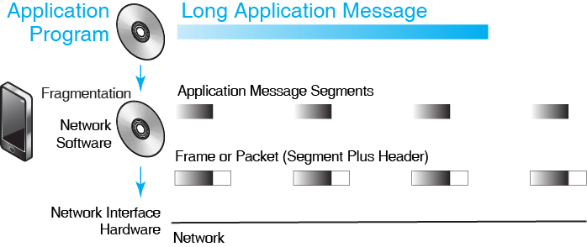
1.12 Fragments, Frames, and Packets

Slide 33
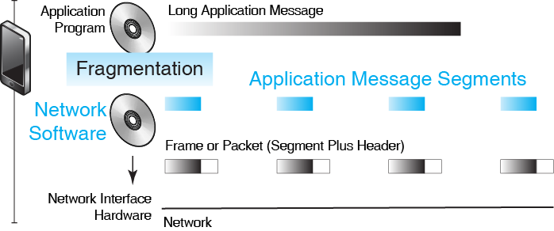
1.12 Fragments, Frames, and Packets

Slide 34
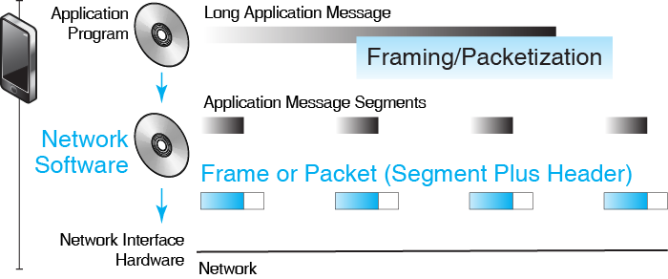
1.12 Fragments, Frames, and Packets

Slide 35
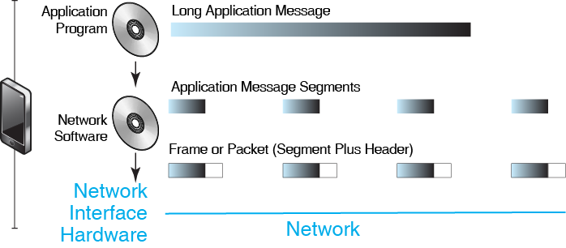
1.12 Fragments, Frames, and Packets

Slide 36
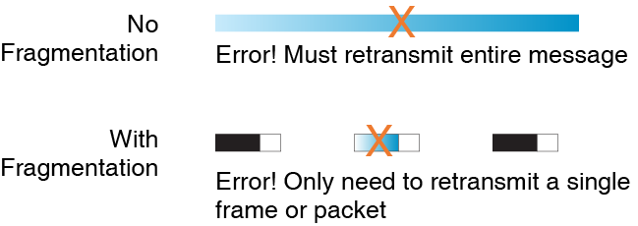
1.13 Fragmentation & Error Correction

Slide 37
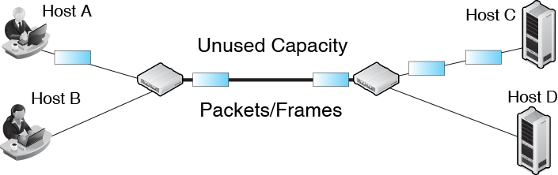
1.14 Fragmentation and Multiplexing

Slide 38
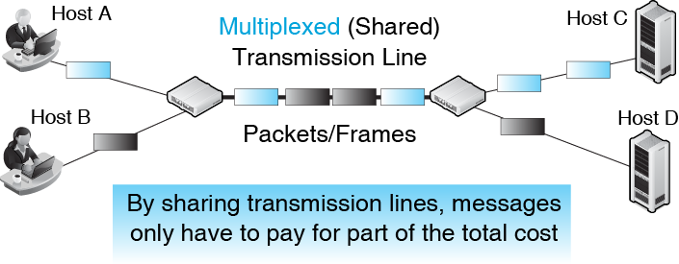
1.14 Fragmentation and Multiplexing

Slide 39
1.15 EUI-48 Addresses
Different single-network standards use different types of addresses
A common type of single-network address is the EUI-48 address
  EUI stands for extended unique identifier
  It is 48 bits long
  Used in Ethernet 802.3, Wi-Fi 802.11, and Bluetooth
  However, not all single-network addresses are EUI-48 addresses

Slide 40
1.15 EUI-48 Addresses
Formerly called a media access control (MAC) address
  Still commonly referred to as MAC addresses
Written as six pairs of number or letter symbols separated by dashes
  Example A1-B2-CC-92-FF-00
Not all single-network addresses follow the EUI-48 format

Slide 41
Netflix Jumps Into the Amazon
Messages
Single Networks
Internets
Standards Layers

Slide 42
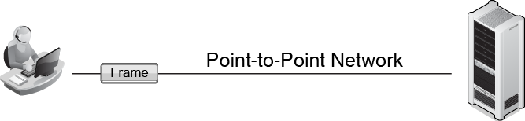
1.16 Point-to-Point Single Network

Slide 43
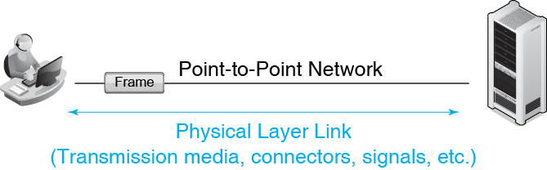
1.16 Point-to-Point Single Network

Slide 44
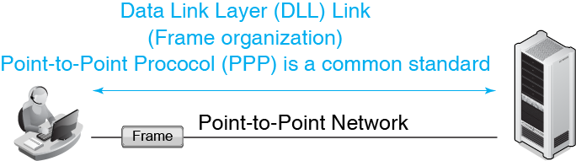
1.16 Point-to-Point Single Network

Slide 45
1.17 Physical and Data Link Layer Standards
Layered Standards
  Often, standards are created in layers, with each layer supporting the next higher layer
    For example, in driving…
    The soil layer supports the road layer
    The road layer supports the tire layer
    The tire layer supports the body layer
    The body layer supports the driver layer

Slide 46
1.17 Physical and Data Link Layer Standards
Layering allows specialization
  Road engineers do not have to understand tire standards or body standards in detail

Slide 47
1.17 Physical and Data Link Layer Standards
Physical Layer Standards
  The physical connection between adjacent devices in a network is a physical link
  Govern transmission media and connectors
  Govern signaling to transmit ones and zeroes
  Layer 1 (L1) standards

Slide 48
1.17 Physical and Data Link Layer Standards
Data Link Layer (DLL) Standards
  The end-to-end path of a frame between the source and destination host is a data link
  Govern frame organization
  Govern how forwarding devices (access points, switches) forward frames over multiple hops
  Govern DLL addresses
  Layer 2 (L2) standards

Slide 49
1.17 Physical and Data Link Layer Standards
Point-to-Point Protocol (POP)
  The dominant data link layer standard for point-to-point networks

Slide 50
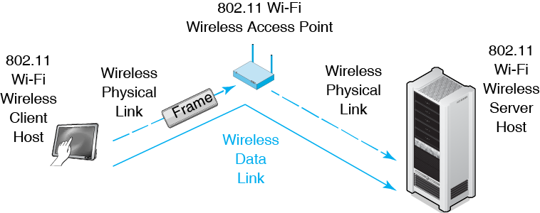
1.18 802.11 Wireless Single Networks

Slide 51
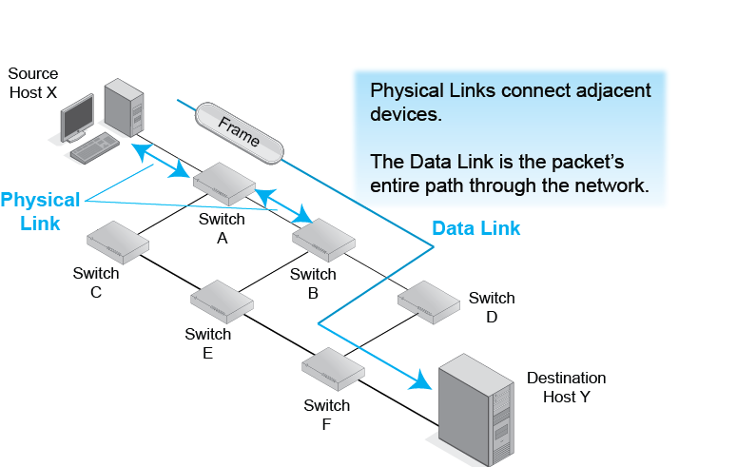
1.19 Physical and Data links

Slide 52
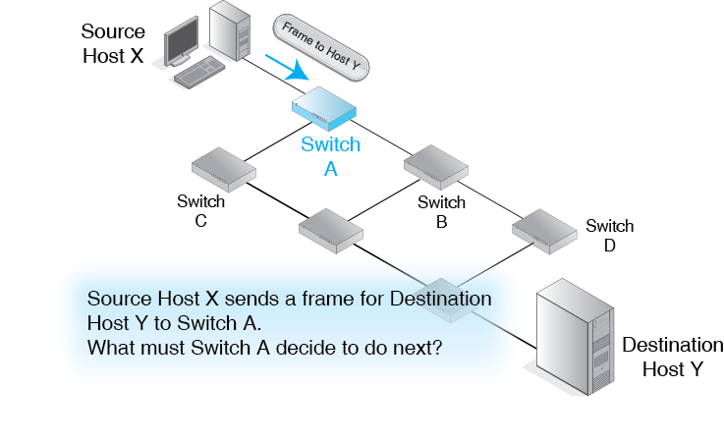
1.20 Switched Network

Slide 53
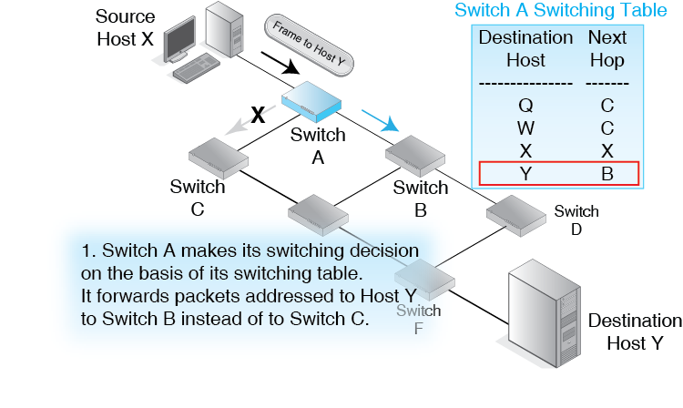
1.20 Switched Network

Slide 54
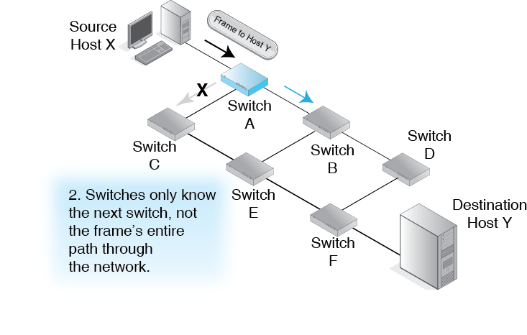
1.20 Switched Network

Slide 55
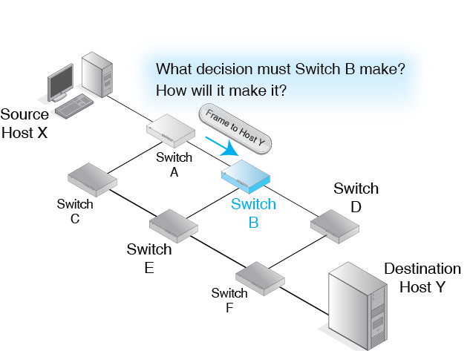
1.20 Switched Network

Slide 56
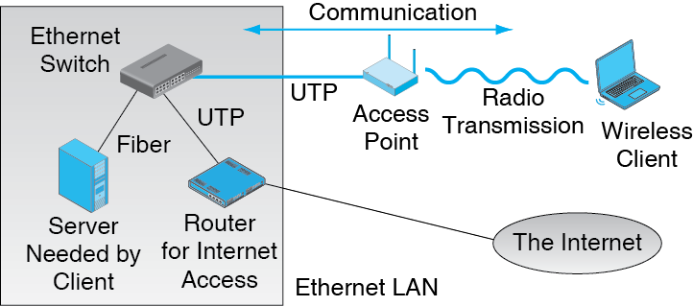
1.21 Hybrid Switched/Wireless Network

Slide 57
Netflix Jumps Into the Amazon
Messages
Single Networks
Internets
Standards Layers

Slide 58
1.22 Problems Connecting Hosts on Different Single Network
Different Standards
Overlapping Addresses
  Even if the two networks follow the same standard, a host on one network may have the same DLL address as a host on the other network.
Link to Connect the Single Network
  If the link used the standards of one network, it would not connect to the other network for the first two reasons

Slide 59
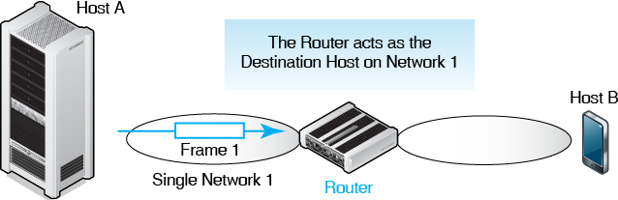
1.23 Internetworking with a Router

Slide 60
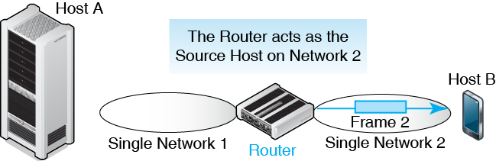
1.23 Internetworking with a Router

Slide 61
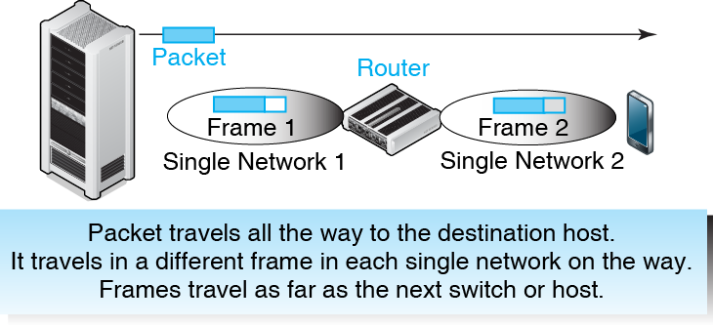
1.24 IP Packet and Data Link Layer Frame

Slide 62
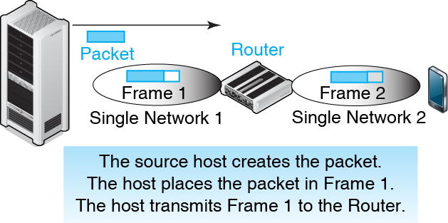
1.24 IP Packet and Data Link Layer Frame

Slide 63
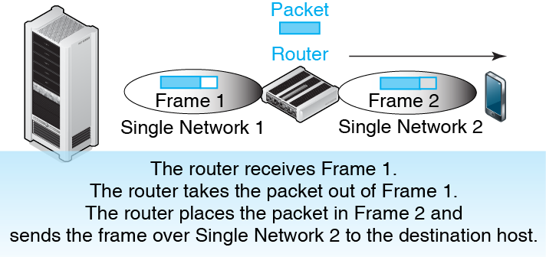
1.24 IP Packet and Data Link Layer Frame

Slide 64
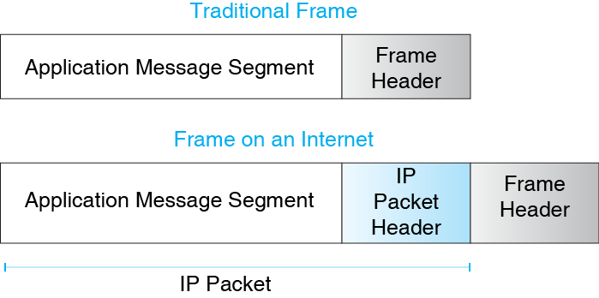
1.25 Encapsulation of Network Messages

Slide 65
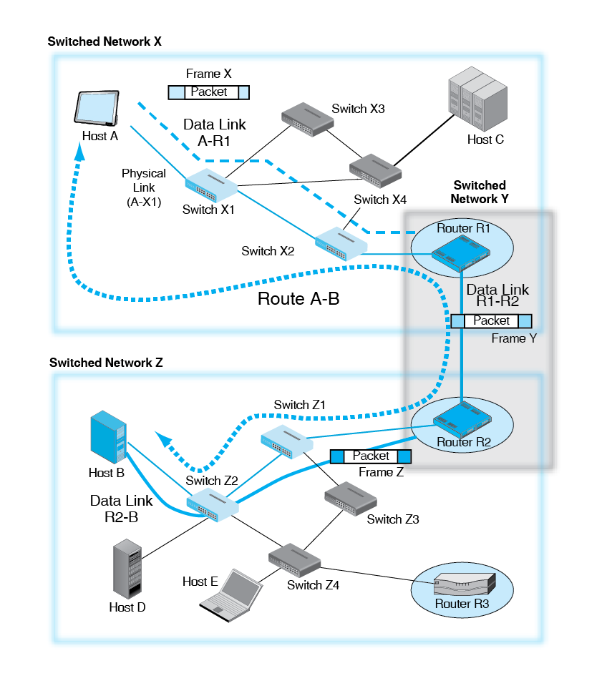
1.26 More Complex Internet

Slide 66
1.27 Repeated Concepts at the Data Link and Internet Layers
Concept | Data Link Layer | Internet Layer
Layer Number | Layer 2 (L2) | Layer 3 (L3)
Name | Data Link Layer | Internet Layer
Main Standard | Various (Ethernet 802.3, Wi-Fi 802.11, PPP, etc.) | IP
Addresses | Data Link Layer addresses (Often EUI-48 addresses) | IP addresses
Messages | Frames | Packets
Forwarding Devices | Switches, Access Points, etc. | Routers
Paths | Data Links | Routes

Slide 67
1.28 “Packet Switching”
Fragmentation and placing in an envelope is generically called packet switching
  However, packets are routed
  And frames are switched
So technically speaking, packets are never switched

Slide 68
Netflix Jumps Into the Amazon
Messages
Single Networks
Internets
Standards Layers

Slide 69
1.29 General Standards Layers
Num | Name | Role
5 | Application | Standardize communication between two application programs of a certain type.
4 | Transport | Fragmentation and other functions.
3 | Internet | Transmit a packet across an internet. Packet organization, router operation, other things needed to transmit a packet across a route in an internet.
2 | Data Link | Transmit a frame across a single network. Frame organization, switch and access point operation, and other things needed to transmit a frame across a data link in a single network.
1 | Physical | Transmission media, plugs and connectors, signaling.

Slide 70
1.30 Networking Standards Agencies and Architectures
Architecture | OSI | TCP/IP
Standard agency/agencies | ISO and ITU-T | Internet Engineering Task Force (IETF)
Architecture name | OSI | TCP/IP
Examples of standards | 802.3 Ethernet, 802.11 Wi-Fi, optical fiber | TCP, IP, DNS
Layers at which dominant | Physical (1) and Data Link (2) | Internet (3) and Transport (4)

Slide 71
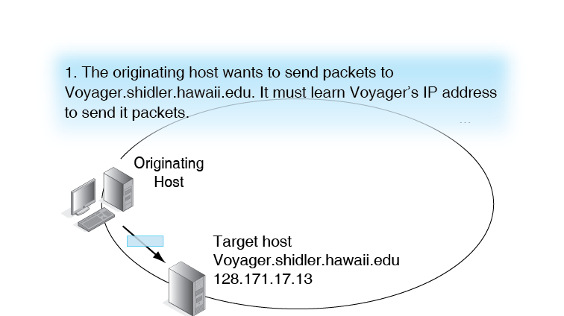
1.31 Domain Name System (DNS)

Slide 72
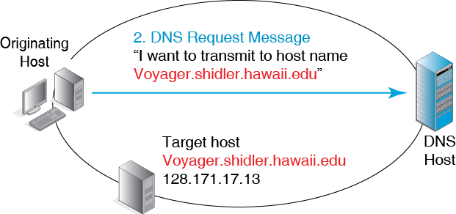
1.31 Domain Name System (DNS)

Slide 73
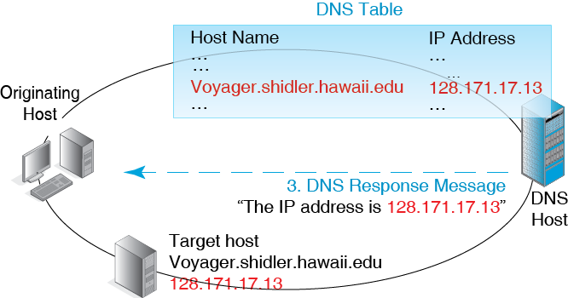
1.31 Domain Name System (DNS)

Slide 74
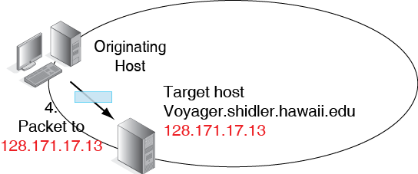
1.31 Domain Name System (DNS)

