Slide 1
Carrier Wide Area Networks (WANs)
End Page
Chapter 10

Slide 2
Corporate WANs
Network Access
The Network Core
WAN Optimization
More on SDN

Slide 3
10.1: LANs versus WANs (and MANs)
Category | Local Area Network | Metropolitan Area Network | Wide Area Network
Abbreviation | LAN | MAN | WAN
Service Area | On customer premises (home, apartment, office, building, campus, etc.) | Between sites in a metropolitan area. (city and its suburbs) A Type of WAN | Between sites in a region, a country, or around the world.

Slide 4
10.1: LANs versus WANs (and MANs)
Category | Local Area Network | Metropolitan Area Network | Wide Area Network
Implementation | Self | Carrier | Carrier
Ability to Choose Technology | High | Low | Low
Who Manages the Network? | Self | Carrier | Carrier

Slide 5
10.1: LANs versus WANs (and MANs)
Category | Local Area Network | Metropolitan Area Network | Wide Area Network
Price | Highly related to cost | Based on pricing strategy. Highly unpredictable. | Based on pricing strategy. Highly unpredictable.
Cost per Bit Transmitted | Low | Medium | High
Therefore Typical Transmission Speed | 1 Gbps and more | 10 Mbps to 1 Gbps | 1 to 100 Mbps

Slide 6
10.1: LANs versus WANs (and MANs)
Category | Local Area Network | Metropolitan Area Network | Wide Area Network
Diversity of Technologies | Low: 802.3 and 802.11 | Medium | High

Slide 7
10.2: Single Networks versus Internets
Technology | LAN | WAN
Can be a single switched or wireless network? | Yes | Yes
Can be an internet? | Yes | Yes

Slide 8
Corporate WANs
The Internet
  Ubiquitous and inexpensive
  Lacks the QoS requirements of organizations
Corporate WANs
  Offer the required QoS
  Much more expensive than the Internet to meet traffic engineering requirements
  Mostly for transmission between a corporation’s sites

Slide 9
Corporate WANs
Network Access
The Network Core
WAN Optimization
More on SDN

Slide 10
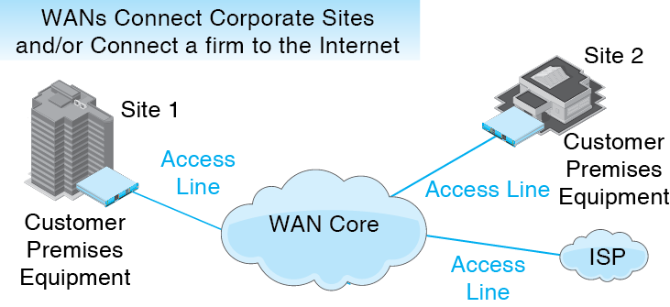
10.3: Basic WAN Components
Copyright © 2015 Pearson Education, Inc.

Slide 11
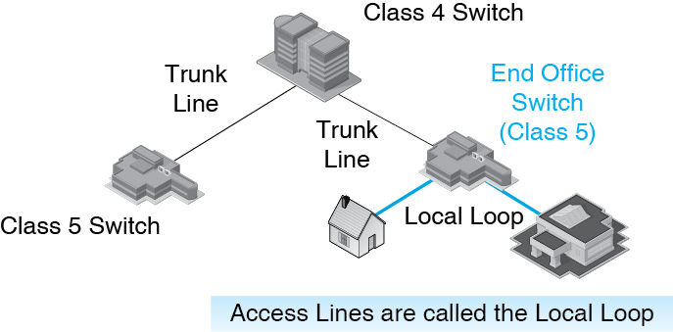
10.4: The Public Switched Telephone Network (PSTN)

Slide 12
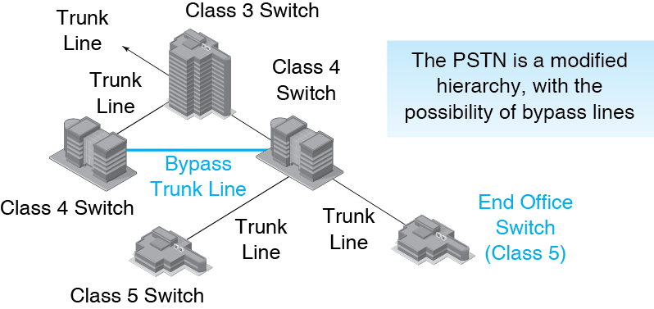
10.4: The Public Switched Telephone Network (PSTN)

Slide 13
10.5: Asynchronous Digital Subscriber Line (ADSL)
The local loop brings a 1-pair vice grade UTP line to every household
Not designed to carry data
ADSL uses advanced technology to deliver data over these 1-pair VG lines
The lines are already installed, so there is no need to run a new line to the subscriber
This makes ADSL inexpensive

Slide 14
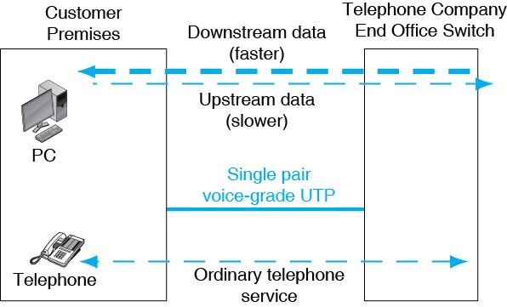
10.5: Asymmetric Digital Subscriber Line (DSL) Service for Residences

Slide 15
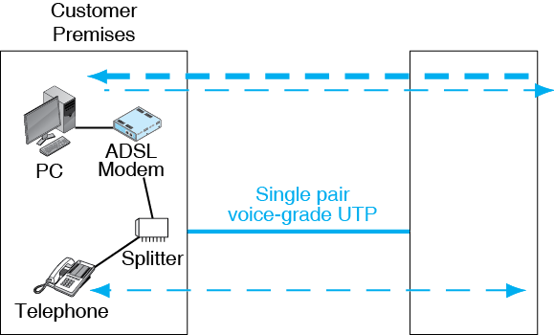
10.5: Asymmetric Digital Subscriber Line (DSL) Service for Residences

Slide 16
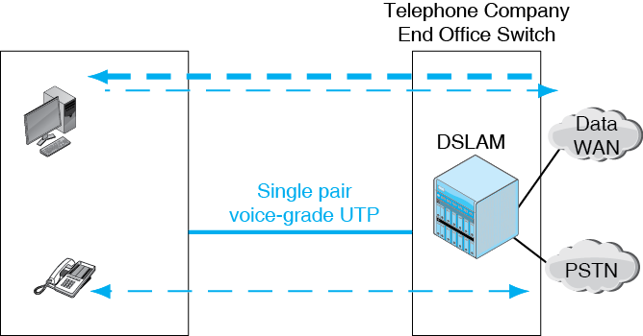
10.5: Asymmetric Digital Subscriber Line (DSL) Service for Residences
DSLAM = DSL Access Multiplexer

Slide 17
Cable Modem Service
Coaxial cable service was created to bring television to homes that had poor over-the- air reception
Now also offers two-way data service called cable modem service
Popular in the United States
Not popular in most countries

Slide 18
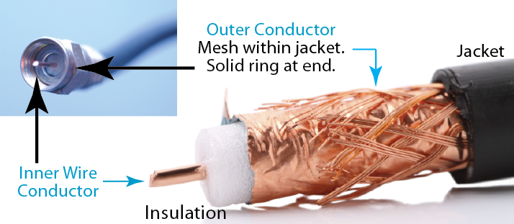
10.7: Coaxial Cable
Two conductors: central wire and coaxial ring

Slide 19
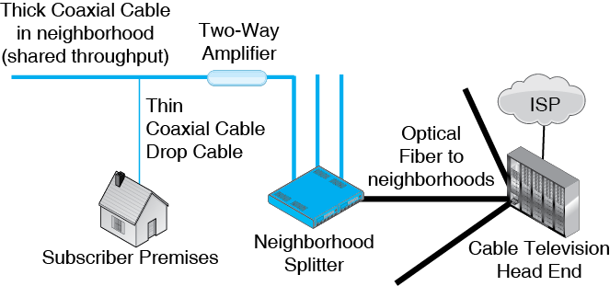
10.6: Cable Modem Service
5
1
6
3
7
8
4
2

Slide 20
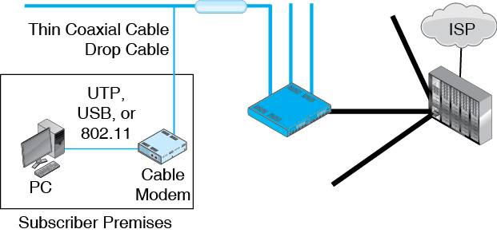
10.6: Cable Modem Service

Slide 21
ADSL versus Cable Modem Service
In general …
Cable modem service offers somewhat faster individual throughput at a somewhat higher cost.
ADSL service offers somewhat slower individual throughput at a somewhat lower cost.

Slide 22
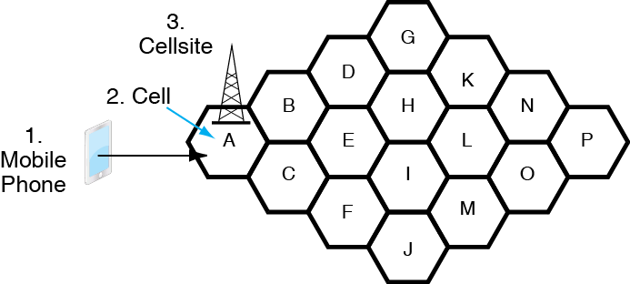
10.8: Cellular Telephone Service
Note that a cell is a geographical region while a cellsite is a building with cellular equipment

Slide 23
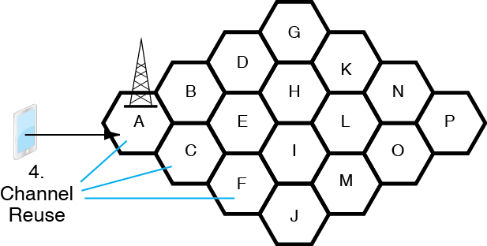
10.8: Cellular Telephone Service
4.
A channel can be reused in multiple cells.
The carrier can serve more customers.

Slide 24
Cellular Technology
Channel Reuse
  The same channel can be used in multiple cells.
    This allows subscribers in different sites to use the same channel.
    Consequently, the carrier can serve multiple customers per channel.
    This is the reason for using cells
    (Having multiple access points in an 802.11 Building WLAN serves the same purpose)

Slide 25
Cellular Technology
Channel Reuse
  Example without channel reuse:
    If 500 channels, only 500 simultaneous subscribers can be served in the entire system.
  Example with channel reuse in each cell
    500 channels
    100 cells
    Can serve 50,000 simultaneous subscribers

Slide 26
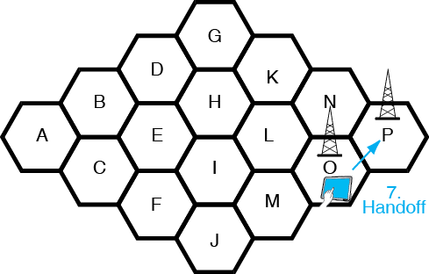
10.8: Cellular Technology
If you travel between cells, you will be handed off to a new cell site in the new cell (P)

Slide 27
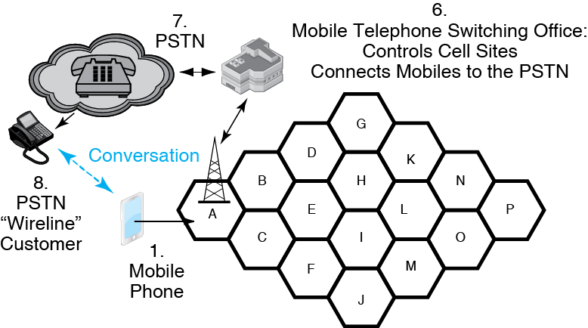
10.8: Cellular Telephony
Placing a call from a mobile phone to a wireline customer.
(Or vice versa)

Slide 28
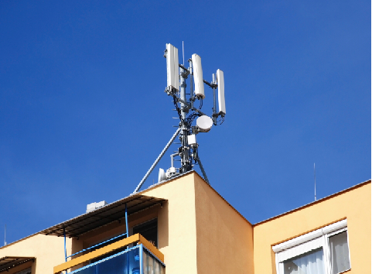
10.9: Cellsite for Mobile Telephones
Cellular
Antennas
Point-to-Point Microwave
Antenna to MTSO
Cellsite

Slide 29
10.10: Cellular Data Speeds
Speeds
  Early cellular systems were limited to about 20 kbps
  Today, most carriers give peak download speeds of 5 to 10 Mbps with the best giving 15 to 20 Mbps
  100 Mbps is on the horizon
  Nearly all carriers now use LTE (long-term evolution) technology

Slide 30
10.10: Cellular Data Speeds
LTE Advanced
  The next generation of LTE
  Currently, speeds are required to be 3 Gbps downstream, half of that upstream
3G, 4G, and 5G
  The ITU creates definitions of generations
  Marketers are using the terms in a meaningless manner

Slide 31
10.10: Cellular Data Speeds
Throughput Differs Widely from Rated Speeds
  There is extensive overhead in cellular transmission. The data transmission rate is always less than the bit transmission rate.
  If the user is riding in a car, throughput will fall.
  If more customers use a cellsite, the cellsite may have to decrease the transmission speed to each.
  In particular, speed will depend on the time of day.
Copyright © 2015 Pearson Education, Inc.

Slide 32
10.10: Cellular Data Speeds
Throughput Differs Widely from Rated Speeds
  If the user travels into an area with an overloaded cellsite, speed will be lower.
  At greater distances from a cellsite, speed falls, just as in Wi-Fi.
  Weakened signal strength caused by transmission through buildings will also reduce speed.
Copyright © 2015 Pearson Education, Inc.

Slide 33
Corporate WANs
Network Access
The Network Core
WAN Optimization
More on SDN

Slide 34
10.3: Basic WAN Components and Business Uses
Copyright © 2015 Pearson Education, Inc.

Slide 35
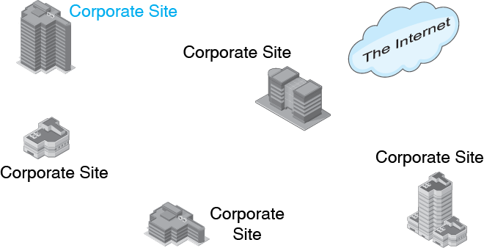
10.11: Wired Carrier WANs for Business
Corporations need to connect their sites with high-quality transmission networks with better QoS than the Internet

Slide 36
Wired Carrier WAN Core Technologies
Leased Lines
  Layer 1
  Access lines
  Leased line networks
Carrier Ethernet
  Layer 2
  Extends site Ethernet LANs to the corporation
Multiprotocol Label Switching (MPLS)
  Layer 3
  Strong traffic engineering for high QoS

Slide 37
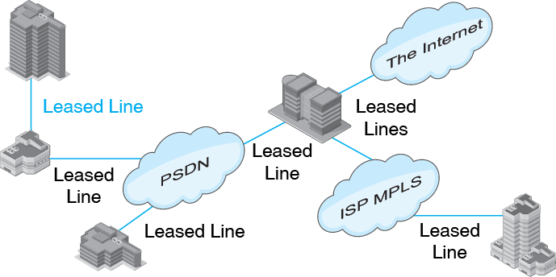
10.11: Wired Carrier WANs for Business
E
A
D
B
F
C
Most firms use multiple wired LAN carriers

Slide 38
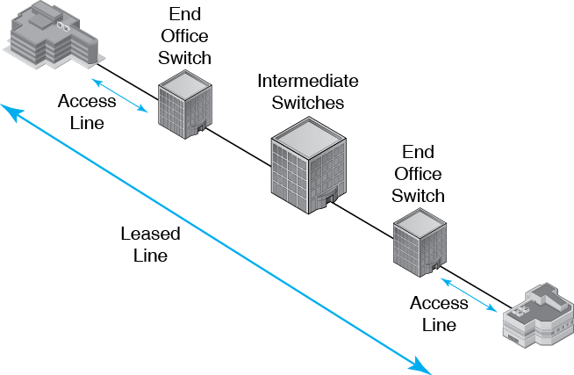
10.12: Access Lines vs Leased Lines
Each customer site must have a CSU/DSU interface to the telephone network.

Slide 39
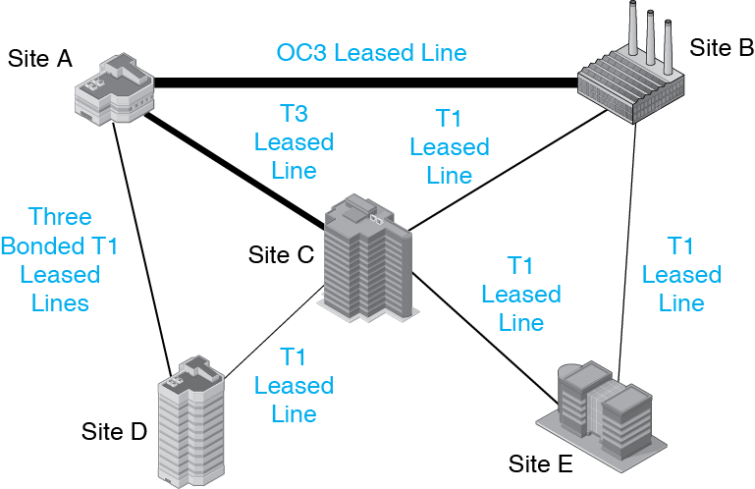
10.13: Leased Line Data Network

Slide 40
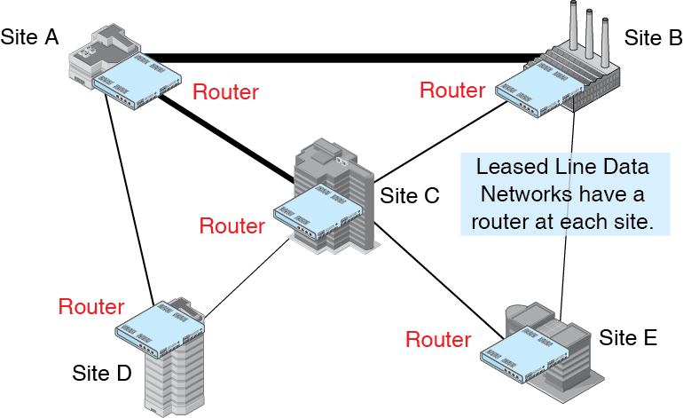
10.13: Leased Line Data Network

Slide 41
10.14: Leased Line Speeds
North American Digital Hierarchy
Line | Speed | Typical Transmission Medium
T1* | 1.544 Mbps | 2-Pair Data-Grade UTP
T3 | 44.736 Mbps | Carrier Optical Fiber

Slide 42
10.14: Leased Line Speeds
CEPT Hierarchy
Line | Speed | Typical Transmission Medium
E1* | 2.048 Mbps | 2-Pair Data-Grade UTP
E3 | 34.368 Mbps | Carrier Optical Fiber

Slide 43
10.14: Leased Line Speeds
Often offer synchronous DSL over existing 1-pair VG UTP rather than offering traditional T1 and E1 service over 2-pair data grade UTP, which must be pulled to the customer’s premises.

Slide 44
10.14: Leased Line Speeds
Fractional T1 speeds are often offered by carriers. These typically include some subset of the speeds 128 kbps, 256 kbps, 384 kbps, 512 kbps, and 768 kbps.
T1 and E1 lines can be bonded to provide double, triple, or quadruple the capacity of a single line

Slide 45
10.14: Leased Line Speeds
SONET/SDH Speeds
Line | Speed (Mbps) | Transmission Medium
OC3/STM1 | 155.52 | Carrier Optical Fiber
OC12/STM4 | 622.08 | Carrier Optical Fiber
OC48/STM16 | 2,488.32 | Carrier Optical Fiber
OC192/STM64 | 9,953.28 | Carrier Optical Fiber
OC768/STM256 | 39,813.12 | Carrier Optical Fiber
Above 50 Mbps, transmission lines are standardized

Slide 46
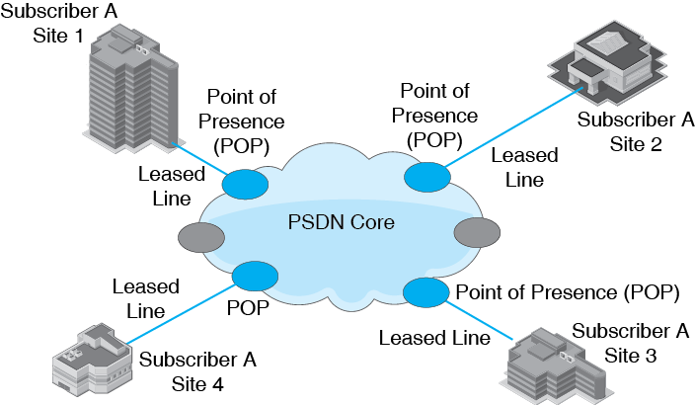
10.15: Public Switched Data Network (PSDN)

Slide 47
10.15: Public Switched Data Network (PSDN)
Switched (Layer 2) Technology
  Carrier Ethernet
    Yes, Ethernet
  Historical PSDN technologies
    Dead or dying
    Frame Relay
    ATM

Slide 48
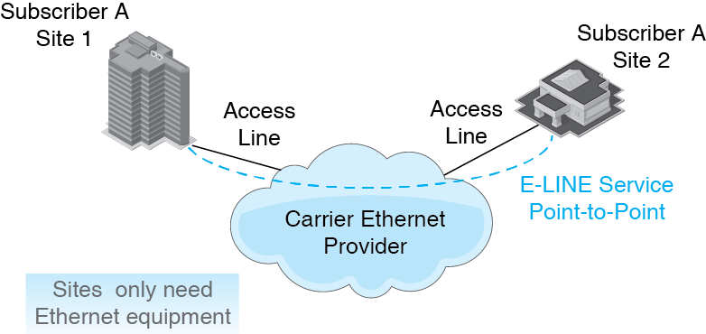
10.16: Carrier Ethernet PSDN Services
E-Line service is like having a leased line

Slide 49
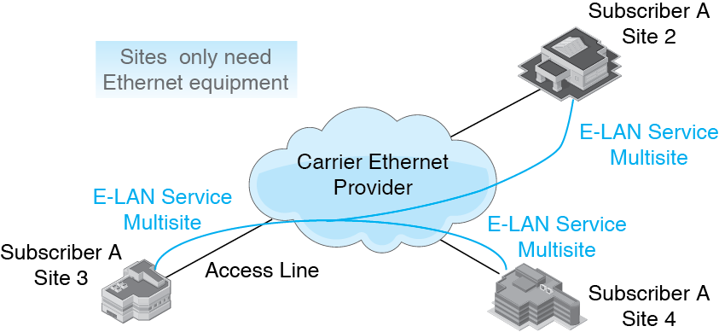
10.16: Carrier Ethernet PSDN Services
E-LAN service extends site Ethernet LANs to cover multiple sites

Slide 50
10.17: Carrier Ethernet Attractions
Low cost
Familiarity of the technology for the firm’s networking staff
High speeds are available
Speed agility: Increases in speed can be provisioned rapidly
Quality of service
Security

Slide 51
Multiprotocol Label Switching
Routers route each packet individually, going through the three steps we saw in the last chapter.
  Even if the next packet is going to the same destination IP address, the router will go through all three steps.
  This consumes a great deal of processing power per packet.
  This makes traditional routing expensive.

Slide 52
Multiprotocol Label Switching
MPLS addresses this issue.
  Routers identify the best route for a range of IP addresses before sending data.
  That route is given a label number.
  Each packet in a stream gets a label with this label number.
  Routers do only a quick table lookup per packet.
  Table lookups require little processing power.
  So multiprotocol label switching is much less expensive than traditional routing.

Slide 53
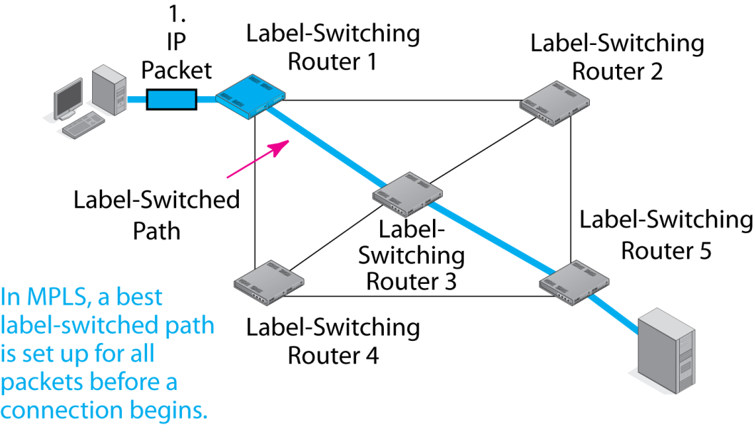
10.18: Multiprotocol Label Switching (MPLS)

Slide 54
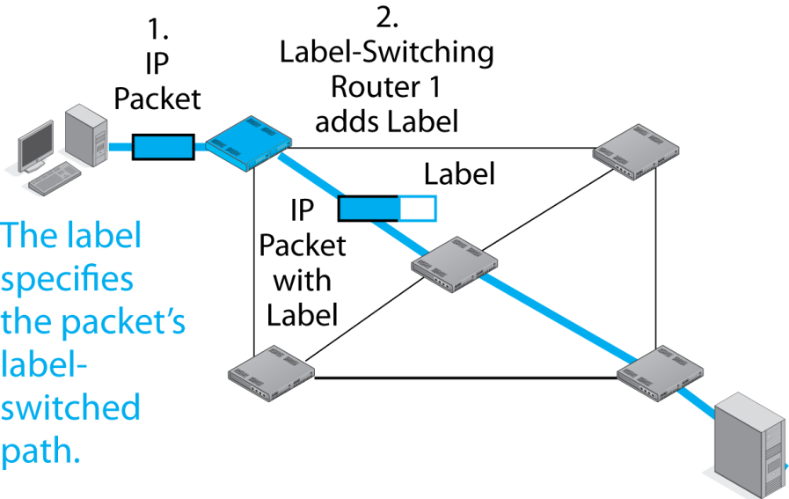
10.18: Multiprotocol Label Switching (MPLS)
Label Number is 123

Slide 55
10.18: MPLS
Label sits between the frame header and the IP packet header.
IP Packet
Header
MPLS Label
Frame Header

Slide 56
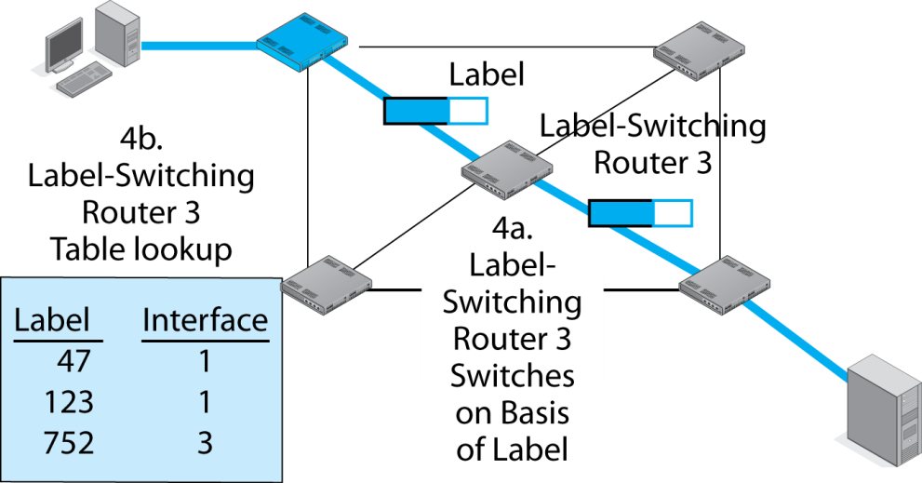
10.18: Multiprotocol Label Switching (MPLS)
Router 3 sends the packet out through Interface 1

Slide 57
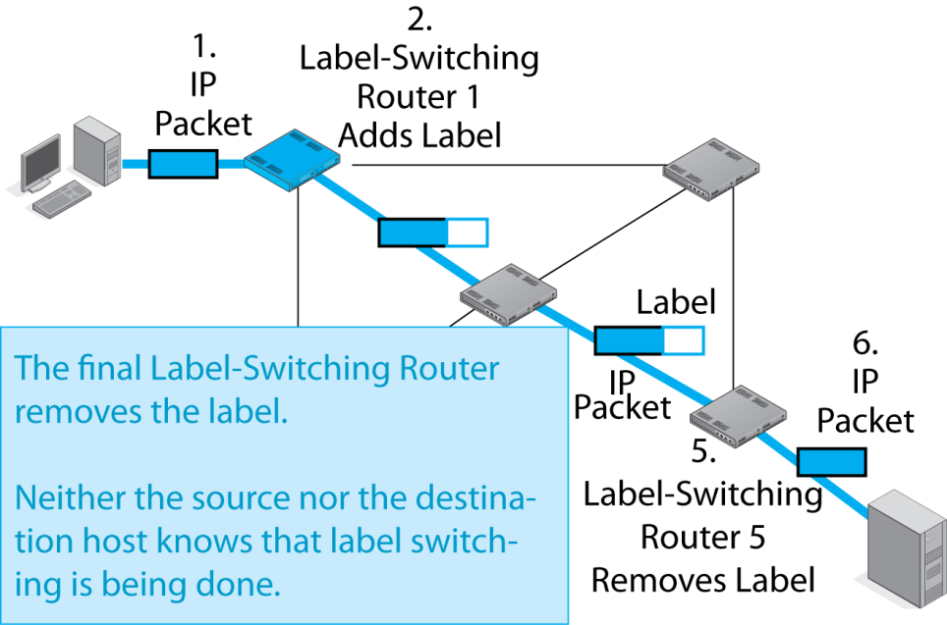
10.18: Multiprotocol Label Switching (MPLS)

Slide 58
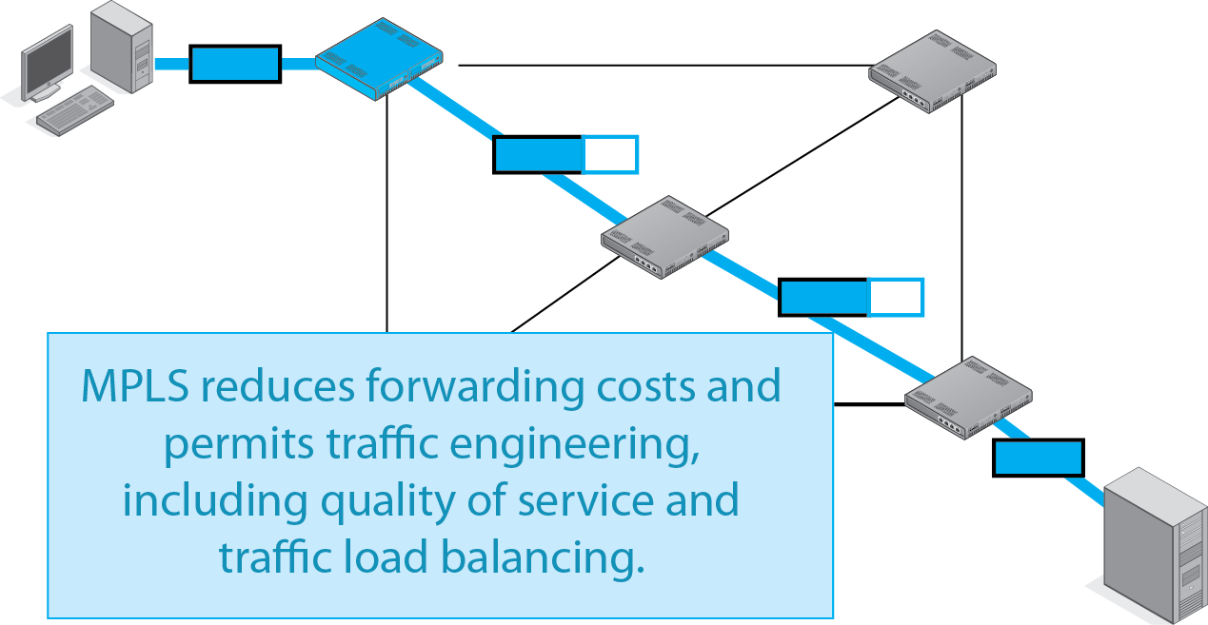
10.18: Multiprotocol Label Switching (MPLS)

Slide 59
Network Core Alternatives
Leased Line Networks
  Company must manage the network itself
  Can be expensive and requires head count
Carrier Ethernet
  Carrier does the management work
  Familiar technology
  Economies of scale give attractive prices
MPLS
  The highest QoS and the highest prices

Slide 60
Network Core Alternatives
A service may not be available for all sites
Using two or more carrier Ethernet or MPLS carriers may run into in incompatibilities that harm interoperability
Most companies use a mix of leased lines, MPLS, and carrier Ethernet (or another PSDN) to link their sites

Slide 61
Corporate WANs
Network Access
The Network Core
WAN Optimization
More on SDN

Slide 62
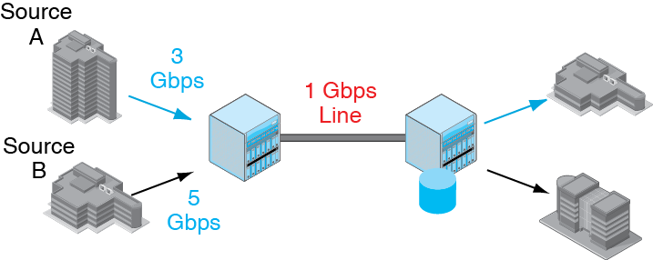
10-19: WAN Optimization: Compression
We have a problem.

Slide 63
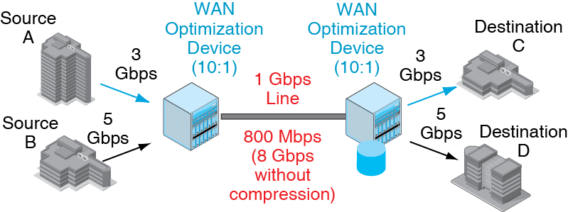
10-19: WAN Optimization: Compression

Slide 64
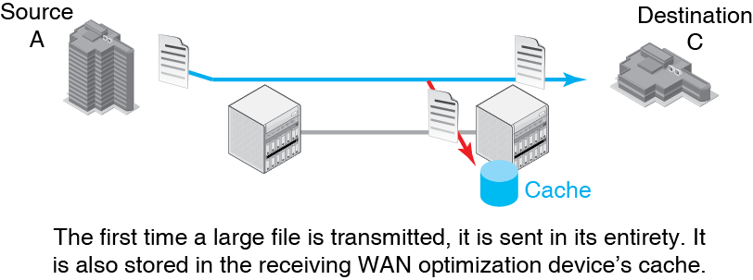
10.20: WAN Optimization: Caching

Slide 65
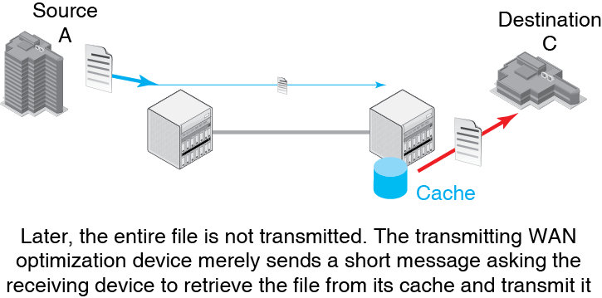
10.20: WAN Optimization: Caching

Slide 66
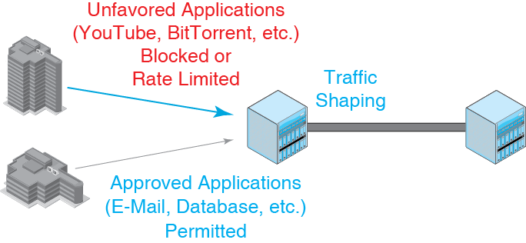
10.21: WAN Optimization: Traffic Shaping and Acceleration

Slide 67
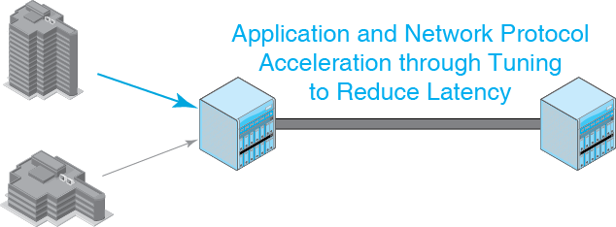
10.21: WAN Optimization: Traffic Shaping and Acceleration

Slide 68
Corporate WANs
Network Access
The Network Core
WAN Optimization
More on SDN

Slide 69
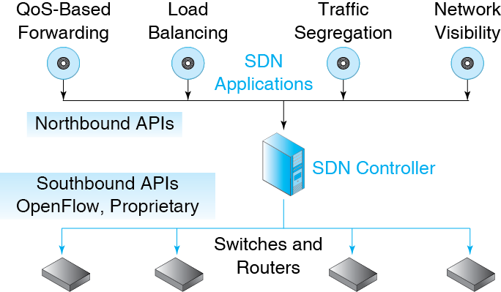
10.22: Software-Defined Networking (SDN)

Slide 70
10.22: Forwarding Table Rules
Row | IP Src Addr | IP Dest Addr | TCP Dest Port | Ethernet Priority | IP Class Number | Action
1 | External | 128.3.2.8 | 443 | 7 | Any | Pass with Priority
2 | External | 128.3.2.8 | 443 | Any | 17 | Pass Apply Class Rule 17
3 | External | 128.3.2.8 | 443 | Any | Any | Drop
4 | Not Finance | Finance | Any | Any | Any | Drop Log
5 | Internal | 128.7.65.1 | 443 | Any | Any | Authenticate
6 | Internal | External | 80 | Any | Any | Drop
7 | Internal | External | 443 | Any | Any | Pass
8 | Any | Honeypot | Any | Any | Any | Pass Alarm

