Slide 1
Network Security
Chapter 3
Panko and Panko
Business Data Networks and Security
Copyright © 2015 Pearson Education, Inc.

Slide 2
The Target Breach
Attacks and Attackers
Protecting Dialogs Cryptographically
Other Forms of Authentication
Firewalls
Antivirus Protection

Slide 3

The Target Breach
Christmas Season 2013
BlackPOS malware “scrapes” transaction data
Debit/credit transactions of 40 million customers
In separate attack, information stolen on 70 million Target customers
Sales losses, stock decline, technology officer fired, CEO fired

Slide 4
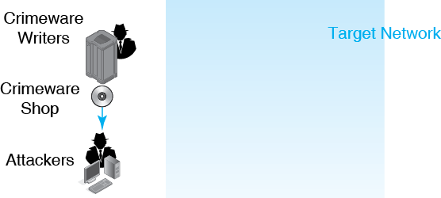
3.1 The Target Breach
BlackPOS

Slide 5
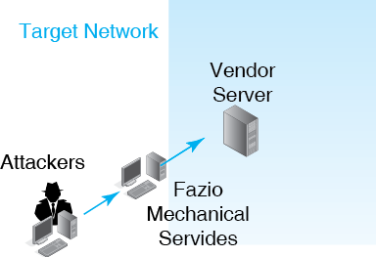
3.1 The Target Breach
E-Mail Spear Phishing Attack
Fazio Mechanical Services

Slide 6
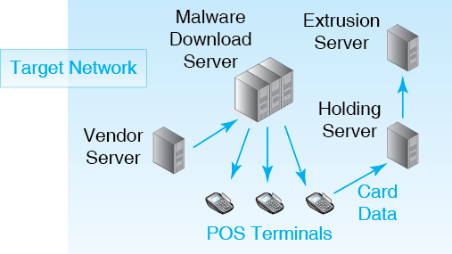
3.1 The Target Breach

Slide 7
3.1 The Target Breach
Not shown:
Constant ongoing
command and control communication from the outside

Slide 8
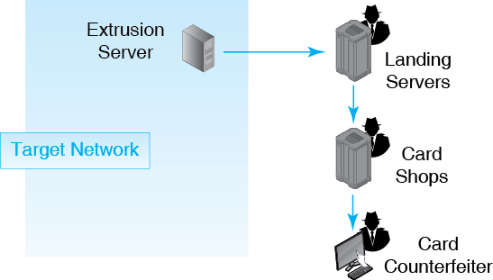
3.1 The Target Breach

Slide 9
The Target Breach
Attacks and Attackers
Protecting Dialogs Cryptographically
Other Forms of Authentication
Firewalls
Antivirus Protection

Slide 10
3.2 Malware and Vulnerabilities
Malware
  A general name for evil software

Slide 11
3.2 Malware and Vulnerabilities
Vulnerabilities
  Security flaws in specific programs
  Enable specific attacks against these programs
  Vendors release patches to close vulnerabilities
  However, users do not always install patches promptly or at all, so continue to be vulnerable
  Also, zero-day attacks occur before the patch is released for the vulnerability

Slide 12
3.3 Viruses and Worms
Viruses
  Pieces of code that attach themselves to other programs
Worms
  Stand-alone programs that do not need to attach to other programs

Slide 13
3.3 Viruses and Worms
Typical Propagation Vectors
  E-mail attachments
  Visits to websites (even legitimate ones)
  Social networking sites
  Many others (USB RAM sticks, peer-to-peer file sharing, etc.)
  These requires human gullibility, which is slow

Slide 14
3.3 Viruses and Worms
Directly propagating worms
  Jump to victim hosts directly
  Target hosts must have a specific vulnerability for this to succeed
  No action is necessary on the part of the victim
  Directly propagating worms can spread with amazing speed

Slide 15
3.4 Other Types of Malware
Mobile Code on Webpages
  HTML webpages can contain scripts
  Commands in a simplified programming language
  Scripts are called mobile code because they are downloaded with the webpage
  Scripts are normally benign but may be damaging if the browser has a vulnerability

Slide 16
3.4 Other Types of Malware
Trojan Horses
  Trojan horses are programs that disguise themselves as system files
  Spyware Trojans collect sensitive data and send the data to an attacker

Slide 17
3.4 Other Types of Malware
Downloaders
  Malware that downloads a larger malware program onto the infected computer
Spam
  Unsolicited Commercial E-Mail

Slide 18
3.5 Payloads
After propagation, viruses and worms execute their payloads
Malicious payloads do damage
  Payloads can erase hard disks
  Payloads can send users to pornography sites if they mistype URLs
Even malware without payloads can do damage
  Not all malware has payloads—malicious or otherwise
  Can still cause computer to run slowly or crash

Slide 19
3.6 Attacks on Human Judgment
Social Engineering
  Tricking the victim into doing something against personal or organizational security interests
  Open E-Mail Attachments, visit websites, etc.

Slide 20
3.6 Attacks on Human Judgment
Phishing Attacks
  A sophisticated social engineering attack in which an authentic-looking e-mail or website entices the user to enter his or her username, password, or other sensitive information
  Spear phishing attacks have contact customized for a particular purpose

Slide 21
3.6 Attacks on Human Judgment
Credit Card Number Theft
  Uses stolen credit card numbers to make unauthorized transactions
Identity Theft
  Involves collecting enough data to impersonate the victim in large financial transactions
  Can result in much greater financial harm to the victim than credit card theft
  May take a long time to restore the victim’s credit rating

Slide 22
3.7 Human Break-Ins (Hacking)
Hacking
  Intentionally using a computer resource
  without authorization or
  in excess of authorization.

Slide 23
3.7 Human Break-Ins (Hacking)
Hacking
  Intentionally using a computer resource
  without authorization or
  in excess of authorization
Is it hacking if you find a username and password on the street and log in to the account? Explain.

Slide 24
3.7 Human Break-Ins (Hacking)
Hacking
  Intentionally using a computer resource
  without authorization or
  in excess of authorization
Is it hacking if you log in to your legitimate e-mail account and find that you can see the e-mail of other users. You spend about five minutes looking around. Is this hacking? Justify your answer.

Slide 25
3.7 Human Break-Ins (Hacking)
Hacking
  Intentionally using a computer resource
  without authorization or
  in excess of authorization
You click on an e-mail link and find yourself inside an Internal Revenue Service server. Is this hacking? Justify your answer.

Slide 26
3.7 Human Break-Ins (Hacking)
Hacking
  Intentionally using a computer resource
  without authorization or
  in excess of authorization
Is it hacking if you log into an account that the user gave poor protection to by giving it the password 123456?

Slide 27
3.7 Human Break-Ins (Hacking)
Hacking
  Intentionally using a computer resource
  without authorization or
  in excess of authorization
Is it hacking if you just want to test the security of your bank and discover that it has a poor firewall?

Slide 28
3.7 Human Break-Ins (Hacking)
Hacking
  Intentionally using a computer resource
  without authorization or
  in excess of authorization
Is it illegal to test a company’s firewall on your own initiative, find a vulnerability, and tell the company that you will tell them about it if you give them $1,000?

Slide 29
3.7 Human Break-Ins (Hacking)
Penalties Depend on the Amount of Damage Done
  Easy to do damage accidentally

Slide 30
3.8 Stages in an Attack
Exploit
  The actual break-in
  The tool used is also called an exploit
After the Break-In
  Manually exploits the resource
  Leaves a Trojan horse behind for continuous automated exploitation

Slide 31
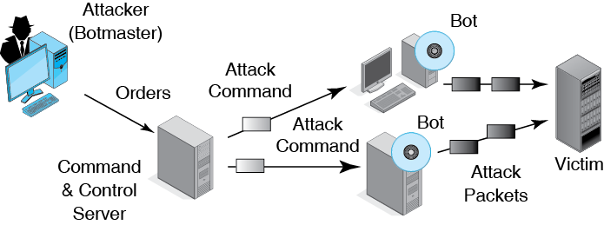
3.9 Distributed Denial-of-Service (DDoS) Attack with Bots

Slide 32
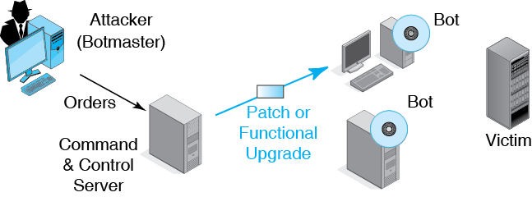
3.9 Distributed Denial-of-Service (DDoS) Attack with Bots

Slide 33
3.10 Advanced Persistent Threats
Long-term attack on an organization
  Can last months or even years
Uses extremely advanced techniques
  Often begins with a spear phishing attack
Difficult and expensive to do
  So usually done by national governments
  Although well-funded criminal groups can do it

Slide 34
3.11 Types of Attackers
Hackers
  Old-school hackers driven by curiosity, a desire for power, and peer reputation
  Today, most hackers are career criminals who hack for money
  Criminal attackers are well-funded and have an online criminal infrastructure
    Purchase malware
    Hire expertise when needed
    Credit card “fences, “etc.

Slide 35
3.11 Types of Attackers
Malware Attackers
  It is not illegal to write malware
  It is illegal to release malware against a company
  Caveat: if you write malware for someone to use in an attack, this is conspiracy and carries the same penalty as the attack
New: Caveat is not in the book.

Slide 36
3.11 Types of Attackers
Employees, Ex-Employees, and Other Insiders
  Current employees: revenge or theft
  Extremely dangerous
    Already have access
    Know the systems
    Know how to avoid detection
    Are trusted by the organization

Slide 37
3.11 Types of Attackers
Employees, Ex-Employees, and Other Insiders
  IT and security employees are the most dangerous
  Ex-employees are Dangerous, so all access must be terminated before Leaving
  Contractors with access permissions are also “insiders”

Slide 38
3.11 Types of Attackers
On the Horizon
  Cyberterror attacks by terrorists
  Cyberwar by nations
  Dangerous because tend to be sophisticated
  Dangerous because focus on doing widespread damage instead of committing isolated crimes

Slide 39
The Target Breach
Attacks and Attackers
Protecting Dialogs Cryptographically
Other Forms of Authentication
Firewalls
Antivirus Protection

Slide 40
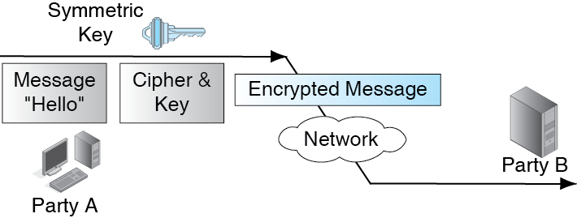
3.12 Symmetric Key Encryption for Confidentiality

Slide 41
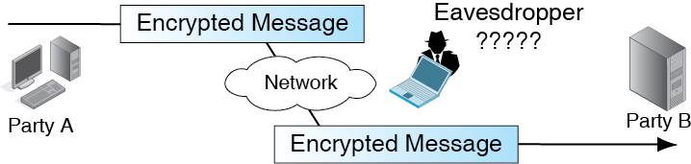
3.12 Symmetric Key Encryption for Confidentiality

Slide 42
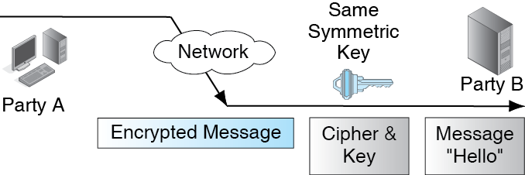
3.12 Symmetric Key Encryption for Confidentiality

Slide 43
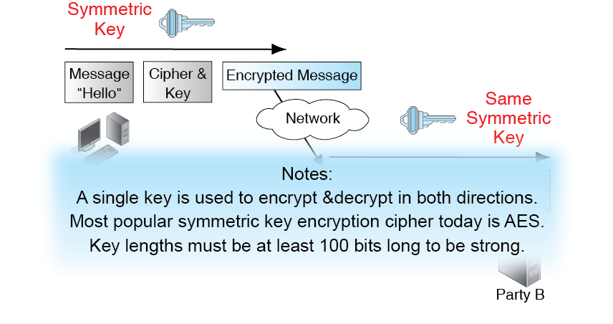
3.12 Symmetric Key Encryption for Confidentiality

Slide 44
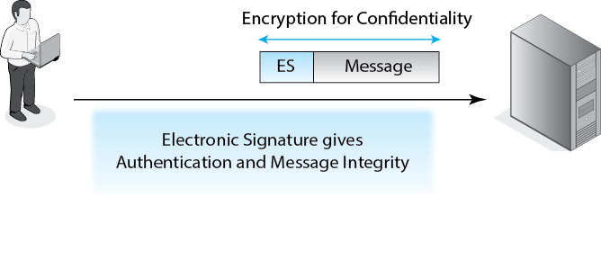
3.13 Electronic Signature Authentication

Slide 45
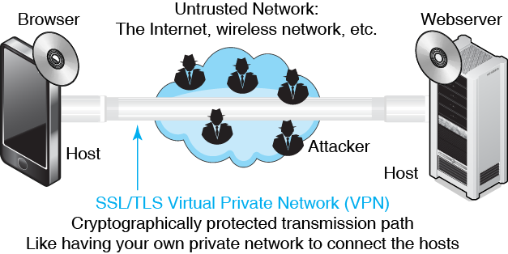
3.14 SSL/TLS Host-to-Host VPN

Slide 46
The Target Breach
Attacks and Attackers
Protecting Dialogs Cryptographically
Other Forms of Authentication
Firewalls
Antivirus Protection

Slide 47
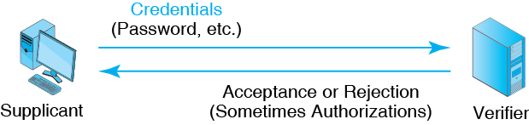
3.15 General Authentication Concepts

Slide 48
3.16 Reusable Password Authentication
Reusable Passwords
  Passwords are strings of characters
  They are typed to authenticate the use of a username (account) on a computer
  They are used repeatedly and so are called reusable passwords

Slide 49
3.16 Reusable Password Authentication
Benefits
  Ease of use for users (familiar)
  Inexpensive (often free) because they are built into operating systems

Slide 50
3.16 Reusable Password Authentication
Often Weak (Easy to Crack)
  Hackers use password dictionaries that include common passwords, names, and simple variations such as capitalizing the first letter and adding a number at the end
  Dictionary attacks can crack almost all passwords in seconds or minutes.
  A password that can be cracked using a dictionary can never be adequately strong-no matter how long it is.
Processing1

Slide 51
3.16 Reusable Password Authentication
Passwords Should Be Long and Complex
  Should have a minimum of eight to twelve characters
  Should mix case, digits, and other keyboard characters ($, #, etc.)
  Example: r8pWm#4D*&2B
  Can only be cracked with brute force attacks (trying all combinations of characters)
  This is very difficult and often impossible
  However, long, complex passwords are often written down

Slide 52
3.16 Reusable Password Authentication
Perspective
  Overall, can only be used for the least sensitive assets

Slide 53
3.17 Other Forms of Authentication
Perspective
  Goal is to replace reusable passwords
Access Cards
  Permit door access
  Can be used for computer access
  Proximity access cards do not require physical contact

Slide 54
3.17 Other Forms of Authentication
Biometrics
  Biometrics uses body measurements to authenticate you
  Vary in cost, precision, and susceptibility to deception
  Fingerprint recognition
  Inexpensive but poor precision, deceivable
  Sufficient for low-risk uses
  On a notebook, may be better than requiring a reusable password

Slide 55
3.17 Other Forms of Authentication
Biometrics
  Biometrics uses body measurements to authenticate you
  Vary in cost, precision, and susceptibility to deception

Slide 56
3.17 Other Forms of Authentication
Fingerprint recognition
  Inexpensive
  Only moderate precision
  Deceivable
  Sufficient for low-risk uses
  On a notebook, may be better than requiring a reusable password

Slide 57
3.17 Other Forms of Authentication
Iris recognition
  Based on patterns in the colored part of your eye
  Expensive but precise and difficult to deceive
Facial recognition
  Based on facial features
  Controversial because can be done surreptitiously—without the supplicant’s knowledge

Slide 58
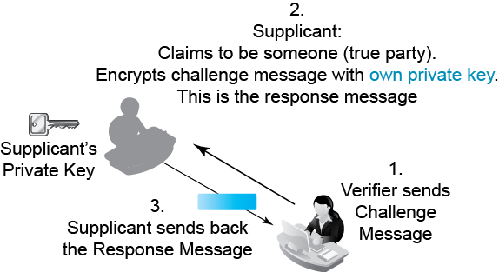
3.18 Digital Certificate Authentication

Slide 59
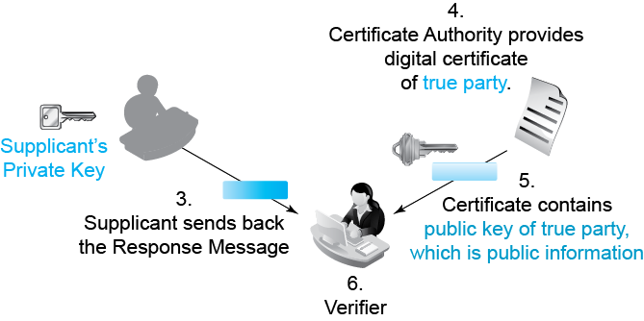
3.18 Digital Certificate Authentication

Slide 60
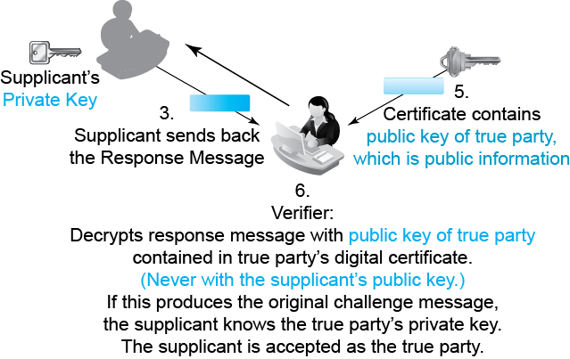
3.18 Digital Certificate Authentication

Slide 61
3.18 Digital Certificate Authentication
True Party | Has a Public and Private Key
Supplicant | Encrypts challenge message with supplicant’s private key
Verifier | Decrypts response message with true party’s public key
Choice | If decryption works, supplicant knows the true party’s private key so must be the true party

Slide 62
3.19 Two-Factor Authentication
Supplicant needs two forms of credentials
Example: debit card and PIN
Strengthens authentication
Fails if
  Attacker controls user’s computer
  Attacker can intercept authentication communication

Slide 63
The Target Breach
Attacks and Attackers
Protecting Dialogs Cryptographically
Other Forms of Authentication
Firewalls
Antivirus Protection

Slide 64
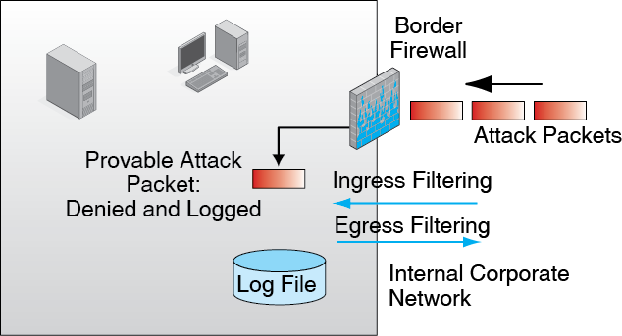
3.20 General Firewall Operation

Slide 65
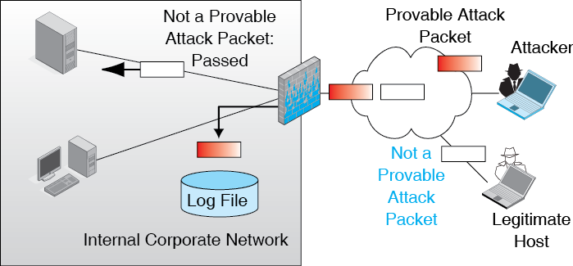
3.20 General Firewall Operation

Slide 66
3.20 General Firewall Operation
What happens if a provable attack packet arrives?
What happens if a legitimate packet arrives?
What happens if a packet that is probably an attack packet arrives?
  What are the implications of the answer?

Slide 67
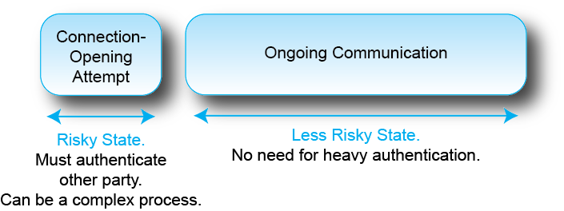
3.21 States in a Conversation
Stateful Inspection Firewalls use the concept of communication states

Slide 68
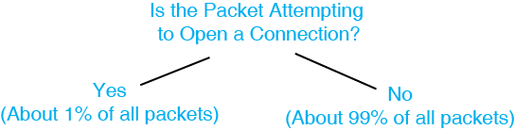
3.22 Stateful Packet Inspection (SPI)
What would the firewall do with
a packet containing a SYN segment?

Slide 69
3.22 Stateful Packet Inspection (SPI)
What would the firewall do with
a packet containing a FIN segment?

Slide 70
3.22 Stateful Packet Inspection (SPI)
What would the firewall do with
a packet containing a pure ACK segment?

Slide 71
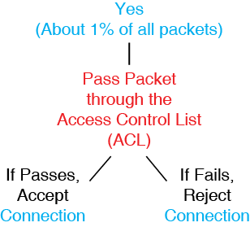
3.22 Stateful Packet Inspection (SPI)
Yes (Trying to Open a Connection)

Slide 72
3.23 Access Control Lists (ACLs) for Attempts to Open a Connection
Rule | Destination IP Address or Range | Service | Action
1 | ALL | 25 | Allow connection
2 | 10.47.122.79 | 80 | Allow connection
3 | ALL | ALL | Do not allow connection
What will the SPI firewall do if the destination host is 10.47.122.79 and the service is 80?

Slide 73
3.23 Access Control Lists (ACLs) for Attempts to Open a Connection
Rule | Destination IP Address or Range | Service | Action
1 | ALL | 25 | Allow connection
2 | 10.47.122.79 | 80 | Allow connection
3 | ALL | ALL | Disallow connection
What will the SPI firewall do if the destination host is 10.47.122.79 and the service is 25?

Slide 74
3.23 Access Control Lists (ACLs) for Attempts to Open a Connection
Rule | Destination IP Address or Range | Service | Action
1 | ALL | 25 | Allow connection
2 | 10.47.122.79 | 80 | Allow connection
5 | ALL | ALL | Disallow connection
What packets will match the third row?

Slide 75
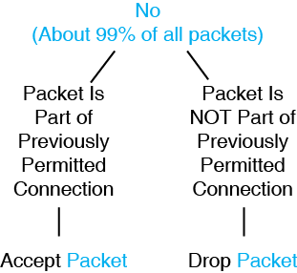
3.22 Stateful Packet Inspection (SPI)
No (Not Trying to Open a Connection)

Slide 76
3.22 Stateful Packet Inspection (SPI)
Approved Connections Table
 | Internal Host |  | External Host
Connec-tion | IP Address | Port | IP Address | Port
1 | 128.171.17.13 | 3270 | 10.74.118.4 | 80
2 | 128.171.34.5 | 4747 | 60.3.5.75 | 25
What if the internal IP address is 128.171.34.5, the external IP address is 60.3.5.75 and the source and destination addresses are 4747 and 25?

Slide 77
3.22 Stateful Packet Inspection (SPI)
Approved Connections Table
 | Internal Host |  | External Host
Connec-tion | IP Address | Port | IP Address | Port
1 | 128.171.17.13 | 3270 | 10.74.118.4 | 80
2 | 128.171.34.5 | 4747 | 60.3.5.75 | 25
What if the internal IP address is 128.171.34.9, the external IP address is 60.3.5.75 and the source and destination addresses are 4747 and 25?

Slide 78
3.25 Next-Generation Firewalls (NGFWs)
Limitations of Stateful Packet Inspection (SPI) Firewalls
  Limited primarily to examining socket data
  Cannot detect what applications are actually using Port 80
  Cannot identify problems in streams of packets

Slide 79
3.25 Next-Generation Firewalls (NGFWs)
Next-Generation Firewall (NGFW) Operation
  Uses deep Inspection
    Examines all fields in the internet and transport layer
    Examines application layer content as well
  Requires reassembling application messages from multiple segments

Slide 80
3.25 Next-Generation Firewalls (NGFWs)
Application Awareness
  Can identify what application created traffic
  Can base rules on application policies for specific applications
  Even understands malware applications

Slide 81
3.25 Next-Generation Firewalls (NGFWs)
Intrusion Detection System (IDS) Functionality
  Can detect suspicious traffic
  Log suspicious traffic
  Notify the security administrator of high-threat suspicious traffic
  Produce many false alarms that can dull vigilance

Slide 82
3.25 Next-Generation Firewalls (NGFWs)
Intrusion Prevention Systems (IPS) Functionality
  IDSs that drop packets that are suspicious but for which there is high confidence that they are attacks

Slide 83
3.25 Next-Generation Firewalls (NGFWs)
Reputation Management
  Whitelists and blacklists in external reputation management databases
  Use to inform decisions about packets to and from listed sites
NAT and VPN Traversal
  Traditional firewall functionality
  VPN traversal passes encrypted traffic without inspection

Slide 84
3.25 Next-Generation Firewalls (NGFWs)
Need Wire-Speed Operation
  Processing work per packet is heavy
  Yet must be able to process at the highest speed of incoming transmission lines
  Traditional firewalls are general-purpose computers that do processing with step-by-step software
  NGFWs use purpose-built hardware than can do processing in hardware
    Much faster than doing the same processing in software

Slide 85
The Target Breach
Attacks and Attackers
Protecting Dialogs Cryptographically
Other Forms of Authentication
Firewalls
Antivirus Protection

Slide 86
3.26 Antivirus Protection
Firewalls versus Antivirus Filtering
  Firewalls work on packets and groups of packets
  Antivirus filtering works on files
Antivirus Filtering
  Not limited to viruses
  Looks for all forms of malware

Slide 87
3.26 Antivirus Protection
Signature Detection
  Looks for byte patterns that characterize individual malware programs
  There are now too many malware programs to test for all malware program signatures
  Also, many malware programs mutate, changing their signatures

Slide 88
3.26 Antivirus Protection
Behavioral Detection
  Analysis of what the program is attempting to do
  Reformat the hard drive, etc.
  If appropriate, delete the program
  May run programs in a sandbox (environment it cannot escape from) to study it

