Slide 1
Network Standards
Chapter 2
Panko and Panko
Business Data Networks and Security
Copyright © 2015 Pearson Education, Inc.

Slide 2
How the Internet Came to Be
Introduction
Message Ordering
Message Syntax
Encoding Application Messages
Vertical Communication on Hosts

Slide 3
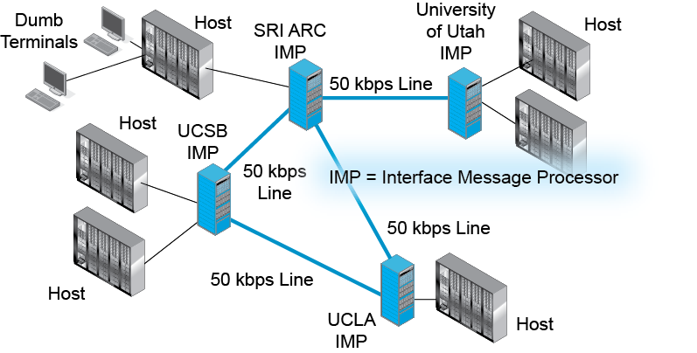
2.1 The Early ARPANET

Slide 4
The Network Working Group
Bolt, Beranek, and Newman designed the IMPs
But there were no standards for application programs or protocols for hosts to communicate with other hosts
An informal group formed to create needed standards: the Network Working Group
Mostly engineers and graduate students, the NWG had no formal standing

Slide 5
The Network Working Group
Called their “standards” Requests For Comments (RFCs) instead of standards
Informal and egalitarian, working on rough consensus rather than voting
Designed simple standards based on running code; quick and inexpensive to implement
The Internet Engineering Task Force (IETF) emerged from the NWG, kept many of their characteristics

Slide 6
How the Internet Came to Be
Introduction
Message Ordering
Message Syntax
Encoding Application Messages
Vertical Communication on Hosts

Slide 7
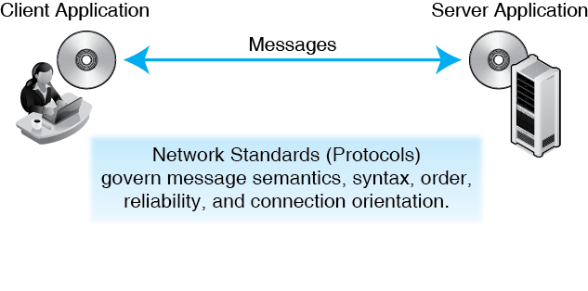
2.2 Network Standards

Slide 8
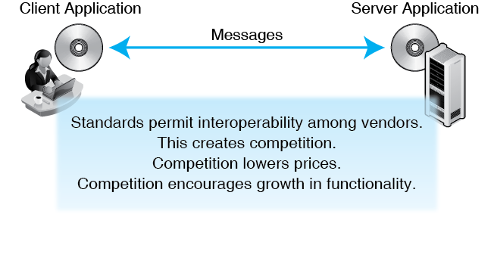
2.2 Network Standards

Slide 9
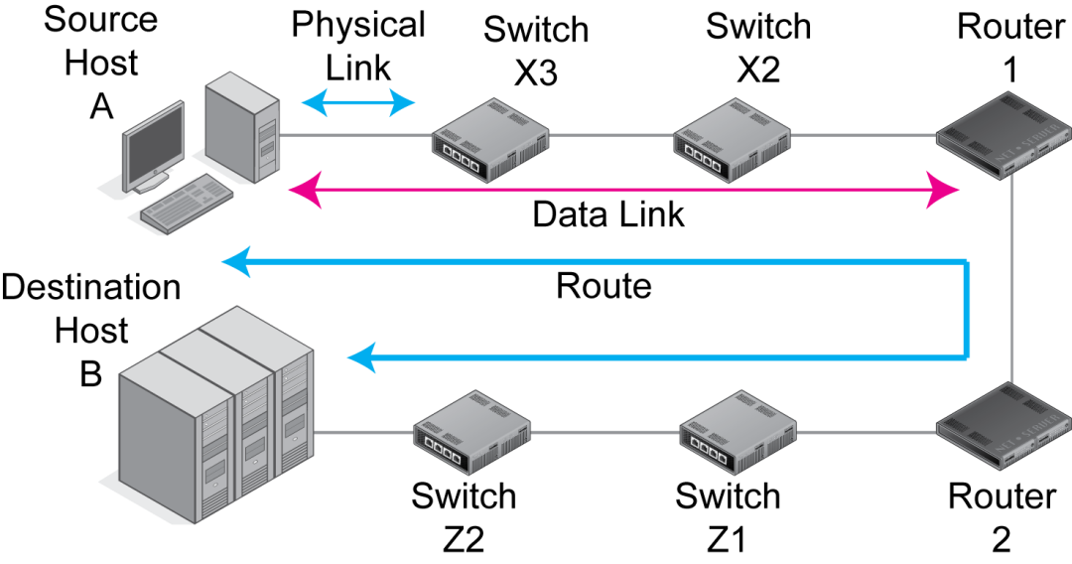
2.3 Physical, Data Link, and Internet Layers
Notes:
Recap

Slide 10
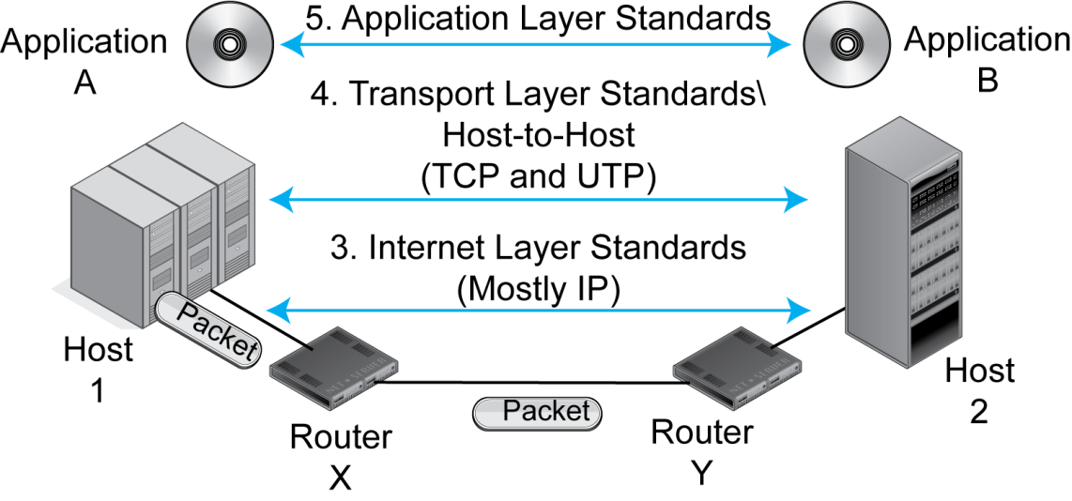
2.4 Transport and Application Processes
Notes:
Recap

Slide 11
2.5 Layers Recap
Broad Function | Layer | Name | Specific Function
Interoperability of application programs | 5 | Application | Application layer standards govern how two applications work with each other, even if they are from different vendors.
Notes:
Recap

Slide 12
2.5 Layers Recap
Broad Function | Layer | Name | Specific Function
Transmission across an internet | 4 | Transport | Aspects of end-to-end communication between two end hosts that are not handled by the internet layer.
 | 3 | Internet | The transmission of packets across an internet—typically by sending them through several routers along the route. Also govern packet syntax and reliability.
Notes:
Recap

Slide 13
2.5 Layers Recap
Broad Function | Layer | Name | Specific Function
Transmission across a single network | 2 | Data Link | Transmission of frames across a single network—typically by sending them through several switches along the data link. Also govern frame syntax and reliability.
 | 1 | Physical | Transmission between adjacent devices connected by a transmission medium.
Notes:
Recap

Slide 14
How the Internet Came to Be
Introduction
Message Ordering
Message Syntax
Encoding Application Messages
Vertical Communication on Hosts

Slide 15
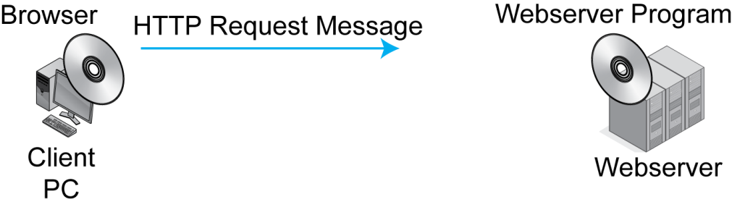
2.7 HTTP Request/Response Cycle

Slide 16
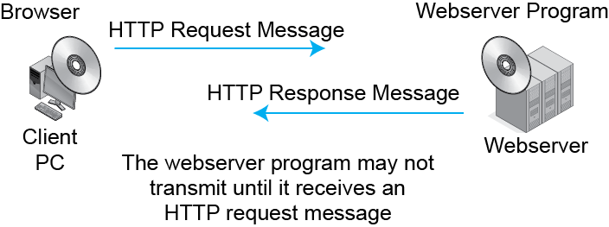
2.7 HTTP Request/Response Cycle

Slide 17
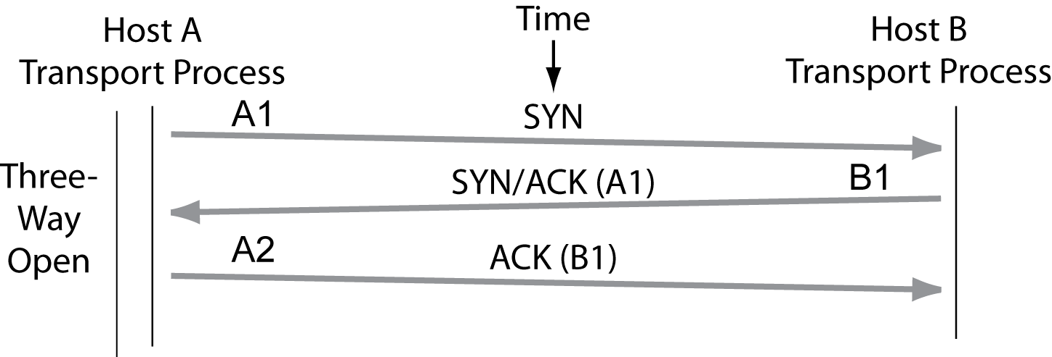
2.8 A TCP Session

Slide 18
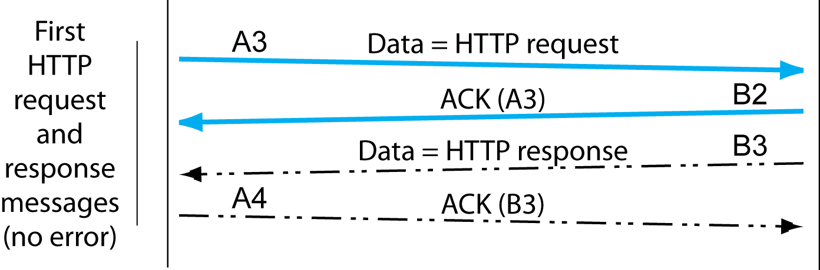
2.8 A TCP Session

Slide 19
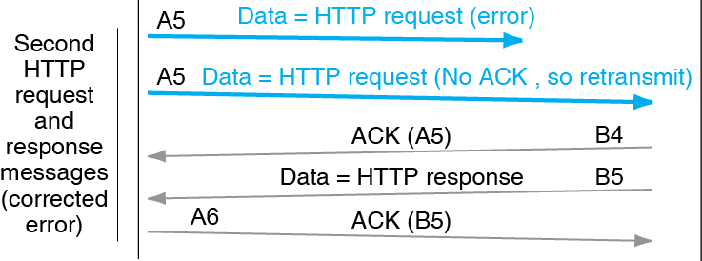
2.8 A TCP Session

Slide 20
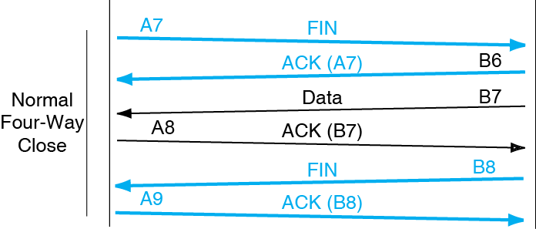
2.8 A TCP Session

Slide 21
Connection Orientation
HTTP
TCP
  Connectionless
  No openings, closings, ACKs
  Creates a light load on the network
  Unreliable
  Connection-Oriented
  Openings, closings, ACKs place a heavy load on the network
  Reliable

Slide 22
How the Internet Came to Be
Introduction
Message Ordering
Message Syntax
Encoding Application Messages
Vertical Communication on Hosts

Slide 23
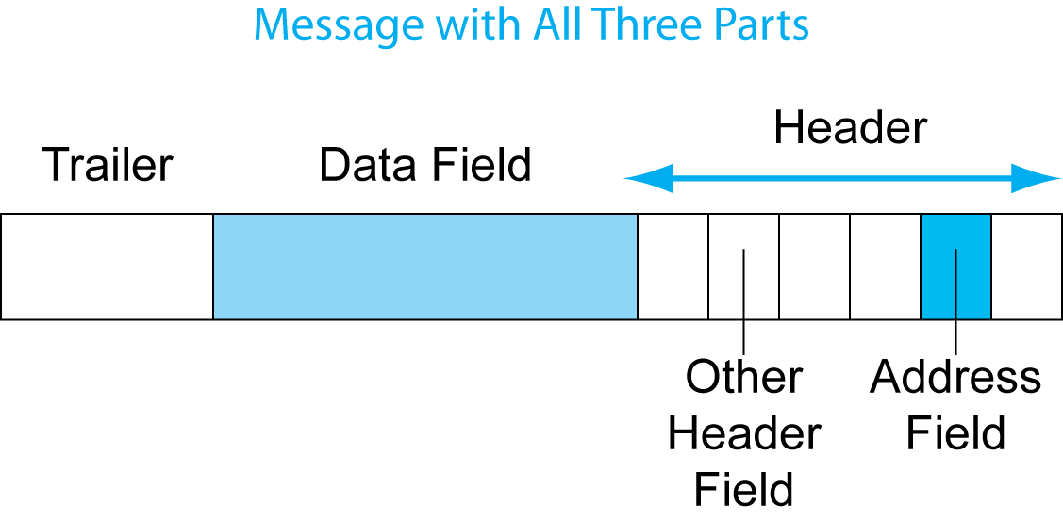
2.9 General Message Organization

Slide 24
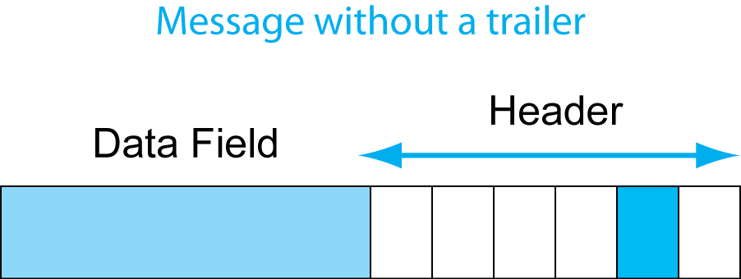
2.9 General Message Organization

Slide 25
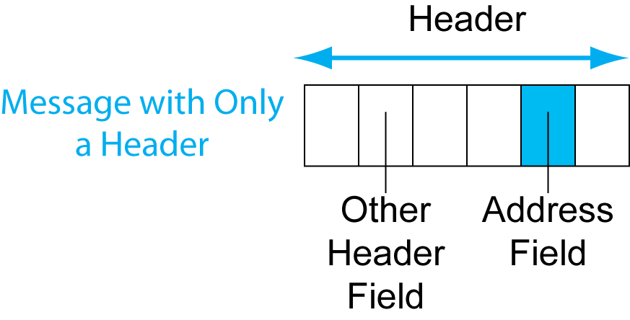
2.9 General Message Organization

Slide 26
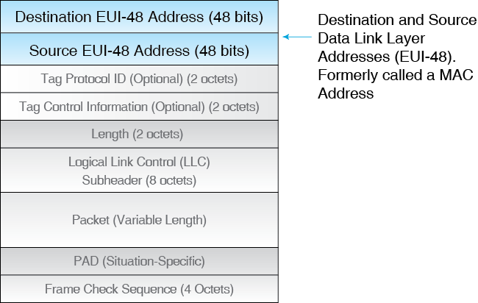
2.10 Ethernet Frame
In Ethernet frame syntax, fields are listed in order, each is a certain number of octets (bytes) long

Slide 27
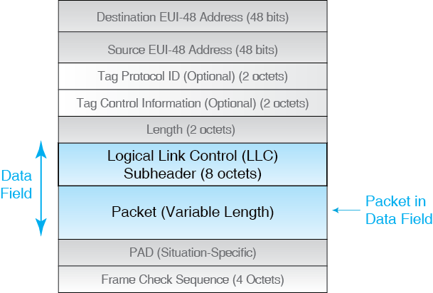
2.10 Ethernet Frame

Slide 28
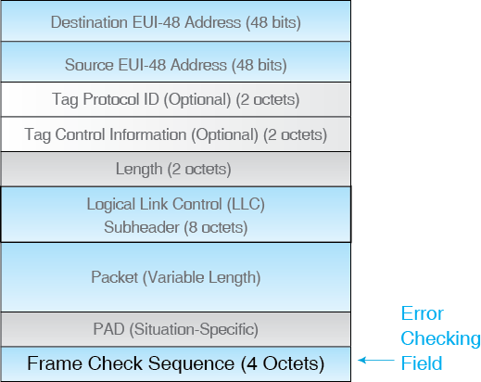
2.10 Ethernet Frame

Slide 29
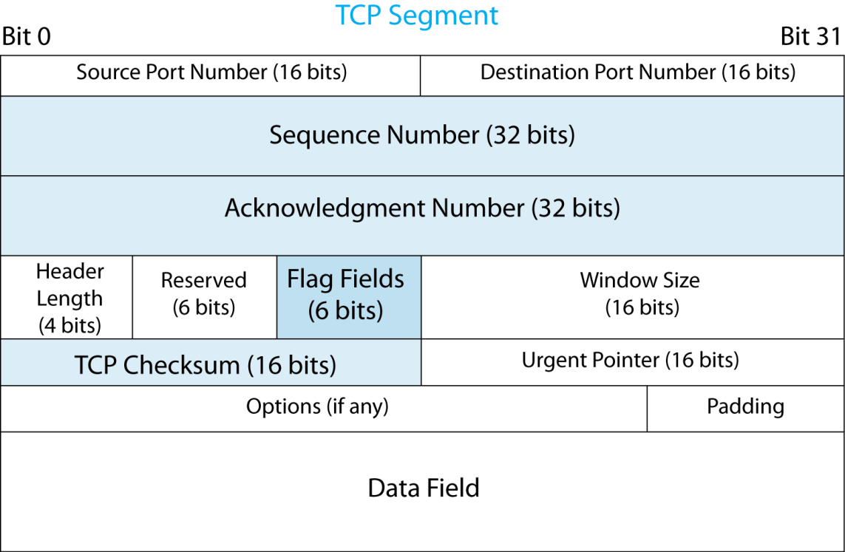
2.12 TCP Segment and UDP Datagram

Slide 30
2.12 TCP Segment and UDP Datagram
Flag fields are one-bit fields
Value 1 is set;
Value 0 is not set.
Flags fields include SYN, ACK, SYN, and three others

Slide 31
2.12 TCP Segment and UDP Datagram

Slide 32
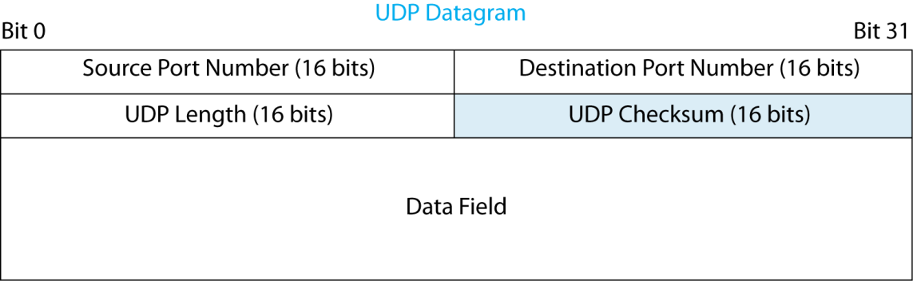
2.11 IP Packet Syntax in IPv4

Slide 33
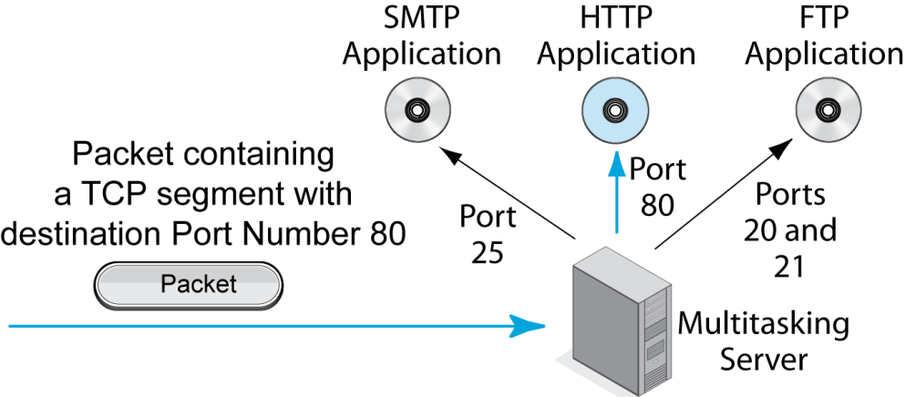
2.13 Server Port Numbers
Multitasking servers run multiple applications. Each is associated with a port number.

Slide 34
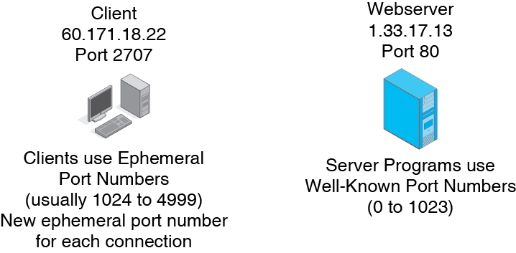
2.14 Client Port Numbers and Sockets

Slide 35
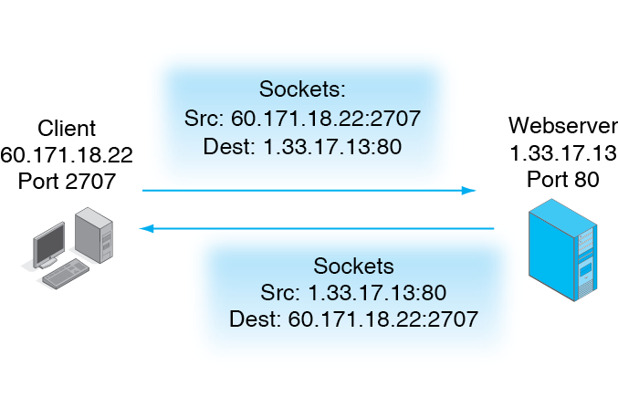
2.14 Client Port Numbers and Sockets

Slide 36
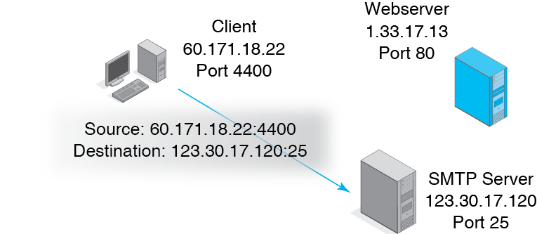
2.14 Client Port Numbers and Sockets

Slide 37
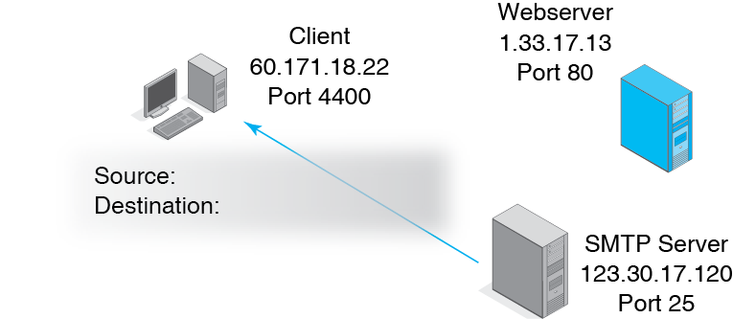
2.14 Client Port Numbers and Sockets

Slide 38
2.15 HTTP Message Syntax
HTTP
  The application layer is the highest layer
  It has more standards than at any other layer
  HTTP is not the only application layer standard; it is one of many
  Many application layer protocols, such as SMTP for e-mail, are much more complex than HTTP

Slide 39
2.15 HTTP Message Syntax
HTTP Request Message
  GET /panko/home.htm HTTP/1.1[CRLF]
  Host: voyager.shidler.hawaii.edu
  Connection: Keep-Alive

Slide 40
2.15 HTTP Message Syntax
HTTP Response Message
  HTTP/1.1 200 OK[CRLF]
  Date: Tuesday, 20-MAR-2014 18:32:15 GMT[CRLF]
  Server: name of server software[CRLF]
  MIME-version: 1.0[CRLF]
  Content-type: text/plain[CRLF]
  [CRLF]
  File to be downloaded. A string of bytes that may be text, graphics, sound, video, or other content.

Slide 41
2.15 HTTP Message Syntax
Notes
  A relatively old feeling protocol
  Fields ended by CRLF, which starts a new line
  Based on e-mail (an old protocol) for rapid development

Slide 42
How the Internet Came to Be
Introduction
Message Ordering
Message Syntax
Encoding Application Messages
Vertical Communication on Hosts

Slide 43
2.16 Encoding Text as ASCII
Category | Meaning | 7-Bit ASCII Code | 8th bit in Transmitted Byte
Upper-Case Letters | A | 1000001 | Unused
Lower-Case Letters | a | 1100001 | Unused
Digits (0 through 9) | 3 | 0110011 | Unused
Punctuation | Period | 0101110 | Unused
Punctuation | Space | 0100000 | Unused
Control Codes | Carriage Return | 0001101 | Unused
Control Codes | Line Field | 0001010 | Unused

Slide 44
2.17 Converting Binary to Decimal
Representing Decimal (Base 10) Numbers
Position Exponent | 10⁴ | 10³ | 10² | 10¹ | 10⁰
Position Value in decimal | 10,000 | 1,000 | 100 | 10 | 1
Decimal Number |  |  | 5 | 0 | 3
Decimal Representation | 503 = 5*100 + 0*10+ 3*1

Slide 45
2.17 Converting Binary to Decimal
Representing Binary(Base 2) Numbers
Position Exponent | 2⁴ | 2³ | 2² | 2¹ | 2⁰
Position Value in decimal | 16 | 8 | 4 | 2 | 1
Binary Number | 0 | 1 | 0 | 1 | 0
Decimal Equivalents | 0 | 8 | 0 | 2 | 0
Decimal Representation | 1010 = 1*8 + 1*2 = 10

Slide 46
2.18: Encoding a Decimal Number in Binary
Position / Value / Step |  |  |  |  | Remainder
Binary Position | 4 | 3 | 2 | 1
Binary Value | 8 | 4 | 2 | 1
Step 0: Decimal num = 11 | -- | -- | -- | -- | 11
Step 1: 8 is largest digit that will fit into 11 | 1 | 0 | 0 | 0 | 11-8 = 3
Step 2: 2 is the largest digit that will fit into 3 | 1 | 0 | 1 | 0 | 8-2 = 1
Step 3: 1 is the largest digit that will fit into 1 | 1 | 0 | 1 | 1 | 1-1 = 0 (finished)
Final binary number | 1 | 0 | 1 | 1

Slide 47
2.19 Binary Encoding for Number of Alternatives
Bits in Field | Number of Alternatives that can be Encoded | Possible Bit Sequences | Examples
1 | 2¹ = 2 | 0, 1 | Yes or No, Male or Female, etc.
2 | 2² = 4 | 00, 01,10, 11 | North, South, East, West; Red, Green, Blue, Black
4 | 2⁴ = 16 | 0000, 0001, 0010, … | Top 10 security threats. Three bits would only give 8 alternatives. (With 4 bits, 6 values go unused)
8 | 2⁸ = 256 | 00000000, 00000001, … | One byte per color gives 256 possible colors levels.

Slide 48
2.19 Binary Encoding for Number of Alternatives
Bits in Field | Number of Alternatives that can be Encoded | Possible Bit Sequences | Examples
16 | 2¹⁶ = 65,536 | 0000000000000000, 0000000000000001, ‘… | Two bytes per color gives 65,536 color levels.
32 | 2³² = 4,294,967,296 | 000000000000000 0000000000000000, etc. | Number of Internet Protocol Version 4 addresses

Slide 49
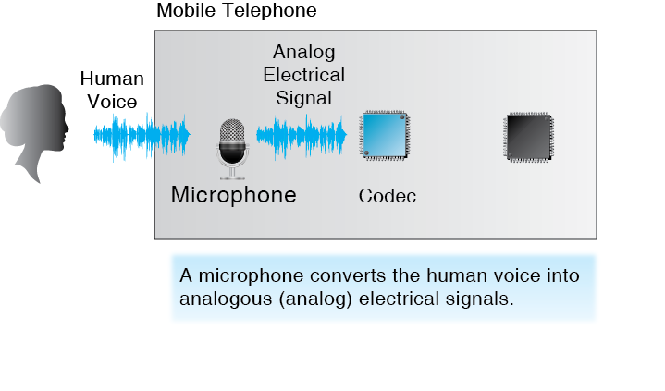
2.20 Encoding Voice

Slide 50
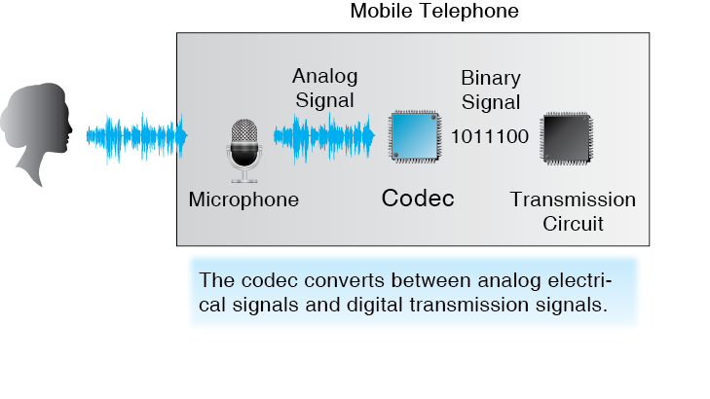
2.20 Encoding Voice

Slide 51
How the Internet Came to Be
Introduction
Message Ordering
Message Syntax
Encoding Application Messages
Vertical Communication on Hosts

Slide 52
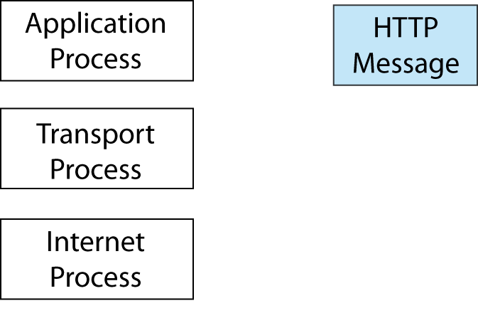
2.21 Layered Communication on the Source Host

Slide 53
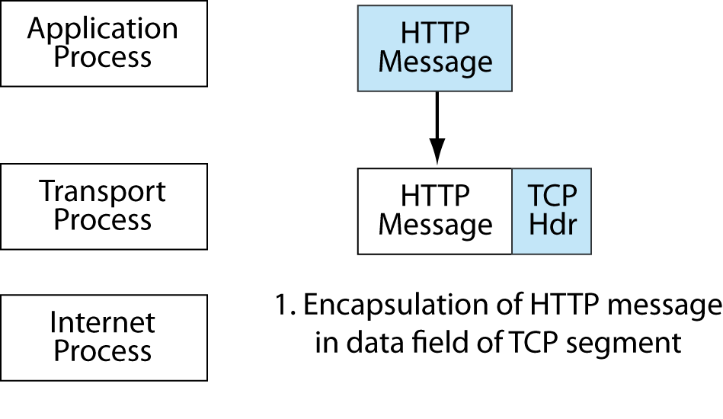
2.21 Layered Communication on the Source Host

Slide 54
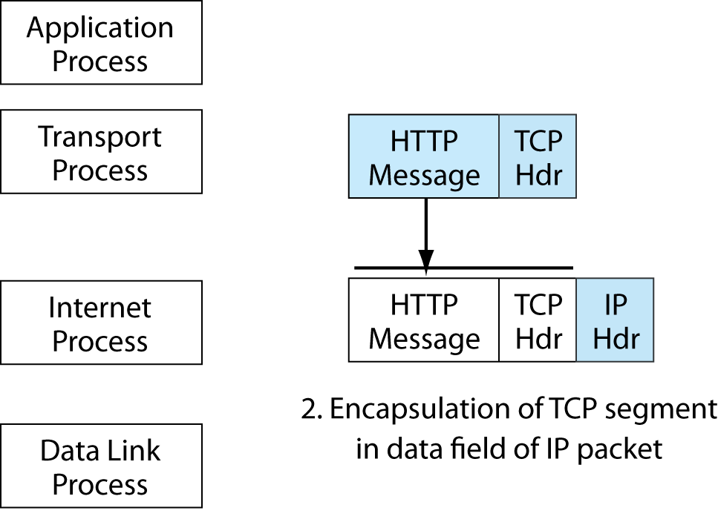
2.21 Layered Communication on the Source Host

Slide 55
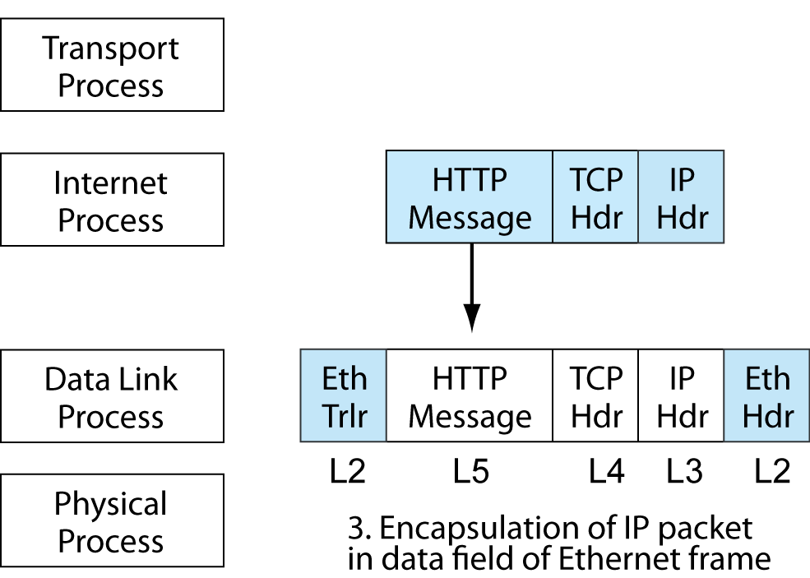
2.21 Layered Communication on the Source Host

Slide 56
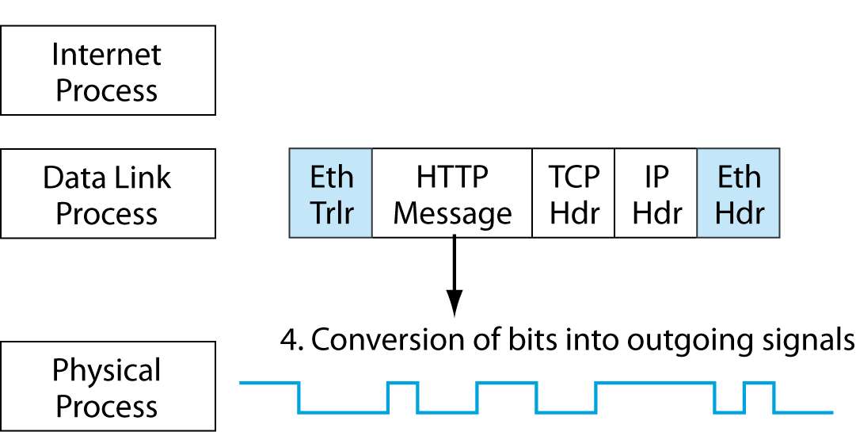
2.21 Layered Communication on the Source Host

Slide 57
2.22 Protocols in This Chapter
Layer | Protocol | Connection-Oriented or Connectionless? | Reliable or Unreliable?
5 (Application) | HTTP | Connectionless | Unreliable
4 (Transport) | TCP | Connection-oriented | Reliable
4 (Transport) | UDP | Connectionless | Unreliable
3 (Internet) | IP | Connectionless | Unreliable
2 (Data Link) | Ethernet | Connectionless | Unreliable

