Slide 1
Network and Security Management
Chapter 4
Panko and Panko
Business Data Networks and Security
Copyright © 2015 Pearson Education, Inc.

Slide 2
Failure in the Target Breach
Cost Matters
Network Quality of Service QoS
Network Design
Security Planning Principles
Centralized Management

Slide 3
Failures in the Target Breach
Security is a Process, not a Product
Fazio Engineering Services
  Contractor with weak security
  Fell for spear phishing attack, giving access to the vendor server
  Fazio used a free antivirus program not meant for corporations
    Did not warn for individual messages

Slide 4
Failures in the Target Breach
Was Able to Move to Sensitive Servers
  Should not have been able to
Ignored Explicit Warnings
  Priority warning from the FireEye IDS service
  November 30, December 1, December 3
  Exfiltration began on December 2
  If had stopped the attack then, damage would have been minimal or nonexistent

Slide 5
Kill Chain Analysis
For a weapon to succeed, a number of steps must go correctly
This is called the kill chain
Security attacks also have kill chains
Companies must look for evidence of kill chain patters and end the chain before the end
Target did not

Slide 6
Failure in the Target Breach
Cost Matters
Network Quality of Service QoS
Network Design
Security Planning Principles
Centralized Management

Slide 7
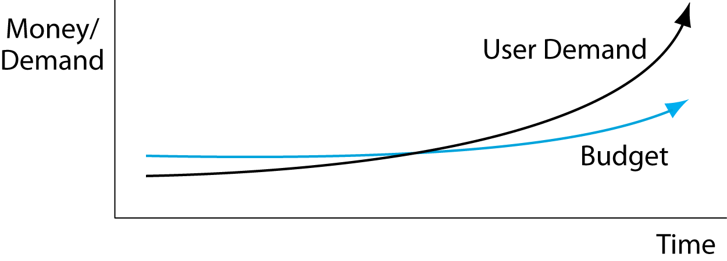
4.1 Network Demand and Budgets
User demand is growing much faster than network budgets.
Cost efficiency is always critical.

Slide 8
Failure in the Target Breach
Cost Matters
Network Quality of Service QoS
Network Design
Security Planning Principles
Centralized Management

Slide 9
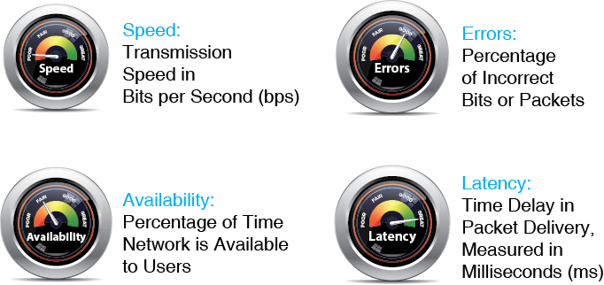
4.2 Quality-of-Service (QoS) Metrics

Slide 10
4.3 Rated Speed, Throughput, Aggregate Throughput, and Individual Throughput
Rated Speed
  The speed a system should achieve
  According to vendor claims or to the standard that defines the technology
Throughput
  The data transmission speed a system actually provides to users

Slide 11
4.3 Rated Speed, Throughput, Aggregate Throughput, and Individual Throughput
Aggregate versus Rated Throughput on Shared Lines
  The aggregate throughput is the total throughput available to all users in part of a network
Individual Throughput
  The individual throughput is an individual’s share of the aggregate throughput

Slide 12
4.3 Rated Speed, Throughput, Aggregate Throughput, and Individual Throughput
Individual throughput
Aggregate throughput
Rated speed

Slide 13
Speed Knowledge Check
You are in a Wi-Fi hot spot with 20 other people. The access point router is rated as following the 802.11ac standard with options providing 300 Mbps. Throughput is about 50%. At a certain moment, you and four others are sending and receiving. What individual throughput are you likely to receive?

Slide 14
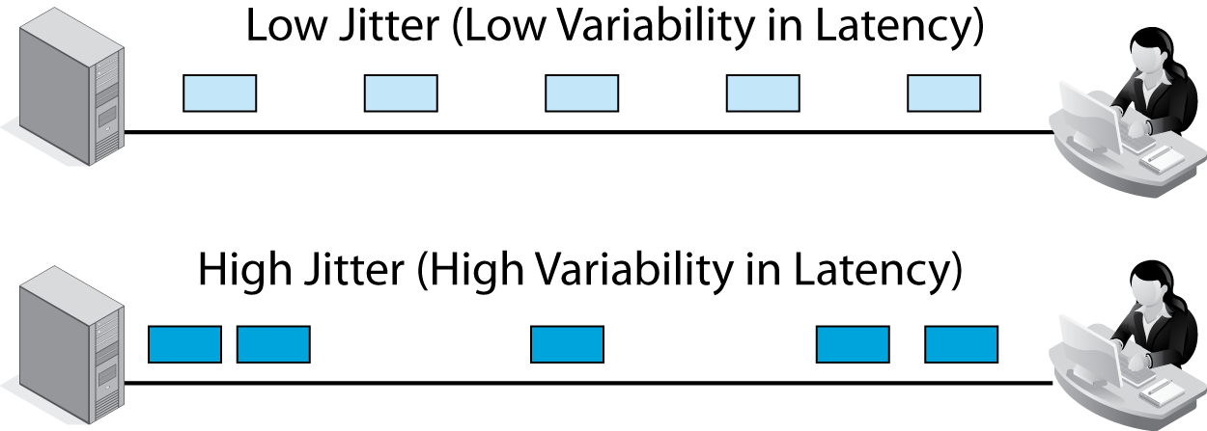
4.4 Jitter
Jitter is variability in latency
Makes voice and video seem “jittery”
Engineering networks to reduce jitter can be expensive

Slide 15
4.5 Service Level Agreements (SLAs)
Service Level Agreements (SLAs)
  Guarantees for performance
  Penalties if the network does not meet its service metrics guarantees

Slide 16
4.5 Service Level Agreements (SLAs)
Guarantees specify worst cases (no worse than)
  Lowest speed (e.g., no worse than 1 Mbps)
  Maximum latency (e.g., no more than 125 ms)
  SLAs are like insurance policies

Slide 17
4.5 Service Level Agreements (SLAs)
Often written on a percentage basis
  No worse than 100 Mbps 99.5% of the time
  Because as the percentage increases, additional engineering raises network costs
  100% compliance would be prohibitively expensive

Slide 18
4.5 Service Level Agreements (SLAs)
Residential services are rarely sold with SLA guarantees
  It would be expensive to engineer the network for high-percentage guarantees for residential customers
  This would make prices unacceptable
  Businesses require high-percentage guarantees and so are willing to pay higher prices

Slide 19
Failure in the Target Breach
Cost Matters
Network Quality of Service QoS
Network Design
Security Planning Principles
Centralized Management

Slide 20
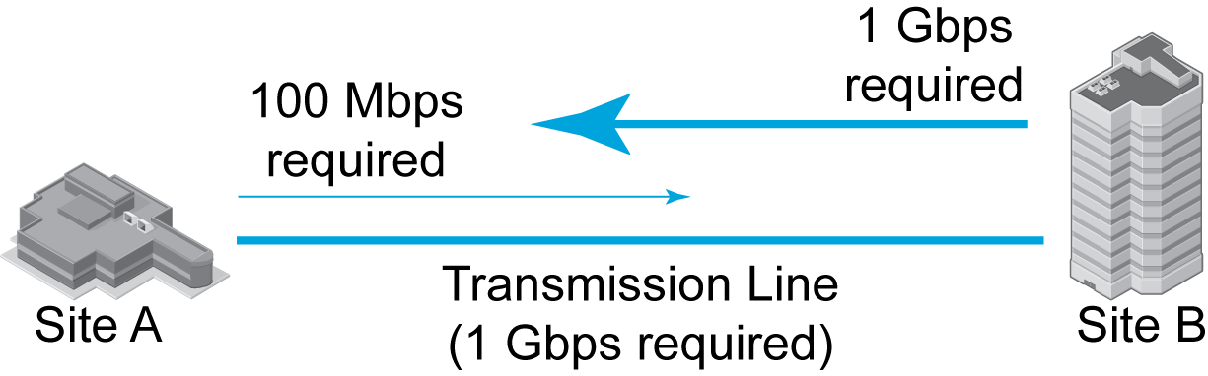
4.6 Two-Site Traffic Analysis
Network design is based on speed requirements
These may be different in the two directions
Most transmission lines are symmetric in speed
In such cases, the higher-speed dictates line speed

Slide 21
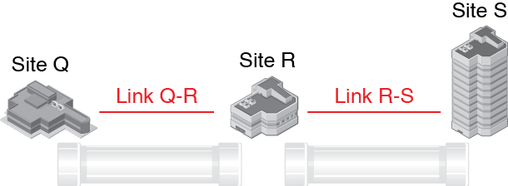
4.7 Three-Site Traffic Analysis
There are three sites connected by two links

Slide 22
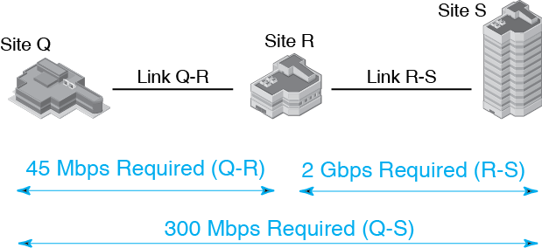
4.7 Three-Site Traffic Analysis
Link QR must carry the traffic flowing between Q and R
and the traffic flowing between R and S

Slide 23
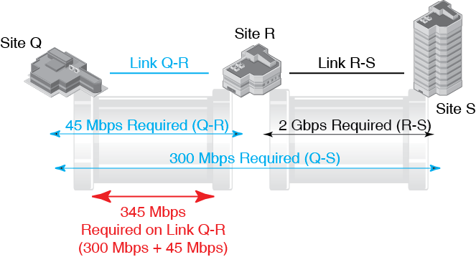
4.7 Three-Site Traffic Analysis

Slide 24
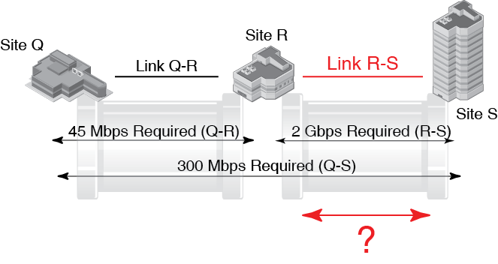
4.7 Three-Site Traffic Analysis

Slide 25
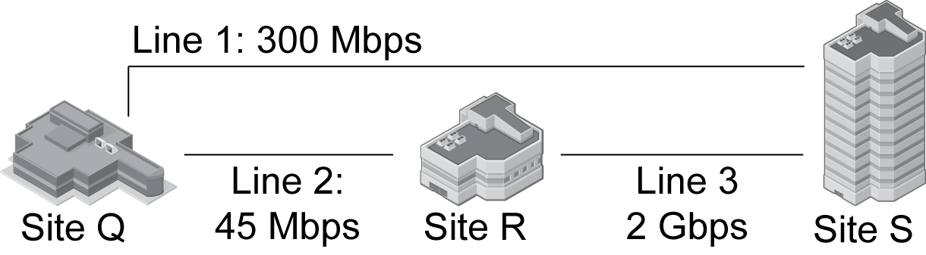
4.8 Three-Site Traffic Analysis with Redundancy
Each pair of sites is connected
Lines only carry traffic between site pairs

Slide 26
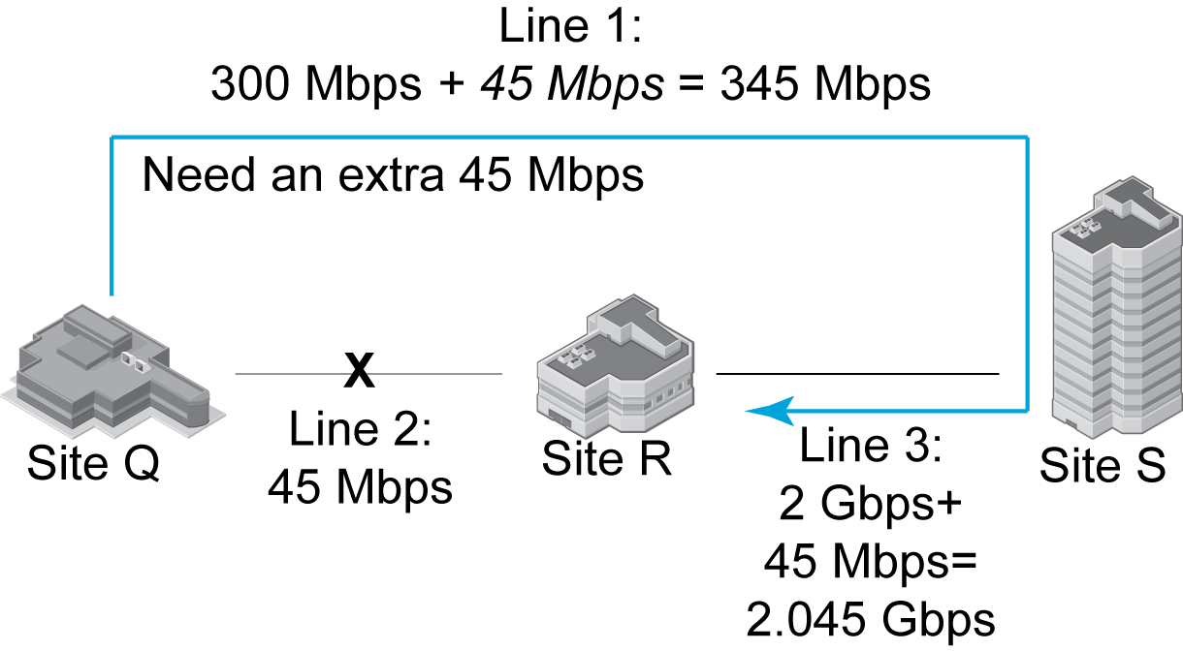
4.8 Three-Site Traffic Analysis with Redundancy
How can traffic get from Q to R?

Slide 27
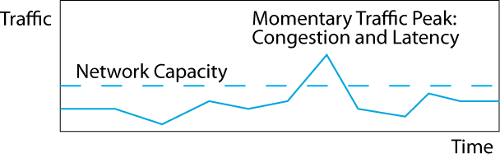
4.9 Addressing Momentary Traffic Peaks
Normally, network capacity is higher than the traffic.
Sometimes, however, there will be momentary traffic peaks above the network’s capacity—usually for a fraction of a second to a few seconds.

Slide 28
4.9 Addressing Momentary Traffic Peaks
Congestion causes latency because switches and routers must store frames and packets while waiting to send them out again.
Buffers are limited, so some packets may be lost.

Slide 29
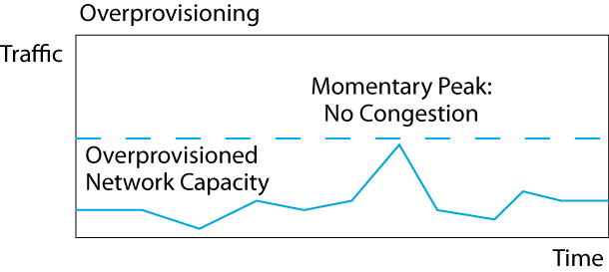
4.9 Addressing Momentary Traffic Peaks
Overprovisioning is providing far more capacity than the network normally needs.
This avoids nearly all momentary traffic peaks wasteful of transmission line capacity.

Slide 30
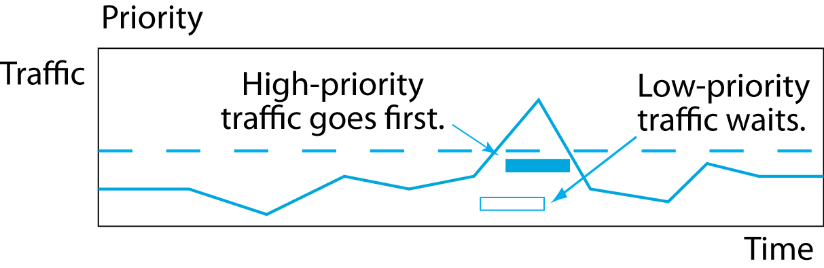
4.9 Addressing Momentary Traffic Peaks
With priority, latency-intolerant traffic, such as voice, is given high priority and will go first.
Latency-tolerant traffic, such as e-mail, must wait.
More efficient than overprovisioning; also more labor-intensive.

Slide 31
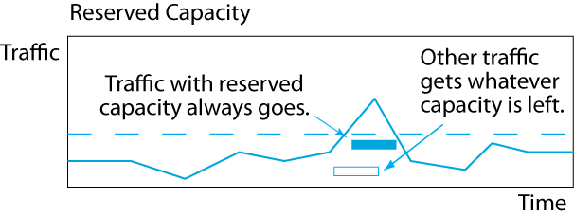
4.9 Addressing Momentary Traffic Peaks
QoS guarantees reserved capacity for some traffic, so this traffic always gets through.
Other traffic, however, must fight for the remaining capacity.

Slide 32
Failure in the Target Breach
Cost Matters
Network Quality of Service QoS
Network Design
Security Planning Principles
Centralized Management

Slide 33
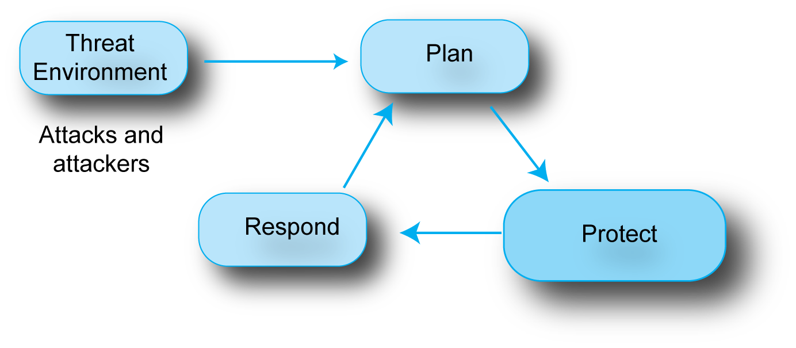
4.10 Threat Environment
You cannot defend yourself unless you know the threat environment you face.

Slide 34
4.10 Plan-Protect-Respond
Companies defend themselves with a process called the Plan-Protect-Respond Cycle.

Slide 35
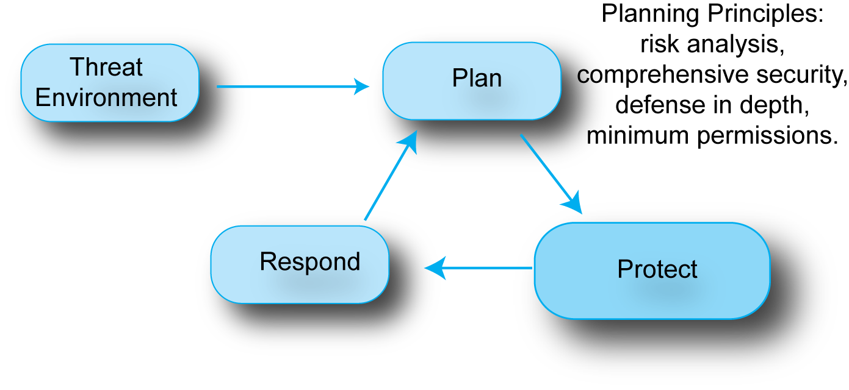
4.10 Planning
The Plan-Protect-Respond Cycle starts with Planning.
We will look at important planning principles.

Slide 36
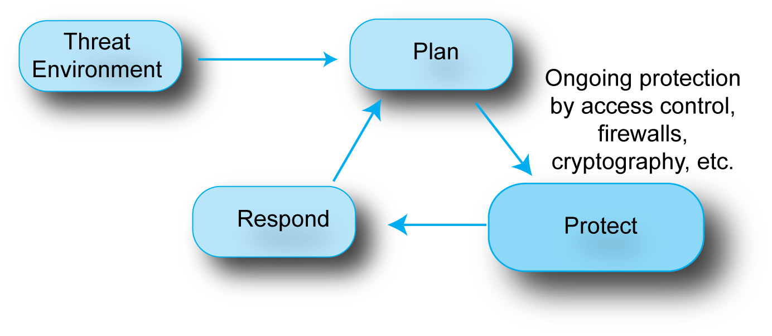
4.10 Protecting
Companies spend most of their security effort on
the protection phase, in which they apply
planned protections on a daily basis.
We covered this phase in Chapter 3.

Slide 37
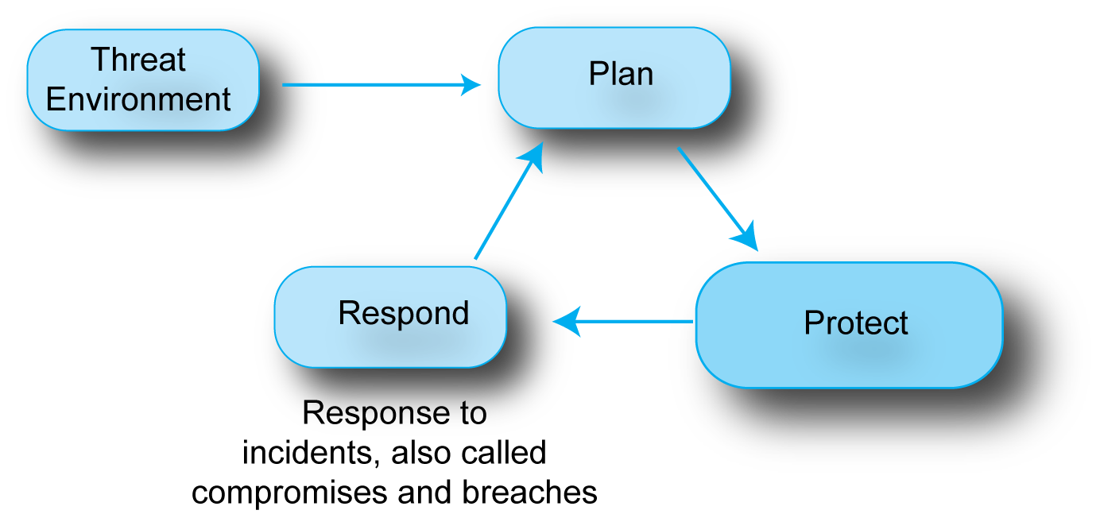
4.10 Response
Even with great planning and protection, incidents
will happen, and a company must have a well-rehearsed plan for responding to them.

Slide 38
4.11 Security Planning Principles
Security Is a Management Issue, Not a Technology Issue
  Without good management, technology cannot be effective
  A company must have good security processes

Slide 39
4.11 Security Planning Principles
Security Planning Principles
  Risk analysis
  Comprehensive security
  Defense in depth
  Weakest link analysis
  Single points of takeover
  Least permissions in access control

Slide 40
4.11 Risk Analysis
The goal is not to eliminate all risk
You would not pay a million dollars for a countermeasure to protect an asset costing ten dollars
You should reduce risk to the degree that it is economically reasonable
You must compare countermeasure benefits with countermeasure costs

Slide 41
4.12: Risk Analysis Calculation
Countermeasure | None | A
Damage per successful attack | $1,000,000 | $500,000
Annual probability of a successful attack | 20% | 20%
Annual probability of damage | $200,000 | $100,000
Annual cost of countermeasure | $0 | $20,000
Net annual probable outlay | $200,000 | $120,000
Annual value of countermeasure |  | $80,000
Adopt the countermeasure? |  | Yes
Countermeasure A
cuts the damage per successful attack in half,
but does not change the annual probability of occurrence.

Slide 42
3.10 Risk Analysis Calculation
Countermeasure | None | A
Damage per successful attack | $1,000,000 | $500,000
Annual probability of a successful attack | 20% | 20%
Annual probability of damage | $200,000 | $100,000
Annual cost of countermeasure | $0 | $20,000
Net annual probable outlay | $200,000 | $120,000
Annual value of countermeasure |  | $80,000
Adopt the countermeasure? |  | Yes
Countermeasure A
Will have a net savings of $80,000 per year.

Slide 43
3.10 Risk Analysis Calculation
Countermeasure | None | B
Damage per successful attack | $1,000,000 | $1,000,000
Annual probability of a successful attack | 20% | 15%
Annual probability of damage | $200,000 | $150,000
Annual cost of countermeasure | $0 | $60,000
Net annual probable outlay | $200,000 | $210,000
Annual value of countermeasure |  | -$10,000
Adopt the countermeasure? |  | No
Countermeasure B
cuts the frequency of occurrence in half,
but does not change the damage per occurrence.

Slide 44
3.10 Risk Analysis Calculation
Countermeasure | None | B
Damage per successful attack | $1,000,000 | $1,000,000
Annual probability of a successful attack | 20% | 15%
Annual probability of damage | $200,000 | $150,000
Annual cost of countermeasure | $0 | $60,000
Net annual probable outlay | $200,000 | $210,000
Annual value of countermeasure |  | -$10,000
Adopt the countermeasure? |  | No
This time, the countermeasure is too expensive.

Slide 45
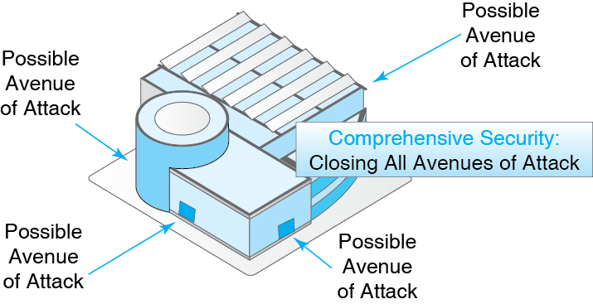
4.13 Comprehensive Security

Slide 46
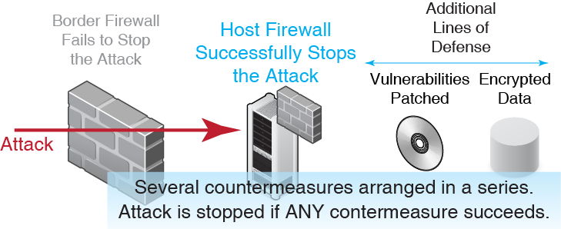
4.14 Defense in Depth

Slide 47
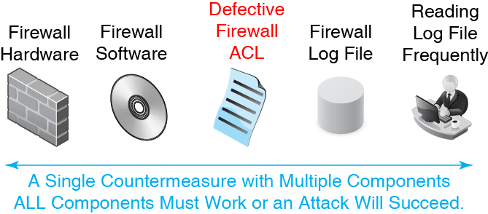
4.15 Identifying Weakest Links

Slide 48
Weakest Link versus Defense in Depth
 | Defense in Depth | Weakest Link
Countermeasures | Several | One
Criterion | One must succeed | All components must succeed
Outcome if Meets Criterion | Success | Failure

Slide 49
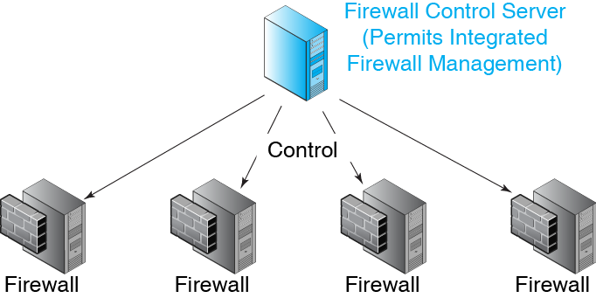
4.16 Protecting Single Points of Take-Over
Central control is crucial to reducing labor costs and implementation speed

Slide 50
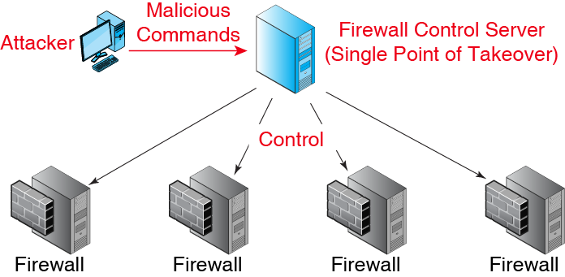
4.16 Protecting Single Points of Take-Over

Slide 51
4.17 Least Permissions in Access Control
Access Control
  If attackers cannot get access to a resource, they cannot exploit it
  Access control is limiting who may have access to each resource
  And limiting his or her permissions when using the resource

Slide 52
4.17 Least Permissions in Access Control
Authentication versus Authorizations (Permissions)
  Authentication: Proof of identity
  Authorizations: Permissions a particular authorized user is given with a resource
  Just because a user is authenticated does not mean that he or she will be permitted to do everything

Slide 53
4.17 Least Permissions in Access Control
Principle of Least Permissions
  Give each authenticated user only the minimum permissions he or she needs to do his or her job
  Cannot do unauthorized things that will compromise security

Slide 54
4.17 Least Permissions in Access Control
Examples of Limited Permissions
  Create files but not delete files
  Cannot see files above a certain level of sensitivity
  Read files but not write (edit) them
  See files in own folders but not all folders
  Connect to the person’s department server but not to the Finance server
  Do certain things but cannot give others permission to do them

Slide 55
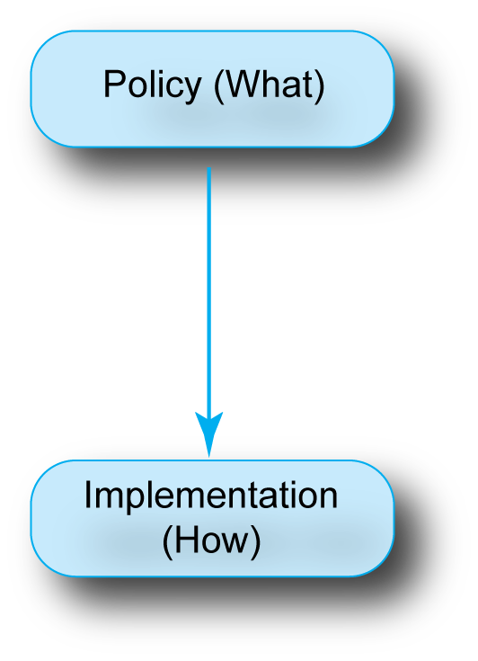
4.18 Policy-Based Security
Planners create policies, which specify what to do but not how to do it.
Policy-makers create policies with global knowledge.
Implementers implement policies with local and technical expertise.

Slide 56
4.18 Policy-Based Security
Policy Example
  Use strong encryption for credit cards.
Implementation of the Policy
  Choose a specific encryption method within this policy.
  Select where in the process to do the encryption.
  Choose good options for the encryption method.

Slide 57
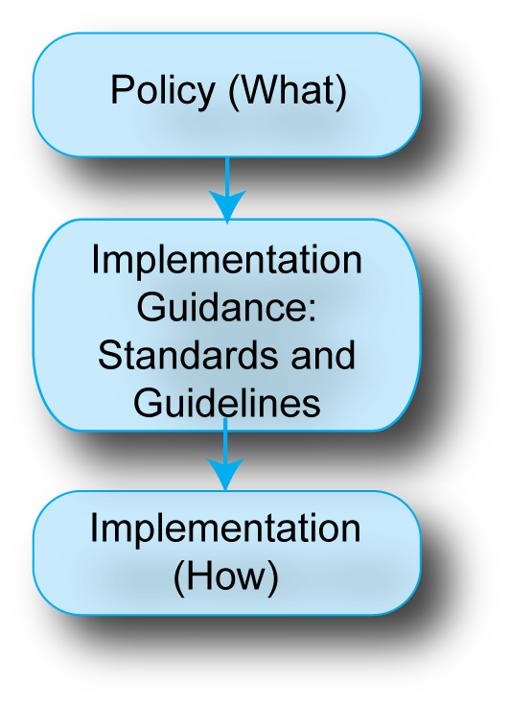
4.18 Policy-Based Security
Implementation guidance goes beyond pure “what” by constraining to some extent the “how”.
For example, it may specify that encryption keys must be more than 100 bits long.
Constrains implementers so they will make reasonable choices.

Slide 58
4.18 Policy-Based Security
Implementation Guidance has two forms.
Standards MUST be followed by implementers.
Guidelines SHOULD be followed, but are optional.
However, guidelines must be considered carefully.

Slide 59
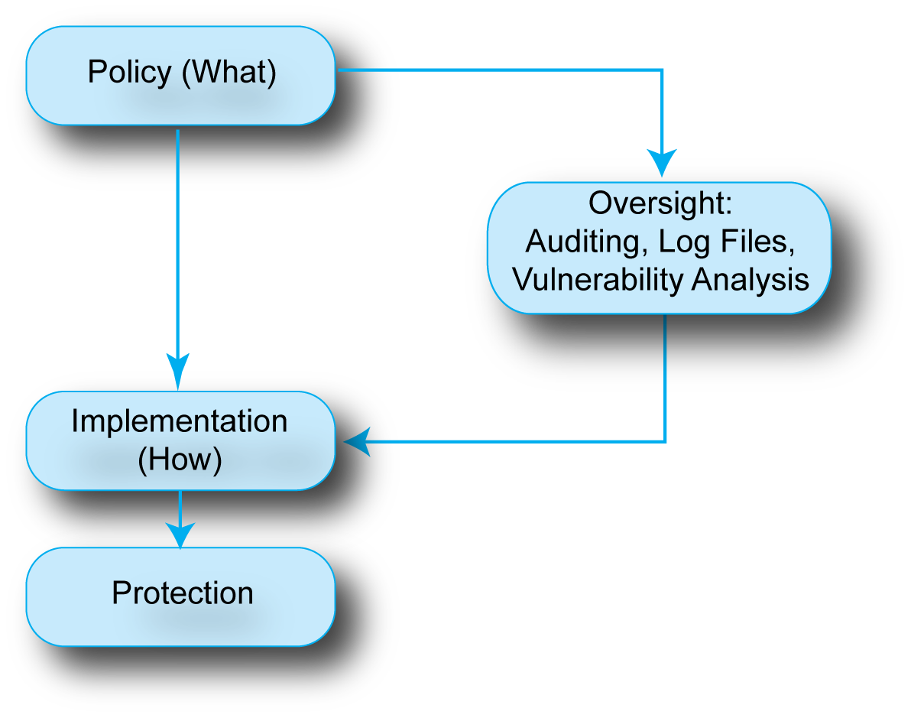
4.18 Policy-Based Security
Oversight checks that policies are being implemented successfully.
Good implementation +
Good oversight =
Good protection

Slide 60
4.18 Policy-Based Security
Policies are given to implementers and oversight staff independently.
Oversight may uncover implementation problems or problems with the specification of the policy.

Slide 61
Failure in the Target Breach
Cost Matters
Network Quality of Service QoS
Network Design
Security Planning Principles
Centralized Management

Slide 62
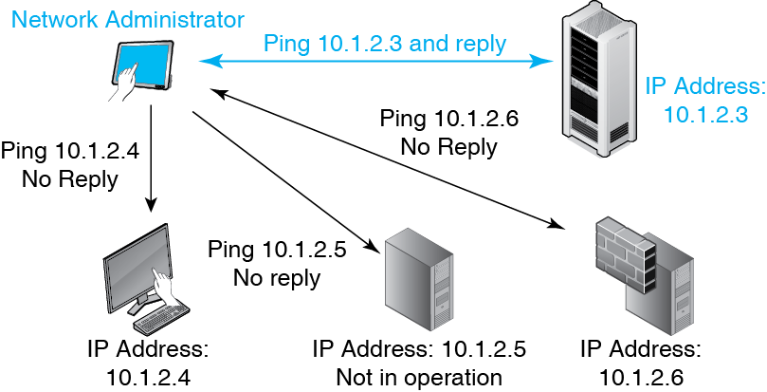
4.19 Ping

Slide 63
4.20: Simple Network Management Protocol (SNMP)
It is desirable to have network visibility—to know the status of all devices at all times.
Ping can determine if a host or router is reachable.
The simple network management protocol (SNMP) is designed to collect extensive information needed for network visibility.

Slide 64
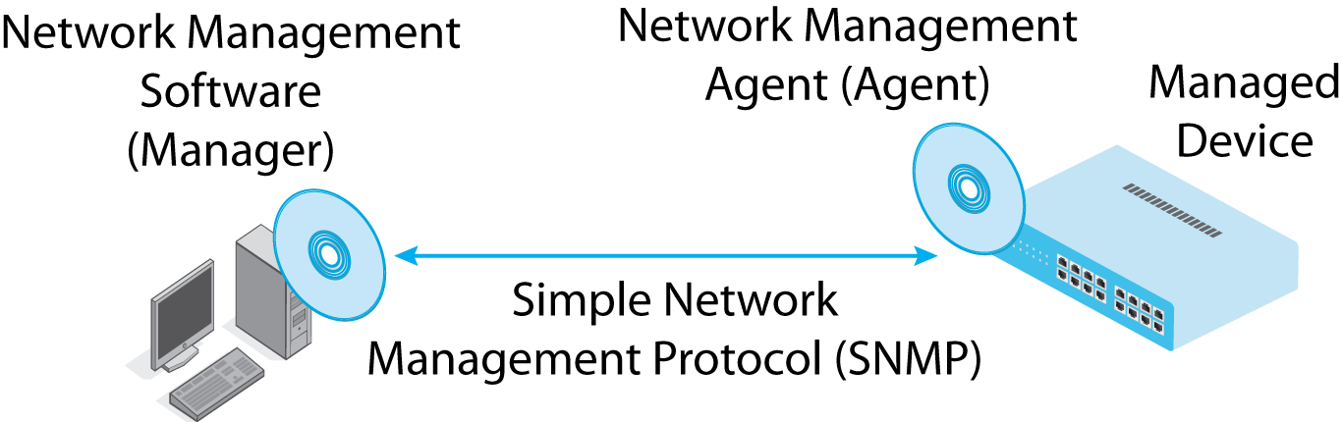
4.20: SNMP
Central manager program communicates with each managed device.
Actually, the manager communicates with a network management agent on each device.

Slide 65
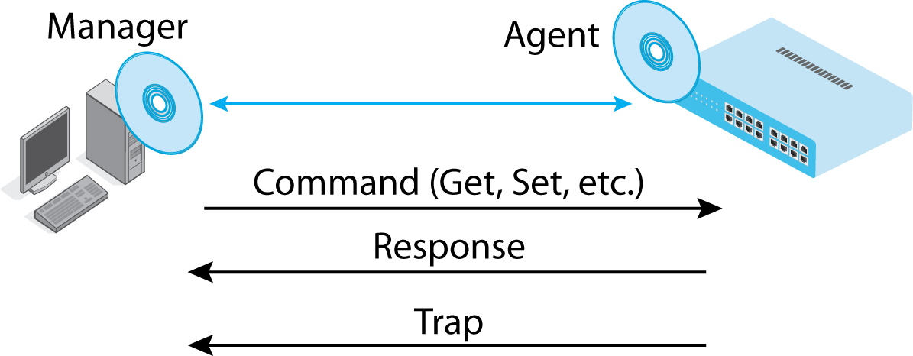
4.20: SNMP
The manager sends SNMP commands and gets SNMP responses.
Agents can send SNMP traps (alarms) if there are problems.

Slide 66
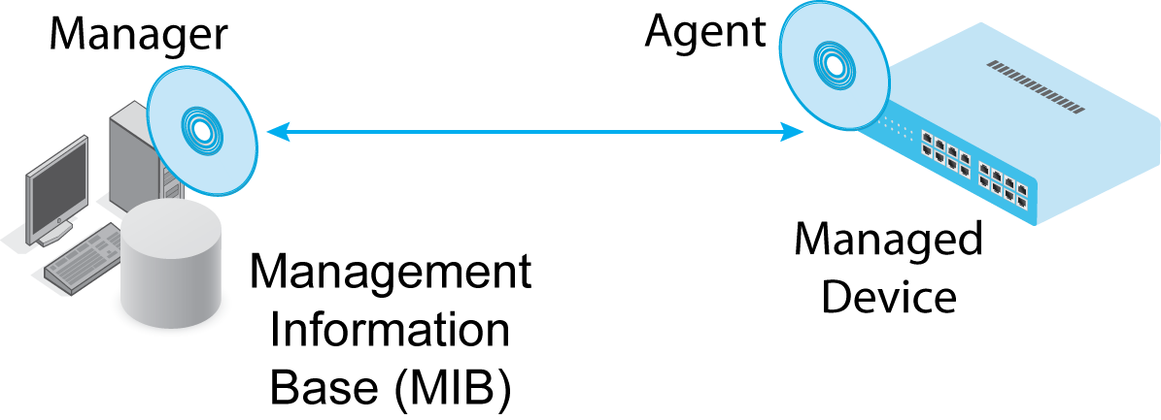
4.20: SNMP
Information from agents is stored in the SNMP management information base.

Slide 67
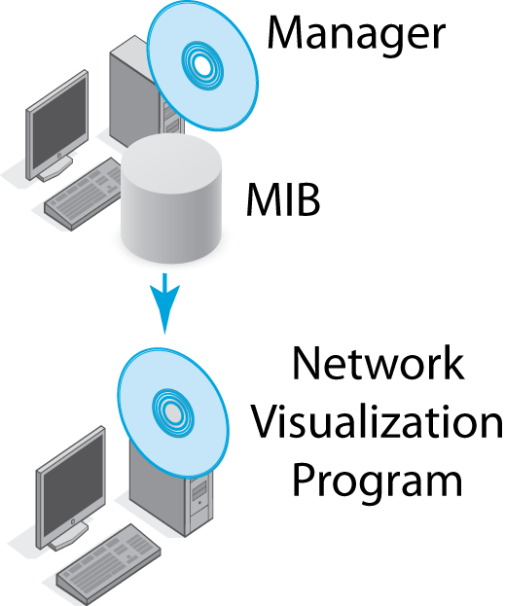
4.20: SNMP
Network visualization programs analyze information from the MIB to portray the network, do troubleshooting, and answer specific questions.

Slide 68

4.20: SNMP
SNMP interactions are standardized, but network visualization program functionality is not, in order not to constrain developers of visualization tools.

Slide 69
4.21 Traditional Device Control in Networking
Firewall Forwarding
  How the firewall deals with incoming packets
  What interface (port) to send them out
Firewall Control
  Creates the rules for firewall forwarding
  In comparison, firewall forwarding is comparatively simple

Slide 70
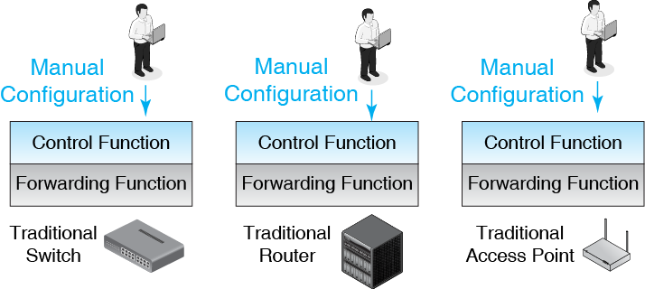
4.21 Traditional Device Control in Networking

Slide 71
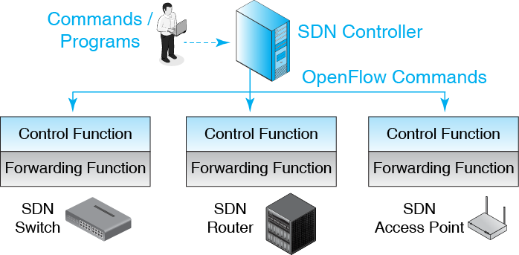
4.22 Software-Defined Networking (SDN) Control

Slide 72
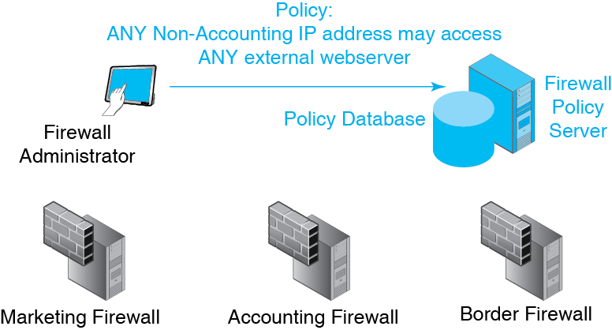
4-23 Centralized Firewall Management

Slide 73
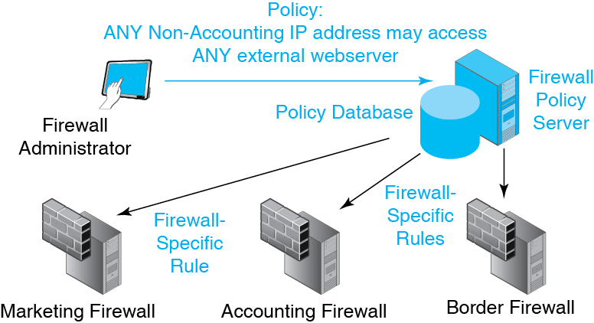
4-23 Centralized Firewall Management

